Slide 1
PROTECT YOUR
SHEEP
Notes:
Let’s learn about ways to protect your sheep from diseases.
For more biosecurity resources, visit www.cfsph.iastate.edu/biosecurity
This presentation was developed by veterinarians at the Center for Food Security and Public Health, Iowa State University, College of Veterinary Medicine. Feel free to customize it to fit your needs. Please credit the original creators.

Slide 2
Types of Germs
Bacteria
  Campylobacter, Mycobacterium (Johne’s Disease),
  Pasteurella, Salmonella
Parasites
  Roundworms, coccidia, crypto
Viruses
  Ovine progressive pneumonia (OPP), bluetongue,
  foot and mouth disease (FMD)
Oh My!
Notes:
There are many types of germs, or organisms, that cause disease in sheep and other animals. Some even cause disease in people. Examples of bacteria include Campylobacter, Mycobacterium (Johne’s disease), Pasteurella, and Salmonella. (CLICK) Examples of parasites include roundworms, coccidia, and cryptosporidiosis. (CLICK) Examples of viruses that infect sheep include ovine progressive pneumonia, bluetongue, and foot and mouth disease (FMD). (CLICK) Oh My! This list can be very long. Let’s take a look at a way to simplify protecting your sheep from these germs.

Slide 3
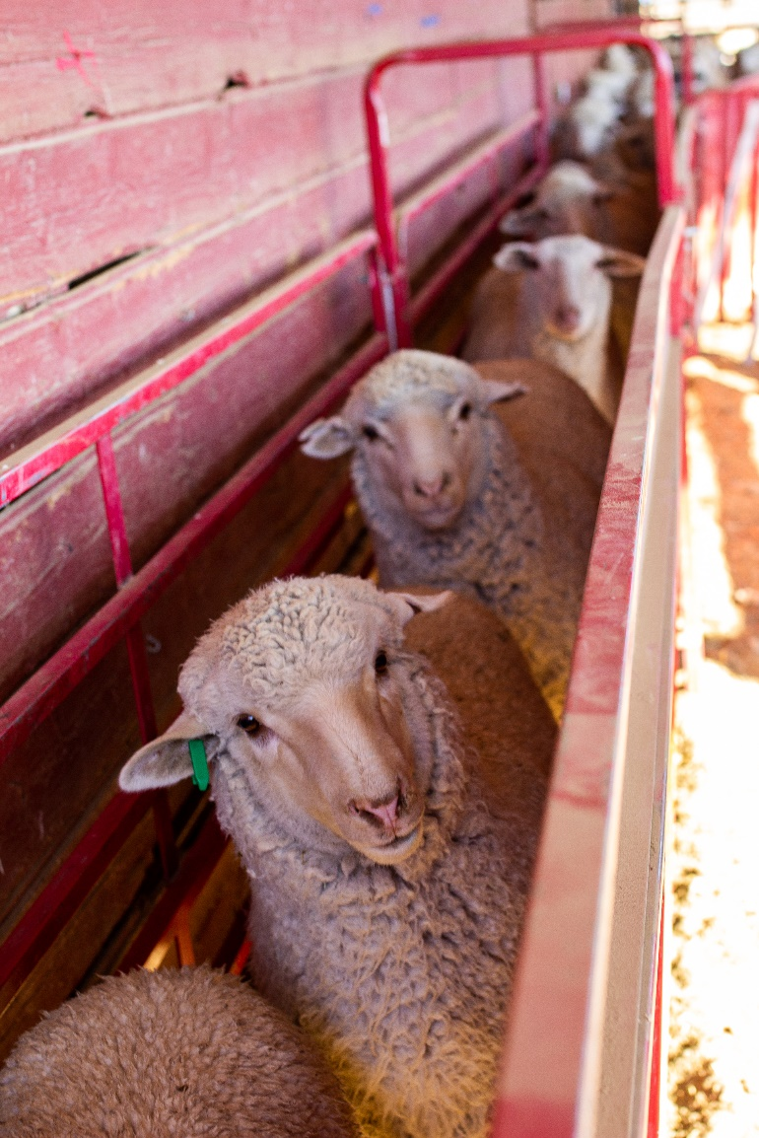
Germ Spread
Animal animal
Animal human “zoonotic”
Animal or human must be
exposed to develop disease
Understand different
routes of exposure =
Gain control, prevent!
Notes:
If we look at how diseases or the germs that cause them spread, we can find ways to control and prevent them.
Some diseases are spread between animals only. Ovine Progressive Pneumonia is one example of an animal to animal spread disease.
Some diseases are spread between animals and people and are called “zoonotic” diseases. Salmonellosis is one example of a zoonotic disease. It can be in the feces of sheep or people and spreads when it gets into the mouth. While germs and the diseases they cause vary, they all have one thing in common: the animal or human must be exposed to them to get the disease. Once we understand how disease-causing germs enter a body, it is easier to control them. Thinking about how animals or people are exposed lets us put steps in place to prevent exposure.
Photo source: American Sheep Industry (ASI) Association

Slide 4
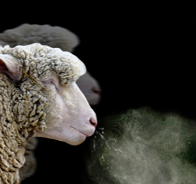
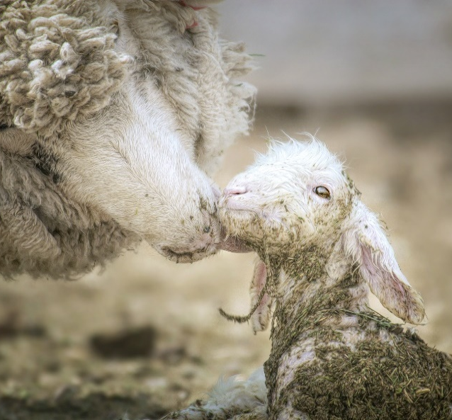
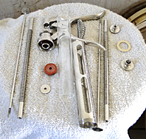
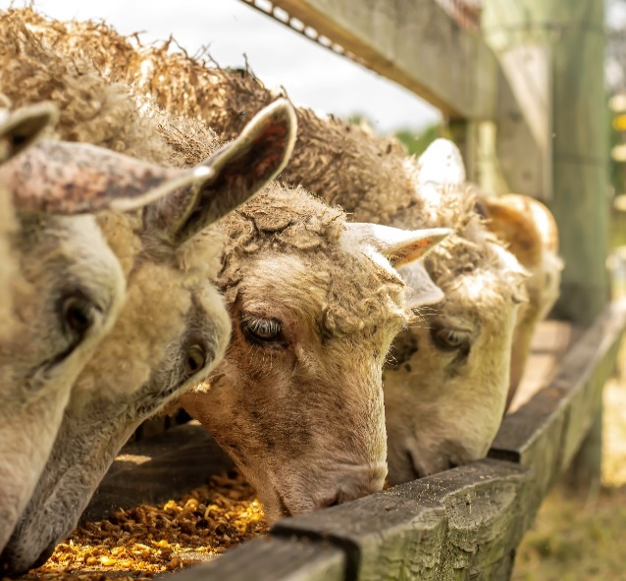
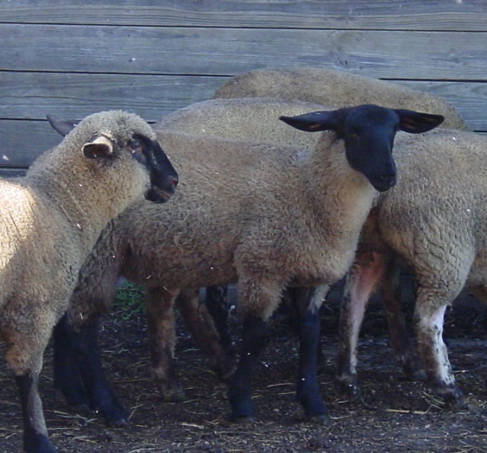
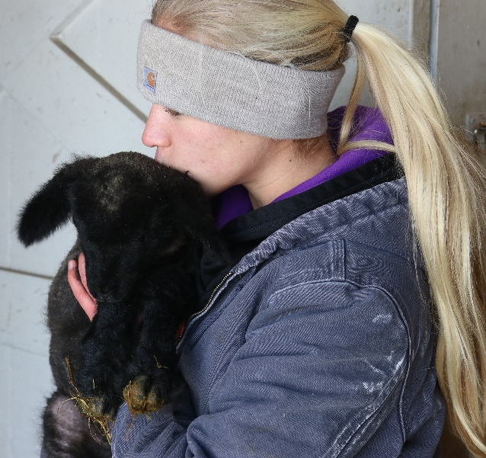
Six Incredible Ways!
1
2
3
Aerosol
Direct contact
Fomite
Oral
Vector
Zoonotic
4
5
6
Notes:
When you think about all the diseases animals or people can get, there are only six incredible ways they can be spread! This is easier to remember than the many bacteria, parasites and viruses. The pictures are examples of each route of exposure:
Aerosol: A sheep sneezing. If it is infected and another sheep breathes in the same droplets, spread can happen.
Direct contact: This ewe is licking her newborn lamb. If the ewe carried a disease, it could be spread directly through the uterus or during birth.
Fomite: If a needle becomes contaminated with a germ and shared between animals, it can be spread to the rest of the animals it touches.
Oral: If a sheep eats feed that is contaminated with manure, saliva, or urine from an infected animal, they can become infected.
Vector: These sheep are exposed to bugs outdoors, like flies and mosquitos, which can spread diseases.
Zoonotic: If the lamb, or the girl, is carrying a germ like E. coli or crypto, they could share that through contact.
Aerosol: Graphic designed by Dani Ausen, CFSPH, Iowa State University.
Direct contact: ASI Association
Fomite: Danelle Bickett-Weddle, CFSPH, Iowa State University
Oral: ASI Association
Vector: Danelle Bickett-Weddle, CFSPH, Iowa State University
Zoonotic: Andrew Kingsbury, CFSPH, Iowa State University

Slide 5
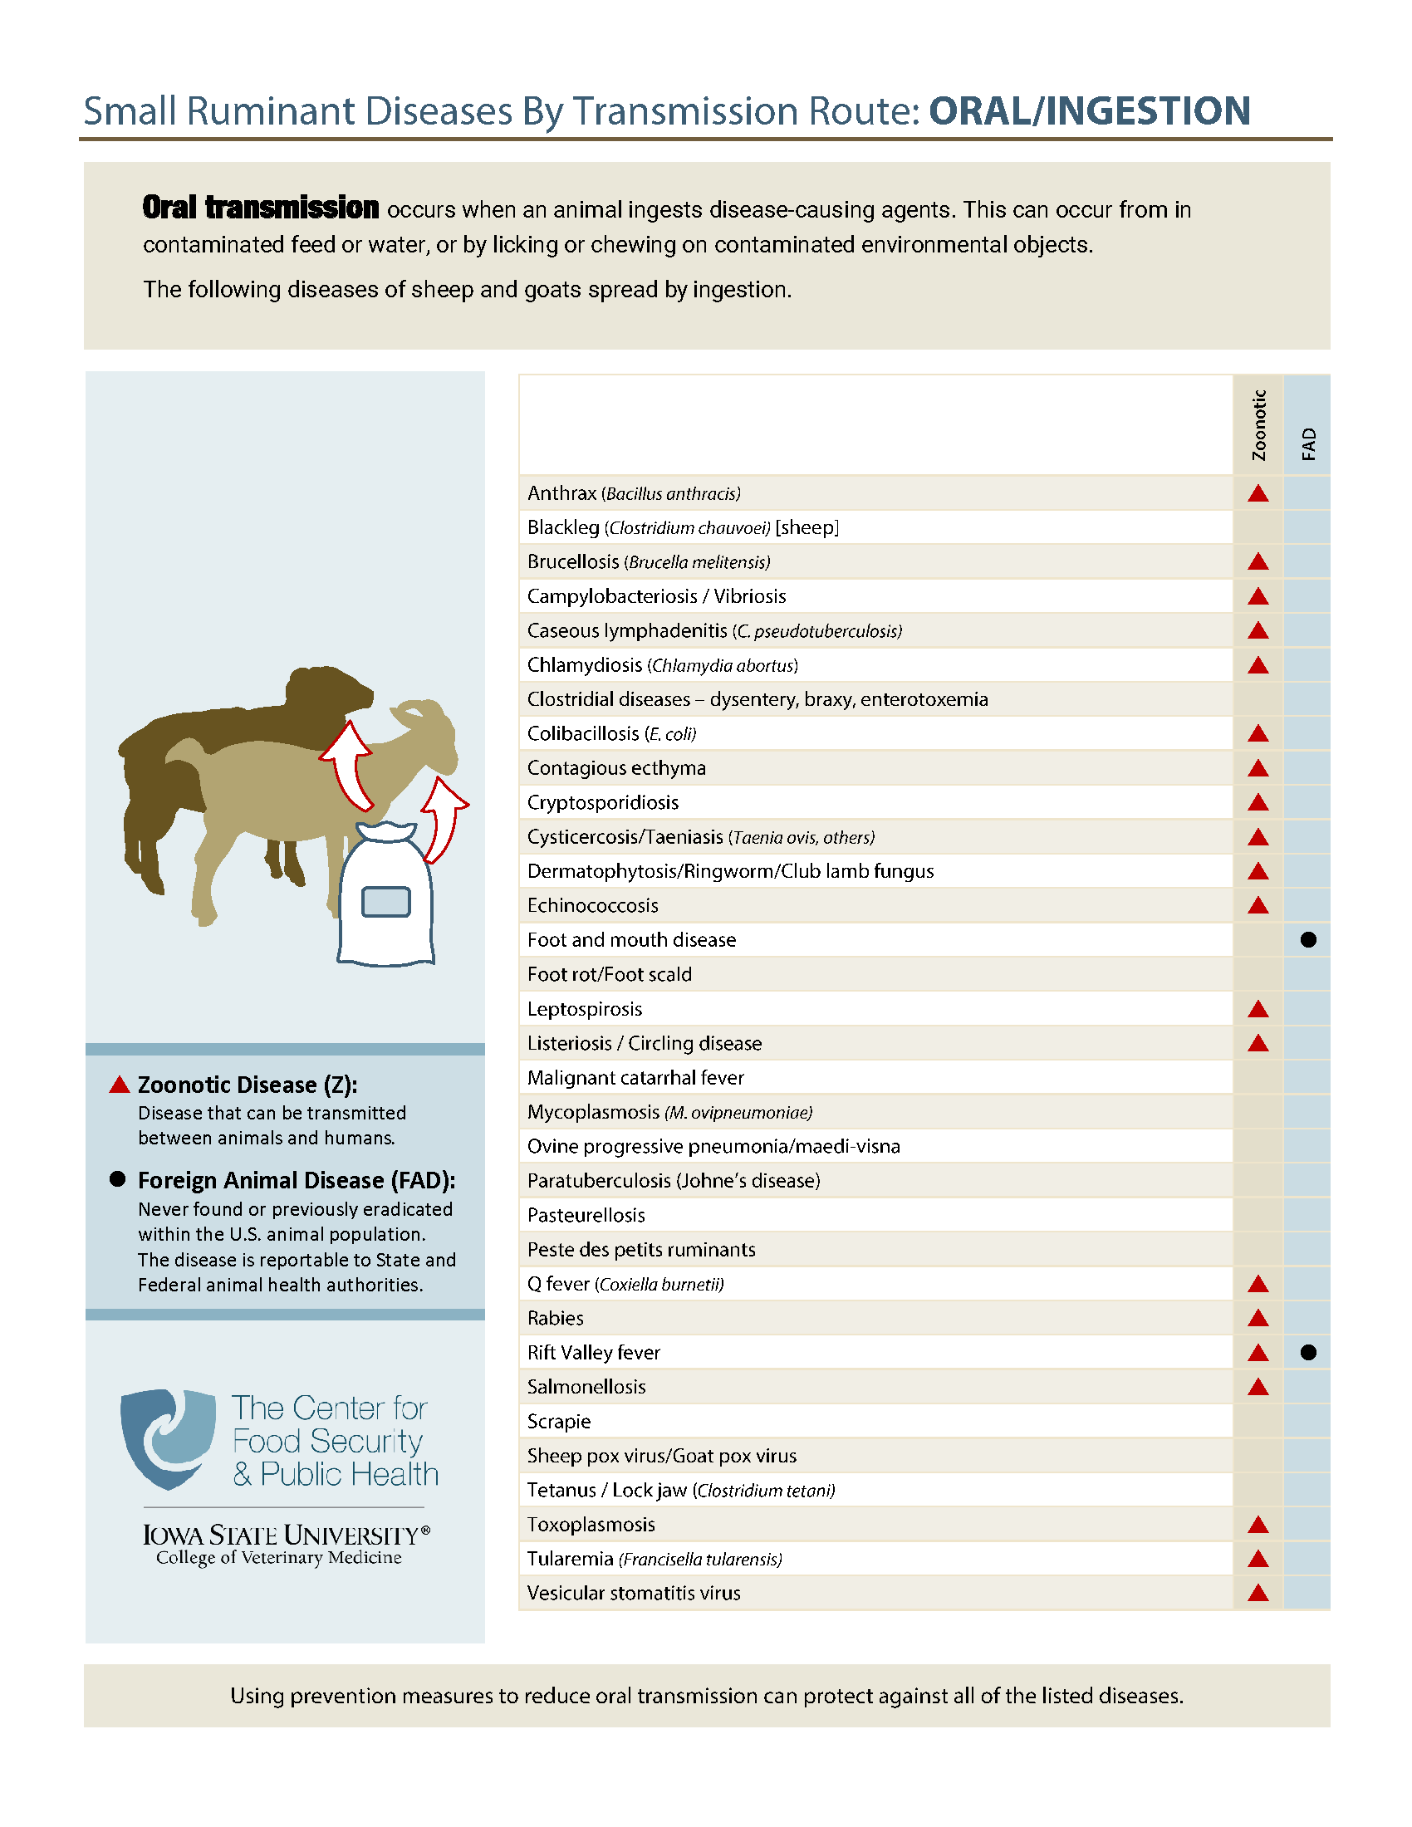
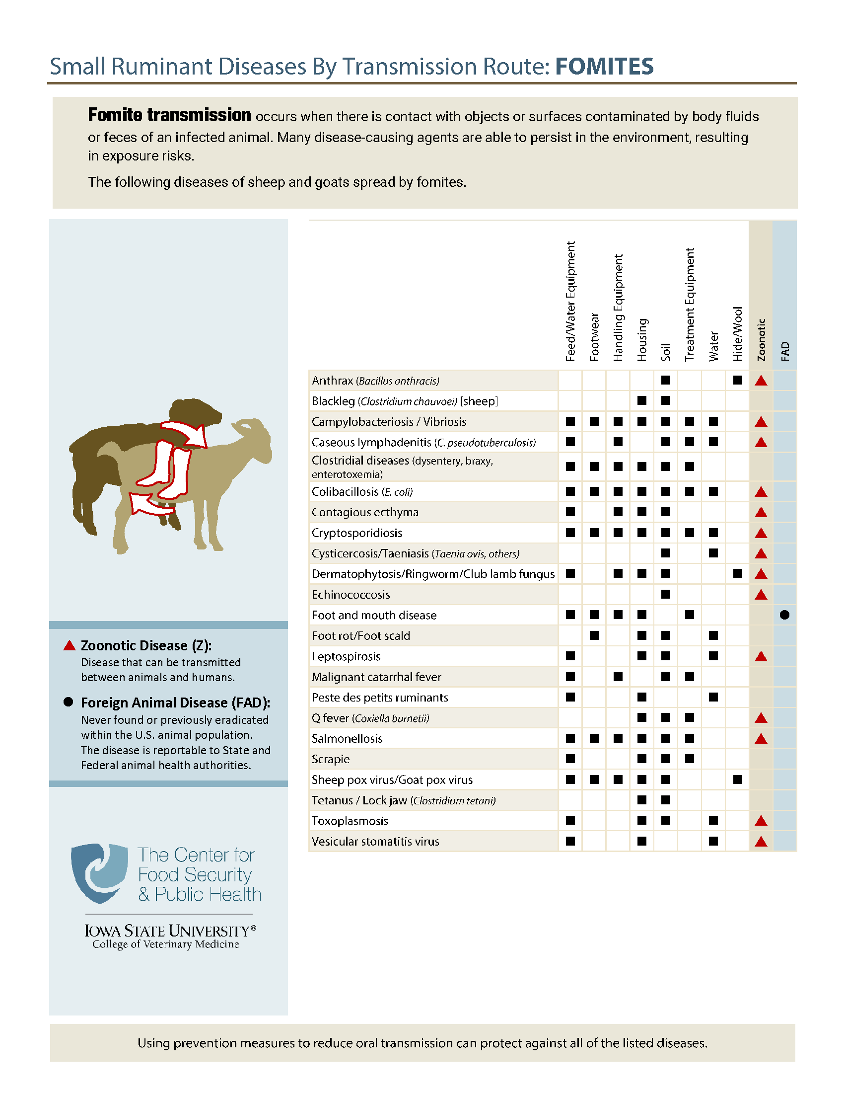
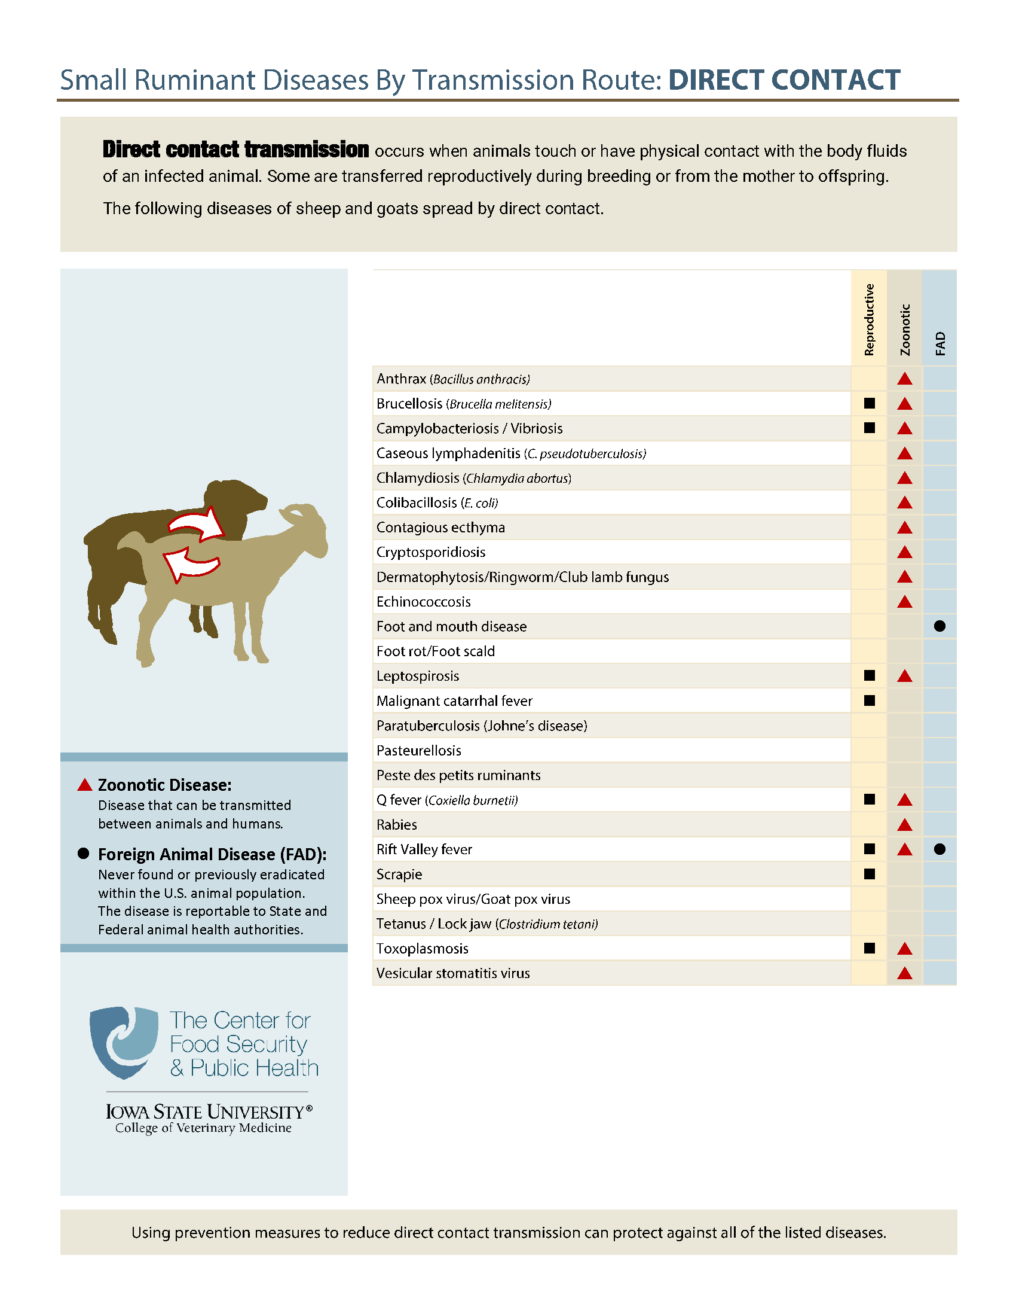
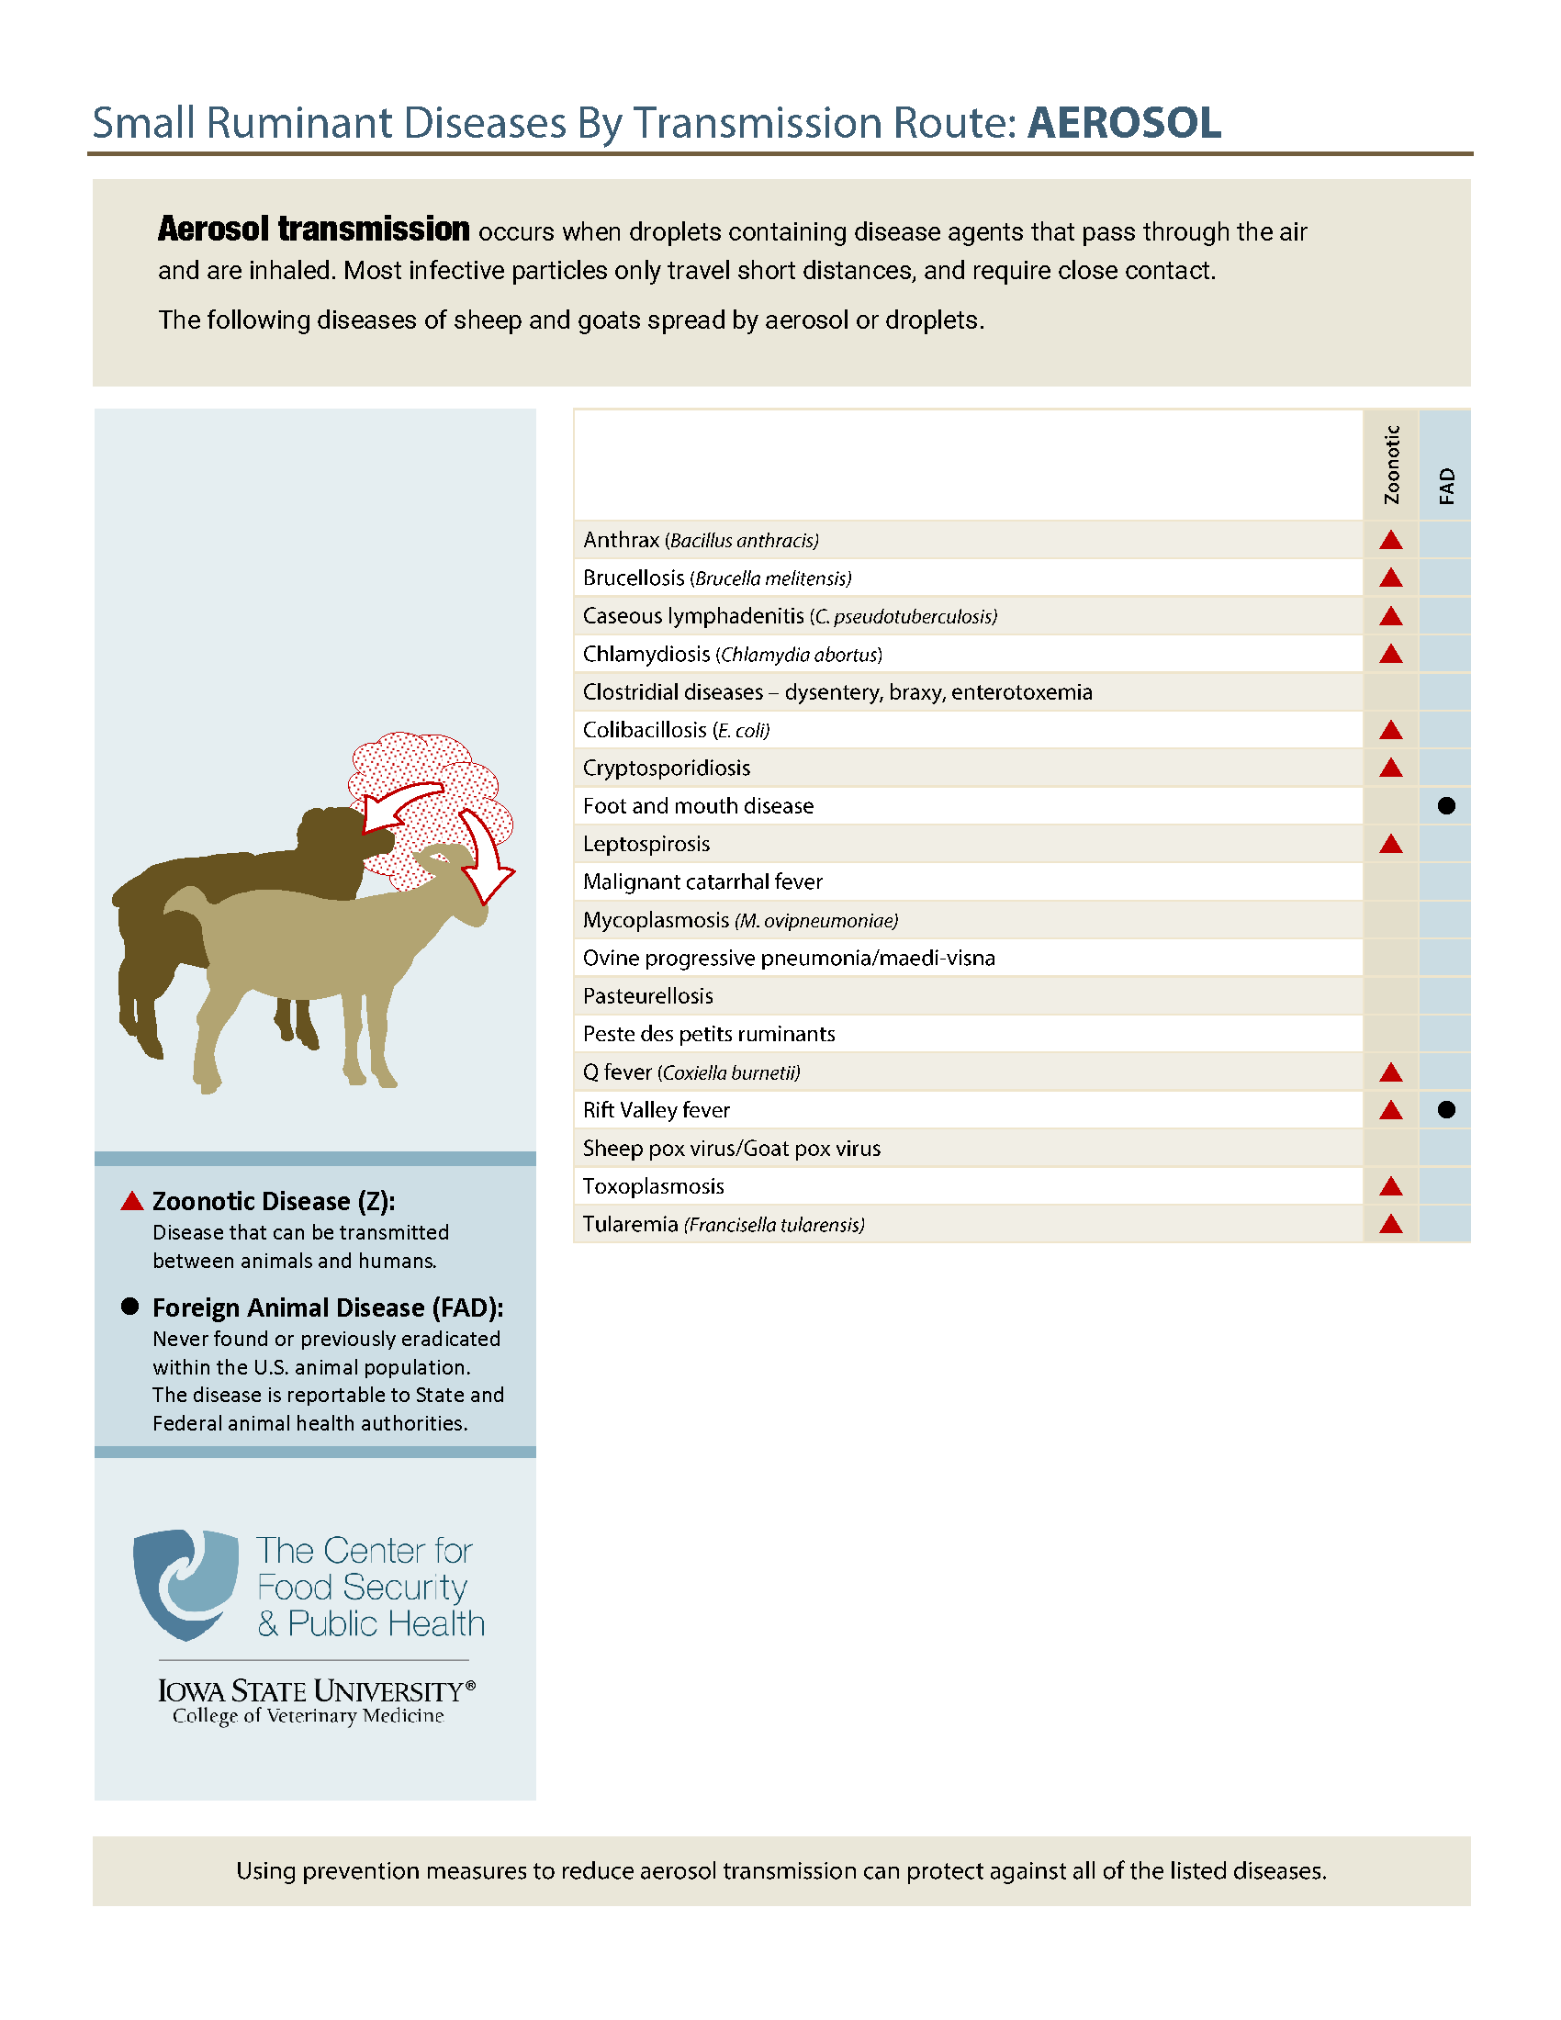
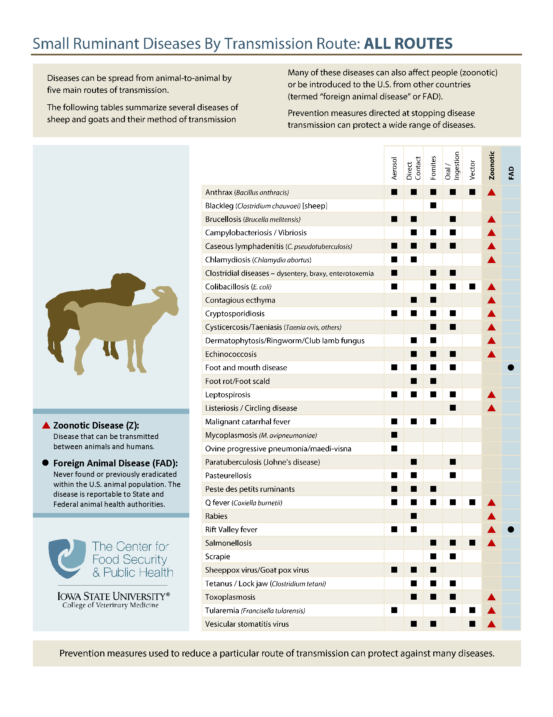
www.cfsph.iastate.edu/infection-control/routes/
Notes:
(ANIMATED – appear while talking)
If you are interested in learning about which diseases are spread by each of the 6 ways, visit the Center for Food Security and Public Health website for handouts on sheep as shown. These also show which diseases are common, known as endemic, and which ones are foreign animal, meaning not currently found in the United States. These handouts also show which diseases affect people – zoonotic diseases.

Slide 6
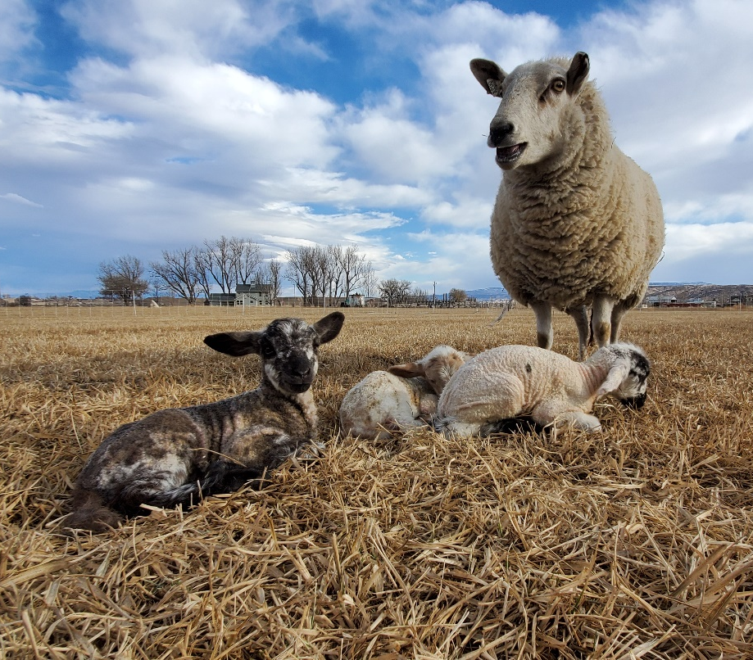
Disease Spread
Animals may not show
obvious signs of disease
Knowing ways
disease is spread
helps with prevention
  Limit disease spread risk
  to livestock and people contacting them
Notes:
We must remember that disease spread can happen without animals showing obvious signs of disease. Knowing the different ways diseases are spread can help with prevention. This can also limit the risk of disease spread to livestock and people contacting them.
Photo: ASI Association

Slide 7
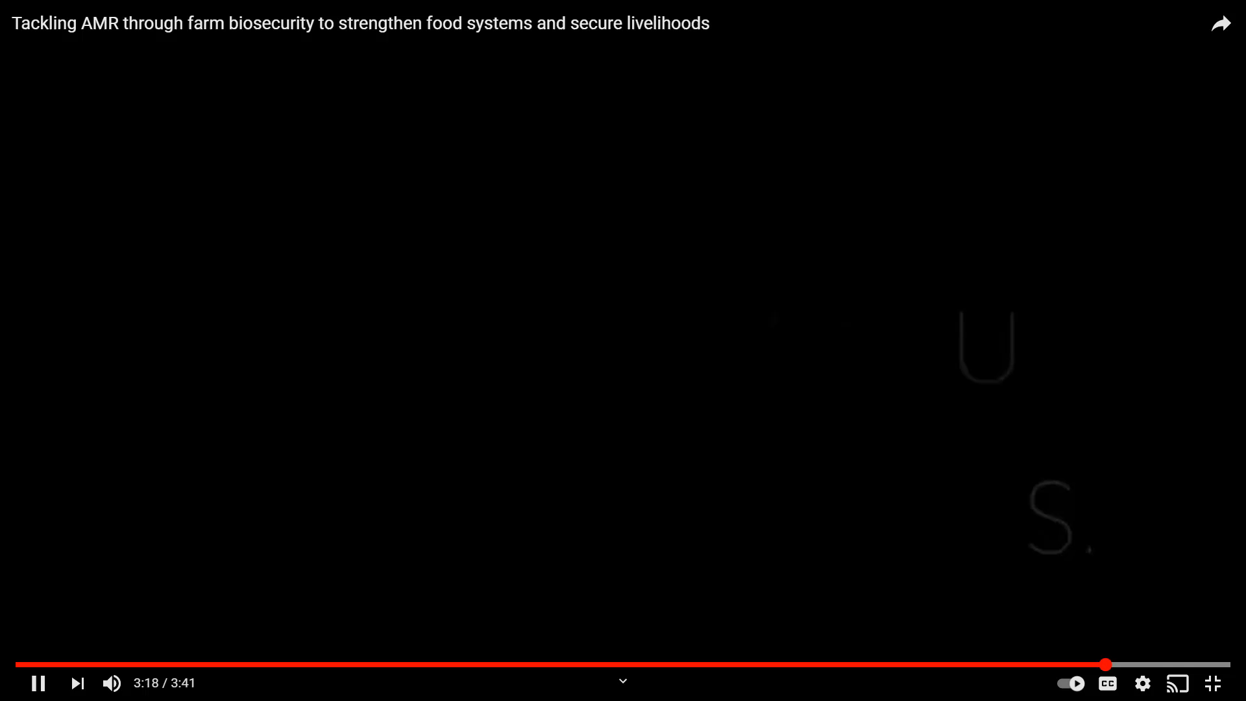
Biosecurity
“Procedures intended to protect humans or animals against disease or harmful biological agents”
  Oxford Dictionary
Source: Food and Agriculture Organization
https://youtu.be/9iy9Ebqr5-w
Notes:
Biosecurity is defined in the Oxford dictionary as “Procedures intended to protect humans or animals against disease or harmful biological agents”.
(VIDEO PLAYS AUTOMATICALLY) The video clip states: “Biosecurity towards promoting animal health, protecting public health and ensuring food security. Let’s Go!” It is from the FAO, and the video is titled: Tackling AMR through farm biosecurity to strengthen food systems and secure livelihoods, created November 18, 2020 and available at: https://youtu.be/9iy9Ebqr5-w

Slide 8
What diseases worry you most?
Foot rot
Salmonella
Johne’s Disease
Scrapie
E. coli
Q Fever
Foot and mouth disease
Notes:
(ANIMATED – appear while talking)
TRAINERS: Change as needed for your audience.
When it comes to diseases, which ones worry you the most? Working with your veterinarian to design biosecurity steps to keep diseases off your farm is a great place to start. Start by identifying the diseases you are most concerned with or at most risk from. Then focus on putting biosecurity measures in place to protect your flock.

Slide 9
Biosecurity = Disease Prevention
Disease prevention = insurance
  Paying premiums
  Hope it’s never needed
  Appreciate it when “disaster” strikes
If biosecurity is working, NO ONE KNOWS
  Hard to put a value on its effectiveness
When there is a labor shortage, time is a
precious commodity
  Effective biosecurity takes time, practice
Notes:
Biosecurity is the insurance needed for disease prevention. By investing in biosecurity regularly, we are are paying those “premiums”. The goal is to never need to submit a “claim”. We all hope a disease challenge never happens. We appreciate the investment in daily biosecurity practices when disaster strikes.
(CLICK) In reality, if biosecurity is working, NO ONE KNOWS. This makes it hard to put a value or dollar amount on its effectiveness. The value comes when a challenge arises, and the animals do not become sick.
(CLICK) Animal agriculture has faced some big challenges with labor shortages. Time is precious on a farm when there are not enough people to get everything done. This can create challenges to make sure biosecurity steps are followed. To do biosecurity well and to be effective, it takes time. Not cutting corners, or leaving things dirty, or rushing between tasks. Effective biosecurity also takes practice to do well and become routine. All of these are reasons to start doing things now to help protect animal health.

Slide 10
Benefits to Biosecurity NOW
Common disease prevention
  Similar exposure routes for foreign animal or unknown diseases
Q Fever
Direct contact
  Blood, saliva, feces,
  urine, reproductive
Fomites
Oral
  Consuming feces, urine, milk from infected animals
Foot and Mouth Disease
Direct contact
  Blood, saliva, feces,
  urine, reproductive
Fomites
Oral
  Consuming feces, urine,
  milk from infected animals
Notes:
What are some of the benefits to putting biosecurity in place NOW? Instead of waiting for a disease challenge like a highly contagious Foreign Animal Disease (FAD)?
First, many common diseases are spread the same way that FADs or unknown disease are. For instance, Q Fever (Coxiella burnetii) in sheep…(CLICK)
An infected animal can spread Q fever to another sheep through direct contact, through fomites which are contaminated objects, and orally when eating or drinking things contaminated with the virus. Q Fever is also spread through vectors and aerosol.
Let’s compare that to an FAD that affects sheep (CLICK), Foot and Mouth Disease (FMD). While FMD is MUCH MORE CONTAGIOUS than Q Fever, how an animal gets exposed is similar. They can be exposed through direct contact, contaminated fomites, and oral consumption.
Biosecurity steps that prevent exposure to Q Fever can help protect from other diseases spread the same ways.

Slide 11
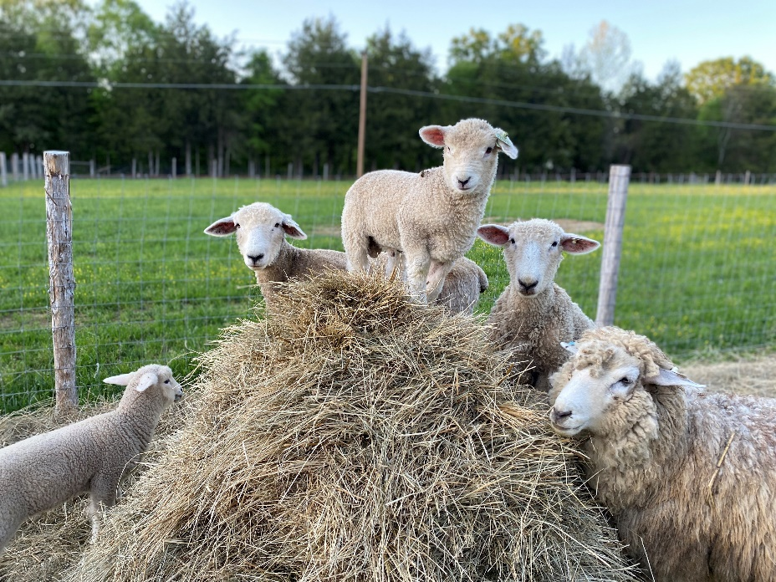
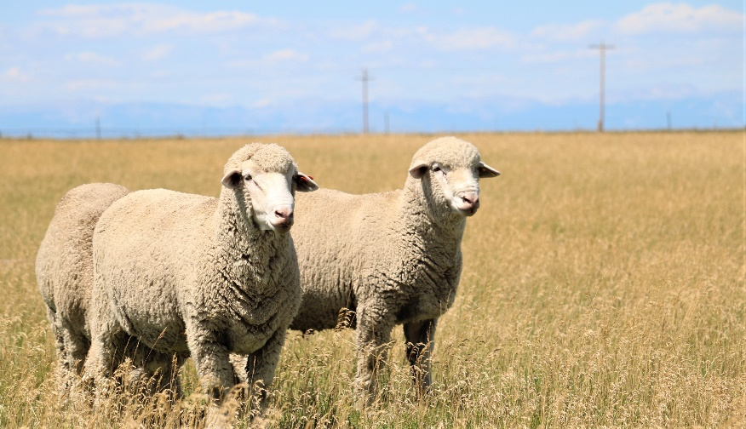
Benefits to Biosecurity NOW
Less disease challenges = better animal health
Decrease infectious burden = better animal health
  Dose = Severity
Better animal health = economic benefits
Notes:
Other benefits to putting biosecurity in place NOW is having less overall disease challenges. This can lead to better animal health. Most diseases cannot be completely eliminated, but the risk can be managed. For nearly all diseases there is a relationship between exposure dose and severity of disease. For diseases that are always present (endemic), reducing the dose of infectious agent the animal is exposed to can positively affect the animal’s health. Better animal health leads to economic benefits for the producer, the industry, the state. It also helps justify the cost of implementing biosecurity.
Photo sources: ASI Association

Slide 12
Daily to Enhanced Biosecurity
Preparing for the Unexpected to Maintain Sheep Health
Notes:
Daily to Enhanced Biosecurity: Preparing for the Unexpected to Maintain Sheep Health

Slide 13
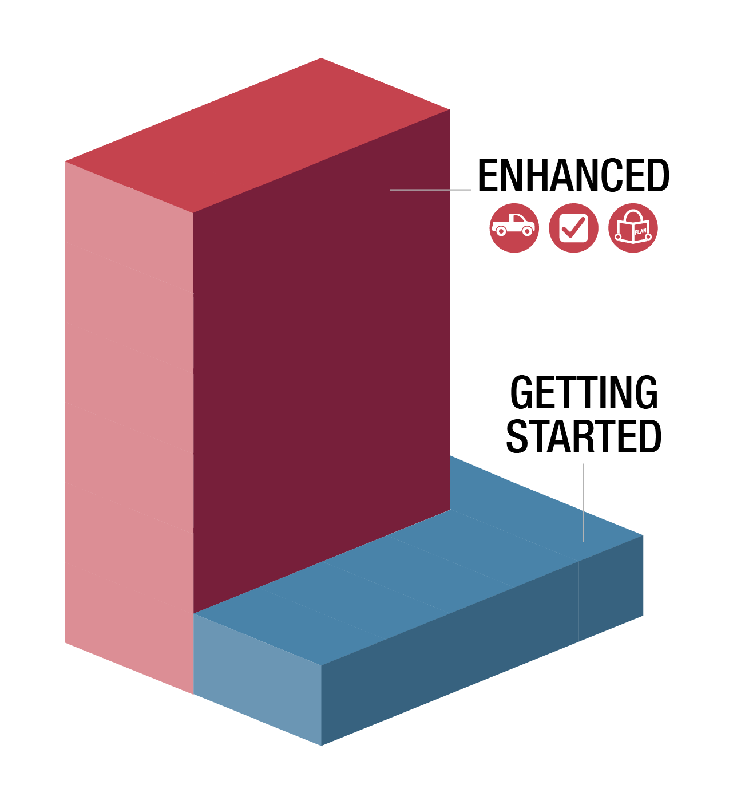

Protecting the Flock
Majority of producers have not dealt with new,
highly contagious disease
  Enhanced biosecurity needed
  Animals never zero risk
  of exposure
It will be hard for some flocks
to go from no/little biosecurity
to enhanced…
Notes:
Most producers have not had to deal with a new, highly contagious disease. It will take an enhanced level of biosecurity to keep highly contagious diseases out of the flock. One of those highly contagious disease is foot and mouth disease (FMD). Animals are never at zero risk of disease exposure. However, doing whatever we can to protect the animals in our care is important.
(CLICK) It will be hard for some flocks to go from no or little biosecurity to enhanced to protect their animals. That can be a tough journey.
Graphic source: CFSPH, Iowa State University

Slide 14
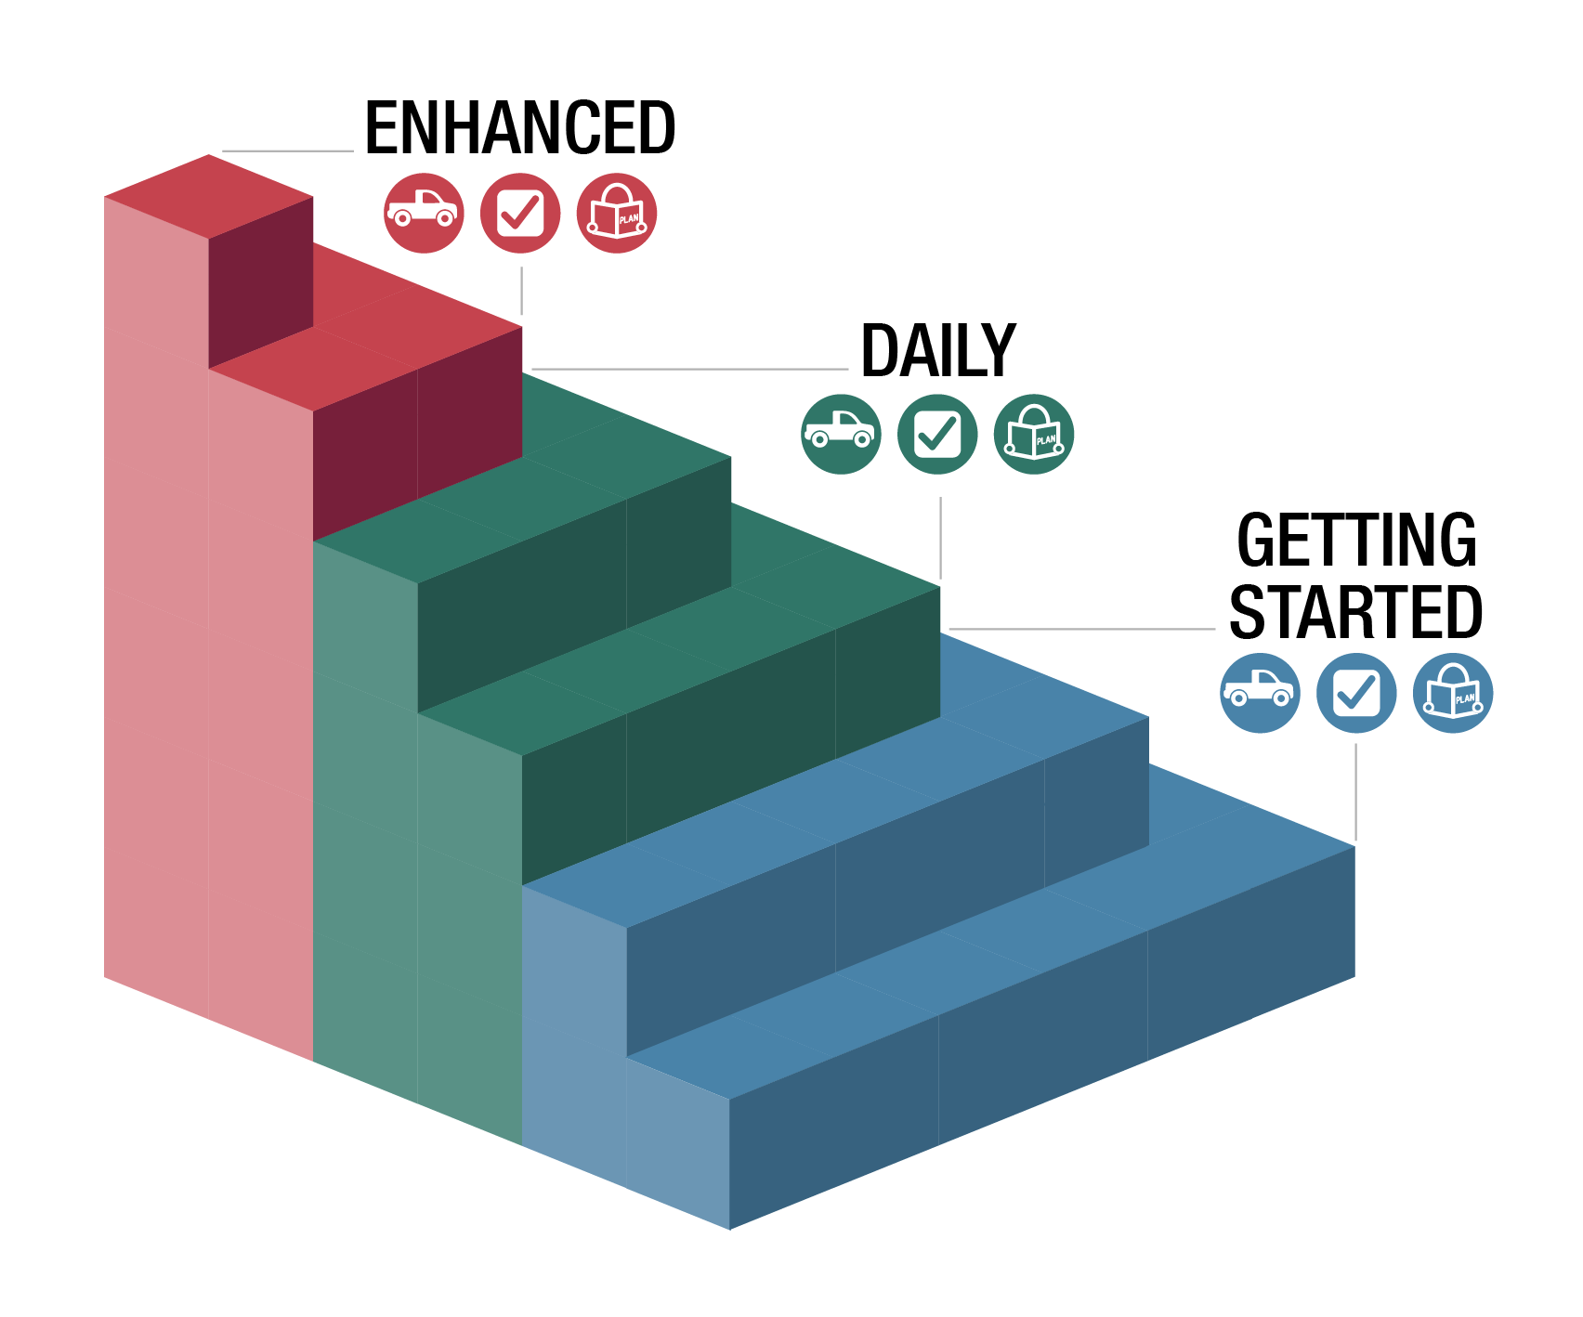
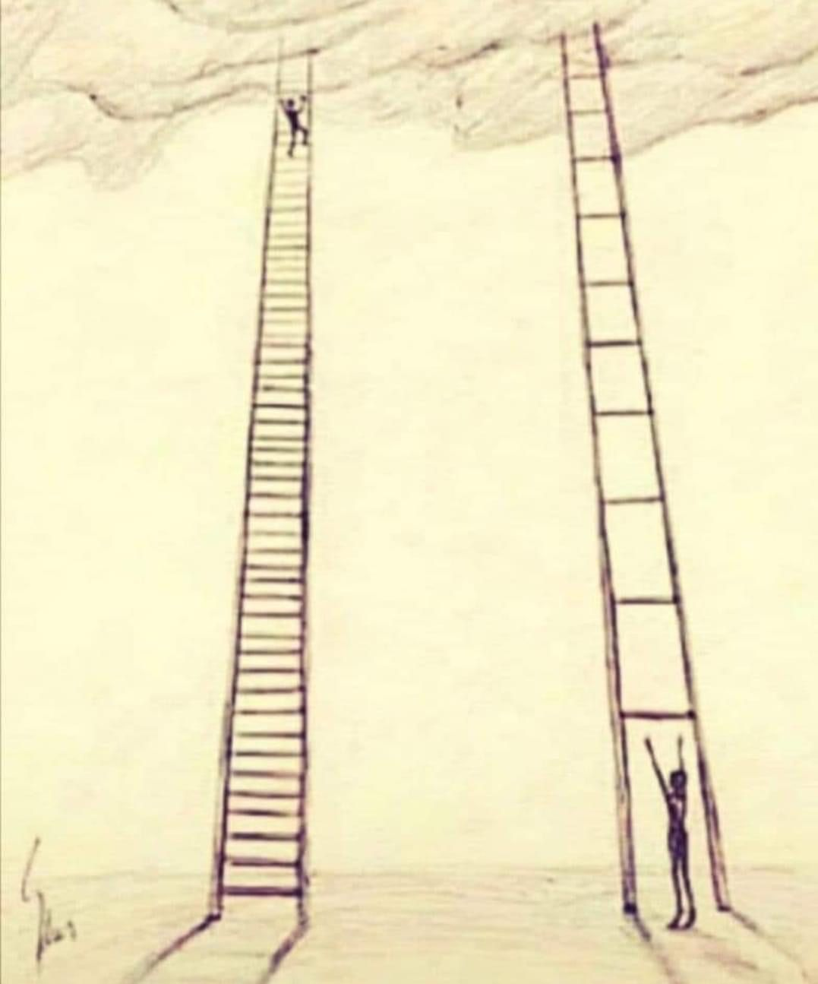
Big journeys begin with small steps
Notes:
Big journeys begin with small steps. It takes time to get to enhanced biosecurity. This is the same for any big changes on livestock operations. For instance, months to years may be needed for genetic improvement of the flock, better finished weights, and better wool production. Sometimes, getting started is a big first step.
(CLICK) To help producers go from no or little biosecurity, several steps have been created to help get started, practice it daily, so they are more ready for enhanced biosecurity.
Graphic sources (left): https://i.pinimg.com/564x/60/92/6f/60926f4d71aea485a9bd25e510fe8087.jpg
(right) CFSPH, Iowa State University

Slide 15
Movement Risks
Notes:
Let’s start by looking at the different movements risks for sheep operations that could expose animals to diseases.

Slide 16
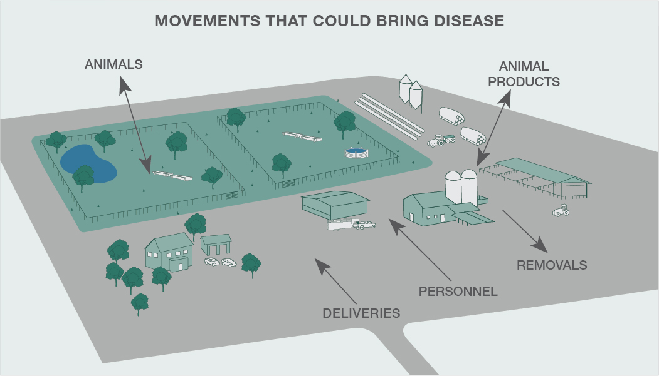
Notes:
Items moving on and off your farm or ranch can bring disease. Identifying movement risks can help you prevent them. Some of the areas to focus on include:
Animals – these could be new animals added to your flock or animals returning from shows, fairs, or breeding.
Animal products – especially if they have not been treated to kill potential germs. Semen and embryos can’t be treated prior to use. Knowing the source and the disease status of the source flock is important to keeping diseases from your animals.
Deliveries – especially if the vehicle or equipment drives in animal areas or areas where animals travel.
Removals – seems odd to think things leaving could introduce disease, but what item is leaving and how? Is it a dead animal and a vehicle needs to enter to pick it up? Where was that vehicle or equipment prior to your farm? Same for manure removal. Vehicles that go farm to farm could pose a risk (livestock trucks, shearing trailers)
Personnel – especially if they will have direct contact with animals on your operation.
Graphic source: CFSPH, Iowa State University

Slide 17
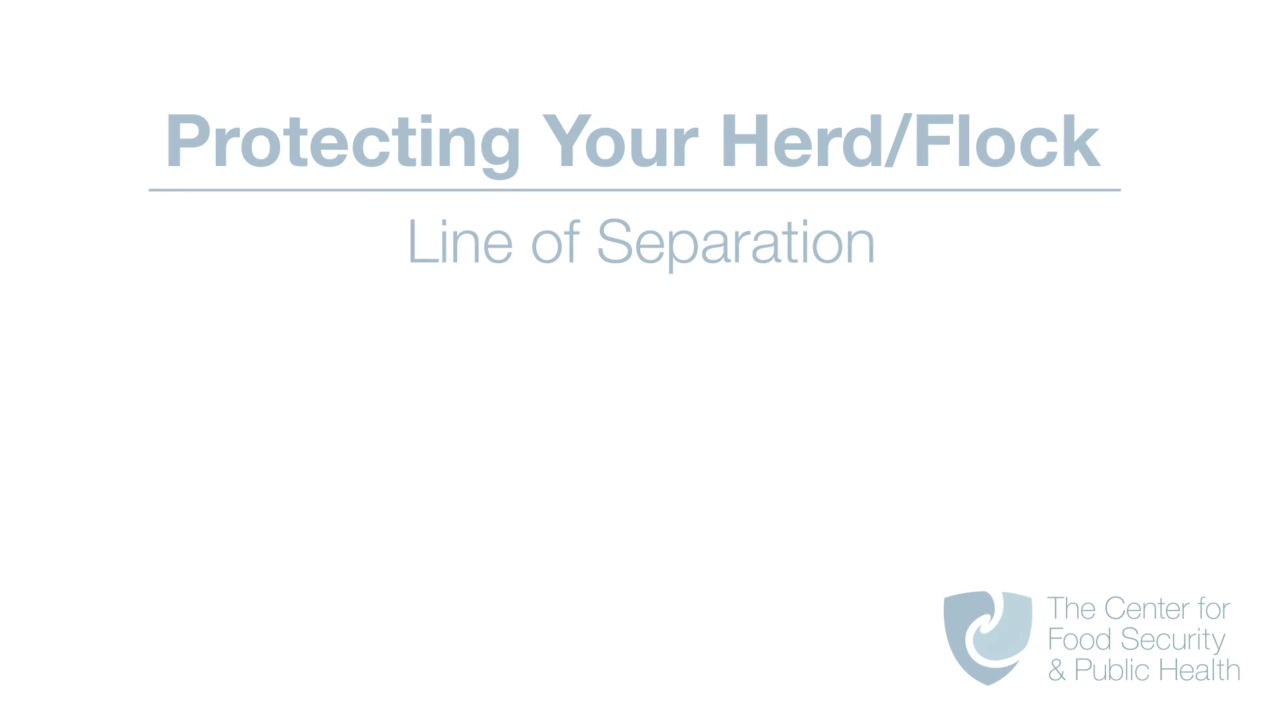
Notes:
(VIDEO SHOULD START PLAYING AUTOMATICALLY – 2 minutes with full credits at end)
Protecting Your Herd and Flock: Line of Separation video downloaded from: Video downloaded from: https://vimeo.com/user68158100/download/553543741/24fb8bbe01
Source: CFSPH, Iowa State University; Narration, Danelle Bickett-Weddle, DVM

Slide 18

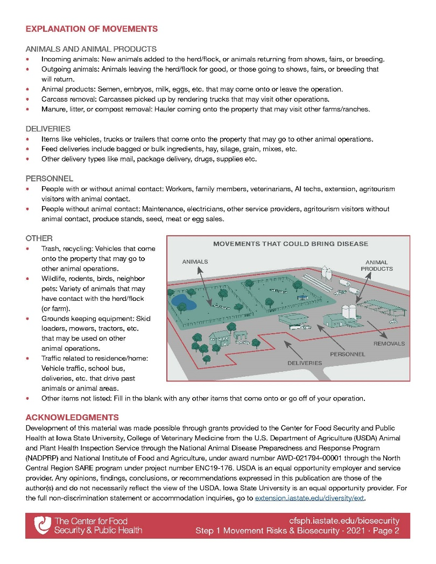
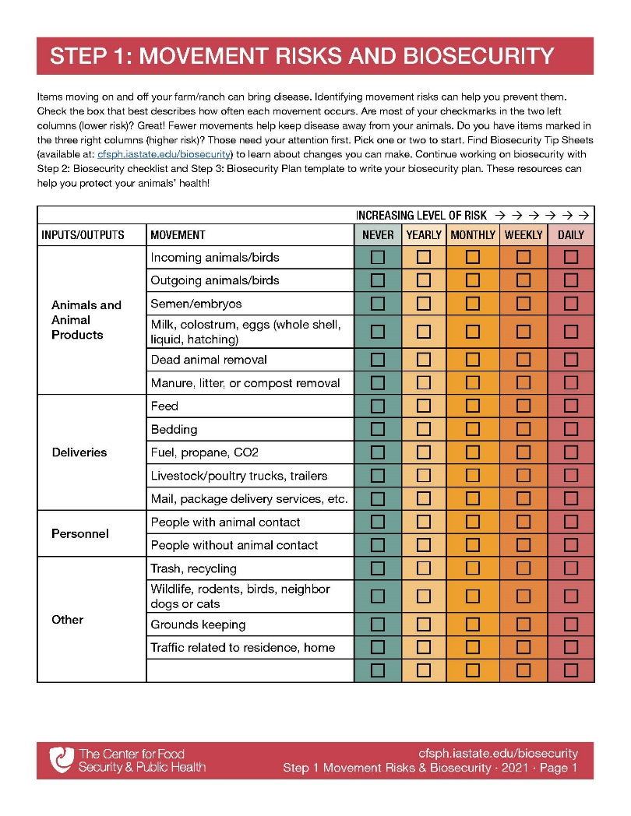
Step 1: Movement Risks
Fill it out for a typical week
or month
Focus on daily movements first
What initial biosecurity steps could protect the flock?
www.cfsph.iastate.edu/biosecurity/
Notes:
The Center for Food Security and Public Health at Iowa State University created an easy-to-use checklist to explore the different movements that come onto your farm. Step 1 Movement Risks is pictured and can be downloaded from the website: cfsph.iastate.edu/biosecurity/. Producers are encouraged to fill it out for a typical week or month. It is a fillable PDF. Just check the box that best describes how often each movement occurs. Are most of your checkmarks in the two left columns (lower risk)? Great! Fewer movements help keep disease away from your animals. Do you have items marked in the three right columns (higher risk)? Those need your attention first, especially daily movements. Pick one or two to start. Next we will talk about some of the biosecurity steps that could protect the flock.
Graphic source: CFSPH, Iowa State University

Slide 19

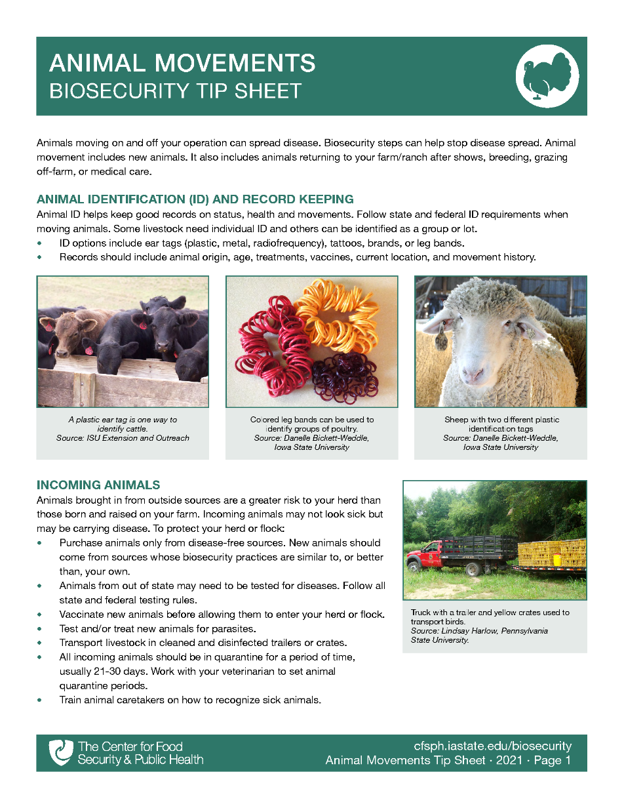
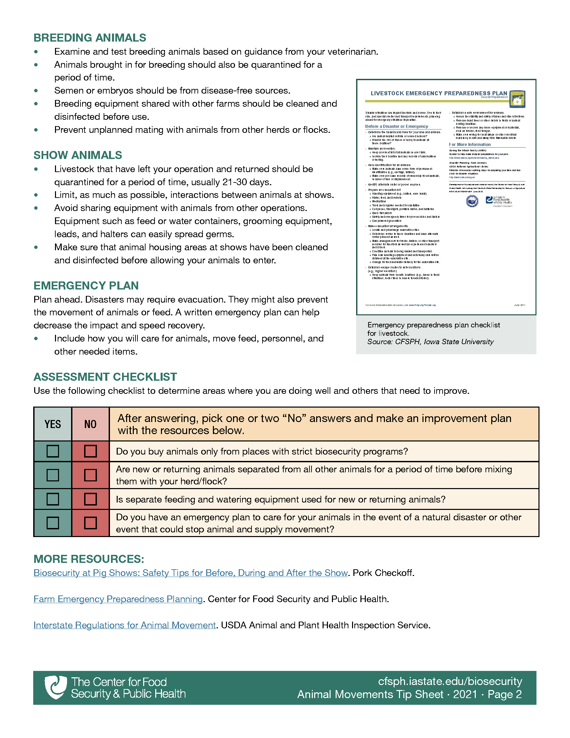
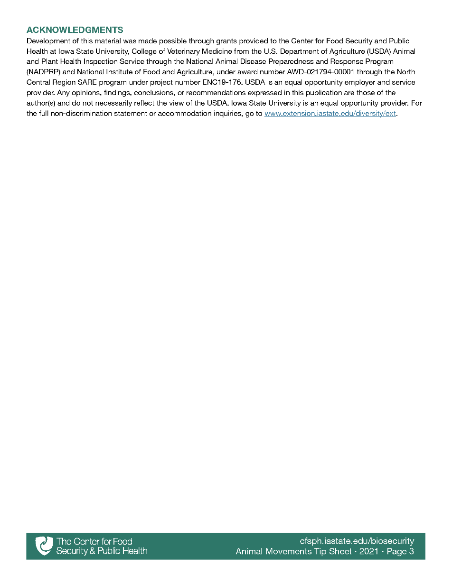
Where can I learn more?
Biosecurity Tip Sheets provide more info on biosecurity actions to protect your flock!
www.cfsph.iastate.edu/biosecurity/
Notes:
Once you have figured out the more common movements, there are Biosecurity Tip Sheets with steps to protect your flock from exposure. Pictured is the Animal Movement Biosecurity Tip Sheet. This is available on the Center’s website listed on the screen.
Graphic source: CFSPH, Iowa State University

Slide 20
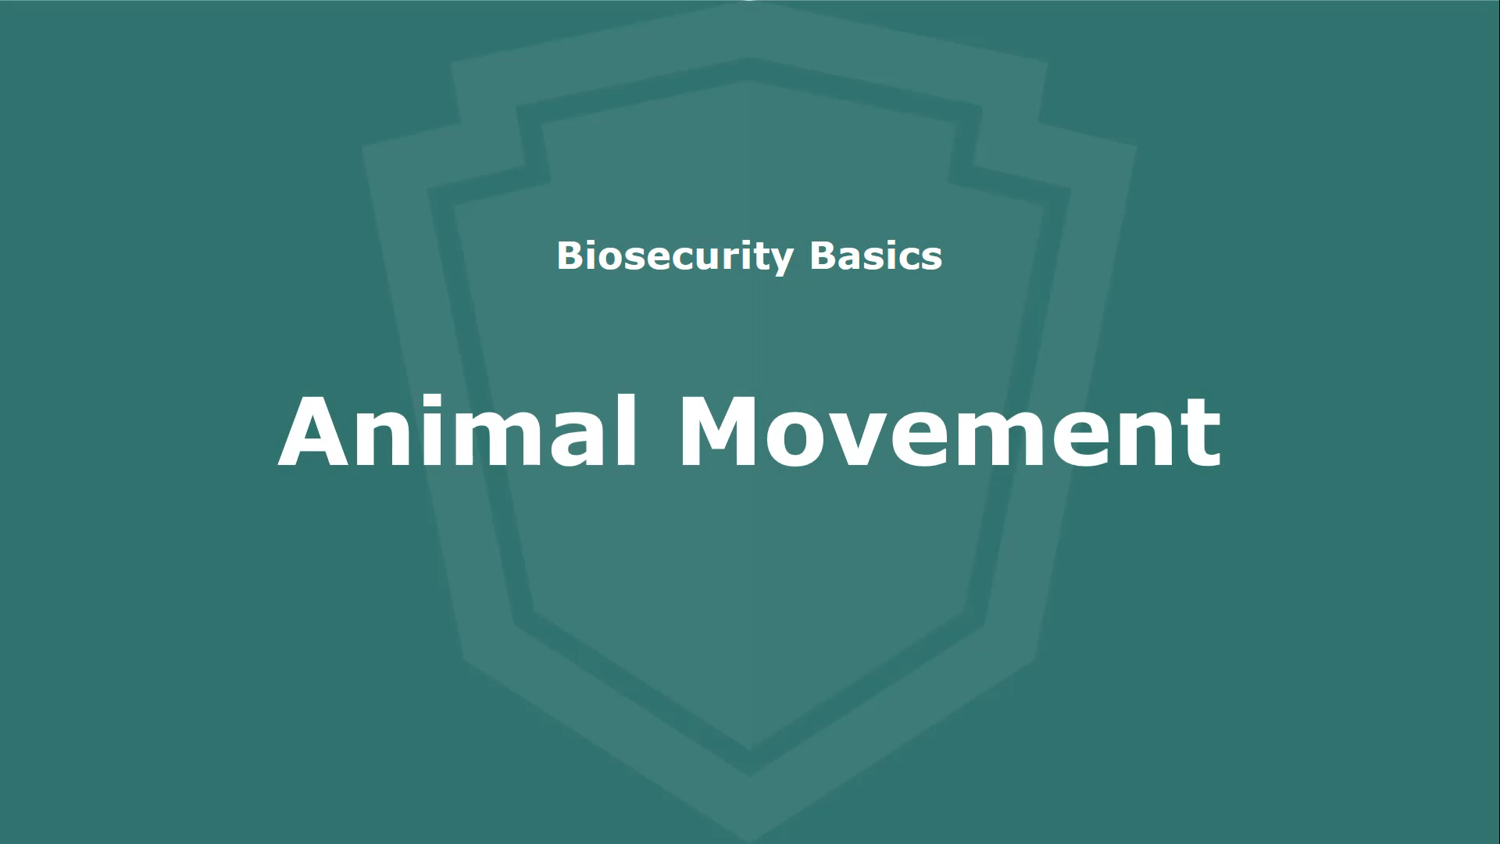
Tip Sheets – Videos
www.cfsph.iastate.edu/biosecurity/
Notes:
Want even more biosecurity ideas? Each Tip Sheet has a corresponding video full of pictures! Find them on the Center’s website listed on the screen.
(CLICK ON VIDEO TO PLAY – 6 minutes with full credits at end)
NOTE TO TRAINERS: There are also PPTs available for your use to present live or customize for your audience. Those are available on the “training” web page: https://www.cfsph.iastate.edu/biosecurity-resource/train-the-trainer/
Source: CFSPH, Iowa State University; Narration, Glenda Dvorak, DVM

Slide 21
Tip Sheets – Checklist
Notes:
Within each Tip Sheet (and PPT) is a checklist that has a few questions to uncover other areas of strength and gaps in biosecurity steps. There are also “More Resources” to explore for more tips.
Graphic source: CFSPH, Iowa State University

Slide 22

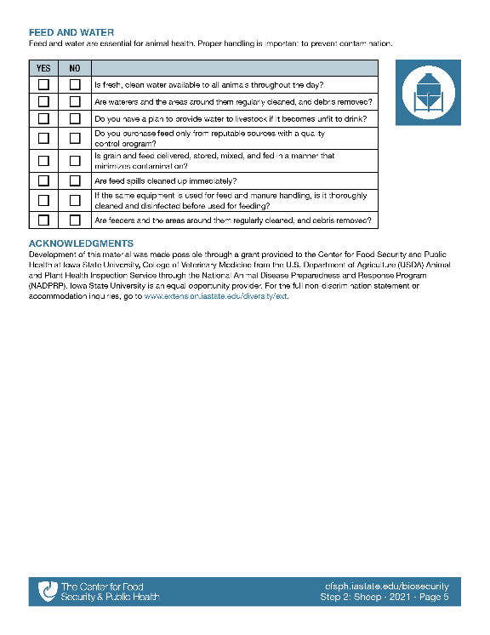
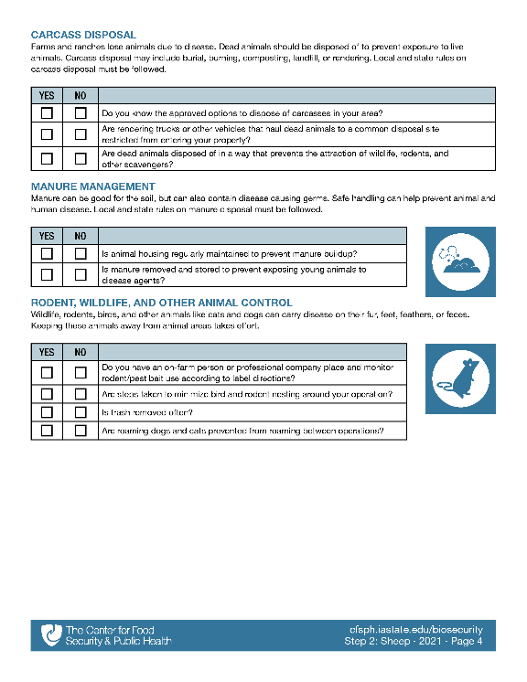
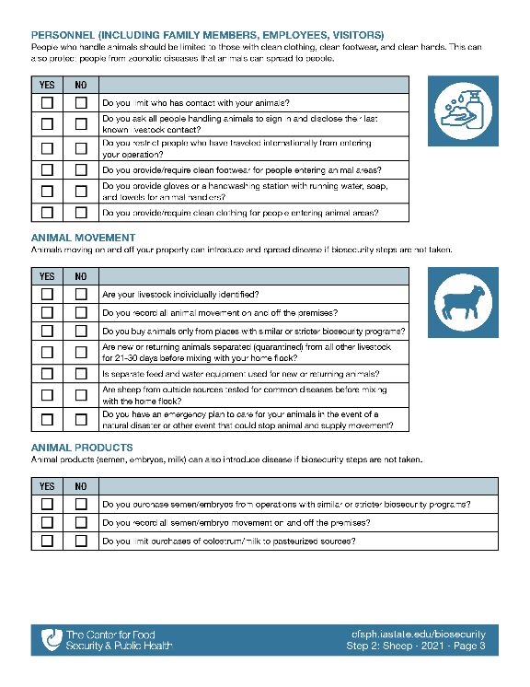
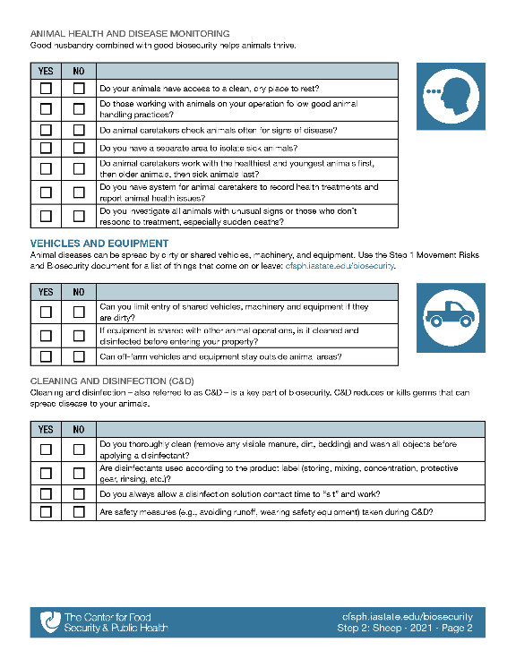

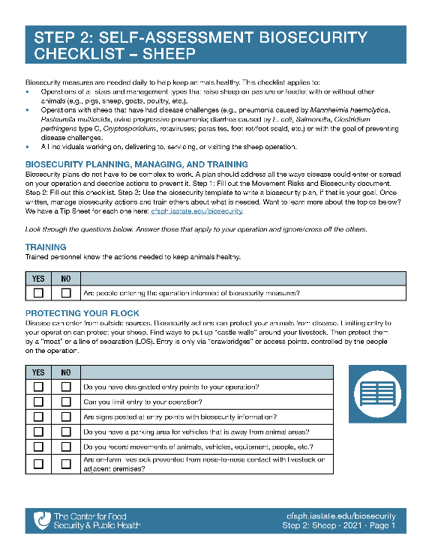
Step 2: Assess Biosecurity
Biosecurity checklist has a series of questions to find strengths and gaps
www.cfsph.iastate.edu/biosecurity/
Notes:
After doing one or two checklists in the Tip Sheets, are you ready to assess other biosecurity actions? Step 2 is a self-assessment biosecurity checklist. The same questions found in the Tip Sheets are here too. They are meant to find strengths and gaps.
TRAINERS: The Sheep checklist has 42 questions.
Graphic source: CFSPH, Iowa State University

Slide 23



Checklist Topics
Training
Protecting Your Flock
Animal Health and Disease Monitoring
Vehicles and Equipment
Cleaning and Disinfection
Personnel (Family, Employees, Visitors)
Animal Movement
Animal Products
Carcass Disposal
Manure Management
Wildlife, Rodent, Other Animal Control
Feed and Water
www.cfsph.iastate.edu/biosecurity/
Notes:
Listed on the screen are all the topics found in the Sheep Self-Assessment Checklist
Graphic source: CFSPH, Iowa State University

Slide 24



Tip Sheet Topics
Protecting Your Flock
Animal Health and Disease Monitoring
Vehicles and Equipment
Cleaning and Disinfection
Personnel (Family, Employees, Visitors)
Animal Movement
Carcass Disposal
Manure, Litter, Bedding Management
Wildlife, Rodent, Other Animal Control
Feed and Water
More!
www.cfsph.iastate.edu/biosecurity/
Notes:
Listed on the screen are all the Tip Sheet topics found on the biosecurity resources web page. These match the checklist topics. There are additional tip sheets in development. There are also several additional tip sheets on item-specific cleaning and disinfection.
Graphic source: CFSPH, Iowa State University

Slide 25

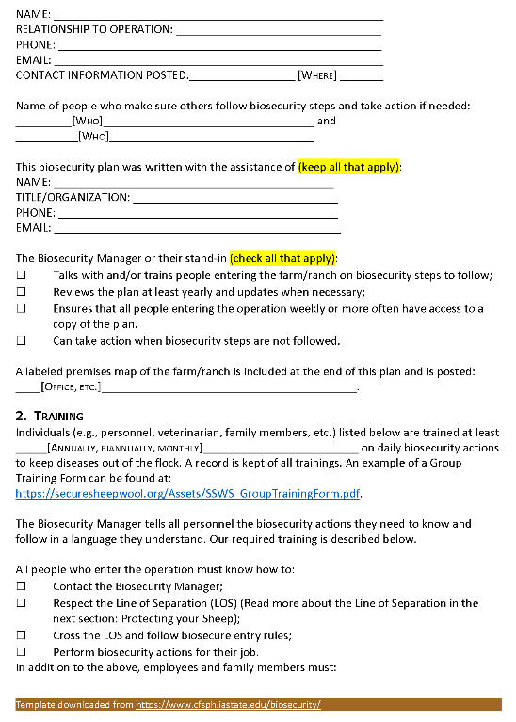
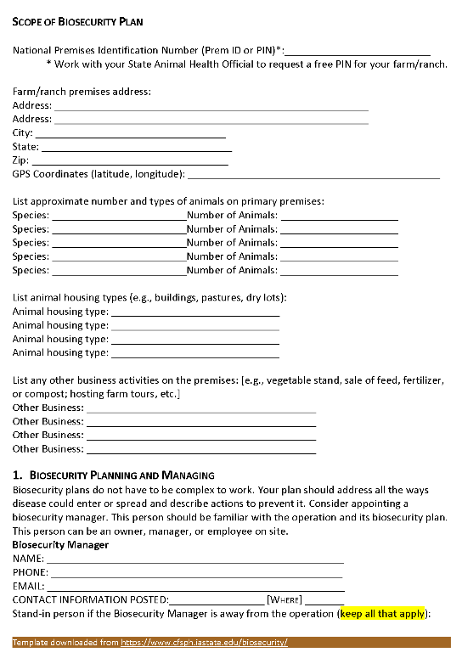
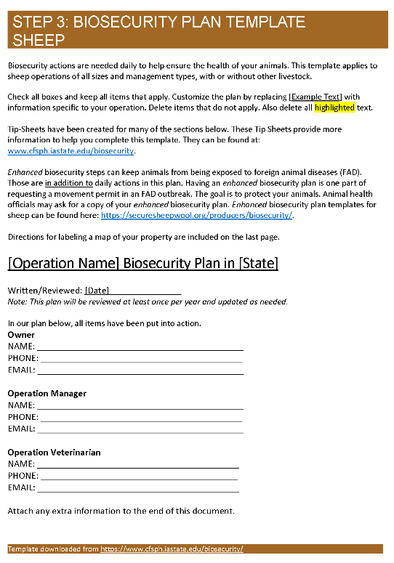
Step 3: Biosecurity Plan Template
Ready to write a plan?
Step 3: Biosecurity Template – Sheep is a great place to start!
Voluntary
  www.cfsph.iastate.edu/biosecurity/
Notes:
Is writing a biosecurity plan a goal? Then the Biosecurity Plan Template for sheep is just what you need.
This template lines up with the Step 2: Sheep Biosecurity Checklist, giving producers additional tools to protect their flock. Writing a biosecurity plan is completely voluntary.
Graphic source: CFSPH, Iowa State University

Slide 26
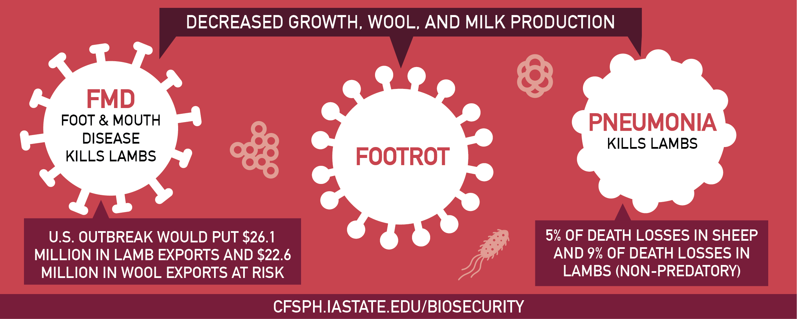
Diseases Harm Animal Health
Diseases are Costly
Notes:
Common and foreign animal diseases harm animal health and are costly. FMD, or Foot and Mouth Disease, footrot, and pneumonia cause decreased growth, decreased wool and milk production. If the U.S. were to have an outbreak of FMD, a foreign animal disease, not only would it kill lambs but it would also put $26.1 million in lamb exports and $2.6 million in wool exports at risk. Pneumonia, a more common disease, causes 5% of death losses in sheep and 9% of non-predatory death losses in lambs.
Graphic source: CFSPH, Iowa State University

Slide 27
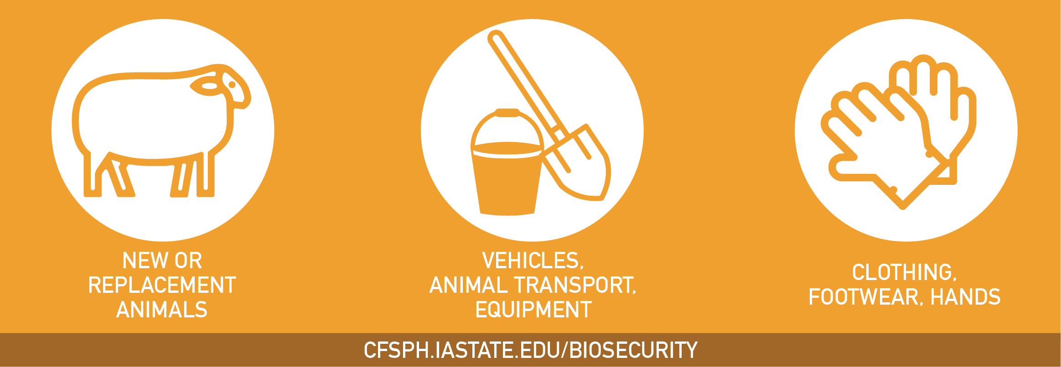
Diseases are Spread By…
Notes:
FMD, footrot, pneumonia, and many others diseases, are spread by adding new or replacement animals to a flock, contaminated vehicles, animal transport, equipment, clothing, footwear and hands that contact animals.
Graphic source: CFSPH, Iowa State University

Slide 28
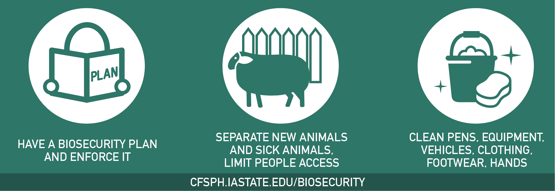
Take Steps Today to Keep Diseases Out!
Protect Your Flock
Notes:
Take steps today to keep diseases out and protect your flock by having a biosecurity plan in place and enforcing it. Separate new animals and sick animals from the home flock. Limit people access to your animals to only those with clean clothing, footwear and hands. Also, make sure animal pens are kept clean as well as equipment and vehicles used with animals or in their areas. For more information on biosecurity, visit www.cfsph.iastate.edu.
Graphic source: CFSPH, Iowa State University

Slide 29
Enhanced Biosecurity
Foreign Animal Disease Readiness to Protect Your Flock
Notes:
Next we will discuss putting enhanced biosecurity in place. This is a readiness step to protect your flock from foreign animal diseases. The focus will be on foot and mouth disease or FMD.

Slide 30
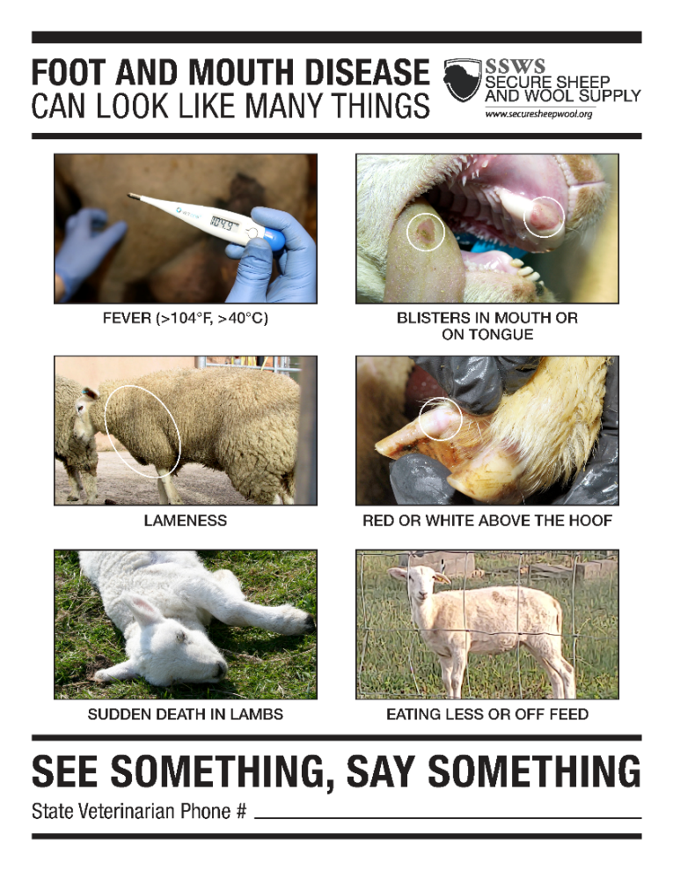
Foot and Mouth Disease:
Very Contagious Disease of Animals
Sheep, cattle, pigs, goats = blisters
Death: low in adults
Sickness: high
Not a public health or
food safety concern
1929: Last U.S. case
World trade-limiting disease
Notes:
Foot and mouth disease (FMD), sometimes called “hoof” and mouth disease, is a very contagious foreign animal disease of cloven-hooved animals (sheep, cattle, pigs, and goats). FMD causes blisters on the feet and in the mouth. Adult animals do not die from FMD but it does make them very sick. It does NOT affect public health or food safety. Meat and milk are safe to eat and drink. The U.S. has not had a case since 1929 but it can be found in over two-thirds of the countries in the world. Worldwide, FMD is a trade limiting disease because it is so contagious.
Graphic source: CFSPH, Iowa State University

Slide 31
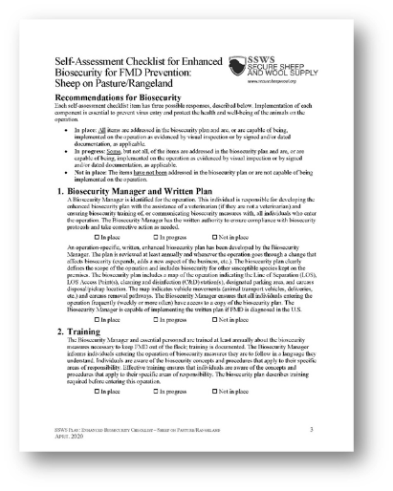
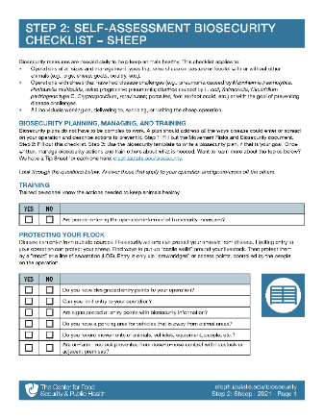
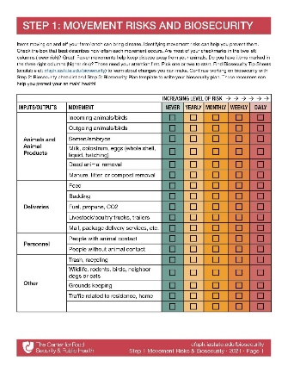
Pneumonia
Q Fever
Routine Biosecurity
Caseous Lymphadenitis
Foot Rot
Notes:
Routine biosecurity measures for common diseases (CLICK – words appear automatically) like pneumonia, Q Fever, caseous lymphadenitis, and foot rot are not enough to protect sheep from FMD. If FMD gets into the United States, (CLICK) you will have to step up to Enhanced Biosecurity to prevent exposing your sheep. That becomes a LOT easier when you are already halfway or two-thirds up the staircase! How do you get started on that climb? With the “getting started” and “daily” biosecurity resources described earlier and shown here.

Slide 32
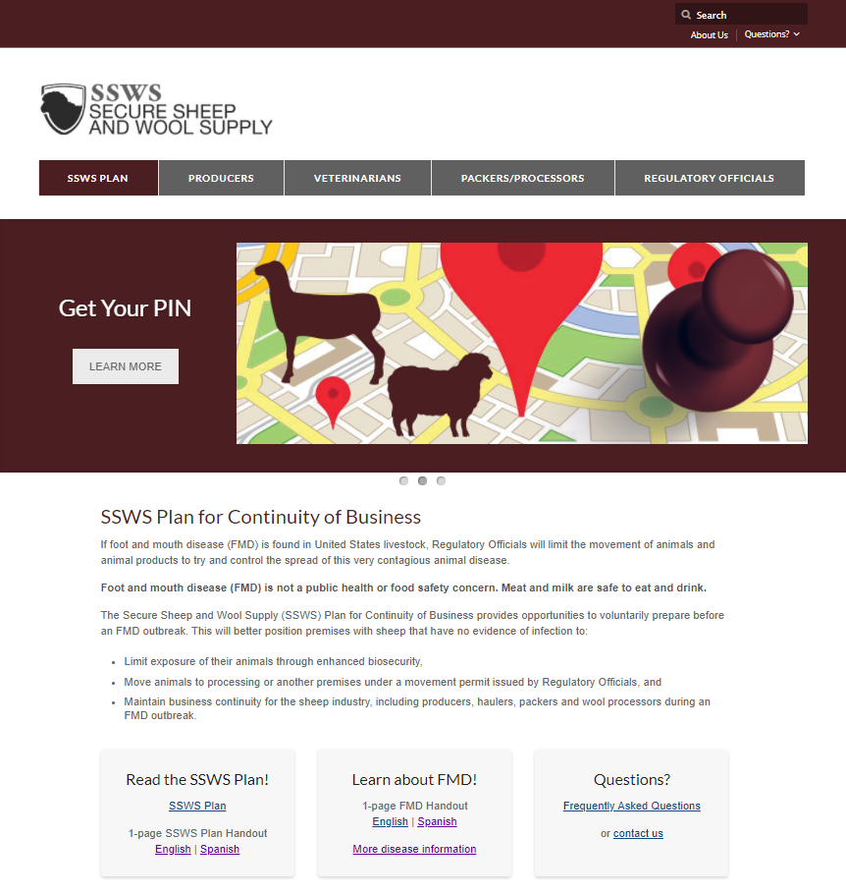
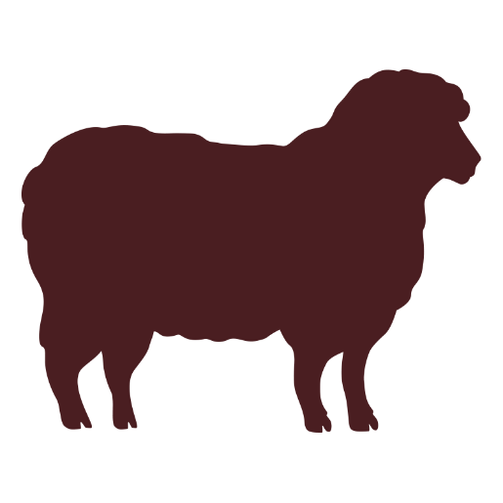

www.securesheepwool.org
Notes:
The Secure Sheep and Wool Supply Plan was developed to provide business continuity guidance for your sheep operation during an FMD outbreak. For full details on the Secure Sheep and Wool Supply Plan, visit securesheepwool.org and (CLICK) watch the short video or (CLICK) read the plan. The best way to ensure business continuity is to make sure sheep do not become INFECTED with FMD. Put enhanced biosecurity in place to prevent exposure. The Secure Sheep website has the resources you need to get started today!
Graphic: CFSPH, Iowa State University

Slide 33
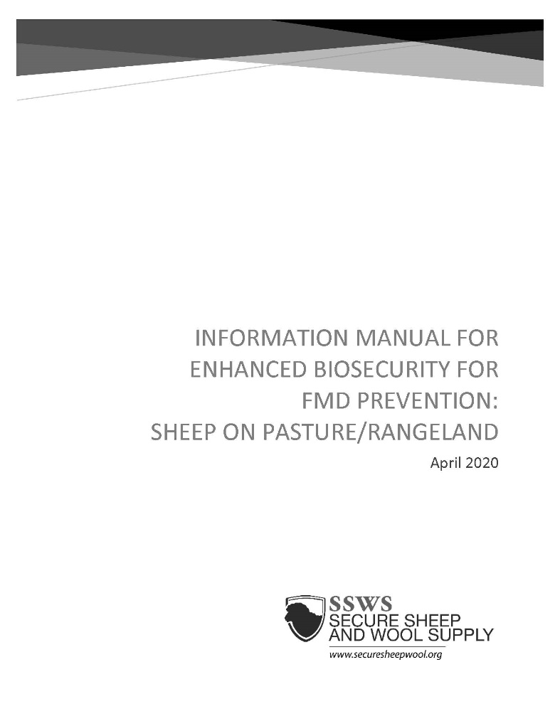
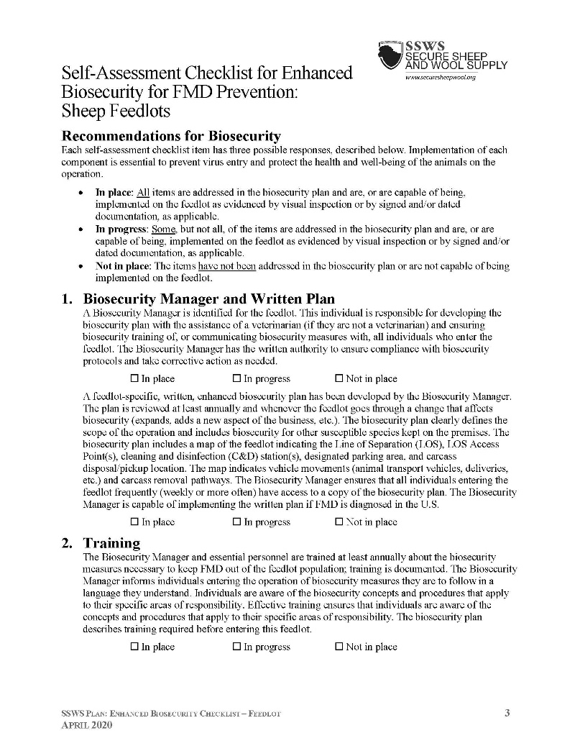
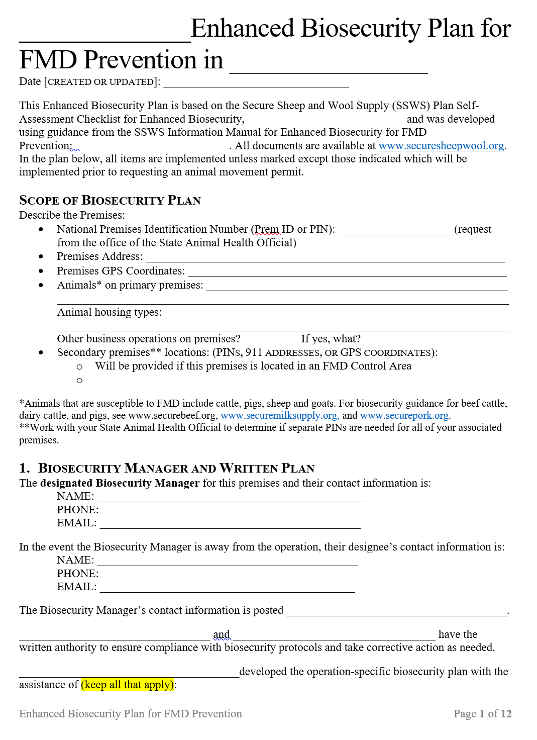
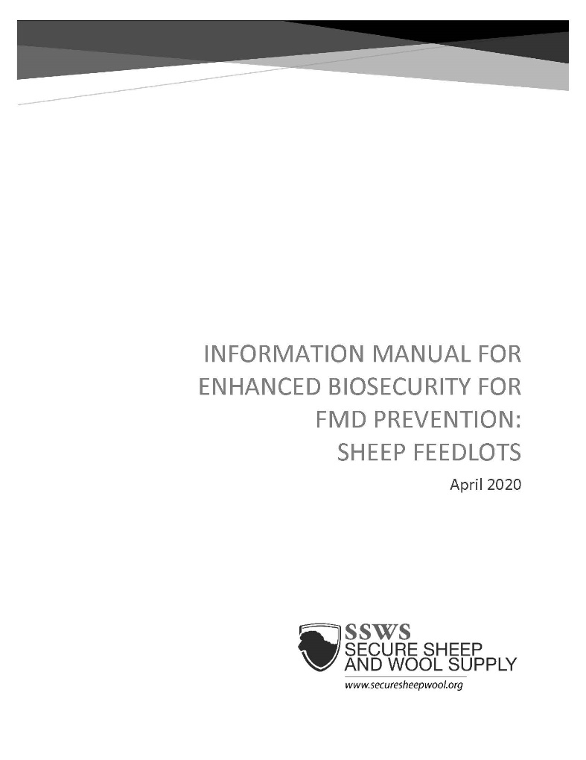
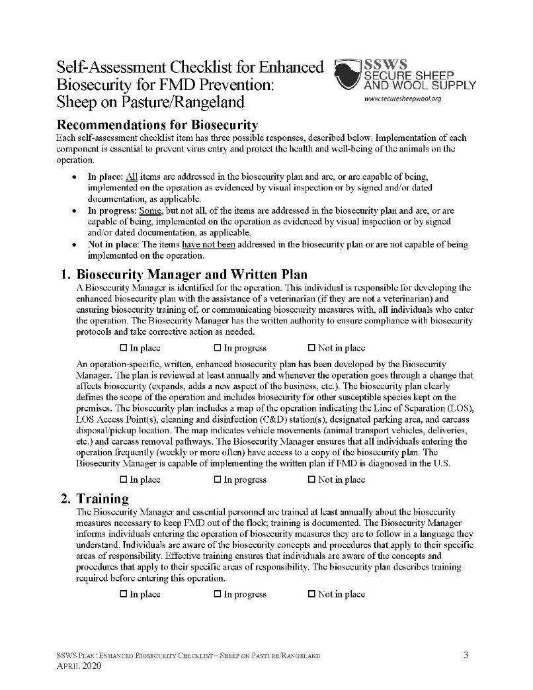
Resources
Enhanced Biosecurity for Feedlots, Pasture
www.securesheepwool.org
Notes:
The Secure Sheep and Wool Supply Plan includes ENHANCED biosecurity steps based on how FMD spreads. Producers can work with their flock veterinarian and use the (CLICK) Self-Assessment Checklist, (CLICK) corresponding Information Manual, and (CLICK) template. These help develop an operation-specific, written, (CLICK) ENHANCED BIOSECURITY plan. (CLICK) These resources are all available on the SSWS website.
Graphic: CFSPH, Iowa State University

Slide 34


Checklist/Plan Topics
Training
Protecting Your Flock
Vehicles and Equipment
Cleaning and Disinfection
Personnel
Animal Movement
Animal Products
Carcass Disposal
Manure Management
Wildlife, Rodent, Other
Animal Control
Feed
www.securesheepwool.org
Notes:
Listed on the screen are all the topics found in the Enhanced Biosecurity Checklist and Plan. Look familiar? It should. These are the SAME TOPICS in the Daily Biosecurity resources for sheep. This helps producers STEP UP from daily to enhanced with consistency.
Graphic source: CFSPH, Iowa State University

Slide 35
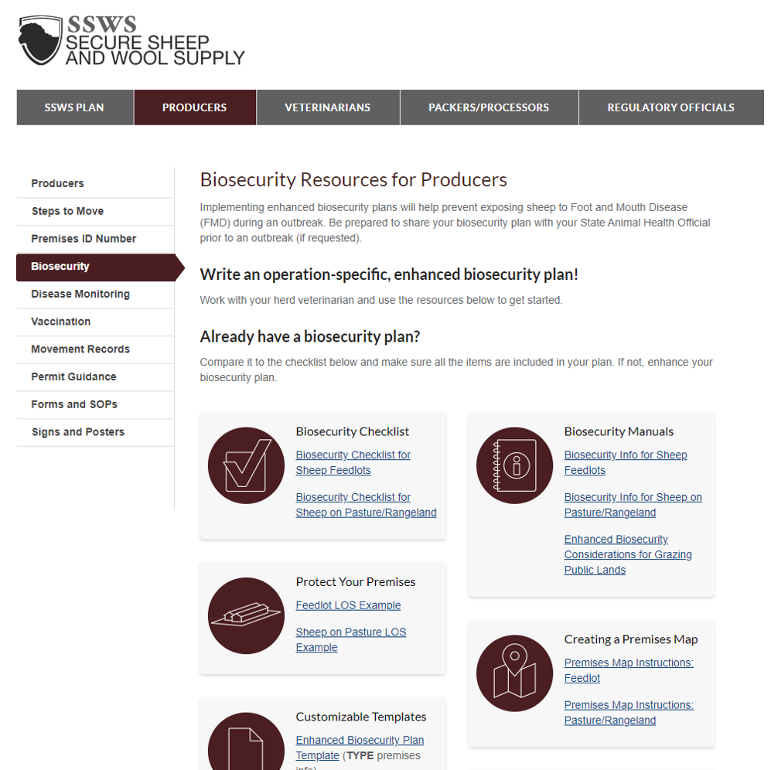


www.securesheepwool.org
Enhanced Biosecurity
Notes:
Where can you find the enhanced biosecurity plan template? (CLICK) On the SSWS website, under Producers – shown in burgundy at the top of the page. (CLICK) Select Biosecurity from the left menu (also highlighted burgundy on this slide). Again, using these resources is voluntary.
Graphic: CFSPH, Iowa State University

Slide 36



Biosecurity Posters
www.securesheepwool.org
Notes:
(ANIMATED – appear while talking)
The enhanced biosecurity measures are also included on some biosecurity posters available on the Secure Sheep and Wool Supply website. These can help communicate expectations to all those entering the operation during an FMD outbreak. These are available in Spanish too.
Graphics: CFSPH, Iowa State University

Slide 37

www.cfsph.iastate.edu/biosecurity/
Funding provided by USDA NADPRP and USDA NIFA NCR SARE
Notes:
For these biosecurity resources and more, please visit: cfsph.iastate.edu/biosecurity. You can sort by your species of interest or go to “Getting Started”.
Funding for the development of this material was provided by USDA’s National Animal Disease Preparedness and Response Program (NADPRP) and National Institute of Food and Agriculture through the North Central Region Sustainable Agriculture Research and Education (NCR-SARE) programs.

Slide 38
Acknowledgements
Development of this material was made possible through a grant provided to the CFSPH, ISU, CVM from the American Sheep Industry Association and the USDA APHIS through the NADPRP. ISU is an equal opportunity provider. For the full non-discrimination statement or accommodation inquiries, go to www.extension.iastate.edu/diversity/ext.
Funding for the Secure Sheep and Wool Supply Plan was made possible through a grant provided to the CFSPH from the American Sheep Industry (ASI) Association and USDA APHIS.
Notes:
Development of this material was made possible through a grant provided to the Center for Food Security and Public Health at Iowa State University, College of Veterinary Medicine from the American Sheep Industry Association and the U.S. Department of Agriculture (USDA) Animal and Plant Health Inspection Service (APHIS) through the National Animal Disease Preparedness and Response Program (NADPRP). Iowa State University is an equal opportunity provider. For the full non-discrimination statement or accommodation inquiries, go to www.extension.iastate.edu/diversity/ext. Funding for the Secure Sheep and Wool Supply Plan was made possible through a grant provided to the CFSPH from the American Sheep Industry (ASI) Association and USDA APHIS.
Author: Danelle Bickett-Weddle, DVM, MPH, PhD, DACVPM
Reviewers/Contributors: Katie Steneroden, DVM, MPH, PhD, DACVPM; Ellen Dauphinais, Alicia Burleson

