Slide 1
PROTECT YOUR POULTRY
Notes:
Let’s learn about ways to protect your poultry from diseases.
For more biosecurity resources, visit www.cfsph.iastate.edu/biosecurity
This presentation was developed by veterinarians at the Center for Food Security and Public Health, Iowa State University, College of Veterinary Medicine. Feel free to customize it to fit your needs. Please credit the original creators.
Author: Danelle Bickett-Weddle, DVM, MPH, PhD, DACVPM
Reviewers/Contributors: Katie Steneroden, DVM, MPH, PhD, DACVPM; Ellen Dauphinais, Alicia Burleson

Slide 2
Types of Germs
Bacteria
  Pasteurella (fowl cholera), Mycoplasma, Salmonella
Parasites
  Roundworms, coccidia, mites
Viruses
  Marek’s disease, Newcastle disease, Avian Influenza
Oh My!
Notes:
There are many types of germs, or organisms, that cause disease in poultry and other animals. Some even cause disease in people. Examples of bacteria include Pasteurella (fowl cholera), Mycoplasma, and Salmonella. (CLICK) Examples of parasites include roundworms, coccidia, and mites. (CLICK) Examples of viruses that infect poultry include Marek’s disease, Newcastle Disease and Avian Influenza. (CLICK) Oh My! This list can be very long. Let’s take a look at a way to simplify protecting your poultry flock from these germs.

Slide 3
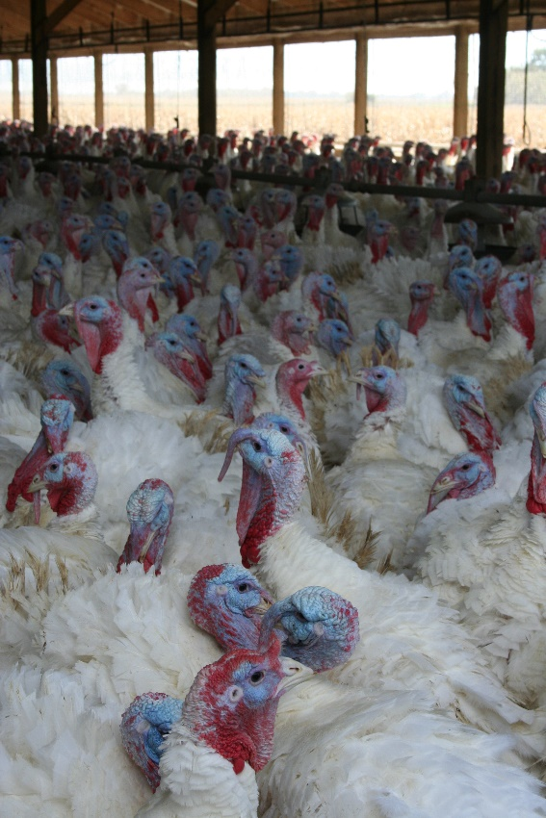
Germ Spread
Animal animal
Animal human “zoonotic”
Animal or human must be
exposed to develop disease
Understand different
routes of exposure =
Gain control, prevent!
Notes:
If we look at how diseases or the germs that cause them spread, we can find ways to control and prevent them.
Some diseases are spread between animals only. Marek’s disease is one example of an animal-to-animal spread disease.
Some diseases are spread between animals and people and are called “zoonotic” diseases. Salmonella is one example of a zoonotic disease. It can be in the feces of poultry and spreads when it gets into the mouth. While germs and the diseases they cause vary, they all have one thing in common: the animal or human must be exposed to them to get the disease. Once we understand how disease-causing germs enter a body, it is easier to control them. Thinking about how animals or people are exposed lets us put steps in place to prevent exposure.
Photo source: Laura Durben, Minnesota Turkey Growers Association

Slide 4
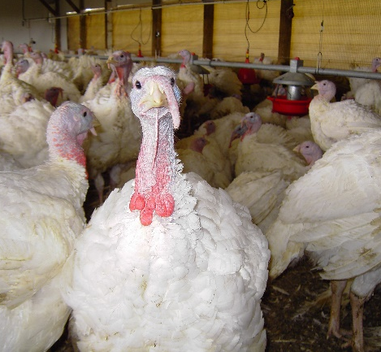
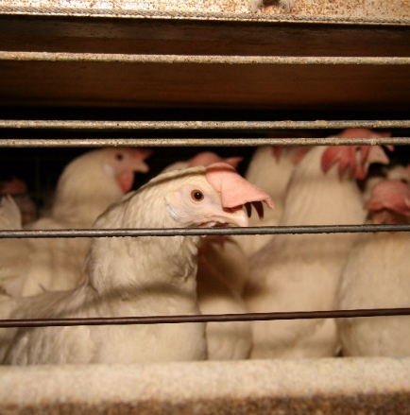
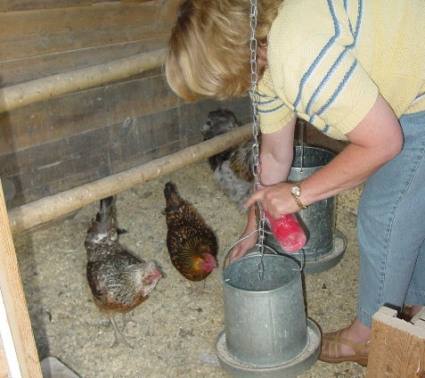
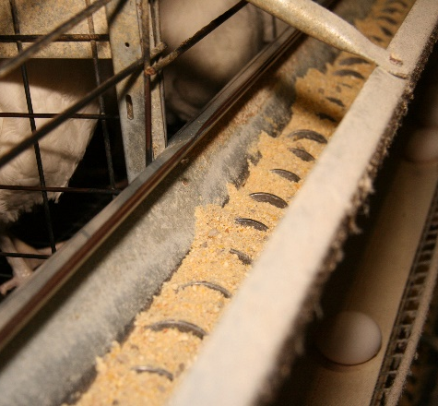
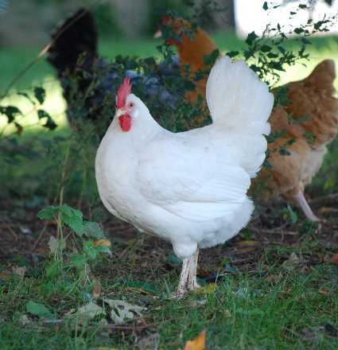
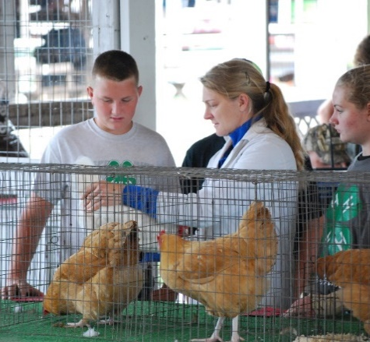
Six Incredible Ways!
Aerosol
Direct contact
Fomite
Oral
Vector
Zoonotic
2
3
1
4
5
6
Notes:
When you think about all the diseases animals or people can get, there are only six incredible ways they can be spread! This is easier to remember than the many bacteria, parasites and viruses. The pictures are examples of each route of exposure:
Aerosol: If one turkey is infected with a respiratory disease, spread can happen to the turkeys around it when they breathe out the germs.
Direct contact: The chickens are next to each other in their crate. If a chicken is infected, spread can happen.
Fomite: If the feeder or person’s footwear is contaminated with a germ, the chickens can be exposed.
Oral: If a chicken eats feed that is contaminated with feces or saliva from an infected animal, they can become infected.
Vector: These poultry could be bitten by mosquitos and disease can spread.
Zoonotic: If the poultry, or the people, are carrying a germ like Salmonella, they could share that through contact.
Aerosol: Laura Durben, Minnesota Turkey Growers Association
Direct contact: Andrew Kingsbury, CFSPH, Iowa State University
Fomite: Danelle Bickett-Weddle, CFSPH, Iowa State University
Oral: Pam Zaabel, CFSPH, Iowa State University
Vector: Pam Zaabel, CFSPH, Iowa State University
Zoonotic: Pam Zaabel, CFSPH, Iowa State University

Slide 5
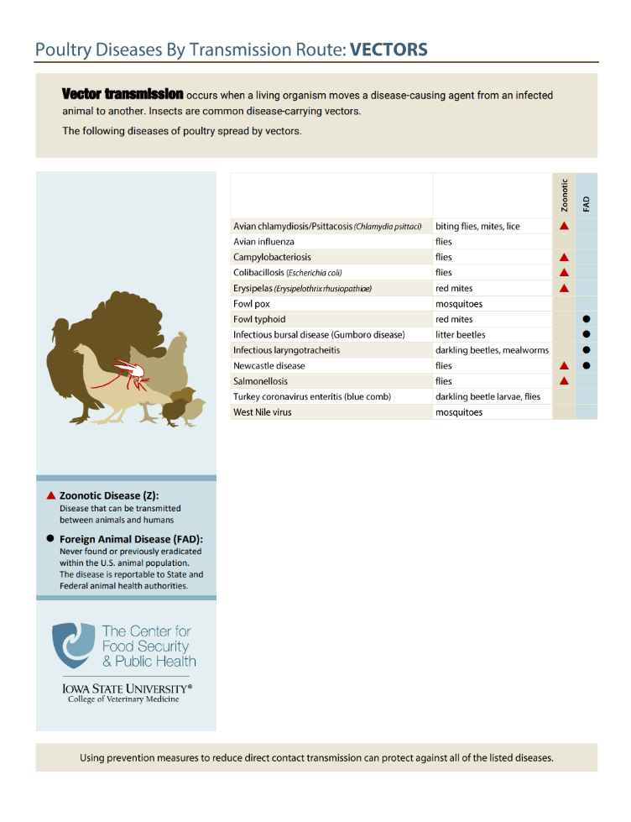
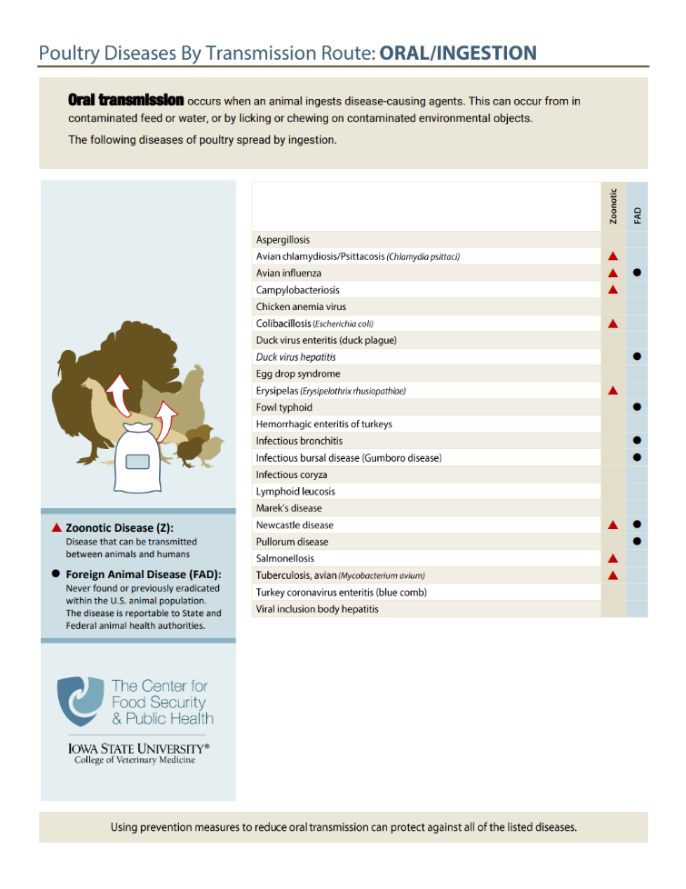
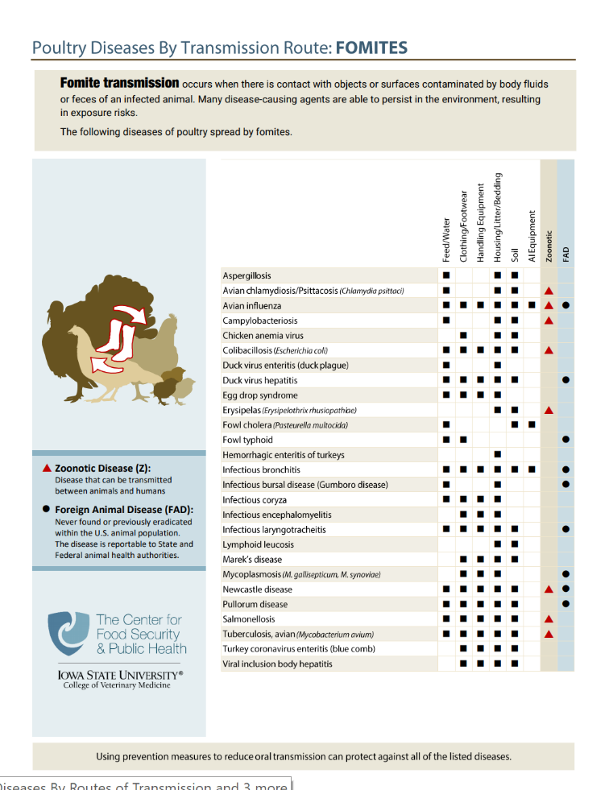
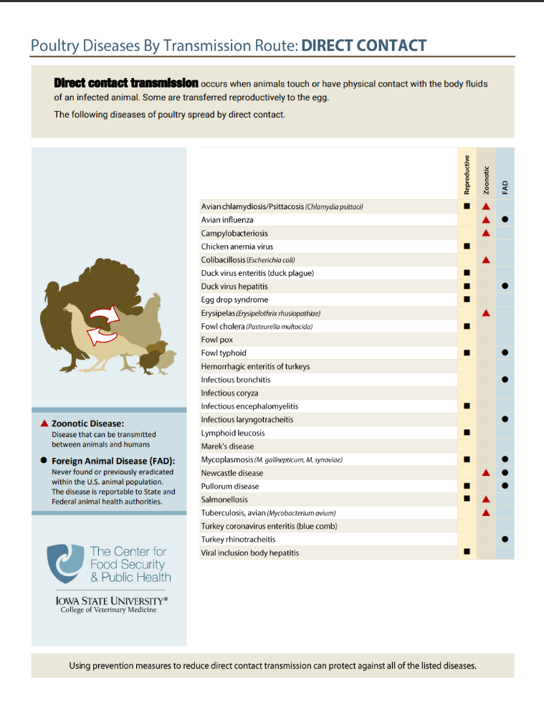
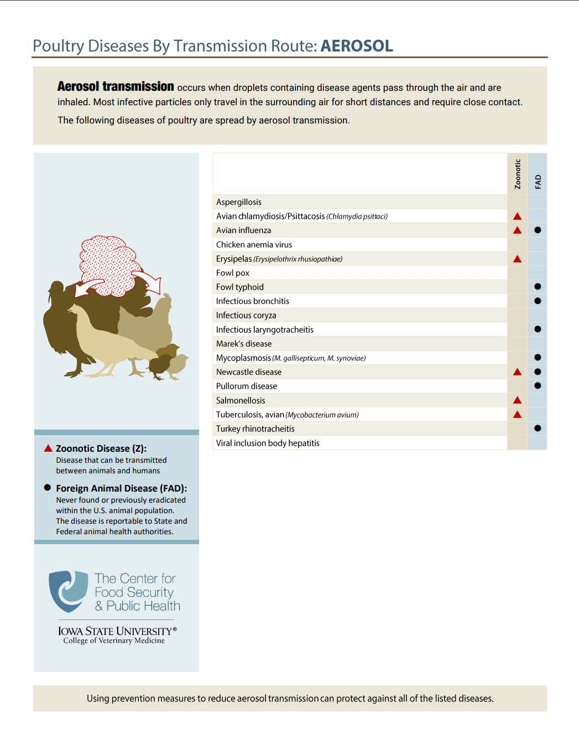
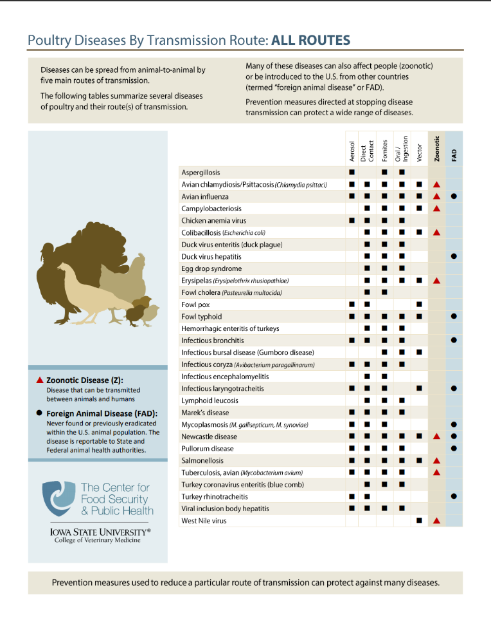
www.cfsph.iastate.edu/infection-control/routes/
Notes:
(ANIMATED – appear while talking)
If you are interested in learning about which diseases are spread by each of the 6 ways, visit the Center for Food Security and Public Health website for handouts on poultry as shown. These also show which diseases are common, known as endemic, and which ones are foreign animal, meaning not currently found in the United States. These handouts also show which diseases affect people – zoonotic diseases.
Graphic source: CFSPH, Iowa State University

Slide 6
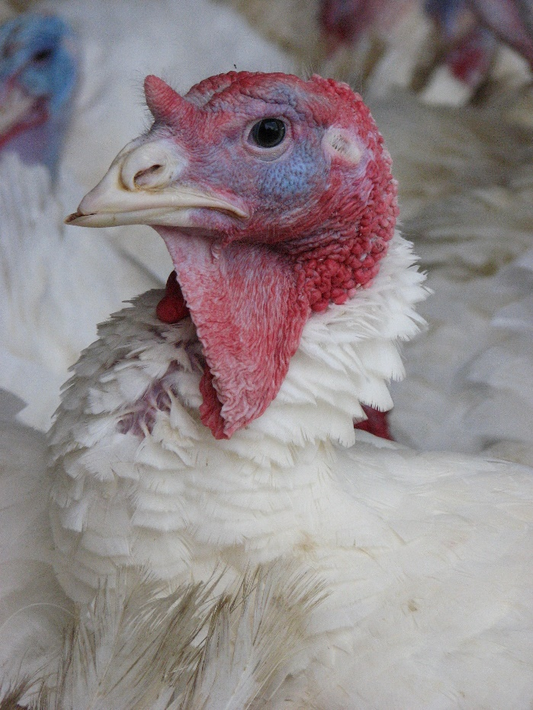
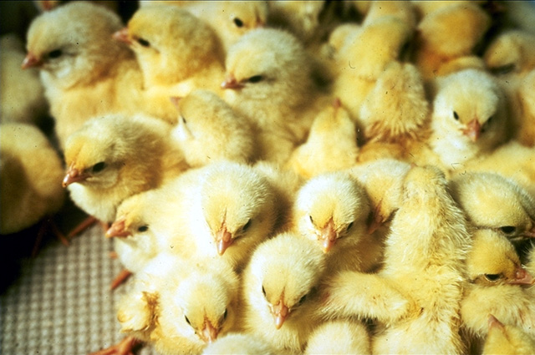
Disease Spread
Animals may not show
obvious signs of disease
Knowing ways
disease is spread
helps with prevention
  Limit disease spread risk
  to livestock and people contacting them
Notes:
We must remember that disease spread can happen without animals showing obvious signs of disease. That is why awareness of the ways disease can spread is so important to prevention planning. It is important so we can limit the risk of disease spread to livestock and people.
Photo (top): Laura Durben, Minnesota Turkey Growers Association; (bottom): USDA.

Slide 7
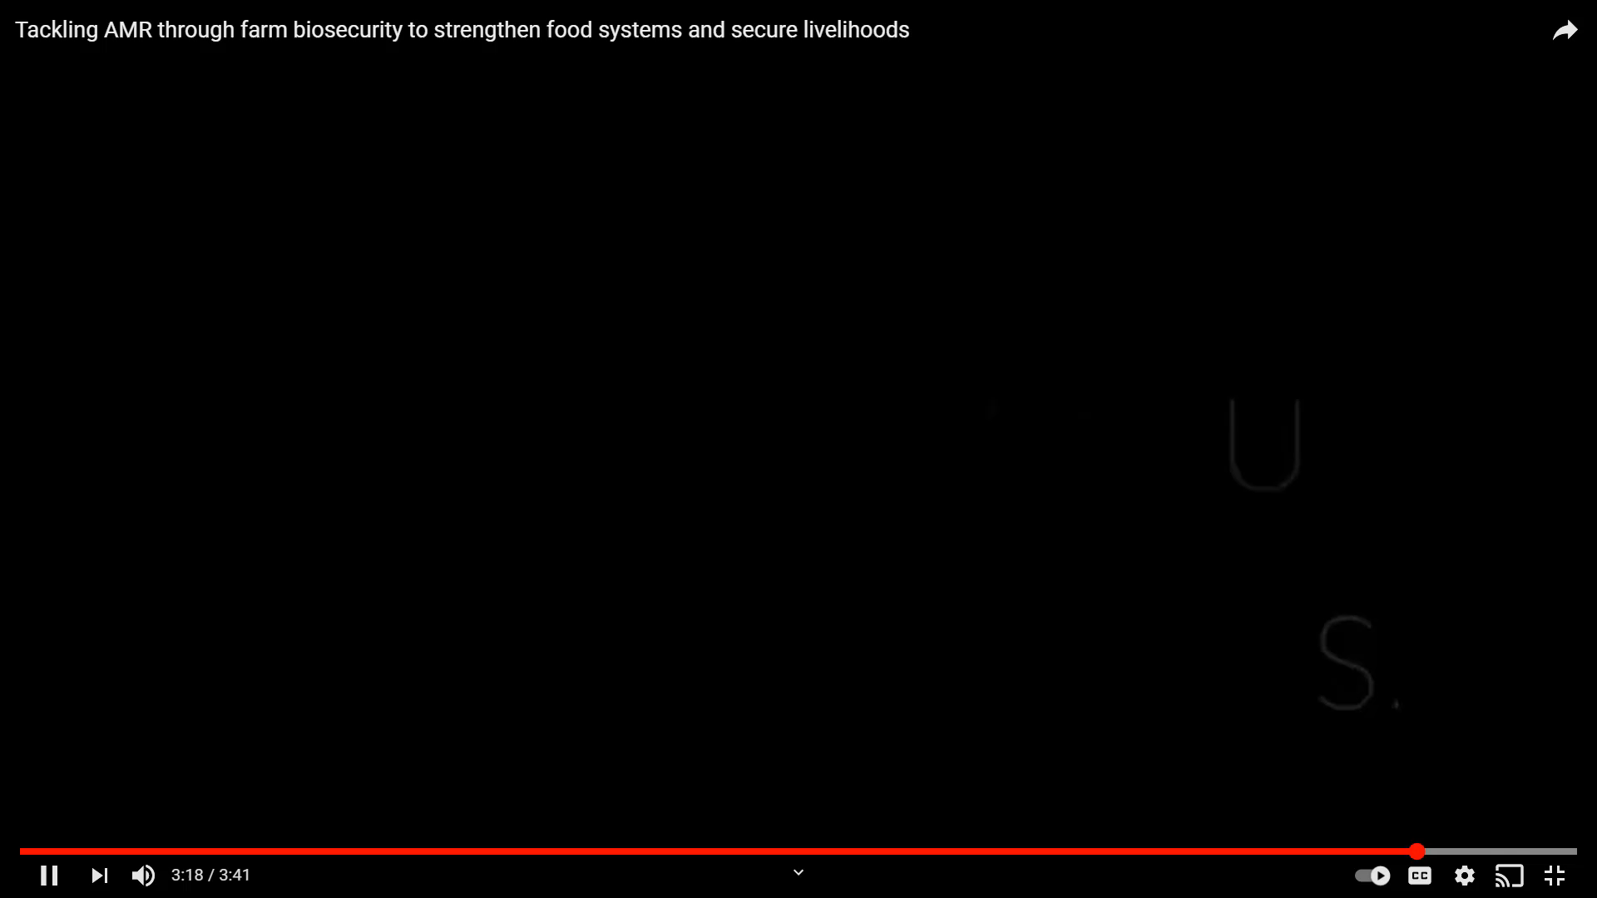
Biosecurity
“Procedures intended to protect humans or animals against disease or harmful biological agents”
  Oxford Dictionary
Source: Food and Agriculture Organization
https://youtu.be/9iy9Ebqr5-w
Notes:
Biosecurity is defined in the Oxford dictionary as “Procedures intended to protect humans or animals against disease or harmful biological agents”.
(VIDEO PLAYS AUTOMATICALLY) The video clip states: “Biosecurity towards promoting animal health, protecting public health and ensuring food security. Let’s Go!” It is from the FAO, and the video is titled: Tackling AMR through farm biosecurity to strengthen food systems and secure livelihoods, created November 18, 2020 and available at: https://youtu.be/9iy9Ebqr5-w

Slide 8
What diseases worry you most?
Pullorum
Avian Influenza
Marek’s
Fowl Typhoid
Salmonellosis
Infectious
Laryngotracheitis
Newcastle Disease
Notes:
(ANIMATED – appear while talking)
TRAINERS: Change as needed for your audience.
When it comes to diseases, which ones worry you the most? Working with your veterinarian to design biosecurity steps to keep diseases off your farm is a great place to start. Start by identifying the diseases you are most concerned with or at most risk from. Then focus on putting biosecurity measures in place to protect your flock.

Slide 9
Biosecurity = Disease Prevention
Disease prevention = insurance
  Paying premiums
  Hope it’s never needed
  Appreciate it when “disaster” strikes
If biosecurity is working, NO ONE KNOWS
  Hard to put a value on its effectiveness
When there is a labor shortage, time is a
precious commodity
  Effective biosecurity takes time, practice
Notes:
Biosecurity is the insurance needed for disease prevention. By investing in biosecurity regularly, we are paying those “premiums”. The goal is to never need to submit a “claim”. We all hope a disease challenge never happens. We appreciate the investment in daily biosecurity practices when disaster strikes.
(CLICK) In reality, if biosecurity is working, NO ONE KNOWS. This makes it hard to put a value or dollar amount on its effectiveness. The value comes when a challenge arises, and the animals do not become sick.
(CLICK) Animal agriculture has faced some big challenges with labor shortages. Time is precious on a farm when there are not enough people to get everything done. This can create challenges to make sure biosecurity steps are followed. To do biosecurity well and to be effective, it takes time. Not cutting corners, or leaving things dirty, or rushing between tasks. Effective biosecurity also takes practice to do well and become routine. All of these are reasons to start doing things now to help protect animal health.

Slide 10
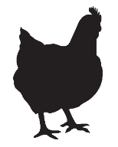
Benefits to Biosecurity NOW
Common disease prevention
  Similar exposure routes for foreign animal or unknown diseases
Infectious Laryngotracheitis (ILT)
Aerosol
Fomites
Oral
  Consuming contaminated feed or water
Avian Influenza
Aerosol
Fomites
Oral
  Consuming contaminated feed or water
Notes:
What are some of the benefits to putting biosecurity in place NOW? Instead of waiting for a disease challenge like a highly contagious Foreign Animal Disease (FAD)? This is a chicken example.
First, many common diseases are spread the same way that FADs or unknown diseases are. For instance, Infectious Laryngotracheitis (ILT) in chickens… (CLICK)
An infected chicken can spread ILT to other poultry through aerosol, fomites which are contaminated objects, and orally from contaminated feed or water.
Let’s compare that to an FAD that affects poultry (CLICK), Avian Influenza. While AI is MUCH MORE CONTAGIOUS than ILT, how an animal gets exposed is similar. They can be exposed through aerosol, fomite, or oral routes.
Biosecurity steps that prevent exposure to ILT can help protect from other diseases spread the same way.
Graphic source: CFSPH, Iowa State University

Slide 11
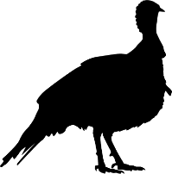
Benefits to Biosecurity NOW
Common disease prevention
  Similar exposure routes for foreign animal or unknown diseases
Newcastle Disease
Aerosol
Fomites
Oral
  Consuming contaminated feed or water
Avian Influenza
Aerosol
Fomites
Oral
  Consuming contaminated feed or water
Notes:
What are some of the benefits to putting biosecurity in place NOW? Instead of waiting for a disease challenge like a highly contagious Foreign Animal Disease (FAD)? This is a turkey example.
First, many common diseases are spread the same way that FADs or unknown disease are. For instance, Newcastle disease in turkeys… (CLICK)
An infected bird can spread Newcastle disease to other poultry through aerosol, by fomites which are contaminated objects, and orally from contaminated feed or water.
Let’s compare that to an FAD that affects turkeys (CLICK), Avian Influenza. While AI is MUCH MORE CONTAGIOUS than Newcastle Disease, how an animal gets exposed is similar. They can be exposed through aerosol, fomites, and oral consumption.
Biosecurity steps that prevent exposure to Newcastle Disease can help protect from other diseases spread the same way.
Graphic source: CFSPH, Iowa State University

Slide 12
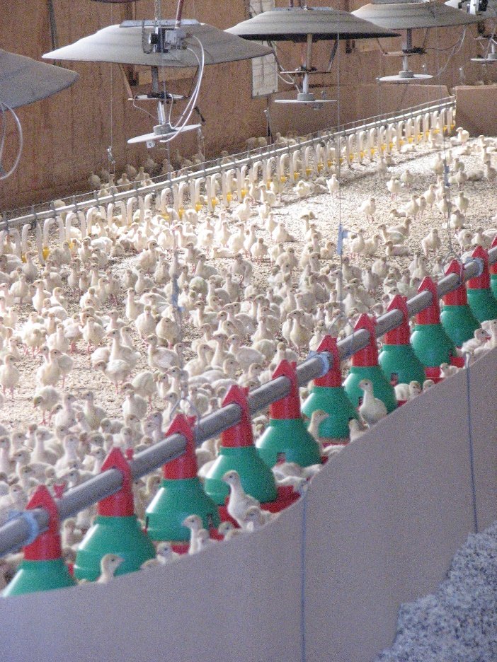
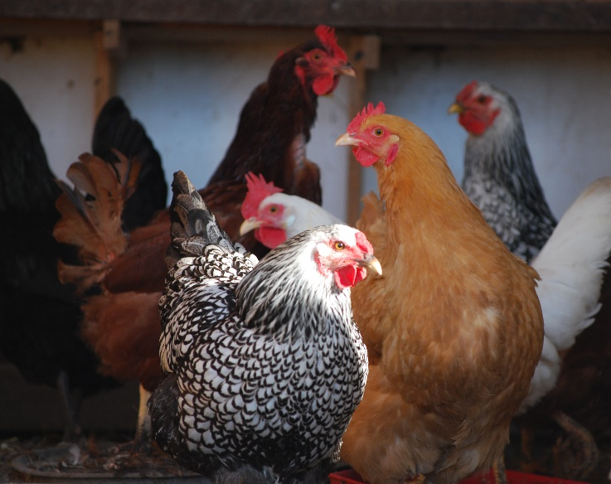
Benefits to Biosecurity NOW
Less disease challenges = better animal health
Decrease infectious burden = better animal health
  Dose = Severity
Better animal health = economic benefits
Notes:
Other benefits to putting biosecurity in place NOW is having less overall disease challenges. This can lead to better animal health. Most diseases cannot be completely eliminated, but the risk can be managed. For nearly all diseases there is a relationship between exposure dose and severity of disease. For diseases that are always present (endemic), reducing the dose of infectious agent the animal is exposed to can positively affect the animal’s health. Better animal health leads to economic benefits for the producer, the industry, the state. It also helps justify the cost of implementing biosecurity.
Photo sources: Laura Durben, Minnesota Turkey Growers Association (top); Pam Zaabel, Iowa State University (bottom).

Slide 13
Daily to Enhanced Biosecurity
Preparing for the Unexpected to Maintain Poultry Health
Notes:
Daily to Enhanced Biosecurity: Preparing for the Unexpected to Maintain Poultry Health

Slide 14
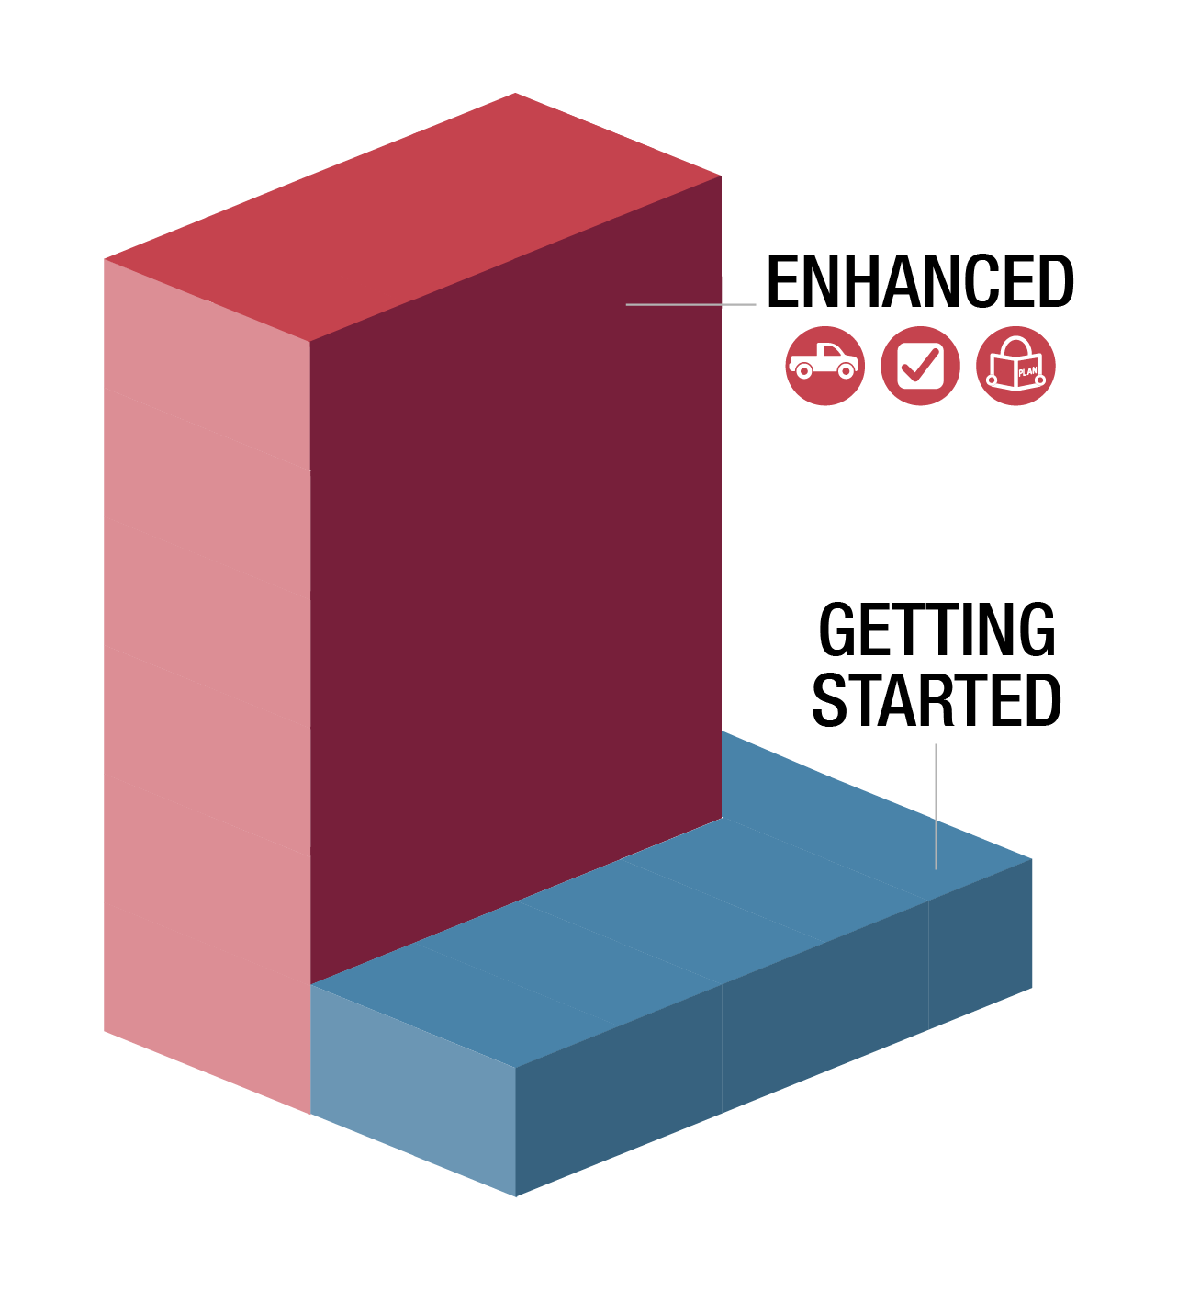

Protecting the Flock
Some producers have not dealt with
highly contagious diseases
  Enhanced biosecurity needed
  Animals never zero risk
  of exposure
It will be hard for some flocks
to go from no/little biosecurity
to enhanced…
Notes:
Some producers have not had to deal with highly contagious diseases. It will take an enhanced level of biosecurity to keep highly contagious diseases out of flocks. Our animals are never at zero risk of disease exposure.
(CLICK) It will be hard for some flocks to go from no or little biosecurity to enhanced to protect their animals. That can be a tough journey.
Graphic source: CFSPH, Iowa State University

Slide 15
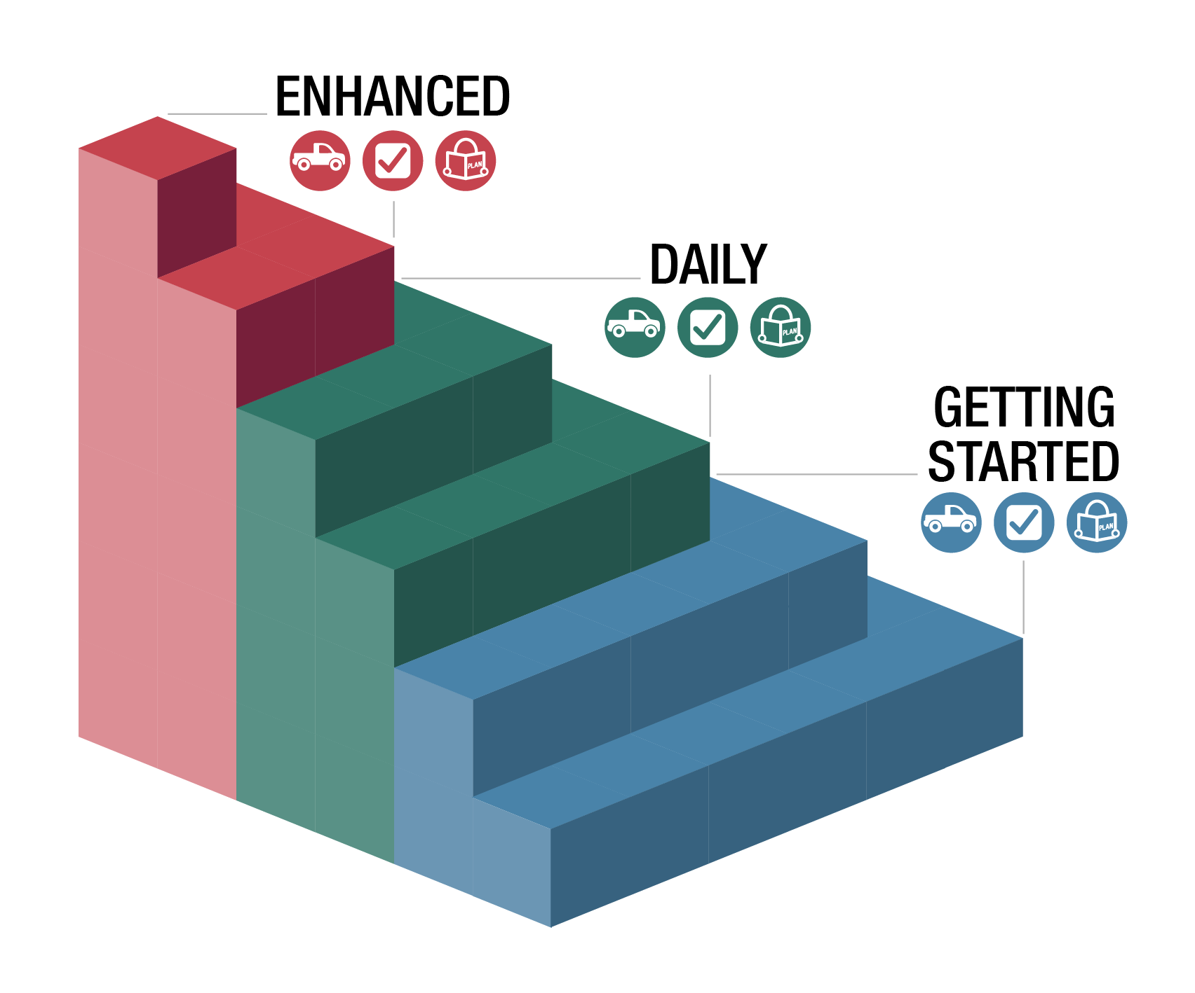
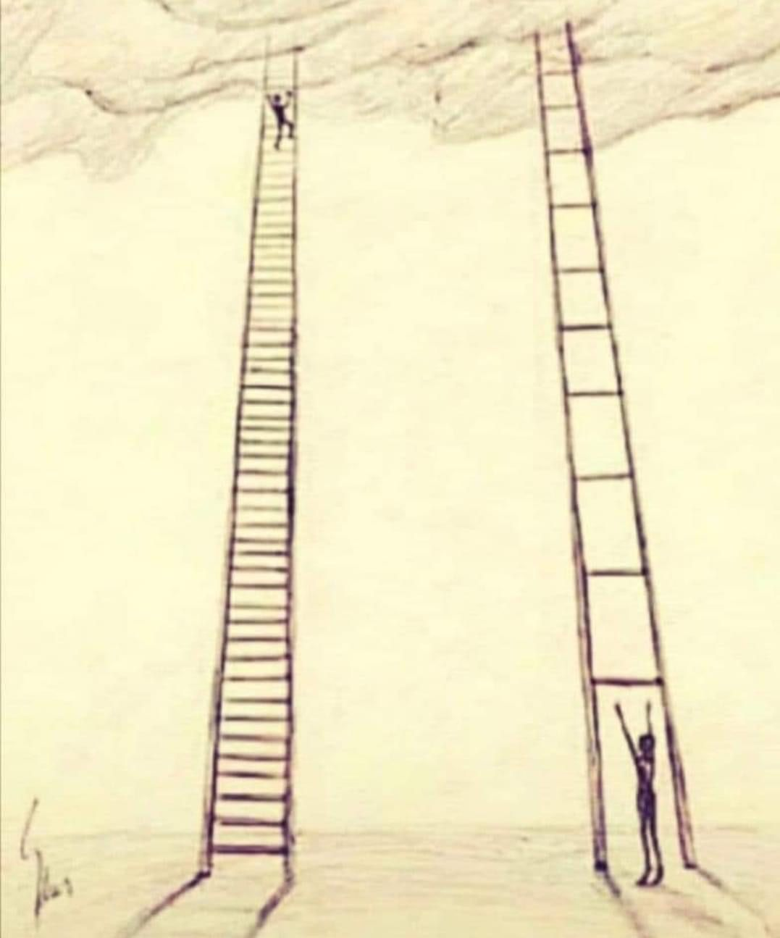
Big journeys begin with small steps
Notes:
Big journeys begin with small steps. It takes time to get to enhanced biosecurity. This is the same for any big changes on livestock operations. For instance, months to years may be needed for genetic improvement of the flock, better finished weights, and more egg production. Sometimes, getting started is a big first step.
(CLICK) To help producers go from no or little biosecurity, several steps have been created to help get started, practice it daily, so they are more ready for enhanced biosecurity.
Graphic sources (left): https://i.pinimg.com/564x/60/92/6f/60926f4d71aea485a9bd25e510fe8087.jpg
(right) CFSPH, Iowa State University

Slide 16
Movement Risks
Notes:
Let’s start by looking at the different movements risks for poultry operations that could expose animals to diseases.

Slide 17
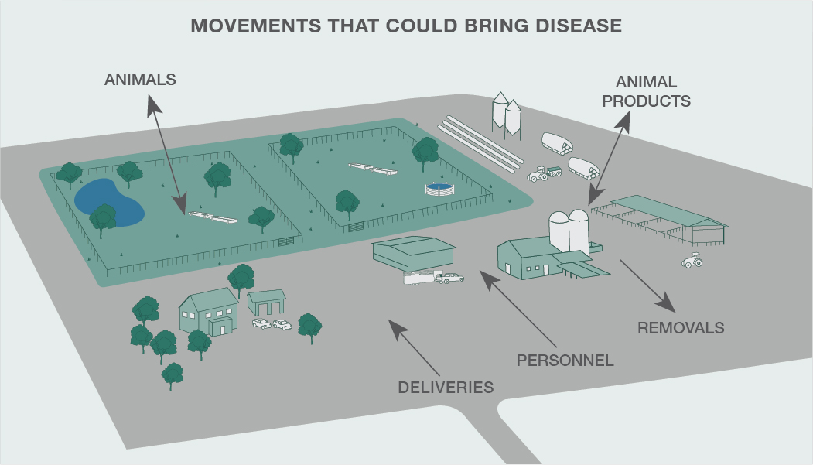
Notes:
Items moving on and off your farm can bring disease. Identifying movement risks can help you prevent them. Some of the areas to focus on include:
Animals – these could be new animals added to your flock or animals returning from shows, fairs, or breeding.
Animal products – especially if they have not been treated to kill potential germs. Knowing the source and the disease status of the source flock is important to keeping diseases from your animals.
Deliveries – especially if the vehicle or equipment drives in animal areas or areas where animals travel.
Removals – seems odd to think things leaving could introduce disease, but what item is leaving and how? Is it dead birds and a vehicle needs to enter to pick it up? Where was that vehicle or equipment prior to your farm? Same for litter removal. Vehicles that go farm to farm could pose a risk (turkey loaders, spent hens, etc.).
Personnel – especially if they will have direct contact with birds on your operation.
Graphic source: CFSPH, Iowa State University

Slide 18
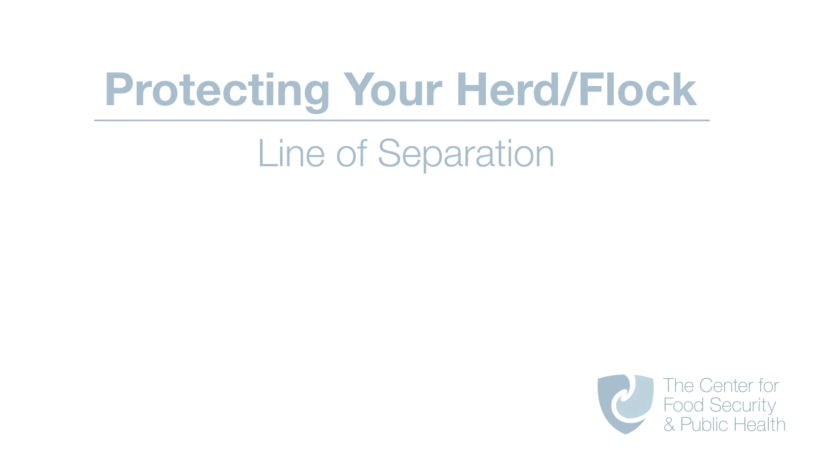
Notes:
(VIDEO SHOULD START PLAYING AUTOMATICALLY – 2 minutes with full credits at end)
Protecting Your Herd and Flock: Line of Separation video downloaded from: Video downloaded from: https://vimeo.com/user68158100/download/553543741/24fb8bbe01
Source: CFSPH, Iowa State University; Narration, Danelle Bickett-Weddle, DVM

Slide 19

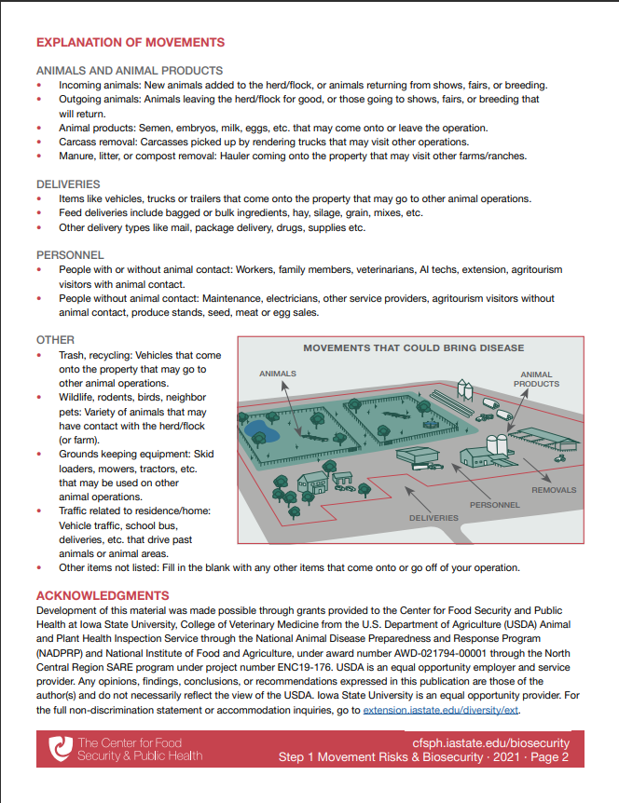
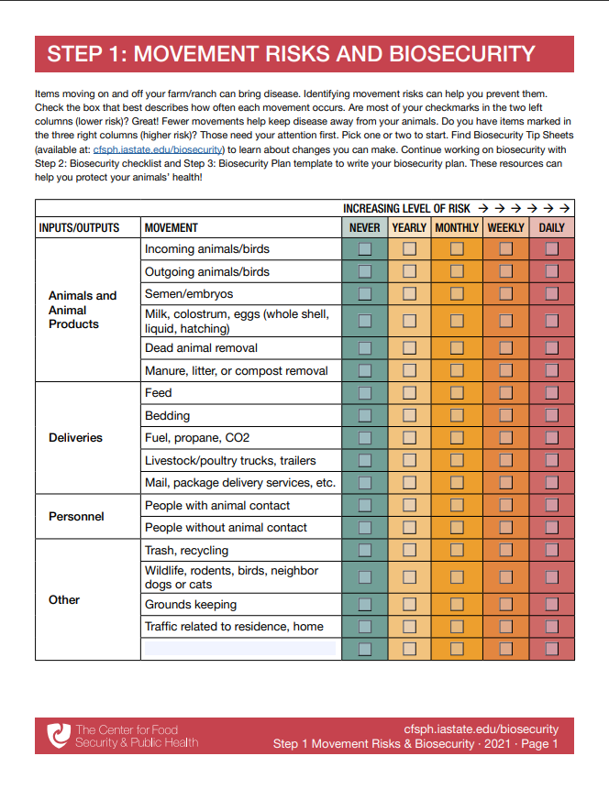
Step 1: Movement Risks
Fill it out for a typical week
or month
Focus on daily movements first
What initial biosecurity steps could protect the flock?
www.cfsph.iastate.edu/biosecurity/
Notes:
The Center for Food Security and Public Health at Iowa State University created an easy-to-use checklist to explore the different movements that come onto your farm. Step 1 Movement Risks is pictured and can be downloaded from the website: cfsph.iastate.edu/biosecurity/. Producers are encouraged to fill it out for a typical week or month. It is a fillable PDF. Just check the box that best describes how often each movement occurs. Are most of your checkmarks in the two left columns (lower risk)? Great! Fewer movements help keep disease away from your animals. Do you have items marked in the three right columns (higher risk)? Those need your attention first, especially daily movements. Pick one or two to start. Next we will talk about some of the biosecurity steps that could protect the flock.
Graphic source: CFSPH, Iowa State University

Slide 20

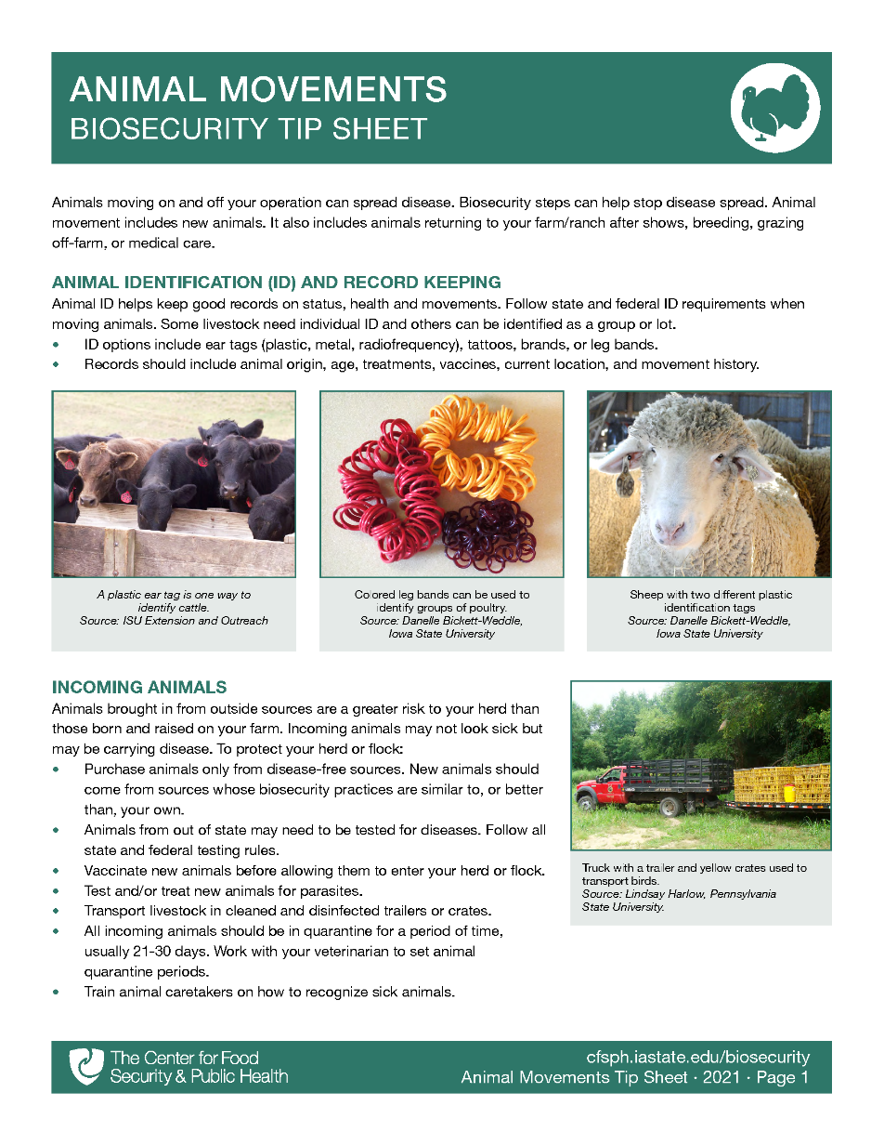
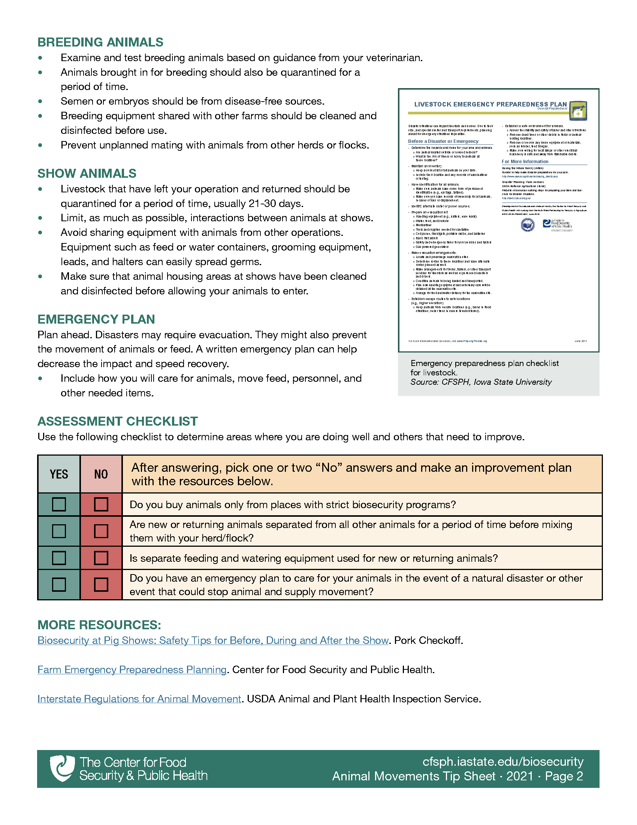
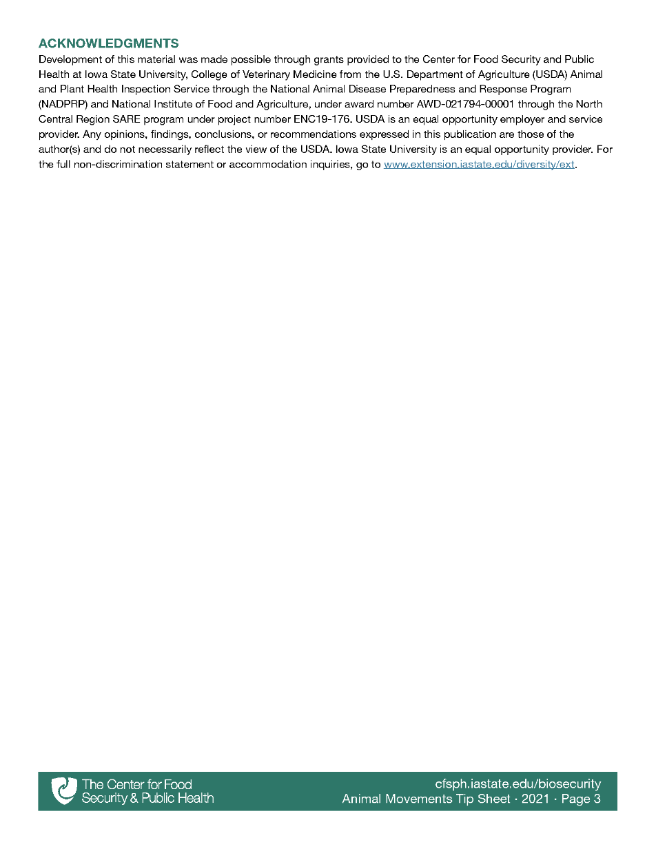
Where can I learn more?
Biosecurity Tip Sheets provide more info on biosecurity actions to protect your flock!
www.cfsph.iastate.edu/biosecurity/
Notes:
Once you have figured out the more common movements, there are Biosecurity Tip Sheets with steps to protect your flock from exposure. Pictured is the Animal Movement Biosecurity Tip Sheet. This is available on the Center’s website listed on the screen.
Graphic source: CFSPH, Iowa State University

Slide 21
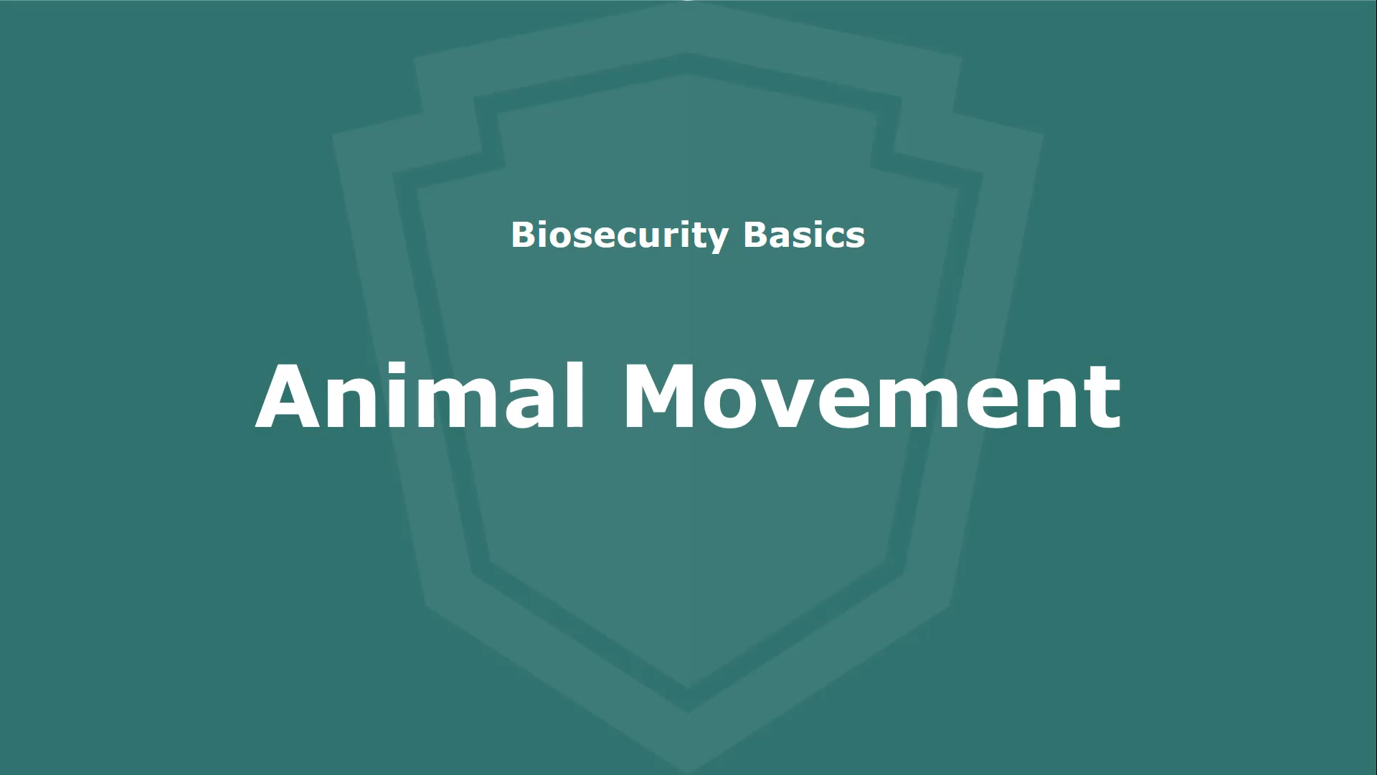
Tip Sheets – Videos
www.cfsph.iastate.edu/biosecurity/
Notes:
Want even more biosecurity ideas? Each Tip Sheet has a corresponding video full of pictures! Find them on the Center’s website listed on the screen. (CLICK ON VIDEO TO PLAY – 6 minutes with full credits at end)
NOTE TO TRAINERS: There are also PPTs available for your use to present live or customize for your audience. Those are available on the “training” web page: https://www.cfsph.iastate.edu/biosecurity-resource/train-the-trainer/
Source: CFSPH, Iowa State University; Narration, Glenda Dvorak, DVM

Slide 22
Tip Sheets – Checklist
Notes:
Within each Tip Sheet (and PPT) is a checklist that has a few questions to uncover other areas of strength and gaps in biosecurity steps. There are also “More Resources” to explore for more tips.
Graphic source: CFSPH, Iowa State University

Slide 23

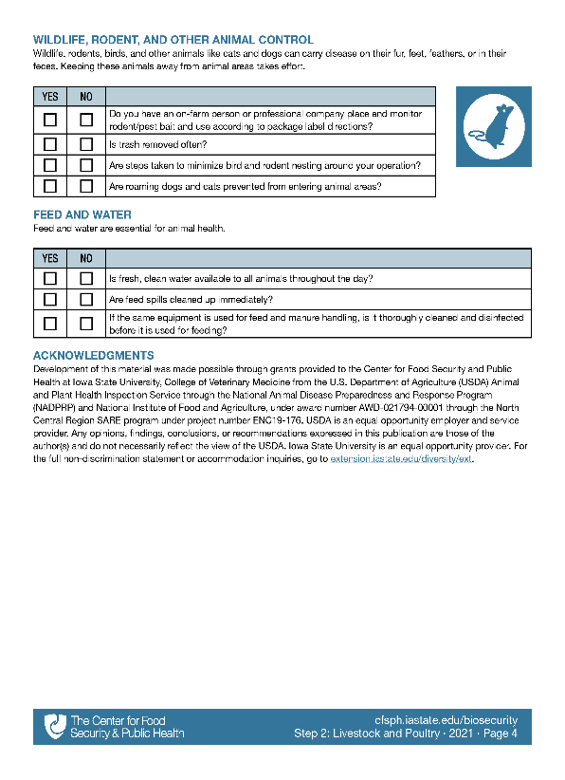
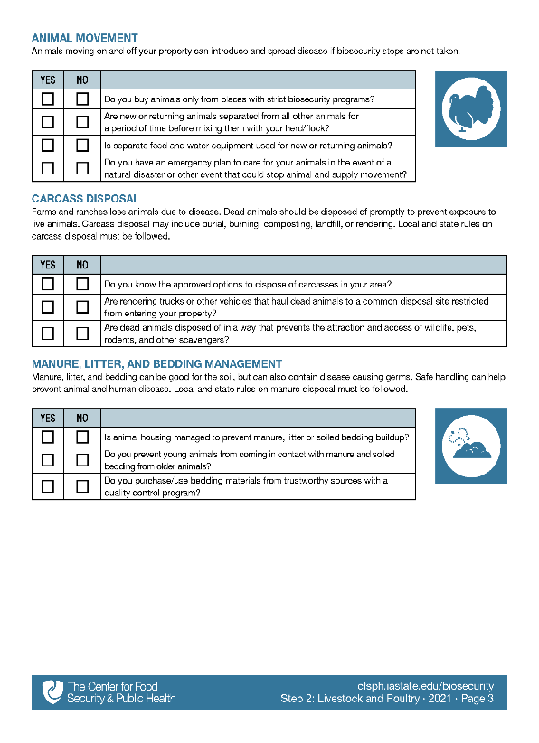
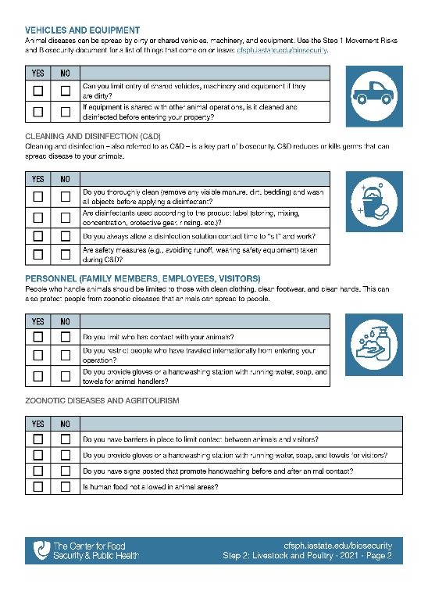
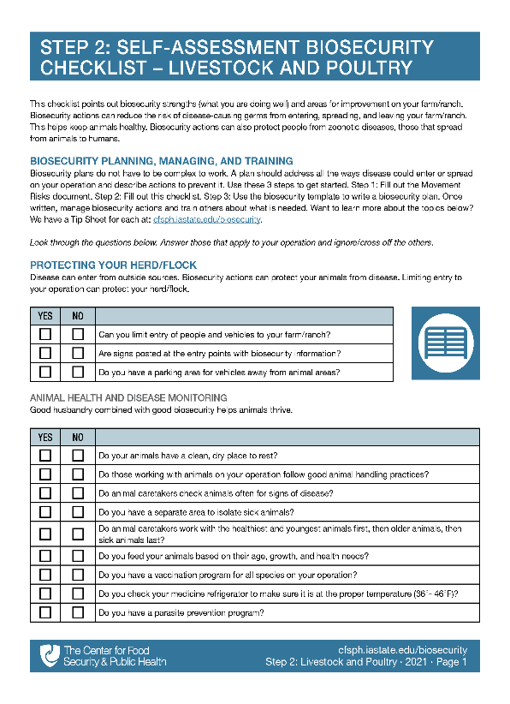

Step 2: Assess Biosecurity
Biosecurity checklist has a series of questions to find strengths and gaps
www.poultrybiosecurity.org
Notes:
After doing one or two checklists in the Tip Sheets, are you ready to assess other biosecurity actions? Step 2 is a self-assessment biosecurity checklist. The same questions found in the Tip Sheets are here too. They are meant to find strengths and gaps.
TRAINERS: The Livestock and Poultry checklist has 42 questions.
Graphic source: CFSPH, Iowa State University

Slide 24



Checklist Topics
(Livestock-Poultry)
Protecting Your Herd/Flock
Animal Health and Disease Monitoring
Vehicles and Equipment
Cleaning and Disinfection
Personnel (Family, Employees, Visitors)
Zoonotic Diseases and Agritourism
Animal Movement
Carcass Disposal
Manure, Litter, Bedding Management
Wildlife, Rodent, Other Animal Control
Feed and Water
Notes:
Listed on the screen are all the topics found in the Livestock and Poultry Self-Assessment Biosecurity Checklist.
Graphic source: CFSPH, Iowa State University

Slide 25



Tip Sheet Topics
Protecting Your Flock
Animal Health and Disease Monitoring
Vehicles and Equipment
Cleaning and Disinfection
Personnel (Family, Employees, Visitors)
Animal Movement
Carcass Disposal
Manure, Litter, Bedding Management
Wildlife, Rodent, Other Animal Control
Feed and Water
More!
www.cfsph.iastate.edu/biosecurity/
Notes:
Listed on the screen are all the Tip Sheet topics found on the biosecurity resources web page. These match the checklist topics. There are additional tip sheets in development. There are also several additional tip sheets on item-specific cleaning and disinfection.
Graphic source: CFSPH, Iowa State University

Slide 26

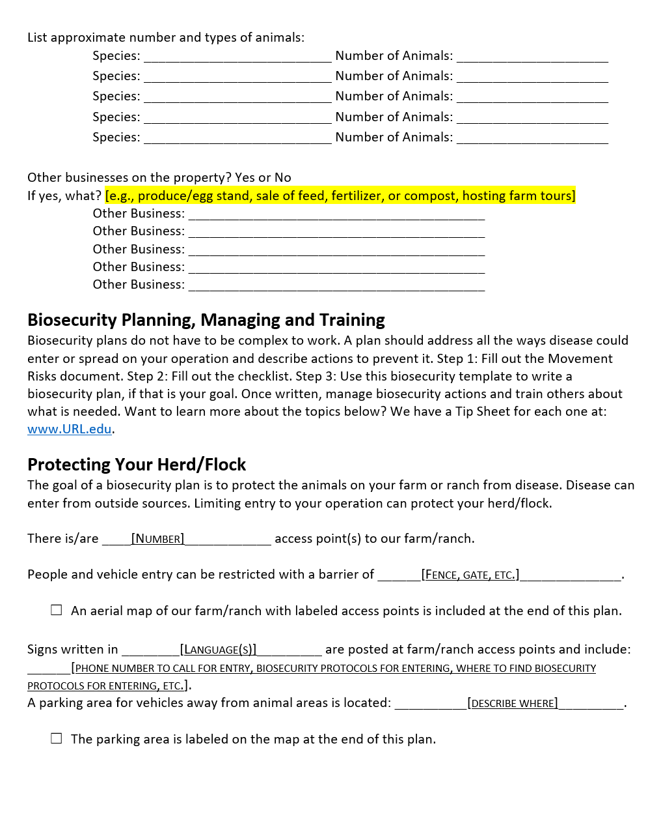
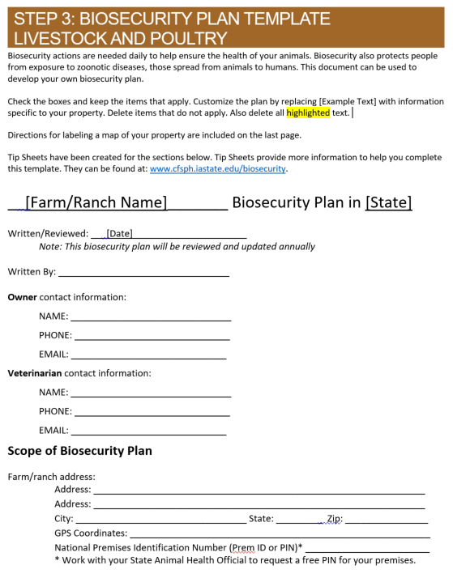
Step 3: Biosecurity Template
Ready to write a plan?
Step 3: Biosecurity Plan for Livestock and Poultry is a great start!
Voluntary
  http://www.cfsph.iastate.edu/biosecurity/
Notes:
Is writing a biosecurity plan a goal? Then the Livestock and Poultry Biosecurity Plan Template is just what you need.
This template lines up with the Livestock and Poultry Biosecurity Step 2 Checklist, giving producers additional tools to protect their flock. Writing a biosecurity plan is completely voluntary.
Graphic source: CFSPH, Iowa State University

Slide 27
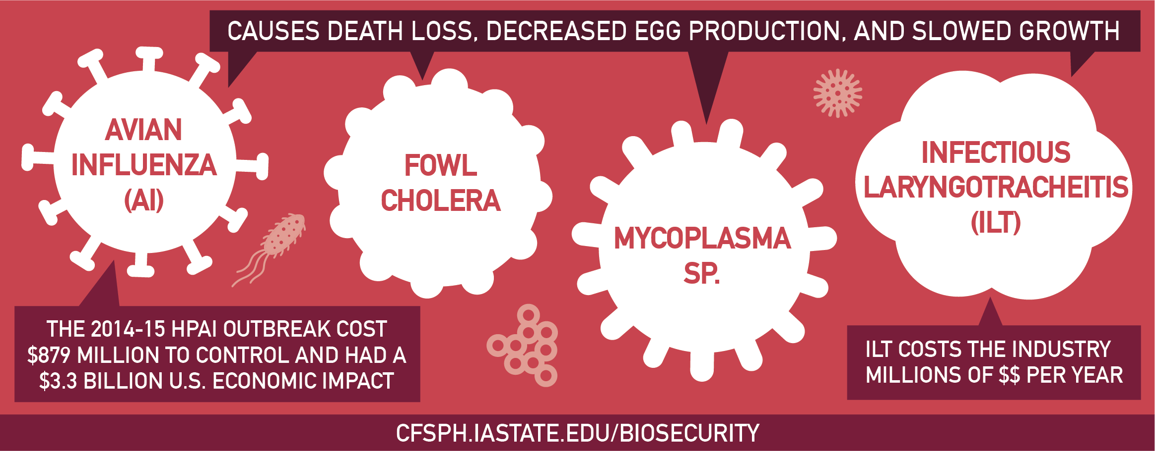
Diseases Harm Animal Health
Diseases are Costly
Notes:
Common and foreign animal diseases harm animal health and are costly. Avian Influenza, or AI, Fowl Cholera, Mycoplasma species, and Infectious Laryngotracheitis, or ILT, cause death loss, decreased egg production, and slowed growth. In the 2014-15 Highly Pathogenic Avian Influenza (HPAI) outbreak, a foreign animal disease that killed millions of poultry, cost $879 million to control and had a $3.3 billion U.S. economic impact. Infectious Laryngotracheitis, a common disease, costs the industry millions of dollars per year.
Graphic source: CFSPH, Iowa State University

Slide 28
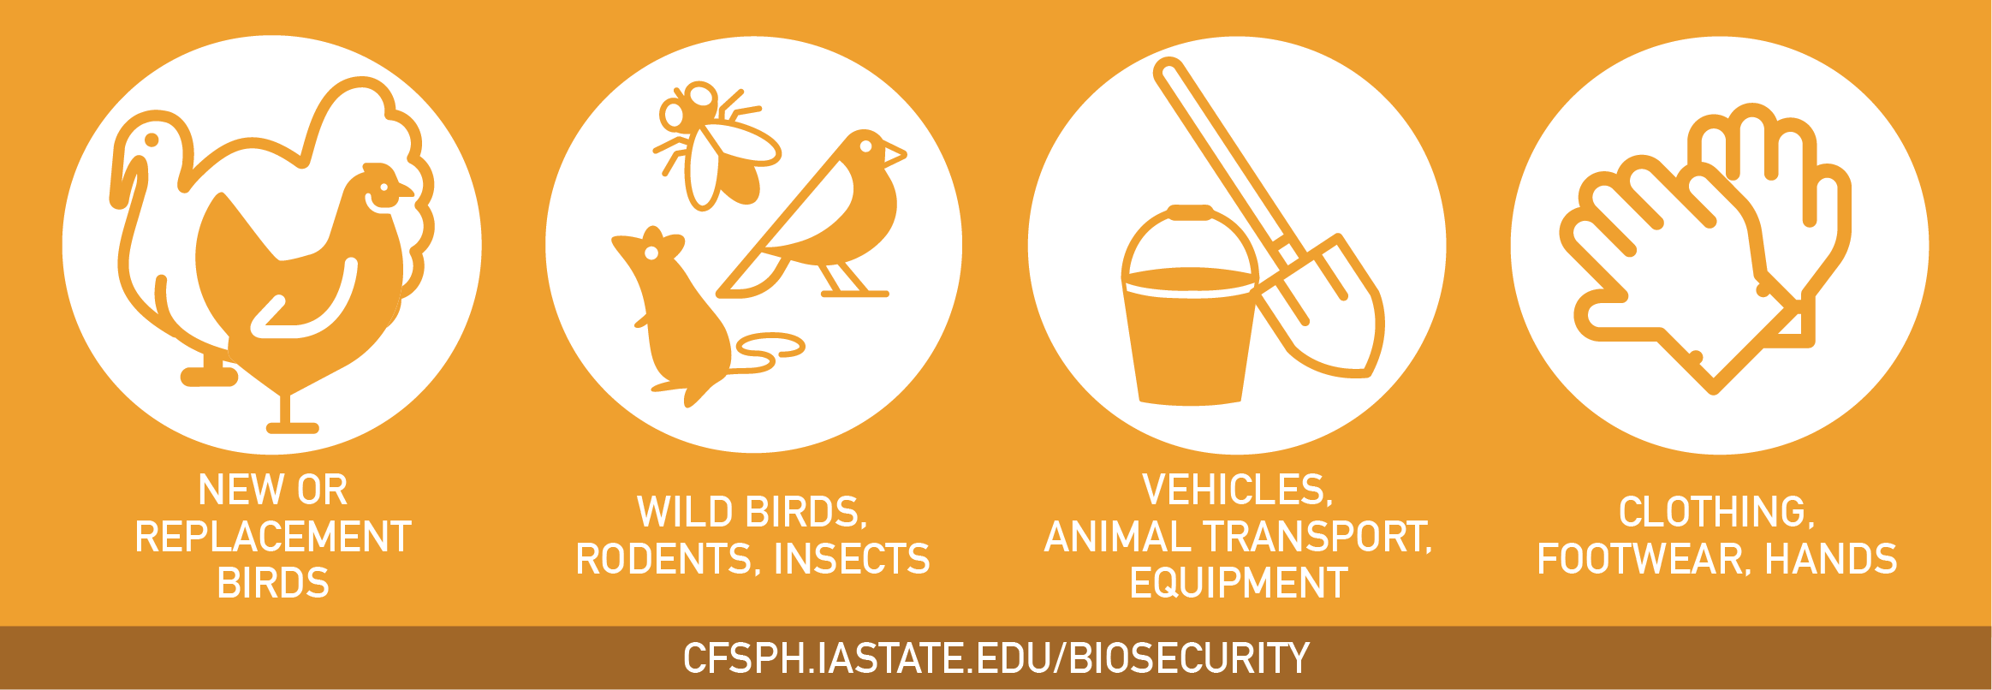
Diseases are Spread By…
Notes:
AI, Fowl Cholera, ILT, and many others, are spread by new or replacement birds, wild birds, rodents, or insects. Poultry diseases are also spread by contaminated vehicles, animal transport, equipment, clothing, footwear, and hands.
Graphic source: CFSPH, Iowa State University

Slide 29

Take Steps Today to Keep Diseases Out!
Protect Your Flock
Notes:
Take steps today to keep diseases out and protect your flock by having a biosecurity plan in place and enforcing it. Separate new animals and sick animals from the home flock. Limit people access to your birds to only those with clean clothing, footwear and hands. Also, make sure animal pens are kept clean as well as equipment and vehicles used with birds or in their areas. For more information on biosecurity, visit www.cfsph.iastate.edu.
Graphic source: CFSPH, Iowa State University

Slide 30
Enhanced Biosecurity
Foreign Animal Disease Readiness to Protect Your Flock
Notes:
Next we will discuss putting enhanced biosecurity in place. This is a readiness step to protect your flock from foreign animal diseases. The focus will be on highly pathogenic avian influenza, or HPAI.

Slide 31
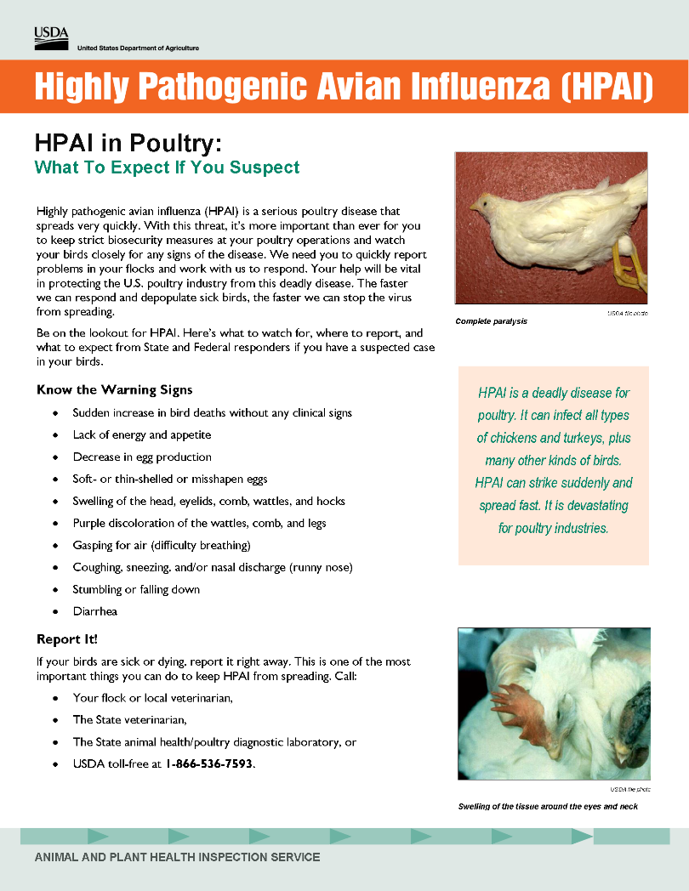
Highly Pathogenic Avian Influenza:
Very Contagious Disease of Poultry
Sudden death in birds
Also coughing, sneezing,
depression, fewer eggs, diarrhea
Zoonotic – people can get sick
U.S. outbreaks: Millions of birds died
www.aphis.usda.gov/
Notes:
Highly Pathogenic Avian Influenza (HPAI), sometimes called Bird Flu, is a very contagious disease of poultry. HPAI causes sudden death. In birds that it does not kill, it causes coughing, sneezing, nasal discharge, depression, drop in egg production, even diarrhea. HPAI is zoonotic – people handling sick birds need to protect themselves because they can get sick. The United States has had several HPAI outbreaks since 2014, the largest in 2015 killing over 50 million birds.
USDA HPAI factsheet source: https://www.aphis.usda.gov/publications/animal_health/2015/fs-hpai-what-to-expect-if-you-suspect.pdf

Slide 32
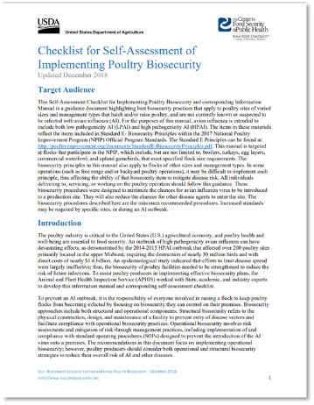
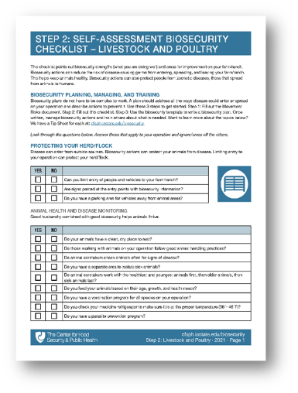

Salmonellosis
Mycoplasma
Routine Biosecurity
Marek’s Disease
Fowl Cholera
Notes:
Routine biosecurity measures for common diseases (CLICK – words appear automatically) like Salmonellosis, Mycoplasma, Marek’s Disease, and Fowl Cholera are not enough to protect poultry from Highly Pathogenic Avian Influenza (HPAI). If HPAI is found in poultry or wild birds in your area, (CLICK) you will have to step up to Enhanced Biosecurity to prevent exposing your birds. That becomes a LOT easier when you are already halfway or two-thirds up the staircase! How do you get started on that climb? With the “getting started” biosecurity resources described earlier and shown here.

Slide 33
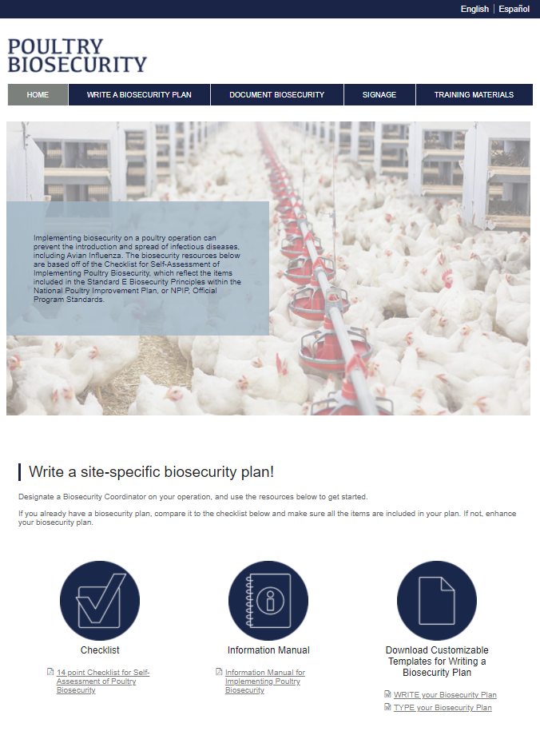
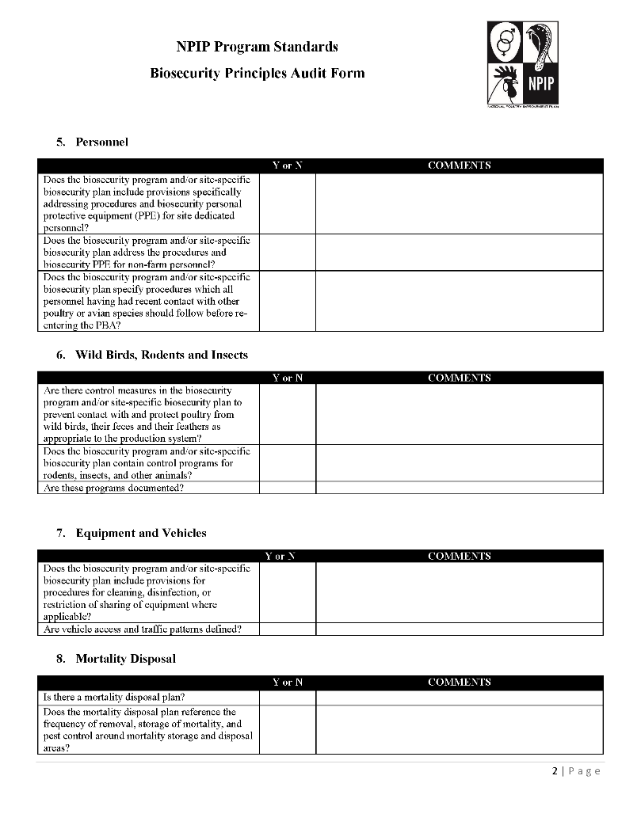
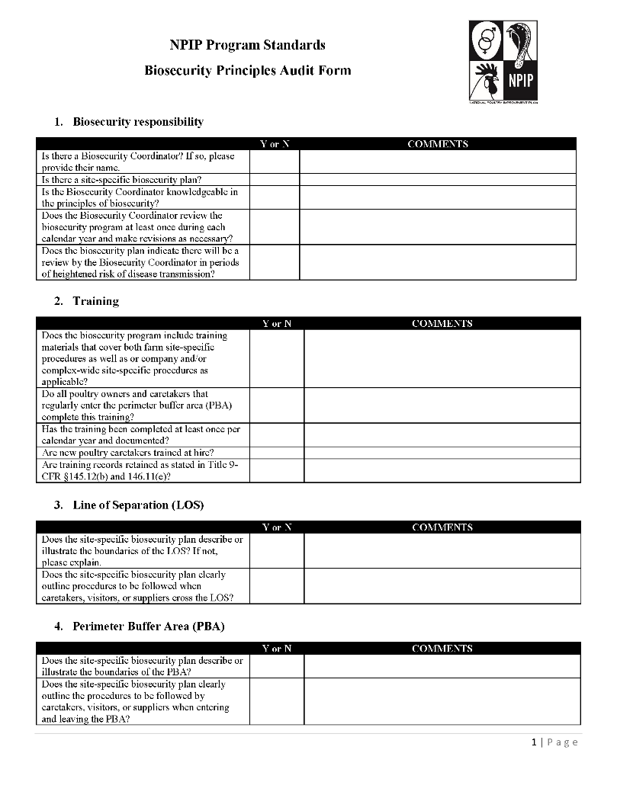
Enhanced Biosecurity Resources
www.poultrybiosecurity.org
www.poultryimprovement.org
Notes:
The best way to protect your poultry is to put enhanced biosecurity in place before an outbreak. The Poultry Biosecurity website has the resources you need to get started today! These align with the National Poultry Improvement Plan (NPIP) Standard E Biosecurity Principles. Pictured on the right is the Audit Form which is based on flock size as outlined in the Code of Federal Regulations. In the event of an HPAI outbreak, only premises that pass the audit will be eligible for indemnity.
More info available at: www.poultrybiosecurity.org and www.poultryimprovement.org

Slide 34
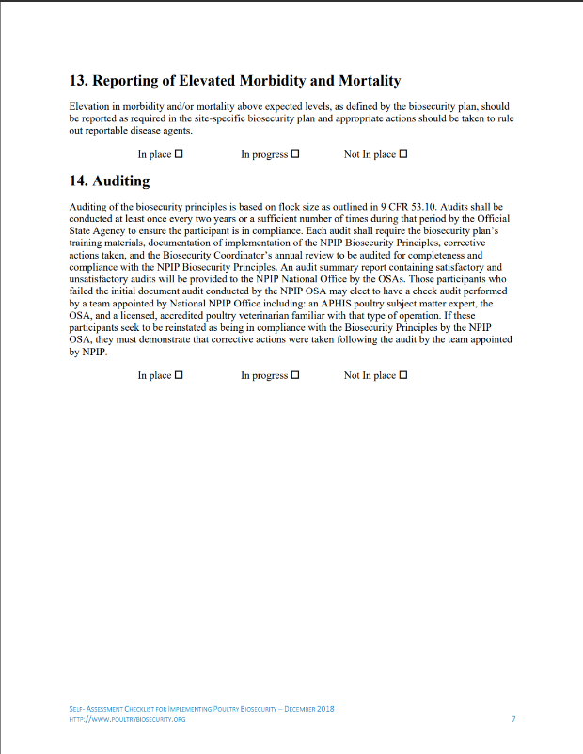
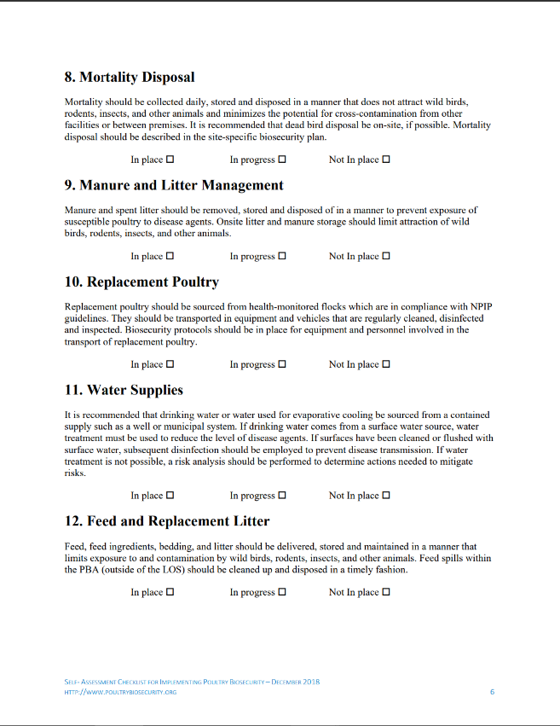
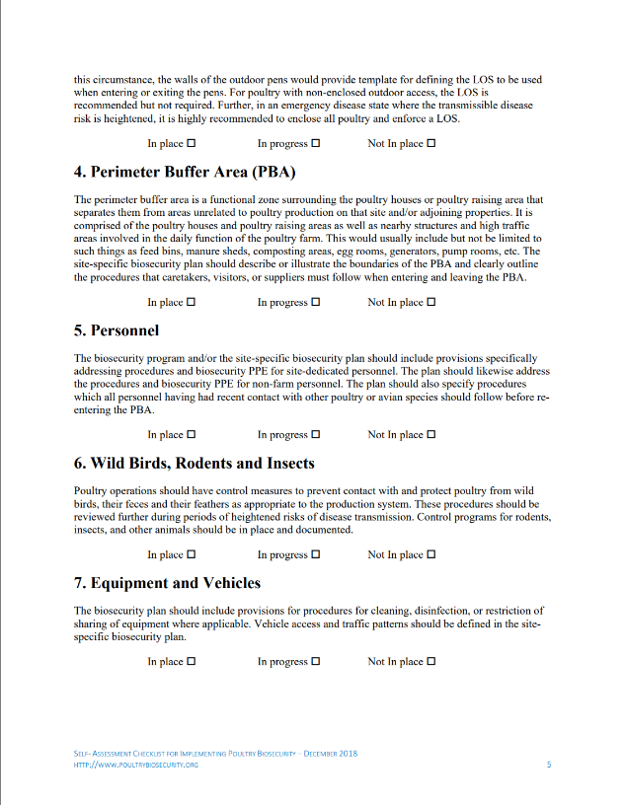
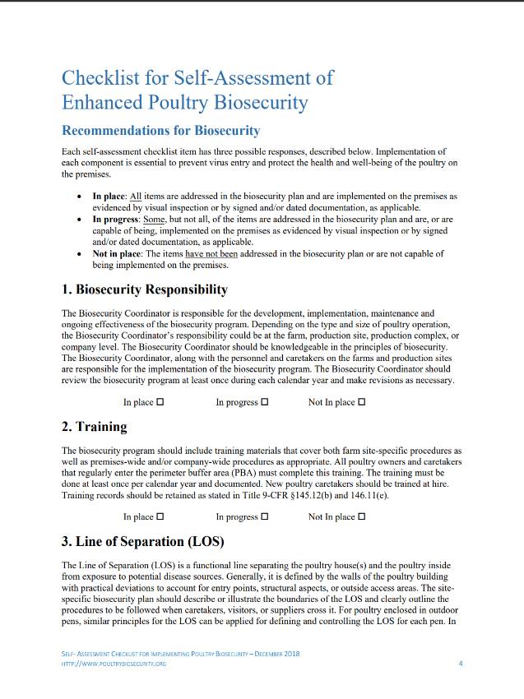
Checklist Topics
Biosecurity responsibility
Training
Line of Separation (LOS)
Perimeter Buffer Area (PBA)
Personnel
Wild birds, Rodents, and Insects
Equipment and Vehicles
Mortality Disposal
Manure and Litter Management
Replacement Poultry
Water Supplies
Feed and Replacement Litter
Reporting Elevated Morbidity and Mortality
Auditing
www.poultrybiosecurity.org
Notes:
Listed on the screen are all the topics found in the NPIP Standard E – Biosecurity Principles. These are aligned with the majority of topics in the Step 2 Livestock and Poultry Checklist shown earlier.
Graphic source: CFSPH, Iowa State University

Slide 35
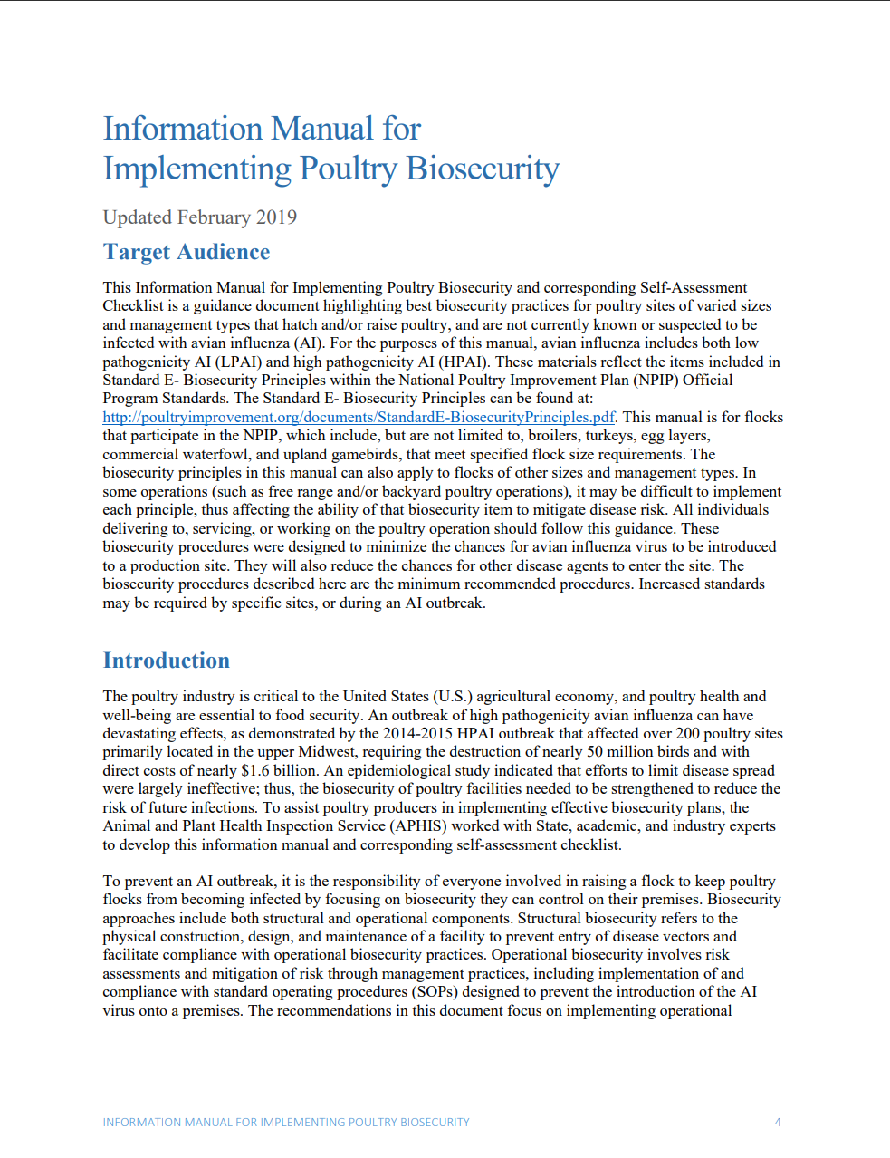



Enhanced Biosecurity
Enhanced Biosecurity for
Your Poultry Flock
www.poultrybiosecurity.org
Notes:
In addition to the Self-Assessment Checklist, which is based on how HPAI spreads, there is a (CLICK) corresponding Information Manual, and (CLICK) template. These help develop an operation-specific, written, (CLICK) ENHANCED BIOSECURITY plan for your flock. All of these resources are available on the Poultry Biosecurity website.

Slide 36


www.poultrybiosecurity.org
Notes:
Where can you find the enhanced biosecurity plan template? (CLICK) On the Poultry Biosecurity website, under Write A Biosecurity Plan. (CLICK). Choose whether you want to write or type the plan.

Slide 37





Biosecurity Handouts
www.poultrybiosecurity.org
Notes:
(ANIMATED – appear while talking)
The enhanced biosecurity steps are also included on some biosecurity handouts available on the Poultry Biosecurity website. These can help communicate expectations to all those entering the operation. These are available in Spanish too.
Graphics: CFSPH, Iowa State University

Slide 38



USDA Defend the Flock
https://www.aphis.usda.gov/aphis/ourfocus/animalhealth/animal-disease-information/avian/defend-the-flock-program
Notes:
The USDA Defend the Flock Program has a variety of biosecurity resources specific to poultry. Checklists, videos and animated GIFs in English and Spanish like the two shown here teach the important steps to keep birds healthy.
Source: USDA APHIS
GIF source (top): https://www.aphis.usda.gov/publications/animal_health/keep-new-birds_eng.gif
(bottom): https://www.aphis.usda.gov/publications/animal_health/dont-haul-sp.gif

Slide 39

www.cfsph.iastate.edu/biosecurity/
Funding provided by USDA NADPRP and USDA NIFA NCR SARE
Notes:
For these biosecurity resources and more, please visit: cfsph.iastate.edu/biosecurity. You can sort by your species of interest or go to “Getting Started”.
Funding for the development of this material was provided by USDA’s National Animal Disease Preparedness and Response Program (NADPRP) and National Institute of Food and Agriculture through the North Central Region Sustainable Agriculture Research and Education (NCR-SARE) programs.

Slide 40
Acknowledgements
Development of this material was made possible through a grant provided to the CFSPH, ISU, CVM from the USDA Animal and Plant Health Inspection Service through the NADPRP. ISU is an equal opportunity provider. For the full non-discrimination statement or accommodation inquiries, go to www.extension.iastate.edu/diversity/ext.
Funding for PoultryBiosecurity.org and resources was made possible through a grant provided to the CFSPH from USDA APHIS.​
Notes:
Development of this material was made possible through a grant provided to the Center for Food Security and Public Health at Iowa State University, College of Veterinary Medicine from the U.S. Department of Agriculture (USDA) Animal and Plant Health Inspection Service through the National Animal Disease Preparedness and Response Program (NADPRP). Iowa State University is an equal opportunity provider. For the full non-discrimination statement or accommodation inquiries, go to www.extension.iastate.edu/diversity/ext.
Funding for the PoultryBiosecurity.org website and resources was made possible through a grant provided to the CFSPH from USDA APHIS.​

