Slide 1
PROTECT YOUR PIGS
Notes:
Let’s learn about ways to protect your pigs from diseases.
For more biosecurity resources, visit www.cfsph.iastate.edu/biosecurity
This presentation was developed by veterinarians at the Center for Food Security and Public Health, Iowa State University, College of Veterinary Medicine. Feel free to customize it to fit your needs. Please credit the original creators.

Slide 2
Types of Germs
Bacteria
Strep suis, Salmonella, Mycoplasma, E. coli
Parasites
Roundworms, whipworms, tapeworms, coccidiosis
Viruses
Porcine Epidemic Diarrhea (PED), African Swine Fever (ASF), foot and mouth disease (FMD)
Oh My!
Notes:
There are many types of germs, or organisms, that cause disease in pigs and other animals. Some even cause disease in people. Examples of bacteria include Strep suis, Salmonella, Mycoplasma, and E. coli. (CLICK) Examples of parasites include roundworms, whipworms, tapeworms and coccidiosis. (CLICK) Examples of viruses that infect pigs include porcine epidemic diarrhea (PED), African Swine Fever (ASF), and foot and mouth disease (FMD). (CLICK) Oh My! This list can be very long. Let’s take a look at a way to simplify protecting your pigs from these germs.

Slide 3
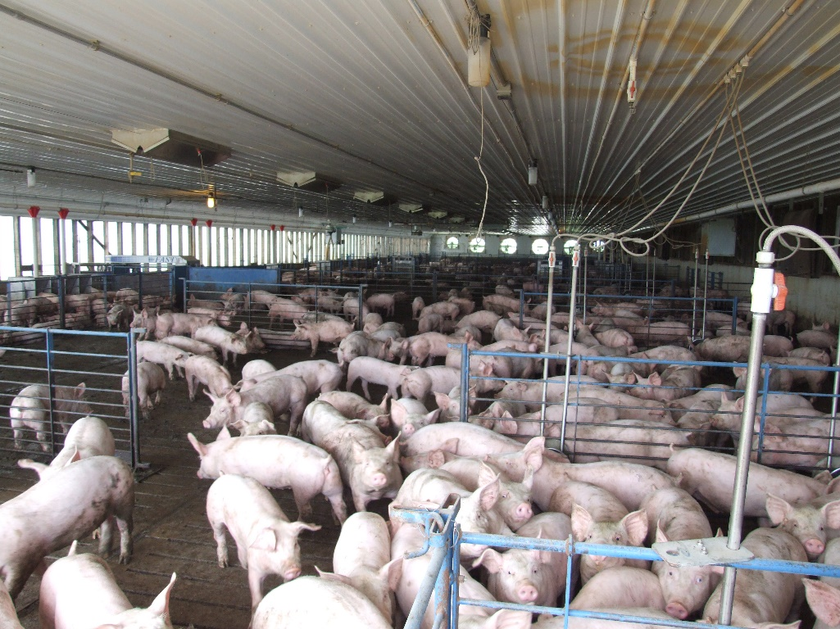
Germ Spread
Animal animal
Animal human “zoonotic”
Animal or human must be exposed to develop disease
Understand different routes of exposure = Gain control, prevent!
Notes:
If we look at how diseases or the germs that cause them spread, we can find ways to control and prevent them.
Some diseases are spread between animals only. PEDV is one example of an animal to animal spread disease.
Some diseases are spread between animals and people and are called “zoonotic” diseases. Salmonella is one example of a zoonotic disease. It can be in the feces of pigs or people and spreads when it gets into the mouth. While germs and the diseases they cause vary, they all have one thing in common: the animal or human must be exposed to them to get the disease. Once we understand how disease-causing germs enter a body, it is easier to control them. Thinking about how animals or people are exposed lets us put steps in place to prevent exposure.
Photo source: Alex Ramirez, CFSPH, Iowa State University

Slide 4
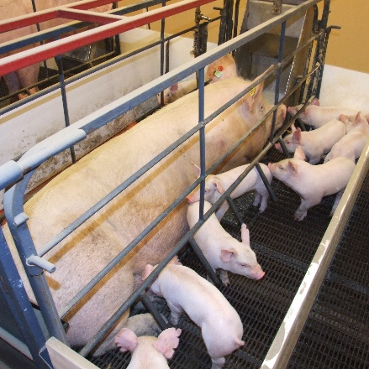
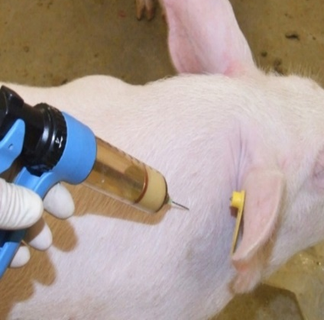
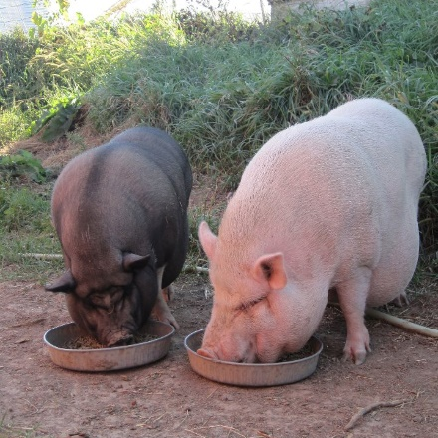
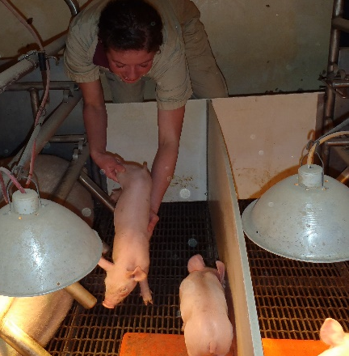
Six Incredible Ways!
1
2
3
Aerosol
Direct contact
Fomite
Oral
Vector
Zoonotic
4
5
6
Notes:
When you think about all the diseases animals or people can get, there are only six incredible ways they can be spread! This is easier to remember than the many bacteria, parasites and viruses. The pictures are examples of each route of exposure:
Aerosol: A pig sneezing. If it is infected and another pig breathes in the same droplets, spread can happen.
Direct contact: This sow is surrounded by her piglets. If the sow carried a disease, it could be spread directly through the uterus or during birth.
Fomite: If the needle becomes contaminated with a germ and shared between animals, germs can be spread.
Oral: If a pig eats feed that is contaminated with manure, saliva, or urine from an infected animal, they can become infected.
Vector: If pigs are kept outside, they can be exposed to a lot of bugs like flies or mosquitos which can spread diseases.
Zoonotic: If the piglet, or the human, is carrying a germ like E. coli or Salmonella, they could share that through contact.
Aerosol: Graphic designed by Dani Ausen, CFSPH, Iowa State University.
Direct contact: Alex Ramirez, Iowa State University
Fomite: Alex Ramirez, Iowa State University
Oral: Amber Langmeier, Iowa State University
Vector: Alex Ramirez, Iowa State University
Zoonotic: Alex Ramirez, Iowa State University

Slide 5
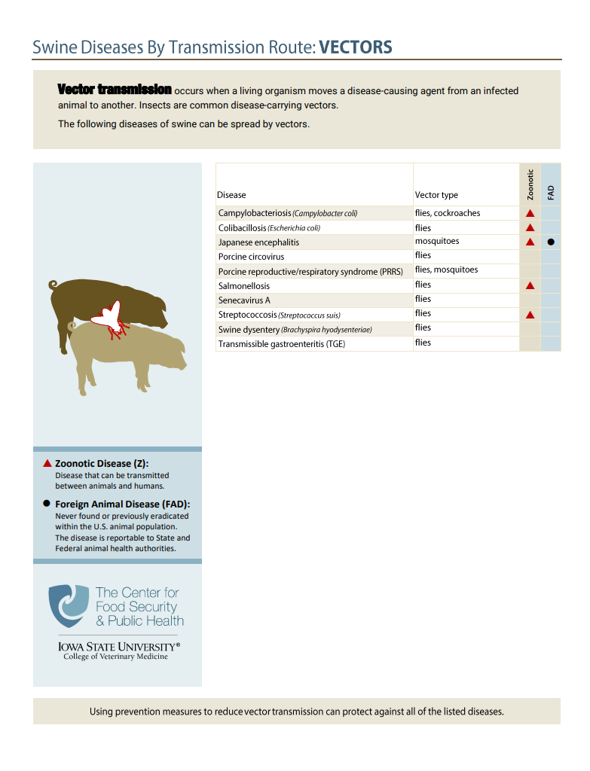
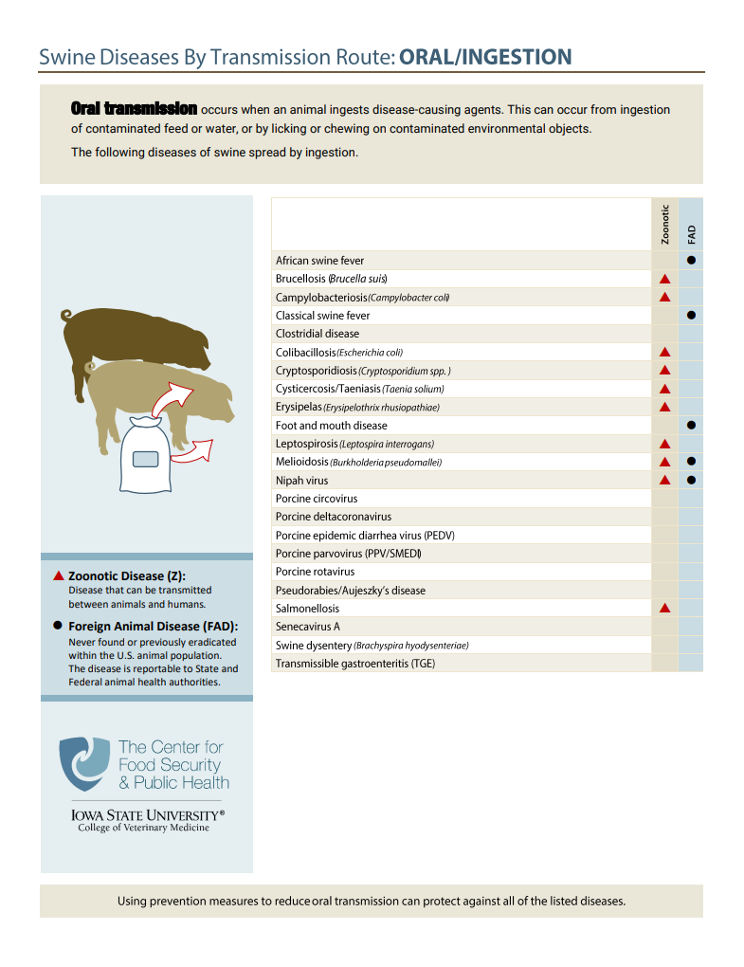
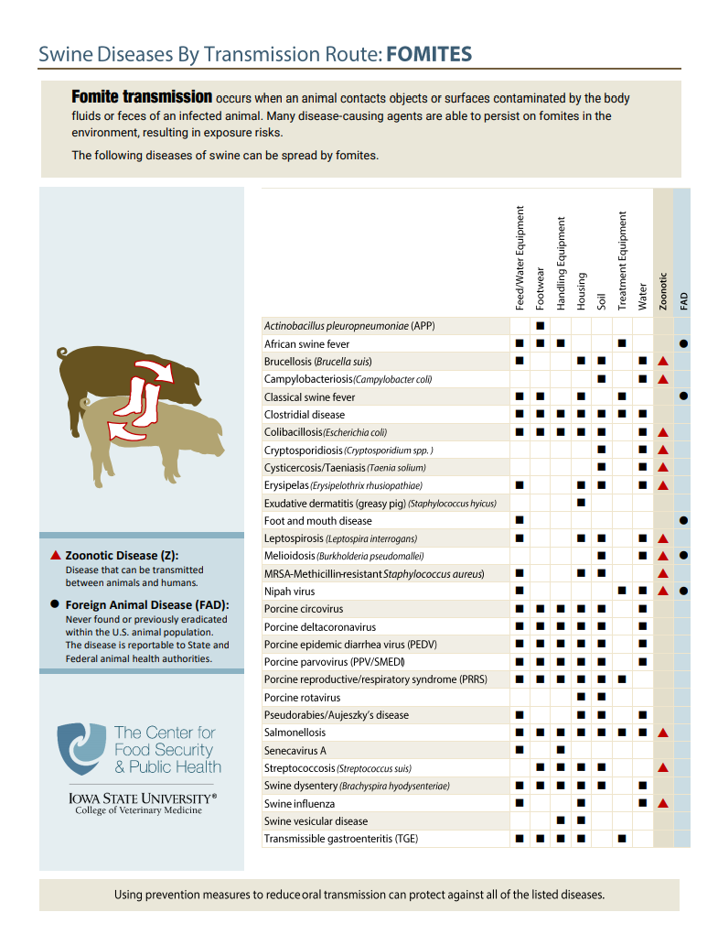
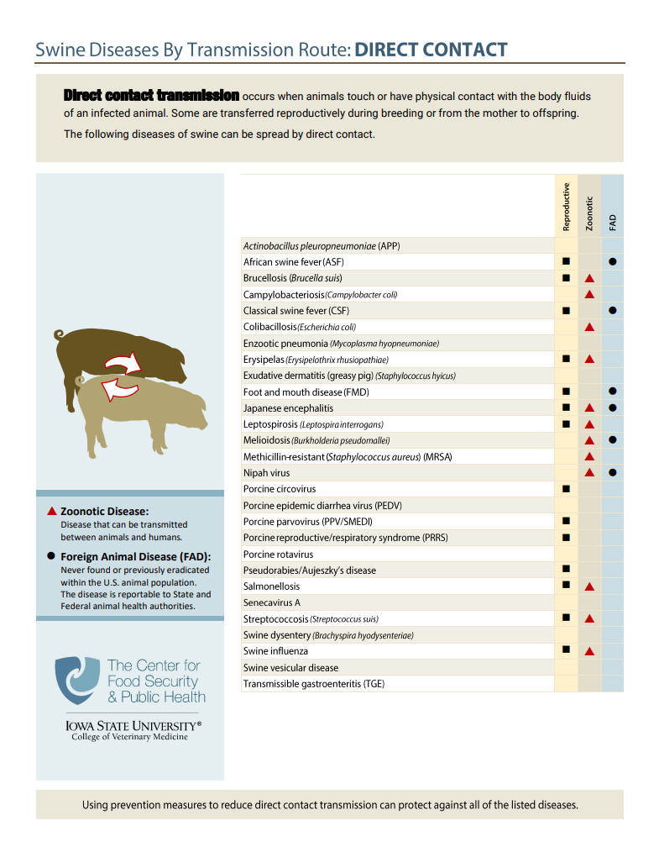
www.cfsph.iastate.edu/infection-control/routes/
Notes:
(ANIMATED – appear while talking)
If you are interested in learning about which diseases are spread by each of the 6 ways, visit the Center for Food Security and Public Health website for handouts on pigs as shown. These also show which diseases are common, known as endemic, and which ones are foreign animal, meaning not currently found in the United States. These handouts also show which diseases affect people – zoonotic diseases.

Slide 6
Disease Spread
Animals may not show obvious signs of disease
Knowing ways disease is spread helps with prevention
Limit disease spread risk to livestock and people contacting them
Notes:
We must remember that disease spread can happen without animals showing obvious signs of disease. Knowing the different ways diseases are spread can help with prevention. This can also limit the risk of disease spread to livestock and people contacting them.
Photo: Pam Zaabel, CFSPH, Iowa State University

Slide 7
Biosecurity
“Procedures intended to protect humans or animals against disease or harmful biological agents”
Oxford Dictionary
Source: Food and Agriculture Organization https://youtu.be/9iy9Ebqr5-w
Notes:
Biosecurity is defined in the Oxford dictionary as “Procedures intended to protect humans or animals against disease or harmful biological agents”.
(VIDEO PLAYS AUTOMATICALLY) The video clip states: “Biosecurity towards promoting animal health, protecting public health and ensuring food security. Let’s Go!” It is from the FAO, and the video is titled: Tackling AMR through farm biosecurity to strengthen food systems and secure livelihoods, created November 18, 2020 and available at: https://youtu.be/9iy9Ebqr5-w

Slide 8
What diseases worry you most?
PRRS
African swine fever
Influenza
TGE
PEDV
Strep suis
Foot and mouth disease
Notes:
(ANIMATED – appear while talking) TRAINERS: Change as needed for your audience.
When it comes to diseases, which ones worry you the most? Working with your veterinarian to design biosecurity steps to keep diseases off your farm is a great place to start. Start by identifying the diseases you are most concerned with or at most risk from. Then focus on putting biosecurity measures in place to protect your herd.

Slide 9
Biosecurity = Disease Prevention
Disease prevention = insurance
Paying premiums
Hope it’s never needed
Appreciate it when “disaster” strikes
If biosecurity is working, NO ONE KNOWS
Hard to put a value on its effectiveness
When there is a labor shortage, time is a precious commodity
Effective biosecurity takes time, practice
Notes:
Biosecurity is the insurance needed for disease prevention. By investing in biosecurity regularly, we are paying those “premiums”. The goal is to never need to submit a “claim”. We all hope a disease challenge never happens. We appreciate the investment in daily biosecurity practices when disaster strikes.
(CLICK) In reality, if biosecurity is working, NO ONE KNOWS. This makes it hard to put a value or dollar amount on its effectiveness. The value comes when a challenge arises, and the animals do not become sick.
(CLICK) Animal agriculture has faced some big challenges with labor shortages. Time is precious on a farm when there are not enough people to get everything done. This can create challenges to make sure biosecurity steps are followed. To do biosecurity well and to be effective, it takes time. Not cutting corners, or leaving things dirty, or rushing between tasks. Effective biosecurity also takes practice to do well and become routine. All of these are reasons to start doing things now to help protect animal health.

Slide 10
Benefits to Biosecurity NOW
Common disease prevention
Similar exposure routes for foreign animal or unknown diseases
Porcine Epidemic Diarrhea
Direct contact
Blood, feces, semen
Fomites
Oral
Consuming feces from infected animals
Foot and Mouth Disease
Direct contact
Blood, feces, semen
Fomites
Oral
Consuming feces from infected animals
Notes:
What are some of the benefits to putting biosecurity in place NOW? Instead of waiting for a disease challenge like a highly contagious Foreign Animal Disease (FAD)?
First, many common diseases are spread the same way that FADs or unknown disease are. For instance, Porcine Epidemic Diarrhea in swine… (CLICK)
An infected animal can spread PED to another pig through direct contact, through fomites which are contaminated objects like boots and clothing, and orally when eating or drinking things contaminated with feces from an infected animal.
Let’s compare that to an FAD that affects swine (CLICK), Foot and Mouth Disease (FMD). While FMD is MUCH MORE CONTAGIOUS than PED, how an animal gets exposed is similar. They can be exposed through direct contact, contaminated fomites, and oral consumption.
Biosecurity steps that prevent exposure to PED can help protect from other diseases spread the same ways.

Slide 11
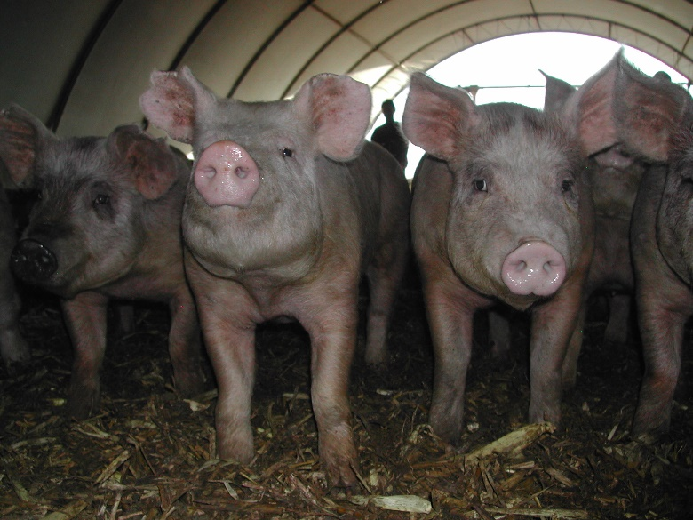
Benefits to Biosecurity NOW
Less disease challenges = better animal health
Decrease infectious burden = better animal health
Dose = Severity
Better animal health = economic benefits
Notes:
Other benefits to putting biosecurity in place NOW is having less overall disease challenges. This can lead to better animal health. Most diseases cannot be completely eliminated, but the risk can be managed. For nearly all diseases there is a relationship between exposure dose and severity of disease. For diseases that are always present (endemic), reducing the dose of infectious agent the animal is exposed to can positively affect the animal’s health. Better animal health leads to economic benefits for the producer, the industry, and the state. It also helps justify the cost of implementing biosecurity.
Photo sources: Danelle Bickett-Weddle, CFSPH, Iowa State University (top); Alex Ramirez, Iowa State University (bottom)

Slide 12
Daily to Enhanced Biosecurity
Preparing for the Unexpected to Maintain Pig Health
Notes:
Daily to Enhanced Biosecurity: Preparing for the Unexpected to Maintain Pig Health

Slide 13
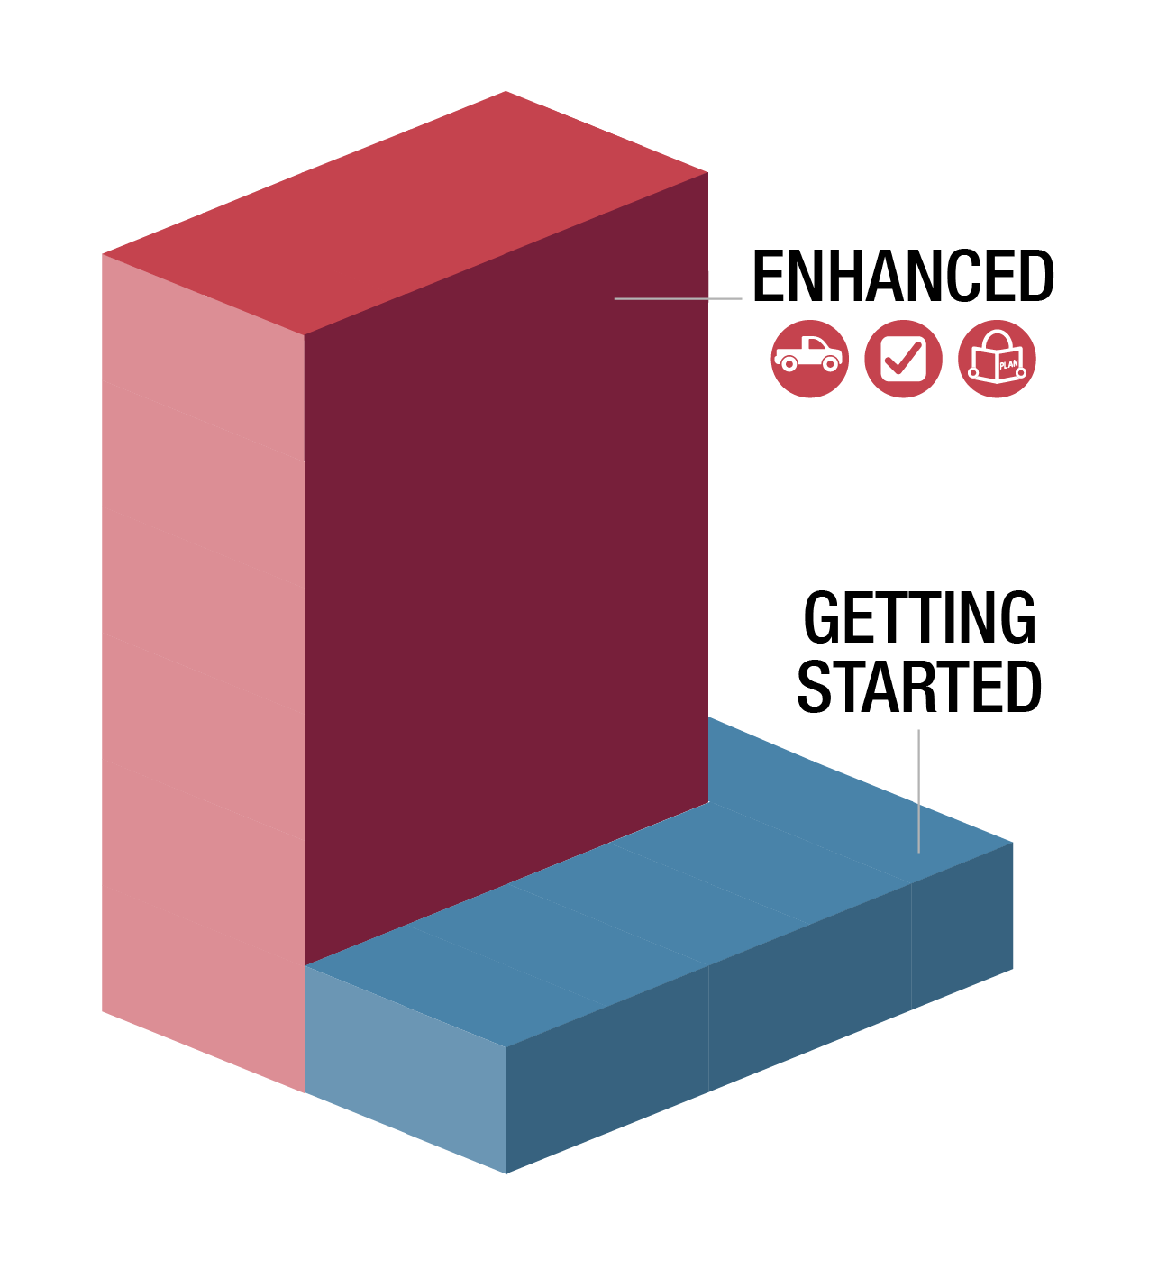
Protecting the Herd
Some producers have not dealt with new, highly contagious disease
Enhanced biosecurity needed
Animals never zero risk of exposure
It will be hard for some herds to go from no/little biosecurity to enhanced…
Notes:
Some producers have not had to deal with a new, highly contagious disease. It will take an enhanced level of biosecurity to keep highly contagious diseases out of herds. Our animals are never at zero risk of disease exposure.
(CLICK) It will be hard for some herds to go from no or little biosecurity to enhanced to protect their animals. That can be a tough journey.
Graphic source: CFSPH, Iowa State University

Slide 14
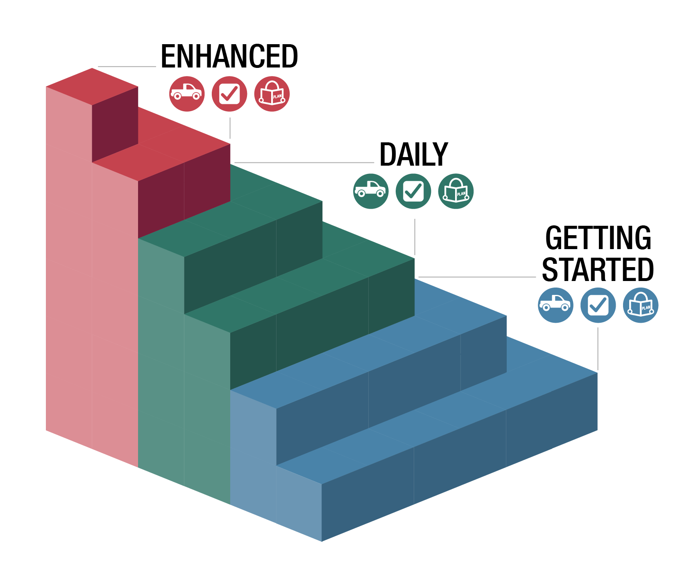
Big journeys begin with small steps
Notes:
Big journeys begin with small steps. It takes time to get to enhanced biosecurity. This is the same for any big changes on livestock operations. For instance, months to years may be needed for genetic improvement of the herd or better finished or weaning weights. Sometimes, getting started is a big first step.
(CLICK) To help producers go from no or little biosecurity, several steps have been created to help get started, practice it daily, so they are more ready for enhanced biosecurity.
Graphic sources (left): https://i.pinimg.com/564x/60/92/6f/60926f4d71aea485a9bd25e510fe8087.jpg (right) CFSPH, Iowa State University

Slide 15
Movement Risks
Notes:
Let’s start by looking at the different movements risks for swine operations that could expose animals to diseases.

Slide 16
Notes:
Items moving on and off your farm or site can bring disease. Identifying movement risks can help you prevent them. Some of the areas to focus on include:
Animals – these could be new animals added to your herd or animals returning from shows, fairs, or breeding.
Animal products – especially if they have not been treated to kill potential germs. Semen can’t be treated prior to use. Knowing the source and the disease status of the source herd is important to keeping diseases from your animals.
Deliveries – especially if the vehicle or equipment drives in animal areas or crosses paths with on-site equipment.
Removals – seems odd to think things leaving could introduce disease, but what item is leaving and how? Is it a dead animal and a vehicle needs to enter to pick it up? Where was that vehicle or equipment prior to your farm? Same for manure removal. Vehicles that go site to site could pose a risk (livestock trucks).
Personnel – especially if they will have direct contact with animals on your operation.
Graphic source: CFSPH, Iowa State University

Slide 17
Notes:
(VIDEO SHOULD START PLAYING AUTOMATICALLY – 2 minutes with full credits at end)
Protecting Your Herd and Flock: Line of Separation video downloaded from: Video downloaded from: https://vimeo.com/user68158100/download/553543741/24fb8bbe01
Source: CFSPH, Iowa State University; Narration, Danelle Bickett-Weddle, DVM

Slide 18
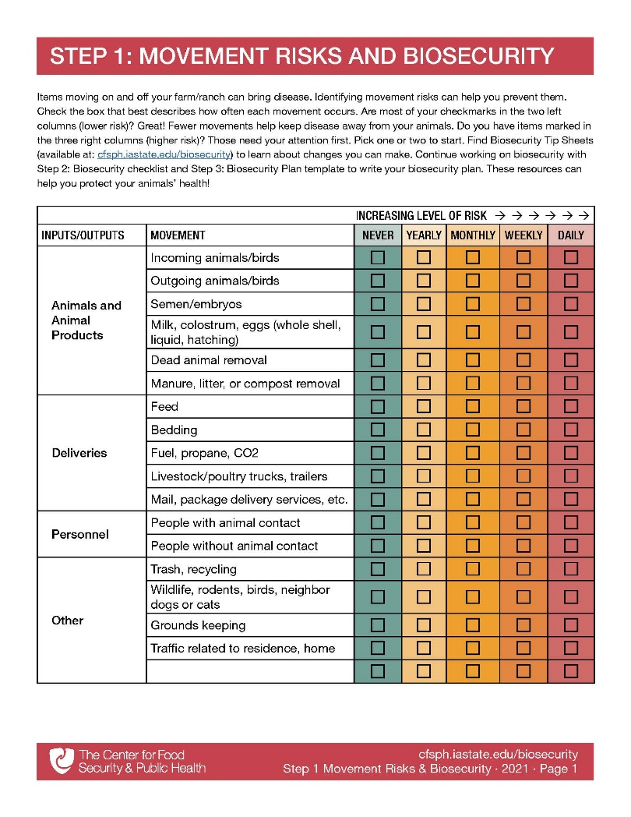
Step 1: Movement Risks
Fill it out for a typical week or month
Focus on daily movements first
What initial biosecurity steps could protect the herd?
www.cfsph.iastate.edu/biosecurity/
Notes:
The Center for Food Security and Public Health at Iowa State University created an easy-to-use checklist to explore the different movements that come onto your farm. Step 1 Movement Risks is pictured and can be downloaded from the website: cfsph.iastate.edu/biosecurity/. Producers are encouraged to fill it out for a typical week or month. It is a fillable PDF. Just check the box that best describes how often each movement occurs. Are most of your checkmarks in the two left columns (lower risk)? Great! Fewer movements help keep disease away from your animals. Do you have items marked in the three right columns (higher risk)? Those need your attention first, especially daily movements. Pick one or two to start. Next we will talk about some of the biosecurity steps that could protect the herd.
Graphic source: CFSPH, Iowa State University

Slide 19
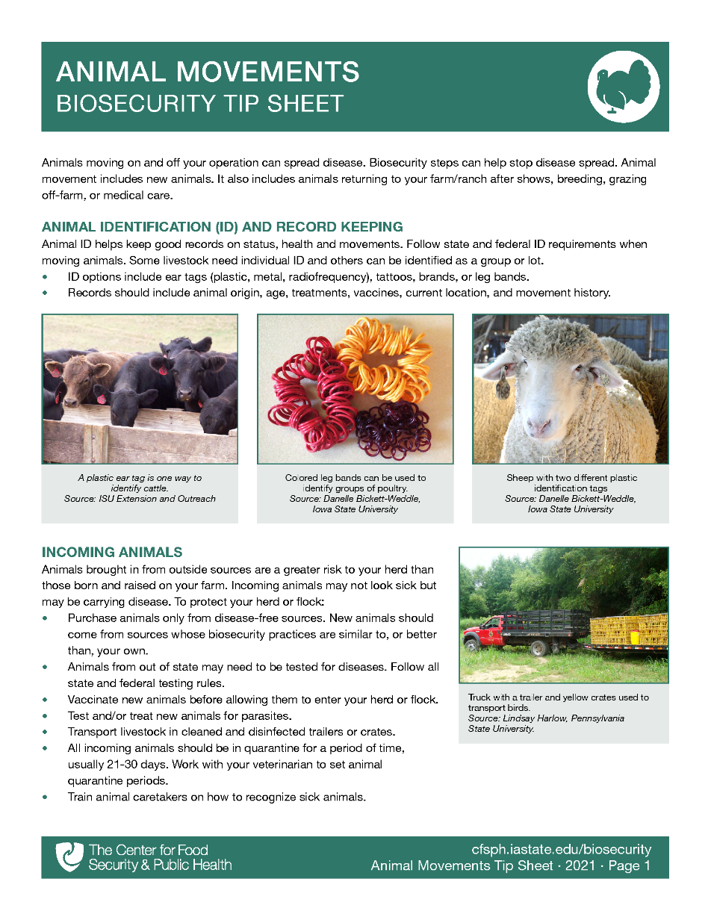
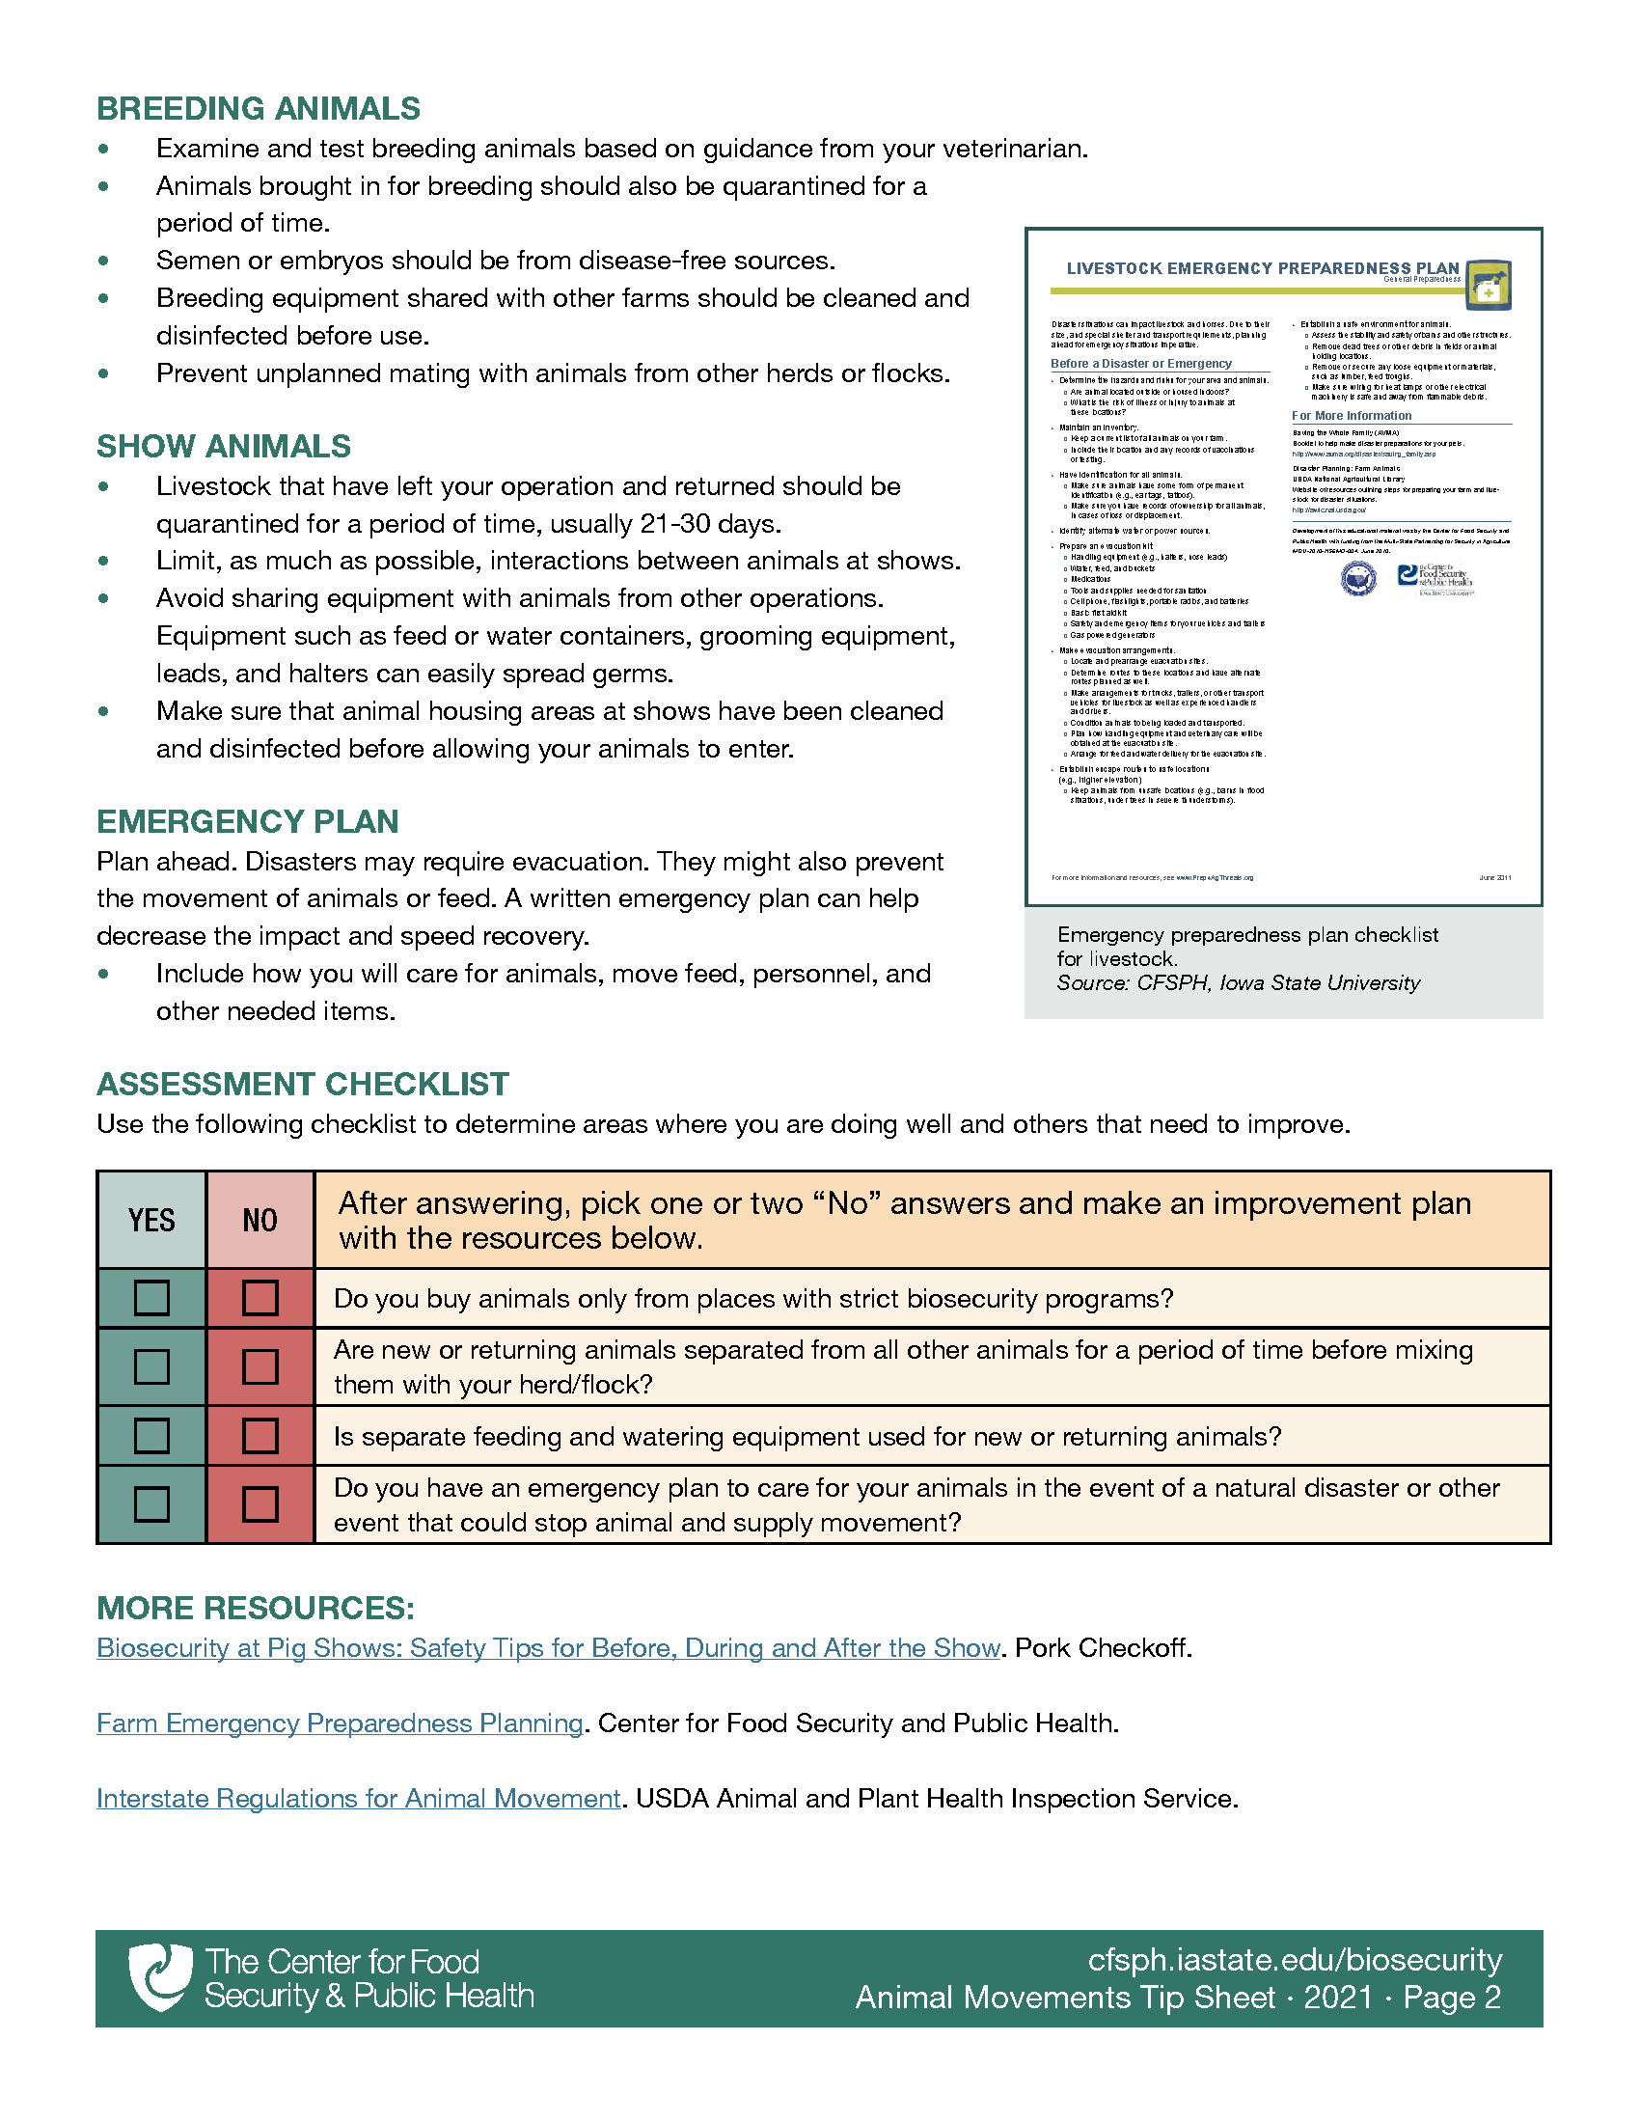
Where can I learn more?
Biosecurity Tip Sheets provide more info on biosecurity actions to protect your herd/flock!
www.cfsph.iastate.edu/biosecurity/
Notes:
Once you have figured out the more common movements, there are Biosecurity Tip Sheets with steps to protect your herd from exposure. Pictured is the Animal Movement Biosecurity Tip Sheet. This is available on the Center’s website listed on the screen.
Graphic source: CFSPH, Iowa State University

Slide 20
Tip Sheets – Videos
www.cfsph.iastate.edu/biosecurity/
Notes:
Want even more biosecurity ideas? Each Tip Sheet has a corresponding video full of pictures! Find them on the Center’s website listed on the screen.
(CLICK ON VIDEO TO PLAY – 6 minutes with full credits at end)
NOTE TO TRAINERS: There are also PPTs available for your use to present live or customize for your audience. Those are available on the “training” web page: https://www.cfsph.iastate.edu/biosecurity-resource/train-the-trainer/
Source: CFSPH, Iowa State University; Narration, Glenda Dvorak, DVM

Slide 21
Tip Sheets – Checklist
Notes:
Within each Tip Sheet (and PPT) is a checklist that has a few questions to uncover other areas of strength and gaps in biosecurity steps. There are also “More Resources” to explore for more tips.
Graphic source: CFSPH, Iowa State University

Slide 22
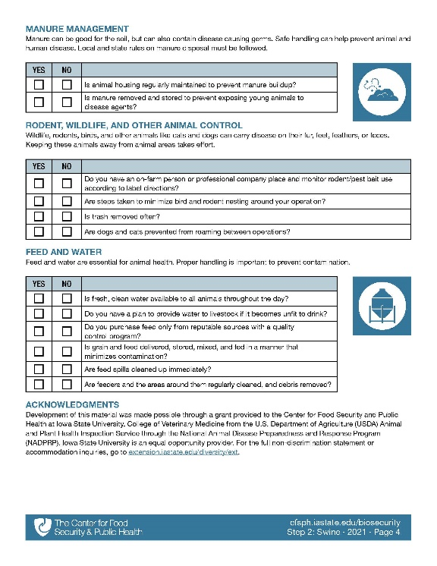
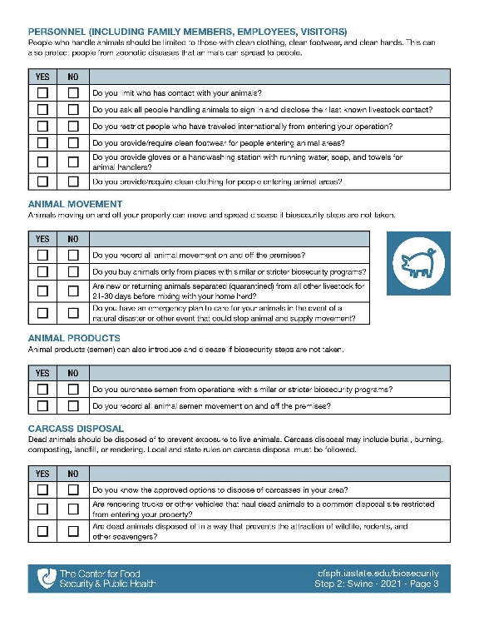
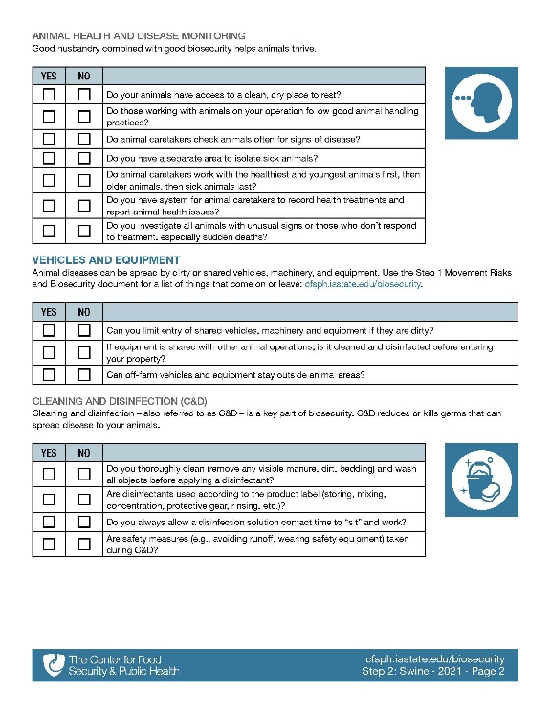
Step 2: Assess Biosecurity
Biosecurity checklist has a series of questions to find strengths and gaps
www.cfsph.iastate.edu/biosecurity/
Notes:
After doing one or two checklists in the Tip Sheets, are you ready to assess other biosecurity actions? Step 2 is a self-assessment biosecurity checklist. The same questions found in the Tip Sheets are here too. They are meant to find strengths and gaps.
TRAINERS: The Swine checklist 47 has questions.
Graphic source: CFSPH, Iowa State University

Slide 23
Checklist Topics
Training
Protecting Your Herd
Animal Health and Disease Monitoring
Vehicles and Equipment
Cleaning and Disinfection
Personnel (Family, Employees, Visitors)
Animal Movement
Animal Products
Carcass Disposal
Manure, Litter, Bedding Management
Wildlife, Rodent, Other Animal Control
Feed and Water
www.cfsph.iastate.edu/biosecurity/
Notes:
Listed on the screen are all the topics found in the Swine Self-Assessment Checklist
Graphic source: CFSPH, Iowa State University

Slide 24
Tip Sheet Topics
Protecting Your Herd/Flock
Animal Health and Disease Monitoring
Vehicles and Equipment
Cleaning and Disinfection
Personnel (Family, Employees, Visitors)
Animal Movement
Carcass Disposal
Manure, Litter, Bedding Management
Wildlife, Rodent, Other Animal Control
Feed and Water
More!
www.cfsph.iastate.edu/biosecurity/
Notes:
Listed on the screen are all the Tip Sheet topics found on the biosecurity resources web page. These match the checklist topics. There are additional tip sheets in development. There are also several additional tip sheets on item-specific cleaning and disinfection.
Graphic source: CFSPH, Iowa State University

Slide 25
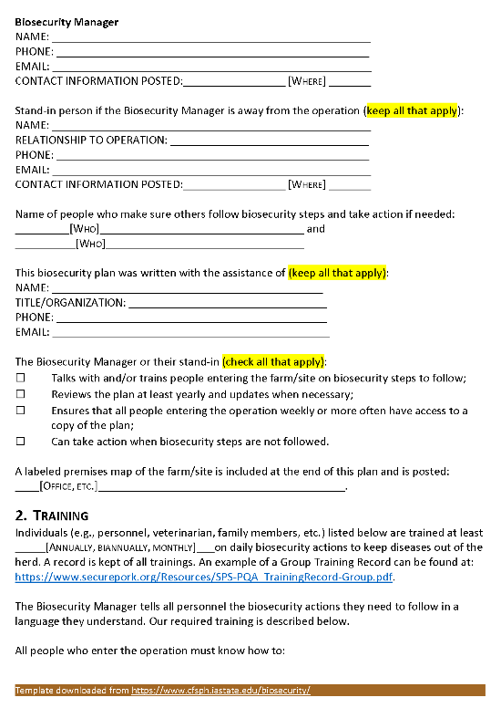
Step 3: Swine Template
Ready to write a plan?
Step 3: Biosecurity Plan Template for Swine is a great start!
Voluntary
Notes:
Is writing a biosecurity plan a goal? Then the Swine Biosecurity Plan Template is just what you need.
This template lines up with the Swine Biosecurity Step 2 Checklist, giving producers additional tools to protect their herd. Writing a biosecurity plan is completely voluntary.
Graphic source: CFSPH, Iowa State University

Slide 26
Diseases Harm Animal Health
Diseases are Costly
Notes:
Common and foreign animal diseases harm animal health and are costly. Take PRRS for instance. Not only does it kill pigs, it costs $82 more for every breeding female and almost $5 for every pig sold in the United States. PED or Porcine Epidemic Diarrhea kills piglets. ASF, or African Swine Fever, a foreign animal disease, also kills pigs and could cost $15 billion dollars if it enters the United States and $50 billion dollars if it gets into feral pigs.
Graphic source: CFSPH, Iowa State University

Slide 27
Diseases are Spread By…
Notes:
PRRS, PED, and ASF, and many others, are spread by semen and artificial insemination if the boar carries the disease, adding new or replacement animals to a herd, contaminated vehicles, animal transport, equipment, clothing, footwear and hands that contact animals.
Graphic source: CFSPH, Iowa State University

Slide 28
Take Steps Today to Keep Diseases Out!
Protect Your Herd
Notes:
Take steps today to keep diseases out and protect your herd by having a biosecurity plan in place and enforcing it. Separate new animals and sick animals from the home herd. Limit people access to your animals to only those with clean clothing, footwear and hands. Also, make sure animal pens are kept clean as well as equipment and vehicles used with animals or in their areas. For more information on biosecurity, visit www.cfsph.iastate.edu.
Graphic source: CFSPH, Iowa State University

Slide 29
Enhanced Biosecurity
Foreign Animal Disease Readiness to Protect Your Herd
Notes:
Next we will discuss putting enhanced biosecurity in place. This is a readiness step to protect your herd from foreign animal diseases.

Slide 30
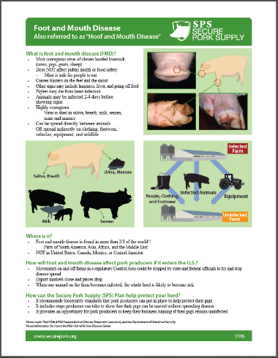
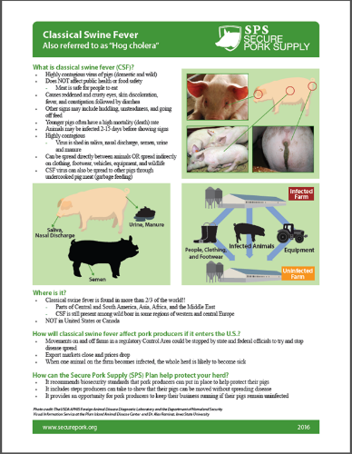
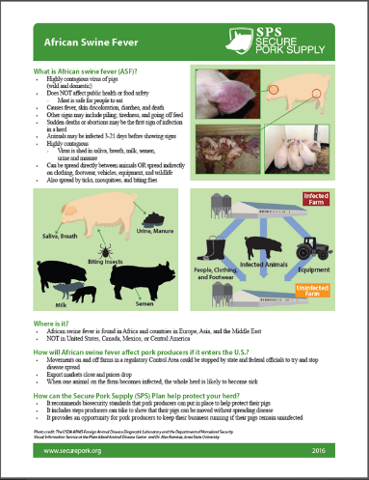
FMD, CSF, ASF
www.securepork.org
Notes:
(ANIMATED – runs on its own)
The three foreign animal diseases we will discuss are foot and mouth disease (or FMD), classical swine fever (or CSF), and African swine fever (or ASF). The one page handouts shown here are available on the Secure Pork website and they describe each the three diseases. It is important to know that these diseases are NOT a public health or food safety concern.
Graphic source: CFSPH, Iowa State University

Slide 31
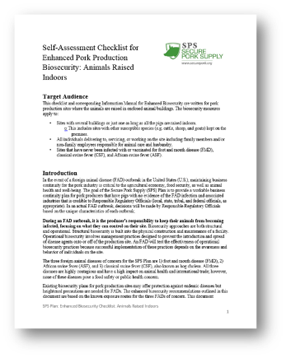
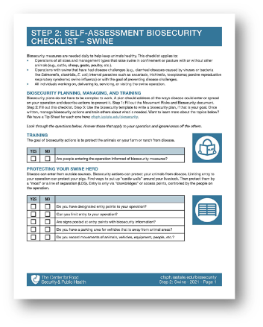
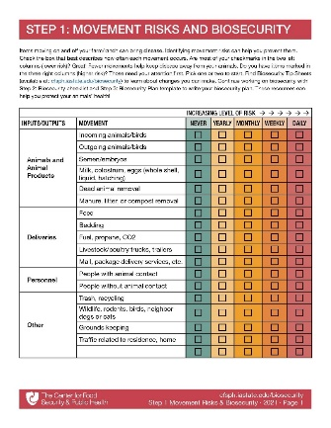
TGE
Mycoplasma
Routine Biosecurity
Porcine Epidemic Diarrhea (PED)
PRRS
Notes:
Routine biosecurity measures for common diseases (CLICK) like TGE, Mycoplasma, Porcine Epidemic Diarrhea (PED), and PRRS are not enough to protect pigs from FMD, ASF or CSF. If FMD gets into the United States, (CLICK) you will have to step up to Enhanced Biosecurity to prevent exposing your pigs. That becomes a LOT easier when you are already halfway or two-thirds up the staircase! How do you get started on that climb? With the “getting started” and “daily” biosecurity resources described earlier and shown here.

Slide 32
www.securepork.org
Notes:
The Secure Pork Supply Plan provides business continuity guidance for your pigs operation during an FMD outbreak. For full details on the Secure Pork Supply Plan, visit securepork.org and watch the short video or (CLICK) read the plan. The best way to ensure business continuity is to make sure pigs do not become INFECTED with FMD, ASF, or CSF. Put enhanced biosecurity in place to prevent exposure. The Secure Pork website has the resources you need to get started today!
Graphic: CFSPH, Iowa State University

Slide 33
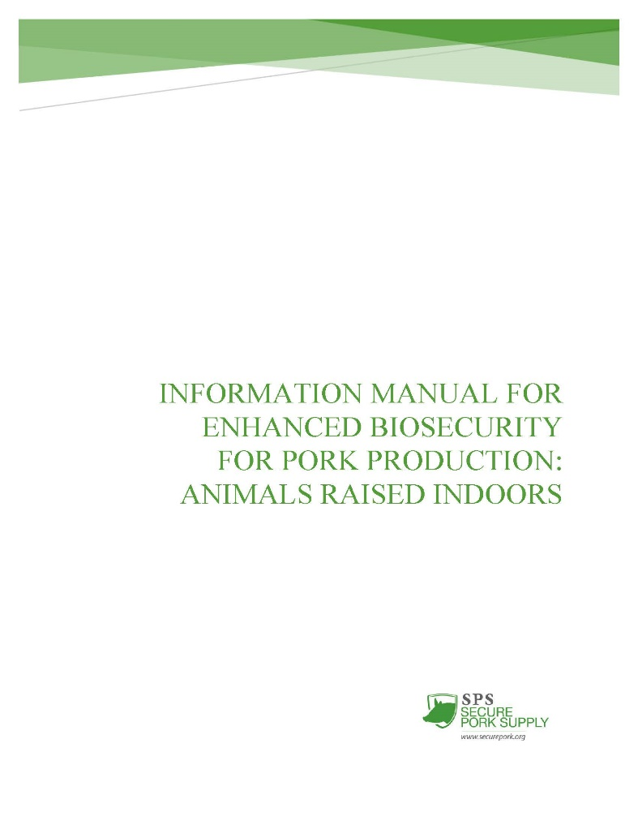
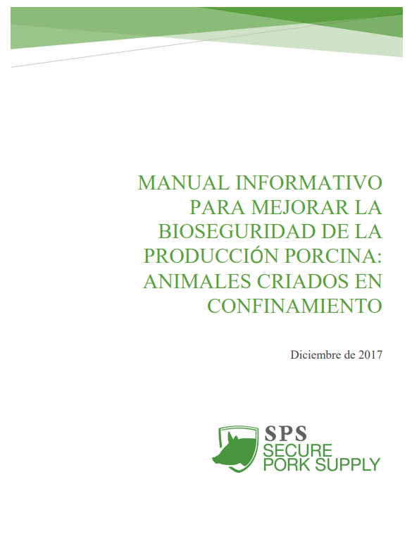
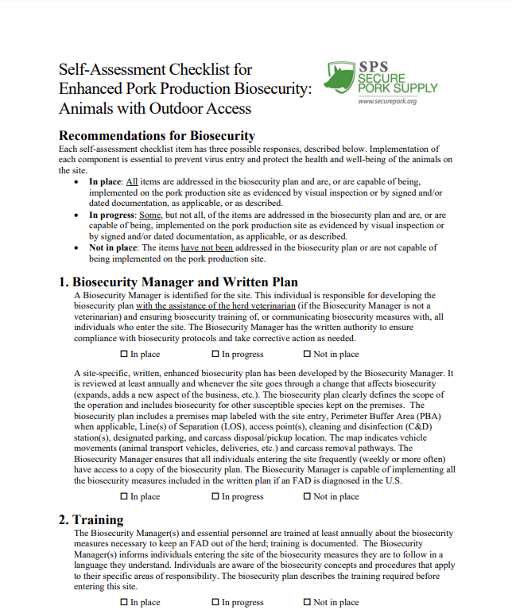
Resources
Enhanced Biosecurity for Indoor, Outdoor
www.securepork.org
Notes:
The SPS Plan includes ENHANCED biosecurity steps based on how FMD, ASF and CSF spread. Producers can work with their herd veterinarian and use the (CLICK) Self-Assessment Checklist, (CLICK) corresponding Information Manual, and (CLICK) template. These help develop an operation-specific, written, (CLICK) ENHANCED BIOSECURITY plan for their pigs raised indoors or outside. All of these resources are available on the Secure Pork website.

Slide 34
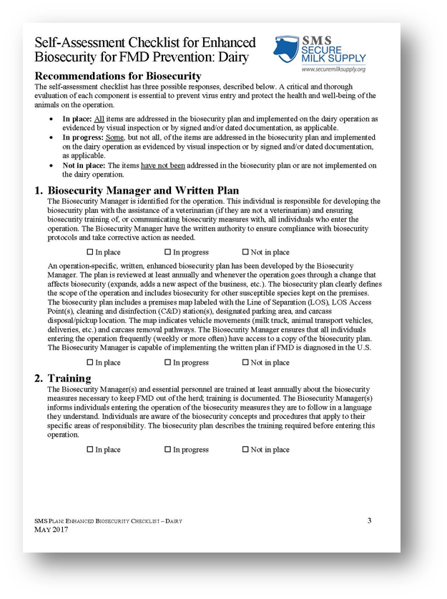
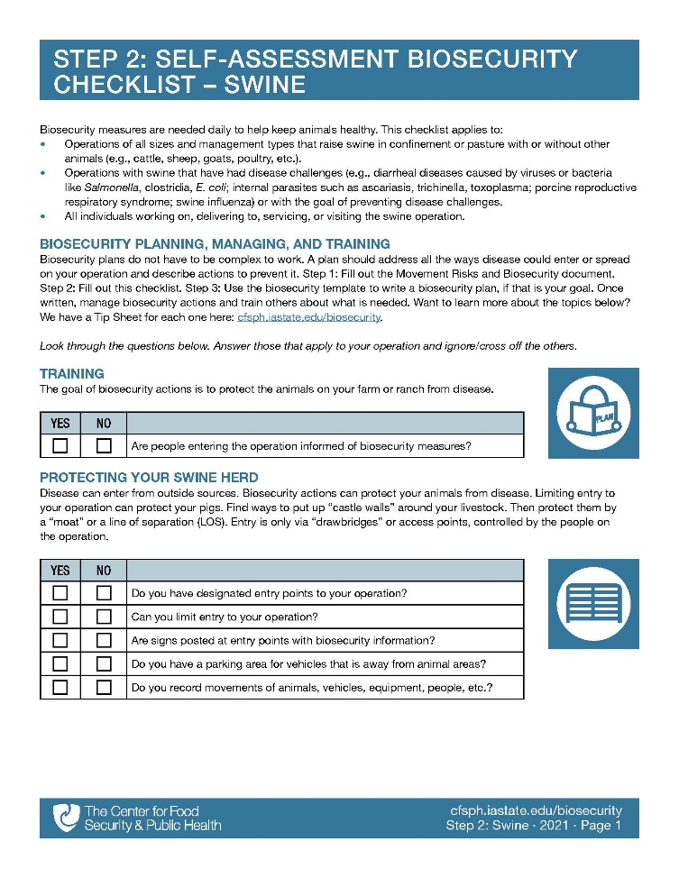
Checklist/Plan Topics
Training
Protecting Your Herd
Vehicles and Equipment
Cleaning and Disinfection
Personnel
Animal Movement
Animal Products
Carcass Disposal
Manure Management
Wildlife, Rodent, Other Animal Control
Feed
www.securepork.org
Notes:
Listed on the screen are all the topics found in the Enhanced Biosecurity Checklist and Plan. Look familiar? It should. These are the SAME TOPICS in the Daily Biosecurity resources for pigs. This helps producers STEP UP from daily to enhanced with consistency.
Graphic source: CFSPH, Iowa State University

Slide 35
www.securepork.org
Enhanced Biosecurity
Notes:
Where can you find the enhanced biosecurity plan template? On the Secure Pork Supply website, under (CLICK) Pork Producers – shown in gray at the top of the page. (CLICK) Select Biosecurity from the left menu (also highlighted gray on this slide). Again, using these resources is voluntary.

Slide 36
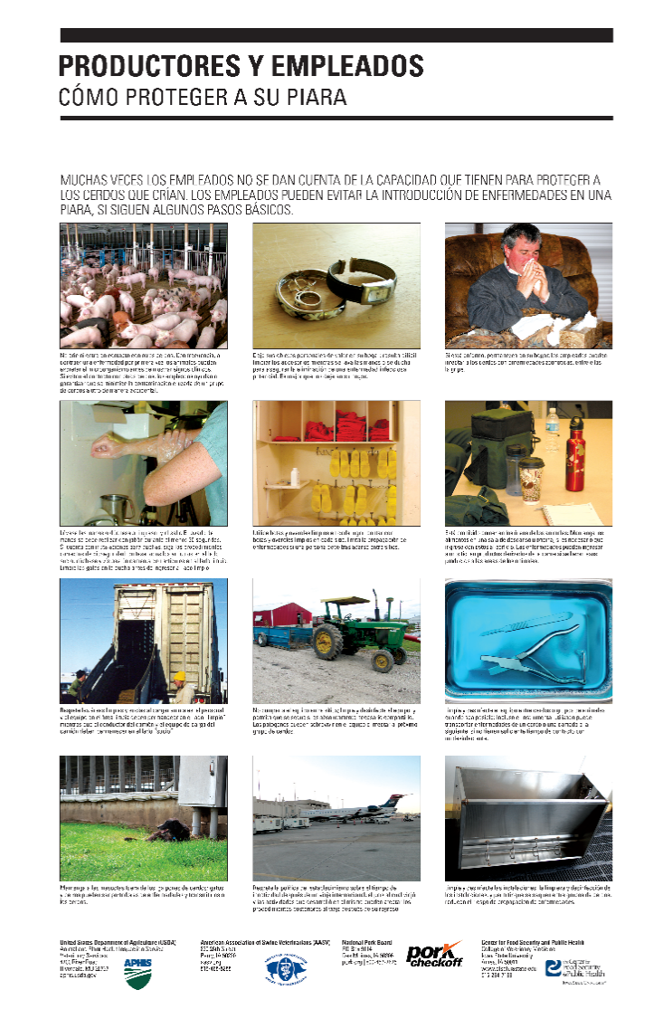
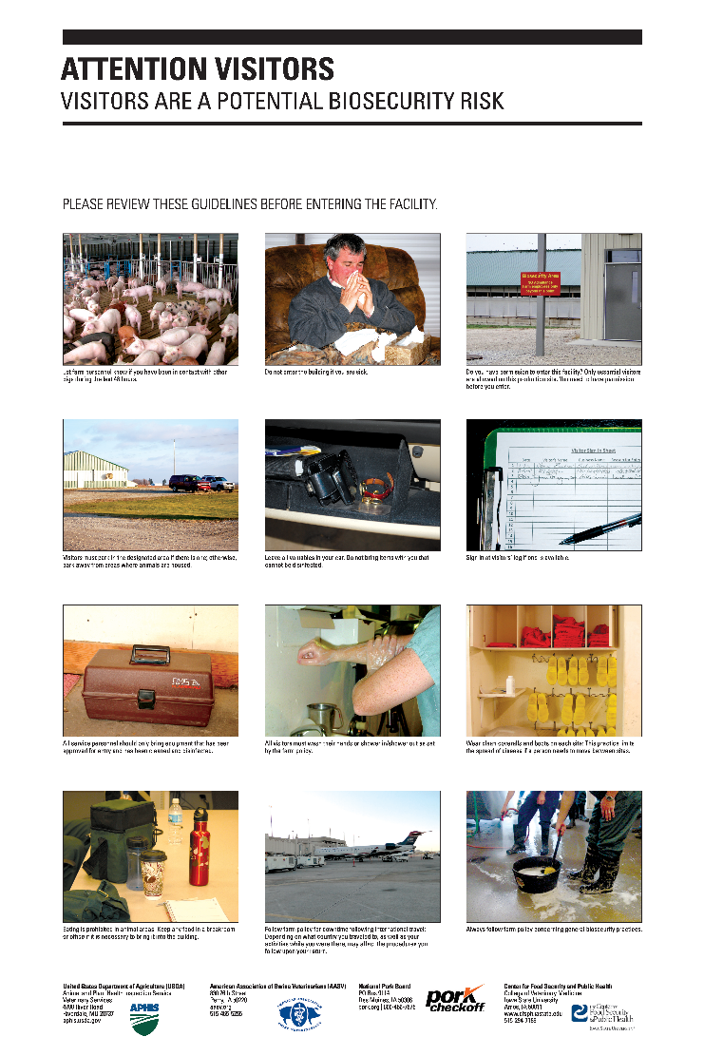
Biosecurity Posters
www.securepork.org
Notes:
The enhanced biosecurity steps are also included on some biosecurity posters available (CLICK) on the Secure Pork Supply website. These can help communicate expectations to all those entering the operation during a foreign animal disease outbreak. Producers can also order free laminated copies in English and Spanish from The Pork Store.
Graphics: CFSPH, Iowa State University

Slide 37
www.cfsph.iastate.edu/biosecurity/
Funding provided by USDA NADPRP and USDA NIFA NCR SARE
Notes:
For these biosecurity resources and more, please visit: cfsph.iastate.edu/biosecurity. You can sort by your species of interest or go to “Getting Started”.
Funding for the development of this material was provided by USDA’s National Animal Disease Preparedness and Response Program (NADPRP) and National Institute of Food and Agriculture through the North Central Region Sustainable Agriculture Research and Education (NCR-SARE) programs.

Slide 38
Acknowledgements
Development of this material was made possible through a grant provided to the CFSPH, ISU, CVM from the USDA APHIS through the NADPRP. ISU is an equal opportunity provider. For the full non-discrimination statement or accommodation inquiries, go to www.extension.iastate.edu/diversity/ext.
Funding for the Secure Pork Supply Plan was made possible through a grant provided to the CFSPH from USDA APHIS and The Pork Checkoff.
Notes:
Development of this material was made possible through a grant provided to the Center for Food Security and Public Health at Iowa State University, College of Veterinary Medicine from the U.S. Department of Agriculture (USDA) Animal and Plant Health Inspection Service (APHIS) through the National Animal Disease Preparedness and Response Program (NADPRP). Iowa State University is an equal opportunity provider. For the full non-discrimination statement or accommodation inquiries, go to www.extension.iastate.edu/diversity/ext. Funding for the Secure Pork Supply Plan was made possible through a grant provided to the CFSPH from USDA APHIS and The Pork Checkoff.
Author: Danelle Bickett-Weddle, DVM, MPH, PhD, DACVPM
Reviewers/Contributors: Katie Steneroden, DVM, MPH, PhD, DACVPM; Ellen Dauphinais, Alicia Burleson

