Slide 1
Mass Depopulation
& Euthanasia
Non-Domestic and
Aquatic Animal Euthanasia
Adapted from the FAD PReP/NAHEMS
Guidelines: Mass Depopulation and Euthanasia (2015)
Notes:
This presentation outlines general methods of non-domestic and aquatic animal euthanasia that may be appropriate during a response to an animal health emergency. This information was derived from the Foreign Animal Disease Preparedness and Response (FAD PReP)/National Animal Health Emergency Management System (NAHEMS) Guidelines: Mass Depopulation and Euthanasia (2015) and also the web-based training module.

Slide 2
Non-Domestic Zoological and Exhibition Animals
Notes:
The purpose of this presentation will review techniques for the euthanasia of non-domestic zoological and exhibition animals. This guidance focuses on emergency situations, and considerations could be different in non-emergency euthanasia protocols.
Test Template HANDS 2011-03
2

Slide 3
Euthanasia and Depopulation
Euthanasia
  Transitioning painlessly and stress-free as possible
Mass Depopulation
  Large numbers, quickly and efficiently
  Consideration to welfare as practicable
  Terms used interchangeably here
Notes:
It is important to understand that USDA APHIS recognizes a difference between euthanasia and depopulation. Euthanasia involves transitioning an animal to death as painlessly and stress-free as possible. Mass depopulation is a method by which large numbers of animals must be destroyed quickly and efficiently with as much consideration given to the welfare of the animals as practicable. However, for the purposes of this presentation, the terms mass depopulation and euthanasia may be used interchangeably or simply be referred to as “euthanasia,” regardless of whether they are actually considered euthanasia or depopulation.

Slide 4
Euthanasia and Depopulation
May be practiced during an animal health emergency
Goals of Euthanasia
  Provide humane treatment
  Select acceptable method
  Minimize negative emotional impact
  Safeguard food chain
  Prevent or mitigate disease spread
Notes:
Euthanasia and depopulation may be practiced during an animal health emergency, such as a major disease outbreak or a foreign animal disease (FAD), to help prevent or mitigate the spread of the disease through the elimination of infected, exposed, or potentially exposed animals. It also serves to remove contaminated livestock from the food supply, protect the nation‘s agricultural and national economy, and safeguard public health. The overall goals of euthanasia are to: provide humane treatment of animals at all times until they are euthanized; select and use an acceptable method of depopulation/euthanasia to be executed as quickly, efficiently, and humanely as possible; minimize the negative emotional and psychological impact on animal owners, caretakers, and the public; prevent adulterated or potentially adulterated meat products from entering the food chain; and prevent or mitigate disease spread in the event of the introduction of a FAD within the U.S.

Slide 5
Handling
Goal: Humane Treatment
Careful restraint and handling to minimize distress, pain, and injury
Appropriate facilities
  Humane and compatible with species involved
Competent, experienced personnel
Notes:
One of the overall goals in conducting euthanasia is to provide humane treatment of animals at all times until they are euthanized. Euthanasia must be performed by competent personnel who are trained and experienced in species-specific euthanasia methods. In all cases, the animal must be restrained and handled in a manner that minimizes stress and risk of injury or undue pain. The procedures and facilities used for the restraint and euthanasia of these animals must be humane and compatible with the needs of the species involved. Equally important is the safety of responders. The Safety Officer should be consulted where handling the animals may cause significant danger to personnel.

Slide 6
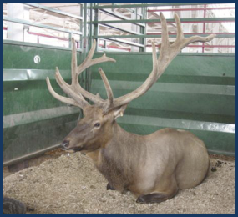
Non-Domestic Animals
Consult with experts when designing euthanasia plan
  Zoo animals: USDA support
  Game park animals: USDA lead
Handled only by trained
personnel
May not metabolize
drugs, handle stress
like domestic species
Notes:
When selecting and developing a practical and humane euthanasia plan for non-domestic or game park animals, consult with experienced personnel from a recognized facility, institution, agency or association. The American Association of Zoo Veterinarians (AAZV) has published a comprehensive document of guidelines for euthanasia of non-domestic animals. Euthanasia of non-domestic animals is also discussed in the American Veterinary Medical Association (AVMA) Guidelines for the Euthanasia of Animals: 2013 Edition. When zoological collections must be euthanized, the USDA will provide support and assistance to staff veterinarians to develop and carry out euthanasia activities. For other facilities, such captive game hunting ranches, the USDA will assume the lead role in making euthanasia decisions. Non-domestic species should be handled by personnel with experience and training with non-domestic animals. If similar domestic species exist, a good starting point in selection of the euthanasia method for non-domestic animals may be methods approved for similar domestic species. However, even if non-domestic animals appear similar to domestic species, there may be differences in the way these animals metabolize drugs or handle stress. [This photo shows a bull elk housed in a pen. Photo source: Danelle Bickett-Weddle, Iowa State University]

Slide 7
Euthanasia- Free Ranging
Acceptable
  Noninhaled anesthetic
Conditionally Acceptable
  Inhaled agents (anesthetics, inert gas)
  Gunshot
Kill traps
Captive bolt
Notes:
Acceptable and conditionally acceptable methods of euthanasia have been outlined in the AVMA Guidelines for the Euthanasia of Animals: 2013 Edition.
For free-ranging wildlife, the AVMA has stated that overdoses of injectable anesthetic agents are acceptable means of euthanasia. Conditionally acceptable methods of anesthesia for free ranging wildlife are the administration of inhaled anesthetics or inert gas such as carbon dioxide or carbon monoxide. Gunshot is also conditionally acceptable. Kill traps are not considered consistently humane but, in some cases, may be used to humanely kill free-ranging wildlife- particularly small mammals. In some cases where animals can be restrained without undue stress, the use of a captive bolt may be acceptable.

Slide 8
Euthanasia- Zoo Animals
Potentially Acceptable
  Noninhaled anesthetic
Potentially Conditionally Acceptable
  Inhaled agents (anesthetics, inert gas)
  Gunshot
Captive bolt
Notes:
Zoos are often comprised of a diverse animal population. Euthanasia methods should be adapted to the specific species of concern. It is likely that overdoses of injectable anesthetic agents or administration of inhaled anesthetics or inert gas are acceptable for some species. Gunshot is also conditionally acceptable for some species. In some cases where zoo animals can be restrained without undue stress, the use of a captive bolt may be acceptable.

Slide 9
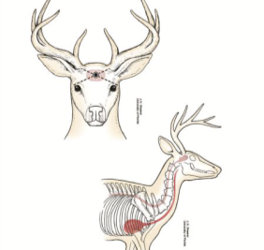
Gunshot or Captive Bolt
Handling and restraint may cause extreme stress
Gunshot may be most practical
Cervids
  Captive bolt if able to
  restrain
  Free bullet also
  acceptable
Notes:
When selecting a euthanasia method, consider that non-domestic animals may experience extreme stress when handled or restrained for certain types of anesthesia, often making gunshot the choice method. If it is not feasible to capture and restrain the animal to be euthanized, gunshot may be the only practical option. For cervids, such as deer and elk, if the animal can be chemically or physically restrained, captive bolt or free bullet are acceptable euthanasia methods. In cervids, aim the captive bolt or gun at the intersection point of two imaginary lines drawn from the middle of the base of the ear to the lateral canthus of the opposite eye. You may also aim the bolt or bullet down the center of the horn ridge aiming at the base of the tongue, similar to horned sheep. Practice extreme caution in the use of free bullets to avoid injury to the gun operator or damage or injury to property or persons in the background beyond the animal. [This illustration shows the proper aiming point for a captive bolt or gunshot euthanasia in a cervid. Photo source: JK Shearer, Iowa State University]

Slide 10
Injectable Agents
Projectile equipment (dart guns)
  Wide variety available
  Utilize powerful restraint agents
Used by veterinarians with specialized training
Notes:
A wide variety of projectile equipment, sometimes called dart guns, utilizing very powerful chemical restraint agents is sometimes used by veterinarians and personnel specializing in zoo animal or wildlife practice. If this equipment and these agents are used, veterinarians with the specialized training to use them safely should be employed. In an animal health crisis event when a decision to euthanize captive ruminants, or wild, exotic, or zoo animals has occurred, expert opinion is critical for success.

Slide 11
Confirmation of Death
Confirmation of death can be difficult
  Sustained lack of heartbeat and respiration
  Rigor mortis
  Evaluate by competent, experienced personnel
Notes:
Following the application of a euthanasia method, death must be confirmed. Lack of a heartbeat and respiration (at least 10 minutes) as well as onset of rigor mortis are indicators that death has occurred. Animals should be evaluated for confirmation of death by competent and experienced personnel.

Slide 12
Finfish/Aquatic Invertebrates
Notes:
The farmed fish industry is a growing industry in the United States. As with exotic mammals, expert opinion should be sought when making decisions to depopulate farmed fish/aquatic species.
Test Template HANDS 2011-03
12

Slide 13
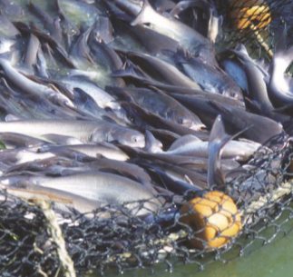
Finfish/Aquatic Invertebrates
Little published information on aquatic euthanasia techniques
Seek expertise
Notes:
Currently, there is little published concerning humane euthanasia procedures for aquatic species, particularly fish. In an event involving depopulation of farmed fish/aquatic species, veterinary and husbandry experts in these fields should be consulted for expertise and guidance. [This photo shows pond-reared fish ready for harvest. Photo source: Peggy Greb, USDA]

Slide 14
Euthanasia Methods
Physical methods
Noninhaled methods
Adjunctive methods
Notes:
The AVMA considers several physical methods of euthanasia acceptable with conditions and include manually applied blunt force trauma to the head, decapitation, and cervical transaction. Each of these physical methods should be followed by pithing. Other physical methods that may be considered include the use of a captive bolt, rapid chilling, and maceration. Noninhaled methods such as immersion in an overdose of anesthetic solution or carbon dioxide saturated water, or injection of euthanasia solution or an overdose of anesthetic are also acceptable. Pithing, freezing and decapitation may also be used as a second, or adjunctive, depopulation method of to ensure death.

Slide 15
Confirmation of Death
Confirmation of death difficult in finfish/aquatic invertebrates
  Loss of eyeroll
  Sustained absence of cardiac activity
  Loss of movement/reactivity
  Flaccidity of body
  Respiratory arrest
Notes:
Death in aquatic species can be difficult to determine, in part because of anatomic and physiologic adaptations. Indicators of death include: loss of eyeroll; the eyeroll is also known as the vestibulo-ocular reflex and describes the eye movement when a finfish is moved or manipulated from side to side. Loss of cardiac activity (heart beat) and no movement or reactivity to stimulus is also a strong indicator. Body flaccidity and respiratory arrest (cessation of rhythmic opercular activity) for at least 10 minutes are strong indicators death has occurred.

Slide 16
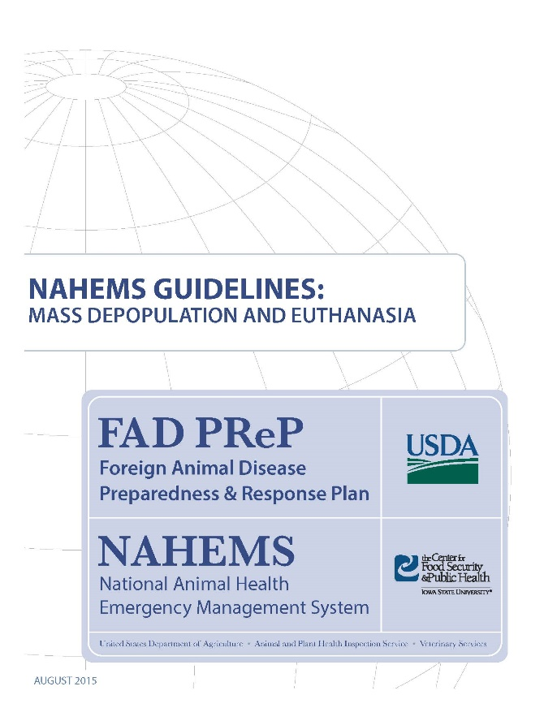
For More Information
FAD PReP/NAHEMS Guidelines: Mass Depopulation and Euthanasia (MDE) (2015)
  http://www.aphis.usda.gov/fadprep
MDE web-based training module
  http://naherc.sws.iastate.edu/
Notes:
More details can be obtained from the sources listed on the slide, available on the USDA website (http://www.aphis.usda.gov/fadprep) and the NAHERC Training Site (http://naherc.sws.iastate.edu/).

Slide 17
Guidelines Content
Authors (CFSPH):
Reneé Dewell DVM,MS
Nichollette Rider, Veterinary Student
Significant contributions to the content were provided by
USDA APHIS VS:
Lori P. Miller, PE
Darrel K. Styles, DVM, PhD
Notes:
This slide acknowledges the authors and those who made a significant contribution to the content of the FAD PReP/NAHEMS Guidelines: Mass Depopulation and Euthanasia document. Please see the Guidelines document for others who also provided additional assistance with content development.

Slide 18
Acknowledgments
Development of this presentation was by the Center for Food Security and Public Health at Iowa State University through funding from the USDA APHIS Veterinary Services
PPT Authors: Dawn Bailey, BS; Kerry Leedom Larson, DVM, MPH, PhD, DACVPM
Reviewers: Glenda Dvorak, DVM, MPH, DACVPM: Cheryl L. Eia, JD, DVM, MPH, Patricia Futoma, BS, Veterinary Student, Reneé Dewell DVM,MS
Notes:
Information provided in this presentation was developed by the Center for Food Security and Public Health at Iowa State University College of Veterinary Medicine, through funding from the US Department of Agriculture, Animal and Plant Health Inspection Service, Veterinary Services.

