Slide 1
Mass Depopulation
& Euthanasia
Avian Euthanasia
Adapted from the FAD PReP/NAHEMS
Guidelines: Mass Depopulation and Euthanasia (2015)
Notes:
The purpose of this presentation is to describe general methods and techniques that might be selected for euthanasia of avian species during an animal health emergency. This information was derived from the Foreign Animal Disease Preparedness and Response (FAD PReP)/National Animal Health Emergency Management System (NAHEMS) Guidelines: Mass Depopulation and Euthanasia (2015) and also the web-based training module.

Slide 2
Euthanasia and Depopulation
Euthanasia
  Transitioning painlessly and stress-free as possible
Mass Depopulation
  Large numbers, quickly and efficiently
  Consideration to welfare as practicable
  Terms used interchangeably here
Notes:
It is important to understand that USDA APHIS recognizes a difference between euthanasia and depopulation. Euthanasia involves transitioning an animal to death as painlessly and stress-free as possible. Mass depopulation is a method by which large numbers of animals must be destroyed quickly and efficiently with as much consideration given to the welfare of the animals as practicable. However, for the purposes of this document, the terms mass depopulation and euthanasia may be used interchangeably or simply be referred to as “euthanasia,” regardless of whether they are actually considered euthanasia or depopulation.

Slide 3
Euthanasia and Depopulation
May be practiced during an animal health emergency
Goals of Euthanasia
  Provide humane treatment
  Select acceptable method
  Minimize negative emotional impact
  Safeguard food chain
  Prevent or mitigate disease spread
Notes:
Euthanasia and depopulation may be practiced during an animal health emergency, such as a major disease outbreak or a foreign animal disease (FAD), to help prevent or mitigate the spread of the disease through the elimination of infected, exposed, or potentially exposed animals. It also serves to remove contaminated livestock from the food supply, protect the nation‘s agricultural and national economy, and safeguard public health. The overall goals of euthanasia are to: provide humane treatment of animals at all times until they are euthanized; select and use an acceptable method of depopulation/euthanasia to be executed as quickly, efficiently, and humanely as possible; minimize the negative emotional and psychological impact on animal owners, caretakers, and the public; prevent adulterated or potentially adulterated meat products from entering the food chain; and prevent or mitigate disease spread in the event of the introduction of a FAD within the U.S.

Slide 4
Handling
Goal: Humane Treatment
Decrease animal stress, excitement
Competent, trained and experienced personnel
Restrain without undue
injury or pain
Handle animals quietly
Notes:
One of the overall goals in conducting euthanasia is to provide humane treatment of animals at all times until they are euthanized. As required for mammalian species, euthanasia must be performed by competent personnel trained and experienced in species-specific euthanasia methods. The animals must be restrained in a manner that does not elicit injury or undue pain. Decreasing stress and excitement during movement and handling will increase bird welfare as increase human safety and efficiency. Avoid shouting and screaming. Restrain animals in a manner that does not elicit undue risk of injury or pain to themselves or personnel. Animals handled in a rough or hurried manner will become excited, making further handling unnecessarily difficult.

Slide 5
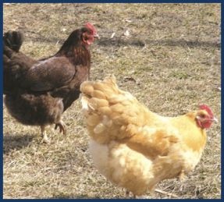
Euthanasia Methods
Acceptable (noninhalant)
Conditionally acceptable
Adjunct
“Other”
Consider disease agent
when choosing method
  Zoonotic potential
Notes:
Acceptable and conditionally acceptable methods of euthanasia have been outlined in the American Veterinary Medical Association (AVMA) Guidelines for the Euthanasia of Animals: 2013 Edition. Guidance has been provided for adjunctive, or supplementary, methods of euthanasia. In addition, nonconventional methods not addressed by the AVMA have been specifically designed for mass depopulation. If the method used is dangerous to the operator, then the process must be carried out according to guidelines established by the Safety Officer. When planning for mass depopulation due to disease outbreak, it is critical to consider the agent involved and zoonotic potential. Depopulation methods that reduce or eliminate contact between humans and the animal should be considered for diseases that pose a zoonotic risk to personnel. [This photo shows two free range laying hens. Photo source: Elizabeth Wormley, Iowa State University]

Slide 6
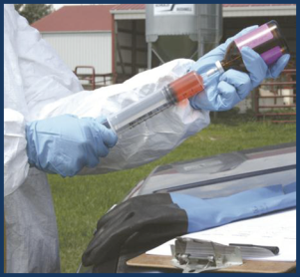
Noninhalant Injectables
Injectable barbituates
Barbituate derivates
Notes:
Acceptable and conditionally acceptable methods of euthanasia have been outlined in the AVMA Guidelines for the Euthanasia of Animals: 2013 Edition. For poultry, the AVMA has stated that the use of noninhalants such as injectable barbiturates or barbiturate derivatives are acceptable means of euthanasia. [This photo shows chemical euthanasia being drawn up in a single use-syringe. Photo source: Andrew Kingsbury, Iowa State University]

Slide 7
Inhalant
Conditionally acceptable
  Carbon dioxide
  Carbon monoxide
  Nitrogen
  Argon
Notes:
Inhaled agents such as carbon dioxide, carbon monoxide, nitrogen, or argon have been designated by the AVMA as conditionally acceptable.

Slide 8
Physical Methods
Conditionally acceptable
  Cervical dislocation
  Decapitation
  Electrocution
  Gunshot
  Percussive stunning/Captive bolt
  Manually applied blunt force trauma
Notes:
Physical methods such as cervical dislocation, decapitation, electrocution, gunshot, and percussive stunning or captive bolt are also possible avian euthanasia methods. The AVMA has conditionally approved the use of manually applied blunt force trauma for euthanasia or some poultry but this is not a practical euthanasia method during an animal health emergency if large numbers of birds must be depopulated.

Slide 9
Additional Methods
For mass/emergency depopulation
  Water-based foam for land-based poultry and waterfowl
  Ventilation shut down
Notes:
Depopulation methods have been specifically designed for mass depopulation of avian species. Water-based foam is a newer method of emergency depopulation for land-based poultry and waterfowl that has been used in the United States and other countries during avian influenza outbreaks. Although water-based foam has not been officially approved as a euthanasia tool, it is used and approved for poultry mass depopulation under APHIS specified emergency response conditions. This foam is similar to that used by firefighters and is generated from a foam concentrate and air or an anoxic gas using specially designed equipment. Poultry die from physical asphyxiation rather than from chemical asphyxiation as with CO2. Ventilation shutdown is defined as the cessation of natural or mechanical ventilation of atmospheric air in a building where birds are housed, with or without action to increase the ambient temperature. If possible, other euthanasia methods should be considered.

Slide 10
Adjunct Methods
  Potassium chloride or magnesium sulfate
    IV or Intracardiac
  Exsanguination (consider biosecurity)
  Bird MUST be unconscious
Notes:
If the primary euthanasia measure fails to cause rapid death, personnel should be prepared to immediately apply an adjunct measure. The AVMA has listed the intravenous or intracardiac injection of a saturated solution of potassium chloride or magnesium sulfate as an acceptable adjunct method. Exsanguination is also an approved option but may present significant biosecurity risks since the disease of interest may be blood borne. These methods must only be used on unconscious birds.

Slide 11
Injectable Chemical Agents
Small number of birds, companion birds
Intraperitoneal injection
  Nonirritating euthanasia agent
  Restrain with Ketamine hydrochloride, if necessary
  Death is prolonged when compared to intravenous methods
Notes:
If only a few birds require euthanasia, an IV intraperitoneal injection of nonirritating euthanasia agent is an acceptable method. This will be the method of choice for destruction of companion birds if necessary. Ketamine hydrochloride (20-50 mg/Kg IM) can be used to provide restraint if absolutely necessary. When injecting chemical euthanasia into the peritoneal cavity, one can expect it to require an extended period of time (minutes) for absorption of the chemical. The time from administration to death is considerably prolonged when compared to intravenous methods. The use of injectable chemical agents, also known as noninhaled agents also presents potential carcass disposal issues. Thus, it is not a likely option for widespread use in an animal health emergency.

Slide 12
Types of Gaseous Agents
CO₂– used extensively
  Heavier than air, will remain near floor
Nitrogen, argon
  Specific gravity similar to air
  Does not sink
  Must be used in a completely closed system
Notes:
There are several types of gaseous agents which can be employed for euthanasia. Carbon dioxide has been used extensively in the past for mass euthanasia during disease eradication. Carbon dioxide is heavier than atmospheric air and will sink to the bottom of the room or container in which it is used. Carbon monoxide may be used but produces more convulsions when compared to carbon dioxide. Nitrogen and argon gas may also be used to euthanize poultry. The specific gravity of these gases is near that of atmospheric air, making them more difficult to use. They will not remain at the bottom of containers like carbon dioxide and must be used in a completely closed (gas tight) system where the oxygen concentration remains at less than 2%. If an asphyxiant or toxic gas is used, personnel must be provided with appropriate safety training and PPE.

Slide 13
Physical- Cervical Dislocation
Should only be performed by well-trained individuals
Only practical if:
  Small birds
  Small number to be euthanized
  Tissues collection
When learning technique, sedate or anesthetize birds first
Notes:
Cervical dislocation for the euthanasia of avian species should only be performed by well-trained individuals proficient in the technique. It is reasonable to use cervical dislocation with smaller birds and when a small number of birds are being euthanized or when tissues are being collected. When training personnel to perform this technique, birds should be heavily sedated or anesthetized. Carbon dioxide in a suitable container may be used for anesthesia.

Slide 14
Physical- Decapitation
Not recommended in mass depopulation situations
  Risk of disease spread
  Offensive
  Stressful to birds and responders
  Inefficient
  Welfare concerns
Notes:
Decapitation is not recommended as a method of euthanasia for avian species in most mass depopulation situations even though it is accepted by the AVMA as a humane method under certain conditions. Decapitation is offensive to onlookers and personnel and poses a risk for disease spread. When compared to other euthanasia methods, it is inefficient because each bird must be handled individually. Handling of the birds and the procedure itself may be unduly stressful for both the birds and the personnel involved. Additionally, there is a debated welfare issue that brain activity continues for at least 13-14 seconds post decapitation. Unless there is a need to collect physically or chemically undamaged brain tissue, other methods of euthanasia are recommended.

Slide 15
Physical- Percussive Stunning
Cash Poultry Killer (CPK)
  Chickens, turkeys, ducks, geese
  Cartridge-powered
    New cartridge for each use
    May overheat with continuous use
  Air-powered
    Intended for production slaughter
Notes:
The Cash Poultry Killer (CPK) is a physical euthanasia method which has been specifically designed for euthanizing poultry in emergency situations. When applied correctly, the CPK renders the bird immediately unconscious and kills the bird. The CPK is suitable for use on chickens, turkeys, ducks, and geese. There are two types of devices: 1) cartridge-powered and 2) air-powered. Although the cartridge-powered tool is excellent when an independent power source is needed, it may not be suitable for depopulating large numbers of poultry because it was not designed for high volume stunning. The cartridge must be replaced after each fire of the CPK, and the device may overheat when used continuously for an extended period of time. The air powered CPK, originally intended for slaughter production purposes, is a better choice for large numbers of birds.

Slide 16
Physical- Electrocution
Successfully used with poultry
Mobile electrical water bath systems
  On-farm stunning, euthanasia
  Sufficient to kill without need for adjunct method
  Requires individual handling and leg-shackling necessary
No existing electrocution mass depopulation systems in the U.S.
Notes:
Electrocution has been used successfully to euthanize poultry. Mobile electrical water bath systems have been designed for on-farm stunning and euthanasia of poultry in other countries. The voltage on these machines is set at sufficient levels that birds are killed without the need for exsanguination as an adjunct method. One drawback to consider when using this technique is the need to individually handle and leg-shackle live birds. This may be a safety issue if a zoonotic disease is involved. In addition, there are no currently existing electrocution mass depopulation systems in the United States. Thus, this is not likely to be used to euthanize large populations of avian species in the United States.

Slide 17
Physical- Gunshot
Acceptable for small number of feral/wild birds that cannot be moved, trapped
  Use appropriate shot size
Acceptable for large birds or ratites
Notes:
When euthanasia of small numbers of feral or wild birds becomes necessary and they cannot be moved into a building or otherwise trapped, the use of shotguns with shot size appropriate to the size of the birds can be used. Gunshot may also be an appropriate euthanasia method for ratites and other large birds.

Slide 18
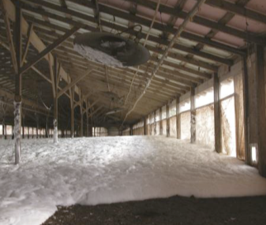
Water-Based Foam
Advantages:
  Decreased labor
  Little/no bird handling
  Decreases dust
Disadvantages:
  Water supply
  Birds must be on floor
Notes:
The advantages of water-based foam depopulation include increased speed of depopulation compared to other methods and decreased labor because fewer personnel are needed. There is little or no bird handling and the foam may reduce biosecurity risks from dust and airborne pathogens. Disadvantages of foam include the availability of copious amounts of water. Also, some advance preparation is involved because birds must be on floor and slats and other items allowing birds to be off floor must be removed. [This photo shows water-based foam being applied in a floor-housed broiler system. Photo source: Eric Benson, University of Delaware]

Slide 19
Confirmation of Death
Confirmation of death can be difficult
  Sustained lack of heartbeat and respiration
  Rigor mortis
  Evaluate by competent, experienced personnel
Notes:
Following the application of a euthanasia method, death must be confirmed. Lack of a heartbeat and respiration (at least 10 minutes) as well as onset of rigor mortis are indicators that death has occurred. Animals should be evaluated for confirmation of death by competent and experienced personnel.

Slide 20
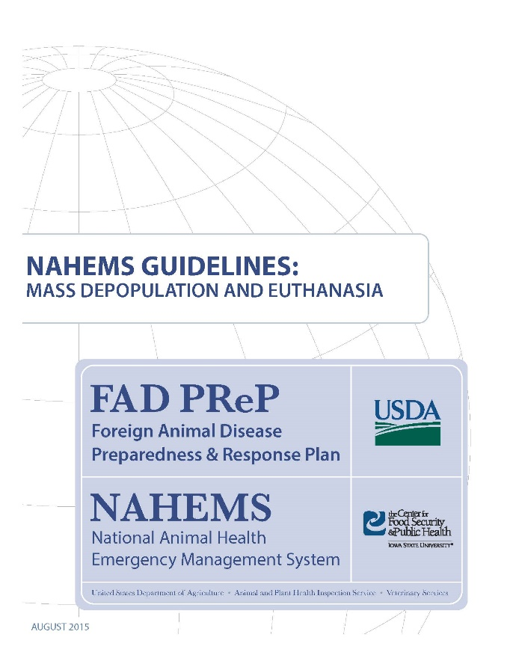
For More Information
FAD PReP/NAHEMS Guidelines: Mass Depopulation and Euthanasia (MDE) (2015)
  http://www.aphis.usda.gov/fadprep
MDE web-based training module
  http://naherc.sws.iastate.edu/
Notes:
More details can be obtained from the sources listed on the slide, available on the USDA website (http://www.aphis.usda.gov/fadprep) and the NAHERC Training Site (http://naherc.sws.iastate.edu/).

Slide 21
Guidelines Content
Authors (CFSPH):
Reneé Dewell DVM,MS
Nichollette Rider, Veterinary Student
Significant contributions to the content were provided by
USDA APHIS VS:
Lori P. Miller, PE
Darrel K. Styles, DVM, PhD
Notes:
This slide acknowledges the authors and those who made a significant contribution to the content of the FAD PReP/NAHEMS Guidelines: Mass Depopulation and Euthanasia document. Please see the Guidelines document for others who also provided additional assistance with content development.

Slide 22
Acknowledgments
Development of this presentation was by the Center for Food Security and Public Health at Iowa State University through funding from the USDA APHIS Veterinary Services
PPT Authors: Dawn Bailey, BS; Kerry Leedom Larson, DVM, MPH, PhD, DACVPM
Reviewers: Glenda Dvorak, DVM, MPH, DACVPM: Cheryl L. Eia, JD, DVM, MPH, Patricia Futoma, BS, Veterinary Student, Reneé Dewell DVM,MS
Notes:
Information provided in this presentation was developed by the Center for Food Security and Public Health at Iowa State University College of Veterinary Medicine, through funding from the US Department of Agriculture, Animal and Plant Health Inspection Service, Veterinary Services.

