Slide 1
Mass Depopulation & Euthanasia
Sheep & Goat Euthanasia
Adapted from the FAD PReP/NAHEMS Guidelines: Mass Depopulation and Euthanasia (2015)
Notes:
The purpose of this presentation is to outline general methods of sheep and goat euthanasia that may be employed in the event of an animal health emergency. This information was derived from the Foreign Animal Disease Preparedness and Response (FAD PReP)/National Animal Health Emergency Management System (NAHEMS) Guidelines: Mass Depopulation and Euthanasia (2015) and also the web-based training module.

Slide 2
Euthanasia and Depopulation
Euthanasia
Transitioning painlessly and stress-free as possible
Mass Depopulation
Large numbers, quickly and efficiently
Consideration to welfare as practicable
Terms used interchangeably here
Notes:
It is important to understand that USDA APHIS recognizes a difference between euthanasia and depopulation. Euthanasia involves transitioning an animal to death as painlessly and stress-free as possible. Mass depopulation is a method by which large numbers of animals must be destroyed quickly and efficiently with as much consideration given to the welfare of the animals as practicable. However, for the purposes of this presentation, the terms mass depopulation and euthanasia may be used interchangeably or simply be referred to as “euthanasia,” regardless of whether they are actually considered euthanasia or depopulation.

Slide 3
Euthanasia and Depopulation
May be practiced during an animal health emergency
Goals of Euthanasia
Provide humane treatment
Select acceptable method
Minimize negative emotional impact
Safeguard food chain
Prevent or mitigate disease spread
Notes:
Euthanasia and depopulation may be practiced during an animal health emergency, such as a major disease outbreak or a foreign animal disease (FAD), to help prevent or mitigate the spread of the disease through the elimination of infected, exposed, or potentially exposed animals. It also serves to remove contaminated livestock from the food supply, protect the nation‘s agricultural and national economy, and safeguard public health. The overall goals of euthanasia are to: provide humane treatment of animals at all times until they are euthanized; select and use an acceptable method of depopulation/euthanasia to be executed as quickly, efficiently, and humanely as possible; minimize the negative emotional and psychological impact on animal owners, caretakers, and the public; prevent adulterated or potentially adulterated meat products from entering the food chain; and prevent or mitigate disease spread in the event of the introduction of a FAD within the U.S.

Slide 4
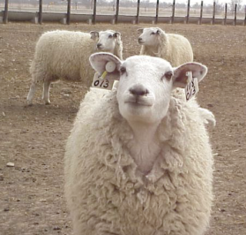
Handling
Goal: Humane Treatment
Decrease animal stress, excitement
Conveyors, tunnel electrocution system
Do not force animals to travel quickly
Avoid electric prods
Human body position
Flight zones
Flags, plastic paddles
Handle animals quietly
Notes:
One of the overall goals in conducting euthanasia is to provide humane treatment of animals at all times until they are euthanized. Decreasing stress and excitement during movement and handling will increase small ruminant welfare and increase human safety and efficiency. In large-scale depopulation efforts conveyors will likely be used to deliver small ruminants efficiently to euthanasia stations. The use of the conveyors will reduce stress and increase efficiency of euthanasia activities. If electrocution is chosen as a euthanasia method, conveyors may be modified to create a tunnel electrocution system. If a conveyor system is not used, euthanasia personnel will move the animals to the restrainer. For practical as well as humane considerations, do not force sheep and goats to travel faster than normal walking speed. Keep the use of electric prods to an absolute minimum, i.e. only used when an animal refuses to enter a restrainer or other area. Instead of electric prods or sticks, use human body position and flight zones as well as flags or plastic paddles or sticks with plastic ribbons attached to move animals. Handle sheep and goats as quietly as possible on non-slip surfaces. Restrain animals in a manner that does not elicit injury or undue pain. Animals handled in a rough or hurried manner will become excited, making further handling unnecessarily difficult. As a humane consideration, euthanize nonambulatory or disabled animals where they are and move them to the disposal site after death. [This photo shows domestic sheep. Photo source: Reneé Dewell, Iowa State University]

Slide 5
Euthanasia Methods
Acceptable (noninhalant injectable)
Barbiturates
Barbiturate derivatives
Conditionally Acceptable (physical)
Penetrating captive bolt
Gunshot
Electrocution
Carbon dioxide (sheep only)
Notes:
Acceptable and conditionally acceptable methods of euthanasia have been outlined in the American Veterinary Medical Association (AVMA) Guidelines for the Euthanasia of Animals: 2013 Edition. For small ruminants, the AVMA has stated that the use of noninhalants such as injectable barbiturates or bariturate derivatives are acceptable means of euthanasia. Conditionally acceptable methods of euthanasia for small ruminants include physical methods such as a penetrating captive bolt or gunshot. Although not considered practical for routine use and not specifically listed as acceptable by the AVMA, electrocution is also a potential euthanasia method during an animal health emergency. It requires specialized equipment and training in electrode placement as well as a source of electricity. Although not listed as acceptable by the AVMA, the Code of Federal Regulations (9 CFR Part 313: Humane Slaughter of Livestock) designates carbon dioxide as a humane method for sheep.

Slide 6
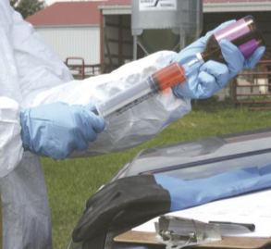
Noninhalant Injectable
Usually impractical
Slow process
Expensive
Carcass disposal
Record keeping
Consider if animal is a companion/hand raised
Notes:
The use of injectable noninhalant injectable such as barbiturates or barbiturate derivatives in sheep and goats is usually impractical, even for very small numbers of animals. The process will be necessarily slow because it requires prolonged individual handling and adequate restraint. In addition, this method is comparatively expensive and may make carcass disposal a hardship due to contaminated tissues. Unless a Drug Enforcement Agency (DEA) unscheduled product (e.g. T-61) is made available, the adoption of a protocol utilizing injectable euthanasia agents in small ruminants is unlikely. Even if carcass disposal were not an issue, the necessary record keeping and special requirements of scheduled substances is a strong deterrent. Even so, the use of injectable euthanasia agents may be a practical euthanasia method for sheep and goats in certain situations. Consider this option when animals have been hand raised (e.g., 4-H projects), particularly if the owner insists on being present during euthanasia. [This photo shows chemical euthanasia being drawn up in a single use-syringe. Photo source: Andrew Kingsbury, Iowa State University]

Slide 7
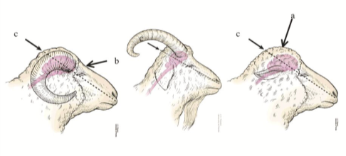
Physical- Captive Bolt
Use appropriate restraint to ensure personnel safety
Bolt positioning
Polled animal
Horned animal
Adjunct method available
Notes:
Euthanasia of caprine and ovine species by means of a penetrating captive bolt is both humane and efficient. Appropriate restraint must be used to ensure that the method is also safe for personnel. In polled sheep, one point of entry is the center of the highest point of the head with the bolt pointed straight down. In polled and horned sheep, the captive bolt may also target the area just above the eyes in the middle of the forehead. This point of entry also may be used for goat kids less than four months of age. When using this site, the operator must take care to align the captive bolt with the angle of the neck. In the case of horned sheep and goats, the captive bolt is placed immediately behind the ridge between the horns and angled to fire the bolt just slightly forward, toward the base of the tongue. Used correctly, captive bolt euthanasia produces a rapid death. However, personnel should be prepared to utilize an adjunct method if death is not immediate. The point of entry as illustrated here is the same for a free bullet, but euthanasia by gunshot has significant differences as discussed on the next slide. [This illustration shows the proper aiming point for a penetrating captive bolt or gun in a horned goat. Photo source: JK Shearer, Iowa State University]

Slide 8
Physical- Gunshot
Conditionally acceptable
Species-appropriate ammunition, appropriate caliber weapon
Proper training, skills, experience
Close range, same point of entry as captive bolt
Muzzle 2-10 inches from entry point
Mature goat brain is located much farther back than might be expected
Notes:
According to AVMA Guidelines, the use of gunshot with species-appropriate ammunition and weapons of the appropriate caliber is considered a conditionally acceptable, rather than an acceptable, method of euthanasia for small ruminants due to the potential for human injury. Gunshot should be performed only by personnel with the appropriate skills, training, and experience. Safety guidelines jointly developed and agreed to by local law enforcement and the Safety Officer should be strictly followed. For firearms used at close range, the anatomical site for entrance of the projectile is the same as for the penetrating captive bolt. The firearm should NEVER be placed in contact with the head of the animal. Hold the muzzle of the firearm 2-10 inches from the intended entry point. In mature horned sheep and goats skull ossification may deflect some projectiles. In these animals, it is necessary to be very sure that the aiming point is behind the ridge between the horns. The path of the projectile should be angled slightly forward toward the base of the tongue as described for the captive bolt weapon. It should be noted that the brain in the mature goat is much further back than might be expected. Consider the application of silencers to firearms whenever possible to reduce noise and associated stress for both animals and people. As a safety reminder, with the use of firearms for euthanasia, all nonessential personnel should be excluded from the site. Use extreme caution to avoid damage or injury to property or persons in the background beyond the animal.

Slide 9
Electrocution
If used:
Electric current through brain to stun
Ear to ear, poll to muzzle
Electric current through heart
Sides of animal over heart
Notes:
It may be difficult, and potentially dangerous, to use electrocution on caprine and ovine species in the field if adequate facilities are not available. The amount of individual handling necessary for small ruminants using current technology makes this an unwieldy technique that should only be considered if there is no other practical method available. If electrocution is used for euthanasia, the electrodes must be positioned to ensure that the electric current passes directly through the brain to achieve stunning. This can be accomplished either by positioning the electrodes from ear to ear or from poll to muzzle. It is critical that the animal is rendered unconscious before proceeding. After stunning, the electrodes should be rapidly repositioned to pass current through the heart and produce fibrillation. The electrodes should be positioned on the sides of the animal over the heart or on the dorsal and ventral regions of the body.

Slide 10
Carbon Dioxide
Acceptable, but impractical euthanasia method
Extensive infrastructure needed
Truck or tight room could be used as chamber, with careful planning
Notes:
Carbon dioxide can be used to euthanize sheep and may be presumed to be an option for goats; although use of carbon dioxide in goats is not addressed in 9 CFR 313.5. However, the extensive infrastructure necessary to handle a large number of animals makes it unlikely that this would be a suitable field method during an animal disease emergency. With careful planning, a truck or adequately tight room could be used as a chamber for carbon dioxide euthanasia.

Slide 11
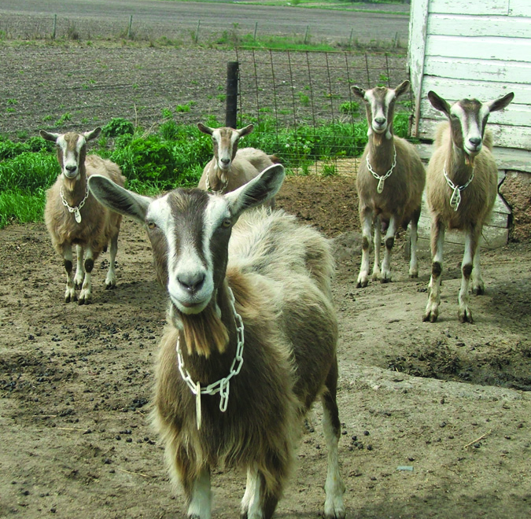
Adjunct Methods
Second shot
IV potassium chloride or magnesium sulfate
Pithing
Exsanguination
Notes:
If the primary euthanasia measure fails to cause rapid death, personnel should be prepared to immediately apply an adjunct measure. A second gunshot or application of the captive bolt is an acceptable adjunct method. The AVMA has also listed the IV injection of a saturated solution of potassium chloride or magnesium sulfate. Pithing could also be employed to ensure rapid death and prevent the possibility of a stunned animal regaining consciousness. Exsanguination is also an approved option but may present significant biosecurity risks since the disease of interest may be blood borne. With the exception of the second shot, these methods must only be used on small ruminants in a deep surgical plane of general anesthesia. [This photo shows domestic goats. Photo source: Cassi and Paul Plummer, Iowa State University]

Slide 12
Confirmation of Death
Confirmation of death can be difficult
Sustained lack of heartbeat and respiration
Rigor mortis
Evaluate by competent, experienced personnel
Notes:
Following the application of a euthanasia method, death must be confirmed. Lack of a heartbeat and respiration (at least 10 minutes) as well as onset of rigor mortis are indicators that death has occurred. Animals should be evaluated for confirmation of death by competent and experienced personnel.

Slide 13
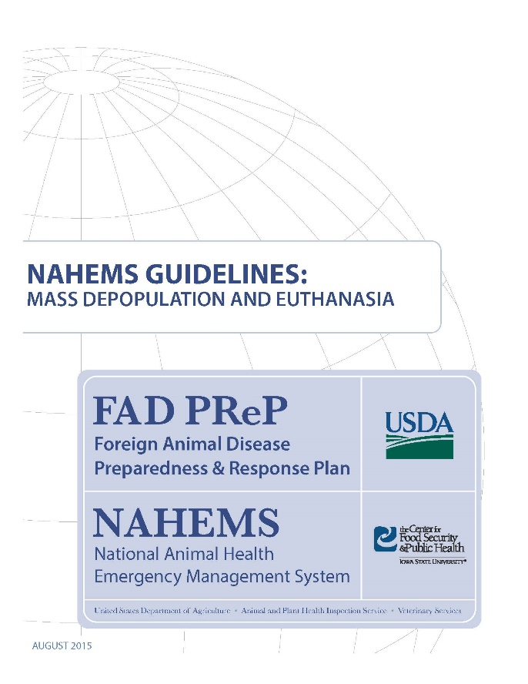
For More Information
FAD PReP/NAHEMS Guidelines: Mass Depopulation and Euthanasia (MDE) (2015)
http://www.aphis.usda.gov/fadprep
MDE web-based training module
http://naherc.sws.iastate.edu/
Notes:
More details can be obtained from the sources listed on the slide, available on the USDA website (http://www.aphis.usda.gov/fadprep) and the NAHERC Training Site (http://naherc.sws.iastate.edu/).

Slide 14
Guidelines Content
Authors (CFSPH):
Reneé Dewell DVM,MS
Nichollette Rider, Veterinary Student
Significant contributions to the content were provided by USDA APHIS VS:
Lori P. Miller, PE
Darrel K. Styles, DVM, PhD
Notes:
This slide acknowledges the authors and those who made a significant contribution to the content of the FAD PReP/NAHEMS Guidelines: Mass Depopulation and Euthanasia document. Please see the Guidelines document for others who also provided additional assistance with content development.

Slide 15
Acknowledgments
Development of this presentation was by the Center for Food Security and Public Health at Iowa State University through funding from the USDA APHIS Veterinary Services
PPT Authors: Dawn Bailey, BS; Kerry Leedom Larson, DVM, MPH, PhD, DACVPM
Reviewers: Glenda Dvorak, DVM, MPH, DACVPM: Cheryl L. Eia, JD, DVM, MPH, Patricia Futoma, BS, Veterinary Student, Reneé Dewell DVM,MS
Notes:
Information provided in this presentation was developed by the Center for Food Security and Public Health at Iowa State University College of Veterinary Medicine, through funding from the US Department of Agriculture, Animal and Plant Health Inspection Service, Veterinary Services.

