Slide 1
Mass Depopulation & Euthanasia
Overview
Adapted from the FAD PReP/NAHEMS
Guidelines: Mass Depopulation and Euthanasia (2015)
Notes:
This presentation provides an overview of topics related to emergency depopulation of livestock during an animal health emergency. [This information was derived from the Foreign Animal Disease Preparedness and Response (FAD PReP)/National Animal Health Emergency Management System (NAHEMS) Guidelines: Mass Depopulation and Euthanasia (2015).] Additional presentations addressing these issues in greater detail are also available.

Slide 2
Euthanasia and Depopulation
Prevent or mitigate disease spread
Remove contaminated livestock
Protect agriculture and national economy
Safeguard public health
Notes:
Euthanasia and depopulation may be practiced during an animal health emergency, such as a major disease outbreak or a foreign animal disease (FAD), to help prevent or mitigate the spread of the disease through the elimination of infected, exposed, or potentially exposed animals. It also serves to remove contaminated livestock from the food supply, protect the nation‘s agricultural and national economy, and safeguard public health.

Slide 3
Euthanasia Goals
Provide humane treatment
Select acceptable methods
Minimize negative emotional impact
Safeguard the food chain
Prevent or mitigate disease spread
Notes:
The goals of euthanasia are to (a) provide humane treatment of animals at all times until they are euthanized; (b) select and use an acceptable form of depopulation/euthanasia to be executed as quickly, efficiently, and humanely as possible; (c) minimize the negative emotional and psychological impact on animal owners, caretakers, and the public; (d) prevent adulterated or potentially adulterated meat products from entering the food chain; and (e) prevent or mitigate disease spread in the event of the introduction of a FAD within the U.S. Qualified personnel must be proficient in the performance of depopulation procedures using the quickest, safest, and most humane methods practicable given the circumstances. During an FAD outbreak, depopulation measures are implemented to prevent or mitigate disease spread, thus protecting the economic viability of the agricultural industry and the nation and also, if the disease is zoonotic, the health and well-being of the public.

Slide 4
Euthanasia and Depopulation
Euthanasia
  Painless and stress free as possible
Mass Depopulation
  Many animals
  Quick and efficient
  Welfare is considered
Notes:
It is important to understand that USDA APHIS recognizes a difference between euthanasia and depopulation. Euthanasia involves transitioning an animal to death as painlessly and stress-free as possible. Mass depopulation is a method by which large numbers of animals must be destroyed quickly and efficiently with as much consideration given to the welfare of the animals as practicable. However, for the purposes of this document, the terms mass depopulation and euthanasia may be used interchangeably or simply be referred to as “euthanasia,” regardless of whether they are actually considered euthanasia or depopulation. [This photo shows a group of young dairy heifers as a reminder that many animals may be involved in depopulation. Photo source: Danelle Bickett-Weddle, Iowa State University]

Slide 5
Euthanasia Group
Provides advice and recommendations
Notifies owners/operators
Coordinates with Logistics Section
Coordinates essential decisions
Notes:
The Euthanasia Group, supervised by the Euthanasia Group Supervisor has several responsibilities. The Euthanasia Group provides advice and recommendations to the Command level on euthanasia procedures. The Euthanasia Group notifies owners or operators of Infected or Contact Premises of mass depopulation or euthanasia procedures that will be used and secures acceptance for these procedures. The Euthanasia Group coordinates closely with the Logistics Section to secure the necessary equipment and supplies and coordinates essential decisions such as scheduling and location of euthanasia activities with those planned by the Disposal Group and other affiliated Groups. [This photo shows the NVRT team strategizing and organizing emergency response events. Photo source: Reneé Dewell, Iowa State University]

Slide 6
Interaction and Collaboration
Multi-group interaction
Determines depopulation methods
Extent of depopulation
Comply with AVMA and OIE when possible
Notes:
When the decision is made to depopulate, interaction and collaboration with several groups occur. The Euthanasia Group, with approval from the Epidemiology Group and State Animal Health Official, determines the method(s) of depopulation. The Epidemiology Group and the Vaccination Group also play a role in the decision to depopulate in determining the method and extent of depopulation. Whenever possible, APHIS will comply with recommendations regarding the methods and approaches used for depopulation detailed in the American Veterinary Medical Association‘s (AVMA) Guidelines for Euthanasia as well as the recommendations outlined in Chapter 7.6 of the 2009 World Organization for Animal Health (OIE) Terrestrial Animal Health Code.

Slide 7
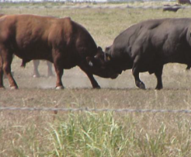
Safety Considerations
Animal size and body weight
Species temperament
Familiarity and comfort
with humans
Dangerous animals
Restraint
methods/equipment
Euthanasia methods/equipment
Notes:
Safety of the Euthanasia Group may be affected by several factors, including the size and body weight of the animals to be euthanized and the temperament of the species being euthanized. The animals’ familiarity and comfort with humans is also considered when determining safety risk, and special care and precautions must be taken if the animals are unaccustomed to being handled by humans. Animals generally regarded as being dangerous such as bulls, bison, and large boars are also given special consideration. Available equipment for animal restraint and methods must be sufficient to ensure the safety of team members. In addition, the means of restraint must facilitate the depopulation or euthanasia procedures and allow adequate time for its completion. Methods and/or equipment chosen for euthanasia is a primary concern since human safety is a primary consideration when choosing methods of depopulation or euthanasia. Hazards inherent to certain procedures such as free bullets, CO2, and electrocution should be weighed when choosing euthanasia equipment and methods. [This photo shows that large animals can be dangerous. Photo source: Reneé Dewell, Iowa State University]

Slide 8
Training and Briefings
Must be properly trained
Just-in-time training (if necessary)
Briefings
  Safety requirements
  Site conditions
  Specific tasks
Notes:
It is essential that Euthanasia Group members are properly trained in the euthanasia method(s) that will be utilized before they participate in euthanasia activities. The Euthanasia Group Supervisor must identify all Euthanasia Group members and the specific tasks for which each is responsible. If necessary, the Euthanasia Group Supervisor arranges just-in-time training for personnel. However, just-in-time training in euthanasia methods should occur only when absolutely necessary, because the techniques often require practice to master. The Euthanasia Group Supervisor will also identify specific briefings required before euthanasia activities, including safety requirements, site conditions, and specific tasks.

Slide 9
General Considerations
Humane
Aesthetic
Psychological
Documentation
Notes:
Euthanasia should take place in such a way as to minimize an animal‘s pain and stress. To meet this requirement, the animal should be rendered unconscious as quickly as possible. Essential to the fulfillment of this objective are the careful selection of the quickest, most humane euthanasia methods, and skillful use of these methods on the part of the Euthanasia Team. Public perceptions of the humaneness of the procedures used also are important and efforts should be made to educate and gain public support. Mass depopulation is emotionally draining on those whose animals are being depopulated as well as those involved with carrying out the euthanasia activities. To mitigate the negative psychological effects of involvement in mass euthanasia activities, psychological counselors should be made available to both staff and the stakeholders. Euthanasia activities must be carefully documented, particularly if the method involves the use of controlled substances. The use of controlled substances during euthanasia activities requires careful documentation and compliance with rules outlined by the Drug Enforcement Administration. [This photo shows that careful records must be maintained when using controlled substances. Photo source: Center for Food Security and Public Health, Iowa State University]

Slide 10
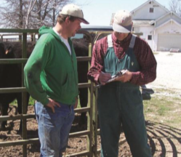
Animal Welfare Issues
Euthanasia group works to:
  Ensure animals are appropriately housed, maintained, euthanized
  Consult on animal welfare issues
  Make effort to comply with counsel of APHIS Animal Welfare personnel
Notes:
The Euthanasia Group should work closely with welfare experts within the USDA as well as industry welfare experts on all aspects of euthanasia related to animal welfare. Guidance documents such as the American Veterinary Medical Association Guidelines for the Euthanasia of Animals may also provide valuable information. Expertise within the USDA will likely include qualified Veterinary Medical Officers and field personnel with training in animal welfare and depopulation procedures. These individuals may serve in an advisory capacity to ensure that animals are appropriately housed, maintained, and depopulated or euthanized humanely. The Euthanasia Group should make a concerted effort to comply with the counsel of APHIS Animal Welfare personnel when it is reasonable and practical to do so. [This photo shows a veterinarian talking with a producer on-site. Photo source: Danelle Bickett-Weddle, Iowa State University]

Slide 11
Methods
Physical
  Often preferred
  Must be skilled
  Requires extreme caution
Chemical
  Often not practical
  For unique circumstances
  Positive public perception
Notes:
Two main methods of euthanasia will be considered in the event of an animal health emergency. They are physical methods and chemical methods. Physical methods are an appropriate, and often a preferred, method of mass euthanasia. Personnel using such methods should be skilled in the physical technique or experienced in the use of the equipment. Extreme care should be exercised in performing procedures to prevent harm to the operator or others in the immediate area. In most cases the use of chemical methods to euthanize livestock during an animal health crisis is not practical because of the residue potential if carcasses must be rendered. This method should be considered only for unique circumstances such as euthanasia of pet livestock. The use of chemical methods is often perceived as being more refined and humane than the physical techniques. [These photos show two types of penetrating captive bolt guns commonly used as a physical method of euthanasia, particularly in slaughter facilities. Photo source: JK Shearer, Iowa State University]

Slide 12
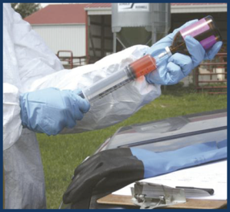
Methods (cont’d)
Physical
  Captive bolt
  Gunshot
  Blunt Trauma
  Electrocution
Chemical
  Noninhalants
  Inhalants
Notes:
Physical methods that would be primarily considered for euthanasia include the use of captive bolts, gunshot, manually applied blunt trauma, and electrocution. Adequate training for inexperienced personnel and a clear demonstration of proficiency should be required before they are permitted to use an unfamiliar euthanasia method. Chemical methods of euthanasia are often classified as noninhalants and inhalants. Noninhalant chemical euthanasia methods are often administered intravenously (IV). Any product to be used for lethal injection must be recognized as an effective and humane option. Barbiturate anesthetic agents meet these criteria and are the principle drugs used in several of the injectable euthanasia agents currently available. When considering barbiturates for mass euthanasia, cost and issues related to carcass disposal may be a significant deterrent for large animals. Inhalants may include anesthetic gas as well as carbon dioxide, carbon monoxide, argon and nitrogen. [This photo shows chemical euthanasia being drawn up in a single use-syringe. Photo source: Andrew Kingsbury, Iowa State University]

Slide 13
Method Selection
Available personnel
Disease
Safety
Biosecurity issues
Compatibility
Premises location
Number of animals
Notes:
For each depopulation/euthanasia situation, criteria for selecting the optimal method of depopulation/euthanasia should include several factors. Among these factors are consideration for the training, experience, and expertise level of available personnel for the proposed euthanasia method. The virulence, disease pathogenesis, zoonotic potential, and personnel safety in implementing the proposed euthanasia method should be considered when planning and selecting a euthanasia method. Potential biosecurity issues associated with the proposed method and the compatibility with the situation‘s requirements and purpose should also be considered. Premises location and the number of animals to be euthanized also figure into determining the best depopulation method.

Slide 14
Method Selection (cont’d)
Psychological effect
Location/size/weight/species
Facilities
Post-euthanasia plans
Notes:
Potential negative psychological effect of the method on personnel, owners, and observers should also be considered when choosing a euthanasia method. The location, size, weight and species of the animals to be euthanized should also figure into the decision. In addition, the availability of facilities - including adequate means of animal restraint is an important consideration. Compatibility of the proposed euthanasia method with subsequent plans for evaluation, examination, carcass disposal, or use of animal tissue must also be considered when selecting a euthanasia method.

Slide 15
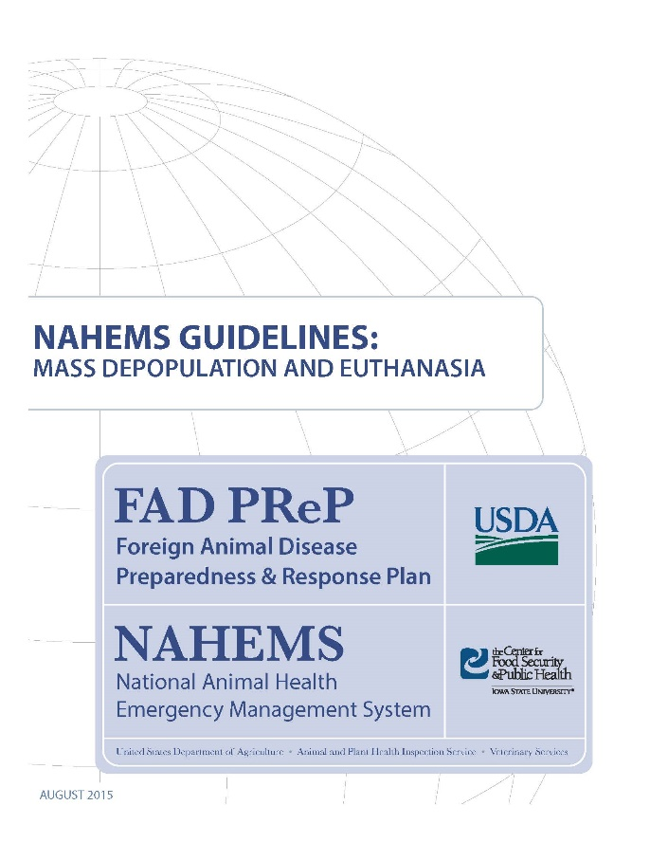
For More Information
FAD PReP/NAHEMS Guidelines: Mass Depopulation and Euthanasia (MDE) (2015)
  http://www.aphis.usda.gov/fadprep
MDE web-based training module
  http://naherc.sws.iastate.edu/
Notes:
More details can be obtained from the sources listed on the slide, available on the USDA website (http://www.aphis.usda.gov/fadprep)
and the NAHERC Training Site (http://naherc.sws.iastate.edu/).

Slide 16
Guidelines Content
Authors (CFSPH):
Reneé Dewell DVM,MS
Nichollette Rider, Veterinary Student
Significant contributions to the content were provided by
USDA APHIS VS:
Lori P. Miller, PE
Darrel K. Styles, DVM, PhD
Notes:
This slide acknowledges the authors and those who made a significant contribution to the content of the FAD PReP/NAHEMS Guidelines: Mass Depopulation and Euthanasia document. Please see the Guidelines document for others who also provided additional assistance with content development.

Slide 17
Acknowledgments
Development of this presentation was by the Center for Food Security and Public Health at Iowa State University through funding from the USDA APHIS Veterinary Services
PPT Authors: Dawn Bailey, BS; Kerry Leedom Larson, DVM, MPH, PhD, DACVPM
Reviewers: Glenda Dvorak, DVM, MPH, DACVPM: Cheryl L. Eia, JD, DVM, MPH, Patricia Futoma, BS, Veterinary Student, Reneé Dewell DVM,MS
Notes:
Information provided in this presentation was developed by the Center for Food Security and Public Health at Iowa State University College of Veterinary Medicine, through funding from the US Department of Agriculture, Animal and Plant Health Inspection Service, Veterinary Services.

