Slide 1
Wildlife Management and Vector Control for an FAD Response in Domestic Livestock
Developing a Wildlife Management Plan
Adapted from the FAD PReP/NAHEMS
Guidelines: Wildlife Management and Vector Control for an FAD Response in Domestic Livestock
Notes:
In order to effectively control, contain, and eradicate a foreign animal disease (FAD) in domestic livestock, the response effort must consider the role that wildlife may play in disease transmission. In the event that wildlife play a role in an FAD outbreak, the Animal and Plant Health Inspection Service (APHIS), will cooperate with Federal, State, and Tribal agencies that have primary jurisdiction over wildlife. Managing wildlife during an FAD outbreak is critical to controlling the spread of the disease agent. Developing a good management plan for wildlife as well as vector control can improve the effectiveness of FAD control and eradication measures. This presentation is guidance only, and does not provide prescriptive procedures. [This information was derived from the Foreign Animal Disease Preparedness and Response (FAD PReP)/National Animal Health Emergency Management System (NAHEMS) Guidelines: Wildlife Management and Vector Control for an FAD Response in Domestic Livestock.]

Slide 2
This Presentation
Developing a management plan
for wildlife
  Epidemiology
  Ecology
  Resources
  Socio-political
Controlling vectors to spread diseases
Other ongoing activities
Notes:
This presentation will discuss the considerations when developing a management plan for wildlife, including epidemiology, ecology, resources, and socio-political factors, as well as controlling vectors that could spread the disease agent. Other ongoing response activities that intersect with wildlife management and vector control activities will also be briefly reviewed.

Slide 3
General Considerations in Plan Development
Notes:
In outbreak situations involving wildlife, Incident Command, in coordination with the Wildlife Cell and Vector Control Group, will need to develop a wildlife management plan. The decision to implement control measures in wildlife will be based not only on the risk assessment and surveillance, but also the feasibility of conducting successful control measures. This presentation begins with some general considerations in developing a plan. In all cases, the wildlife management plan must be conducted in compliance with local laws and regulations.

Slide 4
Objectives
Short-term
  Containing, controlling outbreak in domestic livestock
Long-term
  Eradicate FAD
Unintended consequences
  Animal welfare, occupational health, chemical use, environment, non-targeted animals/species, public opinion
Demonstrating disease freedom
  If required for OIE-free status/trading partners
Notes:
In the short term, the foremost objective is to contain and control the outbreak in domestic livestock. However, in the longer-term, depending on the FAD, the objective may be to eradicate the FAD from the wildlife species. This may require extended wildlife management activities, including activities such as containment and reduction of wildlife populations so the disease can no longer persist; elimination of populations; or vaccination to reduce the spread of infection. In all cases, the implications of short-term and long-term unintended consequences needs to be considered, such as animal welfare, occupational health, use of chemicals, environmental damage and/or contamination, effects on non-targeted animals, presence of threatened or vulnerable species, and views of local citizens and animal owners. The wildlife management plan should specify whether demonstrating freedom from the FAD in wildlife is required for OIE-free status, and, if so, how to demonstrate freedom from disease in wildlife to national and international standards and to trading partners.

Slide 5
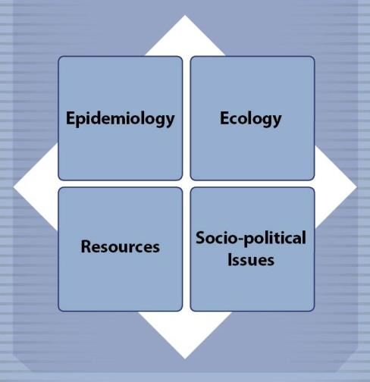
Factors to Consider
Epidemiology
  Study distribution of disease
  Data, observations of animals
Ecology
  Location, habitat, seasonal social/feeding behavior
Resources
  Availability, personnel, equipment
Socio-political
  Economy, law, regulation,
  public opinion, safety
Notes:
The epidemiological factors are critically important in creating a wildlife management plan for an incident. Such factors include the transmission pathways of the disease, the epidemiological importance of wildlife, disposal issues, and availability of veterinary countermeasures. However, other factors are also critically important to consider in the development of a wildlife management plan:
Epidemiology: the study of the distribution of disease in populations and of factors that determine its occurrence. Investigations involve observing animal populations and making inferences from data and observations.
Ecology: the location(s) of the disease outbreak, and habitat for wildlife. The season may also be important in terms of social and feeding behavior. Additionally, the presence of other susceptible species in the area, and the likely movement of susceptible animals should be considered. The current density of the wildlife population, as well as vulnerabilities should be weighed.
Resources: the availability of resources to complete the outbreak response should be fully evaluated. Depending on the scope and activities, the benefits and costs of properly trained personnel and needed equipment should be considered.
Socio-political Issues: issues such as the local, regional, and national economy may play a role in the wildlife management plan. Law, regulation, policy guidance at various jurisdictional levels, public opinion, and public safety should also be considered.
[This graphic shows factors to consider when developing a wildlife management plan. Graphic illustration by: Kate Harvey, Iowa State University]

Slide 6
Personnel - Hazards
Trained/experienced personnel
Safety Officer - safe work procedures
Potential hazards
  Physical
  Environmental
  Psychological
  Zoonotic diseases
  Avoid unnecessary exposure/use PPE
  Report unsafe working conditions
Notes:
Effective planning will specify the personnel and equipment needed, the locations in which activities will be conducted, and protocols for responder safety. All personnel involved in wildlife management activities should be properly trained, and fully understand biosecurity and safety requirements. Potential exposure to physical, environmental, and psychological hazards will depend on the type of activities required, the location and time of year. While protecting the health and safety of response personnel is everyone’s responsibility, the Safety Officer’s duties include identifying current and potential hazards, establishing and training responders on safe work procedures, and preparing a Health and Safety Plan specific for the incident. Potential hazards include:
Physical: bites, kicks, slips, trips or falls, fatigue, and repetitive motion injuries.
Environmental: extremes in weather and temperatures, and insect vectors.
Psychological: long unusual hours, physical demands and emotional stress.
In addition, some FADs are also zoonotic diseases (transmissible between animals and humans). Responders should avoid unnecessary exposure to all hazards and use protective measures, including personal protective equipment (PPE) to reduce the risks, especially if the FAD is zoonotic. Vaccinations for wildlife responders may be indicated, depending on the risk and the FAD, but may also include protection against endemic wildlife diseases like rabies. Report injuries, accidents, or unsafe working conditions to the Safety Officer.

Slide 7
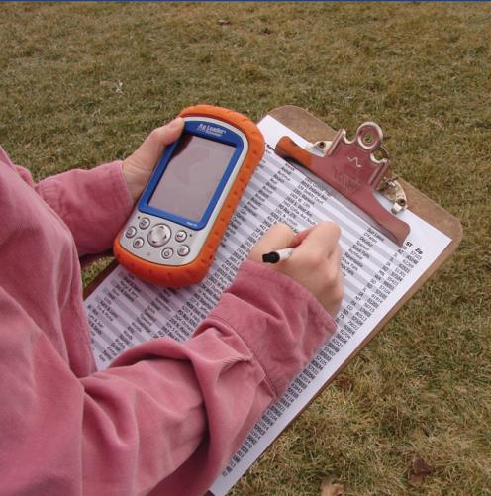
Equipment, Information Reporting
Required equipment
  Depends on specific situation, conditions
  Nothing unessential
  Biosecurity, cleaning and disinfection, safety, proficiency
  Compliance with laws
Information reporting
  Collect, manage, store,
  analyze, disseminate
Notes:
Required equipment will vary, and depend on the location, scale of the incident, species involved, activities conducted, and the specific conditions. Equipment may include traps, cages, tranquilizer guns, firearms, and items such as laptops, GPS units, cell phones, and sample collection and/or packing materials. Any unessential equipment should not enter an affected area. Equipment for use in fieldwork should be disposable when possible, packaged in pre-planned supply kits, and easy to clean and disinfect. Personnel should be aware of biosecurity measures (including, but not limited to, cleaning and disinfection), safety concerns, and be proficient in using equipment required for their activities. Utilizing trucks, boats and all-terrain vehicles may require special training, as well as thorough decontamination. The use of all equipment (sedation agents, firearms, vehicles) should be in compliance with local laws and regulations. A wildlife management plan also needs to consider how information collected during the population surveys, surveillance, diagnostic testing, and any control measures is to be managed, stored, analyzed, and disseminated to appropriate personnel throughout the relevant authorities. The preparation of routine reports, at intervals as specified by the Incident Commander, is an important part of developing and executing a wildlife management plan. [This photo shows a person holding a GPS unit and recording data. Photo source: Danelle Bickett-Weddle, Iowa State University]

Slide 8
Vector Control in an FAD Outbreak in Domestic Livestock
Notes:
Vector control is an important consideration and component for an FAD response. Many FADs that are spread by arthropod vectors (e.g., biting midges, mosquitoes, ticks, and flies) affect domestic livestock as well as wildlife species. Vectors can transmit disease over relatively large distances, significantly complicating disease control efforts. Disease transmission by arthropod vectors can occur by mechanical or biological means. Mechanical transmission involves the transfer of a pathogen by an external body part (e.g., legs) of the vector; the pathogen remains unchanged (i.e., does not replicate or develop further). Most species of flies serve as mechanical vectors. Biological transmission involves the alteration of the pathogen within the vector. The vector uptakes the pathogen–usually through a blood meal from an infected animal–and the pathogen undergoes further development or replication within the arthropod vector before being transferred to a susceptible animal, usually through a bite. Midges, ticks, and mosquitoes are common biological disease vectors. Additionally, myiasis—the infestation of the skin or wounds by fly larvae—can also be of great economic concern and can affect wildlife and domestic livestock.

Slide 9
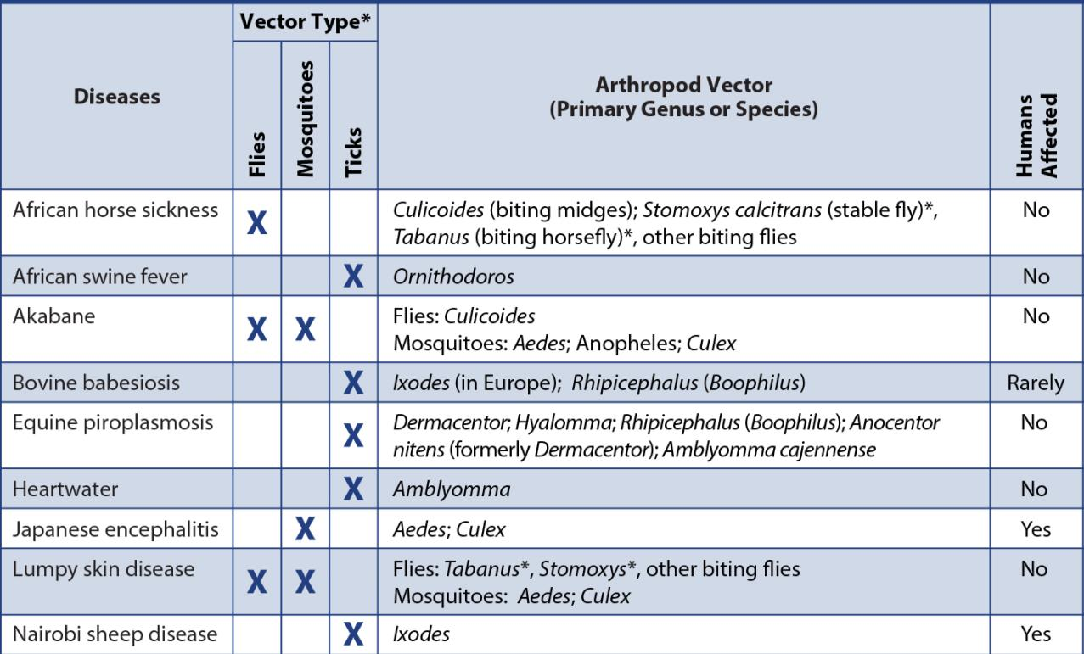
Vector-Borne Diseases
Notes:
This table lists key vector-borne diseases which may affect domestic and wildlife populations in the United States. This table does not imply that there is evidence of vector competence in the United States for these agents; it is solely to provide information about these FAD threats. In some cases, the competence of North American vectors to carry these diseases may not be established. While most of the arthropod genera listed in the table are found in North America, Hyalomma ticks and Old World and New World screwworms are not found in the United States, Mexico, or Canada. Other means of transmission for the listed FADs, such as direct contact, or ingestion may also be possible.

Slide 10
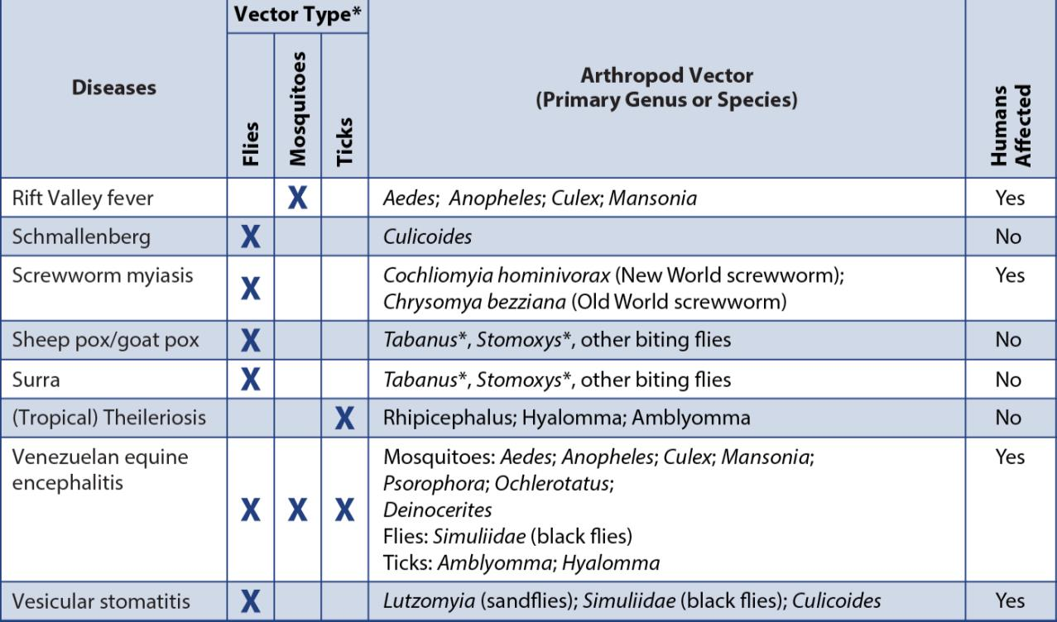
Vector-Borne Diseases cont’d
Notes:
The table on this slide is an extension of the one on the previous slide that discusses vector-borne diseases.

Slide 11
Authority for Vector Control
Local authorities
Public health leads for human health
  APHIS coordinates on control strategies
Pesticides registered with EPA, FIFRA
  And possibly States
APHIS collaborates with CDC in vector-borne FAD outbreaks which involve public health
Notes:
In the United States, vector control is primarily left to the discretion of county or municipal governments; public health departments typically take the lead on vector control issues affecting human health. In an FAD outbreak involving arthropod vectors, APHIS will coordinate and collaborate with these agencies and entities to implement vector control strategies. Personnel with appropriate skills and experience in vector control are likely to be incorporated. Pesticides used in the United States to control arthropod vectors are registered and licensed through the Environmental Protection Agency (EPA) under its authority from the Federal Insecticide, Fungicide, and Rodenticide Act (also known as FIFRA). States may also register or license pesticide products. In vector-borne FAD incidents, which also involve public health (especially mosquito-borne diseases), APHIS will collaborate with the Centers for Disease Control and Prevention who works closely with State and local health departments.

Slide 12
Methods of Vector Control
Prevent, eliminate vector populations
Understand life cycle and relationship to host and pathogen
More efficient to control egg, larva
than adult
Focus on habitat reduction, minimizing contact, chemical
control, biological control
Notes:
Vector control focuses on measures to prevent or eliminate vector populations and begins with an understanding of the arthropod’s life cycle as well as the vector-pathogen-host relationship. Arthropod life stages (e.g., egg, larvae, pupae, adult) vary and the control approach for one species may not work for another. Additionally, different control measures may be needed to target a particular life stage of the vector for greater effectiveness. Understanding the vector life cycle can aid in better design of vector management and control programs. Controlling the egg and larval stages is generally more efficient than controlling adults. Vector control measures generally focus on four measures: habitat reduction, minimizing contact, chemical control, and biological control. Personnel with the appropriate skills and experience in vector control issues would be integrated into the Incident Command structure for an FAD response effort in domestic livestock.

Slide 13
Methods of Vector Control cont’d
Habitat reduction
  Change vector-required conditions
Minimizing contact
  Limit exposure to habitat or during activity
Chemical control
  Supplemental measure
  Apply to vector habitat, to animal, or
  feed as insect growth regulators
  Biological control
  Release agents or natural predators
Notes:
Vector control, in an effort to reduce the spread of a vector-borne FAD, may involve one or more of these four methods.
Habitat Reduction: disrupting, eliminating or reducing specific conditions required by the vector to breed or develop can reduce population growth. Examples include minimizing stagnant water, agitating water sources, mowing vegetation, or disposing of manure or organic material.
Minimizing Contact: limiting animal exposure to arthropod vectors or their habitats can reduce infection risks. Excluding access of livestock (or wildlife) to vector habitat areas or avoiding exposure during peak vector activity times are examples.
Chemical Control: insecticides and chemicals may be some important (although least efficient) methods of vector control. Most often used as supplemental measures, some products are used in vector habitat areas, while others may be applied directly to animals. Additionally, insect growth regulators can be feed additives used to disrupt the life cycle of some vectors by making manure inhospitable to larval development. Proper precautions must be used when handling or applying them; some can be harmful or deadly to humans. It is a violation of State and Federal Law to use a pesticide in a manner that differs from the product label. Use only according to label directions to preserve efficacy, and to avoid meat or milk residue hazards, environmental damage, and animal or human injury. Examples include environmental sprays, pour-ons, and ear tags.
Biological Control: biological agents or natural predators for the vectors may reduce vector populations. Examples include bacterial toxins (e.g., Bacillus thuringiensis), mosquitofish, parasitic wasps, dung beetles that feed on arthropod larvae, or the release of sterilized male screwworms that reduce breeding of these flies in efforts to control this vector.

Slide 14
Arthropod Vectors of FADs
Biting midges
  Also called “no-see-ums”, blood feeders
  Require moisture for larvae, pupae
  Limit moist areas, use insecticide mist
Mosquitoes
  Require moisture for larvae, pupae
  Eliminate standing water, reduce
  weeds, stock fish
  Only use approved larvicides
Notes:
The Vector Control Group, as part of Operation Section, would assess the involvement of arthropod vectors and the actions needed to control and prevent the further spread of the FAD agent.
Biting Midges, also called no-see-ums, are a Family (Ceratopogonidae) of small flies. The blood feeding species Culicoides are important vectors of several FADs. Adult midges lay eggs on wet, organic matter. The moisture is required to keep the larvae and pupae alive; therefore, minimizing moist areas can significantly reduce the number of biting midges in an area. If possible, animals should be housed at least 2 miles from moist areas. Fine insecticide mists can be used to kill adult biting midges but typically need to be applied daily to be effective.
Mosquitoes are in the Family Culicidae. There are about 200 different species of mosquitoes in the United States, all of which live in specific habitats, exhibit unique behaviors, and bite different species of animals. Mosquitoes in the genera Aedes, Anopheles, and Culex can transmit a number of FADs to livestock and wildlife species. All mosquitoes require water to complete their life cycle. Most eggs hatch within 48 hours. Both the larvae and pupae live in the water and feed on organic matter in the water. The best way to control mosquitoes is to remove potential egg laying sites–standing water. Drain any containers or structures (e.g., barrels, old tires) that may trap water. Reduce weeds and other vegetation that may shelter mosquitoes during the day. In areas with ponds, stocking mosquito-eating fish can reduce mosquito numbers. Only approved larvicides should be used, but should not be applied to moving water sources (e.g., streams).

Slide 15
Arthropod Vectors of FADs cont’d
Ticks
  Arachnids, persistent blood suckers
  Feed for long periods, transmitting diseases
  Hard ticks, soft ticks
  Mow vegetation around buildings
Flies
  Require moisture for eggs
  Control wet areas
  Residual sprays, strips, tapes, traps
Notes:
Ticks are important as FAD vectors. Classified as arachnids (vs. insects), they are highly efficient at transmitting several diseases, in part because they are persistent bloodsuckers. Ticks prefer vegetation and are able to live for many years, even under unfavorable environmental conditions. Ticks have a wide host range and may feed on several different species throughout their lifetime. They attach and feed for long periods of time, which allows the pathogen to enter the host, as well as extends the time and distance that the ticks are transported by the host. Hard ticks (Family Ixodidae) are responsible for the transmission of the majority of tick-borne diseases in the United States. Soft ticks (Family Argasidae), in particular the genus Ornithodoros, are vectors for the African swine fever virus. Livestock should be examined regularly for the presence of ticks. Mowing vegetation and removing leaves and brush from around buildings can aid in reducing these vectors. Many chemical pour-on and spray products are also available.
Flies belong to Order Diptera. Several biting fly genera, including Tabanus spp. (horse flies), Chrysops (deer flies), Stomoxys (stable flies), as well as species in the Family Simuliidae (black flies), are important mechanical vectors for FADs. Like the biting midge, adult flies prefer to lay eggs on wet organic matter. Wet bedding, spilled feed, lagoons, and manure around feeders must be disturbed to prevent fly eggs from hatching; insecticides are commonly used to control flies. Residual sprays are also available and can be applied to surfaces where flies rest, killing them through contact. Fly strips or tapes, and fly traps are environmental control options aimed at reducing adult fly populations.

Slide 16
Other Response Activities
Notes:
Many other critical activities will be ongoing at the same time as wildlife management and vector control activities as part of an FAD response. Many of these activities will intersect with wildlife management and vector control activities; there may be competing interests and priorities during the response effort. Resources need to be allocated appropriately, based on the goals and stated objectives of the outbreak response.

Slide 17
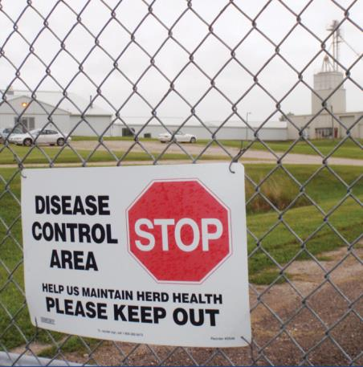
Quarantine and Movement Control
Control Area established by Incident Command
  Infected Zone+Buffer Zone
Personnel, wildlife, product movement must adhere to guidelines
Extensive mitigation activities for wildlife reservoirs in Control Area
Notes:
Upon detection of an FAD in livestock, a Control Area will be established by Incident Command. This includes the Infected Zone plus the Buffer Zone. In the event that wildlife are involved in the FAD outbreak in domestic livestock, hunting and other activities, such as field trials, should be identified to determine the risk. Wildlife personnel and any wildlife or wildlife product physically transported by personnel must adhere to the quarantine and movement control guidance provided by Incident Command. As stated in VS Memo 573.1, interstate movement requirements for livestock and/or poultry, including captive animals, should require States or zones with known wildlife reservoirs of the causative agent to conduct more extensive mitigation activities than States or zones of equivalent status that do not have a wildlife reservoir.
[This photo shows a biosecurity sign hanging at the perimeter of a response site. Photo source: Alex Ramirez, Iowa State University]

Slide 18
Health, Safety, Communication
Health, Safety - PPE
  Personnel safety is critical
  Protect from zoonotic, physical, environmental, psychological hazards
Communication
  Public support necessary
  Many groups affected by FAD outbreak
  Public Information Officer handles media, public statements
Notes:
Health and Safety
As discussed previously, the health and safety of responders is critically important in an FAD outbreak. Responders must be protected from zoonotic diseases, physical hazards such as scratches and kicks, environmental hazards such as severe weather, as well as psychological hazards such as anxiety caused by depopulation activities. The donning of personal protective equipment (PPE) may also be necessary depending on the FAD at hand.
Communication
Public support for FAD response activities is essential for success. The general public, including various constituency groups such as consumptive and non-consumptive wildlife users, sport-hunting interests, farmers, and animal welfare activists, will be affected by an FAD outbreak. The Public Information Officer will be responsible for providing information to the general public and the media, and making any public statements. Specific information to justify wildlife response activities to media outlets will be developed by Incident Command, specifically the Public Information Officer in coordination with the Wildlife Cell and Vector Control Group.

Slide 19
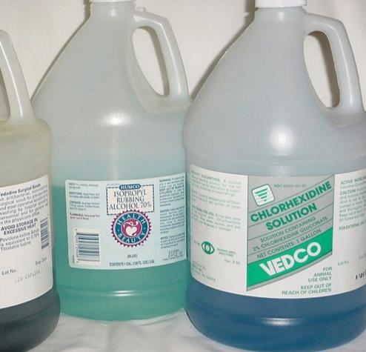
Biosecurity, C&D
Biosecurity
  Prevent FAD introduction
  Standard practice
Cleaning and disinfection
  Procedures remove, inactivate, reduce, destroy disease agents
  Apply to personnel, vehicles, equipment, supplies
Notes:
Biosecurity
Biosecurity measures in an FAD response, work to prevent the introduction of the FAD to naïve animals. Biosecurity measures are also implemented as standard practice, to ensure diseases are not transmitted onto or off of premises. All personnel involved in wildlife management need to follow Incident Command’s procedures.
Cleaning and Disinfection
Cleaning and disinfection (C&D) procedures are used to remove, inactivate, reduce, or destroy contagious agents from contaminated premises, equipment, and vehicles in order to prevent the spread of pathogens. Cleaning and disinfection procedures may vary according to the FAD agent. Cleaning and disinfection policies and procedures will apply to all personnel, vehicles, equipment, and supplies.
[This photo shows several containers of disinfectant solution. Photo source: Carla Huston, Mississippi State University]

Slide 20
Euthanasia/Depopulation
May be necessary
Treat humanely at all times
Reduce pain, distress to
greatest extent
Use accepted methods for
euthanasia
Follow proper carcass
disposal protocols
Notes:
Euthanasia or depopulation of domestic livestock or poultry may occur in an FAD response. All animals subject to euthanasia or depopulation procedures must be provided with humane treatment at all times until animals are euthanized or depopulated. Regardless of the method selected, efforts to reduce pain and distress to the greatest extent possible should be taken. Only use humane, accepted methods for animal euthanasia and depopulation. Always follow proper carcass disposal protocols for the disease agent, taking local ordinances in to consideration.

Slide 21
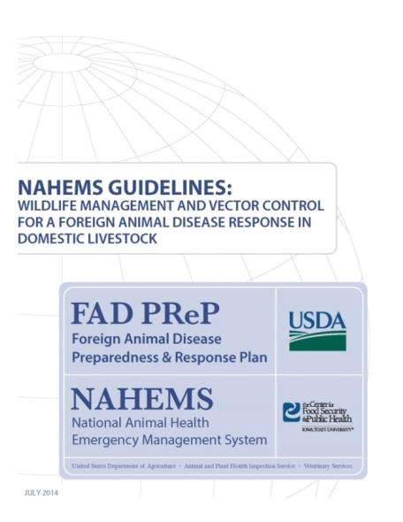
For More Information
FAD PReP/NAHEMS Guidelines: Wildlife Management and Vector Control for an FAD Response in Domestic Livestock
http://www.aphis.usda.gov/fadprep
Wildlife Management and Vector Control web-based training module
  http://naherc.cfsph.iastate.edu/
Notes:
More details can be obtained from the sources listed on the slide, available on the USDA website (http://www.aphis.usda.gov/fadprep) and the National Animal Health Emergency Response Corps (NAHERC) Training Site (http://naherc.cfsph.iastate.edu/).

Slide 22
Guidelines Content
Authors (CFSPH)
Glenda Dvorak, DVM, MS,
MPH, DACVPM
Nicole Seda, BS
Meghan Blankenship, BS
Heather Allen, PhD, MPA
Contributor (USDA)
Jonathan Zack, DVM
Notes:
The print version of the Guidelines document is an excellent source for more detailed information. In particular, the Guidelines document has listings of additional resources. This slide acknowledges the Guidelines’ authors and contributor. It can be accessed at http://www.aphis.usda.gov/fadprep.

Slide 23
Guidelines Content
Reviewers (USDA)
Randall Levings, DVM, MS
Randall Crom, DVM
Michael Messenger, PhD
Michael David MS, VMD, MPH
Wildlife Disease Steering Committee
Subject Matter Experts
Claudio L. Afonso
Samantha Gibbs, DVM, PhD
D. Scott McVey, DVM, PhD, DACVM
David Suarez, DVM
Notes:
This slide acknowledges those who assisted in the development of the print version of the Guidelines document.

Slide 24
Acknowledgments
Development of this presentation was by the Center for Food Security and Public Health at Iowa State University through funding from the USDA APHIS Veterinary Services
PPT Authors: Abbey Smith, Student Intern; Janice Mogan, DVM
Reviewers: Glenda Dvorak, DVM, MPH, DACVPM; Heather Allen, PhD, MPA
Notes:
Information provided in this presentation was developed by the Center for Food Security and Public Health at Iowa State University College of Veterinary Medicine, through funding from the US Department of Agriculture, Animal and Plant Health Inspection Service, Veterinary Services.

