Slide 1
Wildlife Management and Vector Control for an FAD Response in Domestic Livestock
Wildlife Management
Adapted from the FAD PReP/NAHEMS
Guidelines: Wildlife Management and Vector Control for an FAD Response in Domestic Livestock
Notes:
In order to effectively control, contain, and eradicate a foreign animal disease (FAD) in domestic livestock, the response effort must consider the role that wildlife may play in disease transmission. In the event that wildlife play a role in an FAD outbreak, the Animal and Plant Health Inspection Service (APHIS), will cooperate with Federal, State, and Tribal agencies that have primary jurisdiction over wildlife. This presentation is not intended to be prescriptive or to provide procedural direction to personnel performing wildlife activities. Simply, this presentation provides general information on wildlife management for an FAD outbreak in domestic livestock. [This information was derived from the Foreign Animal Disease Preparedness and Response (FAD PReP)/National Animal Health Emergency Management System (NAHEMS) Guidelines: Wildlife Management and Vector Control for an FAD Response in Domestic Livestock.]

Slide 2
This Presentation
Wildlife management
  Assess wildlife involvement
  Carry out disease surveillance
  Contain, control susceptible wildlife to prevent disease spread
  Demonstrate freedom from disease
  in wildlife, as needed
Notes:
This presentation discusses how wildlife involvement will be assessed and the various activities that may occur during wildlife management in an FAD outbreak. The management of wildlife species during an FAD outbreak in livestock or poultry will involve four steps (adapted from AUSVET, 2011). The extent to which activities will be carried out under each of these four steps will depend on the specific outbreak situation; the order of the steps may be changed, and activities may occur simultaneously.
These steps include:
Assessing the extent of wildlife involvement
Carrying out disease surveillance in wild animals
Containing and controlling susceptible wildlife to prevent the further transmission of the disease
Demonstrating freedom from disease in wildlife, as needed.

Slide 3
Wildlife Management
APHIS coordinates with agencies with jurisdiction
Resource constraints
Simultaneous activities
Varying feasibility
Success depends on:
  Species, animal density/distribution, topography, practicality
Notes:
In an FAD outbreak in domestic livestock, APHIS will coordinate with agencies that have primary jurisdiction over wildlife in a Unified Command. Some of these agencies have specific response guidance of how to manage various disease agents in wildlife. Many activities will be competing for resources in the event of an FAD outbreak, and many activities will need to be ongoing simultaneously in order for effective control, containment, and eradication of the disease. Wildlife management and control measures may have varying feasibility, and the likelihood of their success will depend on the species involved, animal density, geographic distribution, topography, and the practicality of needed measures.

Slide 4
Assessment of Wildlife Involvement
Notes:
The first step of wildlife management is to assess the involvement of wildlife in an FAD outbreak. The epidemiological situation will need to be assessed by the Planning Section and Operations Section within the Incident Command System to determine the level of risk of infection and transmission of the targeted pathogen by wildlife.

Slide 5
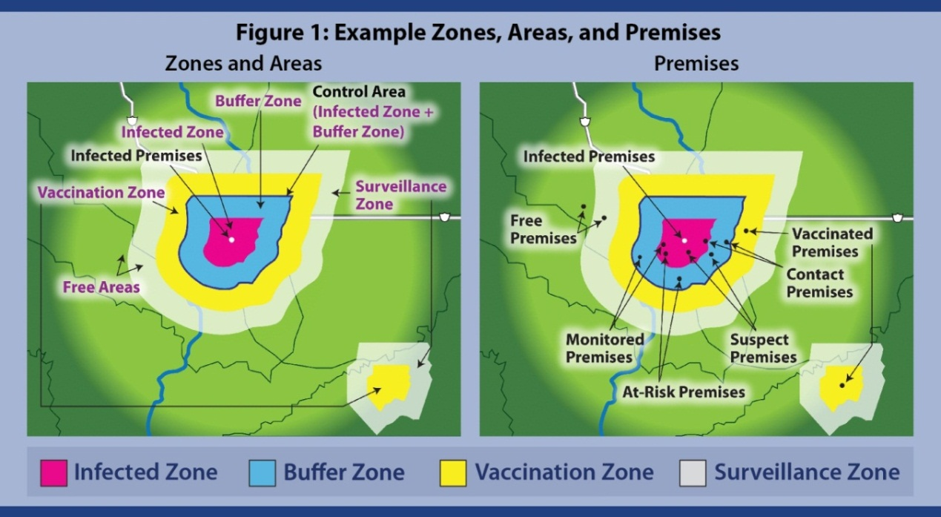
Zone, Area, and Premises Designations
Determine level of infection risk, transmission
Notes:
The epidemiological assessment will focus on the regulatory Control Area surrounding an Infected Premises. The maps on this slide illustrates the zones, areas, and premises designations to be used in an FAD outbreak. As seen in this illustration, the Control Area is made up of the Infected Zone (center dark pink) and the Buffer Zone (surrounding light blue). [This graphic shows an example of standardized zones, areas and premises designations to be used in an FAD outbreak. Zone illustration provided by: USDA; Graphic illustration by: Dani Ausen, Iowa State University]

Slide 6
Assessment Parameters
Assess which wildlife species exist in Control Area
Determine infection and risk
Considerations
  Species present
  Susceptibility of wildlife to FAD
  Potential spread of disease agent
  Level of exposure and interaction
Notes:
Epidemiologists will need to quickly assess which wildlife species exist in the Control Area and determine whether they are infected with the FAD or pose a risk for disease transmission to domestic animals. Many factors will be considered by epidemiologists and Incident Command, including which wildlife species are present, the susceptibility of the wildlife species to the FAD, their potential to spread the disease agent, and the level or likelihood of exposure and interaction between wildlife and domestic livestock.

Slide 7
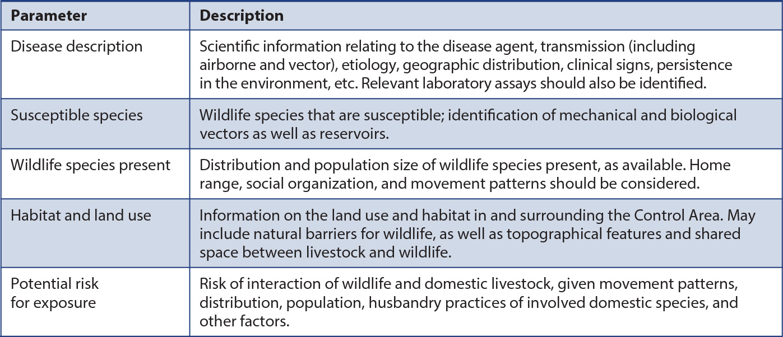
Assessment Parameters cont’d
Notes:
This table lists key assessment parameters that will be considered to better understand the role of wildlife in the FAD outbreak. The extent of the wildlife assessment which occurs prior to commencing response activities will be at the Incident Command’s discretion. Initially, the assessment may be conducted rapidly, based on the best current epidemiological information; response activities may change or evolve as new information becomes available. As the outbreak continues, additional assessments may occur which will guide mitigation strategies. If wildlife populations are determined to be infected, appropriate wildlife management principles will be applied to reduce exposure to livestock. If wildlife populations are determined not to be infected, wildlife management tools will be implemented to keep wildlife populations from acting as mechanical vectors. The susceptibility of many wildlife species in the United States to many FADs is not well understood; agencies that have primary jurisdiction over wildlife will need to work together to assess the possible involvement of wildlife species.

Slide 8
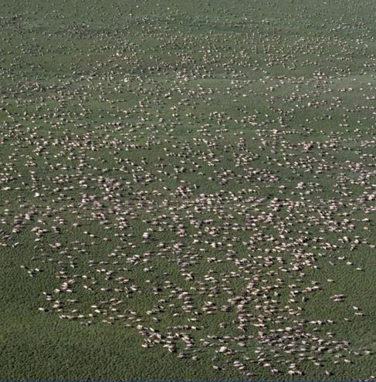
Wildlife Population Data
Population surveys: determine size, location
of wildlife populations
Visual inspection:
find evidence of
sick/dead animals
  Ground surveys: counts, trapping for small species, time consuming
  Aerial surveys: helicopter, airplane used for counting large species, expensive
Notes:
Collecting data to assess the distribution, density, and involvement of wildlife in an FAD outbreak may be difficult. There may be multiple sources of information, having different advantages and disadvantages. The list below provides brief descriptions of different ways that wildlife data can be obtained in an FAD outbreak. Existing local knowledge from farmers, ranchers, hunters, wildlife biologists, and others familiar with the area and wildlife should be leveraged.
Population surveys: This data may already be available from local or State wildlife agencies. The information may help to determine the size and location of wildlife populations.
Visual inspection: This method can be used to find evidence of sick or dead animals. It may involve different types of surveying techniques.
Ground surveys: This methodology may involve spotlight and day counts, trapping, and indirect detection (e.g., looking for dens or tracks). It can be time consuming, but may be useful in obtaining initial information about targeted susceptible species. This method should be followed up with another method.
Aerial surveys: This methodology is often conducted by helicopter or airplane, and works best for larger species. It can be expensive, and counting the animals themselves may not be practical.
[This aerial photo shows a caribou aggregation. Photo source: U. S. Fish and Wildlife Service]

Slide 9
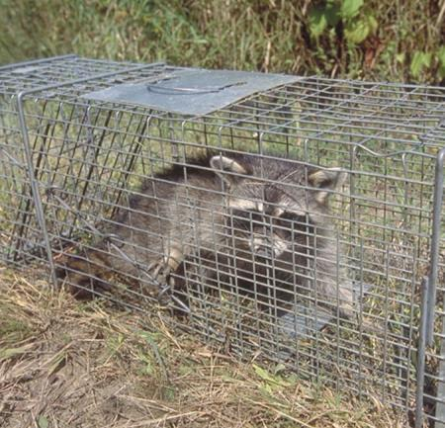
Wildlife Population Data cont’d
Local reports/knowledge: learn wildlife characteristics
Carcasses: necropsies
Live animal capture: determine disease status
Sentinels: deliberately placed animals to detect disease presence
Notes:
Data collection can also involve -
Local reports/knowledge: Often local knowledge and reports are an important resource for obtaining information on normal or abnormal characteristics of wild animals in the area, including wildlife morbidity and mortality. These reports may originate from land managers, wildlife biologists, hunters, and others.
Carcasses: Wildlife carcasses can be a useful source of information, and necropsies may be possible if carcasses are located rapidly after death. Carcasses may come from hunters and trappers, sharp shooters, carcass searches, and road-kill surveillance; these methods should be applied as determined appropriate by the Incident Command.
Live animal capture: Another means of obtaining wildlife populations data can be through the use of live animal capture. This method can also be used to determine disease status. In some instances, the capture of live animals may not be desirable or practical.
Sentinels: Sentinel animals, placed deliberately in an environment to detect the presence of the disease, may be used in limited and specific circumstances, as determined by the Incident Command. [This photo shows a raccoon in a live capture trap. Photo source: USDA APHIS]

Slide 10
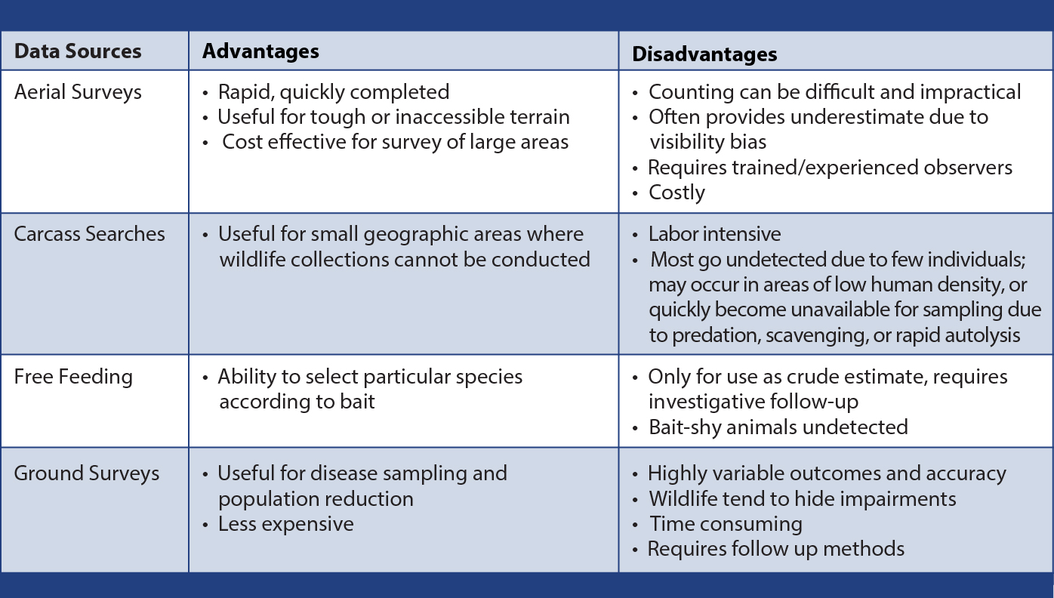
Population Data Source Comparison
Notes:
This table offers a comparison of the advantages and disadvantages of these various methods of collecting information on wildlife populations. For example, an aerial survey may be rapid, and useful for inaccessible terrain, but this type of data collection may be impractical and costly, and require trained observers.

Slide 11
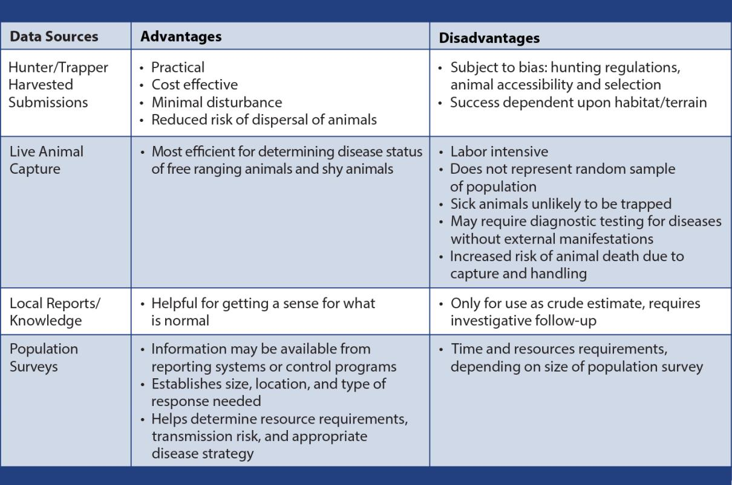
Population Data Source Comparison cont’d
Notes:
The table on this slide is an extension of the table on the previous slide that discusses advantages and disadvantages of additional ways to count populations of wildlife during a disease outbreak.

Slide 12
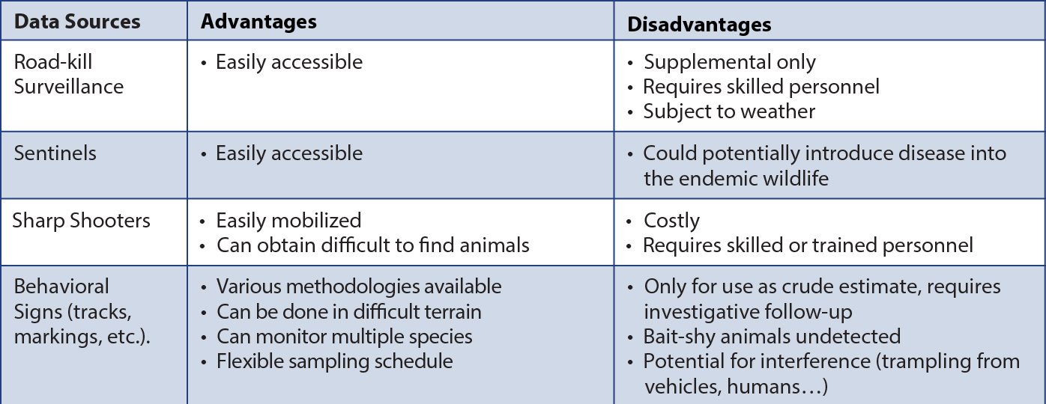
Population Data Source Comparison cont’d
Notes:
The table on this slide is also an extension of the table on the previous slide that discusses advantages and disadvantages of additional ways to count populations of wildlife during a disease outbreak.

Slide 13
Disease Surveillance in a Wildlife Population
Notes:
Based on the assessment of the wildlife population, disease surveillance—potentially including both visual surveillance and/or diagnostic testing—may be necessary. Surveillance of wildlife will be based on the prevailing local circumstances of the outbreak. Any surveillance for the FAD in wildlife considered necessary by the Incident Command in an FAD response effort will be closely coordinated with relevant State, Federal, and Tribal authorities with primary jurisdiction that are involved in wildlife disease management. Experienced wildlife personnel must be involved. Surveillance will help to demonstrate the absence, presence, spread, and/or prevalence of the FAD in a given wildlife population.

Slide 14
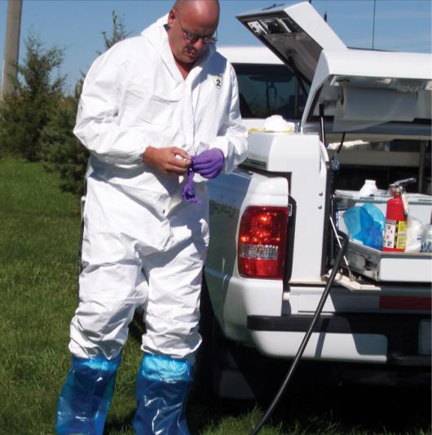
Personnel Safety
Develop chain of command
Prepare equipment, personnel beforehand
Communicate safety
plans to all personnel
Wear necessary PPE
Have back up plans
Have protocols for
injured personnel
Notes:
During all wildlife handling and restraint procedures, personnel safety is paramount. Develop a chain of command and assign each person to a specific duty. Determine ahead of time how the animal is to be released if necessary. Have all resources including equipment and personnel prepared and available ahead of time. Prior to any handling and restraint procedures, safety plans and protocols should be in place and communicated to all personnel present. This should include verbal and hand signals to be used. Personal protective equipment such as gloves or goggles may often be necessary. Back up plans should be in place as personnel should not expect things to go as planned all the time. There should be procedures in place for handling injured personnel, should anything go wrong.
[This photo shows a responder donning personnel protective equipment. Photo source: Dani Ausen, Iowa State University]

Slide 15
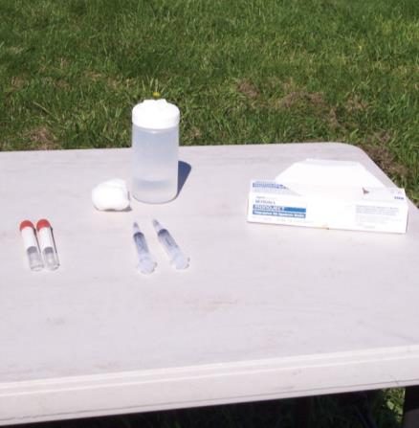
Surveillance Plan
Factors in developing plan
  Case definition for FAD
  Targeted population
  Surveillance area
Wildlife movement poses surveillance challenges
Assess FAD spread between wildlife
and livestock
Notes:
Incident Command will consider many factors in developing a surveillance plan in wildlife, including:
the case definition for the FAD (which is defined prior to an incident, but may change over the course of the outbreak),
the targeted population (wildlife species at risk), and
the area in which surveillance must be conducted.
Because wildlife are likely to move into and out of the Control Area, this may pose additional challenges to developing an effective surveillance plan. In particular, it is important to survey the animal population to assess if the FAD has spread between wildlife and domestic livestock populations, and if so, the extent to which it has spread.
[This photo shows several diagnostic sampling supplies. Photo source: Dani Ausen, Iowa State University]

Slide 16
Diagnostic Sampling
Sampling parameters
  Type: serum, swab, inspection
  Unit: individual or pooled samples
  Size: samples gathered
  Time, duration, frequency of
  sample collection
  Methods: random, targeted, systematic
Samples sent to diagnostic lab with care, biosecurity, packaging, labeling
Notes:
Diagnostic sampling of wildlife may be necessary in order to detect or confirm the presence or absence of the FAD in a wildlife population. Disease samples can be obtained by a number of different methods, such as live capture, observation, and carcass collection. Many of the sampling parameters may be dictated by the availability of resources and feasibility of sampling wildlife. Sampling parameters should be described in detail for an effective surveillance plan. Prior to sampling, parameters, such as these listed, must be determined:
Sample type: e.g., serum or swab or possibly visual inspection (or any combination),
Sample unit: whether the samples will be individual or pooled samples from multiple individuals,
Sample size: number of individual samples to be gathered,
Sample time, duration, and frequency: when samples will be collected, for how long they will be collected, and how frequently they will be collected during a given period,
Sampling methods: e.g., random sampling of a population, targeted sampling of animals with clinical signs, systematic sampling (of every n^{th} animal), etc.
Samples collected from wildlife in an FAD outbreak will be sent to a diagnostic laboratory as identified by Incident Command, State officials, and/or Federal officials. Care should be taken in evaluating diagnostic test results in the event that the laboratory assay has not been validated for specific wildlife species. Appropriate biosecurity measures, as well as packaging and labeling procedures consistent with other diagnostic sampling activities should be followed.

Slide 17
Handling and Restraint of Wildlife
Methods may differ depending on species, skills of responder, safety
Only trained/experienced personnel
Minimize animal stress
  Eye contact, noises, gestures
  Visual barriers
  Sedate, anesthetize, blindfold
  Predator/prey contact
Notes:
Handling and restraint of wildlife may be necessary in an FAD outbreak. Diagnostic samples may need to be taken or the wildlife may need to be moved to another area. Handling and restraint methods will differ depending on species of animal, skill level of responder and other personnel- and animal-safety considerations. For the safety of animals and personnel, handling and restraint of wildlife should only be performed by trained personnel who have extensive experience and certification to perform these activities. Focus on minimizing distress and anxiety in the animals. The following techniques may be used, as appropriate:
Avoid direct eye contact, and minimize loud noises and threatening gestures.
Direct animals with visual barriers (similar to chutes for large livestock).
Sedate, anesthetize, or blindfold the animal, if appropriate.
Avoid handling predator species prior to prey species.

Slide 18
Handling and Restraint of Wildlife cont’d
Do not leave animal unattended
Humane and safe measures
Appropriate equipment
Physical, chemical restraint
  Physical: corrals, cages, chutes, etc.
  Chemical: sedatives, anesthesia
    DEA licensing, accurate records
Notes:
An animal should never be left unattended nor should it be muzzled if there is any chance that the animal may escape. Both physical and chemical restraint may be used to effectively accomplish the goals of the surveillance and control program. Regardless of the method, humane treatment and safety measures must be implemented. It must always be ensured that the appropriate equipment is available and functioning properly. Physical restraint methods may include corrals, cages, nets, shields, and squeeze chutes. Chemical restraint requires knowledge of the various drugs and dosages for each particular species, as well as proper training on drug administration. The possession and administration of many restraint drugs requires licensing from the Drug Enforcement Agency (DEA) and the maintenance of accurate records. A list of drugs and reversal agents for each species should be available.

Slide 19
Myopathy & Euthanasia/Depopulation
Capture myopathy can occur
  Contracted muscles, decreased blood flow, high body temperature
  Worsened by tranquilization, muscle breakdown can lead to kidney failure
  Results: sudden death, renal failure
Euthanasia/depopulation
  Performed by humane methods
Notes:
Capture and restraint of wild animals can result in a fatal condition in some species called capture myopathy. Muscles remain in a contracted state, decreasing blood perfusion, and thereby the amount of oxygen reaching the muscle. High body temperature is another characteristic of capture myopathy. Tranquilization can worsen capture myopathy due to the drop in blood pressure that results, leading to even less perfusion of the tissues. Additionally, products from the muscle breakdown can cause damage to the kidney as they are being excreted, which can lead to kidney failure. The effects of capture myopathy can occur immediately (i.e., sudden death), develop within a few hours, or take as long as several weeks after the stressful event. Delayed deaths are usually due to renal failure. Prey species are generally more susceptible but young predator animals can also have increased risk. At times, euthanasia and/or depopulation of one or more wild animals may be required. This may be necessary for humane reasons or for diagnostic sample collection, particularly to initially indicate whether the disease has spread to wildlife. Appropriate and humane methods must be selected.

Slide 20
Wild Animal Containment and Control
Notes:
The primary objective of wildlife containment and control is to stop the transmission of disease in order to control and eradicate the FAD. However, containment of wild animals can be a very difficult endeavor, given their elusive nature.

Slide 21
Wild Animal Containment and Control
May be difficult or challenging
Manipulation of wildlife, habitat, or other factors
Risk may not be eliminated
Apply chosen techniques to all animal species, if possible
Activities prioritized/coordinated
by Unified (State-Federal) Incident Command
Notes:
Containment and control wildlife may be difficult or challenging. Measures employed can involve the manipulation of the wildlife population itself, habitat, or factors affecting the disease agent and/or human behavior. In many cases, the risk cannot be eliminated. In the event that multiple species are involved in the transmission of the FAD agent, it is ideal if the chosen techniques apply to all species. This enables operations to be more effective and resources to be used more efficiently. If this is not possible, it is important to ensure that techniques used for one species do not compromise the effectiveness of efforts used for another species. If resources are limited, it is important to prioritize which species of wildlife should be targeted first. Again, all wildlife activities in an FAD incident in domestic livestock will be coordinated through the Unified (State-Federal) Incident Command. Individuals with the appropriate skills, knowledge, experience, and abilities will conduct such activities.

Slide 22
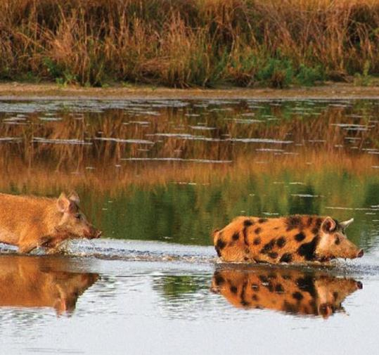
Manipulating Wildlife Populations
Incident Command
receives assessment
for wildlife manipulation
Removal, relocation, dispersal, containment
Manipulation methods may evolve
Monitor, surveillance
for effectiveness
Impacts evaluated
Notes:
Incident Command will receive an assessment of the need for manipulating wildlife populations in an FAD outbreak to minimize disease spread or illness. In the event that wildlife infected with the FAD are detected, preventive measures may need to be instituted to reduce the incidence of infection, and lower the risk of transmission to domestic animals. This may include the removal, relocation, or dispersal of such wildlife, and possibly the vaccination or treatment of animals depending on the disease agent. Containment of wildlife to prevent the spread of disease can be a very difficult task and procedures for manipulating wildlife populations require careful planning and coordination. Methods for manipulating wildlife populations may change as the outbreak response evolves. Additionally, monitoring and surveillance will be necessary in order to determine the effectiveness of the program. Some of the challenges with disease control procedures in wildlife involve their ability to evade detection and disperse broadly. Short-term and long-term consequences must be evaluated and require consideration of the impact the control measures may have on animal species and ecosystems in the area, as well as the potential effects on wildlife populations. [This photo shows two feral swine crossing a waterway. Photo source: USDA Forest Service]

Slide 23
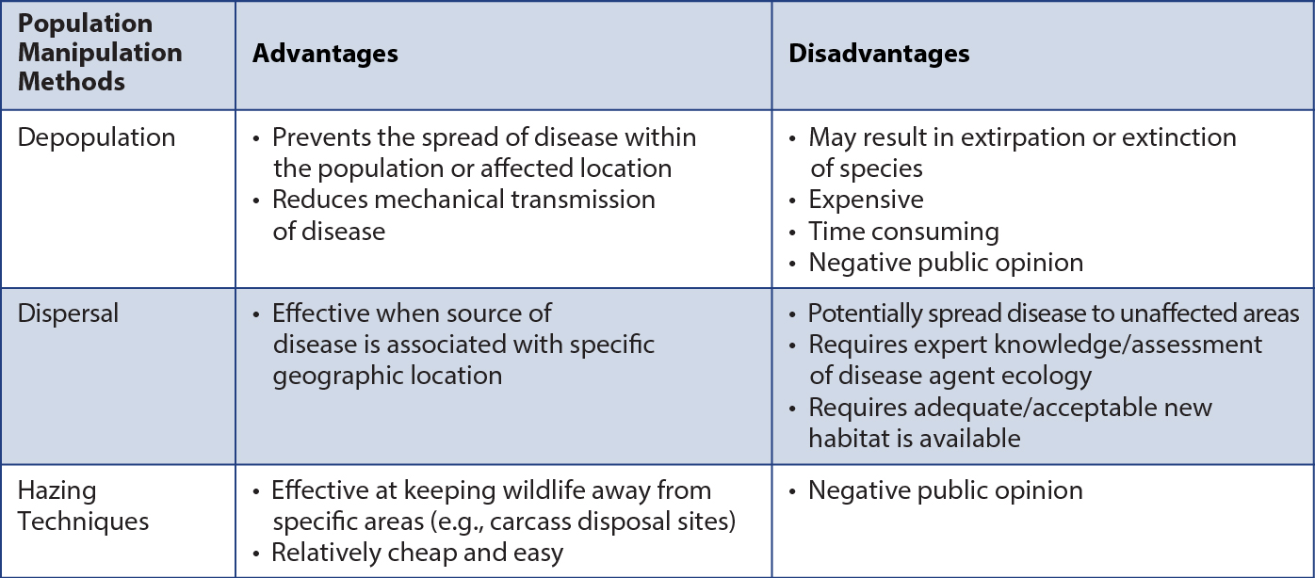
Population Manipulation Methods
Notes:
This table offers a comparison of the advantages and disadvantages of various population manipulation methods. Certain methods may be more applicable to certain species than others and no one method is better than all the rest. Methods should be used effectively for as many species as possible, but may not work with all species involved in the situation.

Slide 24
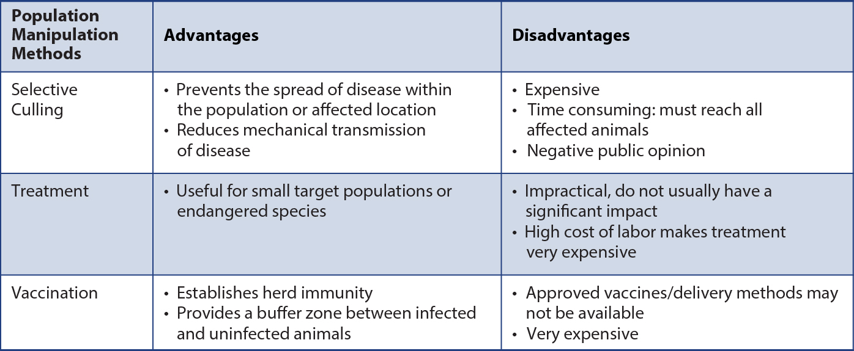
Population Manipulation Methods cont’d
Notes:
The table on this slide is an extension of the one on the previous slide and discusses more population manipulation methods for wildlife.

Slide 25
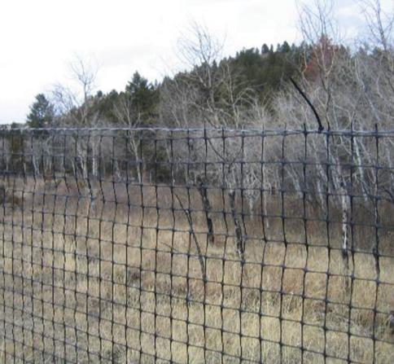
Manipulating Wildlife Habitats
Manipulate habitats with natural, artificial barriers
Fencing
  Prevent movement,
  dispersal
  Reduce exposure,
  not eradicate FAD
Habitat alteration
  Create buffer zones
  Change environmental conditions
Notes:
In addition to manipulating wildlife populations, manipulating wildlife habitats is another option to prevent disease spread. Habitat manipulation in response to an FAD outbreak can involve the use of physical structures or habitat alterations to change the distribution, density, and composition of wildlife populations. Containment may use natural or artificial barriers, to restrict the movement of wildlife. The methods for manipulating wildlife habitats are likely to evolve as the response effort continues. Fencing may be useful in separating infected animals from non-infected animals, or in preventing movement or dispersal of wildlife between infected and uninfected zones. This method should only be considered when the goal is to reduce disease exposure, not eradicate the FAD. Factors affecting the efficiency of fencing include the target species, the size and topography of the geographical area, availability of personnel for monitoring and maintenance of the fence, length of time the barrier must be in place, and the daily and seasonal movement patterns of wildlife in the area. Habitat alteration may be used under some circumstances to eliminate the attractiveness of certain areas for wildlife, to create buffer zones between infected and uninfected wildlife, or to attract wildlife to areas away from the FAD outbreak. The manipulation of habitat areas may also change environmental conditions so they are less favorable for the survival of the disease agent being controlled or, vectors able to transfer it.
[This photo shows a tall fence placed around the perimeter to keep out unwanted wildlife species. Photo source: USDA Forest Service]

Slide 26
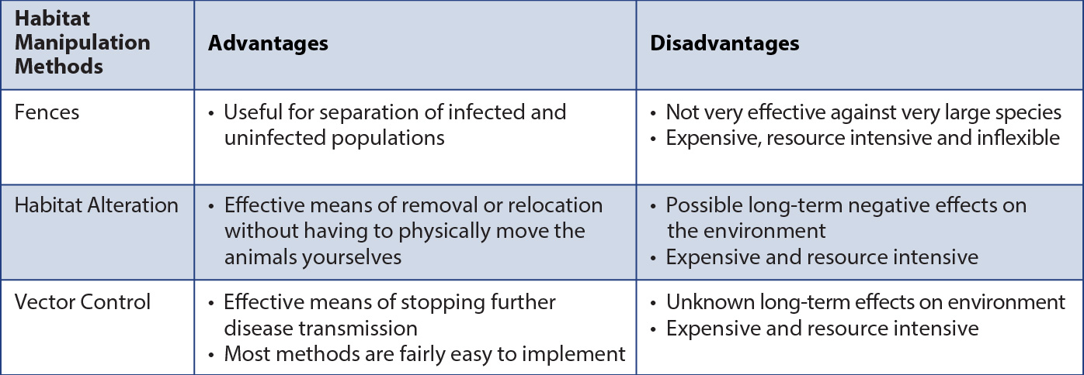
Habitat Manipulation Methods
Notes:
This table compares various habitat manipulation methods. Habitat alteration can involve activities like controlled burning, manipulation of water and water movements, cultivation of soil, and changing vegetation. These activities serve to reduce or eliminate food, water, cover, or other resources in an area affected with an FAD. These activities may have long-term effects on the local environment and need to be evaluated for their effectiveness and environmental impact before they are chosen as a habitat manipulation method.

Slide 27
Education and Training
Change public practices
  Modified hunting practices
  Feeding, baiting wildlife
Education, training
  Hunters, farmers, ranchers
  Control, contain disease
  Rapid identification of sick animals,
  odd behavior
Notes:
Implementing management strategies that change public practices can also influence the spread and transmission of the FAD when wildlife is involved (Fischer and Gerhold, 2003). For example, hunting practices may be modified, or feeding or baiting of wildlife which causes populations to congregate. Education and training, particularly for hunters, farmers, ranchers, and others closely involved with wildlife species can also help to control and contain the disease, through rapid identification of sick animals or atypical behavior in wildlife.

Slide 28
Demonstrating Disease
Freedom
Notes:
It may be necessary to demonstrate freedom from disease in wildlife to reestablish international trade, depending on the disease agent.

Slide 29
Demonstrating Disease Freedom
May be required to reestablish trade
Wildlife-specific surveillance plan may need to be developed
Not always feasible, practical
for wildlife
FAD PReP/NAHEMS Guidelines: Surveillance, Epidemiology,
and Tracing
Notes:
To reestablish international trade, a wildlife-specific surveillance plan for disease-freedom may need to be developed based on the wildlife species, disease agent, diagnostic tests available, and epidemiology of the outbreak. Proving freedom from disease in wildlife populations may not be feasible or practical. For further information on epidemiology and disease surveillance in general, and specifically for proof of disease-freedom, please see the FAD PReP/NAHEMS Guidelines: Surveillance, Epidemiology, and Tracing. It can be accessed at http://www.aphis.usda.gov/fadprep.

Slide 30
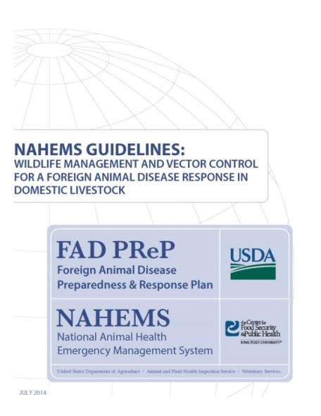
For More Information
FAD PReP/NAHEMS Guidelines: Wildlife Management and Vector Control for an FAD Response in Domestic Livestock
http://www.aphis.usda.gov/fadprep
Wildlife Management and Vector Control web-based training module
  http://naherc.cfsph.iastate.edu/
Notes:
More details can be obtained from the sources listed on the slide, available on the USDA website (http://www.aphis.usda.gov/fadprep) and the National Animal Health Emergency Response Corps (NAHERC) Training Site (http://naherc.cfsph.iastate.edu/).

Slide 31
Guidelines Content
Authors (CFSPH)
Glenda Dvorak, DVM, MS,
MPH, DACVPM
Nicole Seda, BS
Meghan Blankenship, BS
Heather Allen, PhD, MPA
Contributor (USDA)
Jonathan Zack, DVM
Notes:
The print version of the Guidelines document is an excellent source for more detailed information. In particular, the Guidelines document has listings of additional resources. This slide acknowledges the Guidelines’ authors and contributor. It can be accessed at http://www.aphis.usda.gov/fadprep.

Slide 32
Guidelines Content
Reviewers (USDA)
Randall Levings, DVM, MS
Randall Crom, DVM
Michael Messenger, PhD
Michael David MS, VMD, MPH
Wildlife Disease Steering Committee
Subject Matter Experts
Claudio L Afonso
Samantha Gibbs, DVM, PhD
D. Scott McVey, DVM, PhD, DACVM
David Suarez, DVM
Notes:
This slide acknowledges those who assisted in the development of the print version of the Guidelines document.

Slide 33
Acknowledgments
Development of this presentation was by the Center for Food Security and Public Health at Iowa State University through funding from the USDA APHIS Veterinary Services
PPT Authors: Abbey Smith, Student Intern; Janice Mogan, DVM
Reviewers: Glenda Dvorak, DVM, MPH, DACVPM; Heather Allen, PhD, MPA
Notes:
Information provided in this presentation was developed by the Center for Food Security and Public Health at Iowa State University College of Veterinary Medicine, through funding from the US Department of Agriculture, Animal and Plant Health Inspection Service, Veterinary Services.

