Slide 1
Wildlife Management and Vector Control for an FAD Response in Domestic Livestock
USDA APHIS Authorities
Adapted from the FAD PReP/NAHEMS Guidelines: Wildlife Management and Vector Control for an FAD Response in Domestic Livestock
Notes:
In order to effectively control, contain, and eradicate a foreign animal disease (FAD) in domestic livestock, the response effort must consider the role that wildlife may play in disease transmission. In the event that wildlife play a role in an FAD outbreak, the Animal and Plant Health Inspection Service (APHIS), will cooperate with Federal, State, and Tribal agencies that have primary jurisdiction over wildlife. This presentation provides general information on the cooperative activities which may be implemented in an FAD response when wildlife may be involved. This presentation is guidance only, and does not provide prescriptive procedures. [This information was derived from the Foreign Animal Disease Preparedness and Response (FAD PReP)/National Animal Health Emergency Management System (NAHEMS) Guidelines: Wildlife Management and Vector Control for an FAD Response in Domestic Livestock.]

Slide 2
This Presentation
Definitions
Laws, regulations
Relevance of wildlife
Roles and responsibilities of authorities during an FAD response
Notes:
This presentation will discuss specific definitions of wildlife and other related terms, laws and regulations, relevance of wildlife, and roles and responsibilities of authorities during an FAD response.

Slide 3
Definitions
Wild animal: (OIE) an animal that has a phenotype unaffected by human selection and lives independent of direct human supervision or control
Wildlife: (APHIS) all free-ranging animals, including native and exotic wildlife species, as well as feral domestic animals
Notes:
A wild animal, as defined by the World Organization for Animal Health (OIE) in the 2014 Terrestrial Animal Health Code, is “an animal that has a phenotype unaffected by human selection and lives independent of direct human supervision or control.” The use of the term “wildlife” for this presentation is further defined as “all free-ranging animals, including native and exotic wildlife species, as well as feral domestic animals” in the United States (APHIS VS Memorandum 573.1). This definition does not include privately-owned captive wildlife, whether native or exotic, nor does it include zoological collections, which are defined as captive animals. This presentation focuses on situations involving wild mammals (e.g., ungulates, carnivores, and rodents) and birds (e.g., waterfowl); these species are most likely to have important implications for disease transmission in an FAD outbreak.

Slide 4
Definitions cont’d
Feral: domestic animals not confined
Wildlife reservoir: free-ranging species living as a potential source of infection/infestation
Vector: any living organism that can carry disease agents
Biological transmission: disease agent transfer from host to susceptible animal
Mechanical transmission: disease agent transfer from host to susceptible animal via external body parts
Notes:
In an FAD outbreak, susceptible wild animal species may become infected, serve as a reservoir, or further spread the pathogen to domestic livestock or poultry. Terms describing these modes of involvement as used in this presentation are defined here.
Feral: domestic animals (e.g., cats, horses, pigs) that are not confined or under control.
Wildlife reservoir: any population of free-ranging or free-living species in which an infectious agent/vector has become established, lives and multiplies and is therefore a potential source of infection/infestation to other domestic and free ranging species; Veterinary Services (VS) recognizes that the initial source of infection of a wildlife reservoir may be an agricultural animal population (VS Memo 573.1).
Vector: any living organism, including, but not limited to arthropods, rodents, and scavengers, that can carry disease causing agents from an infected animal to a susceptible animal, either biologically (e.g., an arthropod bite) or mechanically (e.g., carrying microorganisms on the body, such as feet or fur).
Biological transmission: transfer of a disease agent from a host to a susceptible animal after the pathogen has undergone some part of its life cycle within the host (e.g., mosquito, feral swine).
Mechanical transmission: transfer of a disease agent to a susceptible animal via external body parts of a host species; the pathogen does not undergo any development or multiplication while on the host species (e.g., flies).

Slide 5
USDA APHIS Authorities for Responding to an FAD Outbreak in Domestic Livestock
Notes:
APHIS is authorized by statutory and regulatory authorities to respond to FADs and other communicable diseases of livestock and poultry. Multiple APHIS units, including Wildlife Services, Veterinary Services, Animal Care, and International Services, all play a role in current wildlife disease activities. In an FAD incident and coordinated response, the Code of Laws of the United States of America (U.S.C.) and the Code of Federal Regulations (CFR) provide policy for the USDA, via statutes and regulations; interim regulations can be implemented—in the event of an outbreak—to prevent the spread of disease.

Slide 6
FAD and Emerging Diseases
FAD: animal disease or pest not known to exist in US or territories
Emerging disease: change or mutation in pathogenicity, communicability or zoonotic potential to become a threat
When livestock outbreak involves wildlife - USDA APHIS and authorities with jurisdiction over wildlife collaborate
Notes:
An FAD is a terrestrial animal disease or pest, or an aquatic animal disease or pest, not known to exist in the United States or its territories.
An Emerging animal disease may be any terrestrial animal, aquatic animal, or zoonotic disease not yet known or characterized, or any known or characterized terrestrial animal or aquatic animal disease, in the United States or its territories, that changes or mutates in pathogenicity, communicability, or zoonotic potential to become a threat to terrestrial animals, aquatic animals, or humans.
An FAD or emerging animal disease may involve livestock, poultry, other animals, and/or wildlife. In the event of an FAD or emerging animal disease outbreak in domestic livestock that involves wildlife, USDA APHIS will work in close collaboration, communication, and coordination with State, Tribal and Federal wildlife agencies that have primary jurisdictional authority and subject matter expertise for wildlife.

Slide 7
Animal Health Protection Act
APHIS authority through AHPA Act
Enables Secretary of Agriculture to:
Prevent, detect, control, eradicate diseases and pests
To protect health/welfare, economic interests, environment and commerce
Prohibit or restrict importation, entry, interstate movement
Cooperate with agencies to control animal diseases
Notes:
APHIS receives its permanent and general regulatory authority from the Animal Health Protection Act (AHPA), 7 U.S.C. 8301 et seq. The AHPA enables the Secretary of Agriculture to prevent, detect, control, and eradicate diseases and pests of animals, including foreign animal and emerging diseases, in order to protect animal health, the health and welfare of people, economic interests of livestock and related industries, the environment, and interstate and foreign commerce in animals and other articles. The Secretary may also prohibit or restrict the importation, entry, or interstate movement of any animal, article, or means of conveyance to prevent the introduction into or dissemination within the United States of any pest or disease of livestock (7 U.S.C. 8303‑8305). The AHPA also provides the Secretary of Agriculture authority to cooperate with other Federal agencies, States, or political subdivisions of States, national or local governments of foreign countries, domestic or international organizations or associations, Indian Tribes, and other persons to prevent, detect, or control animal diseases (7 U.S.C. 8310).

Slide 8
Code of Federal Regulations
9 CFR 71.2: Issue rule governing quarantine, movement of diseased animals, poultry
9 CFR 71.3: Prohibited movement of diseased animals and poultry
9 CFR 53: Certain communicable diseases of livestock or poultry
9 CFR 161: Standards for AVs and revocation of accreditation
Notes:
Title 9 of the CFR provides detailed USDA APHIS administrative regulations for the control and eradication of animal diseases, including FADs and emerging animal diseases. Following are several key sections of the CFR to safeguard public health, animal health, animal products, interstate commerce, and international trade:
9 CFR 71.2
Secretary (of Agriculture) to Issue Rule Governing Quarantine and Interstate Movement of Diseased Animals, Including Poultry
9 CFR 71.3
Interstate Movement of Diseased Animals and Poultry Generally Prohibited
9 CFR 53
Foot-and-Mouth Disease, Pleuropneumonia, Rinderpest, and Certain Other Communicable Diseases of Livestock or Poultry
9 CFR 161
Requirements and Standards for Accredited Veterinarians (AVs) and Suspension or Revocation of Such Accreditation.

Slide 9
Guidance for Veterinary Services
VS Memorandum 573.1 -
USDA, APHIS, VS Animal Health Policy in Relation to Wildlife
Work with wildlife entities with primary authority and responsibility
Support disease eradication
Movement, testing requirements
Herd plans
Emergency response plans to keep wildlife and livestock apart
Notes:
Additional policy guidance has been developed regarding the role of APHIS VS in an FAD outbreak in domestic livestock that has a wildlife component, given the authority granted to APHIS under the AHPA. VS Memorandum 573.1 “USDA, APHIS, VS Animal Health Policy in Relation to Wildlife” provides guidance specifically for VS. In any FAD outbreak in domestic livestock that involves wildlife, VS will work collaboratively with Federal, State, and Tribal wildlife entities to respond to the outbreak, recognizing that these agencies have primary authority and responsibility for managing free-ranging wildlife. Emergency management plans for FAD outbreak response should address the eradication of the FAD from affected wildlife. “In cases where VS policy supports eradication of an infectious agent/disease/vector, VS will seek measures, through (1) movement and testing requirements; (2) herd plans; and (3) emergency response plans to keep wildlife and livestock apart and to eradicate the disease from all potential reservoirs when eradication is deemed technically feasible.” Additionally, if eradication is not technically feasible, measures must be taken to keep wildlife separate from domestic livestock until there are improved mechanisms to eliminate the disease from wildlife populations.

Slide 10
Guidance for VS cont’d
State fish and wildlife agencies have primary authority and responsibility
VS may implement actions under certain conditions
Secretary of Ag will consult with State authorities
Collaborative relationships
Notes:
As stated in the Memo, “VS recognizes that State fish and wildlife management agencies have primary authority and responsibility for managing free-ranging wildlife.” However, “VS has statutory authority in the AHPA to implement disease control and/or eradication actions for wildlife under certain conditions.” Should wildlife be affected by the control and eradication measures proposed by the Secretary of Agriculture—including in an extraordinary emergency—“the Secretary will consult with the State agency having authority for protection and management of such wildlife.” Efforts to prevent, control, or eliminate transmission of infectious agents/diseases/vectors between animal agriculture populations and wildlife requires collaborative relationships between agencies.

Slide 11
Relevance of Wildlife in an FAD Outbreak in Domestic Livestock or Poultry
Notes:
As stated earlier, in an FAD outbreak, susceptible wild animal species may become infected, serve as a reservoir, or further spread the pathogen to domestic livestock or poultry. Wildlife species can be susceptible to many of the FADs that affect domestic livestock. For example, feral swine are susceptible to and can serve as a reservoir of classical swine fever and African swine fever viruses. This susceptibility can contribute to the epidemiology of the outbreak as well as have implications on the international trade of domestic livestock or poultry.

Slide 12
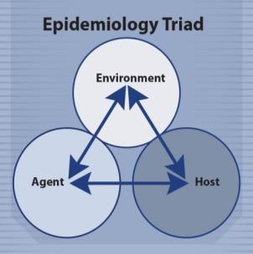
Epidemiological Factors
Interactions between host, agent, environment
Agent: range, resistance, affinity, dose, mode of transmission
Host: species, age, immune/nutritional status
Environment: housing, care, weather, vector presence
Notes:
The epidemiology of any infectious disease involves the complex interaction between factors of the host, disease agent and environment. These factors further impact the distribution of the disease within a population. The interaction of these factors determines characteristics of the disease outbreak. Therefore, epidemiological parameters and considerations will need to be evaluated for an FAD situation involving wildlife species. These may include the following:
Agent factors: host range, environmental resistance, tissue affinity, dose, mode of transmission
Host factors: species, breed, age, nutritional status, immune status
Environment factors: husbandry, housing, climate/season, presence of vectors.
[This graphic shows the epidemiology triad of host, agent and environment interaction to establish disease. Graphic illustration by: Bridget Wedemeier, Iowa State University]

Slide 13
Epidemiological Factors cont’d
Immediately assess wildlife during an FAD
Detect cases
Understand disease characteristics
Identify disease risks
Provide information for control
Evaluate effectiveness of control and adjust
Notes:
In some diseases, wild animals may act as a reservoir for the disease and be a threat for the transmission of the FAD to domestic livestock. However, in other diseases, wildlife may simply be a reflection that the disease is already occurring in the domestic livestock in the area. It is critically important to immediately assess the role of wild and/or feral animals in an FAD outbreak in order to identify and evaluate the best options for mitigating the role of wildlife related disease spread and transmission of an FAD pathogen to domestic livestock. Surveillance, epidemiology, and tracing techniques will be employed in an FAD outbreak to:
Detect new and existing cases (animals or premises).
Understand characteristics of the disease (e.g., clinical signs, incubation period, populations affected) and outbreak characteristics (e.g., sources, disease incidence patterns, geographic distribution, transmission dynamics, and reservoirs) and how they affect specific populations.
Identify risk factors associated with disease occurrence (e.g., age, production practices, species, wildlife, vectors).
Provide information for decision-making to design and implement control measures against the disease being targeted, such as designation of zones for disease control procedures.
Evaluate the effectiveness of the control measures implemented and adjust them as the situation dictates.

Slide 14
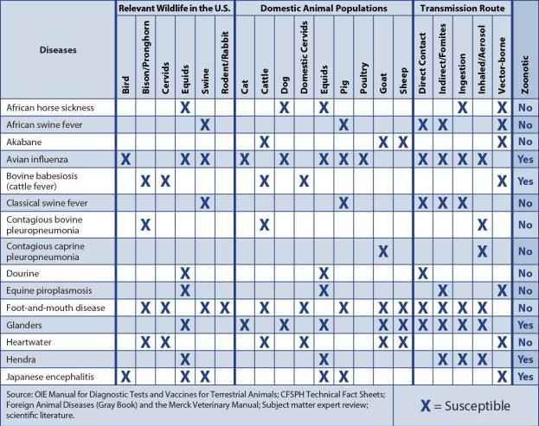
Species Susceptibility
Notes:
The table on this slide and the next lists selected, key diseases that affect both wildlife and livestock, as well as the potential wildlife reservoirs and susceptible domestic livestock species. This list of diseases is based on that found in the APHIS FAD Framework: Response Strategies (FAD PReP Manual 2-0). The “X” denotes animal species that are susceptible to various diseases, whereas boxes with no “X” denote animals with no or unknown susceptibility. The various modes of disease transmission for these agents are also listed. This table is not all inclusive, though it does include many high priority FADs.
Source: OIE Manual for Diagnostic Tests and Vaccines for Terrestrial Animals; CFSPH Technical FactSheets; Foreign Animal Diseases (Gray Book) and the Merck Veterinary Manual; Subject matter expert review; scientific literature. Graphic illustration by: Dani Ausen, Iowa State University.

Slide 15
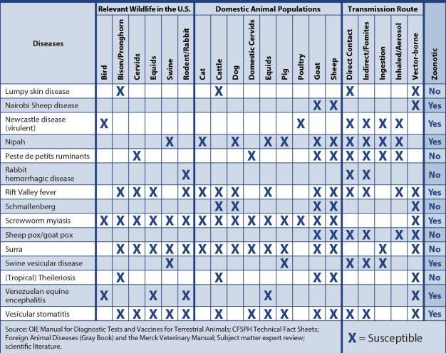
Species Susceptibility cont’d
Notes:
The table on this slide is an extension of the one on the previous slide. The “X”s denote susceptibility of certain species to certain diseases.

Slide 16
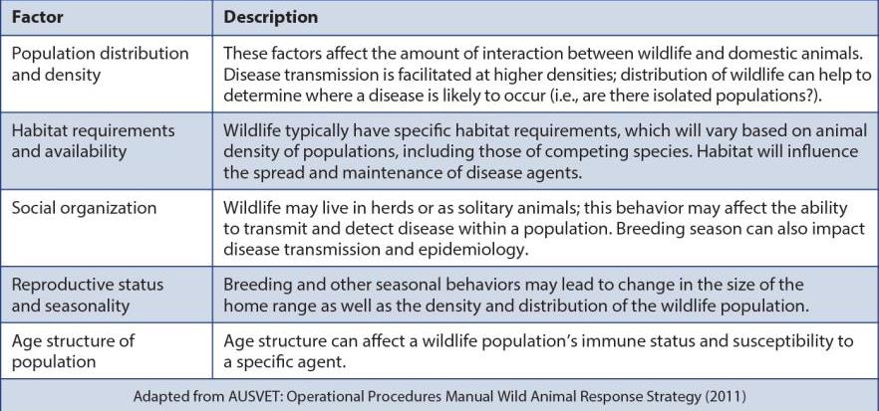
Ecological Factors of Wildlife
Notes:
There are a number of ecological factors that will affect the role that wildlife play in an FAD outbreak in domestic livestock. Many of these factors will affect the transmission, rate of spread and maintenance of disease within a population. There is a significant amount of variation across the United States in terms of distribution, density, and habitats of wildlife species. Wild animals can be difficult to manage. Some species can avoid detection, relocate to inaccessible areas, and rapidly repopulate. Different FADs will have different consequences on wildlife populations. These factors are listed on the table on this slide and the next have been adapted from AUSVET: Operational Procedures Manual Wild Animal Response Strategy (2011).

Slide 17
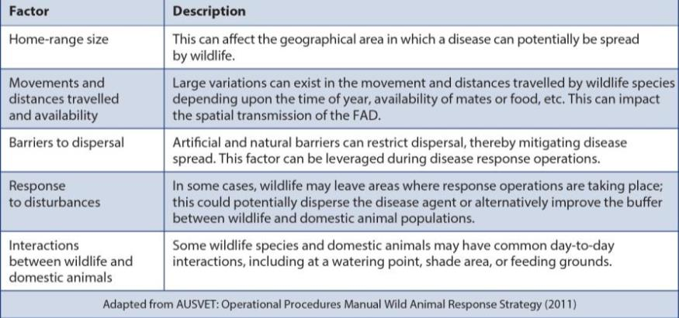
Ecological Factors of Wildlife cont’d
Notes:
More ecological factors of wildlife are discussed on this slide which has been adapted form AUSVET: Operational Procedures Manual Wild Animal Response Strategy (2011).

Slide 18
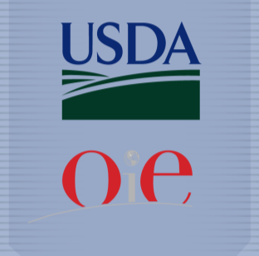
International Trade
OIE distinguishes between wildlife infection and domestic infection for some diseases
wildlife role in transmission, maintenance of agent
Not all countries will follow OIE guidelines for trade
Notes:
In addition to the epidemiological implications of wildlife, there may also be international trade implications depending on whether or not wildlife are affected. For certain disease agents, the World Organization for Animal Health (OIE) Terrestrial Animal Health Code (2014) distinguishes between infection in wildlife and infection in domestic livestock for purposes of international trade. The OIE policy on diseases which may involve both wildlife and domestic livestock distinguishes whether or not the wild species plays an epidemiologically significant role in the transmission and maintenance of the disease agent in the domestic livestock population. Importing countries may or may not follow the OIE guidelines for trade in animals or their products in the event of an FAD event in an exporting country. [This graphic shows the USDA and OIE logos. Graphic illustration by: Kate Harvey, Iowa State University]

Slide 19
International Trade cont’d
Affected wildlife may not always mean domestic livestock are affected
FAD existence in wildlife may make disease-freedom difficult
Trade may be affected with FAD presence in exporting country
Notes:
In the case of some FADs, the natural reservoir for infection may be in a wild animal (wild bird) population. Although wildlife may be affected, or be the reservoir of the pathogen, it does not necessarily mean that domestic livestock for that country, region, or zone will also be affected. Nevertheless, the existence of the FAD in a wildlife population may make it more difficult to demonstrate disease-freedom. Negotiations to maintain or to resume trade in animals and animal products between trading partners will often occur on a case-by-case basis and will depend on the ability of an affected country to clearly show control and containment of the FAD.

Slide 20
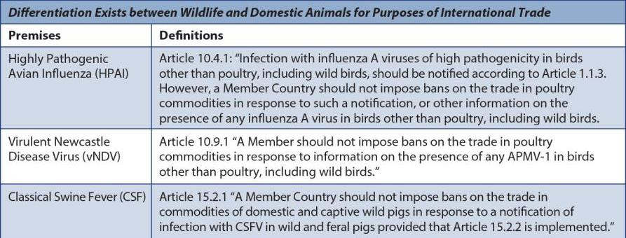
FAD Detection for Disease Agents
For example
Notes:
This table lists three example disease agents and provides information on how the Terrestrial Animal Health Code distinguishes between infection in wildlife and domestic livestock. For other diseases not found in the table, readers should refer to the Terrestrial Animal Health Code for information on requirements for disease freedom: www.oie.int.

Slide 21
Roles and Responsibilities in an FAD Outbreak
Notes:
Response personnel have various roles and responsibilities in an FAD outbreak to efficiently control, contain, and eradicate the disease. The Incident Command System (ICS) and National Incident Management Systems (NIMS) are critical to controlling and managing an FAD outbreak scenario. APHIS will work in a Unified Command with other Federal and State agencies.

Slide 22
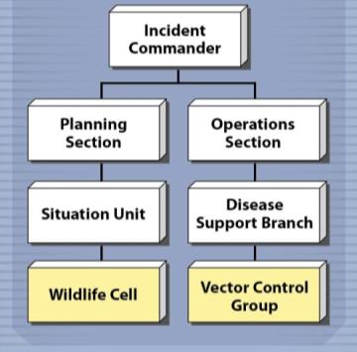
ICS, NIMS, Unified Command
Critical to controlling an outbreak
Wildlife Cell, Vector Control Group
Wildlife and disease management expertise
Planning, Operation Sections
Coordinate activities
Conducted with appropriate agencies
Conducted by skilled personnel
Notes:
This graphic is a condensed example of an ICS organizational chart, showing the Wildlife Cell, comprised of individuals with relevant expertise and knowledge in managing disease in wildlife populations, and the Vector Control Group. The Wildlife Cell and Vector Control Group would be important in leading wildlife management and vector control activities in the event of an FAD outbreak. Together, the Planning Section and Operations Section will coordinate wildlife management and vector control activities with other ICS Groups and Units in an outbreak. Activities related to wildlife will be conducted in collaboration with Federal, State and Tribal wildlife agencies, including APHIS VS, APHIS Wildlife Services, other APHIS units, and the U.S. Department of Interior. Activities will be conducted in accordance with relevant Federal, State, and local laws and by skilled and experienced personnel.
[This graphic shows the Wildlife Cell and Vector Control Group within the Incident Command System structure. Graphic illustration by: Kate Harvey, Iowa State University]

Slide 23
Wildlife and Vector Control Personnel
Team will vary depending on incident
Personnel need wildlife-related experience
Assessing presence of wildlife
Assessing potential for disease spread
Determining wildlife infection
Wildlife surveillance measures
Wildlife disease control
Implementing prevention measures
Notes:
Within the Wildlife Cell and Vector Control Group, there will be different positions based on function and responsibility. The number of personnel will vary depending on the size and the scope of incident, but may include one or more team leaders to supervise on-site activities or functions with associated team members to conduct on-site activities or functions. Objectives of the Wildlife Cell and Vector Control Group include protecting both domestic animals and wildlife through prompt disease control, containment, and eradication. All operational/field personnel within the Unified Command will be required to have the skills and experience to conduct wildlife-related activities. Tasks involved in achieving this goal may include—but are not limited to—the following:
Assessing the presence of susceptible wildlife in the affected areas.
Assessing the potential for spread of the disease agent to or by wildlife.
Determining if infection has occurred in wildlife species.
Determining wildlife surveillance measures and protocols needed.
Determining if disease control within wildlife is necessary.
Implementing management and control measures to prevent the spread of disease from wildlife to livestock.

Slide 24
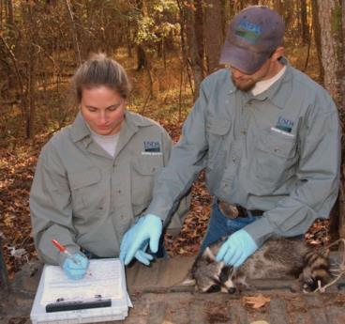
Role of APHIS Wildlife Services
Coordinate with Federal, State partners
SERS, NWDP
Primary emergency response contact
Group of biologists ready for mobilization in 24-48 hours
Receive training, medical clearance, PPE, training drills
SERS - Surveillance and Emergency Response System
NWDP - National Wildlife Disease Program
Notes:
APHIS Wildlife Services will coordinate with VS and other Federal and State partners in the event that wildlife are involved in an FAD outbreak. Within Wildlife Services, the Surveillance and Emergency Response System (SERS) of the National Wildlife Disease Program (NWDP), serves as the primary emergency response contact point within APHIS. SERS has a cadre of wildlife biologists who are prepared to be mobilized within 24–48 hours of a request with extensive Incident Command System training, current medical clearances for personal protective equipment and have participated in emergency response scenario drills.
[This photo shows two USDA APHIS Wildlife Services employees gathering data on a raccoon. Photo source: USDA APHIS]

Slide 25
Role of Livestock Owners/Producers
Prevent the introduction of diseases into domestic livestock
Prevent the spread of disease to wildlife
Fencing barrier – create a buffer
Wire netting, sealed entry points – prevent direct contact
Notes:
Livestock owners have an important role in protecting their herds and flocks from wildlife, both to prevent the introduction of diseases into domestic livestock as well as to prevent the spread of disease to wildlife. For example, fencing may create a buffer between livestock herds and wildlife populations. For diseases like highly pathogenic avian influenza (HPAI) and virulent Newcastle disease virus (vNDV), wire netting and sealing entry points may also prevent direct contact between domestic and wild birds.

Slide 26
Resources for Livestock Owners/Producers
Biosecurity for the Birds
http://healthybirds.aphis.usda.gov
Center for Food Security and Public Health (CFSPH) – disease factsheets
http://www.cfsph.iastate.edu
FAD PReP/NAHEMS Guidelines: Biosecurity
http://www.aphis.usda.gov/fadprep
USDA APHIS Wildlife Services
http://www.aphis.usda.gov/ wildlife_damage/index.shtml
Notes:
Multiple resources are available for owners and producers to learn more about the steps they can take to protect their herds and flocks, as well as learn about the common signs for different FADs to help with rapid detection.
Biosecurity for the Birds resources: http://healthybirds.aphis.usda.gov
Center for Food Security and Public Health (CFSPH) resources: Disease factsheets and disease prevention practices handouts: http://www.cfsph.iastate.edu
FAD PReP/NAHEMS Guidelines: Biosecurity: http://www.aphis.usda.gov/fadprep.
USDA APHIS Wildlife Services: http://www.aphis.usda.gov/wildlife_damage/index.shtml

Slide 27
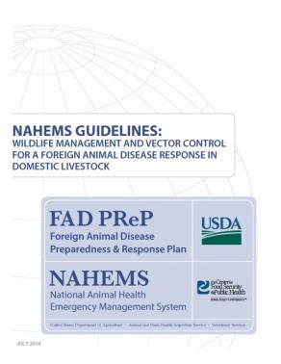
For More Information
FAD PReP/NAHEMS Guidelines: Wildlife Management and Vector Control for an FAD Response in Domestic Livestock
http://www.aphis.usda.gov/fadprep
Wildlife Management and Vector Control web-based training module
http://naherc.cfsph.iastate.edu/
Notes:
More details can be obtained from the sources listed on the slide, available on the USDA website (http://www.aphis.usda.gov/fadprep). and the National Animal Health Emergency Response Corps (NAHERC) Training Site (http://naherc.cfsph.iastate.edu/).

Slide 28
Guidelines Content
Authors (CFSPH)
Glenda Dvorak, DVM, MS, MPH, DACVPM
Nicole Seda, BS
Meghan Blankenship, BS
Heather Allen, PhD, MPA
Contributor (USDA)
Jonathan Zack, DVM
Notes:
The print version of the Guidelines document is an excellent source for more detailed information. In particular, the Guidelines document has listings of additional resources. This slide acknowledges the Guidelines’ authors and contributor. It can be accessed at http://www.aphis.usda.gov/fadprep.

Slide 29
Guidelines Content
Reviewers (USDA)
Randall Levings, DVM, MS
Randall Crom, DVM
Michael Messenger, PhD
Michael David MS, VMD, MPH
Wildlife Disease Steering Committee
Subject Matter Experts
Claudio L. Afonso
Samantha Gibbs, DVM, PhD
D. Scott McVey, DVM, PhD, DACVM
David Suarez, DVM
Notes:
This slide acknowledges those who assisted in the development of the print version of the Guidelines document.

Slide 30
Acknowledgments
Development of this presentation was by the Center for Food Security and Public Health at Iowa State University through funding from the USDA APHIS Veterinary Services
PPT Authors: Abbey Smith, Student Intern; Janice Mogan, DVM
Reviewers: Glenda Dvorak, DVM, MPH, DACVPM; Heather Allen, PhD, MPA
Notes:
Information provided in this presentation was developed by the Center for Food Security and Public Health at Iowa State University College of Veterinary Medicine, through funding from the US Department of Agriculture, Animal and Plant Health Inspection Service, Veterinary Services.

