Slide 1
Vaccination for Contagious Diseases
Preventing Disease Transmission During Vaccination
Adapted from the FAD PReP/NAHEMS
Guidelines: Vaccination for Contagious Diseases (2014)
Notes:
The control of a foreign animal disease outbreak may require large-scale vaccination of livestock and other domestic animals to minimize the impact on animal and public health, ensure continuity of the U.S. food supply, and minimize the economic impact on food producers. The principles discussed in this presentation are intended to provide general information to conduct large-scale vaccination of a variety of domestic animal species as may be required in an animal health emergency. Decisions regarding the choice of vaccine and the selection of animals to vaccinate will vary with the disease involved, species affected and the stage of the outbreak, and may change as the situation evolves. As always, it is important to evaluate each situation and adjust procedures to the risks present in the situation. [This information was derived from the Foreign Animal Disease Preparedness and Response (FAD PReP)/National Animal Health Emergency Management System (NAHEMS) Guidelines: Vaccination of Contagious Diseases (2014)].

Slide 2
This Presentation
Prevention of disease transmission by applying appropriate biosecurity principles
Methods of disease transmission
Vaccination strategies during a disease outbreak
Notes:
This presentation provides information on the following topics:
Preventing transmission of diseases by applying appropriate biosecurity principles;
Introducing methods of disease transmission; and
Describing vaccination strategies that may be employed during a disease outbreak

Slide 3
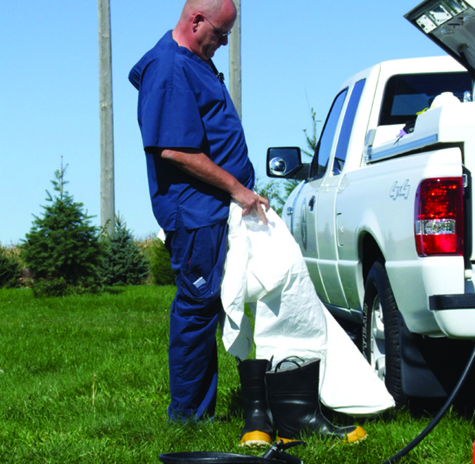
Preventing Transmission
Any mass vaccination program has the potential to spread diseases
Follow appropriate biosecurity measures
  Equipment, clothing, hands, vehicles, or personnel
Notes:
As with other procedures where many animals are handled in a short period of time, any mass vaccination program has the potential to spread diseases from animal to animal or from premises to premises if appropriate precautions are not taken. Emergency vaccination programs will target unaffected animals on clean premises. However, transmission of both endemic disease and foreign highly contagious diseases must be considered. Personnel engaged in vaccination activities need to follow appropriate biosecurity measures to ensure they are not transmitting diseases from one animal population to another by way of equipment, clothing, vehicles, or personnel. Biosecurity protocols may include general practices as well as those targeted at specific pathogens. [A photo of a veterinarian putting on new disposable coveralls next to a truck. Photo source: Jane Galyon, Iowa State University]

Slide 4
Disease Transmission
Pathogenic agents and disease can be spread by five main methods:
  Oral
  Aerosol
  Direct contact
  Fomites
  Vectors
Notes:
Pathogenic agents and disease can be spread by five main methods: oral, aerosol, direct contact, fomites, and vectors. Vaccination efforts have the potential to alter the risk of exposure to disease, directly or indirectly, by all five methods. Following appropriate biosecurity protocols, such as using disposable equipment where feasible, disposing of waste appropriately, and cleaning and disinfecting reusable equipment and clothing are all crucial to reducing disease transmission.

Slide 5
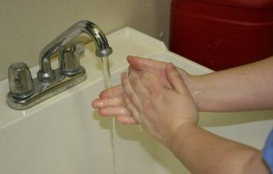
Risk Management
Personnel
  Keep fingernails trimmed and clean
  Pull back hair or cover hair
  Do not wear jewelry
  Wash hands or
  change gloves
  between animals
Notes:
Personnel, especially mobile vaccination crews moving from facility to facility, must be especially careful to reduce disease transmission on fomites. Pathogens can be carried from one animal to another, and from one location to another, on responders’ skin and on contaminated outwear. General biological risk management guidelines for emergency vaccination personnel are as follows:
Keep fingernails trimmed and clean;
Pull back, tie up, or cover hair to minimize exposure and fomite transmission;
Do not wear jewelry;
Wash hands or change examination gloves between animals, barns, or pens;
[This photograph illustrates hand washing as a biosecurity measure. Photo source: Dani Ausen, Iowa State University]

Slide 6
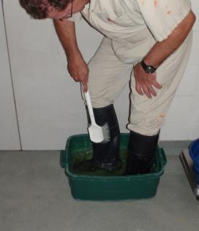
Risk Management
Personnel continued -
  Wear outer protective
  clothing and change
  as appropriate
  Clean boots before and
  after entering
Notes:
Other guidelines for personnel include:
Wear protective clothing or the appropriate level of personal protective equipment (PPE) (i.e., scrubs or coveralls) over personal clothing and change outer clothing when contaminated, or between groups of animals with differing health or immune status, or between facilities as appropriate.
Wear disposable shoe covers or protective boots (i.e., rubber boots) that are easily cleaned and disinfected. Clean boots in a disinfectant bath before entering and after leaving barns and facilities.
[This photograph illustrates cleaning boots with a scrub brush in a boot bath. Photo source: Alex Ramierez, Iowa State University]

Slide 7
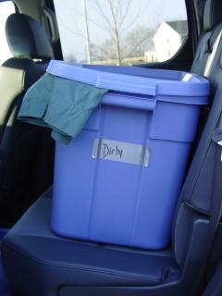
Risk Management
Personnel continued -
  Separate contaminated
  clothing
  Do not wear protective
  clothing home
  Shower in and out of
  large production units
  when possible
Notes:
Additional guidelines for personnel include:
Keep dirty, contaminated clothing in a plastic bag or bin in a designated “dirty” area of the vehicle until it can be washed.
Do not wear protective outer clothing home from a facility.
Shower in and out of large production units when facilities allow.
[This is a photograph of a dirty bin in the back seat of a truck to keep contaminated clothing separate from clean protective clothing. Photo source: Danelle Bickett-Weddle, Center for Food Security and Public Health, Iowa State University]

Slide 8
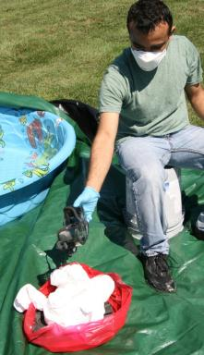
Risk Management
General
  Use disposable equipment
  Use new, sterile needles
  Contain refuse on site
  Use smallest vaccine
  vial possible
  Clean and disinfect
  multi-dose syringes
Notes:
Additional biosecurity practices to avoid disease transmission include management methods, such as:
Use disposable equipment when possible.
Use new, sterile, disposable needles when concerned about spreading diseases between animals within a group.
Contain and dispose of refuse on the site on which it was generated.
Use the smallest vaccine vial that is feasible. A large vial of vaccine will be punctured more times than a smaller vial, increasing the risk of contamination. A large vial of contaminated vaccine will then be administered to more animals than a smaller bottle would be.
Clean and disinfect multi-dose syringes to prevent contamination and spread of disease.
[This photograph illustrates the containment and disposal of contaminated protective outwear into a plastic bag. Photo source: Andrew Kingsbury, Iowa State University]

Slide 9
Risk Management
General
  Decontaminate reusable equipment
    Submerging in disinfectant
    Wiping the surface with disinfectant
  Do not expose the vaccine in the syringe or needle to disinfectant
  Follow farm decon procedures
    Vehicles, equipment, PPE
Notes:
Lastly:
Decontaminate reusable equipment between animals by submerging it in disinfectant, when appropriate, or wiping the surface with disinfectant.
Do not expose the vaccine in the syringe or needle to disinfectant.
Follow all on-farm decontamination procedures for vehicles, equipment, and personal protective equipment.
For further information on methods to reduce disease transmission in a variety of situations, see Infection Control, available on the CFSPH web site (http://www.cfsph.iastate.edu/Infection_Control/index.php), and three FAD PReP/NAHEMS Guidelines: Biosecurity, Cleaning and Disinfection, and Personal Protective Equipment.

Slide 10
Vaccination Strategies During An Outbreak
Notes:
Strategies for the response to, and management of, an FAD outbreak will change as the outbreak progresses and will depend upon the magnitude, location, other characteristics of the outbreak, as well as vaccine availability. At the beginning of an outbreak, and in a small outbreak, the highest priority is to take all measures possible to prevent disease spread, to stamp-out the disease as rapidly as possible, and to reestablish the nation as free of the disease. However, particularly as an outbreak grows, it is of the highest priority to ensure that the response to the disease outbreak does not cause more damage or disruption than the disease itself.

Slide 11
Strategies
Consider no vaccination
  Initially depopulate
  Vaccination inappropriate, impractical
    Insufficient quantities
    Vaccinated vs infected indistinguishable
    (No DIVA vaccine)
Consider vaccination
  Based on epidemiology, vaccine, economic impact (disease-free status)
Notes:
Initially or with a small outbreak, depopulating livestock without vaccinating animals may be the most effective approach to control, contain, and eradicate the disease. Vaccination may also be inappropriate or impractical in instances where sufficient quantities of vaccine are not readily available or when vaccinated animals cannot be distinguished from naturally infected animals. If available, the use of DIVA (Differentiating Infected from Vaccinated Animals) vaccines can prevent confusion over vaccinated vs infected animals, and facilitate the rapid elimination of a pathogen during an outbreak, while minimizing interruptions in animal trade. A vaccination strategy may be considered to prevent spread of the disease and minimize the number of animals depopulated, depending on epidemiological information, availability of effective and sufficient vaccine (DIVA vaccine is preferable), and considering the economic impact (including disease-free status of the decision).

Slide 12
Strategies cont’d
Stamping-out (no vaccination)
Stamping-out modified with emergency vaccination to kill
Stamping-out modified with emergency vaccination to slaughter
Stamping-out modified with emergency vaccination to live
Emergency vaccination to live without stamping-out
Notes:
There are five strategies for the control and eradication of a highly contagious FAD in domestic livestock or poultry; these strategies are not mutually exclusive; 4 of the 5 include emergency vaccination. These include:
Stamping-out (no vaccination program is implemented);
Stamping-out modified with emergency vaccination to kill;
Stamping-out modified with emergency vaccination to slaughter;
Stamping-out modified with emergency vaccination to live;
Emergency vaccination to live without stamping-out.
For more detailed information, please see, Foreign Animal Disease Framework: Response Strategies (FAD PReP Manual 2-0).

Slide 13
Strategies cont’d
Stamping-out
  Depopulation of clinically affected and in-contact susceptible animals
  Most appropriate if outbreak can be readily contained
  Further dissemination of the agent
  is unlikely.
Notes:
Stamping-out is defined as the depopulation of clinically affected and in-contact susceptible animals. Stamping-out has been a common approach in a number of past FAD outbreaks. This strategy is most appropriate if the outbreak is contained to a jurisdictional area or a region in which the FAD can be readily contained and further dissemination of the agent is unlikely.

Slide 14
Strategies cont’d
Stamping-Out Modified with Emergency Vaccination to Kill
  Depopulation of clinically affected and in-contact susceptible animals
  Vaccination of at-risk animals
  Subsequent depopulation and disposal of vaccinated animals
  Example, around Infected Premises or Infected Zone
Notes:
Stamping-Out Modified with Emergency Vaccination to Kill is a suppressive emergency vaccination strategy. It involves the depopulation of clinically affected and in-contact susceptible animals and vaccination of at-risk animals, with subsequent depopulation and disposal of vaccinated animals at a later date. Targeted populations may be susceptible animals in high-risk locations. Ring or regional vaccination around an Infected Premises or Infected Zone is a frequently cited example of this strategy.

Slide 15
Strategies cont’d
Stamping-Out Modified with Emergency Vaccination to Slaughter
  Depopulation of clinically affected and in-contact susceptible animals
  Vaccination of at-risk animals
  Subsequent slaughter and processing of vaccinated animals (if eligible)
Notes:
This is a second suppressive strategy that involves the depopulation of clinically affected and in-contact susceptible animals and vaccination of at-risk animals, with subsequent slaughter and processing of vaccinated animals at a later date, if animals are eligible for slaughter under USDA Food Safety and Inspection Service (FSIS) authority and rules and/or State and Tribal authority and rules. In comparison with vaccinate-to-kill, the targeted populations may be similar, however, the disposition of the vaccinated animals is different.

Slide 16
Strategies cont’d
Stamping-Out Modified with Emergency Vaccination to Live
  Depopulation of clinically affected and in-contact susceptible animals
  Vaccination of at-risk animals
  Without subsequent depopulation or slaughter of vaccinated animals (because of their vaccination status)
  Example, breeding stock, production
Notes:
Stamping-Out Modified with Emergency Vaccination to Live is a protective emergency vaccination strategy. It involves the depopulation of clinically affected and in-contact susceptible animals and vaccination of at-risk animals, without subsequent depopulation or slaughter of vaccinated animals because of their vaccination status. Vaccinated animals intended for breeding, slaughter, milking, or other purpose live out their useful lives. If animals are intended for slaughter, animals must be eligible for slaughter under USDA FSIS authority and rules and/or State and Tribal authority and rules. The targeted population is non-infected animals including valuable genetic stock, long-lived production animals, or areas with a high-density population of susceptible animals at high risk of becoming infected.

Slide 17
Strategies cont’d
Emergency Vaccination to Live Without Stamping-Out
  If disease is widely disseminated
  Resources unavailable
  Policy decision not to stamp-out
  Managed the FAD as an endemic disease
Notes:
Emergency Vaccination to Live Without Stamping-Out is a strategy reserved for a disease outbreak in which the disease is widely disseminated across the United States, affecting many animal industries. Resources are not available for stamping-out, and a policy decision has been made not to stamp-out. This strategy is highly unlikely to be employed initially in an FAD outbreak response. However, if the scope of an outbreak expands to a point that the use of resources for the other strategies is no longer feasible, the decision might be made to implement vaccination to live without stamping out. The FAD may be managed as an endemic disease.

Slide 18
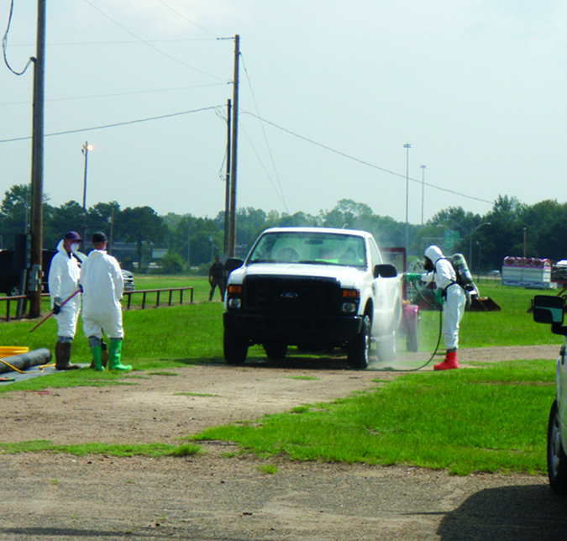
Vaccination Success
Proper vaccine handling and storage
Correct administration protocols
Appropriate animal handling methods
Biosecurity procedures
Animal ID and traceability
DIVA vaccines
Notes:
During an animal health emergency, responders may be required to perform large-scale vaccination of food animals and other livestock. Implementing a successful vaccination program which will help contain the spread of disease depends on:
Proper vaccine handling and storage
Correct administration protocols
Appropriate animal handling methods
Applicable biosecurity procedures
In addition, all response strategies involving vaccination may require vaccinated animal identification and traceability, and the diagnostic capability to differentiate infected from vaccinated animals (DIVA) for movement between zones, interstate commerce, and international trade. The decisions involved in implementing an emergency vaccination plan, as well as movement controls, and an effective, scalable permitting system will be based on information specific to the incident. This photo depicts tires, wheel wells, and the undercarriage being cleaned and disinfected prior to leaving the premises. Photo source: Carla Huston, Mississippi State University]

Slide 19
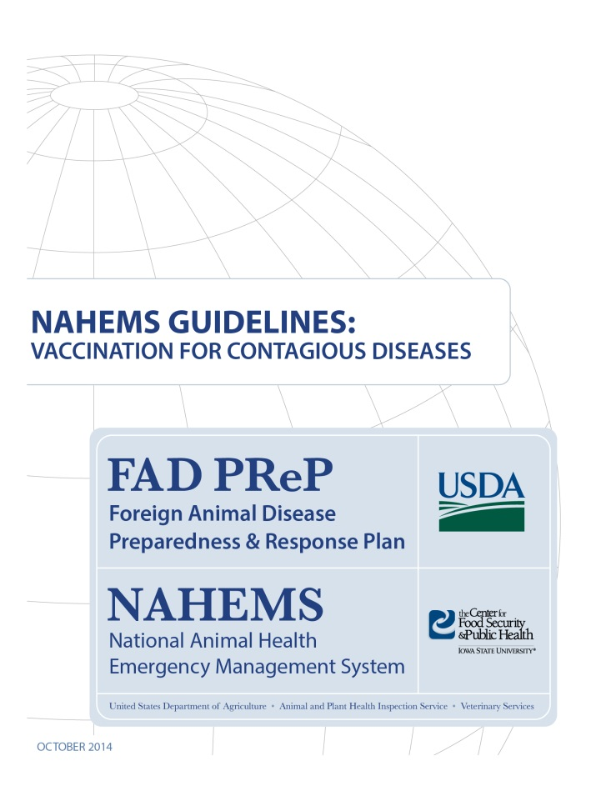
For More Information
FAD PReP/NAHEMS Guidelines: Vaccination for Contagious Diseases
  http://www.aphis.usda.gov/fadprep
Vaccination for Contagious Diseases web-base training module
  http://naherc.sws.iastate.edu/
Notes:
More details can be obtained from the sources listed on the slide, available on the USDA website (http://www.aphis.usda.gov/fadprep) and the National Animal Health Emergency Response Corps (NAHERC) Training Site (http://naherc.sws.iastate.edu/).

Slide 20
Guidelines Content
Authors (CFSPH)
Jim Roth, DVM, PhD, DACVM
Amber Stumbaugh, MS
Anna Rovid-Spickler, DVM, PhD
Danelle Bickett-Weddle, DVM, MPH, PhD, DACVPM
Janice Mogan, DVM
Heather Allen, PhD, MPA
Shaine DeVoe
Reviewers (USDA)
John Zack, DVM
Patricia Foley, DVM, PhD
R. Alex Thompson, DVM, PhD
John Wiemers, DVM, MS
Notes:
The print version of the Guidelines document is an excellent source for more detailed information. In particular, the Guidelines document has listings of additional resources. This slide acknowledges the authors and reviewers of the Guidelines document. It can be accessed at http://www.aphis.usda.gov/fadprep.

Slide 21
Acknowledgments
Development of this presentation was by the Center for Food Security and Public Health at Iowa State University through funding from the USDA APHIS Veterinary Services
PPT Author: Patricia Futoma, Veterinary Student, Iowa State University
Reviewers: Cheryl L. Eia, JD, DVM, MPH; Janice Mogan, DVM
Notes:
Information provided in this presentation was developed by the Center for Food Security and Public Health at Iowa State University College of Veterinary Medicine, through funding from the US Department of Agriculture, Animal and Plant Health Inspection Service, Veterinary Services.

