Slide 1
Vaccination for Contagious Diseases
Vaccine Administration
and Animal Handling
Adapted from the FAD PReP/NAHEMS
Guidelines: Vaccination for Contagious Diseases (2014)
Notes:
The control of a foreign animal disease outbreak may require large-scale vaccination of livestock and other domestic animals to minimize the impact on animal and public health, ensure continuity of the U.S. food supply, and minimize the economic impact on food producers. The principles discussed in this presentation are intended to provide general information to conduct large-scale vaccination of a variety of domestic animal species as may be required in an animal health emergency. Decisions regarding the choice of vaccine and the selection of animals to vaccinate will vary with the disease involved, species affected and the stage of the outbreak, and may change as the situation evolves. As always, it is important to evaluate each situation and adjust procedures to the risks present in the situation. [This information was derived from the Foreign Animal Disease Preparedness and Response (FAD PReP)/National Animal Health Emergency Management System (NAHEMS) Guidelines: Vaccination of Contagious Diseases (2014)].

Slide 2
This Presentation
Vaccines for foreign animal diseases
Vaccine administration
Handling and restraint for vaccination
Notes:
This presentation will provide information implementing an effective and safe emergency vaccination program, including:
Information concerning the availability of vaccines for foreign animal diseases
Guidance on vaccine administration in different species
Species-specific methods of handling and restraint for vaccination

Slide 3
Vaccines for Foreign Animal Diseases
Notes:
USDA APHIS has identified key terrestrial FAD threats that if introduced to the United States, or its Territories, may pose a severe threat to animal health and, in some cases, the economy and/or human health. These FADs may infect one or more species of animals. Some of the vectors that transmit FADs are found in the United States, while others are foreign to the United States. Examples of these diseases include highly pathogenic avian influenza, foot-and-mouth disease, and classical swine fever. Vaccines can be an important tool in an emergency response effort if a suitable vaccine is available and can be administered in a timely manner. Vaccination is intended to increase the disease resistance of susceptible animals to the disease, reducing the shedding of the FAD agent in infected or exposed animals, or both. A full listing of Key Terrestrial FAD Threats to the United States can be found in APHIS Foreign Animal Disease Framework: Response Strategies (FAD PReP Manual 2-0) (http://www.aphis.usda.gov/fadprep).

Slide 4
Vaccines for FADs
All vaccines used in US must be licensed by USDA
Vaccines do not exist for all FADs
Vaccines used elsewhere may or may not be USDA licensed
Circumstances impact availability
  Demand, cost to license and produce, pathogen, level of protection, trade implications, criteria for USDA licensure
Notes:
Many vaccines are manufactured in the United States; all vaccines used in the United States must licensed by USDA. However, vaccines do not exist for all animal diseases that are foreign to the United States. There are some vaccines for FADs that are used in other countries to control endemic situations, but they may or may not be licensed for use in the United States. Circumstances that broadly impact the availability of these vaccines in the United States include market demand, the manufacturer’s cost to achieve licensing by USDA and produce the vaccine, the pathogen, the specificity of the vaccine to protect against a potential disease threat, trade implications should animals be vaccinated, and ultimately meeting the USDA criteria for the license. Also, to be produced in the United States, the level of laboratory biosecurity and containment necessary for development and manufacturing may be elevated; the use of biosecure laboratories may be economically cost prohibitive depending on the demand for the vaccine. The Compendium of Veterinary Vaccines for Transboundary Diseases is intended to be an international web-based resource on the availability of vaccines for transboundary diseases (http://apps.cfsph.iastate.edu/Vaccines/index.php).

Slide 5
Vaccine Administration
Notes:
In a foreign animal disease outbreak that requires vaccination, decisions regarding which vaccines to use and which animals to vaccinate will vary with the disease involved, species affected, and stage of the outbreak, and may change based on evolving information about the situation. USDA licensed vaccines are not available for every foreign animal disease, however with science and technology, additional vaccines are being developed. It is important to use proper technique, route of administration, and the appropriate injection site when administering any vaccines. Ensure the animal is properly restrained to allow successful administration and to reduce the potential for causing injury to the animals and the responders.

Slide 6
Vaccine Administration
For all species:
  Use a new needle for each animal
  Dispose of needles appropriately
  Do not give multiple vaccinations in
  the same site on any animal
  No more then 10 ml in any one site, and separate injection sites by 4 inches
  Check to make sure needle has not punctured a blood vessel
  Maintain careful records on vaccinates
Notes:
During administration of vaccines in all species, remember the following:
A new needle should be used for injecting each animal when there is concern about spreading diseases between animals;
Ensure all needles are accounted for before and after administration. Properly dispose of all used needles in a puncture-proof container.
If giving multiple vaccinations to one animal, do not give them in the same site;
Do not administer more than 10mL in any one site, and separate injection sites by at least four inches;
To ensure that the needle has not inadvertently punctured a blood vessel, draw back the plunger of the syringe to see if any blood appears in the hub of the needle. If blood does appear, simply withdraw the needle, replace it, and try again.
Maintain careful records to identify each and every vaccinated animal.

Slide 7
Vaccine Administration cont’d
Specific route stated on the label
Most common routes
  SC, IM, IN, additional routes in poultry
  Recommended locations for administering injections vary
  among species
  Withdrawal times must be communicated and followed
Notes:
Vaccines licensed for use in the United States are approved for administration by a specific route stated on the label. The most common routes of administration of vaccines are subcutaneous injection (SC), intramuscular injection (IM), and intranasal administration (IN). The SC route injects the vaccine under a loose area of skin on the animal. The IM route injects the vaccine deep into a muscle. The IN route administers the vaccine onto the mucous membranes of the nasal cavity. Vaccination of poultry may also use oral, spray (or nebulization), eye drop, cutaneous scarification, and in ovo injection routes. Recommended locations for administering injections vary among species. Withdrawal time, the number of days from the time a vaccine is administered until the animal or its products such as milk may enter the food chain, must be communicated and followed. In an emergency situation, instructions will be provided by Incident Command on which vaccines to administer, which population of animals are to be vaccinated, which route of administration is appropriate, and recommended withdrawal times (if applicable).

Slide 8
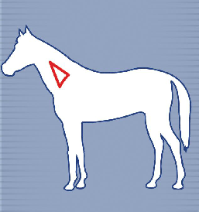
Equine
Neck is the preferred injection site for subcutaneous injection
Administer intramuscular vaccines in the neck
May administer in muscles of the hindquarters
Notes:
Recommended locations for administering injections vary among species. In the horse and other equines, the neck is the preferred injection site for subcutaneous injection of vaccines because of the relatively loose skin in this area. Most intramuscular vaccines in the equine are also administered in the neck. Insert the needle at a 90 degree angle into the triangle area indicated in the diagram, ensure the needle has not entered a blood vessel, and inject the vaccine dose. In some cases, intramuscular injections may be given in the large muscles in the hindquarters of this species. [This illustration shows the injection location on a horse. Illustration by: Andrew Kingsbury, Iowa State University]

Slide 9
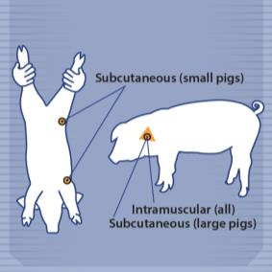
Swine
Small pigs
  Subcutaneous injections: loose flaps of flank skin or behind the elbow
Large pigs
  Subcutaneous injections in the neck, just behind and below the ear
Intramuscular injections: in the neck just behind and below the ear
Notes:
In small pigs, subcutaneous injections of vaccines should be given in the loose flaps of flank skin of the rear leg or below the elbow. In larger pigs, subcutaneous injections can be administered in the neck behind and below the ear and in front of the shoulder. Slide the needle under the skin and away from the site of skin puncture before depositing the vaccination. Intramuscular injections in all pigs should be given in the neck just behind and below the ear and in front of the shoulder similar to the subcutaneous injection site in large pigs. [This illustration shows the injection locations on a pig. Illustration by: Dani Ausen, Iowa State University]

Slide 10
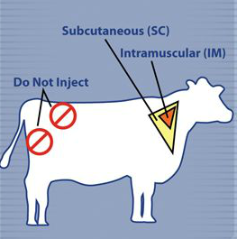
Cattle
Subcutaneous or intramuscular injections
  In triangular region of the neck
Do not inject the upper rump or upper butt
Notes:
To administer a vaccine subcutaneously to cattle, inject the vaccine at an acute angle in the illustrated triangular region of the neck where the skin and subcutaneous fat is thick, avoiding the need to tent the skin. Alternatively, the loose skin of the neck can be tented to position the subcutaneous injection. Injections into the muscle of cattle cause blemishing of the muscle, adversely affecting carcass value. Thus, whenever permitted by the vaccine label, it is best to give injections subcutaneously rather than intramuscularly. If a vaccine injection must be given intramuscularly, it should be given in the neck muscles in a triangle outlined by the shoulder, the vertebrae, and the nuchal ligament. Avoid giving any injections into the upper rump or upper butt, as these yield the more valuable cuts of meat. [This illustration shows the recommended injection locations on a cow. Illustration by: Andrew Kingsbury, Iowa State University]

Slide 11
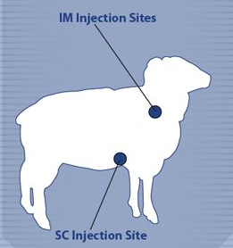
Sheep
Subcutaneous injections in the loose skin of axillary region
Intramuscular injections given in the neck muscles
Notes:
Subcutaneous injections in sheep are usually given in the loose skin of the axillary region, just behind the elbow, where sheep naturally do not have wool. The subcutaneous vaccinations are administered by making a tent of skin and injecting the vaccine. Intramuscular injections ideally are given in the neck muscles. [This illustration shows the recommended injection locations on a sheep. Illustration by: Andrew Kingsbury, Iowa State University]

Slide 12
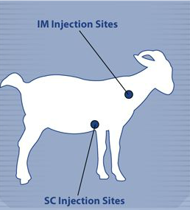
Goat
Subcutaneous injections: axillary region
Intramuscular injections in large muscles along the side of the neck
Notes:
Similar to sheep, in goats subcutaneous injections are commonly given in the axillary region, just behind the elbow. If possible, avoid injections into the muscles of goats because they can cause blemishing of the muscle, adversely affecting carcass value. Intramuscular injections may be given in large muscles along the side of the neck. [This illustration shows the injection locations on a goat. Illustration by: Andrew Kingsbury, Iowa State University]

Slide 13
Needle Sizes
Recommended needle sizes are based on:
  Species
  Age of the animal
  Route of administration
  Vaccine manufacturer’s recommendation
Notes:
Recommended needle sizes for vaccine administration are based on the species, age, and route of administration. The vaccine manufacturer may also provide recommendations for the choice of needle gauge and length. For further information consult FAD PReP/NAHEMS Guidelines: Vaccination for Contagious Diseases (2014).

Slide 14
Handling and Restraint for Vaccination
Notes:
Proper animal handling and restraint plays a key role in the health and welfare of livestock as well as the safety of personnel. The ability to effectively handle and restrain an animal or group of animals for vaccination is critical to the success of any vaccination program. Appropriate animal restraint will reduce the risk of injury and stress in livestock and personnel. Handlers should always work slowly and quietly. Handlers should be aware of the size and strength of the animals they are working with. In this presentation, we will discuss general handling, then species-specific handling recommendations, and lastly, provide guidance on species-specific vaccine administration.

Slide 15
Key Points of Handling
Safety is first consideration
All restraint should be imposed by experienced handlers
Use behavioral principles to move and restrain animals
Always leave an escape route
Notes:
Safety is always the first consideration. Be mindful of safety for the animal, and safety for the handlers. All restraint should be imposed by experienced handlers. Animal handlers should be trained to use behavioral principles to move and restrain animals. Other points to keep in mind include: Do not begin the restraint process until all the supplies and personnel are ready. Livestock unaccustomed to being handled may bolt, kick, or strike when frightened or startled. Breeding males and animals protecting their offspring can be especially dangerous. Handlers should always leave an escape route to avoid becoming trapped.

Slide 16
General Handling
Flight Zone, Point of Balance, Blind Spot
Notes:
Animal handlers should be trained to use behavioral principles such as flight zone and point of balance to make moving and handling the animal much easier, safer and less stressful. In general, animal(s) will turn towards the handler and will be inclined to stop moving when the handler is standing outside the flight zone (position A in the illustration), and will move away when the handler steps into the flight zone (position B). Invading an animal's flight zone too deeply can result in unpredictable behavior and possible injury to both the handler and animal. The size of the flight zone varies depending on the animal’s temperament and the extent of past handling. Most species have blind spots directly behind them where an animal may not see a handler, causing the animal to be startled. These are principles that can be applied to many species, not just the pig. [This illustration depicts a pig’s flight zone. Illustration source: Transportation Quality Assurance, National Pork Board]

Slide 17
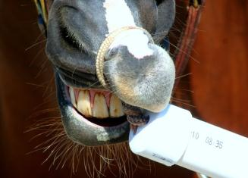
Equine Handling
Halters
  Most common method
Equine Stocks
  Different from cattle stocks, no head catch
  Never enter the stocks with a horse
Twitch
  Places pressure on a horse’s upper lip
Notes:
Halters are the most common method of restraint for equines accustomed to being handled. Equine stocks are commonly used for restraint. Stocks used for equine restraint are different from those used for cattle. The sides of the equine stocks are mostly open and stationary, and there is no head catch. For safety reasons, the handler should never enter the stocks with a horse. A twitch is a device that places pressure around a horse’s upper lip. The pressure distracts the horse during mildly painful procedures. Care must be taken not to apply a twitch too tightly or for too long to prevent injury to the lip. Other common methods of horse handling and restraint include: lead shanks, blindfolds and eyelid pressing as a distraction. Horses may bolt, kick, strike, or bite when frightened or aggressive, and should be handled by experienced individuals. Wild, feral, or horses unaccustomed to being handled should be treated with extreme caution, and handled with an alleyway or in stocks. [This photo illustrates a horse being restrained with a rope twitch applying pressure on the upper lip. Photo source: Patricia Futoma, Iowa State University]

Slide 18
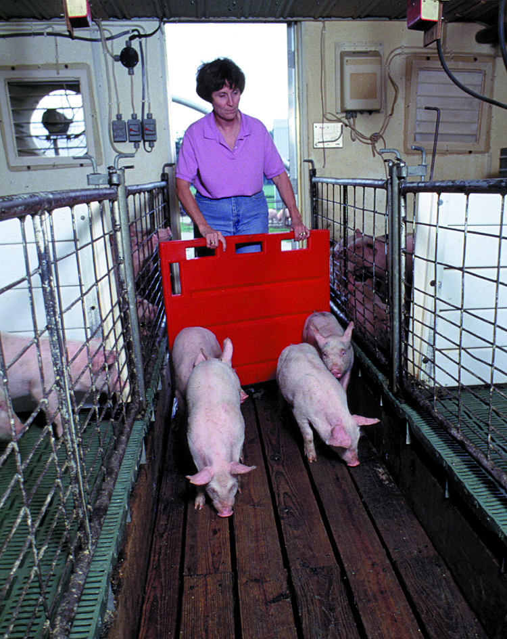
Swine Handling
Often placed into a
smaller pen
Young pigs may be held
Snare poles
Flags, plastic paddles or panels should be used as primary movement aids
Avoid overuse of electric prods
Notes:
When working with swine, work calmly and efficiently. Swine are frequently restrained as a group and moved using principles of the point of balance and flight zone. For handling and vaccination, pigs frequently are placed into a smaller pen giving them less room to move away. The pen size can be reduced by dividing it with a large panel. Young pigs may be held for vaccinations and other routine health care. Snare poles with a cable encircling the upper portion of the snout are a commonly used form of restraint. Flags, plastic paddles, or panels should be used as the primary movement aids. The frequent use of electric prods is detrimental to pig welfare because shocking increases body temperature, heart rate, and the incidence of stressed or non-ambulatory pigs. [This photo depicts swine being moved with a panel as the primary movement aid. Photo source: National Pork Board]

Slide 19
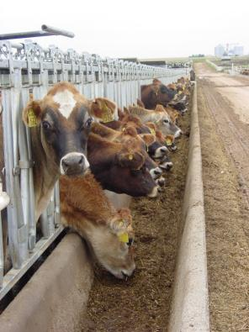
Cattle Handling
Chutes
  With or without headgates and metal arms
‘Lock ups’
  Dairy operations at the feed bunk
Notes:
Chutes, with or without headgates and metal arms to restrain the head, are commonly used for cattle. Dairy operations commonly have ‘lock ups’ at the feed bunk that can restrain the head and can accommodate multiple cows at a time. Keeping safety in mind, aside from hobby or project cattle, beef cattle are generally unaccustomed to being handled, and may be fearful of humans and protective of their calves. Dairy cattle are generally accustomed to being handled regularly for milking and reproductive examinations. [This photo is an image of multiple dairy cows in ‘lock ups’ at the feed bunk. Photo source: Danelle Bickett-Weddle, Iowa State University]

Slide 20
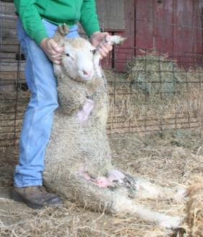
Sheep Handling
Approach slowly, calmly
‘Tipping’ restraint
  Set a sheep onto its rump
Cupping under jaw and behind head to restrain
Cupping under jaw and on dock of tail to move
Alleys and gates
Notes:
When handling sheep, approach them slowly and calmly. Never rush them or pull their wool. Different breeds of sheep may exhibit different behaviors. For example, Rambouillet sheep tend to flock together and remain as a group. Cheviots are more independent than other sheep breeds. Setting a sheep onto its rump, called ‘tipping’ is a common method of restraint. Sheep usually accept this position and it gives the handler access to the hooves and underside of the animal. Another method of restraint is to cup one hand under the bony part of the sheep’s jaw (not the throat), and place the other hand at the back of the sheep’s head. Pointing the nose upwards helps maintain control. To move a sheep to another location, place one hand under the sheep’s chin, and the other hand on the dock, or tail to encourage it to move forward, or use alleys and gates to simplify the process. Single out and catch an individual sheep by crowding the herd into a corner of the pen. Other methods of handling sheep include halters and headgates. [This photo depicts a sheep being set onto its rump, called ‘tipping.’ Photo source: Patricia Futoma, Iowa State University]

Slide 21
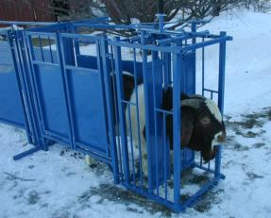
Goat Handling
Tall alleyways, fences
A chute with headgates
Halter
Fitting table or milking stand
Notes:
Goats are more agile than sheep and can be challenging to keep contained. Goats may be difficult to drive or herd, and will commonly find routes of escape. Alleyways, chutes, gates, and fences intended for handling goats are often at least 42 inches tall. Goats should not be restrained by their horns, however, be aware of the horns for safety purposes. For larger herds of goats, a chute with headgates or tall alleyways may be used for vaccination. Some goats are accustomed to handling and can be restrained with a halter. Dairy goats are handled more frequently than meat goats, and may be accustomed to a fitting table or milking stand. Different types of restraints are available for goats that are horned, and those without horns. Other common handling methods including crowding in a small pen, tables (often used for hoof trimming), and collars. [This photo depicts a goat in a chute with a headgate. Photo source: John Lynch, Sydell, Inc]

Slide 22
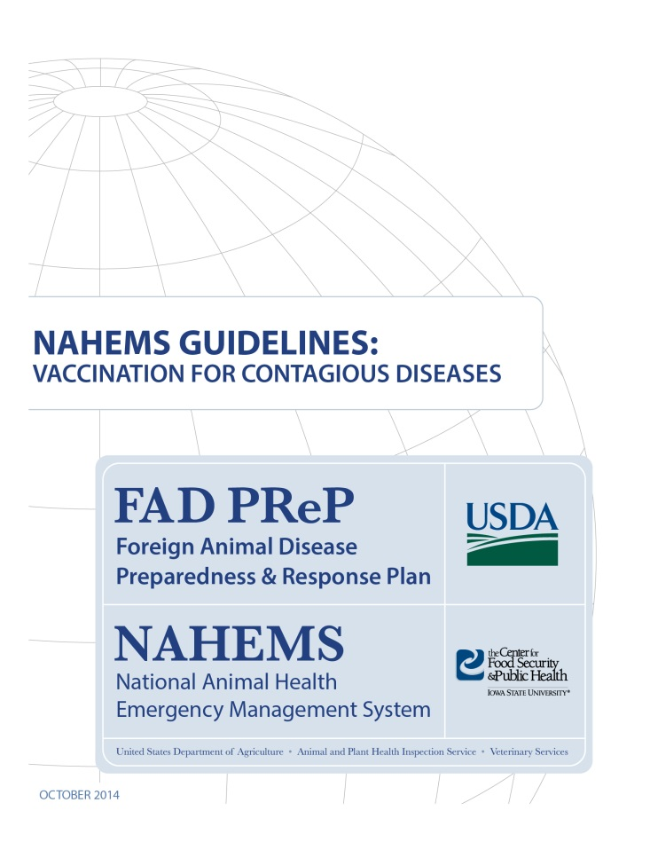
For More Information
FAD PReP/NAHEMS Guidelines: Vaccination for Contagious Diseases
  http://www.aphis.usda.gov/fadprep
Vaccination for Contagious Diseases web-base training module
  http://naherc.sws.iastate.edu/
Notes:
More details can be obtained from the sources listed on the slide, available on the USDA website (http://www.aphis.usda.gov/fadprep) and the National Animal Health Emergency Response Corps (NAHERC) Training Site (http://naherc.sws.iastate.edu/).

Slide 23
Guidelines Content
Authors (CFSPH)
Jim Roth, DVM, PhD, DACVM
Amber Stumbaugh, MS
Anna Rovid-Spickler, DVM, PhD
Danelle Bickett-Weddle, DVM, MPH, PhD, DACVPM
Janice Mogan, DVM
Heather Allen, PhD, MPA
Shaine DeVoe
Reviewers (USDA)
John Zack, DVM
Patricia Foley, DVM, PhD
R. Alex Thompson, DVM, PhD
John Wiemers, DVM, MS
Notes:
The print version of the Guidelines document is an excellent source for more detailed information. In particular, the Guidelines document has listings of additional resources. This slide acknowledges the authors and reviewers of the Guidelines document. It can be accessed at http://www.aphis.usda.gov/fadprep.

Slide 24
Acknowledgments
Development of this presentation was by the Center for Food Security and Public Health at Iowa State University through funding from the USDA APHIS Veterinary Services
PPT Author: Patricia Futoma, Veterinary Student, Iowa State University
Reviewers: Cheryl L. Eia, JD, DVM, MPH; Janice Mogan, DVM
Notes:
Information provided in this presentation was developed by the Center for Food Security and Public Health at Iowa State University College of Veterinary Medicine, through funding from the US Department of Agriculture, Animal and Plant Health Inspection Service, Veterinary Services.

