Slide 1
Vaccination for Contagious Diseases
Vaccine Delivery, Animal Identification, and Records
Adapted from the FAD PReP/NAHEMS
Guidelines: Vaccination for Contagious Diseases (2014)
Notes:
The control of a foreign animal disease outbreak may require large-scale vaccination of livestock and other domestic animals to minimize the impact on animal and public health, ensure continuity of the U.S. food supply, and minimize the economic impact on food producers. The principles discussed in this presentation are intended to provide general information to conduct large-scale vaccination of a variety of domestic animal species as may be required in an animal health emergency. Decisions regarding the choice of vaccine and the selection of animals to vaccinate will vary with the disease involved, species affected and the stage of the outbreak, and may change as the situation evolves. As always, it is important to evaluate each situation and adjust procedures to the risks present in the situation. [This information was derived from the Foreign Animal Disease Preparedness and Response (FAD PReP)/National Animal Health Emergency Management System (NAHEMS) Guidelines: Vaccination of Contagious Diseases (2014)].

Slide 2
This Presentation
Syringes, needles and other vaccine delivery systems
Animal identification
Record keeping
Notes:
This presentation will discuss the following topics:
Syringes, needles and other delivery systems used to administer vaccines to livestock and other domestic animals;
Methods and devices used to identify animals that may be recorded on official documents and help track the animal’s movements; and
Record keeping, particularly minimum information noted on vaccination records.

Slide 3
Syringes, Needles and Other Delivery Systems
Notes:
Selecting the appropriate instrument to deliver a vaccine is critical to the success of a vaccination program. Always consult the vaccine insert for the appropriate dose and route of delivery for a particular vaccine. When selecting a vaccination method, be sure to consider the number of animals being vaccinated, vaccine manufacturer recommendations, efficiency and risks involved.

Slide 4
Syringes and Needles
Single use disposable syringes
  Discard after single use
  Small groups
Automatic multi-dose syringes
  Large groups
Bottle-mount or draw-off syringes
  Large groups
Notes:
Single-use disposable syringes come in a variety of sizes, from 1cc to 60cc. They are relatively inexpensive and meant to be discarded after a single use. Single-use syringes are appropriate for parenteral vaccination of small numbers of animals and for vaccines that come in single-dose vials. Automatic multi-dose syringes usually hold a maximum of 50cc of vaccine. They can be adjusted to deliver a dose of 1cc to 5cc. They are efficient for vaccinating multiple animals. These syringes require cleaning and maintenance. Remember to thoroughly rinse away any detergents or disinfectants after cleaning to prevent deactivation of vaccines. Like automatic multi-dose syringes, bottle-mount or draw-off multi-dose syringes are convenient for vaccinating large numbers of livestock. This type of syringe attaches directly to the vaccine vial via a length of flexible tubing, making repeated punctures of the vaccine vial unnecessary. [This photo shows an automatic multi-dose syringe taken apart for cleaning. Photo source: Danelle Bickett-Weddle, Iowa State University]

Slide 5
Needle-Free Injection
Needle-Free Injection Systems
  Use compressed air or gas
  Injects vaccine into skin
  Bodily fluids less likely to contaminate delivery device
  Relatively expensive,
  difficult to maintain
Notes:
Needle-free injection systems are available from the vaccine manufacturer for some vaccines. This device uses compressed air or gas and a pressure amplifier to inject the vaccine into the skin of the animal without using a needle. The advantage to this type of system is that bodily fluids are less likely to contaminate the delivery device. These devices are relatively expensive to purchase and are difficult to maintain. Needle-free injection is not yet licensed for the majority of parenteral vaccines. [This photo is an example of a needle-free injection system for vaccine delivery. Photo source: Michael Dutcher, Pulse Needle Free Systems]

Slide 6
Other Delivery Systems
Intranasal pipettes
  Single use
  Usually supplied by manufacturer
Ocular drop bulbs/bottles
  Single use
  Usually supplied by manufacturer
Spray Vaccine
Notes:
Other types of delivery devices include intranasal pipettes, ocular drop bulbs or dropper bottles, and spray vaccine delivery systems. Intranasal delivery devices are meant for a single use and are usually supplied by the manufacturer with the vaccine. There may be stand-alone squeeze pipettes or plastic tubes that can attach to a disposable syringe. Ocular vaccine delivery devices are usually supplied by the manufacturer with the vaccine. The dropper bulb or bottle makes it easy to deliver a single drop to the eye. This type of delivery device is most commonly used for fowl. Spray vaccines are sometimes used to inoculate birds in one of two ways: either by inhalation of small particles or by ingestion and mucous membrane contact.

Slide 7
Animal Identification
Notes:
If emergency vaccination is necessary in the face of a disease threat, particularly an FAD event, identifying each individual animal with a nationally unique animal identification number (AIN) and associating that individual with a standardized location identifier at a point in time may be critical. In some circumstances, an alternative may be to identify a group of animals rather than identifying each individual, for example in swine and poultry. It is essential to have accurate information on which animals have been vaccinated in order to manage a disease outbreak. Keeping accurate records such as date, geographic location of the animal, and type of vaccine hinges on the ability to identify to which animal(s) the record refers. In the case of livestock, uniquely identifying individuals, pens, lots, groups, or herds of animals may be necessary to track vaccination records, testing results, or other information for the emergency response. Many, but not all, locations where livestock are housed are uniquely identified with their State or Tribal Nation.

Slide 8
Animal Disease Traceability
System for routine movements
  Officially identified and accompanied
  by ICVI (unless exempt)
  Or other, if agreed upon by shipping
  and receiving State
  ID - official vs herd management
  Record official ID on official documents to trace location
  Agreement between States
Notes:
The United States has a flexible, effective animal disease traceability system for livestock moving interstate under routine circumstances. Unless specifically exempted, livestock moved interstate need to be officially identified and accompanied by an Interstate Certificate of Veterinary Inspection (ICVI). When agreed upon by the shipping and receiving States, other movement documentation and methods of identification may be used. Some livestock identification methods and devices used for interstate movement and disease control programs are recognized as official, and some are used only for herd management purposes. Some official devices and methods are used in multiple species, while others are species-specific. It is required to record all official identification on official animal disease control documents such as test charts, vaccination records, movement permits, sample submission forms, etc. so the animal’s location can be traced through time. Any form of temporary ID, if present, should be recorded as well. It is important to note that some of the ID methods are considered official only when approved and agreed upon by the animal health officials in the shipping and receiving States or Tribes. Other methods may be approved by the APHIS Administrator.

Slide 9

Animal Disease Traceability
Minimum standard for official ID in some species
  Visual eartag
  Example, cattle AIN eartags
    AIN - 15-digit number starting
    with 840 denoting U.S.
    Official Eartag Shield
    Unlawful to Remove
    Manufacturer’s Logo or Trademark
    (printed or impression of)
Notes:
The minimum standard for official identification of some species is a visual eartag.
For example, when using the 840 Animal Identification Number (AIN) for cattle, the minimum identification standard is the visual AIN eartag. Eartags with the AIN are USDA official tags and are designed for one-time use (tamper evident) and imprinted with:
AIN (15-digit number starting with 840 denoting Unites States)
Official Eartag Shield
Unlawful to Remove
Manufacturer’s Logo or Trademark (printed or impression of)
[This graphic is an illustration of the official eartag shield that appears on official cattle 840 AIN eartags. Graphic illustration by: Dani Ausen, Iowa State University]

Slide 10
Emergency Vaccination ID
Official, permanent ID of vaccinates
Temporary identification
  On-farm management
  Supplemental form of ID
  Link to official ID in records
  Guidance from Incident Command
  Compliance with Federal and State regs
Notes:
If emergency vaccination is going to be used as part of an FAD response, official, permanent identification of all vaccinated animals may be necessary. Temporary forms of identification of livestock are not official but may be used for on-farm management and as a supplemental form of ID. Any form of temporary ID should be linked to the official identification device in the records. Based on the circumstances and the nature of the outbreak, guidance will be provided by Incident Command; any action will be in compliance with relevant Federal and State regulations. Information on USDA official identification devices, and species-specific identification and documentation requirements can be found at USDA Animal Disease Traceability (http://www.aphis.usda.gov/traceability).

Slide 11
Permanent Identification
  Radio frequency identification (RFID)
  Tattoos
  Brands
  Ear notches
  Ear tags
  Microchips
Notes:
There are multiple animal identification methods and technologies available for livestock and other domestic animals. Some are considered permanent, and some are considered temporary, which usually are used for on-farm management or at auction markets. Some ID methods and technologies are species-specific. This slide lists some types of permanent identification methods - Radio frequency identification (RFID), tattoos, brands, ear notches, ear tags, and microchips. Acceptance of these as official permanent identification for routine movement may be based on agreement between shipping and receiving States. Guidance on proper identification of animals vaccinated during an emergency FAD response will be provided by Incident Command.

Slide 12
Radio Frequency ID (RFID)
Long term identification
Unique number identifies individual
Number read by ‘scanner’
Data can be captured on computer
Variety of devices for various species
  Ear tags, ear buttons, microchips
Notes:
Radio frequency identification (RFID) is utilized in a variety of permanently attached animal identification devices. These devices contain transponders that use radio waves to transmit the identity in the form of a unique serial number assigned to that individual animal. The number is detected with a reader device (scanner) and the data can be transferred to a computer. Livestock producers in the U.S. are moving toward this form of identification due to advantages of automated data capture systems for eradicating diseases. A variety of identification devices incorporating RFID technology are available for different species, including ear tags and ear buttons, and microchips. RFID devices are commonly used in cattle and sheep as RFID devices placed in ear buttons.

Slide 13
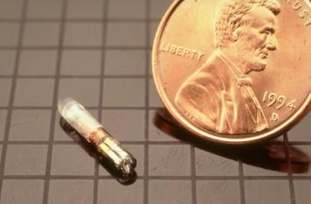
Radio Frequency ID (RFID)
Microchips
  Horses - neck
  Dogs and cats - shoulder
Read by hand held scanner - specific
Universal scanners
are ideal
Notes:
Radio Frequency Identification (RFID) such as a microchip is a long-term method of identifying horses and companion animals. Microchips are small transponders, about the size of a grain of rice, injected under the skin. In horses, the microchip is commonly implanted in the nuchal ligament from the left side, in the middle third of the neck, halfway between the ears and withers. In dogs and cats, microchips are regularly placed between the shoulder blades, although some chips may migrate beneath the skin as far as the ventral chest. Most microchips are read by hand held scanners. Many scanners are brand-specific, and are not capable of reading the codes from other brands of microchips, even if they emit at the same frequency. Universal scanners capable of reading any brand of microchip are ideal for emergency situations. [This photo depicts a microchip with a U.S. penny for size comparison. Photo source: USDA]

Slide 14
Tattoos
A permanent mark made by the injection of colored ink under the skin
May provide a unique number
Locations vary with the species
Commonly used in horses, swine, sheep and goats
Notes:
A tattoo is a permanent mark made by the injection of colored ink under the skin. Tattoos comprised of numbers are commonly used to identify livestock. The tattooed number may be unique to that individual animal, or registered and assigned to a particular farm where the identical tattoo is applied to all animals produced by that farm. Tattoo locations vary with species. Horses may be individually identified by a tattoo inside the upper lip, with that tattoo number registered with a breed registry. Pigs produced by a particular farm may be tattooed on the outside of the ear. Tattoos are commonly used in horses, swine, sheep and goats.

Slide 15
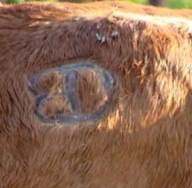
Brands
Permanent mark on hide
Usually identifies owner
Registered with brand inspection agency
Note brand and brand location
Commonly used in horses, cattle, and goats
Notes:
A brand is a permanent mark created on the hide by the application of a hot or cold device, and usually identifies the owner of the animal. The brand is often registered with an official brand inspection agency and accompanied by an official brand inspection certificate. When recording identifying brands, note both the brand and the location of the brand, as the brand location will also be part of the registered information. Brands are commonly used in horses, cattle, and goats. [This photo shows a cow with an identifying brand on its right hip. Photo source: Beth Carlson, North Dakota]

Slide 16
Ear Notches
Small “V” shaped sections removed from the ear edge
Notched for animal
health management and husbandry purposes
Common in the swine industry
Notes:
Ear notches are a form of on-farm animal identification where small “V” shaped sections are removed from the edge of the ear using a special instrument. When pigs, sheep or goats are born, their ears may be surgically notched for animal health management and husbandry purposes. Ear notching is commonly used in the swine industry, providing identification of the animal as an individual or member of a group. [This photo shows a pig with identifying ear notches. Photo source: Danelle Bickett-Weddle, Iowa State University]

Slide 17
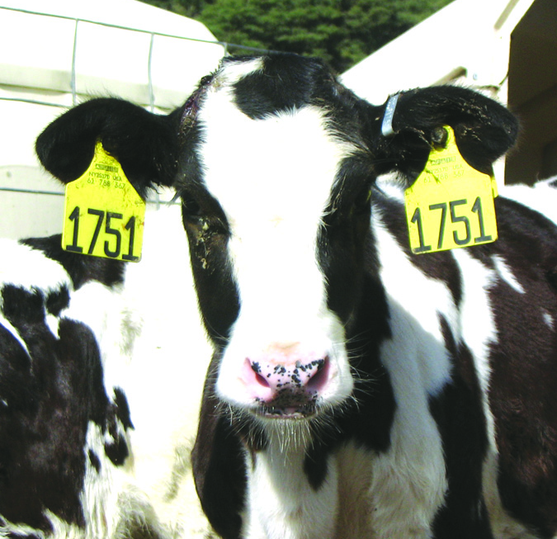
Ear Tags
Variety available
Plastic hang tags that come in a variety of shapes, sizes and colors
Metal tags (brucellosis)
RFID technology
Ear tags used in cattle, pigs, sheep and goats
Notes:
Ear tags are available as plastic dangle tags, metal tags, radio frequency identification (RFID) tags, visual button tag, or some combination thereof. Plastic dangle or hang tags have visually readable numbers and come in a variety of shapes, sizes, and colors. The tags can be purchased either blank or pre-numbered. The shape, color, size, and numbering system of these tags will vary by facility. Often, animals will have an identical tag in each ear, so that the animal can still be identified should one of its ear tags be lost. In cattle, metal tags (orange brucellosis ear tags and bright ear tags) may also be used. For cattle herds that are vaccinated for brucellosis, metal orange brucellosis vaccination tags are placed in the right ear. In herds that do not vaccinate calves for brucellosis, a metal silver ‘bright’ tag can be placed in the right ear and serves as an official form of identification of cattle. Licensed veterinarians can obtain these tags from their State. Some ear tags may also incorporate the RFID technology. Official visual eartags or RFID tags may be purchased from approved manufacturers, from tag managers, or from animal health officials. Ear tags in some form are commonly used in cattle, pigs, sheep and goats. [This photo shows a Holstein calf with matching ear tags in each ear. Photo source: Vicky Olson, Quality Milk Production Services]

Slide 18
Temporary Identification
Temporary Identification
  Temporary marks made on hide
  Stall cards
  USDA back tags
  Collars
Notes:
There are several types of temporary identification that can be used in various species. A few common methods of temporary identification are temporary marks made on the hide, stall cards, USDA back tags, and collars.

Slide 19
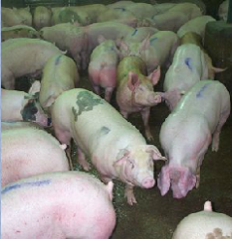
Temporary Marks on Hide
Temporary markings can be made on hide with:
  Chalk, wax pen, permanent marker or a paint brand
Commonly used during vaccination or other health care procedures
Commonly used in cattle, swine, and small ruminants
Notes:
Temporary markings can be made on the hide with chalk, wax pen, permanent marker, or a paint brand. This method of identification is frequently used during medical and health care procedures such as vaccination to identify the animals that have completed the process. Temporary marks on the hide are commonly used in cattle, swine, and small ruminants. [This photo depicts temporary blue marks made down the backs of a group of pigs. Photo source: Lowell Anderson, USDA APHIS]

Slide 20
Stall Cards
Simple document attached to a stall, animal enclosure or pen with animal information
Contain a complete physical description
Could contain a photo
Commonly used in horses
Notes:
Stall cards are a simple document attached to a stall, animal enclosure, or pen with animal information. Ideally the stall card should contain a complete physical description such as color, markings, such as leg and face markings, gender, RFID number, brand, or tattoo. Photos could also be used on the stall card to help identify the animal. Equine facilities often use stall cards as an additional form of identification for horses, but are also used for other species.

Slide 21
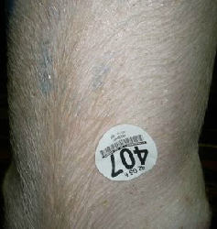
USDA Backtags
A sticky tag placed on the animal’s back, often referred to as an auction or hip tag
Very temporary, often used with other forms of identification
Commonly used in swine, cattle and goats
Notes:
A back tag is often referred to as an auction or hip tag. It is a sticky tag placed on the animal’s back, usually with a visible number. Back tags may be placed on livestock when they are received at an auction market. Because they are so temporary, they are usually used with other forms of identification. Commonly used in swine, cattle, and goats. [This photo illustrates a USDA back tag on a pig. Photo source: Stephen Lewis, USDA Food Safety Inspection Service]

Slide 22
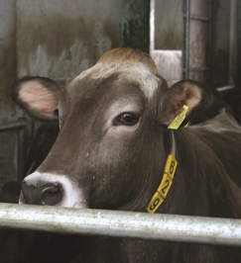
Collars or Neck Straps
Collars or neck straps are similar to dog collars
  Larger, with identification
Used with visually identifiable number or radio-frequency device
Commonly used on dairy cows and dairy goats
Notes:
Collars or neck straps are similar to dog collars, but are larger and carry a form of identification, most often used for on-farm management. Some operations use neck collars with a visually identifiable number and/or a radio-frequency device that can be scanned with a specialized reader. Collars are commonly used on dairy cows and dairy goats, and frequently used in dairy animals or for judging contests. Temporary forms of identification of livestock are not considered official but serve as a supplemental form of ID. Any form of temporary ID should be linked to the official identification device in the records. [This is a photo of a dairy cow wearing an identification collar. Photo source: Danelle Bickett-Weddle, Iowa State University]

Slide 23
Record Keeping
Notes:
Accurate and accessible record keeping is crucial to the success of any vaccination effort. Sufficient data must be recorded to determine which individual animal or herd was vaccinated on a particular date against which disease(s), and to trace the vaccine source and lot number. In an emergency vaccination effort, instructions will be provided as to what information should be recorded. Vaccination records must be available to those involved in coordinating the emergency vaccination program in order to plan and to assess outcomes. The Emergency Management Response System (EMRS) 2.0 is the system of record for all FAD incidents. The EMRS 2.0 is a web-based application used for the reporting of routine investigations of FADs, surveillance and control programs, State-specific disease outbreaks, and national animal health emergency responses (all-hazards).

Slide 24
Vaccination Record
Individual animal or group identification
  Devices and number(s)
Owner’s name and
mailing address
Signalment
  Species, age, sex, breed
Vaccination date
Notes:
The next two slides list the minimum information to include on a vaccination record. Recording the identity of the individual animal or the group, preferably by some form of permanent official identification, is essential. The owner’s name and contact information, such as the mailing address, is important for tracing and future communication. The signalment will provide a further description of those animals vaccinated. The date of vaccination should be noted. [This photo depicts one method of recording accurate vaccination records. Photo source: Danelle Bickett-Weddle, Iowa State University]

Slide 25
Vaccination Record
Vaccination route and anatomical site
Vaccine information
  Brand or manufacturer
  Product name or number
  Lot number
  Expiration date
Withdrawal date (for food-producing animals)
Notes:
In addition, record the route of vaccination and the vaccination site on the animal where the vaccine was administered. Note all the information pertaining to the vaccine that was administered. For food-producing animals, the withdrawal time must be recorded and communicated to the owner. The vaccination withdrawal time is the period between the administration of the vaccination and the time the vaccinated animal or products from that animal can legally enter the human food chain. Animals may not be sent to market until the withdrawal time has elapsed. The withdrawal time is stated in the product license. Again, in an emergency vaccination effort, instructions will be provided as to what specific information should be recorded.

Slide 26
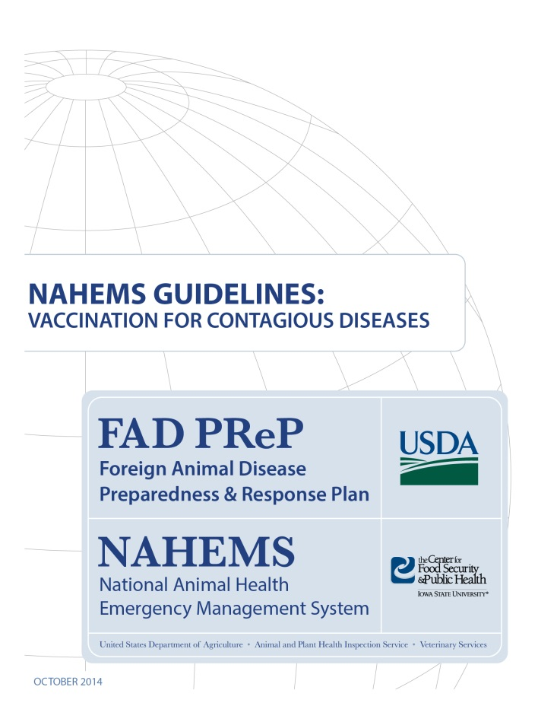
For More Information
FAD PReP/NAHEMS Guidelines: Vaccination for Contagious Diseases
  http://www.aphis.usda.gov/fadprep
Vaccination for Contagious Diseases web-base training module
  http://naherc.sws.iastate.edu/
Notes:
More details can be obtained from the sources listed on the slide, available on the USDA website (http://www.aphis.usda.gov/fadprep) and the National Animal Health Emergency Response Corps (NAHERC) Training Site (http://naherc.sws.iastate.edu/).

Slide 27
Guidelines Content
Authors (CFSPH)
Jim Roth, DVM, PhD, DACVM
Amber Stumbaugh, MS
Anna Rovid-Spickler, DVM, PhD
Danelle Bickett-Weddle, DVM, MPH, PhD, DACVPM
Janice Mogan, DVM
Heather Allen, PhD, MPA
Shaine DeVoe
Reviewers (USDA)
John Zack, DVM
Patricia Foley, DVM, PhD
R. Alex Thompson, DVM, PhD
John Wiemers, DVM, MS
Notes:
The print version of the Guidelines document is an excellent source for more detailed information. In particular, the Guidelines document has listings of additional resources. This slide acknowledges the authors and reviewers of the Guidelines document. It can be accessed at http://www.aphis.usda.gov/fadprep.

Slide 28
Acknowledgments
Development of this presentation was by the Center for Food Security and Public Health at Iowa State University through funding from the USDA APHIS Veterinary Services
PPT Author: Patricia Futoma, Veterinary Student
Reviewers: Cheryl L. Eia, JD, DVM, MPH; Janice Mogan, DVM
Notes:
Information provided in this presentation was developed by the Center for Food Security and Public Health at Iowa State University College of Veterinary Medicine, through funding from the US Department of Agriculture, Animal and Plant Health Inspection Service, Veterinary Services.

