Slide 1
Personal Protective Equipment
Donning and Doffing
Adapted from the FAD PReP/NAHEMS
Guidelines: Personal Protective Equipment (2011)
Notes:
Veterinary responders are needed in emergency situations that threaten animal health, such as the natural occurrence or intentional introduction of a highly contagious foreign animal disease (FAD). This presentation will provide an introduction to Personal Protective Equipment (PPE) Levels, and donning (putting on) and doffing (removing) of PPE Level C that may be utilized in an animal disease emergency. It is the responsibility of the veterinary responder to understand the required PPE and use it correctly. [This information was derived from the Foreign Animal Disease Preparedness and Response (FAD PReP)/National Animal Health Emergency Management System (NAHEMS) Guidelines: Personal Protective Equipment (2011) and also the web-based training module.]

Slide 2
Personal Protective Equipment (PPE): Levels
Notes:
In an animal disease emergency such as an FAD outbreak, PPE has two important purposes: to protect the responder from potential hazards, and to prevent the spread of disease agents. The Occupational Safety and Health Administration (OSHA) classifies PPE into four different levels, depending on the degree of protection for the user. Of the four levels defined by OSHA (Level D through Level A), Level C is the level of protection that will be used in most animal disease emergencies. The most effective use of PPE is dependent on the selection, use and maintenance of individual PPE items. For more information of PPE and its role in biosecurity, consult the FAD PReP/NAHEMS Guidelines: Biosecurity.

Slide 3
PPE Levels
Four OSHA classifications
  Level D: lowest level of protection
  Level C: appropriate in most animal emergency disease situations
    Includes respiratory protection
  Level B: highest level of respiratory protection
  Level A: highest level of respiratory,
  skin, and eye protection
Notes:
The levels of protection, as classified by OSHA, range from D (the lowest level of protection) to A (the highest level of protection).
Level D: This is the lowest level of protection and consists of a basic work uniform to protect against nuisance contamination. For example, this would be sufficient for responding to a non-zoonotic, vector-borne animal disease in the absence of a respiratory hazard.
Level C: This level is used when the concentration and types of airborne substances are known and the criteria for using air purifying respirators are met. This level would be recommended when responding to a highly pathogenic avian influenza (HPAI) outbreak. General agreement exists that Level C PPE would be adequate protection for veterinary responders in most situations.
Level B: This level is used when the highest level of respiratory protection is necessary but a lesser level of skin protection is needed than in Level A. This may be the level required in a Nipah virus outbreak.
Level A: This is the level of protection selected when the greatest level of respiratory, skin, and eye protection is required. An example where this level would be required would be when responding to a large chlorine spill.

Slide 4
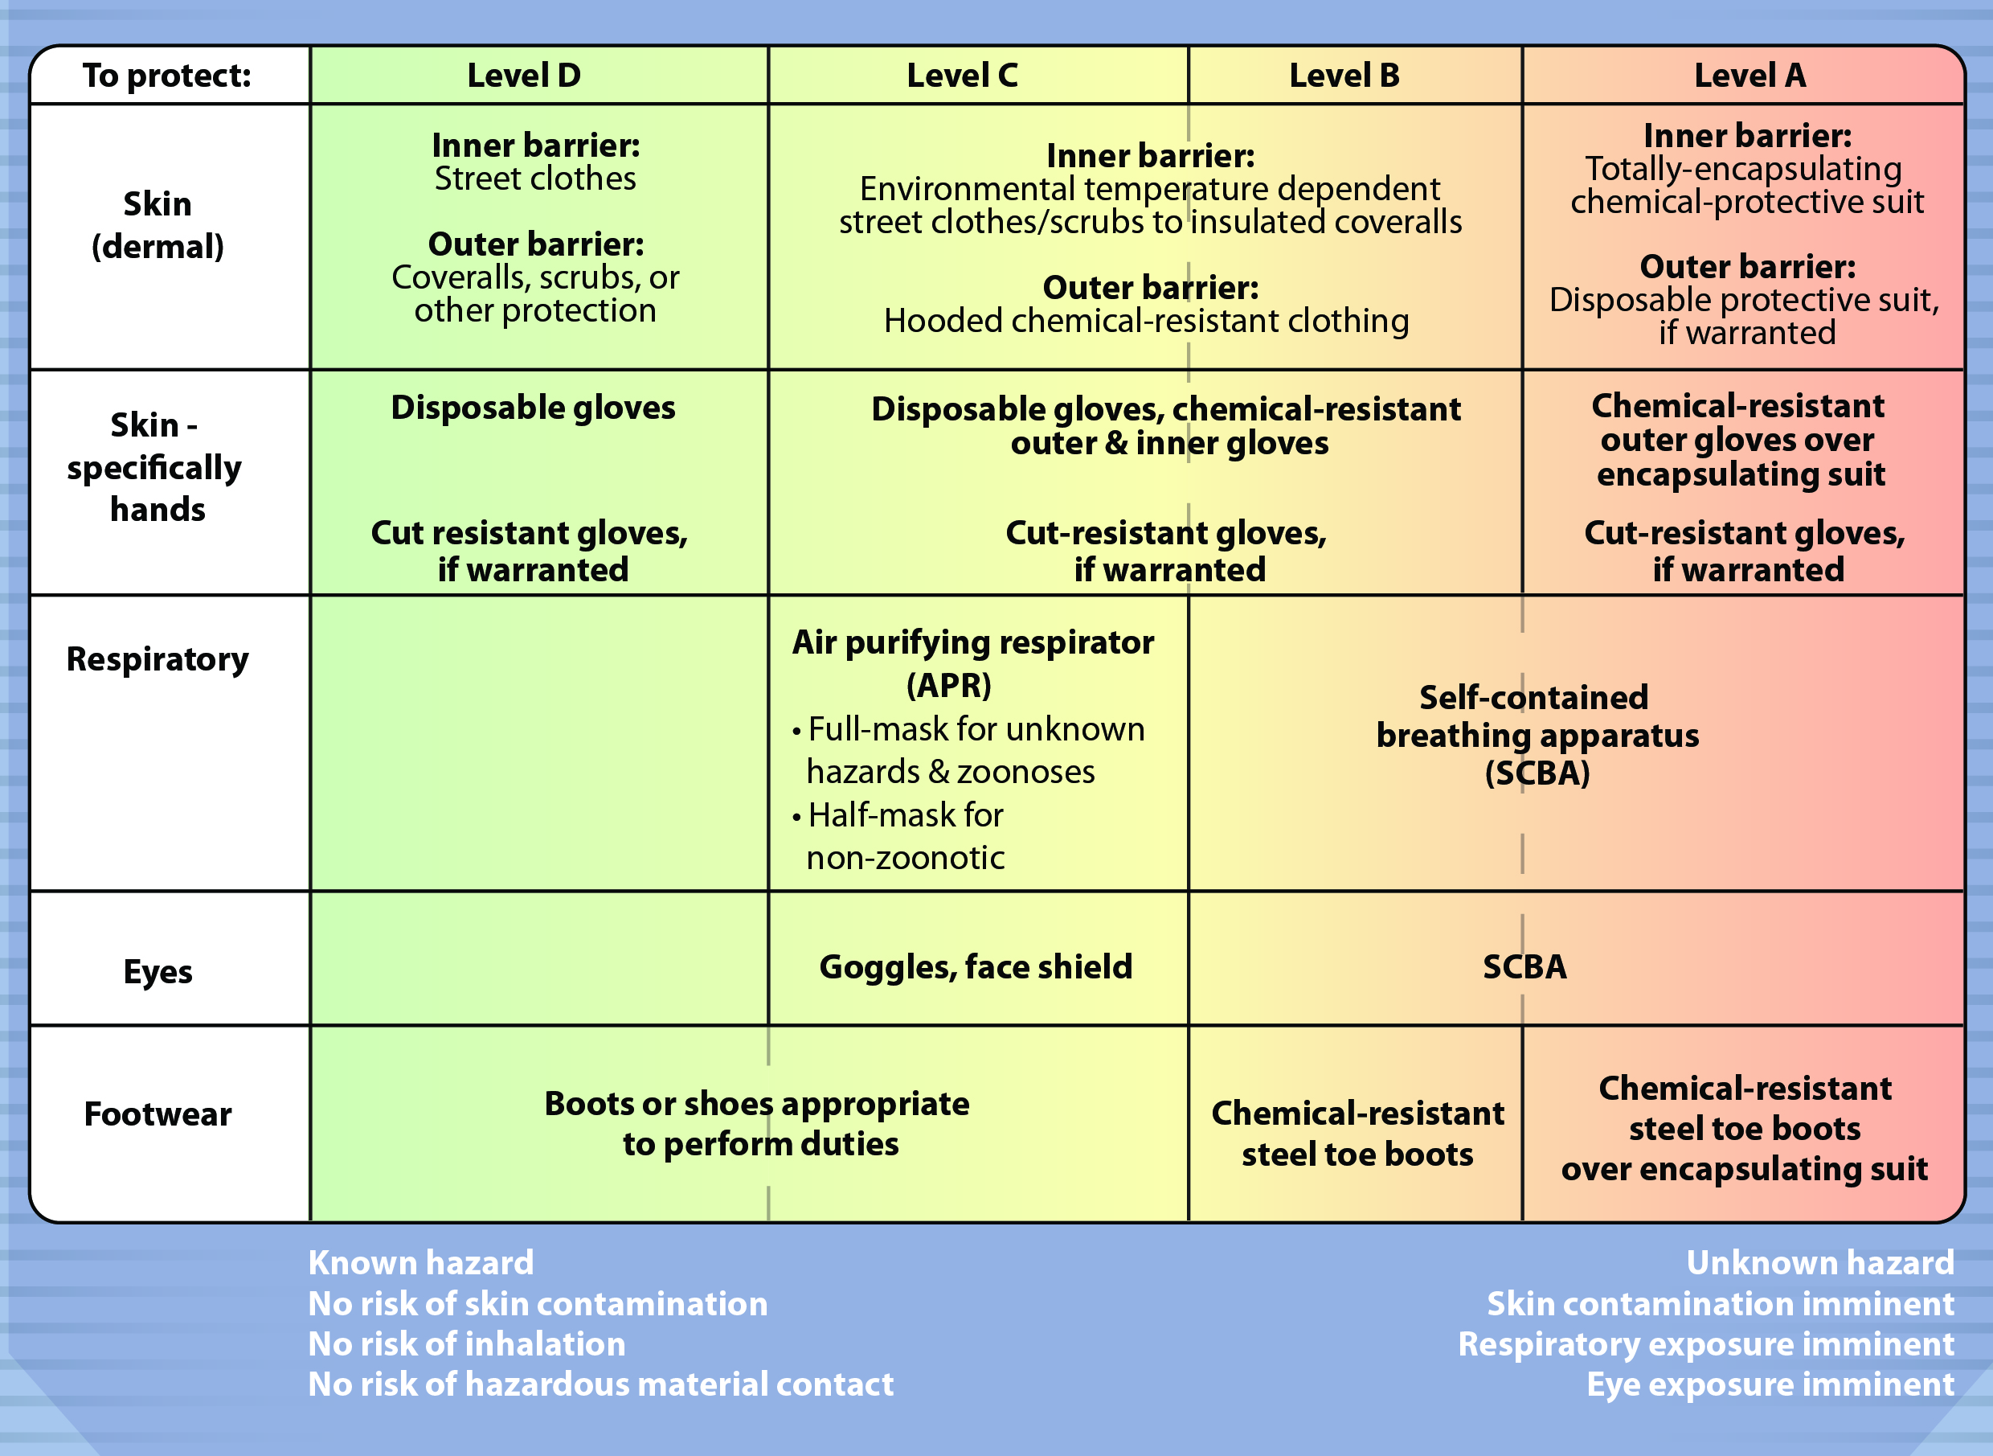
PPE Levels
Notes:
This table lists the four PPE Levels as classified by OSHA and the equipment appropriate to provide that level of protection. Emergency response activities in which veterinary responders are involved will almost never necessitate the use of Level B or A PPE. Veterinary responders should focus on Level C. However, it is possible that veterinary responders may be needed to assist in emergency situations where these expanded levels of protection will be required. A basic familiarity with all levels of PPE protection will expedite onsite training in an actual animal health emergency. [This chart illustrates the protective equipment based on PPE level. Illustration by: Andrew Kingsbury, Iowa State University]

Slide 5
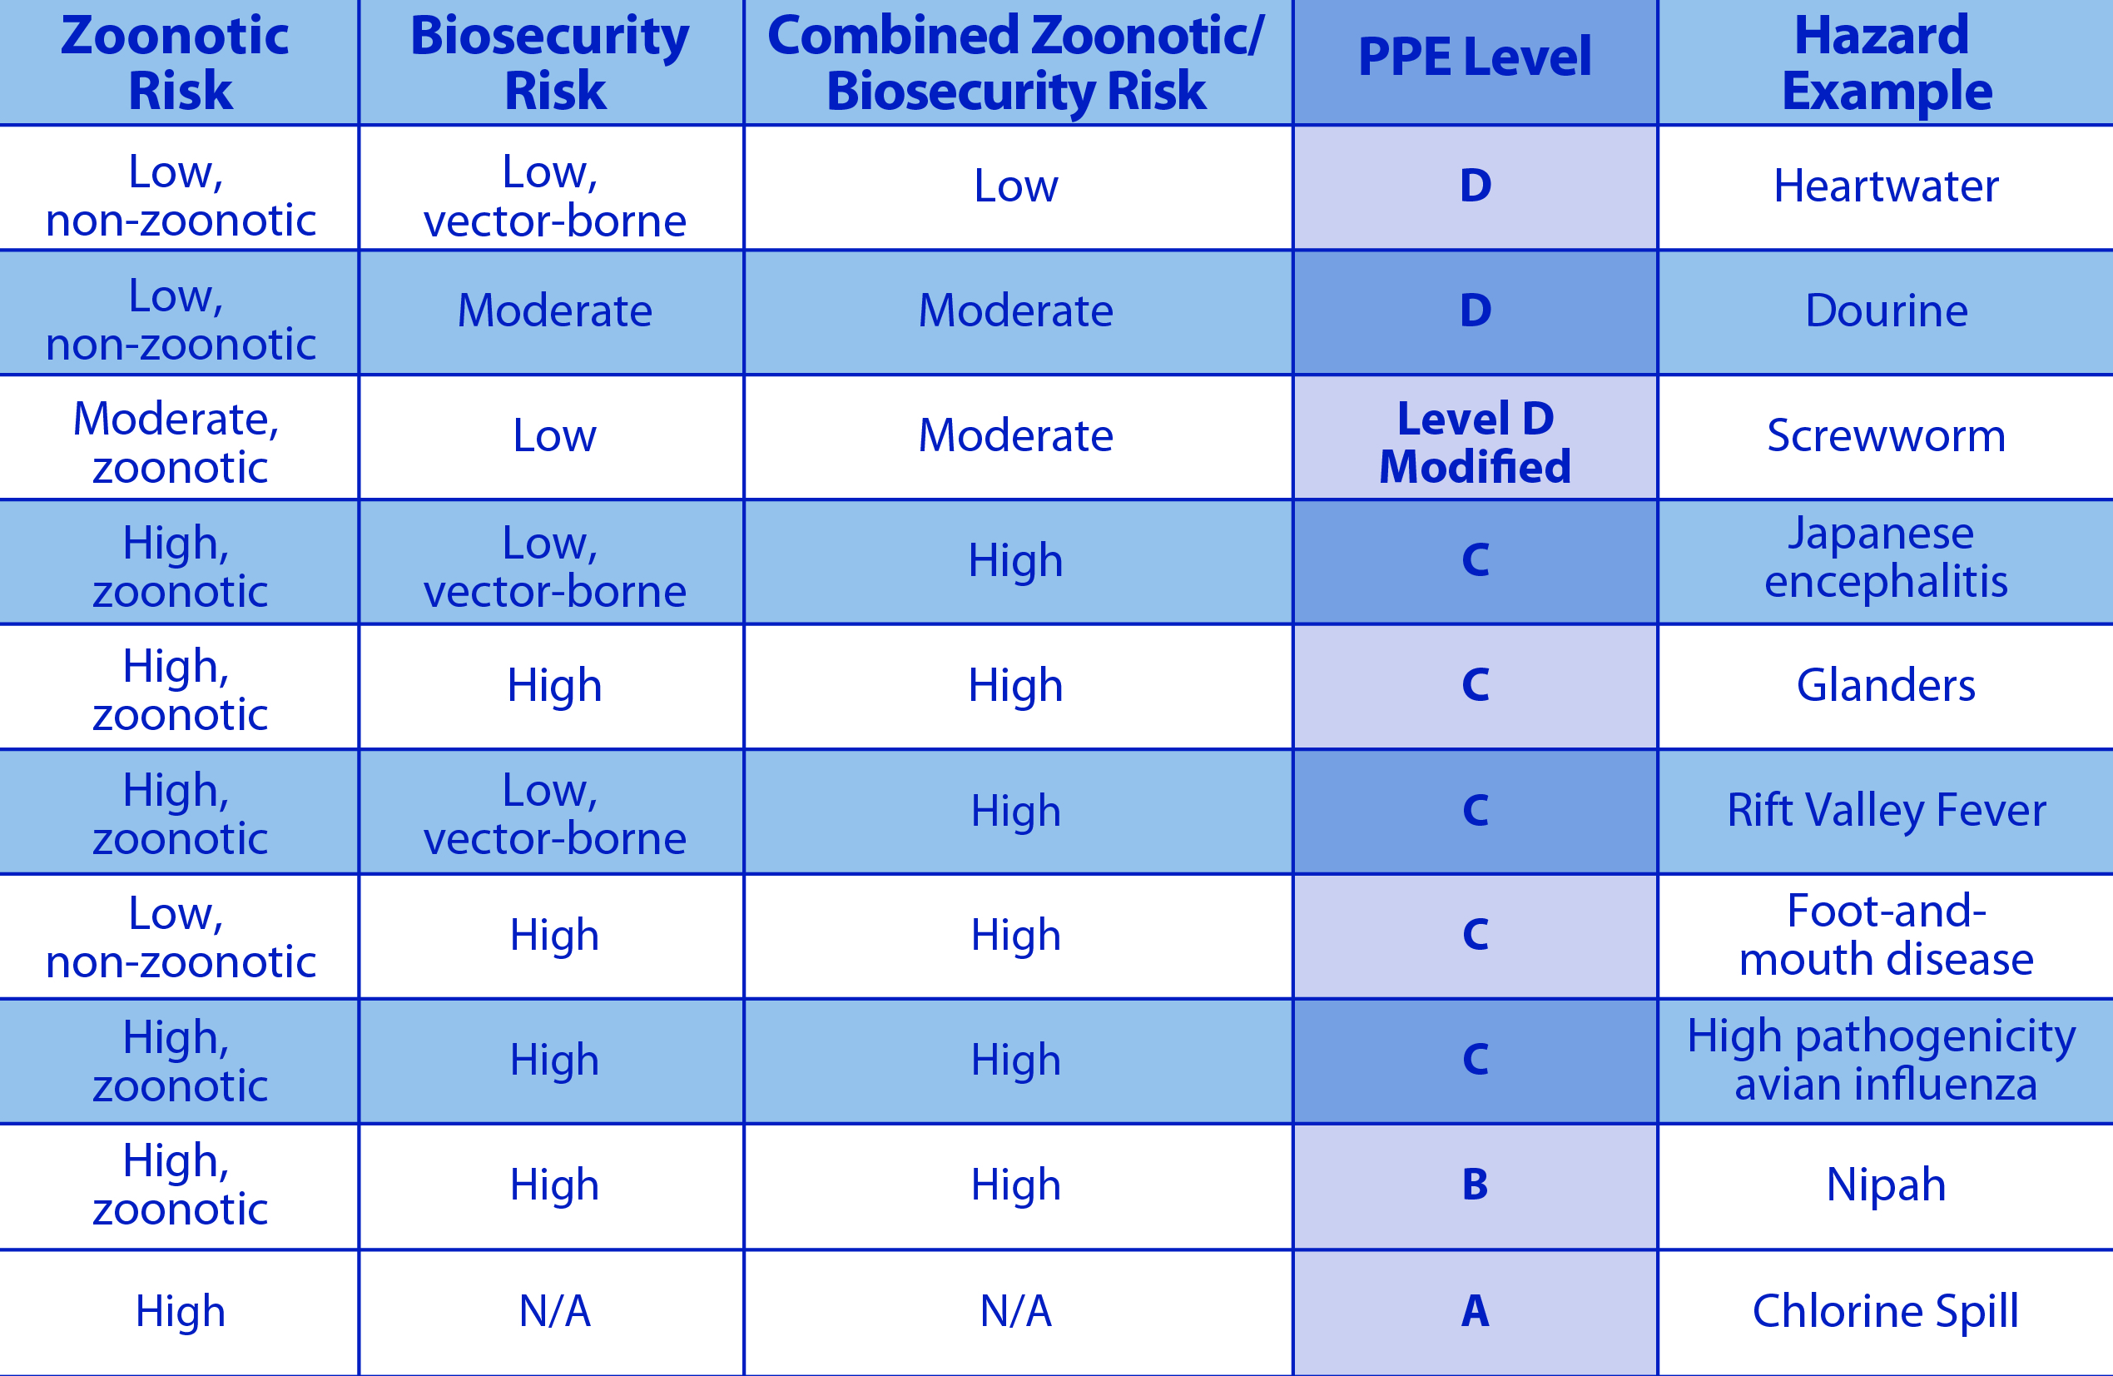
PPE Levels: Combined Risk
Notes:
In an animal disease emergency, PPE serves to protect the responders, as well as a biosecurity tool to prevent the spread of disease. This table suggests the minimum level of PPE an individual should wear based on zoonotic and biosecurity risk of the hazard. However, the decision is always based on the risk assessment of the specific circumstances. The route of transmission and potential method of exposure to a zoonotic disease as well as potential exposure to any respiratory hazard are especially important considerations. Where the zoonotic risk of a disease is greater than its biosecurity risk, zoonotic risk takes precedence. For most disease agents found in livestock, Levels D and C are appropriate. If information about the outbreak suggests serious human threat, higher levels of protection must be considered. [This table shows PPE levels based on combined zoonotic and biosecurity risk. Illustration by: Katlyn Harvey, Iowa State University]

Slide 6
Donning and Doffing
Preparation
Notes:
Donning is the procedure of assembling PPE on the user. Doffing is the procedure for removal of PPE. Responders should only don PPE for which they have been thoroughly trained, medically cleared to use, and fit tested to wear.

Slide 7
Donning Guidelines
Safety of responder – primary
Understand and follow protocols
Establish work zones
  Hot Zone
  Warm Zone
  Cold Zone
Plan exit before entering
Notes:
In an animal disease emergency, the primary focus is responder safety while performing tasks. Protocols for biosecurity, decontamination, and any zoonotic disease protection should be well understood. Establish three work zones and a Decontamination Corridor to help protect responders and contain the hazard. The three major work zones are the Hot Zone (Exclusion Zone), Warm Zone (Contamination Reduction Zone), and the Cold Zone (Support Zone). Donning takes place in the Cold Zone before entering an area of contamination. Responders should plan their exit from the contaminated area, the Hot Zone, before they enter the site. The Decontamination Corridor, where the cleaning and disinfection station is staged, and where doffing takes place before exiting the contaminated area, sits between the Hot Zone and the Warm Zone.

Slide 8
Safety in PPE
Always use the “buddy system”
Wearing PPE can result in:
  Physical stress
  Psychological stress
  Impaired vision, movement, and communication
Use engineering/administrative control measures to maintain safety
Notes:
Use the “buddy system,” which is the term used to describe two responders working cooperatively to don and doff PPE, complete tasks, and respond to emergency situations. Wearing PPE can create responder hazards such as physical and psychological stress, and impaired vision, movement, and communication. Heat and cold stress can be a serious risk. Keeping safety in mind, potential hazards should also be addressed by engineering and administrative control measures such as a process change, limited work shifts, rotations in and out of PPE, and rest periods. When involved in an incident response, a responder’s time in PPE will be limited to maintain responder safety.

Slide 9
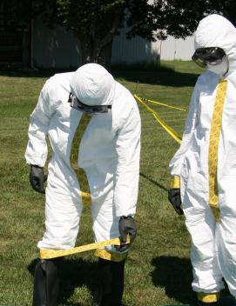
Doffing Guidelines
Doff PPE in order
Avoid cross contamination
  Protects responders
  Maintains biosecurity
Inspect PPE for
damage
Notes:
The exact sequence used for donning PPE may vary. There are a variety of appropriate ways to assemble the PPE on the user. However, attention should be paid to the donning sequence to allow doffing to occur without cross contamination, causing spread of the pathogen. The outwear needs to be decontaminated and removed, or removed and disposed of in such a way that prevents exposure of the responder’s skin and inner clothes to any pathogen that may be contaminating the outerwear. PPE, such as coveralls, boots, and gloves need to be donned in an order, so that the order of removal protects the responders and maintains biosecurity principles. Check all PPE for damage before donning and after doffing. [This photo shows two responders using the buddy system and doffing PPE. Photo source: Andrew Kingsbury, Iowa State University]

Slide 10
Donning and Doffing: Level C
Notes:
As discussed in prior slides, Level C PPE is the level that generally would be adequate protection for veterinary responders in most situations. Donning takes place in the Cold Zone. Doffing starts with decontamination, dry brushing, in the Hot Zone. The decontamination procedure continues in the Decontamination Corridor to allow for safe doffing. Appropriate decontamination is performed on a responder’s PPE as well as equipment, before doffing PPE and returning to the Cold Zone. In the following slides, we will present one example of an appropriate sequence for donning and doffing of Level C PPE. The information for this discussion is based on Appendix A: Donning and Doffing from the FAD PReP/NAHEMS Guidelines: Personal Protective Equipment (2011).

Slide 11
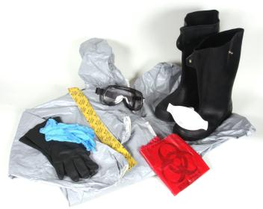
Collect Needed Supplies
Chemical-resistant tape
Blunt-nosed scissors
Inner and outer gloves
Tyvek coveralls
Rubber boots (steel-toed)
N95 or reusable APR
Goggles
Biohazard bag
Supplies for tasks
Notes:
Before donning Level C PPE, gather all needed supplies. For most livestock disease emergencies, this would include: chemical-resistant tape, blunt-nosed scissors - if needed, to cut the tape to the proper length, two pairs of gloves – inner and outer, a Tyvek® or similar suit/coveralls with attached hood and foot pouches, boots that can be thoroughly cleaned (steel-toed, rubber boots are ideal), a N95 respirator or reusable air purifying respirator (APR), goggles, biohazard bag for disposal of PPE, and any supplies needed to perform tasks on-site. [This photo shows necessary PPE supplies. Photo source: Dani Ausen, Iowa State University]

Slide 12
Preparing to Don PPE
Prepare items
  Measure and cut chemical-resistant tape
  Tabs on end for easy removal
Inspect all PPE
    For any tears, rips, defects, or other damage of imperfections - before, during, and after each use
  Sequence used for donning may limit doffing sequence
Notes:
In the Cold Zone, lay out PPE items and prepare to don, following these steps.
Measure and cut separate pieces of chemical-resistant tape long enough to fit around ankles/top of boots, wrists, and over the zipper of the coveralls from crotch to neck. Cut several extra pieces in case one of the pieces accidentally bunches against itself and becomes unusable.
Fold tabs on the chemical-resistant tape to assist with removal.
Remove the coveralls and all PPE from the cellophane wrapping and inspect for tears, rips, defects, or other imperfections. PPE should be inspected before, during, and after use.
Keep in mind the order in which the PPE is donned may limit the order in which it is removed. Inappropriate doffing will cause unintended cross contamination, spread pathogens and potentially expose responders to disease.

Slide 13
Donning Level C PPE
Wear appropriate inner garments
  Disposable or launder
Insert stocking feet into boot pouches
Pull on protective coveralls and zip
  Do not put on hood yet
Step into steel-toed rubber boots
Wrap chemical-resistant tape around top of boot-coveralls junction
Notes:
To properly don Level C PPE, follow these steps:
Wear appropriate inner garments (based on weather, tasks, etc.), including socks that extend up and under pants legs. Ideally, inner garments should be disposable; otherwise, care should be taken to launder inner garments as soon as possible.
Insert stocking feet into the foot pouches of the Tyvek® or similar protective coveralls.
Pull the rest of the protective coveralls on and zip part way up. Do not put on the hood yet.
Step into steel-toed rubber boots.
Using the buddy system, wrap chemical-resistant tape around top of boot at the junction of the protective coveralls to ensure no fluid could enter the boot from the outside. One to three turns should be sufficient. One turn is sufficient with wide tape (3-4 in or 7.6-10 cm in width). Leave a tab on the tape end to help with doffing. If protective coveralls without boot pouches are used, pull the leg of the coverall over the top of the boot and secure in place with chemical-resistant tape. When taping, leave enough give in the legs and arms of the protective coveralls to allow easy movement and to prevent ripping.

Slide 14
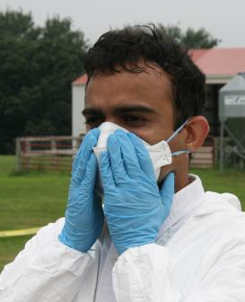
Donning Level C PPE
Put on inner gloves (latex/nitrile)
Don respirator (APR) and seal check
Put on goggles
Pull hood over your head
Notes:
Next, put on the inner (first) pair of gloves. These may be nitrile or latex disposable gloves.
Put on the assigned respirator (APR) - prior medical clearance and fit testing required - and perform the required seal check.
Put on goggles if eye protection is not provided by the APR. Take care not to disrupt the respirator seal.
Pull the hood over your head.
[This photo depicts a responder in PPE properly seating the air purifying respirator (APR) over the nose and mouth to form a tight seal to the face. Photo source: Andrew Kingsbury, Iowa State University]

Slide 15
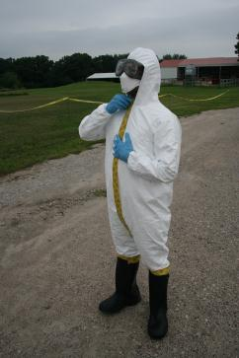
Donning Level C PPE
Zip up coveralls/seal zipper with tape
If full facepiece APR is used, place tape around the facepiece to seal
Don outer chemical-resistant gloves
Notes:
10. Zip up the protective coveralls completely and seal the length of its zipper with chemical-resistant tape. Leave a tab on the tape end to help with doffing.
11. If a full-facepiece respirator is used, place tape around the facepiece, completely sealing the hood of the coveralls to the respirator. Be sure to cover the area under the chin as well.
12. Put on the outer pair of chemical-resistant gloves.
[This is a photo of a responder sealing the zipper of the protective coveralls with chemical-resistant tape. Photo source: Andrew Kingsbury, Iowa State University]

Slide 16
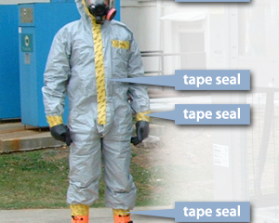
Donning Level C PPE
Stretch arms outward and place chemical- resistant tape on suit/glove junctions
Reverse roles and
repeat
Once PPE is properly
donned, enter the work area
Notes:
13. Pull the cuffs of the protective coveralls over the cuffs of the gloves. Using the buddy system, wrap chemical-resistant tape around each wrist at the junction of the glove and coverall cuff. Stretch out arms and then apply tape. Leave enough give so arms can move freely without ripping of the protective coveralls. Leave a tab on the tape end to help with doffing.
14. Using the buddy system, responders reverse roles to assist the partner in donning PPE.
Finally, once all PPE is properly donned, enter the work area and perform duties.
[This photo shows a responder in Level C PPE, with chemical tape sealing potential gaps at sleeves, boots, zipper, and around full face respirator. Photo source: Tegwin Taylor, Iowa State University; labels by Andrew Kingsbury, Iowa State University]

Slide 17
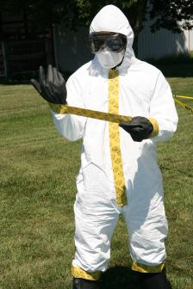
Doffing Level C PPE
Begin in Hot Zone
Enter Decon Corridor
  After decontamination
  Remove all tape
  Unzip coveralls
  Remove outer gloves
Notes:
To properly doff level C PPE, follow these steps:
Begin doffing in the Hot Zone - Exclusion Zone (EZ) by dry brushing off the exterior of the PPE.
Enter the Decontamination Corridor and continue the decontamination procedure to allow for safe doffing. Appropriate decontamination is performed on a responder’s PPE as well as equipment before returning to the Cold Zone – Support Zone (SZ).
After decontamination, remove all chemical-resistant tape from the coveralls, including sleeves, boots, and zipper (and facepiece, if applied). Dispose of tape in provided containers.
Unzip the protective coveralls.
Remove the outer gloves.
[This photo depicts a responder in PPE using the tab of the chemical resistant tape to remove the tape from the sleeve of the coveralls. Photo source: Andrew Kingsbury, Iowa State University]

Slide 18
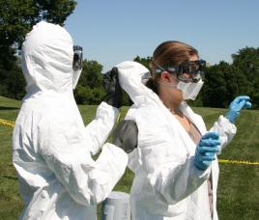
Doffing Level C PPE
Continue doffing
  Roll back hood
  Remove coveralls off
  shoulders
  Remove boots
  Remove coveralls
  (inside out)
  Remove APR and inner gloves
  Shower and expectorate
Notes:
To properly doff level C PPE, continue with these steps:
6. Reach inside the hood and roll it back, touching only the inside of the coveralls. This step is easiest with the assistance of a team member who, while still in full PPE, may be able to grasp the outside of the hood.
7. Pull the protective coveralls off the shoulders (turning the suit inside out) to ensure any residual contamination is kept away from the body.
8. Sitting on a stool or other support, remove boots and place them in a designated container.
9. Peel the protective coveralls down from head to toe and step out of the coveralls. Touch only the inner side of the coveralls with the inner gloves.
10. Dispose of coveralls in a provided container.
11. Remove the APR and inner gloves. Place the APR in a designated container. Dispose of gloves in a provided container.
12.Take a complete shower, including a shampoo, and launder inner clothing as soon as possible to eliminate any cross contamination from the outer PPE to inner clothes or skin. Personnel should clean under their fingernails and clear their respiratory passages by blowing their noses, clearing their throats, and expectorating into a sink with running water. This should be done immediately after leaving the infected or exposed area.
[In this photo the buddy system is used to doff the hood of the coveralls. Photo source: Andrew Kingsbury, Iowa State University]

Slide 19
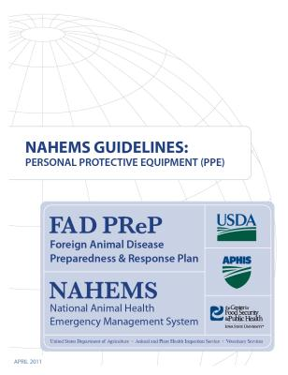
For More Information
FAD PReP/NAHEMS Guidelines & SOP: Personal Protective Equipment (2011)
  http://www.aphis.usda.gov/animal_health/emergency_management/
Personal Protective Equipment web-based training module
  http://naherc.sws.iastate.edu/
Notes:
More details can be obtained from the sources listed on the slide, available on the USDA website (http://www.aphis.usda.gov/animal_health/emergency_management/) and the NAHERC Training Site (http://naherc.sws.iastate.edu/).

Slide 20

Guidelines Content
Authors (CFSPH)
Janice Mogan, DVM
Gayle B. Brown, DVM, PhD
Elizabeth Wormley, Junior Veterinary Student
Reviewers (USDA)
Peter A. Petch, RPIH, CIPS,
CIMT, CHS-V
Stephen Goff, DVM
Notes:
This slide acknowledges the authors and reviewers of the Guidelines document.

Slide 21
Acknowledgments
Development of this presentation was by the Center for Food Security and Public Health at Iowa State University through funding from the USDA APHIS Veterinary Services
PPT Authors: Dawn Bailey, BS; Kerry Leedom Larson, DVM, MPH, PhD, DACVPM
Reviewers: Glenda Dvorak, DVM, MS, MPH, DACVPM; Patricia Futoma, Veterinary Student;
Janice Mogan, DVM
Notes:
Information provided in this presentation was developed by the Center for Food Security and Public Health at Iowa State University College of Veterinary Medicine, through funding from the US Department of Agriculture, Animal and Plant Health Inspection Service, Veterinary Services.

