Slide 1
Health and Safety
Overview
Adapted from the FAD PReP/NAHEMS
Guidelines: Health and Safety (2011)
Notes:
During an animal health emergency response, ensuring the health and safety of responders will be essential. Specific hazards encountered during a response may vary depending on the situation. Increasing your awareness of the potential hazards and procedures for reporting unsafe working conditions will better prepare you to ensure the health and safety of yourself and other responders during the response event. [This information was derived from the Foreign Animal Disease Preparedness and Response (FAD PReP)/National Animal Health Emergency Management System (NAHEMS) Guidelines: Health and Safety (2011)].

Slide 2
This Presentation
Roles and responsibilities
  Responders, ICS Staff
Pre-deployment preparation
Hazards during deployment
Responder security and safety
Incident reporting
Notes:
This presentation will overview the following topics: Worker rights and responsibilities for their health and safety, roles and responsibilities of the Incident Command Staff for health and safety issues of responders, measures to be taken prior to your arrival at the response, as well as specific hazards during your deployment. Finally, it will address how responders can increase their safety and how incidents should be reported. Additional presentations addressing these issues in greater detail are also are available.

Slide 3
Roles and Responsibilities
Notes:
Protecting the health and safety of personnel assigned to an animal health emergency is everyone’s responsibility. Let’s look at policies and regulations designed to protect responders during a response, as well as the role and responsibilities of the ICS staff and responders themselves for health and safety issues.

Slide 4
Statutory Authority
APHIS Directive 6800.1:
  Ensuring the Protection of Employees Involved in
  Highly Pathogenic Avian Influenza Control and
  Eradication Activities
Occupational Safety and Health Act
of 1970
  Employment and place of employment
  Free from recognized hazards that may cause or are likely to cause death or serious physical harm
Notes:
Ensuring the protection of APHIS employees involved in control and eradication activities are outlined in APHIS Directive 6800.1 [www.aphis.usda.gov/library/directives/pdf/APHIS6800_1.pdf]. These policies are based on the Occupational Safety and Health Act of 1970, Section 5(a)(1) [the General Duty Clause of the Act] which states that “each employer shall furnish to each of his employees employment and a place of employment which are free from recognized hazards that are causing or are likely to cause death or serious physical harm to his employees.” Additional regulations are found in the Occupational Safety and Health Administration General Industry Regulations found at 29 CFR §§1910.120; 1910.132; 1910.134.

Slide 5
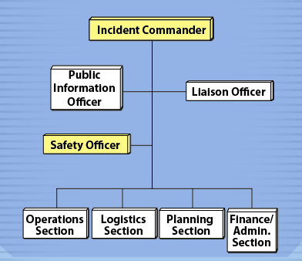
Incident Command System
Incident Commander
  Overall management
Safety Officer
  Identify hazards
  Establish safe
  work procedures
  Communicate health
  and safety information
  Has authority to issue immediate stop work order to halt unsafe activities
Notes:
On-site, within the Incident Command System, the Incident Commander and Safety Officer are responsible for the health and safety of all personnel assigned to an animal health emergency response. Most tasks are conducted by the Safety Officer. These may include:
Identifying any on-site hazards and determining ways to abate them
Establishing safe work procedures and ensuring they are followed
Communicating health and safety information to response personnel, via trainings, meetings, briefings or other forms of communication
Assessing the need for PPE and assuring proper PPE use, cleaning and maintenance
Inspecting and assuring safe working procedures are followed.
The Safety Officer will prepare a Health and Safety Plan (HASP) specific for the incident and will work closely with the various ICS Sections (e.g., Operations, Logistics) to ensure that responders are aware of and adhere to the requirements of the HASP. In the event of any unsafe activity, the Safety Officer has the authority to issue an immediate stop work order until the safety issue can be resolved. [The illustration shows the basic structure of the Incident Command System, including the Incident Commander and Safety Officer. Illustration by: Oriana Hashemi-Toroghi, Iowa State University]

Slide 6
Worker Responsibilities
Awareness of your
health status and physical limits
Follow safe work procedures
Correctly use Personal Protective Equipment (PPE)
Report unsafe actions and conditions
Report all injuries to supervisors
Notes:
While employers are responsible for providing a safe and healthful workplace for their employees, it is also the responsibility of employees to maintain safe working conditions and comply with established work rules and employer health and safety policies. This includes being aware of your own health status and physical limitations, correctly using the assigned PPE, as well as promptly reporting any unsafe actions, conditions, or injuries to supervisors.

Slide 7
Pre-Deployment
Preparation
Notes:
Some health and safety issues require attention prior to arrival at the response site. Next, we will overview these measures. Additional details can be found in the FAD PReP/NAHEMS Health and Safety: Pre-Deployment Preparation PowerPoint presentation.

Slide 8

Personal Health
Physical Exam
Vaccinations
  Rabies
  Influenza
  Tetanus/diphtheria
  Pneumococcal
Chronic disease
Pregnancy
Medications
Notes:
Responders reporting for duty must be in good physical and mental condition to perform their assigned duties. To comply with this requirement, responders are encouraged to have regular physical examinations to assess their current health status. Responders should have a current tetanus/diphtheria booster and know their rabies vaccination status and titer. Seasonal influenza vaccination is highly encouraged if responding to avian or novel H1N1 influenza outbreaks. Individuals over 65 years of age or persons with immunocompromising conditions or chronic lung disease should also receive a pneumococcal vaccine. Responders should be aware of any chronic disease conditions which may affect their ability to perform tasks in the field. Pregnancy may impair one’s ability to perform some tasks, and some tasks may put the fetus at risk. Responders should discuss medical issues of concern, including those that may limit a responder’s abilities, with their personal physicians and their supervisor. Less physically demanding assignments may be available. Responders with medical conditions requiring medication or medical supplies should assume they will not have access to a pharmacy while deployed and should bring at least a 30-day supply of items during deployment. [This photo shows a person receiving a vaccine. Photo source: CDC Image Library]

Slide 9
Training
Incident Command System Training
USDA APHIS Emergency Deployment Generic Health and Safety Plan (HASP)
    http://www.aphis.usda.gov/emergency_response/hasp/
    health_safety_hs_training.shtml
OSHA - HAZWOPER Training
  HAZardous Waste OPerations and Emergency Response
  Training level based on duties and functions
Additional training
Notes:
Training prior to a response is also essential. All response personnel must have incident command training. Personnel must also review the USDA APHIS Emergency Deployment Generic Health and Safety Plan (HASP) which contains the basic health and safety training requirements. This information may be accessed at: http://www.aphis.usda.gov/emergency_response/hasp/health_safety_hs_training.shtml. Pursuant to the Occupational Safety and Health Administration (OSHA) - Hazardous Waste Operations and Emergency Response (HAZWOPER) Standard [29 CFR 1910.120(q)], all personnel involved in an emergency deployment are to be trained in certain items pertinent to health and safety before they are permitted to take part in actual emergency operations at an incident. HAZWOPER training is based on the duties and functions to be performed by the responder. Additional training, such as PPE use, defensive driving, or material handling, may also be necessary prior to deployment based on the tasks you will need to perform.

Slide 10
Health and Safety Briefing
Arrival at incident site
  Check in and receive orientation packet
Initial on-site briefing
  Incident Health and Safety Plan
  Standard operating procedures
  Job Hazard Analysis
  Emergency procedures
  Contingency plans
Daily safety briefings
Notes:
Upon arrival at the response site, responders should check in and receive an orientation packet and attend a general orientation training. This will include major items outlined in the Incident Health and Safety Plan (HASP) (which must also be read and understood prior to beginning work), as well as standard operating procedures, hazards anticipated with the response, emergency procedures and contingency plans. The pre-entry safety and health briefing is required pursuant to 29 CFR 1910.120(b)(4)(iii) before an employee begins work at the site. Personnel should also review the Job Hazard Analysis (JHA) for their assigned tasks. Throughout the response, the Safety Officer will provide a daily health and safety briefing to personnel prior to the beginning of the day’s tasks.
10

Slide 11
Hazards During Deployment
Notes:
Once deployed to a response, any number of physical, environmental, even psychological hazards can occur. Remaining aware and vigilant of these hazards can help to avoid injury as well as prevent accidents. The types of workplace hazards a responder may encounter on a deployment will depend on the nature of the emergency as well as the location of the response site, time of year and weather conditions. The following section describes some hazards responders may encounter while on deployment. Additional details, as well as preventive measures, can be found in the FAD PReP/NAHEMS Health and Safety: Hazards During Deployment PowerPoint presentation.

Slide 12

Work Settings/Shifts
Extended and
unusual shifts
Fatigue, stress,
reduced concentration
Know your limits
Manage work
and rest periods
Notes:
During emergency response activities, responders should expect to work extended or unusual shifts. These conditions may be stressful physically, mentally, and emotionally. The disruption to your body’s regular schedule can cause increased fatigue, stress, and reduced concentration which may lead to an increased risk of operator error, injuries, and accidents. Remain vigilant of your level of fatigue or stress and know your limit. Supervisors must manage work and rest periods, assignment duration, and the length of shifts to ensure employee safety and productivity. [This illustration reflects the cumulative effect of response conditions on responder health. Illustration by: Katlyn Harvey, Iowa State University]
12

Slide 13
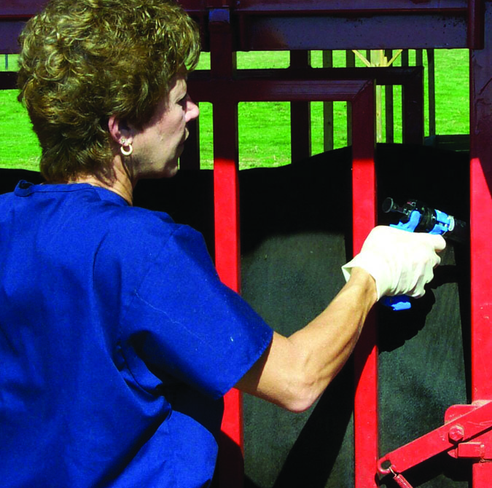
Physical Hazards
Animal related incidents
  Injuries, zoonoses
  Insects, wild animals
Musculoskeletal
injuries
  Strains, sprains,
  ergonomic injury
  Back injuries
Slips, trips and falls
Sharps
Notes:
A number of physical hazards may be present. Interacting with animals during the response can lead to injuries from kicks, crushes, bites or scratches. If the response involves a zoonotic disease (i.e., a pathogen of animals transmissible to humans), responder exposure may also be an issue. Encounters with any number of insects, including mosquitoes, ticks, wasps, or even scorpions, as well as wild animals may also occur during response situations. Musculoskeletal injuries, such as strains, sprains or ergonomic related injuries can also occur. These injuries may occur after repetitive tasks, such as collect of large numbers of blood or tissues samples, or administering multiple vaccinations. Back injuries may be another common musculoskeletal injury if proper lifting techniques are not used. Slips, trips, and falls may occur when walking on uneven, wet or icy surfaces or over rough terrain. Needlesticks are a common type of occupational injury in veterinary practice, and can also occur when conducting certain response tasks. [This photo shows a possible physical hazard (e.g., animal related injury, ergonomic) during an animal health emergency response. Photo source: Phil Prater, USDA]
13

Slide 14
Environmental Hazards
Temperature/Weather
  Heat and cold
Noise
  Animal vocalization, power tools,
  heavy equipment
Electrical Shock
Chemical Exposure
  Animal waste gases, carbon monoxide, disinfectants
Notes:
The response environment itself can produce a number of hazards to be cognizant of. The biggest factor will be the weather conditions. Hot temperatures can lead to heat-related illness and injury, such as sunburn, dehydration, or heat stroke. At the opposite extreme, cold temperatures can produce conditions making frostbite or hypothermia concerns. In many events, responders will be exposed to loud noises (e.g., animal vocalization, power tools), which can, without proper protection, cause hearing damage. Power equipment and cords used at a response site can result in serious injury or death from shock or electrocution. Any number of chemical exposure hazards may also be present. Exposure to animal waste gases can be encountered when entering enclosed animal facilities. Carbon monoxide released from gas-powered tools can build to hazardous levels when used in confined spaces. Some disinfectant products, when aerosolized (e.g., preparation or application) can cause mucous membrane and respiratory tract irritation.

Slide 15

Psychological Hazards
Stress
  Fatigue
  Anxiety
  Anger
  Depression
Ways to reduce stress
  Monitor for signs
  Take frequent rest breaks
Notes:
Responding to an animal disease emergency situation can have a number of psychological hazards. Long unusual hours, physical demands, exposure to traumatic events (e.g., depopulation of large numbers of animals) and emotional stress can affect responder mental health. Physical symptoms of stress include fatigue, nausea, dizziness, headaches, and a high heart rate. Cognitive (thinking and reasoning ability) symptoms include disorientation or confusion, memory problems, or nightmares. Emotional signs include anxiety, guilt, grief, denial, panic, fear, and irritability. Finally, stress may cause changes in behavior, such as anger, withdrawal, emotional outbursts, as well as drug and alcohol abuse and depression. Any or all of these reactions may interfere with an individual’s normal response function ranging from mild, transient distress to moderate psychological symptoms, to a psychiatric illness or disorder. Stress will accompany any response effort, but to minimize the impact, it is important to take preventive steps. These include monitoring yourself and others for signs of fatigue and stress. Take occasional breaks away from the worksite. [This illustration reflects the cumulative effect of stress on responder health. Illustration by: Katlyn Harvey, Iowa State University]

Slide 16
Responder Security and Safety
Notes:
Several mechanisms will be established to ensure responder security and safety during the response. Additional details can be found in the FAD PReP/NAHEMS Health and Safety: Responder Security and Safety PowerPoint presentation.

Slide 17

Site Security and Safety
Work zones
  Control access
  to work site
  Prevent unauthorized persons
  Limit spread of
  hazardous materials
  or disease agents
Notes:
Maintaining security of the incident site is important for protecting the health and safety of both responders and the public. Security measures control access to the work site, prevent unauthorized persons from entering, limit the risk of spreading hazardous materials or diseases agents beyond the control area, and prevent outside interference with response efforts. [This illustration shows a sample security sign. Illustration by: Oriana Hashemi-Toroghi, Iowa State University]

Slide 18
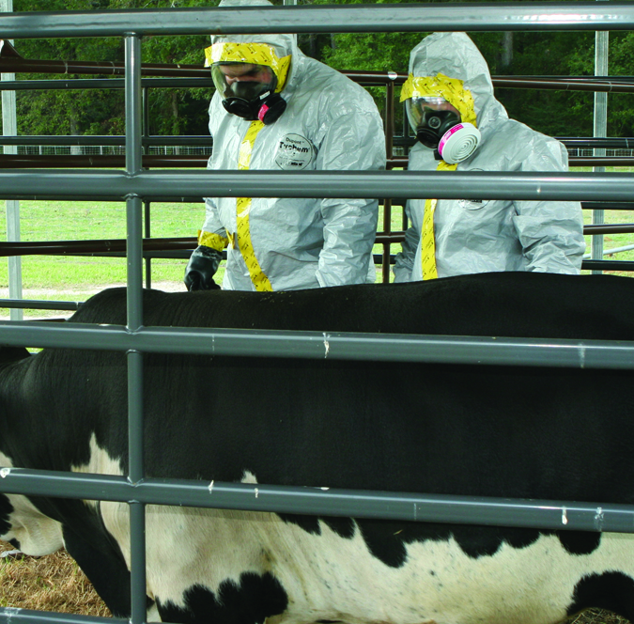
Responder Safety
Accountability
  Personnel must be accounted for at all times
  Check-in and check-out
  Notify supervisor
  when leaving
Buddy system
  Work in pairs
  Observe each other
Medical monitoring
Notes:
Personnel must be accounted for at all times during a deployment. The Communications Plan developed for the incident provides access to personnel and others within the command structure, as well as communications equipment for all personnel. Personnel must enter and exit the deployment area through designated points and follow check-in and check-out procedures. When leaving the facility, responders must verbally notify their Team Leader of their destination. Personnel should utilize the “buddy system” and work in pairs in order to observe each other and quickly summon assistance in the event of an emergency. A medical monitoring program will be used to safeguard the health and welfare of responders exposed to hazardous chemical, biological, radioactive materials and other hazards, such as noise. [This photo shows two responders using the buddy system while working during a response. Photo source: Gordon Harman, FEMA Center for Domestic Preparedness]

Slide 19
Contingency Plans
Events
  Fire, explosion, hazardous material,
  severe weather
Response
  Evacuation
    Pre-determined signal and site
    Ensure all are accounted for
  Shelter-in-place
    Pre-determined locations
    Remain until “all clear” is given
  Emergency medical assistance network
Notes:
Even with the best planning, unforeseen situations, such as fire or severe weather, may arise. Emergency and contingency plans will be developed by the Safety Officer, and should include evacuation and shelter-in-place procedures. All personnel should be made aware of these contingency plans including the predetermined signal to alert personnel to begin the necessary procedure. Prior to the start of operations on the site, the Safety Officer will establish an emergency medical assistance network.

Slide 20
Incident Reporting
Notes:
Recognizing and reporting safety issues, unsafe conditions and injuries is the responsibility of all responders on-site and should be relayed immediately to your supervisor.

Slide 21
Incident Reporting
Notify supervisor immediately
Complete Incident Report
  Date, time and place
  Person(s) involved
  Type of incident
  Description
  Recommendations
Report by phone
within 2 hours of incident
Written report within 5 days of incident
Notes:
In the event an accident or safety incident occurs, personnel should immediately notify their supervisor. The appropriate forms will need to be completed and submitted in a timely manner. Report incidents via telephone to Safety, Health and Environmental Protection Branch (SHEPB) personnel at APHIS as soon as possible, but no later than two hours after the occurrence. Written incident reports must be made within five days of occurrence. Incident reports must include the date, time, and place of occurrence; person(s) involved; type of incident; description of the incident and action taken; and recommendation(s) for prevention of a similar occurrence. The Safety Officer will sign and date the report upon receipt. Recommended hazard control measures should be discussed with, and approved by, the Incident Commander, before being implemented. All incident reports and follow-up action on the incidents will be kept on file by the SHEPB department.
21

Slide 22
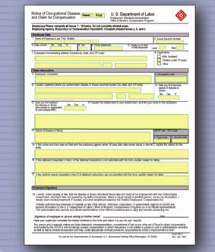
Workers’ Compensation
Government employees
Report injuries as soon as possible
  Time limits for
  reporting claims
  Be aware of filing deadlines
Notes:
Workers’ Compensation is available for government employees injured while working. NAHERC members activated for an emergency response are considered federal employees and are eligible for federal workers’ compensation coverage. It is important to report all injuries as soon as possible and complete all paperwork in a timely manner. There are time limits in place for reporting claims. Consult with a workers’ compensation specialist to make sure you are aware of any filing deadlines. [This illustration shows a Form CA-2, an example of a form that should be completed in order to receive workers’ compensation. Illustration by: Katlyn Harvey, Iowa State University]

Slide 23

For More Information
FAD PReP/NAHEMS Guidelines & SOP: Health & Safety (2011)
  http://www.aphis.usda.gov/animal_health/emergency_management/
Health and Safety web-based training module
  https://naherc.sws.iastate.edu/
Notes:
More details can be obtained from the sources listed on the slide, available on the USDA website (http://www.aphis.usda.gov/animal_health/emergency_management/) and the NAHERC Training Site (http://naherc.sws.iastate.edu/).

Slide 24
Guidelines Content
Author (CFSPH)
Cheryl L. Eia, JD, DVM, MPH
Reviewers (USDA)
Lori P. Miller, PE
Peter A. Petch, RPIH, CIPS, CIMT, CHS-V
Thomas R. Walker, MD
Notes:
This slide acknowledges the authors and reviewers of the Guidelines document.

Slide 25
Acknowledgments
Development of this presentation was by the Center for Food Security and Public Health at Iowa State University through funding from the USDA APHIS Veterinary Services
PPT Authors: Dawn Bailey, BS; Kerry Leedom Larson, DVM, MPH, PhD, DACVPM;
Patricia Futoma, Veterinary Student
Reviewers: Glenda Dvorak, DVM, MPH, DACVPM; Janice Mogan, DVM
Notes:
Information provided in this presentation was developed by the Center for Food Security and Public Health at Iowa State University College of Veterinary Medicine, through funding from the US Department of Agriculture, Animal and Plant Health Inspection Service, Veterinary Services.

