Slide 1
Surveillance, Epidemiology, and Tracing
Personnel and
Premises Designations
Adapted from the FAD PReP/NAHEMS Guidelines: Surveillance, Epidemiology, and Tracing (2014).
Notes:
An animal health emergency could have a detrimental effect on the nation's agriculture, food supply, and economy. Veterinary responders, animal health technicians, and other trained personnel may assist with surveillance, epidemiology, and tracing activities. In order to perform these job duties, a broad understanding of surveillance and epidemiological concepts is required. This presentation reviews personnel that may assist with surveillance, epidemiology, and tracing duties, as well as premises designations in a foreign animal disease (FAD) outbreak. [This information was derived from the Foreign Animal Disease Preparedness and Response (FAD PReP)/National Animal Health Emergency Management System (NAHEMS) Guidelines: Surveillance, Epidemiology, and Tracing (2014).]

Slide 2
This Presentation
Overview of necessary personnel
  Incident Command
  Planning Section
  Operations Section
Premises, zones, and area designations
Notes:
This presentation provides an overview of personnel necessary for implementing surveillance, epidemiology, and tracing activities in a foreign animal disease (FAD). It also discusses the establishment of premises, zones, and area designations during an FAD outbreak.

Slide 3
Personnel
Notes:
Surveillance, epidemiology, and tracing activities are essential elements of an FAD response. The organizational structure for emergency response personnel will follow the Incident Command System (ICS).

Slide 4
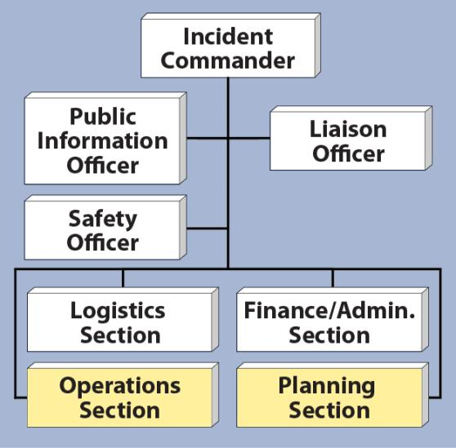
Incident Command System
Incident Command System (ICS)
  Flexible and scalable
    Number and names of deployed groups will vary
  Planning and Operations Sections
  Incident Action Plan
Notes:
The ICS structure is flexible and scalable and the exact number and names of groups deployed during a response will vary according to the scope and nature of the event. The Planning and Operations Sections contain the most personnel with surveillance, epidemiology, and tracing responsibilities. Information generated through these activities is used to develop the Incident Action Plan (IAP) approved by the Incident Commander. An IAP provides a concise, coherent means of capturing and communicating to all personnel the overall incident priorities, objectives, and strategies in the contexts of both operational and support activities. [This is an illustration of an Incident Command System structure highlighting the Operations Section and Planning Section. Illustration by: Dani Ausen, Iowa State University]

Slide 5
Planning Section
Notes:
Within the Planning Section, the Situation Unit is responsible for administrative components of surveillance and epidemiology, including planning surveillance activities and analyzing surveillance information.

Slide 6
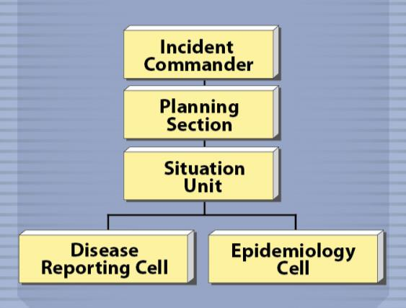
Planning Section
Situation Unit
  Disease Reporting Cell
    Formulates daily surveillance activities
    Summarize and
    organize data
  Epidemiology Cell
    Analyzes data
    Plans outbreak
    response
Notes:
The Situation Unit in the Planning Section is divided into the Disease Reporting Cell and the Epidemiology Cell.
The Disease Reporting Cell formulates daily surveillance activities and analyzes surveillance data. Duties may include: accumulating, entering, checking, and reporting disease data; and summarizing and organizing epidemiological information and graphics to assist epidemiology personnel in investigations.
The Epidemiology Cell carries out administrative components of epidemiology. Duties may include: collecting and analyzing case data reported by the Disease Reporting Cell; and utilizing surveillance reports and other data to plan the outbreak response.
For more information on specific duties, see the disease-specific FAD PReP Standard Operating Procedure (SOP): Surveillance. [This illustration depicts the location of the Disease Reporting Cell and the Epidemiology Cell within the Incident Command System (ICS). Illustration by: Bridget Wedemeier, Iowa State University]

Slide 7
Operations Section
Notes:
The Operations Section is involved in surveillance, epidemiology and tracing activities through the Disease Surveillance Branch.

Slide 8
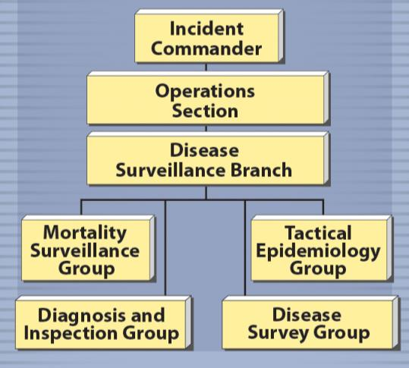
Operations Section
Disease Surveillance Branch consists of four groups:
  Mortality Surveillance
  Group
  Diagnosis and
  Inspection Group
  Disease Survey Group
  Tactical Epidemiology
  Group
Notes:
The Disease Surveillance Branch is responsible for field duties involving surveillance and epidemiology including activities such as collecting, tabulating, and reporting surveillance information. The Disease Surveillance Branch consists of four Groups: the Mortality Surveillance Group, the Diagnosis and Inspection Group, the Disease Survey Group, and the Tactical Epidemiology Group. [This illustration depicts the location of the four Groups in the Disease Surveillance Branch within the Incident Command System (ICS). Illustration by: Bridget Wedemeier, Iowa State University]

Slide 9
Groups in Operations
Mortality Surveillance Group
  Collects and samples dead animals from farms to survey for presence of a disease agent
Diagnosis and Inspection Group
  Conducts investigations and sampling to survey for the presence of the disease agent
Notes:
The Mortality Surveillance Group collects and samples dead animals from farms to survey for presence of a disease agent.
The Diagnosis and Inspection Group conducts investigations and sampling to survey for the presence of the disease agent.

Slide 10
Groups in Operations (cont’d)
Disease Survey Group
  Determines which premises within Control Area have susceptible species
  Collects Global Positioning System (GPS) information for each premises
Tactical Epidemiology Group
  Conducts tracing activities
  Conducts field investigations
  Inputs and extracts outbreak associated data from the electronic database
Notes:
The Disease Survey Group determines which premises within the disease Control Area have susceptible species. This group is also responsible for collecting Global Positioning System (GPS) information for each premises.
The Tactical Epidemiology Group conducts tracing activities, conducts field investigations, and inputs and extracts outbreak associated data from the electronic database.

Slide 11
Premises, Zones, and
Area Designations
Notes:
The Situation Unit (Planning) and the Disease Surveillance Branch (Operations) utilize data collected through surveillance, epidemiology and tracing activities to determine premises designations, and establish disease control zones around these premises. These designations are updated as response activities progress. The disease control zones may be redrawn based on the most current epidemiological information. The next section briefly defines and describes these concepts.

Slide 12
Premises Designations
The premises designations are:
  Infected Premises
  Contact Premises
  Suspect Premises
  At-Risk Premises
  Monitored Premises
  Free Premises
  Vaccinated Premises
Notes:
In an FAD outbreak, premises are assigned a designation based on factors such as the diagnosis of disease on the premises, presence of susceptible animals, and contacts susceptible animals may have had with potentially infected animals. The seven premises designations are listed here.
Infected Premises
Contact Premises
Suspect Premises
At-Risk Premises
Monitored Premises
Free Premises
Vaccinated Premises

Slide 13
Premises Designations (cont’d)
Infected Premises
  Presumptive or confirmed positive – based on lab results, compatible clinical signs, case definition, and international standards
Contact Premises
  Exposed susceptible animals - either directly or indirectly to animals, animal products, fomites, or people from Infected Premises
Notes:
The basis for premises designations is explained in these next few slides. The content is provided by USDA.
Infected Premises - Premises where a presumptive positive case or confirmed positive case exists based on laboratory results, compatible clinical signs, case definition, and international standards.
Contact Premises - Premises with susceptible animals that may have been exposed to the FAD agent, either directly or indirectly, including but not limited to exposure to animals, animal products, fomites, or people from Infected Premises.

Slide 14
Premises Designations (cont’d)
Suspect Premises
  Under investigation - susceptible animals reported to have clinical signs compatible with the FAD
At-Risk Premises
  Susceptible animals – no clinical signs compatible with the FAD. May seek to move susceptible animals or products within the Control Area by permit
Notes:
Suspect Premises - Premises under investigation due to the presence of susceptible animals reported to have clinical signs compatible with the FAD. This is intended to be a short-term premises designation.
At-Risk Premises - Premises with susceptible animals, but none have clinical signs compatible with the FAD. Premises objectively demonstrates that it is not an Infected Premises, Contact Premises, or Suspect Premises. At-Risk Premises seek to move susceptible animals or products within the Control Area by permit. Only At-Risk Premises are eligible to become Monitored Premises.

Slide 15
Premises Designations (cont’d)
Monitored Premises
  Demonstrates that it is not an Infected, Contact, or Suspect Premises. Meets criteria to move susceptible animals or products out of the Control Area by permit.
Free Premises
  Outside of a Control Area - not a Contact or Suspect Premises
Vaccinated Premises
  Emergency vaccination has been performed
Notes:
Monitored Premises - Premises objectively demonstrates that it is not an Infected Premises, Contact Premises, or Suspect Premises. Only At-Risk Premises are eligible to become Monitored Premises. Monitored Premises meet a set of defined criteria in seeking to move susceptible animals or products out of the Control Area by permit.
Free Premises - Premises outside of a Control Area and not a Contact or Suspect Premises.
Vaccinated Premises - Premises where emergency vaccination has been performed. This is a secondary premises designation.

Slide 16
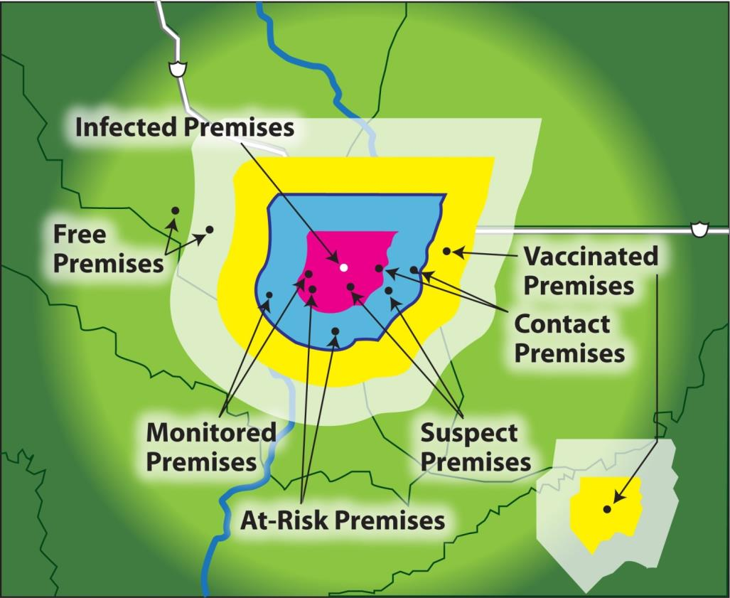
Premises Locations
Notes:
This map provides a visual illustration of where the premises may be located in relation to an Infected Premises identified in the center. The colored disease control zones will be described in the next slides. [This illustration depicts premises designations in relation to an Infected Premises and surrounding disease control zones. Content provided by: USDA. Illustration by: Dani Ausen, Iowa State University]

Slide 17
Zones and Areas
Summary of Zone and Area Designations
Infected Zone (IZ) | Zone that immediately surrounds an infected Premises.
Buffer Zone (BZ) | Zone that immediately surrounds and Infected Zone or Contact Premises
Control Area (CA) | Consists of an Infected Zone and Buffer Zone
Surveillance Zone (SZ) | Zone outside and along the border of a Control Area
Vaccination Zone (VZ) | Emergency Vaccination Zone is classified as either Containment Vaccination Zone (typically inside the control area) or Protection Vaccination Zone (typically outside Control Area). This may be secondary zone designation
Notes:
During an FAD outbreak, disease control zones are established to surround premises with specific designations to control movements and prevent the spread of the disease agent. The types of disease control zones are described in this table.
The Control Area is comprised of the Infected Zone and the Buffer Zone.
The Surveillance Zone may be located along the border of a Control Area.
The Vaccination Zone may be located inside the Control Area (classified as Containment Vaccination Zone), or outside the Control Area in a Free Area (classified as a Protection Vaccination Zone).
The Free Area is not located in any Control Area.
[This table summarizes the Zone and Area Designations. Content provided by USDA. Illustration by: Dani Ausen, Iowa State University]

Slide 18
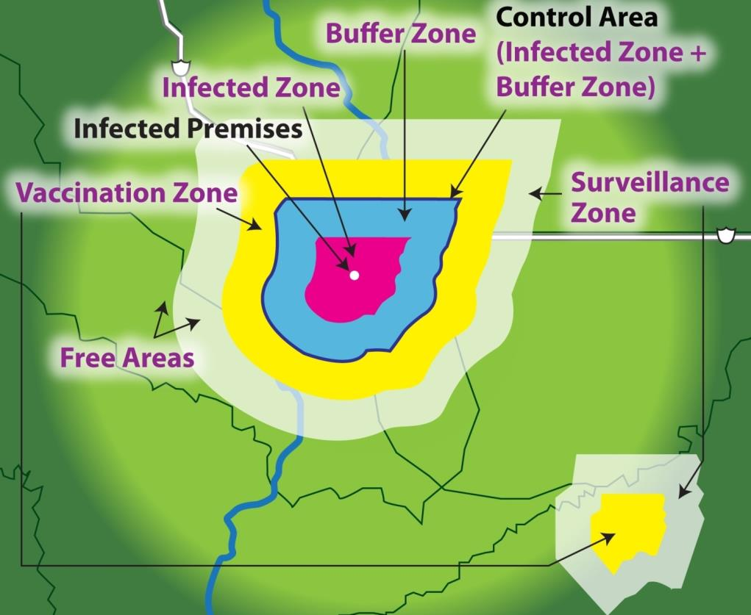
Premises, Zones, and Areas
Notes:
This figure represents all the Premises, Zones, and Areas. The zones are represented by color –
Infected Zone - Pink
Buffer Zone – Blue
The Infected Zone and the Buffer Zone together comprise the Control Area.
Vaccination Zone – Yellow – which can be located inside or outside of a Control Area, as seen on this map. A Vaccination Zone may be either a Protection Vaccination Zone or a Containment Vaccination Zone.
Surveillance Zone - White
Free Areas – are all areas not included in any Control Area
[This illustration depicts all zone and area designations surrounding an Infected Premises. Content provided by: USDA. Illustration by: Dani Ausen, Iowa State University]

Slide 19
Minimum Sizes
Control Area
  Numerous factors determine size
  Varies according to FAD agent and circumstances of the outbreak
Minimum sizes established for:
  Infected Zone
  Buffer Zone
  Control Area
  Surveillance Zone
Notes:
Remember the Infected Zone and the Buffer Zone together comprise the Control Area. Numerous factors determine the size of the Control Area. It depends on the FAD agent and the circumstances of the outbreak. Minimum sizes have been established for the Infected Zone, Buffer Zone, Control Area, and Surveillance Zone. For details on the Premises, Zones, and Areas, see the APHIS Framework for Foreign Animal Disease Preparedness and Response.

Slide 20
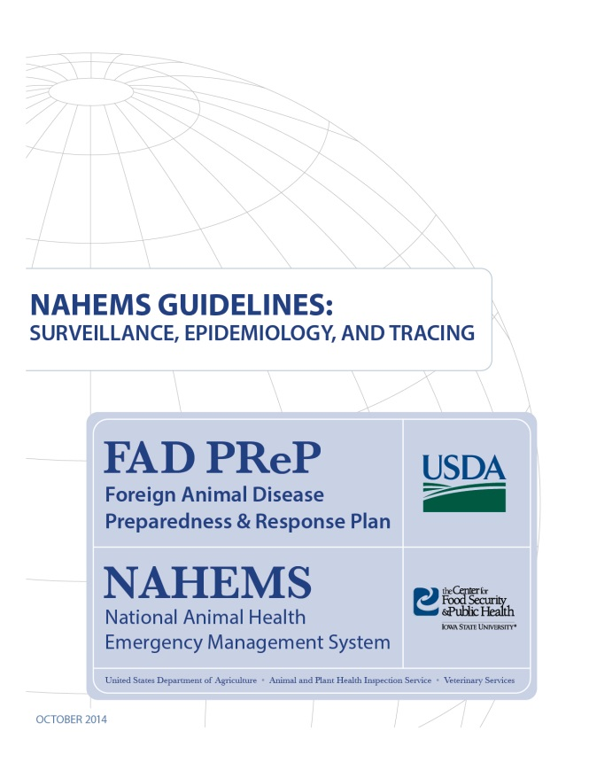
For More Information
FAD PReP/NAHEMS Guidelines: Surveillance, Epidemiology, and Tracing, and SOP: Surveillance
  http://www.aphis.usda.gov/fadprep
Surveillance, Epidemiology,
and Tracing web-based
training module
  http://naherc.sws.iastate.edu/
Notes:
More details can be obtained from the sources listed on the slide, available on the USDA website (http://www.aphis.usda.gov/fadprep) and the NAHERC Training Site (http://naherc.sws.iastate.edu/).

Slide 21

Guidelines Content
Authors (CFSPH)
Kerry Leedom Larson, DVM, MPH, PhD, DACVPM
Glenda Dvorak, DVM, MPH, DACVPM
Janice Mogan, DVM
Courtney Blake, BA
Reviewers (USDA APHIS VS)
Dr. R. Alex Thompson
Dr. Lowell Anderson
Dr. Steve Goff
Dr. Fred Bourgeois
Notes:
The print version of the Guidelines document is an excellent source for more detailed information. In particular, the Guidelines document has listings of additional resources. This slide acknowledges the authors and reviewers of the Guidelines document. It can be accessed at http://www.aphis.usda.gov/fadprep.

Slide 22
Acknowledgments
Development of this presentation was by the Center for Food Security and Public Health at Iowa State University through funding from the USDA APHIS Veterinary Services
PPT Authors: Patricia Futoma, Veterinary Student; Kerry Leedom Larson, DVM, MPH, PhD, DACVPM
Reviewers: Janice Mogan, DVM, Melissa Lang, BS
Notes:
Information provided in this presentation was developed by the Center for Food Security and Public Health at Iowa State University College of Veterinary Medicine, through funding from the US Department of Agriculture, Animal and Plant Health Inspection Service, Veterinary Services.

