Slide 1
Surveillance, Epidemiology, and Tracing
Overview
Adapted from the FAD PReP/NAHEMS Guidelines: Surveillance, Epidemiology, and Tracing (2014).
Notes:
An animal health emergency could have a detrimental effect on the nation's agriculture, food supply, and economy. Veterinary responders, animal health technicians, and other trained personnel may assist with surveillance, epidemiology, and tracing activities. In order to perform these job duties, a broad understanding of surveillance and epidemiological concepts is required. This presentation provides an overview of surveillance, epidemiology, and tracing. [This information was derived from the Foreign Animal Disease Preparedness and Response (FAD PReP)/National Animal Health Emergency Management System (NAHEMS) Guidelines: Surveillance, Epidemiology, and Tracing (2014).]

Slide 2
This Presentation
Introduction to when and why
Definitions for technical terms
Organizational structure
Overview of Surveillance Plan
Notes:
This presentation provides an introduction as to when and why surveillance, epidemiology, and tracing activities are implemented in a foreign animal disease (FAD). It gives definitions for technical terms and explains the organization structure of responding personnel. An overview of the Surveillance Plan, its epidemiological principles and tracing activities are discussed.

Slide 3
Surveillance, Epidemiology, and Tracing Activities
Notes:
This presentation will provide a background on surveillance, epidemiology, and tracing activities. It will introduce terms and principles used to provide a real-time understanding of the situation and enable the earliest possible and most appropriate intervention strategies to be implemented (e.g., quarantine, movement control, vaccination, stamping-out, etc.).

Slide 4
Introduction
Foreign animal disease (FAD)
  Terrestrial or aquatic disease or pest not known to exist in the United States
    High pathogenicity avian influenza
    Foot-and-mouth-disease
  Preventive measures for introduction
    Import restrictions
    Exclusion activities at borders/ports of entry
    Public education programs
Notes:
A foreign animal disease (FAD) is a terrestrial animal disease or pest, or an aquatic animal disease or pest, not known to exist in the United States (U.S.) or its territories. Examples include high pathogenicity avian influenza and foot-and-mouth disease. Preventive measures including import restrictions, exclusion activities at borders and ports of entry, and public education programs to keep FAD agents from entering susceptible animal populations.

Slide 5
Introduction (cont’d)
FAD investigation
  Initiated if an FAD is suspected
    Foreign Animal Disease Diagnostician
    Guidance Document 12001
    APHIS FAD PReP Manual 4-0
Once an FAD is confirmed
  Surveillance, epidemiology, and tracing response components are activated
    Provide real-time understanding
    Enable decisions on interventions
Notes:
In the event an FAD outbreak is suspected, a Foreign Animal Disease Diagnostician (a specially trained veterinarian) conducts an initial site investigation. Instructions for investigating a potential FAD outbreak are found in the Guidance Document 12001: Policy for the Investigation of Potential Foreign Animal Disease/Emerging Disease Incidents (FAD/EDI) and in the APHIS FAD PReP Foreign Animal Disease Investigation Manual (FAD PReP Manual 4-0). Once an animal is presumed positive for an FAD, or an FAD agent has been isolated and identified, appropriate Federal resources may be mobilized in support of the local response depending on the situation. Surveillance, epidemiology, and tracing components of an FAD response must be implemented quickly to contain and eradicate the disease.

Slide 6
Purpose
Surveillance, epidemiology, and tracing techniques are used to:
  Detect cases
  Understand disease characteristics
  Identify risk factors
  Provide information for decision-making
  Design and implement control measures
  Evaluate the effectiveness of the control measures implemented
Notes:
Surveillance, epidemiology, and tracing techniques will be employed in an FAD outbreak to:
Detect new and existing cases (animals or premises);
Understand characteristics of the disease (e.g., clinical signs, incubation period, populations affected) and outbreak characteristics (e.g., sources, disease incidence patterns, geographic distribution, transmission dynamics, and reservoirs) and how they affect specific populations;
Identify risk factors associated with disease occurrence (e.g., age, production practices, species, wildlife, vectors);
Provide information for decision-making to design and implement control measures against the disease being targeted, such as designation of zones for disease control procedures; and
Evaluate the effectiveness of the control measures implemented and adjust them as the situation dictates.

Slide 7
Definitions
Surveillance
  An intensive form of data recording that encompasses gathering, documenting, and analyzing data
Epidemiology
  The study of the distribution of disease in populations and of factors that determine its occurrence
Tracing
  Information gathering on recent movements of animals, personnel, vehicles, and fomites to identify potential spread of disease, and source
Notes:
Surveillance, epidemiology, and tracing activities are essential elements of an FAD response. The terms surveillance, epidemiology, and tracing are interrelated. There are many definitions for each term that vary slightly; we will define them as follows.
Surveillance: an intensive form of data recording that encompasses gathering, documenting, and analyzing data. Information is then disseminated so that action can be taken to evaluate disease status and eradicate or control a disease.
Epidemiology: the study of the distribution of disease in populations and of factors that determine its occurrence. Investigations involve observing animal populations and making inferences from data and observations.
Tracing: information gathering on recent movements (during a defined time period) of animals, personnel, vehicles, and fomites (both to and from affected premises) to identify potential spread of disease to other premises and to detect a potential source of infection for the affected farm.

Slide 8
Zone/Area Designations
Summary of Zone and Area Designations
Infected Zone (IZ) | Zone that immediately surrounds an infected Premises
Buffer Zone (BZ) | Zone that immediately surrounds an Infected Zone or Contact Premises
Control Area (CA) | Consists of an Infected Zone and Buffer Zone
Surveillance Zone (SZ) | Zone outside and along the border of a Control Area
Vaccination Zone (VZ) | Emergency Vaccination Zone is classified as either Containment Vaccination Zone (typically inside the control area) or Protection Vaccination Zone (typically outside Control Area). This may be a secondary zone designation
Notes:
During an FAD outbreak, disease control zones are established to control movements in and out of the Control Area and surrounding areas to prevent the spread of the disease agent. Types of disease control zones are described in this table. Map illustrations of the premises designations and disease control zones are provided in the PowerPoint “Personnel and Premises Designations.” [This table summarizes the Zone and Area Designations. Content provided by USDA. Illustration by: Dani Ausen, Iowa State University]

Slide 9
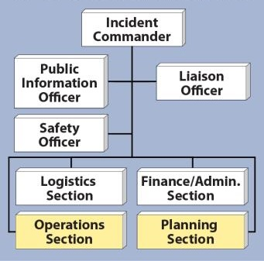
Incident Command System
Incident Command System (ICS)
  Flexible and scalable
    Number and names of deployed groups will vary
  Planning and Operations Sections
  Incident Action Plan
Notes:
The organizational structure for emergency response personnel will follow the Incident Command System (ICS). The ICS structure is flexible and scalable and the exact number and names of groups deployed during a response will vary according to the scope and nature of the event. The Planning and Operations Sections contain the most personnel with surveillance, epidemiology, and tracing responsibilities. Information generated through these activities is used to develop the Incident Action Plan (IAP) approved by the Incident Commander. An IAP provides a concise, coherent means of capturing and communicating to all personnel the overall incident priorities, objectives, and strategies in the contexts of both operational and support activities. [This is an illustration of an Incident Command System structure highlighting the Operations Section and Planning Section. Illustration by: Dani Ausen, Iowa State University]

Slide 10
Surveillance and Epidemiology
Notes:
Surveillance, epidemiology, and tracing activities are all interrelated and occur simultaneously. The next few slides will focus on surveillance which involves ongoing collection, analysis, interpretation, and dissemination of data related to disease, and the study of the factors related to frequency and distribution of the disease, which many refer to as epidemiology.

Slide 11
Role of Surveillance
During an FAD outbreak, surveillance plays a key role in:
  Identifying the infectious agent
  Determining the scope of the outbreak
  Assessing the effectiveness of eradication and control efforts
  Demonstrating a return to disease free status
Notes:
In an FAD outbreak, surveillance activities play a key role in: identifying the infectious agent; determining the scope of the outbreak; assessing the effectiveness of eradication and control efforts; and demonstrating a return to disease free status.

Slide 12
Surveillance Plan Elements
Disease description
Surveillance objectives
Stakeholders and responsible parties
Population description
Case definitions
Data sources
Sampling methods
Diagnostic tests
Notes:
The Surveillance Plan is developed by the Disease Surveillance Branch in collaboration with the Situation Unit. The Surveillance Plan functions as a framework describing the surveillance system and the roles and responsibilities of surveillance team members during the FAD response. The Surveillance Plan includes:
Disease description;
Surveillance objectives;
Identifying stakeholders and responsible parties;
Population description;
Case definitions;
Data sources;
Sampling methods; and
Diagnostic tests.

Slide 13
Case Definitions
Suspect case
  Animal showing clinical signs compatible with FAD
Presumptive positive case
  Animal with clinical signs consistent with FAD and positive test results
Confirmed positive case
  Agent has been isolated and identified using approved tests
Notes:
At least three case definitions are developed during an FAD outbreak. These definitions are likely to evolve as the outbreak progresses.
Suspect case - Animal showing clinical signs compatible with the FAD.
Presumptive positive case - Animal with clinical signs consistent with the disease in question, epidemiological links, and/or laboratory test(s) that would support current infection or exposure to the disease of concern.
Confirmed positive case – indicates the requirements, including laboratory testing and other criteria that are required to unequivocally determine the presence of the FAD agent.
For many high-consequence FADs, case definitions have been developed, and are available in FAD PReP Disease Response Plans or Disease Response Strategies. FAD PReP SOP: Case Definition Development Process provides additional information on how case definitions are derived.

Slide 14
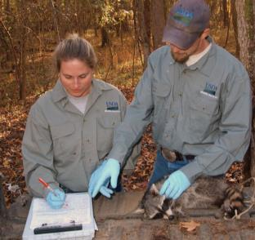
Data Sources
Livestock producers
Veterinarians
Livestock organizations
Disease reporting or notification systems
Control programs
Sentinel units
Post mortem diagnostic specimen collection
Wildlife data
Notes:
Data are facts such as observations, clinical signs and laboratory results collected from multiple sources by the surveillance system. Many sources of data are available to assist with surveillance efforts. A number of various data sources are listed on this slide. Sources from which facts can be gathered may include industry, government, laboratories, and veterinarians. [This image depicts wildlife data collection. Photo source: USDA]

Slide 15
Sampling Methods
Considerations for accurate and practical sampling methods:
  Sample type
  Sample size
  Random sampling vs. targeted sampling
  Sampling duration and frequency
  Sample areas/locations
  Availability of diagnostic tests
  Pooled testing
Notes:
Considerations for developing accurate and practical sampling methods include sample type; sample size; random sampling vs. targeted sampling; sampling duration and frequency; sample areas/locations; availability of diagnostic tests; and pooled testing.

Slide 16
Types of Specimens
Blood or serum
Skin or vesicular lesions
  Epithelial tissue or vesicular fluid
Feces, rectal swabs, cloacal swabs, or genital tract swabs
Nasal, oral, or oropharyngeal swabs
Nasal discharge, saliva, tears
Semen samples
Tissues
  Tonsil, spleen, kidney, liver, lymph node, lung, brain, etc.
Milk
Environmental samples
Notes:
The type of specimen collected is determined by the disease of concern, available diagnostic tests, and the ability to obtain samples from target species. Number and type of specimens to collect is determined and communicated by Incident Command. Diagnostic specimens that may be collected include those listed on the slide, such as tissues from the animal, animal products like milk, or environmental samples. For in-depth information on collecting diagnostic specimens, please see the FAD Investigation Manual (FAD PReP Manual 4-0).

Slide 17
Core Functions
Surveillance
  Ongoing data collection, analysis, interpretation, and dissemination
  Used to determine specific actions for FAD mitigation
Field investigation
  Used to collect additional information about cases identified via surveillance
    Disease source, history of disease, etc.
Notes:
There are four core functions of epidemiology.
Surveillance, as mentioned earlier, involves ongoing collection, analysis, interpretation, and dissemination of data related to disease. This information is used to determine specific actions for FAD mitigation (e.g., quarantine, vaccination, depopulation, etc.). Surveillance is conducted to monitor a population for the presence, or absence, of disease. Surveillance provides information for action. In an FAD outbreak, surveillance will be used to detect cases or clusters of disease cases in the field.
From field investigations, epidemiologists will then collect additional information regarding the disease outbreak. This may include identifying the disease source, determining if other animals have been exposed, and learning more about the history of disease.

Slide 18
Core Functions (cont’d)
Analytic studies
  Utilizes information gleaned from surveillance activities and field investigations
  Disease rates and risk factors
Evaluation
  Effectiveness
  Efficacy
  Impact of activities
Notes:
In an FAD response, information gleaned from surveillance activities and field investigations will be used in analytic studies. Disease rates will be calculated, and parts of the animal population that may be at higher risk than others will be described. This will aid in identification of risk factors for disease, and determination of the source of disease. Many epidemiologic studies will require advanced analytic techniques.
Evaluation is the process of determining the effectiveness, efficiency, and impact of activities with respect to established goals. In an FAD response, strategies to contain, control, and/or eradicate a contagious FAD must be constantly evaluated to ensure that appropriate actions are undertaken.

Slide 19
Disease Occurrence
Endemic
  Present in a population or geographical area at times
Outbreak
  Occurrence of more cases of disease than expected in a given area, or a specific group, over a particular time period
Pandemic
  An outbreak/epidemic that has spread over several countries
Notes:
Epidemiologists also describe disease occurrence: the level or amount of disease occurring in an area and the factors that work together to cause disease. It is important to understand the level of disease present before and during an FAD event.
The following terms are used to describe amounts of disease in a population or area:
Endemic - present in a population or geographical area at all times.
Outbreak - the occurrence of more cases of disease than expected in a given area, or among a specific group, over a particular time period. Many epidemiologists use the terms outbreak and epidemic interchangeably.
Pandemic - an outbreak/epidemic that has spread over several countries or continents.

Slide 20
Risk Factors
A characteristic that is associated with an increase in the occurrence of a particular disease
May include:
  Age
  Species
  Location
  Contact
Notes:
The concept that disease does not occur randomly in a population is critical to epidemiology. The presence of risk factors may make disease more likely to occur in some members of a population than in others. Risk factors may be related to the agent, host, or environment and can include age, species, geographic location, and contact with other animals or fomites. Epidemiologists study the presence and/or absence of risk factors in diseased and non-diseased animals in order to gain a better understanding of an FAD agent.

Slide 21
Epidemiological Principles
Prevent contact between the FAD agent and susceptible animals
  Quarantine, movement controls, biosecurity procedures, target depopulation
Stop production of FAD agent by infected or exposed animals
  Slaughter or mass depopulation
Increase the disease resistance of susceptible animals to the FAD agent
  Emergency vaccination
Notes:
Data collected by surveillance efforts is utilized by epidemiologists in an FAD outbreak. Three basic epidemiological principles form the foundation for response strategies for containing, controlling, and/or eradicating a contagious FAD.
Prevent contact between the FAD agent and susceptible animals. This is accomplished through quarantine of infected animals and movement controls in Control Areas, through biosecurity procedures to protect non-infected animals, as well as accelerated depopulation of animals at risk, as warranted.
Stop the production of the FAD agent by infected or exposed animals. This is accomplished by slaughter or mass depopulation (and disposal) of infected and potentially infected animals.
Increase the disease resistance of susceptible animals to the FAD agent or reduce the shedding of the FAD agent in infected or exposed animals. This is accomplished by strategic emergency vaccination if a suitable vaccine is available and can be administered in a timely manner.
During an FAD outbreak epidemiologists use data collected during surveillance to design plans to achieve these goals.

Slide 22
Phases of Investigation
Generally, disease outbreaks are investigated in three phases:
  Descriptive phase
  Analytic phase
  Intervention phase
Notes:
Generally, disease outbreaks are investigated in three phases: the descriptive phase, the analytic phase, and the intervention phase. Although presented sequentially in this web module, these activities may occur simultaneously during an FAD response.
In the descriptive phase information on case chronology, geography, and demography is collected, and a case definition is developed.
In the analytic phase descriptive data and corresponding laboratory results are used to determine risk factors, and the FAD agent and source are determined (if possible).
In the intervention phase preventative options are considered, and economic benefits and consequences of control measure are assessed.

Slide 23
Tracing Animal Movements
Notes:
Tracing is a critical part of an FAD response. Tracing is the ability to track the movements of an animal or group of animals during a specific time period. By tracking the movements of animals, tracing is intended to identify the source of the infection and identify potentially exposed animals that may be infected and have moved elsewhere. Tracing aids in controlling the spread of an FAD agent or a hazard, and limits the impact of an outbreak by detecting potentially infected premises or animals. In the event of an FAD outbreak, all movements to and from the affected premises must be assessed.

Slide 24
Tracing
Trace-back
  Animals, animal products, fomites, people, vehicles, equipment, and possible vectors that have been moved onto an Infected Premises
  Establish the origin of the agent/hazard
Notes:
Trace-back seeks to identify the origin of all animals, animal products, fomites, people, vehicles, equipment, and possible vectors that have been moved onto an Infected Premises, in order to establish the origin of the agent/hazard.

Slide 25
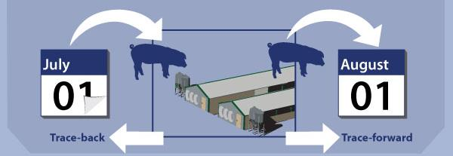
Tracing (cont’d)
Trace-forward
  Animals, animal products, fomites, people, vehicles, equipment, and possible vectors that have left the Infected Premises
Notes:
Trace-forward seeks to track all animals, animal products, fomites, people, vehicles, equipment, and possible vectors that have left the infected premises and could have possibly carried the agent to other animals. Animals located on exposed premises should be investigated and kept under surveillance and/or quarantine until additional data suggest they have remained unaffected. Tracing information can be obtained from many sources. Epidemiologists and animal health officials are encouraged to use all available resources when completing FAD traces.
[This graphic shows movement of a group of swine into and out of a production facility to illustrate trace-forward and trace-back. The illustration depicts swine moving into a production facility, and one month later being moved to another location. The origin and the destination of this group, or of an individual animal, may need to be traced. Illustration by: Katlyn Harvey, Iowa State University]

Slide 26
Additional Operational Procedures
A variety of strategies are required to contain, control and/or eradicate an FAD
  Biosecurity
  Health and safety
  Personal protective equipment
  Cleaning and disinfection
  Quarantine and movement control
Notes:
A variety of strategies are required in order to contain, control, and/or eradicate an FAD. The following operational procedures are related to surveillance and epidemiology/tracing activities and will be implemented in an FAD response: biosecurity, health and safety, personal protective equipment, cleaning and disinfection, and quarantine and movement control. For more information on these operational procedures, see the corresponding FAD PReP/NAHEMS Guidelines document.

Slide 27
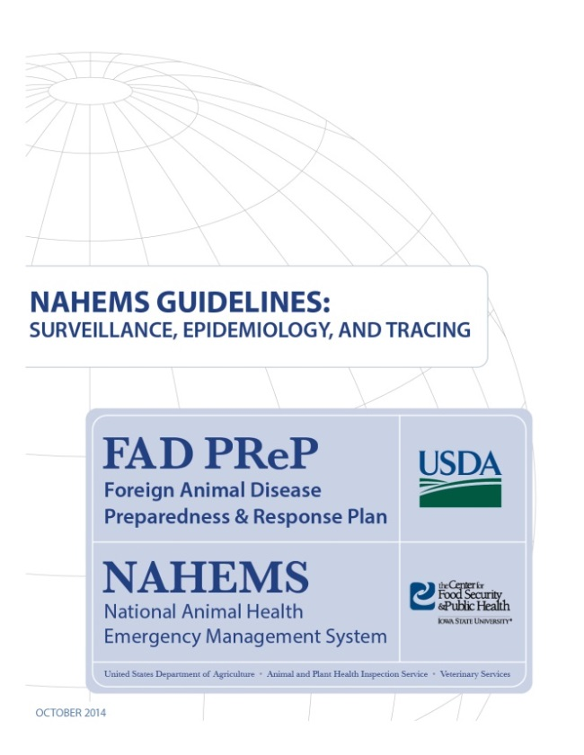
For More Information
FAD PReP/NAHEMS Guidelines: Surveillance, Epidemiology, and Tracing, and SOP: Surveillance
  http://www.aphis.usda.gov/fadprep
Surveillance, Epidemiology,
and Tracing web-based
training module
  http://naherc.sws.iastate.edu/
Notes:
More details can be obtained from the sources listed on the slide, available on the USDA website (http://www.aphis.usda.gov/fadprep) and the NAHERC Training Site (http://naherc.sws.iastate.edu/).

Slide 28

Guidelines Content
Authors (CFSPH)
Kerry Leedom Larson, DVM, MPH, PhD, DACVPM
Glenda Dvorak, DVM, MPH, DACVPM
Janice Mogan, DVM
Courtney Blake, BA
Reviewers (USDA APHIS VS)
Dr. R. Alex Thompson
Dr. Lowell Anderson
Dr. Steve Goff
Dr. Fred Bourgeois
Notes:
The print version of the Guidelines document is an excellent source for more detailed information. In particular, the Guidelines document has listings of additional resources. This slide acknowledges the authors and reviewers of the Guidelines document. It can be accessed at http://www.aphis.usda.gov/fadprep.

Slide 29
Acknowledgments
Development of this presentation was by the Center for Food Security and Public Health at Iowa State University through funding from the USDA APHIS Veterinary Services
PPT Authors: Patricia Futoma, Veterinary Student; Kerry Leedom Larson, DVM, MPH, PhD, DACVPM
Reviewers: Janice Mogan, DVM, Melissa Lang, BS
Notes:
Information provided in this presentation was developed by the Center for Food Security and Public Health at Iowa State University College of Veterinary Medicine, through funding from the US Department of Agriculture, Animal and Plant Health Inspection Service, Veterinary Services.

