Slide 1
Cleaning and Disinfection
C&D Procedures, Part 1
Adapted from the FAD PReP/NAHEMS
Guidelines: Cleaning and Disinfection (2014)
Notes:
This Part 1 presentation outlines general cleaning and disinfection procedures applicable during an animal health or animal disease emergency, such as a foreign animal disease (FAD). Refer to the Site Specific Cleaning and Disinfection Standard Operating Procedures (SOP) developed for C&D protocols for a particular animal health response. This information was derived from the Foreign Animal Disease Preparedness and Response (FAD PReP)/National Animal Health Emergency Management System (NAHEMS) Guidelines: Cleaning and Disinfection (2014) and also the web-based training module.

Slide 2
Disinfection Methods and Regulation
Notes:
Before we discuss general operational C&D procedures, we will focus on different methods of disinfection. With the following slides we will discuss thermal inactivation (heat), ultraviolet radiation and filtration, and will briefly mention chemical disinfection. We will also look at the agencies responsible for regulation of disinfectants.

Slide 3
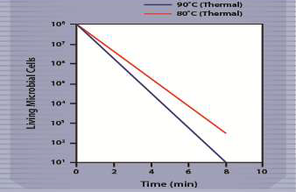
Disinfection Methods
Physical
  Thermal inactivation (heat)
    DNA, protein, oxidative damage
    Moist or dry conditions
  Ultraviolet radiation
    Photochemical reaction
    Primarily a surface effect
  Filtration
    Physical removal of microorganisms
Notes:
The thermal inactivation of infectious agents is one of the oldest and most widely used methods of disinfection. Heat destroys microorganisms by causing DNA disruption (breaks), protein denaturation, oxidative damage, and loss of membrane integrity. Infectious agents vary widely in their susceptibility to thermal inactivation. Heat can be applied under moist (e.g., autoclave, steam) or dry (e.g., flame, baking) conditions. Pasteurization is considered a mild thermal disinfection process (e.g., milk, cheese). It does not kill all microorganisms. Ultraviolet (UV) radiation inactivates organisms though a photochemical reaction that alters the molecular components essential to cell function (e.g., nucleic acids), damaging cellular DNA. UV light (sunlight) produces primarily a surface effect and does not penetrate even a thin layer of protein or pigment. Filtration, while not a disinfection method, can be used to physically remove microorganisms from gasses and fluids. Membrane filters consist of porous disks of biologically inert material that prevents or retards the passage of microorganisms based on their size. High efficiency particulate air (HEPA) filters are microfilters (≥0.3μm) that may be used to filter the air and to assure the safety of air discharged. [This illustration reflects the logarithmic rate of thermal destruction of microorganisms at 90 degrees Centigrade (blue line), and at a slower rate at 80 degrees Centigrade (red line). Illustration by: Andrew Kingsbury, Iowa State University]

Slide 4
Disinfection Methods
Chemical
  USDA APHIS will determine which disinfectants are to be used
  Inactivates a wide variety of microorganisms – not all
  Chemical disinfectant classes
  Selection on characteristics, efficacy, and hazards
Notes:
In the event of a highly contagious foreign animal disease outbreak, USDA APHIS management will provide specific guidance to field personnel about which chemical disinfectants should be used. Chemical disinfectants inactivate a wide variety of microorganisms, but not all. The products may be classified by their chemical nature. Each class has unique characteristics, efficacy, and hazards. Therefore, disinfection selection involves consideration of the product’s spectrum of microorganism, material compatibility characteristics, and human hazards - all of which can usually be found on the product’s label. Most chemical disinfectants work by causing damage to a microorganism’s outermost structural integrity (i.e., disruption of the membrane proteins and lipids) which results in altered function, lysis, or interference with active transport and energy metabolism.

Slide 5
Disinfectants
Chemical classes
Acids
Alcohols
Aldehydes
Alkali agents
Biguanides
Halogen-based compounds
Oxidizing/peroxide-based compounds
Phenols
Quaternary ammonium compounds
Notes:
This slide is a listing of classes of chemical disinfectants. Products may be classified by their chemical nature – acids, alcohols, aldehydes, alkali agents, biguanides, halogen-based compounds, oxidizing agents, phenols, and quaternary ammonium compounds. As said previously, chemical disinfectants inactivate a wide variety of microorganisms, such as most vegetative bacteria and enveloped viruses. However, fungal spores and non-enveloped viruses are generally less susceptible. Mycobacteria, bacterial endospores, and protozoal oocysts are highly resistant to most disinfectants. Prions, the etiologic agents of bovine spongiform encephalopathy and scrapie, are exceptionally resistant to chemical inactivation. A more detailed discussion of chemical disinfectants is presented in this series of PowerPoint presentations titled, Chemical Disinfectants.

Slide 6
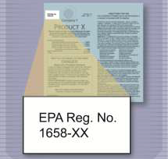
Disinfectant Regulation
Chemical disinfectants regulated by the U.S. EPA
  Federal Insecticide, Fungicide, and Rodenticide Act (FIFRA)
    Chemical disinfectants considered “antimicrobial pesticides”
    Pesticides must be registered
  Novel pathogens
    FIFRA exemption possible
Notes:
Chemical disinfectants in the United States are regulated by the U.S. Environmental Protection Agency (EPA) under the Federal Insecticide, Fungicide, and Rodenticide Act (FIFRA) [Title 40 of the Code of Federal Regulations (CFR), Parts 150 to 189]. Under FIFRA, chemical disinfectants are considered to be “antimicrobial pesticides” that are intended for the control, prevention, and destruction of pathogenic microorganisms on inanimate objects and surfaces. FIFRA requires that any pesticide be registered or exempted before it may be sold or distributed in the United States. FIFRA further requires that all label use directions and safety precautions must be followed. In some situations (e.g., highly contagious foreign animal diseases), a particular pathogen may not be listed on the product label of an EPA-registered disinfectant. In these cases, Section 18 of FIFRA authorizes EPA to grant several different kinds of exemptions to Federal Agencies or States to use unregistered pesticides for a limited time, if EPA determines that emergency conditions exist. If granted, such exemptions would allow the use of non-registered pesticides or the “off-label” uses of a registered pesticide for a specified time period. USDA-APHIS VS Staff will collaborate with the APHIS Policy and Program Development (PPD) Environmental and Risk Analysis Services (ERAS) Staff (phone: 301-734-8963) to obtain exemptions from EPA, either in advance of or immediately after an animal health emergency, as needed. [This illustration shows a registration number on a disinfectant label. Illustration by: Oriana Hashemi-Toroghi, Iowa State University]

Slide 7
C&D Procedures:
Assessment and Planning
Notes:
Cleaning and disinfection procedures require careful planning and coordination to ensure optimum reduction or elimination of the targeted pathogen on the infected premises, to prevent further movement of pathogens between premises, and to ensure the safety of response personnel, animals and the environment.

Slide 8
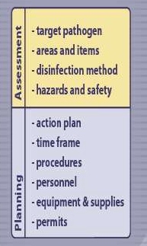
Assessment
First step for any disinfection procedure
Situation assessment includes:
  Identifying pathogen
  Determining areas and items in need of disinfection
  Selecting disinfection methods
  Identifying and addressing potential safety or hazardous issues
Notes:
The first step for any effective disinfection procedure involves a thorough assessment of the situation. This includes identifying the known or suspected pathogen to be controlled or eliminated, determining the areas and items in need of disinfection, selecting the proper disinfection method (e.g., processing and/or product), and identifying and addressing any potential safety or hazardous issues involved. [This illustration lists main points in assessment and planning for C&D procedures. Illustration by: Andrew Kingsbury, Iowa State University]

Slide 9
Planning
Develop site-specific C&D plan
  Specific actions needed
    Chronological order
  Estimated time frame to perform
  Process to certify and record C&D procedures
  Disposal methods
Determine needs
  Personnel, equipment, supplies, permits
Notes:
Next, a site-specific C&D plan should be developed based on the assessment. This action plan should include a list of the specific actions needed (in chronological order) and the estimated time frame to perform the procedures. Protocols for disinfecting structures, pens, and equipment should be established. A process to certify and record C&D procedures will also need to be established. The site-specific C&D plan should also address the details on how to dispose of materials (e.g., gross debris, chemical solutions) in a manner that minimizes the further spread of microorganisms and is compliant with federal, state, and local requirements and policies. Once the situation is thoroughly assessed, the necessary personnel, equipment and supplies can be determined, and any regulatory permits or approvals can be obtained.

Slide 10
Planning
Personnel
  Number of personnel – based on task
  All personnel must be trained on basic C&D procedures, protocols
Equipment and supplies
  Equipment needs
  Work with Logistics Unit during acquisition
PPE
  Many chemical disinfectants hazardous
  Eye/face/respiratory protection,
  chemical resistant gloves,
  waterproof aprons/suits
Notes:
The number of personnel required for a given situation will vary depending on the quantity and size of the areas/buildings/equipment, the sanitary conditions of the premises, and the timeframe within which the work is to be performed. As an example, one or more C&D teams of 5-7 persons each is recommended for disinfecting large farms and stockyards or sale barns. All C&D team personnel, including any contractors used, must be trained on basic C&D procedures, safety protocols and issues, as well as the nature of the situation (e.g., highly contagious foreign animal disease or zoonotic disease) prior to initiating work. Equipment needs for C&D operations will also vary with the situation. Acquisition of equipment should be done in conjunction and coordination with the Logistic Unit for the response. Some equipment and personnel may need to be obtained through leases and contracts with appropriate local officials or businesses. Large amounts of water will also be needed for C&D operations. Water mains or alternative water sources (wells, tankers) should be identified. Basic equipment needed for C&D operations are listed in Appendix E of these Guidelines and described in the FAD PReP SOP: Cleaning and Disinfection (2014). Personal protective equipment (PPE) for C&D team members will be needed. Many chemical disinfectants are hazardous to humans, therefore, eye/face/skin/respiratory protection, as well as chemical resistant gloves should be worn when mixing and applying solutions. Waterproof aprons or suits should be worn when preparing disinfectant solutions, and also perhaps during the operational procedures. Additional information on PPE may be found in the FAD PReP SOP: Cleaning and Disinfection (2014) and the FAD PReP/NAHEMS Guidelines: Personal Protective Equipment (2014).

Slide 11
Documentation
Document the following:
  Materials used and expended, cost
    Include labor charges, rentals, subcontractors
  Personnel number and identity
    Entry log for premises
  Tracking
    Vehicles, heavy equipment
  Type, formulation, quantity, date of disinfectant preparation
Information should be recorded in ink, signed with author’s initials/date
Notes:
During C&D procedures, it will be necessary to maintain various types of documentation. Information on the materials used and expended as well as the cost of such materials will be necessary for indemnity, reimbursement, or cost sharing purposes. The costs associated may include labor charges, equipment rentals or purchases as well as expendable equipment or supplies, or subcontractor costs. Information on personnel will also be needed and may include the number and identity of C&D team members, as well as the hours worked. Documentation will also be essential to tracking vehicles, heavy equipment, and people who exit and enter the area. Log sheets on the type, formulation, quantity and date of preparation for chemical disinfectants will also be pertinent information to record. Written documentation can be maintained in a logbook format. Information should be recorded in ink and anyone making entries into the logbook should sign and date the bottom of the entry page. Any entry errors should have a single line drawn through them with the author’s initials and date. Pages should never be removed from a logbook.

Slide 12
Initiating C&D Protocols
Notes:
Site selection and set up need to be determined before initiating cleaning and disinfection operations. C&D should begin as soon as possible after assessment, however, some measures may need to be delayed until animals are removed (e.g., temporary housing, depopulation) from the premises or area. The level of disinfection required will depend on situation and pathogen involved. For most situations, C&D protocols to be established will include personnel stations, vehicle stations, and equipment and facilities C&D procedures.

Slide 13
Site Selection
C&D station location
  Adjacent to or at entrance points of infected premises
Two scales
  Small: personnel, small equipment
  Large: vehicles, heavy machinery
Additional considerations
  Flat terrain, adequate size
  Away from sensitive areas
Notes:
The location used to establish C&D stations is critical and should be adjacent to or at the entrance points to the infected premises (IP). This will provide easy access for responders, a centralized location for most procedures and serve as a visual indicator of the need to implement disinfection measures. Stations established for C&D efforts will involve two scales: small scale for personnel and small equipment, and large scale (e.g., vehicles, heavy machinery). Stations should be established at areas with flat terrain, large enough to house the necessary C&D components (e.g., disinfection station, water supply, waste water containment). The site (and drainage from the location) should be located away from sensitive environmental areas, such as wetlands or well-head areas. Consideration should be given to the collection of spent C&D fluids for environmentally safe disposal if necessary. When possible, C&D sites should be located near sources of potable water and sanitary sewers.

Slide 14
Station Design and Setup
Movement through C&D station follows basic decontamination staging protocols
Three work zones, one corridor prevent spread of hazards:
  Exclusion Zone
  Contamination Reduction Zone
  Support Zone
  Decontamination Corridor
Notes:
Once a location has been selected, movement through the station should follow basic decontamination staging protocols. Typically, three work zones and a corridor are established to help protect responders and prevent the accidental spread of the hazard. The three major work zones and corridor, according to the FAD PReP/NAHEMS Guidelines: Biosecurity (2014), are: the Exclusion Zone, the Contamination Reduction Zone, the Support Zone, and the Decontamination Corridor. The three zones are also known as the Hot, Warm, and Cold Zone.

Slide 15
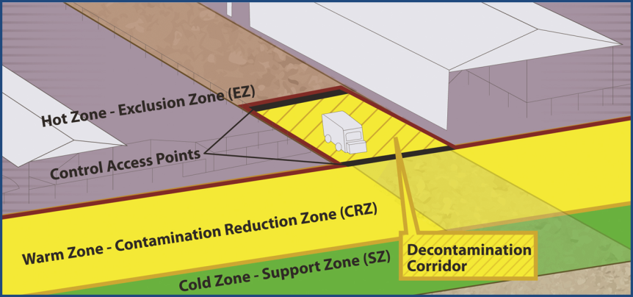
Work Zones
Notes:
The Exclusion Zone (EZ) or Hot Zone is the high risk area where infected animals were housed and is potentially contaminated and considered unsafe. Examples include an area of a farm, local market or roadside stand. PPE must be worn. Appraisal, depopulation, disposal, and facility cleaning and decontamination of the site and equipment occur in this area. Personnel and equipment enter and exit the EZ through designated access points in the Contamination Reduction Zone (CRZ).
The CRZ or Warm Zone is a high risk area due to the potential of exposure to pathogens and chemical disinfectants. Entry from the CRZ to either the Support Zone (SZ) or Exclusion Zone occurs through designated access points. For workers exiting the EZ, final decontamination and disinfection of PPE and equipment, as well as final doffing of PPE occur in the CRZ. Site specific protocols for PPE, decontamination and disinfection must be strictly followed.
The SZ or Cold Zone is the “cleanest” work zone with the lowest relative risk of exposure to pathogens and other hazards such as decontamination chemicals. Facilities for donning PPE before entering other zones are provided. Contaminated articles and equipment are prohibited in these areas; decontamination activities are also prohibited. The size (i.e., width) of these zones will vary with the scale of activities required (e.g., room for vehicles versus personnel). The use of plastic tape can help in differentiating the various C&D zones.
The Decon (Decontamination) Corridor (Figure 2) is the area between the EZ Control Line and the CRZ Control Line. Decontamination of personnel and equipment occurs along the corridor with stations for depositing tools, equipment, protective clothing and other items. The level of contamination should decrease along this corridor from the EZ to the SZ. Teams enter and exit the EZ through the access control points at each end of the corridor.
[This figure shows the three zones, plus the decontamination corridor. Illustration by: Dani Ausen and Andrew Kingsbury, Iowa State University]

Slide 16
Disinfectant Preparation and Application
Notes:
The preparation and application of disinfectant solutions must be in accordance with product label directions or the terms of the Section 18 exemption. Only EPA registered or approved products should be used.

Slide 17
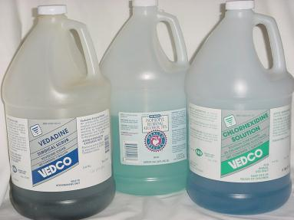
Disinfectant Preparation
Storage
  Cool location, check expiration date
Fresh solutions
  Prepare prior to use
  May require same day preparation
One gallon diluted
disinfectant covers
100-150 sq. ft.
Notes:
Chemical disinfectants should be stored in a cool location to maximize shelf life; some products can lose stability after prolonged storage. Check the product label for the expiration date. Fresh solutions should be prepared prior to use; some disinfectant solutions may only be active for the same day of preparation. Failure to make fresh solutions may result in using a product that has reduced efficacy. The use of test kits can help to determine whether any chemical degradation of the disinfectant’s active ingredients has occurred and that diluted solutions contain the necessary amount of active ingredient. The quantity of disinfectant solution needed for a given situation is determined by the total surface area to be covered (e.g., floor, ceiling, walls, fixed equipment). In general, one gallon of diluted disinfectant usually covers approximately 100-150 square feet of surface area. [This photo shows sample disinfectant stock solutions. Photo source: Carla Huston, Mississippi State University]

Slide 18
Disinfection Application
Follow label recommendations
Systematic implementation
  Top to bottom, small sections
Ensure adequate contact time
Do not apply directly to animals
  Use caution around feeders, waterers
C&D supplies are biohazardous waste
  Discard or disinfect before removal
Notes:
Following a thorough cleaning procedure, application methods for disinfection can vary (e.g., wiping, brushing, spraying, misting, soaking, fumigation) and should be conducted as recommended on the product label. Disinfection efforts should be conducted in a systematic manner (e.g., top to bottom, small sections) to ensure all areas are treated adequately. The necessary contact time must be achieved and surfaces must remain wet during this process; merely damp is not adequate. Disinfectants should not be applied directly to animals unless labeled for such use. Application around feeders, waterers or animal contact areas should be done with caution and be followed by a thorough rinsing before reintroduction. During cold weather, buildings should be heated to approximately 68ºF (20ºC) since some disinfectants are less effective or ineffective at low temperatures. Following application, pressure sprayers and pumps should be properly cleaned to remove potentially corrosive disinfectant solutions. Cleaning and disinfection supplies (e.g., towels, mops) should be treated as biohazardous waste and discarded or properly disinfected before removal from the premises.

Slide 19
Material Composition
Notes:
The variety of materials, equipment and facilities found on animal production areas can be quite diverse. A primary factor to be considered when selecting and performing C&D operations is the kind of surface being treated. The best surfaces for C&D are nonporous, smooth surfaces; however, these are seldom found in animal production situations. This section addresses considerations or contraindications when cleaning and disinfecting various surface types. This will allow for adaptation of methodology regardless of the production situation involved.

Slide 20
Material Composition
Metals
  Smooth surface
  Disinfectants: incompatibility, corrosivity
  Flame guns
Rubber and plastics
  Hard, nonporous surface
  Possible interactions with disinfectants
Glass
  Treat as other hard, nonporous surfaces
Notes:
Metal surfaces (e.g., stainless steel, aluminum), especially when the surfaces are smooth, are generally easier to disinfect than other materials. However, some chemical disinfectants are incompatible or corrosive with metal surfaces. Flame guns may be a useful alternative for some metal surfaces. Rubber and plastics should be treated as hard, nonporous surfaces, however they may have interactions with some chemical disinfectant products. Phenols may be absorbed by plastics and 1% sodium hydroxide should be avoided. Iodophors may cause staining of these materials and can be corrosive to some plastics or rubber. Heat treatments can melt most plastics. Alcohols can swell or harden rubber or certain plastic tubing after prolonged and repeated use. Glass surfaces should be treated as hard, nonporous surfaces.

Slide 21
Material Composition
Concrete
  Porous surface
  Use product registered for concrete
  High pressure washing, flame guns
Wood
  Very porous, difficult to disinfect
  Use product registered for wood
Soil
  Decon – heat, UV light, drying + time
Notes:
Raw concrete surfaces are porous and therefore difficult to decontaminate. Porous surfaces should not be rinsed, soaked, or sprayed with plain water prior to washing or disinfectant application as this can cause unintended dilution. A disinfectant solution of a product registered for concrete surfaces should be applied to all surfaces once gross organic debris has been removed and the area has been washed, rinsed, and dried. If a registered product is not available, then an exempted pesticide should be used. High pressure washing with a disinfectant solution can be helpful for improving adequate contact of these surfaces, but may cause damage to some concrete surfaces. Acid and hypochlorite disinfectants can be corrosive to concrete surfaces. Flame guns may be an alternative disinfection method for concrete surfaces. Wood is extremely porous and therefore difficult to disinfect. Any decaying wood surface that cannot be disinfected should be appraised, removed, and disposed of appropriately (e.g., burn or burial). Wood surfaces should not be rinsed, soaked, or sprayed with plain water prior to washing or disinfectant application as this can cause unintended dilution. A disinfectant solution of a product registered for wood surfaces should be applied once gross organic debris has been removed. If a registered product is not available, then an exempted pesticide should be used. No environmentally safe procedures exist for “disinfecting” soil surfaces (e.g, dirt, sand, packed clay). Decontamination, depending on the pathogen, may need to occur through environmental heat, UV light, drying, and time.

Slide 22

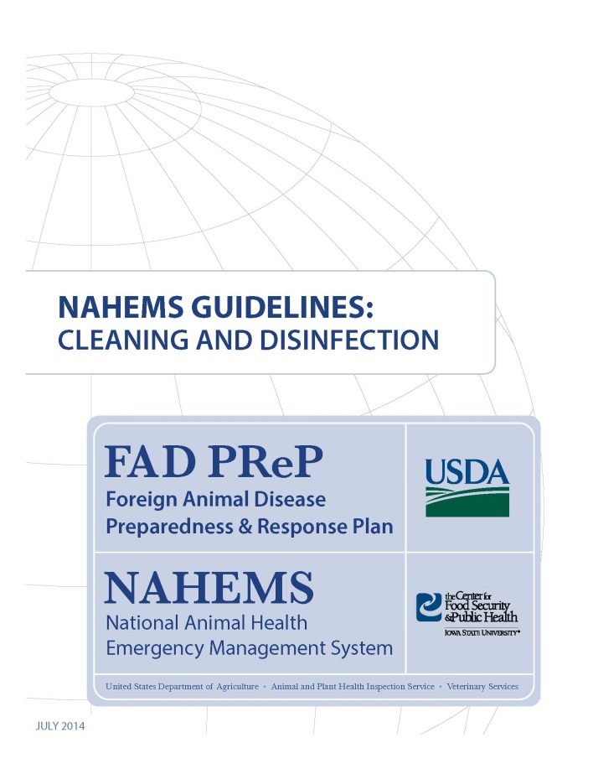
For More Information
FAD PReP/NAHEMS Guidelines & SOP: Cleaning and Disinfection
  http://www.aphis.usda.gov/fadprep
Cleaning and Disinfection web-based training module
  http://naherc.sws.iastate.edu/
Notes:
More details can be obtained from the sources listed on the slide, available on the USDA website (http://www.aphis.usda.gov/fadprep) and the National Animal Health Emergency Response Corps (NAHERC) Training Site (http://naherc.sws.iastate.edu/).

Slide 23
Guidelines Content
Author (CFSPH)
Glenda Dvorak, DVM, MS, MPH, DACVPM
Nichollette Rider, Junior Veterinary Student
Reviewers (USDA)
Nathan G. Birnbaum, DVM
Samantha B. Floyd, Biologist
Notes:
This slide acknowledges the authors and reviewers of the Guidelines document.

Slide 24
Acknowledgments
Development of this presentation was by the Center for Food Security and Public Health at Iowa State University through funding from the USDA APHIS Veterinary Services
PPT Authors: Dawn Bailey, BS; Kerry Leedom Larson, DVM, MPH, PhD, DACVPM;
Reviewers: Glenda Dvorak, DVM, MPH, DACVPM; Patricia Futoma, Veterinary Student;
Janice Mogan, DVM
Notes:
Information provided in this presentation was developed by the Center for Food Security and Public Health at Iowa State University College of Veterinary Medicine, through funding from the US Department of Agriculture, Animal and Plant Health Inspection Service, Veterinary Services.

