Slide 1
Biosecurity
Foreign Animal Disease Response
Adapted from the FAD PReP/NAHEMS
Guidelines: Biosecurity (2016)
Notes:
Biosecurity is a cornerstone of livestock production systems (including poultry production) to maintain food safety and security, protect the environment, and facilitate continuity of business by protecting animals and animal products. In addition to the daily protocols to protect the health of livestock populations, biosecurity is crucial in containing disease in a foreign animal disease (FAD) outbreak. Should the FAD also be zoonotic, biosecurity is necessary to protect public health. Understanding the risks of disease transmission and the necessary preventive procedures will be essential during the response. [This information was derived from the Foreign Animal Disease Preparedness and Response (FAD PReP)/National Animal Health Emergency Management System (NAHEMS) Guidelines: Biosecurity (2016)].

Slide 2
This Presentation
Zones, areas, and premises designations during an FAD response
Roles and responsibilities
Work Zones of a contaminated premises
Concepts of biocontainment and bioexclusion
Notes:
This presentation focuses on biosecurity concepts to be implemented during a foreign animal disease (FAD) response. Response goals and the importance of biosecurity in the implementation of emergency response activities are presented. This presentation describes disease zones, areas, and premises designations that reflect disease and disease-free status. Roles and responsibilities of response personnel assigned to biosecurity activities will be addressed. It discusses Work Zones that limit access to contaminated premises. The biosecurity concepts to prevent the escape of an FAD (biocontainment), as well as to prevent the introduction of an FAD into healthy herds (bioexclusion), are presented.

Slide 3
FAD Response Goals
Detect, control, and contain the disease in animals as quickly as possible;
Eradicate the disease using strategies that seek to stabilize animal agriculture, the food supply, and the economy and that protect public health and the environment; and
Provide science- and risk-based approaches and systems to facilitate continuity of business for non-infected animals and non-contaminated animal products.
Notes:
Three response goals for an FAD outbreak in the United States as outlined in the APHIS Foreign Animal Disease Framework: Response Strategies (FAD PReP Manual 2-0) are:
Detect, control, and contain the disease in animals as quickly as possible;
Eradicate the disease using strategies that seek to stabilize animal agriculture, the food supply, and the economy and that protect public health and the environment; and
Provide science- and risk-based approaches and systems to facilitate continuity of business for non-infected animals and non-contaminated animal products.

Slide 4
FAD Response Goals, cont’d
Achieving these three goals will allow individual livestock facilities, States, Tribes, regions, and industries to resume normal production as quickly as possible.
They will also allow the United States to regain disease-free status without the response effort causing more disruption and damage than the disease outbreak itself.
Biosecurity plays a vital role in each of the three goals.
Notes:
Achieving these three goals will allow individual livestock facilities, States, Tribes, regions, and industries to resume normal production as quickly as possible. The objective is to allow the United States to regain disease-free status without the response effort causing more disruption and damage than the disease outbreak itself. Biosecurity plays a vital role in each of these goals.

Slide 5
Importance of Biosecurity
Biocontainment
  Contains FAD on an infected premises
  Facilitates eradication
Bioexclusion
  Protects health of non-infected animals
Allows continuity of business
If zoonotic, protects public health
Notes:
Again, related to those FAD response goals, biocontainment measures help to control and contain an FAD on a premises that is infected or potentially infected in order to facilitate eradication. Bioexclusion is vital in protecting the health of non-infected animals on premises not considered infected. Biosecurity is an important component that enables continuity of business so that animals and products with no evidence of infection can go into commerce. In addition, if an FAD is zoonotic, biosecurity protects responders’ health along with the public’s health. Biosecurity measures necessary to protect responders in a zoonotic event are explained in FAD PReP/NAHEMS Guidelines: Health and Safety and in FAD PReP/NAHEMS Guidelines: Personal Protective Equipment (PPE).

Slide 6
FAD Response Activities
Contact with infected populations and contaminated premises
  Also involves non-infected animals and premises
Clean or dirty side based on disease/health status of animals
Line of Separation defended
Protocols vary due to multiple factors
  Facility, disease status, pathogen, tasks
Notes:
FAD response activities involve contact with infected animal populations, and with contaminated premises. Response activities also involve those premises with animals considered non-infected. Biosecurity applies to both biocontainment, as well as bioexclusion. To meet the FAD response goals, measures are implemented to prevent the escape and/or introduction of pathogens. The farm, or the area outside the farm, may be considered the dirty or clean side depending on disease status of the animals on the farm. The Line of Separation, imagined or physical, is the line to be defended, across which no pathogen should cross. During an FAD event, implemented biosecurity protocols will vary with the type of livestock facilities–small backyard premises, open outdoor facilities, and confinement facilities including large and complex production units–as well as with the disease/health status of the livestock in the facility, the disease pathogen, and type of response activities ongoing. Employing the most practical and effective measures is based on site-specific risks.

Slide 7
Zones, Areas, Premises Designations in an FAD Outbreak
Notes:
Immediately after an FAD detection, zone, area, and premises designations will be applied to reflect the disease or disease-free status of the animal population related to the FAD. If animals are no longer present, the designation reflects the infective risk of the location, as known at that time. The premises with the infected animals will be designated as an Infected Premises, and quarantined. A regulatory Control Area, comprised of an Infected Zone and Buffer Zone, will be defined to surround the Infected Premises.

Slide 8
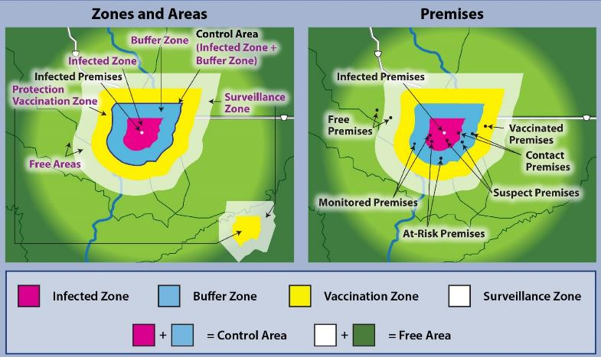
Zones, Areas, and Premises
Notes:
These figures are examples of zones and areas on the left, and on the right, examples of the locations that have been designated with specific premises classifications based on disease/health status of the animals. The location of any FAD-infected animal or animals will immediately be quarantined and designated as an Infected Premises. A regulatory Control Area will be established surrounding the Infected Premises, comprised of two zones, an Infected Zone plus a Buffer Zone. Infected, Contact, and Suspect Premises are considered infected/contaminated locations, or potentially infected/contaminated, and placed under quarantine. Once designated as an Infected Premises, depopulation, disposal, and cleaning and disinfection may be performed, termed dirty operations. Biocontainment is the focus for personnel assigned to response activities on Infected Premises. The results of the epidemiological investigation of Contact and Suspect Premises are needed to confirm the disease status of these animals as infected or non-infected. It is imperative to use biosecure methods of entry onto those premises, so as not to introduce disease, as well as biosecure methods of exit. “Dangerous Contact Premises” may be depopulated; if a premises is being depopulated, it should be treated like an Infected Premises when developing the biosecurity plan.
[Example Zones, Areas, and Premises. Diagrams provided by: USDA; Illustration by: Dani Ausen, Iowa State University]

Slide 9
Zones, Areas, and Premises
Notes:
At-Risk, Monitored, and Free Premises are locations with no evidence of disease. Response activities on these premises, such as surveillance, audits, or vaccination if implemented, are termed clean operations. Uninfected facilities located within a Control Area are at higher risk of becoming infected due to their proximity to infected neighbors. Surveillance of livestock on Free Premises in the Surveillance Zone (which is part of the Free Area), outside of the Control Area, will be conducted for early detection as well as for data collection on freedom from disease. Bioexclusion is the focus in preventing exposure of susceptible animals to the disease. The response zones, areas, and premises designations will change over the course of an incident as the outbreak expands, or is contained and eradicated, and as the premises are decontaminated. More detail on designations of zones, areas, and premises, and the factors considered in determining their size is explained in the FAD PReP/NAHEMS Guidelines: Quarantine and Movement Control. [Example Zones, Areas, and Premises. Diagrams provided by: USDA; Illustration by: Dani Ausen, Iowa State University]

Slide 10
Containment and/or Exclusion
Premises designations
  Source of infection
  Enhanced risk of disease exposure
  Type of response activities
Biocontainment and/or bioexclusion
Business continuity
  Secure Food Supply Plans
    Secure Poultry Supply Plans: Eggs, Turkeys, Broilers
    Milk, Pork, and Beef plans
Notes:
Premises designations identify those premises that may be a source of infection, and those that may be at enhanced risk of exposure to disease. The designations may also indicate the type of activities that may be occurring at these locations and the type of biosecurity measures needed. Specific biosecurity guidance for response activities will be provided by Incident Command focused on biocontainment, bioexclusion, or both. Business continuity plans for Monitored Premises (those within the Control Area and affected by movement restrictions, but not infected with an FAD) provide biosecurity guidance for a premises to be considered eligible for movement of livestock and commodities out of a Control Area. Biosecurity standards are described in, and are specific to, each of the Secure Food Supply Plans (Poultry: Eggs, Turkeys, and Broilers; Milk; Pork; and Beef).

Slide 11
Roles and Responsibilities during an FAD Response
Notes:
In an FAD response, the Incident Command System (ICS) provides guidance on the organizational management structure utilized to coordinate activities, define roles, and delegate specific responsibilities.

Slide 12
Incident Command System (ICS)
Organizational structure
Flexible and scalable
Depends on size, scope, and nature of the incident
Incident Management Team (IMT)
Biosecurity conducted by
Operations Section
Notes:
This system provides an organization that is flexible and scalable based on the needs of the incident. The structure will depend on the size, scope, and nature of the incident at any one time. An Incident Management Team (IMT) composed of the Incident Commander and appropriate staff may be deployed to the incident. Biosecurity activities are usually conducted by personnel assigned to the Operations Section.

Slide 13
Foreign Animal Disease Diagnostician
FADD implements biocontainment principles during the investigation
Premises will be quarantined if an FAD is suspected
  Movement will be restricted
Notes:
Beginning with the first report of a potential FAD, implementation of biosecurity measures is crucial. The foreign animal disease diagnostician (FADD) is responsible for implementing initial biocontainment principles during the FAD investigation. If an FAD is suspected, the premises will be quarantined to prevent movements of animals; other types of movements on/off the premises will be restricted. As an ICS organization is implemented, the responsibility for overseeing biosecurity will be delegated to one or more responders, usually within the Operations Section.

Slide 14
Operations Section
Assessment, design, and supervision
Implementation on-site
Animal Biosecurity Group Supervisor (or designee)
  Site assessment of each contaminated (dirty) premises
  Leads development of site-specific biosecurity plan
  Appropriate biocontainment measures
  Determines resource needs/training
Notes:
Within the Operations Section, responsibilities may be divided into assessment, design, and supervision by personnel at the Incident Command Post, and implementation by those on-site. For example, an Animal Biosecurity Group Supervisor may lead the group responsible for biosecurity and supervise teams and team members’ on-site activities. The personnel within the Operations Section are responsible for ensuring that a site assessment of each contaminated premises is performed, a site-specific biosecurity plan is developed, and appropriate biocontainment measures are implemented to prevent the spread of disease off the premises. In addition, the group responsible for biosecurity determines resource needs, such as personnel, PPE, and C&D equipment, and verifies all personnel assigned to implement biosecurity activities are properly trained.

Slide 15
Operations Section cont’d
Develops biosecurity plan for clean operations
Appropriate bioexclusion measures to protect naïve populations
Used by surveillance teams, etc.
Coordinate with all other on-site activities: C&D, depopulation, and disposal
Procedures must be followed by all
Notes:
The personnel responsible for biosecurity (for example, a Biosecurity Group Supervisor or other designee) also develop the biosecurity plans for the clean side of operations, focused on bioexclusion and protecting naïve animal populations within the Control Area and the Surveillance Zone. Responders tasked with surveillance and other clean activities will look to these protocols. All personnel responsible for biosecurity need to coordinate with other responders responsible for other on-site activities, such as C&D, depopulation, and disposal. Biosecurity plans and procedures must be followed by all.

Slide 16
Biosecurity Managers/Officers
Appointed by Incident Command
Reports to Biosecurity Group Supervisor
Provides on-site management, coordination and gains compliance
Reports needs, problems, and violations
Halts biosecurity breaches
Enforces compliance
Notes:
Biosecurity Managers, Biosecurity Officers, or personnel with other titles appointed by Incident Command may report to a Biosecurity Group Supervisor or other designee. This individual may be assigned to one or more premises to provide on-site management, coordination, and to gain compliance by personnel assigned to other response activities. He/she reports needs, problems, challenges, and biosecurity violations to the appropriate personnel per the chain of command. Biosecurity Managers have the ability to halt operations or stop a worker from breaching biosecurity. In an FAD, it is anticipated that a variety of production systems may be affected; biosecurity plans need to be individualized, and constant attention to compliance is crucial.

Slide 17
Biocontainment
Notes:
Biocontainment refers to measures to prevent disease from spreading off of a premises considered infected. In an FAD outbreak, some responders will be conducting activities within the Control Area on the dirty side of operations, on-site at contaminated premises, or at those considered contaminated, such as Infected Premises, Contact Premises, and Suspect Premises. The activities conducted on these premises may include appraisal, depopulation, disposal, and cleaning and disinfection. Biocontainment of the pathogen will be the focus when conducting these response operations.

Slide 18
Work Zones
Separation between dirty and clean
  Hot Zone-Exclusion Zone (EZ)
  Warm Zone-Contamination Reduction Zone (CRZ)
  Cold Zone-Support Zone (SZ)
Access is controlled
  Decontamination Corridor
Notes:
Containment areas on a premises have been described using Work Zones, with terms related to hazardous materials (HAZMAT) incidents. Work Zones are one method of creating a separation between the dirty area (potential source of infection) and clean area (non-infected). Areas are designated as the Hot Zone-Exclusion Zone (EZ), Warm Zone-Contamination Reduction Zone (CRZ), and Cold Zone-Support Zone (SZ). By implementing these Work Zones, access to contaminated areas is controlled to prevent the transfer of the disease agent to other livestock or areas. These Work Zones also have a defined Decontamination Corridor, which serves as the point of access on or off the premises.

Slide 19
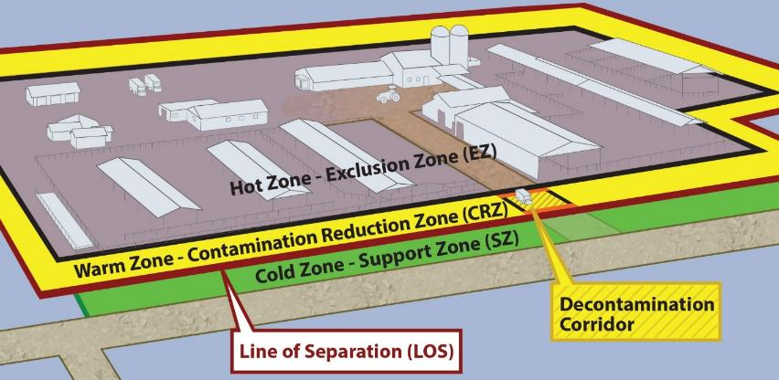
Work Zones cont’d
Notes:
This illustrates an example of Work Zones on a contaminated premises. In this case, the Hot Zone-Exclusion Zone designates the dirty or contaminated premises associated with the infected herd or flock. Full personal protective equipment (PPE) must be worn. The Cold Zone-Support Zone is the non-contaminated area outside the premises. This is the “cleanest” work zone with the lowest relative risk of exposure to pathogens and other hazards, such as decontamination chemicals. The Warm Zone-Contamination Reduction Zone is a transition zone, regarded as having a reduced pathogen load in the environment. It acts as a buffer further separating contaminated from non-contaminated. It is still a high-risk area due to the potential of exposure to pathogens and chemical disinfectants. In an FAD response, all personnel are required to wear full PPE in this zone. The Decontamination Corridor is within the Warm Zone-Contamination Reduction Zone. All movements pass through the Decontamination Corridor before crossing the Line of Separation into the Cold Zone-Support Zone. [This illustration depicts Work Zones imposed on an Infected Premises. Illustration by: Andrew Kingsbury, Iowa State University]

Slide 20
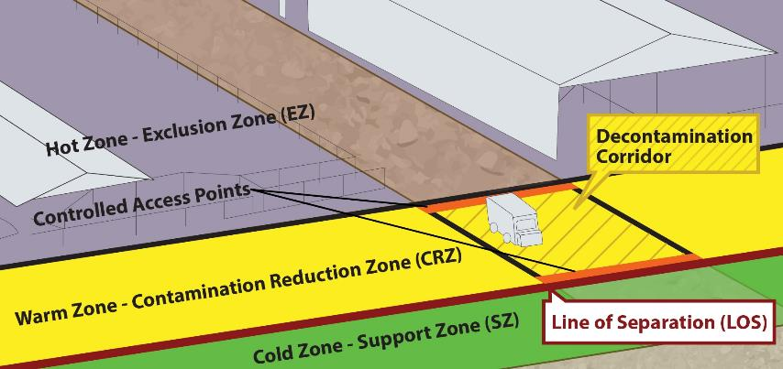
Decontamination Corridor
Notes:
This Decontamination Corridor serves as the controlled access between the Hot and Cold Zones. It is the transition through which the pathogen load is reduced from Hot to Cold. Personnel, equipment and vehicles transition through the Decontamination Corridor before crossing the Line of Separation into the Cold Zone–Support Zone (SZ). This is where biosecurity actions are taken to prevent the disease from “crossing the line” during necessary movements of people, equipment, and possibly vehicles. Site-specific protocols for PPE and decontamination of personnel and equipment, including vehicles, occurs along the corridor with stations for depositing tools, equipment, and other items. Final decontamination and disinfection of PPE as well as final doffing of PPE occur in this corridor. [This illustration is a close up of the Decontamination Corridor and controlled access points. Illustration by: Andrew Kingsbury, Iowa State University]

Slide 21
Protocols for Biocontainment
Prior to entering Hot Zone
  Identify Work Zones
  Vehicles remain in Cold Zone
  Don PPE
  Prepare to contain disposables
  Set up C&D supplies
  Take only necessary items
  Enter through proper access point
Notes:
Biosecurity protocols help prevent the escape of pathogenic agents out of the dirty area of contamination. Movements between contaminated and non-contaminated areas across the Line of Separation must occur through the Decontamination Corridor. Prior to entering the premises, identify the Hot, Warm and Cold Zones. Keep vehicles on the clean side, in the Cold Zone, on a hard surface if possible. Don PPE, which is used as a biosecurity measure, as well as personal protection needed for the assigned task. Prepare to contain used disposable items in a biosecure manner to avoid the transfer of pathogens. Set up all supplies needed to clean and disinfect for a biosecure exit. These supplies will be used at the Decontamination Corridor before crossing the Line of Separation, which is also called the Clean/Dirty Line. Take only necessary supplies, tools, and equipment into the Hot Zone. Note that all supplies and equipment will either be cleaned and disinfected upon exiting, or disposed of. Enter the Hot Zone through the proper access point.

Slide 22
Protocols for Biocontainment cont’d
While in Hot Zone
  Minimize exposure to pathogen
  Restrict environmental contamination
  Limit equipment contamination
  Monitor compliance
  Maintain log and verify authorization
  Perform C&D duties in the Decon Corridor
Notes:
While in the Hot Zone, perform the required tasks while minimizing unnecessary exposure to the pathogen. Avoid straying into other parts of the premises to prevent further spread of environmental contamination. Limit exposure and contact time of heavy equipment and vehicles with contaminated areas. Personnel responsible for biosecurity may be monitoring compliance with the plan for entry and exit. They may be keeping the log of those who enter and leave the contaminated space, and ensuring only those authorized to access enter. They may also be assigned the tasks of cleaning and disinfection in the Decontamination Corridor.

Slide 23
Protocols for Biocontainment cont’d
Upon leaving Hot Zone
  Exit only through Decon Corridor
  C&D all supplies, equipment
  Doff PPE
  Contain trash and disposables
  Cross Line of Separation
  Extra precaution: wash hands, disinfect vehicle tires and wheel wells
  Avoid contact with susceptible species
Notes:
Upon leaving the Hot Zone, exit only through the Decontamination (Decon) Corridor. Clean and disinfect all supplies, tools, and equipment leaving the Hot Zone. This includes reusable PPE such as boots, and large equipment such as vehicles. Doff PPE in the proper sequence to avoid inadvertent cross-contamination. Place all trash and disposable items, including disposable PPE, in a plastic trash bag. Exit the Decontamination Corridor, crossing over the Line of Separation into the Cold Zone. As an extra precaution, wash hands or use a hand sanitizer, and spray vehicle tires and wheel wells with disinfectant prior to driving away. Avoid contact with other susceptible animal populations as directed by Incident Command. If visiting multiple premises during the course of a work day, response personnel must be especially diligent to avoid the risk of disease transmission.

Slide 24
Bioexclusion
Notes:
Biosecurity concepts for bioexclusion in an FAD outbreak are the same as for biocontainment, except the focus is on keeping pathogens out. Non-infected premises such as At-Risk Premises and Monitored Premises will be located within a Control Area and have a higher risk of becoming infected than those outside the Area due to the proximity of infected neighbors. Activities may also be conducted in the Free Area, which is the area not included in any Control Area and includes the Surveillance Zone. The clean side of operations may entail surveillance, sampling, and perhaps vaccination, if implemented. Surveillance to support freedom from disease for trade may be conducted in the Free Area. Bioexclusion will be the focus when conducting response operations.

Slide 25
Protocols for Bioexclusion
Line of Separation
Animal side is considered “clean”
Facility plan may have Perimeter Buffer Area and Line of Separation
  Comply with facility plan
Encourage a facility escort
Notes:
The Line of Separation separates contaminated (dirty) from non-contaminated (clean). However, the animal side is considered clean, similar to the Cold Zone. All other areas are considered potentially contaminated. The livestock facility may have a biosecurity plan establishing a Perimeter Buffer Area as a transitional, peripheral area, to protect the Line of Separation and further enhance the isolation of their herd/flock. At a minimum, comply with the facility’s biosecurity plan. When it is necessary to access the premises, encourage a representative of the premises to serve as an escort to ensure only authorized areas are visited.

Slide 26
Protocols for Bioexclusion cont’d
Prior to entering facility
  Confirm/establish Line of Separation
  Disinfect all items
  Park vehicle outside biosecure area
  Leave all unnecessary items behind
  Don clean outwear and boots
  Prepare fresh C&D supplies
Protect susceptible animal groups
Notes:
Prior to entering a clean facility, confirm or establish the Line of Separation. Ensure that anything that needs to cross the Line of Separation has been disinfected and is free of contamination. Park the vehicle outside the biosecure area, and prepare to leave all unnecessary items, such as all food and jewelry, in the vehicle. Don disposable PPE or freshly laundered outerwear/coveralls, and cleaned and disinfected footwear/boots. Prepare fresh cleaning and disinfection supplies, such as boot baths, to use at entry and exit. After crossing the Line of Separation, if it is necessary to sample or have contact with several groups of animals, start with the most disease susceptible group, and finish with any groups showing clinical signs. An alternative is to change clothes, disinfect boots and all equipment, and use only clean supplies before contacting each group..

Slide 27
Protocols for Bioexclusion cont’d
Exiting the Line of Separation:
  Follow the entry protocols in reverse
  C&D boots and equipment or contain for later cleaning or disposal
  Clean response vehicles
Pay extra attention when collecting samples and/or visiting multiple premises
Notes:
Exiting the Line of Separation, follow the entry protocols in reverse. Clean and disinfect boots and any equipment. Contain used coveralls and all equipment that could not be disinfected on-site in the secure dirty compartment of the vehicle until cleaning and disinfection. Facility-owned outerwear is expected to be laundered on-site. Disposable PPE may be managed on-site or secured like reusable outerwear/coveralls for later disposal. Clean response vehicles between visits to animal production facilities--including interiors and plastic floor mats. Exterior cleaning should focus on any visible organic matter, tires, and wheel wells. Commercial car washes with wheel-well washing provide adequate exterior cleaning. For those responders tasked with collection of surveillance samples for disease detection or environmental sampling of Infected Premises following C&D, biosecurity protocols need to be strictly followed to prevent disease introduction, and to prevent disease escape, particularly since responders may be visiting multiple premises in a day. Consider working in teams of two, so one member remains outside the Line of Separation and can assist the responder who enters the premises.

Slide 28
Conclusion
Maintains food safety and security
Protects the environment
Facilitates continuity of business
Protocols are site/situation specific
Need consistent compliance
Notes:
In conclusion, biosecurity helps to maintain food safety and security, protect the environment, and facilitate continuity of business by protecting animals and animal products. The importance cannot be over-emphasized in plans to contain disease, as well as in daily protocols intended to exclude disease from healthy herds and flocks. Plans and protocols are developed based on the assessment and evaluation of each individual site and circumstances. Established biosecurity measures are effective only when they are consistently followed by everyone.

Slide 29
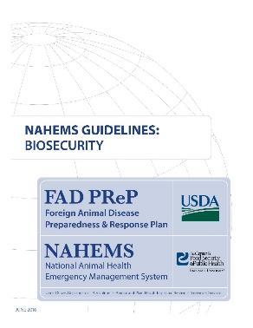
For More Information
FAD PReP/NAHEMS Guidelines
& SOP: Biosecurity (2016)
  http://www.aphis.usda.gov/fadprep
Biosecurity web-based training module:
  http://naherc.sws.iastate.edu/
Notes:
More details can be obtained from the sources listed on the slide, available on the USDA website (http://www.aphis.usda.gov/fadprep) and the National Animal Health Emergency Response Corps (NAHERC) Training Site (http://naherc.sws.iastate.edu/).

Slide 30
Guidelines Content
Authors (CFSPH)
Janice P. Mogan, DVM
Heather Allen, PhD, MPA
Kristen Bretz, MS
Reviewers (USDA)
Jonathan T. Zack, DVM
James A. Roth, DVM, PhD, DACVM
Notes:
The print version of the Guidelines document is an excellent source for more detailed information. This slide acknowledges the authors and reviewers of the Guidelines document. It can be accessed at http://www.aphis.usda.gov/fadprep.

Slide 31
Acknowledgments
Development of this presentation was by the Center for Food Security and Public Health at Iowa State University through funding from the USDA APHIS Veterinary Services
PPT Authors: Janice P. Mogan, DVM; Logan Kilburn
Reviewer: Kristen Bretz, MS
Notes:
Information provided in this presentation was developed by the Center for Food Security and Public Health at Iowa State University College of Veterinary Medicine, through funding from the US Department of Agriculture, Animal and Plant Health Inspection Service, Veterinary Services.

