Slide 1
Disposal
Disposal Method Selection Criteria
Adapted from the FAD PReP/NAHEMS Guidelines: Disposal (2012)
Notes:
Effective disposal of animal carcasses and associated materials is a critical component of a successful response during an animal health emergency, such as a major disease outbreak or a foreign animal disease (FAD). During an animal health emergency, disposal measures are implemented to prevent the introduction of or mitigate the spread of the pathogen through the elimination of infected, or potentially infected, animal carcasses and associated materials. Disposal also serves to remove potentially contaminated feed or food products from the animal feed and human food supply, protect the nation’s agricultural and national economy, and also - if the disease is zoonotic, safeguard public health. This presentation describes selection criteria for disposal methods. [This information was derived from the Foreign Animal Disease Preparedness and Response (FAD PReP)/National Animal Health Emergency Management System (NAHEMS) Guidelines: Disposal (2012)].

Slide 2
Environmental and Biosecurity Considerations
Notes:
All disposal options present some potentially negative environmental effects and must be accounted for in planning. Biosecurity risks are also present to varying degrees in each of the presented disposal methods. Transportation of contaminated disposal materials off-site for processing (e.g., burial, composting, rendering) will present biosecurity challenges to contain the contaminated material, as well as to clean and disinfect the transportation vehicles.

Slide 3
Composting
Low risk of environmental contamination
Proper site selection
Well-compacted soil
Appropriate cover
Potential for nitrogen release
Indoor composting protected
Biosecurity risks
Test compost before transporting
Notes:
When outdoor composting is conducted at a proper site on well-compacted soil with appropriate cover, the risk of environmental contamination is low. However, nitrogen (in the form of ammonia or nitrate) is produced by decaying carcasses and could be released. Compared to outdoor composting, indoor composting is protected from weather (such as wind or drying) and scavengers. On-site composting reduces the biosecurity risks associated with transportation. However, if off-site carbon sources must be obtained, biosecurity plans must be in place for transportation vehicles bringing the co-compost. Composted materials, once the process is believed to be complete, should be tested prior to transportation to assure disease causing pathogens are not present.

Slide 4
Rendering
Environmental regulation
Biosecurity risks
Transportation to rendering facility
Handling at rendering facility
End product is generally safe
Some pathogens or toxins may not be completely eliminated
Rendered carcasses not used as feed
May be safe for landfills
Notes:
The rendering process is closely regulated to keep the process environmentally safe, but biosecurity during transportation to the rendering facility, and handling once at the facility can be problematic. Transportation and handling of infected carcasses and other waste material increase the risk of spreading disease. This risk may be exacerbated if the number of carcasses exceeds facility capacity and some of the carcasses must be stored. Once the carcasses have been rendered, however, the end product is generally considered biosecure. If rendering is chosen as a carcass disposal option, selection of a facility with optimal biosecurity protocols is critical. Carcasses that are contaminated with endotoxins, chemical residues, or are infected with pathogens that are not eliminated by rendering cannot be rendered into feed ingredients, but are sometimes safe for landfills.

Slide 5
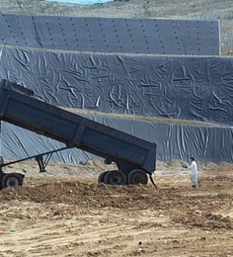
Permitted Landfill
Output: leachate and landfill gas
Landfills
Systems in place for collection
Adjustments may be necessary
Biosecurity risks
Transportation
Carcass handling
Notes:
The output resulting from disposal in a permitted landfill is generally similar to that resulting from typical operations: leachate and landfill gas. Because these are normal byproducts of a landfill, systems are already in place to collect and treat these outputs. Depending on the pathogen, no additional systems may be necessary. However, the disposal of large carcass numbers may warrant adjustments to the collection and/or treatment systems. Like all off-site disposal methods, transportation of carcasses to landfills presents additional biosecurity challenges and plans must be in place to prevent pathogen spread. Workers who handle infectious carcasses should take proper precautions and should be equipped with appropriate PPE in accordance with site-specific plans. [This photo shows the disposal of waste material at a landfill. Photo source: David Meeker, National Renderers Association]

Slide 6
Unlined Burial
Potential water contamination
Pathogens are not inactivated
Long term monitoring, management, environmental testing
Environmental remediation, if necessary
Notes:
Using unlined burial as a disposal method has significant environmental challenges. Contamination from leachate, runoff and ash burial can result in negative impacts to both private and public water supplies. Certain geological conditions, such as sandy soil and a high seasonal water table, can increase the risk of contaminants reaching the groundwater. The selection of a burial site must ensure that water sources are protected as well as private property and residences and public spaces such as roads, public lands, community parks, etc. On-site burial limits the movement of carcasses, but the burial process does not inactivate pathogens which poses a biosecurity issue. Plans must include long term monitoring, management and environmental testing of burial sites, and if necessary, environmental remediation.

Slide 7
Fixed-Facility Incineration
Emission control devices
Ash disposal from closed container
Biosecure transport and handling
Temporary storage, if capacity exceeded
Inactivates prions
Notes:
Although fixed-facility incineration can only dispose of limited amounts of waste material, this method has less negative environmental impact when compared to air-curtain or open-air burning. A fixed-facility incinerator may be equipped with emission control devices that comply with regulations and protect the environment. The resulting ash may be less problematic to manage compared to open–air burning because it is in a discrete closed container rather than distributed over open land. This disposal method would likely require biosecure off-site transportation and handling of carcasses, and potentially temporary storage if capacity is exceeded. During an animal health emergency involving a TSE the use of fixed-facility incineration is very biosecure and advantageous because this method is capable of inactivating prions.

Slide 8
Open-Air Burning
Negative impact on air quality and water sources
Soil contamination from accelerant
Ash disposal
Pathogen may be dispersed in smoke
Public nuisance, unintended fires, and violations of regulatory restrictions
Notes:
Uncontrolled open-air burning has the potential to generate significant pollutants in the form of smoke and odor, negatively impacting air quality. Ground water and soil contamination may also result from pollution by hydrocarbons if used as an accelerant. Each ton of carcasses yields 0.3 tons of ash, which also requires proper disposal. Depending on groundwater considerations ash-disposal options range from burial on-site to disposal at landfills. Biosecurity concerns involve pathogens that may not be inactivated and could be dispersed in smoke particles. Open-air burning holds the possibility of creating a public nuisance, causing unintended fires, and violating regulatory restrictions.

Slide 9
Air-Curtain Incineration
Relatively clean-burning
Can be set up on-site
Fewer air pollutants than open-air burning
Refractory box protects the ground at the site from ash
Biosecure delivery of fuel
Notes:
Air-curtain incineration is one of the most practical and environmentally acceptable emergency incineration options, and is the most rapid of the thermal disposal methods. It is relatively clean-burning if operated correctly (not loaded too fast with carcasses), and can be set up on-site. This incineration method may emit pollutants into the air, but fewer than open-air burning as it traps unburned particles under a curtain of air for further combustion. The use of a refractory box rather than an earthen trench contains the ash and protects the ground at the site. Air-curtain incinerators require fuel to burn, so biosecure delivery of wood or coal should be part of the plan.

Slide 10
Site-Specific Disposal Method Selection Criteria
Notes:
The selection of optimal disposal sites in an animal health incident involves a variety of factors and concerns. Disposal plans must be site-specific and account for many variables including pathogen and species type, environment, and public health perception. This section summarizes some primary considerations in site selection, including decision making, on-site disposal, and additional disposal strategies such as off-site disposal and temporary storage.

Slide 11
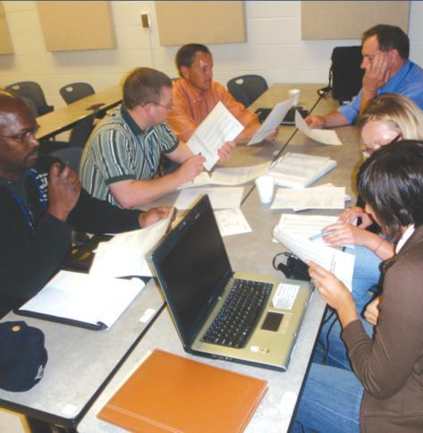
Regional Limitations
Consult authorities to minimize negative effects
Environmental
Pubic health
Other regulations
Consider local geophysical conditions and climatic trends
Notes:
Consult with local, county, state, and federal environmental officials to obtain specific information for the region or community in order to minimize any negative environmental effects associated with the disposal of contaminated material. To gain information regarding geophysical considerations regarding soil type/condition and water table level, consult the USDA Natural Resources Conservation Service. All applicable public health or environmental protection laws, including fire codes and other regulations should be determined and followed. Regional climatic trends should also be considered (for example, the general direction of prevailing winds) and seasonal considerations (precipitation, thermal factors) when considering various on-site methods of disposal. [This photo illustrates the importance of consultation with local, county, state, and federal environmental officials to select an optimal disposal method and site. Photo source: Alex Ramirez, Iowa State University]

Slide 12
Safety Considerations
Safety Officer provides guidance in disposal site selection
All personnel should be trained
OSHA recommendations for people working in hazardous waste operations involving pathogens
CFR, Part 21, Chapter 1910
Notes:
The assigned Safety Officer should be consulted to provide guidance in disposal site and method selection. Careful site selection, method selection, and proper safety protocols must be followed to avoid injury. Site-specific hazards such as slippery footing, falls into trenches, burns, injuries related to heavy machinery, and contact with electric lines need to be avoided. All personnel should be properly trained and knowledgeable of the planned strategies. A Safety Officer should be available at all times for further guidance and direction. The U.S. Occupational Safety and Health Administration (OSHA) has outlined requirements and recommendations for those working in hazardous waste operations involving pathogens (CFR, Part 21, Chapter 1910, http://www.osha.gov/SLTC/hazardouswaste/index.html).

Slide 13
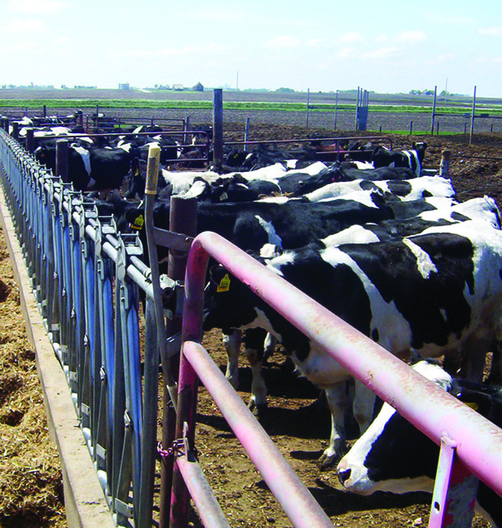
Animals to be Disposed
Biomass
Personnel needed
Necessary equipment
Type/species/number
Potential by-products also requiring disposal
E.g., dairy cows and milk
Notes:
The overall biomass of the animal carcasses to be disposed of must figure heavily into disposal method considerations. Personnel required to carry out disposal activities as well as necessary equipment to handle carcasses will vary by animal type, species and number of animals. In addition, potentially contaminated animal by-products, feed and manure should also be considered when planning. For example, disposal activities related to dairy cattle will also need to include plans for disposal of milk. [This is a photo of dairy cows. A plan to dispose of dairy animal carcasses also needs to consider the disposal of contaminated milk, feed and manure. Photo source: Danelle Bickett-Weddle, Iowa State University]

Slide 14
Temporary Storage
Carcass disposal ideally occurs within 24 hours of depopulation
Temporary storage may be necessary in an animal health emergency
EPA regulations may apply
Storage options
Refrigeration in closed building
Grinding and preserving carcasses
Trenches, silos, pits
Notes:
During an animal health emergency that involves depopulation, members of the Disposal Group strive to properly dispose of contaminated or potentially contaminated animal carcasses and related materials within 24 hours of depopulation. However, in a major animal health emergency temporary storage may be necessary. The EPA has published regulations regarding storage and collection of solid waste, which can be applied to animal mortalities, which are essentially food waste. One option for temporary storage involves refrigeration in a closed building. Another involves grinding and preserving carcasses. In some cases, carcasses may be stored on trucks to await transportation for disposal. Trench silos or pits may also be used to temporarily store carcasses but care must be taken to prevent environmental contamination.

Slide 15
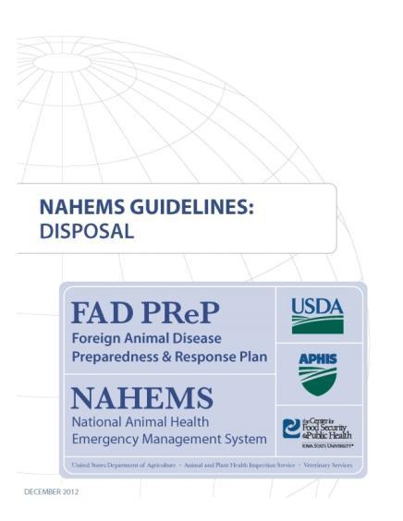
For More Information
FAD PReP/NAHEMS Guidelines & SOP: Disposal (2012)
http://www.aphis.usda.gov/animal_health/emergency_management/
Disposal web-based training module
http://naherc.sws.iastate.edu/
Notes:
More details can be obtained from the sources listed on the slide, available on the USDA website (http://www.aphis.usda.gov/animal_health/emergency_management/) and the NAHERC Training Site (http://naherc.sws.iastate.edu/).

Slide 16
Guidelines Content
Authors
Reneé Dewell, DVM, MS (CFSPH)
Tom Glanville, PhD (Iowa State University)
Significant contributions to the content were provided by USDA APHIS VS:
Lori P. Miller, PE
Darrel K. Styles, DVM, PhD
Notes:
This slide acknowledges the authors and those who made a significant contribution to the content of the FAD PReP/NAHEMS Guidelines: Disposal document. Please see the Guidelines document for others who also provided additional assistance with content development.

Slide 17
Acknowledgments
Development of this presentation was by the Center for Food Security and Public Health at Iowa State University through funding from the USDA APHIS Veterinary Services
PPT Author: Kerry Leedom Larson, DVM, MPH, PhD, DACVPM Reviewers: Janice Mogan, DVM; Reneé Dewell, DVM, MS
Notes:
Information provided in this presentation was developed by the Center for Food Security and Public Health at Iowa State University College of Veterinary Medicine, through funding from the US Department of Agriculture, Animal and Plant Health Inspection Service, Veterinary Services.

