Slide 1
Disposal
Group Responsibilities and Activities
Adapted from the FAD PReP/NAHEMS
Guidelines: Disposal (2012)
Notes:
Effective disposal of waste material is a critical component of a successful response during an animal health emergency, such as a major disease outbreak or a foreign animal disease (FAD). Waste material such as animal carcasses will be produced if mass euthanasia and depopulation are chosen to mitigate disease. It is also likely that some animals would perish due to infection with the disease and these would also require proper disposal. In addition to animal carcasses, related waste materials such as milk, feed materials or wool and hair will also need to be securely disposed of. This presentation describes the preparation, responsibilities, and activities of personnel who are involved with disposal. [This information was derived from the Foreign Animal Disease Preparedness and Response (FAD PReP)/National Animal Health Emergency Management System (NAHEMS) Guidelines: Disposal (2012)].

Slide 2
Roles and Responsibilities
Notes:
Disposal personnel, especially those who will make management decisions, must possess extensive disposal subject matter expertise and thoroughly understand their roles and responsibilities within the context of the Incident Command System.

Slide 3
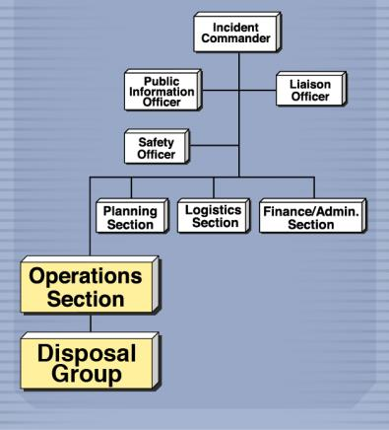
Incident Command System
Used to manage people and resources
Disposal Group personnel
  Operations Section
  Vary depending on incident size and scope
Notes:
The Incident Command System (ICS) is used to efficiently manage people and resources during an incident such as an animal health emergency. In the ICS organizational structure, the Disposal Group is a part of the Operations Section. The total number of personnel for the Disposal Group will vary depending on the size and scope of the incident. [This figure demonstrates the Disposal Group within a sample Incident Command System. Illustration by: Andrew Kingsbury, Iowa State University]

Slide 4
Disposal Group Personnel
Disposal Group Supervisor
  Makes disposal method recommendations
  Organizes and directs disposal activities
Disposal Group Team Leader
  Ensures disposal procedures are carried out
Team Members
  Perform disposal activities
Notes:
The Disposal Group Supervisor is in charge of all Disposal personnel and directly supervises Disposal Team Leaders. This person has extensive training and/or experience in disposal methods, is able to make informed recommendations for optimal disposal options, and possesses the management skills needed to organize and direct all disposal activities for the incident. The Disposal Team Leaders supervise the members of the Disposal Teams; he or she focuses primarily on ensuring that safe, effective, and environmentally sensitive disposal procedures are carried out. Team Members are experienced or trained in Disposal standard operating procedures (SOP) and can carry out disposal activities under supervision.

Slide 5
Responsibilities
Mitigate the spread of the pathogen
Remove potentially contaminated feed or food products
Protect the nation’s agricultural and national economy
Safeguard public health
Notes:
Personnel implement disposal activities to:
Mitigate the spread of the pathogen through the elimination of infected, or potentially infected, animal carcasses and associated materials;
Remove potentially contaminated feed or food products from the animal feed and human food supply;
Protect the nation’s agricultural and national economy; and also
Safeguard public health – by shielding the environment from harmful contamination, and protecting public health from zoonotic diseases.

Slide 6
Goals
Eliminate all animal carcasses and related material in a
  Timely
  Safe
  Biosecure
  Aesthetically acceptable
  Environmentally responsible manner.
Notes:
The overall goal of disposal operations during an animal health incident is to eliminate all animal carcasses and related material in a timely, safe, biosecure, aesthetically acceptable, and environmentally responsible manner. To attain this goal, disposal personnel must identify suitable locations, and implement appropriate protocols employing proper supplies and equipment. Responder safety and biosecurity are critical priorities. Relevant environmental protection regulations should be understood and adhered to. In a large-scale animal health emergency, an integrated response may include disposal, depopulation, vaccination, and decontamination and these activities should be considered together.

Slide 7
Preparation
Notes:
Preparations and considerations need to be made to choose and be ready to implement the most efficient method of disposal. The various disposal methods are discussed in more detail elsewhere in this series of disposal presentations. However, regardless of the method chosen, some general considerations apply to all potential disposal methods.

Slide 8
Contain the Disease
Biosecurity - apply principles to personnel, vehicles, equipment
  Understanding of the pathogen
  Knowledge of effective C&D methods
  Establish Work Zones
Notes:
The goal of containing the disease will be lost unless biosecurity principles are strictly followed. Personal biosecurity measures as well as vehicular and equipment biosecurity is critical. An understanding of the type and strain of pathogen, as well as effective cleaning and disinfection procedures are essential to prevent further spread of infection. The establishment of Work Zones, as seen in the next slide, will restrict access to contaminated areas and help prevent the escape of the pathogen.

Slide 9
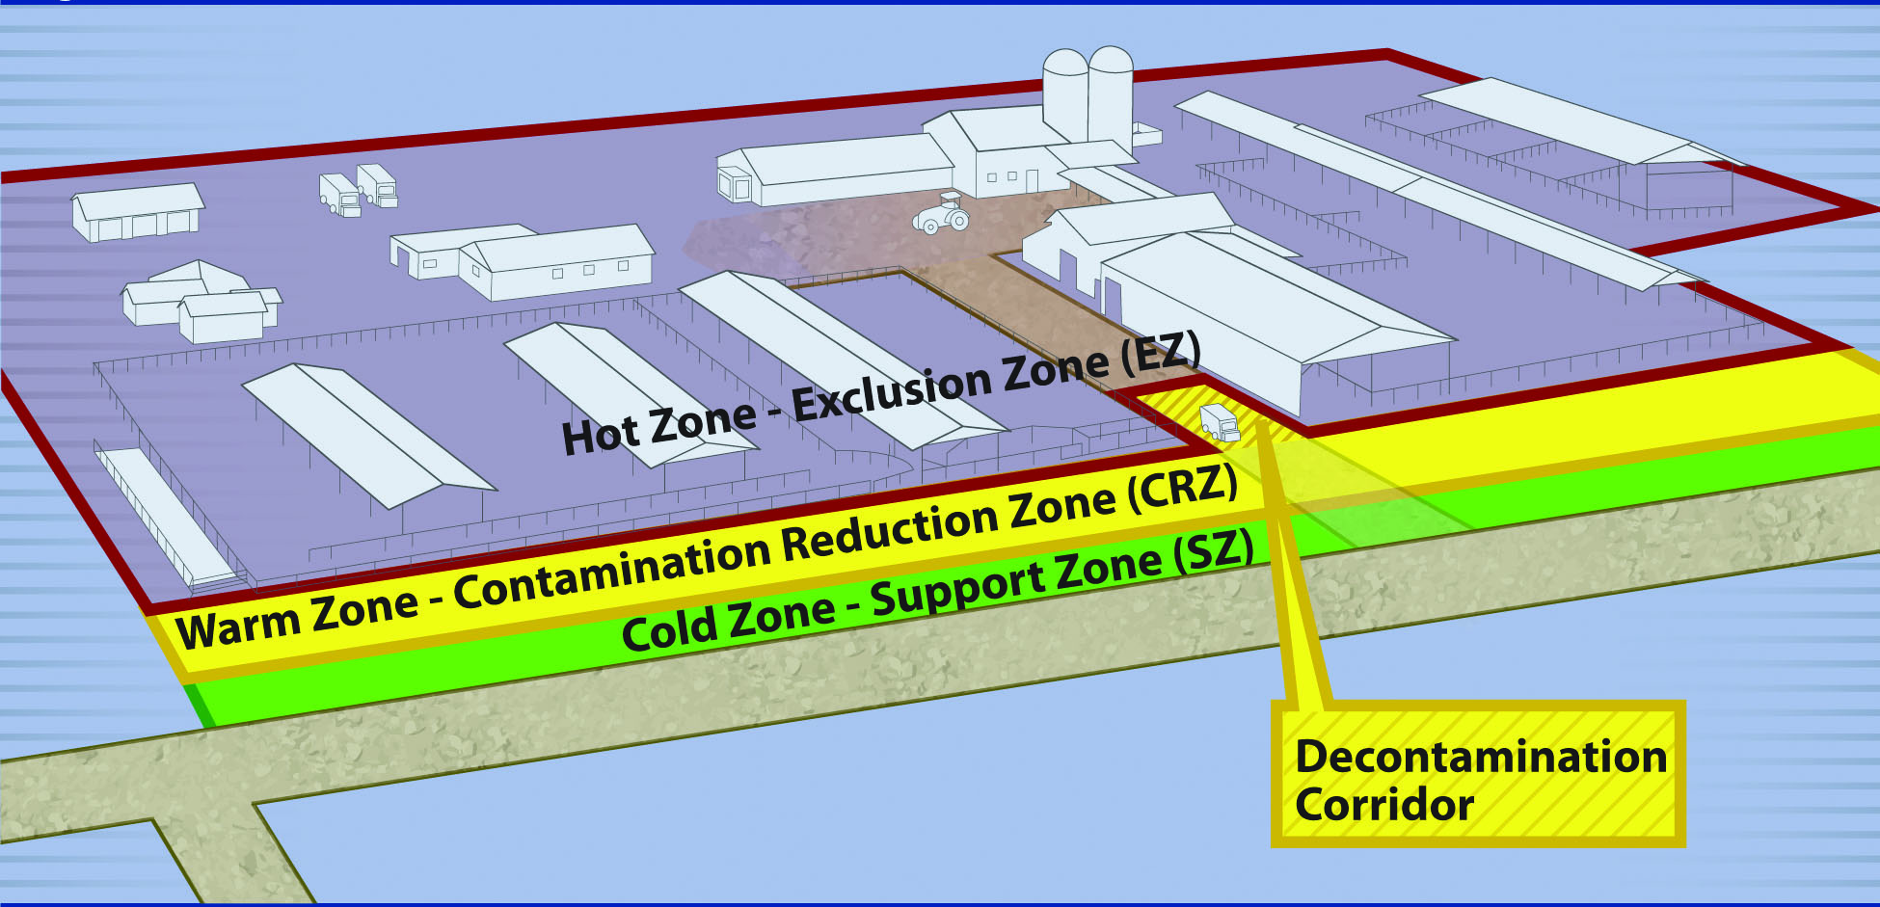
Work Zones
Hot, Warm and Cold Zones
Restricted access
Decontamination Zone
Notes:
Three major work zones and corridor are established to control access to contaminated areas and prevent the spread of infectious agents to uninfected areas. The Hot Zone represents the area of contamination. The Warm Zone, particularly the Decontamination Corridor, is the area where the cleaning and disinfection, as well as final doffing of personal protective equipment occurs. The Cold Zone is the “cleanest” zone with the relatively lowest risk of exposure to pathogens. Respecting proper access and appropriate decontamination when leaving the Hot Zone and prior to entering the Cold Zone will help contain the disease. [This map illustrates Work Zones shown over a farm with the various zones and Decontamination Corridor labeled. Illustration by: Dani Ausen and Andrew Kingsbury, Iowa State University]

Slide 10
Collaboration
Cooperation and communication
  State Veterinarian
  State Agency for Environmental Protection
  Appraisal Group and Compensation Unit
  Euthanasia Group
  Biosecurity Group
  Cleaning and Disinfection Group
Notes:
Collaboration through cooperation and communication are critical in successfully responding to an animal health incident. When preparing to plan, implement, and coordinate disposal activities, the Disposal Group should work closely with associated personnel including the:
State Veterinarian
State Agency for Environmental Protection
Appraisal Group and Compensation Unit
Euthanasia Group
Biosecurity Group
Cleaning and Disinfection Group
In addition, cooperation and communication with Federal inspectors and regulators as well as environmental personnel that are involved in disposal response efforts should occur.

Slide 11
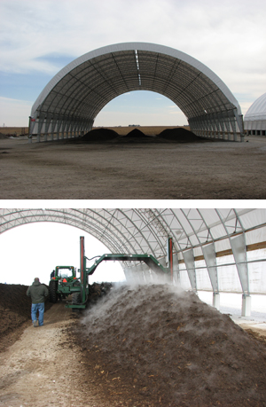
Needs Assessment
Disposal Group
  Determines needs for qualified personnel, vehicles, equipment, and supplies
Logistics
  Secures and delivers required supplies
Notes:
The need for qualified credentialed disposal personnel, vehicles, equipment, and supplies at the time of the animal health emergency will be determined by the Disposal Group Supervisor in consultation with Disposal Team Leaders. Logistics is tasked with securing required supplies including coordination of delivery location, date, and time. [These two photos depict indoor composting, arranged as windrows, to illustrate the need for knowledgeable personnel, and appropriate equipment and supplies. Photo source: Tom Glanville, Iowa State University]

Slide 12
USDA NVS
National Veterinary Stockpile
  Countermeasures – animal vaccines, supplies, equipment
  3D response support services
  depopulation, disposal, and decon
  3D Contractors – self-contained teams
Notes:
The National Veterinary Stockpile (NVS) program within the USDA APHIS VS National Center for Animal Health Emergency Management provides veterinary countermeasures, such as animal vaccines, antivirals, or therapeutic products, supplies, equipment, and response support services that states, tribes, and territories need to respond to damaging animal disease outbreaks. In addition to physical countermeasures, the NVS maintains contracts to support 3D response support services. 3D is the acronym for “depopulation, disposal, and decontamination.” As an additional resource for response, NVS-chosen contractors can deploy as self-contained teams to assist states with disposal activities.

Slide 13
Hazard Communication
Requirements
  Safety precautions/hygiene briefing
  Personal protective equipment (PPE)/safety equipment description
    E.g., respirators, gloves, eye protection, hearing protection
  Biosecurity procedures
  Cleaning and disinfection measures
Notes:
Before any disposal activities are initiated, Disposal Team Members should be briefed fully as to the nature of the disease with which they are dealing and any associated hazards. Specific safety precautions and/or hygiene requirements should be explained before the team enters the premises. In addition, the team should be supplied with appropriate personal protective equipment (PPE) and other necessary safety equipment. Respiratory protection, gloves, and eye and/or ear protection, for example, must be supplied if the personnel are at risk from a disease organism, a chemical hazard, loud noise, or if significant amounts of dust are generated, or upon individual request. Additional biosecurity and cleaning and disinfection procedures may be required to address the risks posed by serious zoonotic diseases.

Slide 14
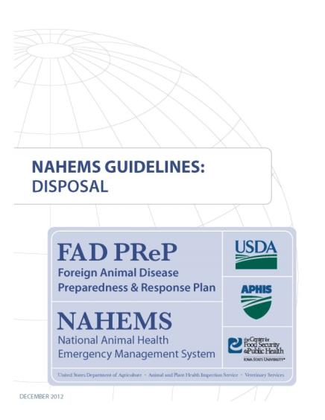
For More Information
FAD PReP/NAHEMS Guidelines & SOP: Disposal (2012)
  http://www.aphis.usda.gov/animal_health/emergency_management/
Disposal web-based training module
  http://naherc.sws.iastate.edu/
Notes:
More details can be obtained from the sources listed on the slide, available on the USDA website (http://www.aphis.usda.gov/animal_health/emergency_management/) and the NAHERC Training Site (http://naherc.sws.iastate.edu/).

Slide 15

Guidelines Content
Authors
Reneé Dewell, DVM, MS (CFSPH)
Tom Glanville, PhD (Iowa State University)
Significant contributions to the content were provided by
USDA APHIS VS:
Lori P. Miller, PE
Darrel K. Styles, DVM, PhD
Notes:
This slide acknowledges the authors and those who made a significant contribution to the content of the FAD PReP/NAHEMS Guidelines: Disposal document. Please see the Guidelines document for others who also provided additional assistance with content development.

Slide 16
Acknowledgments
Development of this presentation was by the Center for Food Security and Public Health at Iowa State University through funding from the USDA APHIS Veterinary Services
PPT Author: Kerry Leedom Larson, DVM, MPH, PhD, DACVPM
Reviewers: Janice Mogan, DVM; Reneé Dewell, DVM, MS
Notes:
Information provided in this presentation was developed by the Center for Food Security and Public Health at Iowa State University College of Veterinary Medicine, through funding from the US Department of Agriculture, Animal and Plant Health Inspection Service, Veterinary Services.

