Slide 1
Disposal
Overview
Adapted from the FAD PReP/NAHEMS
Guidelines: Disposal (2012)
Notes:
Effective disposal of animal carcasses and associated materials is a critical component of a successful response during an animal health emergency, such as a major disease outbreak or a foreign animal disease (FAD). During an animal health emergency, disposal measures are implemented to prevent the introduction of, or mitigate the spread of the pathogen through the elimination of infected, or potentially infected, animal carcasses and associated materials. Disposal also serves to remove potentially contaminated feed or food products from the animal feed and human food supply, protect the nation’s agricultural and national economy, and also - if the disease is zoonotic, safeguard public health. This presentation provides an overview of emergency disposal activities. [This information was derived from the Foreign Animal Disease Preparedness and Response (FAD PReP)/National Animal Health Emergency Management System (NAHEMS) Guidelines: Disposal (2012)].

Slide 2
This Presentation
Responder roles and responsibilities
Overview of disposal methods
Selection considerations
Classification of waste materials
Notes:
This presentation describes the roles and responsibilities of personnel involved in disposal activities, and illustrates the Disposal Group’s position within the Incident Command organization. It provides an overview of disposal methods that may be used during an animal health emergency. It discusses considerations in the selection of a disposal site and method, as well as introduces the types of waste classification.

Slide 3
Roles and Responsibilities
Notes:
Disposal personnel, especially those who will make management decisions, must possess extensive disposal subject matter expertise and thoroughly understand their roles and responsibilities within the context of the Incident Command System. Decision makers must be comfortable choosing the quickest, safest, and most environmentally responsible disposal methods practicable given the circumstances.

Slide 4
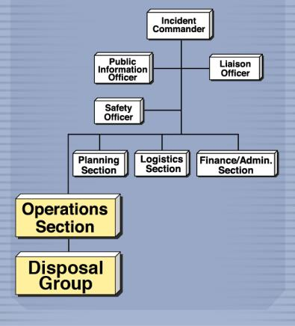
Incident Command System
Used to manage people and resources
Disposal Group personnel
  Operations Section
  Vary depending on incident size and scope
Notes:
The Incident Command System (ICS) is used to efficiently manage people and resources during an incident such as an animal health emergency. In the ICS organizational structure, the Disposal Group is a part of the Operations Section. The total number of personnel for the Disposal Group will vary depending on the size and scope of the incident. [This figure demonstrates the Disposal Group within a sample Incident Command System. Illustration by: Andrew Kingsbury, Iowa State University]

Slide 5
Disposal Group Personnel
Disposal Group Supervisor
  Makes disposal method recommendations
  Organizes and directs disposal activities
Disposal Group Team Leader
  Ensures disposal procedures are carried out
Team Members
  Perform disposal activities
Notes:
The Disposal Group Supervisor is in charge of all Disposal personnel and directly supervises Disposal Team Leaders. This person has extensive training and/or experience in disposal methods, is able to make informed recommendations for optimal disposal options, and possesses the management skills needed to organize and direct all disposal activities for the incident. Each Disposal Team Leader supervises the members of his or her Disposal Team. Depending on the scope of the event, there may be multiple Teams, each with a Team Leader focused primarily on ensuring that safe, effective, and environmentally sensitive disposal procedures are carried out. Team Members are experienced or trained in Disposal standard operating procedures (SOP) and can carry out disposal activities under supervision.

Slide 6
Preparation
Cooperation and communication
  State Veterinarian
  State Agency for Environmental Protection
  Appraisal Group and Compensation Unit
  Euthanasia Group
  Biosecurity Group
  Cleaning and Disinfection Group
Notes:
Cooperation and communication are critical in successfully responding to an animal health incident. In the planning, implementation, and coordination of disposal activities, the Disposal Group should work closely with associated personnel including the:
State Veterinarian
State Agency for Environmental Protection
Appraisal Group and Compensation Unit
Euthanasia Group
Biosecurity Group
Cleaning and Disinfection Group
In addition, cooperation and communication with federal inspectors and regulators as well as environmental personnel that are involved in disposal response efforts should occur.

Slide 7
Specific Disposal Methods
Notes:
This section describes specific disposal methods including composting, rendering, permitted landfill/burial, and thermal disposal methods that may be used during an animal health emergency.

Slide 8
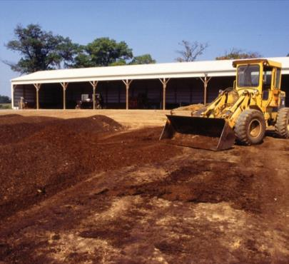
Composting Overview
Decomposition method
  Carcasses placed between layers of carbon rich organic materials
  Aerobic process
  Nitrogen provided by carcasses
  Carbon provided by plant materials (co-compost/
  cover materials)
Notes:
Composting is a carcass disposal method that promotes decomposition through placement of carcasses between layers (approximately two feet thick) of carbon rich organic materials. Although technically an aerobic process, a totally aerobic composting process is typically only reached under intensively managed (i.e. industrial) conditions that are unlikely to occur in emergency composting. In carcass composting, carcasses serve as a source of nitrogen and the addition of high carbon plant material (referred to as co-compost or cover material) such as sawdust or straw serves to meet the carbon requirement, absorb excess moisture, and retain heat/sustain high internal temperatures necessary for rapid decomposition and pathogen suppression. Both indoor and outdoor composting may occur. [This image depicts a composting pile at an outdoor composting facility. Photo source: Tom Glanville, Iowa State University]

Slide 9
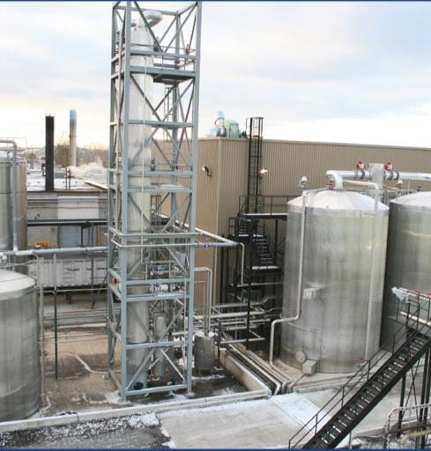
Rendering Overview
Uses heat to convert carcasses into
  Protein-based solids
  Water
  Melted fat/tallow
Inedible products
Dry rendering
Batch or continuous
throughput
Notes:
Rendering is an off-site process that uses heat to convert carcasses into protein-based solids (meat and bone meal), water, and melted fat/tallow. Rendering plants may be integrated with existing packing or poultry processing plants or may operate independently. Some rendering plants may produce edible fats and proteins if they conform to Food and Drug Administration (FDA) processing standards. Others may produce only inedible products which are then used in livestock feeds, soap, and other production processes. Only inedible rendering will be discussed in this presentation. Dry rendering is the only type of inedible rendering used in the U.S. Both batch and continuous systems may be used. [This is an image of a rendering plant. Photo source: David Meeker, National Renderers Association]

Slide 10
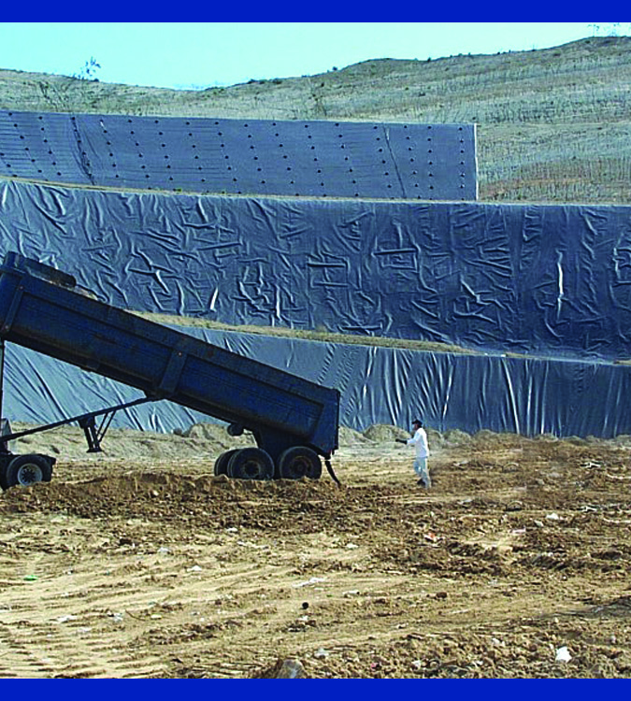
Permitted Landfill Overview
Three types of permitted landfills
  Construction and demolition
  Hazardous waste
  Municipal solid waste
    Used for catastrophic carcass disposal
Notes:
Three types of permitted landfills exist in the United States: construction and demolition, hazardous waste, and municipal solid waste. Municipal solid waste landfills are often the most appropriate for catastrophic carcass disposal. Landfill sites may be privately owned or may be operated by municipalities. For landfills to be considered a viable disposal option, officials should obtain a pre-catastrophe agreement with the landfill management/ownership for use of the site if necessary during an animal health emergency. In many states, disposal in landfills is permitted, although different options may be allowed under different circumstances. [This photo shows the disposal of waste material at a landfill. Photo source: David Meeker, National Renderers Association]

Slide 11
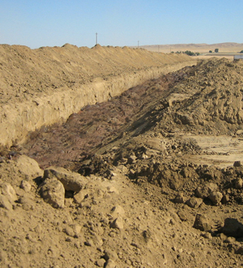
Unlined Burial Overview
Carcasses or waste materials placed in trench, earthen hole, or pit
Buried materials degrade over time
Leachate produced
  Groundwater contamination possible
Heavy equipment needed
Notes:
Unlined burial may be designed and engineered for the emergency disposal of carcasses and associated materials. In general, unlined burial of carcasses and materials such as ash from other disposal procedures involves placing them in a trench or large, earthen hole or pit. Eventually, buried materials are degraded and broken down into minerals and organic material. Carcass degradation may generate significant quantities of leachate, and groundwater contamination may result. The costs of environmental remediation may be significant. An extensive inventory of heavy equipment will likely be necessary to facilitate burial when used as a disposal method. [This is an image of trench burial. Photo source: Jeff G. Taber, County of Kings Department of Public Health, Hanford, California]

Slide 12
Thermal Methods Overview
High-temperature combustion
Three methods
  Fixed facility incineration
    Highly controlled and effective
  Open-air (uncontrolled) burning
    Poorly controlled, negative air quality effects
  Air-curtain incineration
    Forced air and fuel improve efficiency
Notes:
Thermal methods use high-temperature combustion to destroy animal carcasses and associated animal materials. In this presentation, three methods will be described. Fixed-facility incineration takes place in a completely contained environment and is usually highly controlled. With open-air burning, as was used in the 2001 FMD response in the United Kingdom, neither the fuel nor air inputs can be controlled. The result of open-air burning is often an incomplete (very smoky) and relatively low-temperature combustion. Public perception of open-air burning is overwhelmingly negative and this method can have adverse effects on air quality. Air–curtain incineration is a thermal method that uses a combination of forced air and fuel (such as diesel or wood) to burn carcasses and/or associated materials. This method, which may be either a mobile technology or fixed technology, still burns carcasses or other materials outside but, in contrast to open-air burning, a manifold increases air flow and accelerates carcass combustion.

Slide 13
Novel Disposal Methods
Disposal options in development
  Lactic acid fermentation
  Gasification
  In situ plasma vitrification
  Alkaline hydrolysis
Drawbacks
  Expensive
  Used in highly specialized operations
  Sized for routine use
Notes:
There are a number of novel disposal methods in development; these include lactic acid fermentation, gasification, in situ plasma vitrification, and alkaline hydrolysis. Currently, these disposal options are expensive and are typically used only by highly specialized operations such as veterinary schools or large research facilities. They are typically sized for routine operations rather than emergencies.

Slide 14
Site-Specific Disposal Method Selection Criteria
Notes:
The selection of optimal disposal sites in an animal health incident involves a variety of factors and concerns. Disposal plans must be site-specific and account for many variables including pathogen and species type, environment, and public health perception. This section summarizes some primary considerations in method and site selection, including decision making, on-site disposal, and additional disposal strategies such as off-site disposal and temporary storage.

Slide 15
Disposal Method Selection
Regional limitations
Safety considerations
Animals to be disposed
  Biomass (including by-products)
  Equipment
  Species
  Personnel
Temporary storage
Notes:
Consultation with local, county, state, and federal environmental officials will be necessary to obtain specific information for the region or community in order to minimize any negative environmental effects associated with the disposal of contaminated material. The assigned Safety Officer should be consulted to provide guidance in disposal methods and site selection. All personnel should be properly trained and knowledgeable of the planned strategies. There are also considerations related to the animals to be disposed of: these include biomass (including by-products such as milk), equipment, species, and personnel requirements. Although carcass disposal should ideally occur within 24 hours of depopulation, storage may be necessary in an animal health emergency.

Slide 16
Avoiding Negative Impacts
Environmental
  Air and water quality
  Soil integrity
Biosecurity
  Transportation (human/vehicular traffic)
  Wildlife and scavengers
  Impact human and/or animal health
Notes:
Even with emergency disposal activities, the potential negative impacts, both environmental and biological, need consideration. All disposal options present some potentially negative environmental effects and biosecurity challenges that must be addressed during planning. Air quality, water quality, soil integrity, and other environmental factors should be considered. For example, the distance between a proposed unlined burial disposal site and water reservoirs and wells should be appropriate to avoid water contamination. To prevent the potential spread of disease, human and vehicular traffic involved in transport of waste to disposal locations should be included in the biosecurity plan. Efforts should also be directed at protecting wildlife and domestic scavengers from exposure to the disease agent, as well as preventing mechanical transfer or unintended movement of infected tissue. Negative effects may ultimately impact human and/or animal health.

Slide 17
Waste Classification and Disposal
Notes:
During an animal disease emergency involving large numbers of animal mortalities, carcass disposal will be a priority. However, in addition to animal carcasses, significant amounts of associated materials will require disposal. This section covers the classification of disposal waste materials.

Slide 18
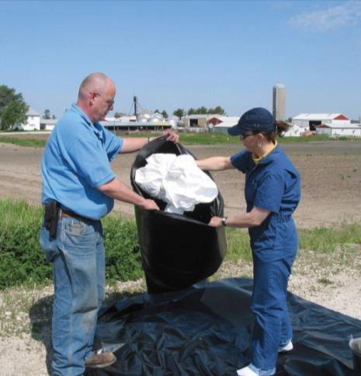
Classification Overview
All non-nuclear waste designated as “solid”
  Hazardous (solid) waste
  Medical/infectious
  (solid) waste
Utilize professionals to help classify waste
Notes:
Unless designated as nuclear waste, all wastes are termed “solid”— further classifications may then occur. Solid waste materials related to disposal are likely to be further classified into the following categories: hazardous (solid) waste, and medical and infectious (solid) waste. Waste classifications may vary widely in regards to diseased animal disposal as well as disposal of associated waste materials. Professionals familiar with all regulations in the affected states should be included in planning and response related to waste classification and disposal methods. [This photo shows the disposal of personal protective equipment that may be used during a FAD response. Photo source: Iowa Department of Agriculture and Land Stewardship ]

Slide 19
Associated Waste Materials
Waste materials can include:
  Liquid wastes (milk, wastewater, etc.)
  Manure, litter, slurry
  Livestock feeds
Disposal methods vary according to pathogen
  May include burning, burial, composting, or landfilling
Notes:
In addition to animal carcasses, waste materials may include liquid wastes (milk, dairy wastewater, or fluids from lagoons) and manure, litter or slurry. Livestock feeds such as dry grains, hay, and straw can also act as fomites and should be properly disposed of. Depending on the pathogen, contaminated materials may be burned, buried, or composted. In some cases, off-site management, such as transport to a landfill, could be an option. If this is chosen, biosecurity measures must be utilized to prevent further transmission of disease through transport of this material.

Slide 20
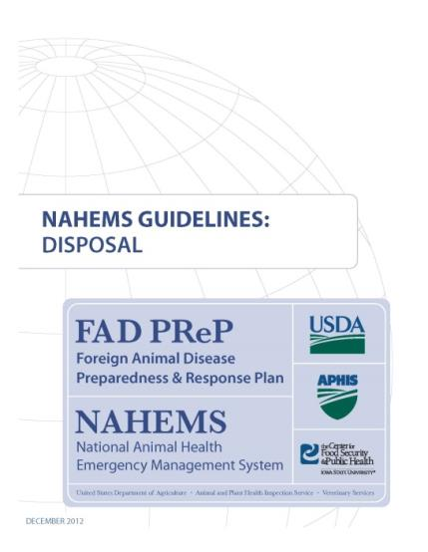
For More Information
FAD PReP/NAHEMS Guidelines & SOP: Disposal (2012)
  http://www.aphis.usda.gov/animal_health/emergency_management/
Disposal web-based training module
  http://naherc.sws.iastate.edu/
Notes:
More details can be obtained from the sources listed on the slide, available on the USDA website (http://www.aphis.usda.gov/animal_health/emergency_management/) and the NAHERC Training Site (http://naherc.sws.iastate.edu/).

Slide 21
Guidelines Content
Authors
Reneé Dewell, DVM, MS (CFSPH)
Tom Glanville, PhD (Iowa State University)
Significant contributions to the content were provided by
USDA APHIS VS:
Lori P. Miller, PE
Darrel K. Styles, DVM, PhD
Notes:
This slide acknowledges the authors and those who made a significant contribution to the content of the FAD PReP/NAHEMS Guidelines: Disposal document. Please see the Guidelines document for others who also provided additional assistance with content development.

Slide 22
Acknowledgments
Development of this presentation was by the Center for Food Security and Public Health at Iowa State University through funding from the USDA APHIS Veterinary Services
PPT Author: Kerry Leedom Larson, DVM, MPH, PhD, DACVPM
Reviewers: Janice Mogan, DVM; Reneé Dewell, DVM, MS
Notes:
Information provided in this presentation was developed by the Center for Food Security and Public Health at Iowa State University College of Veterinary Medicine, through funding from the US Department of Agriculture, Animal and Plant Health Inspection Service, Veterinary Services.

