Slide 1
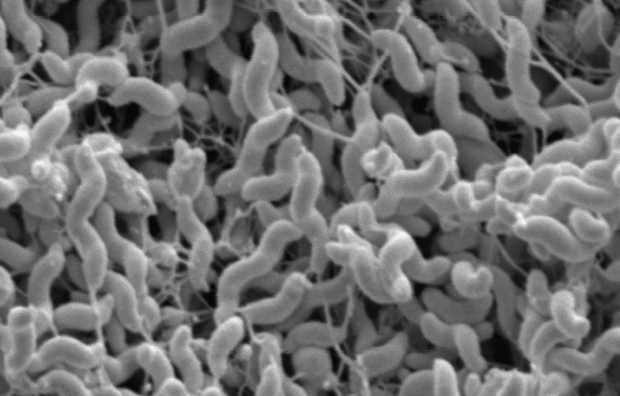
Campylobacter
What you do….
helps reduce the numbers

Slide 2

Campylobacter
A family of bacteria
found in the intestines
of many animals,
including poultry
The organisms are microscopic
Notes:
What is Campylobacter?
Campylobacter are bacteria that live in the intestine of many animals, including poultry.
Campylobacter image courtesy of Qijing Zhang at https://www.news.iastate.edu/media/2016/11/9T14.jpg.

Slide 3
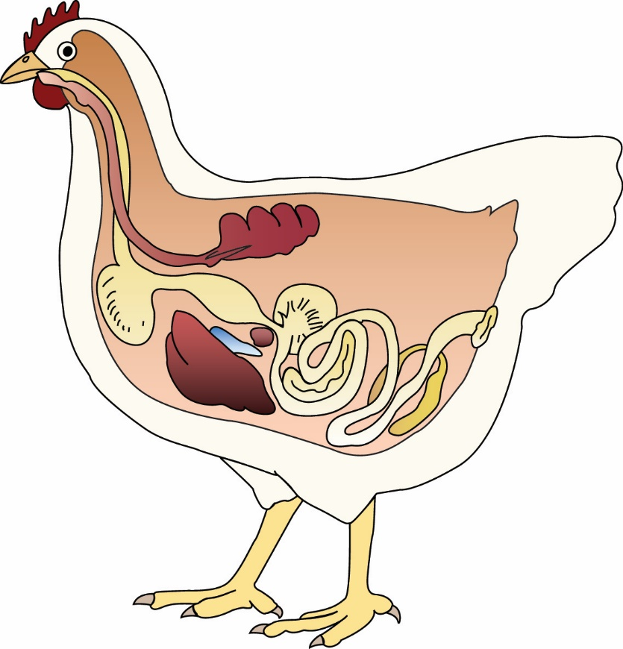
Birds with Campylobacter
do not usually appear sick
Notes:
Chicken and turkeys carry high levels of Campylobacter in their intestines. Most of the time, Campylobacter does not cause disease in poultry, in other words, it doesn’t make poultry sick.

Slide 4
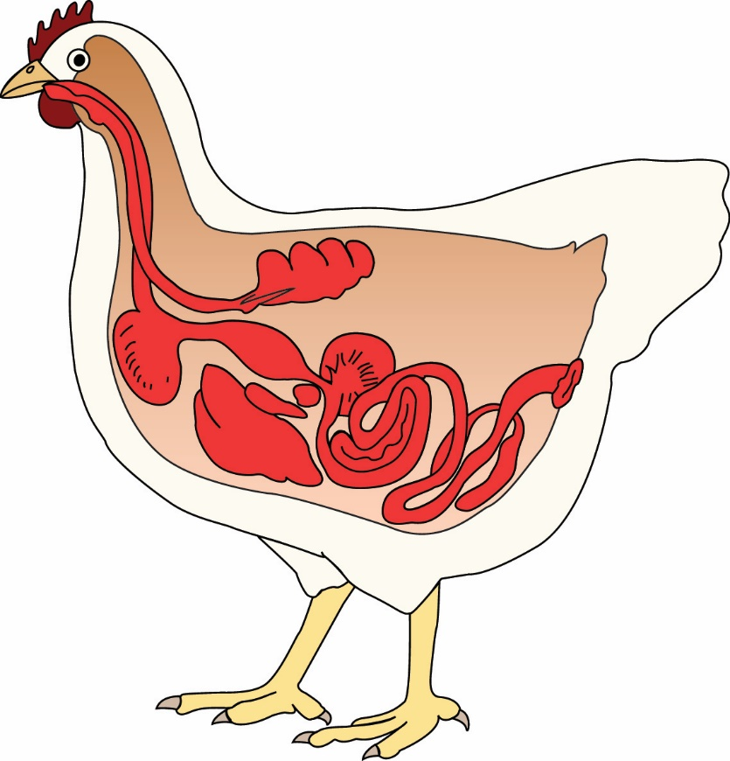
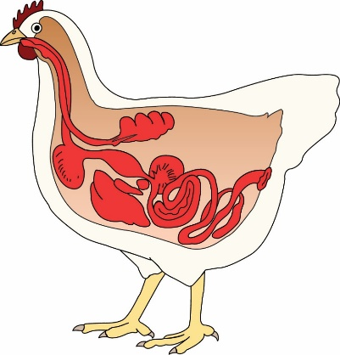
Birds with Campylobacter
do not usually appear sick
but the bacteria in their intestines
are shed in the feces and
spread rapidly
Notes:
…but the bacteria in their intestines are shed in the feces and spread rapidly to other birds, the environment, equipment, vehicles, clothing, and Campylobacter can also contaminate poultry carcasses during processing.

Slide 5
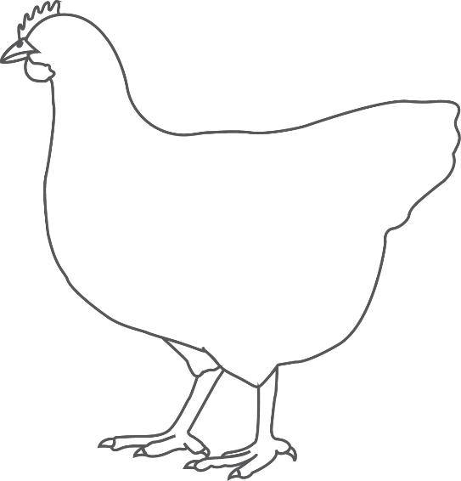
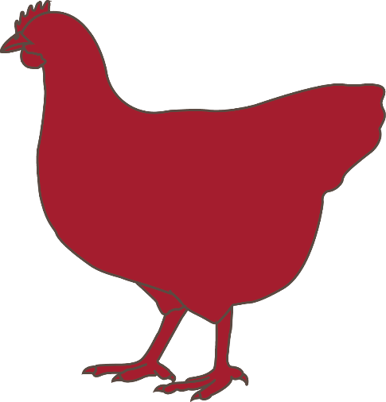
…..to other birds, the environment, equipment, vehicles, clothing
and Campylobacter can also contaminate poultry carcasses during processing.
Notes:
If Campylobacter lives in the intestine of poultry, how does it contaminate poultry products?
Campylobacter can exist in very high numbers in the intestines and feces of poultry, as much as hundreds of thousands (10⁵) to millions (10⁶) of organisms per gram of feces. Any contact with the intestinal content or feces will result in contamination. On the farm, this spreads Campylobacter to other chickens. At the processing plant, it spreads the bacteria to chicken products. During processing, around 50% of poultry carcasses can be contaminated with Campylobacter.
There are two major ways fecal material or intestinal content can contact poultry carcass:
Contamination from feces and contaminated poultry feathers and skin, and
Exposure and spread during the evisceration step in the processing plant.

Slide 6


If people
eat poultry products
contaminated with
Campylobacter,
it can make them sick.
FEVER
VOMITING
ABDOMINAL PAIN
SEVERE DIARRHEA
Some illnesses can be severe and lead to hospitalization,
or even death.
Notes:
Why do we need to learn about Campylobacter?
When humans eat poultry products that are contaminated with Campylobacter, it can make them sick and possibly lead to hospitalization or even death.

Slide 7

Campylobacter
affects more than
800,000
people each year in the U.S
Notes:
Campylobacter is estimated to affect more than 800,000 people in the United States every year, which is not far behind Salmonella (1 million people each year in the United States).
Poultry, particularly meat products are one of the major sources of human Campylobacter infections. By learning about Campylobacter and ways to reduce carcass contamination, you can have a positive impact on human health. You can actually save lives in your community, nationwide or even worldwide.

Slide 8
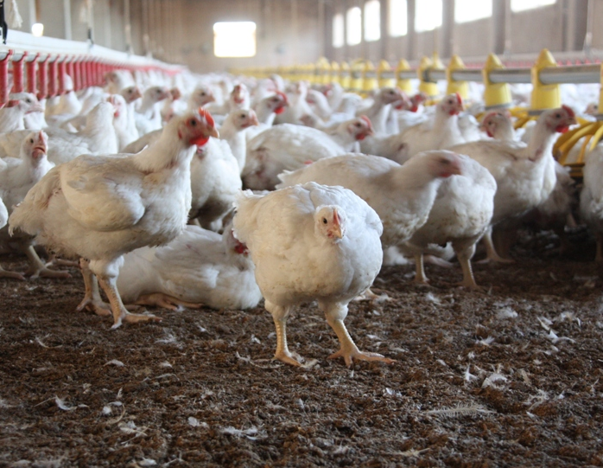
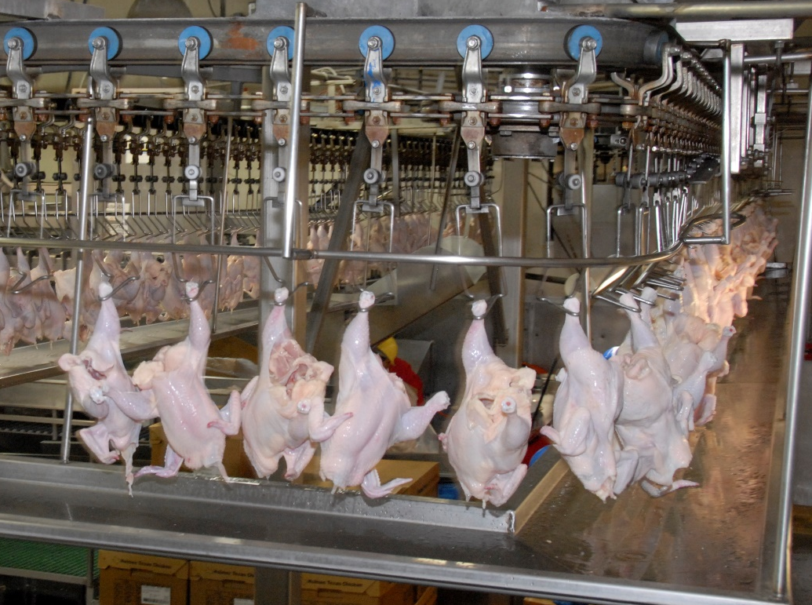
Interventions
on the farm
AND
at the
processing plant
can reduce bacteria numbers
Notes:
Interventions on both the live production side and on the processing plant side can significantly reduce contamination of poultry products by Campylobacter.
Photos: Left: Poultry Farm. By jlastras [CC BY-SA 2.0 (https://creativecommons.org/licenses/by-sa/2.0)], via Wikimedia Commons; Right: Chicken processing. By Alice Welch/USDA.

Slide 9
Epidemiology of Campylobacter
Not spread from parents to progeny through the egg (vertical transmission)
Rarely detected in birds under 3 weeks of age
  Once a bird is positive after 3 weeks of age,
  it can quickly spread the bacteria to other birds;
  In fact, almost all birds in a flock
  will eventually become positive
  (high prevalence)
Spreads from an infected bird
(or its feces) to other birds in the flock (horizontal transmission)
Prevalence
the percentage of a population that is affected with a particular disease
at a given time
Notes:
As previously mentioned, chicken and turkeys carry high levels of Campylobacter in their intestines. Most of the time, Campylobacter does not cause disease in poultry, in other words, it doesn’t make poultry sick. Campylobacter is rarely detected in birds under 3 weeks of age and vertical transmission (i.e., from parents to progeny through the egg) does not play an important role in Campylobacter transmission. But, once a bird is positive after 3 weeks of age, it can quickly spread the bacteria to other birds; in fact, almost all birds in a flock will eventually become positive (high prevalence). However, there is variability in prevalence between flocks and production sites. Some flocks and some farms have consistently low prevalence numbers.

Slide 10
Epidemiology
Major sources of Campylobacter on the farm include:
Hands, clothing or footwear of persons on the farm, including both workers and visitors.
Old litter which contains the microorganism.
Equipment and transport vehicles which are contaminated from infected birds and feces.
Rodents, flies and other insects, wildlife species, and domestic pets (which can serve as disease vectors).
While feed and water are not major contributors to the initial introduction of Campylobacter; these sources can contribute to the spread of the microorganism among individual birds within infected flocks.
Notes:
Major sources of Campylobacter on the farm include:
Hands, clothing or footwear of persons on the farm, including both workers and visitors.
Old litter which contains the microorganism.
Equipment and transport vehicles which are contaminated from infected birds and feces.
Rodents, flies and other insects, wildlife species, and domestic pets (which can serve as disease vectors).

Slide 11


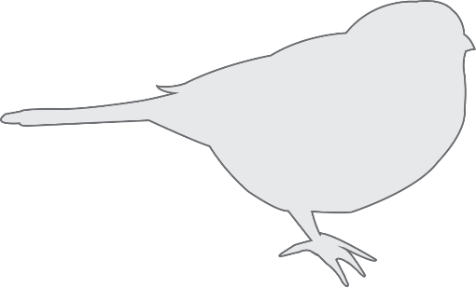
Epidemiology
Campylobacter infection of poultry is usually higher…..
  In warm weather and the summer months, but it does occur year round
    Increases have been linked to increased populations of vectors
  In organic and free-range flocks than those reared in conventional production settings
Notes:
Campylobacter infections are usually higher in prevalence in warmer weather and the summer, perhaps because of increased fly populations during this period. Typically, Campylobacter also has higher prevalence in organic and free-range flocks versus those reared in conventional production settings.

Slide 12

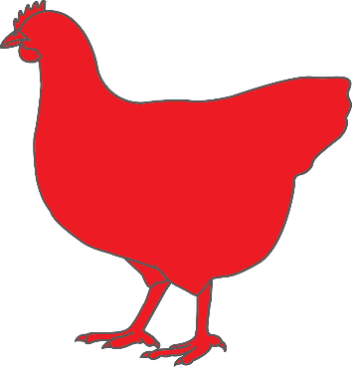


Prevalence can vary between flocks and between farms
Some flocks and some farms have consistently low infection rates

Slide 13
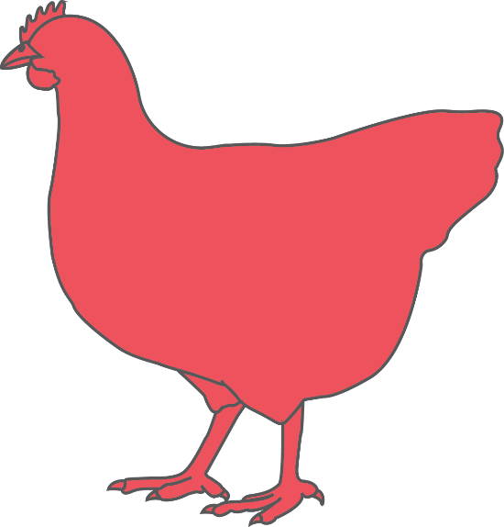
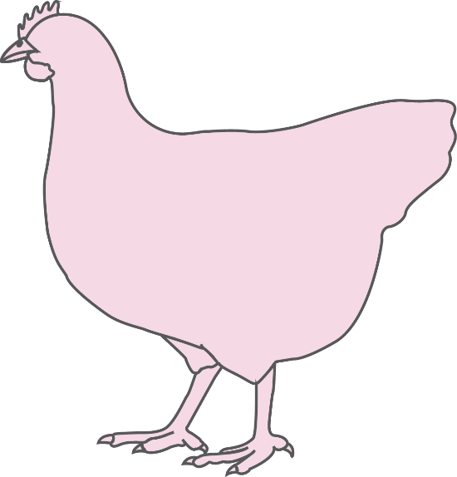

When the Campylobacter numbers in a particular flock are very high, it will be very difficult to prevent bacteria from contaminating the meat during processing.
When the Campylobacter numbers in a particular flock are very low, it can be much easier to prevent contamination of the meat in the processing plant.
Notes:
If contamination happens in the processing plant, why is live production important?
While the actual meat contamination can happen only in the processing plant, the process of reducing contamination starts before that—at the farm or production site. Imagine the number of Campylobacter cells in the intestines and feces of one particular broiler or turkey flock is very high, then it becomes very difficult to prevent bacteria from contaminating the meat during processing, no matter how good the processing plant is. Now, imagine the opposite, the number of Campylobacter in the feces of one particular broiler or turkey flock is very low, this makes it much easier to prevent lower numbers from contaminating the meat in the processing plant.
So, prevention efforts to reduce Campylobacter from contaminating poultry meat actually starts on the live production side by trying to make the numbers as low as possible. This will then make the processing plant’s job much easier and much more effective.

Slide 14
It is sometimes hard to grasp the concept and reality of bacterial numbers.
When, the numbers are in the millions or even in the billions, reducing the bacterial load by a hundred fold or a thousand fold, or even ten thousand fold will still be “not enough” to prevent contamination or control infection.
But, if the bacterial load coming into the processing plant is reduced to the hundreds or the thousands, then prevention during processing becomes much more effective in controlling contamination.
So, it’s “a numbers game!!”

Slide 15
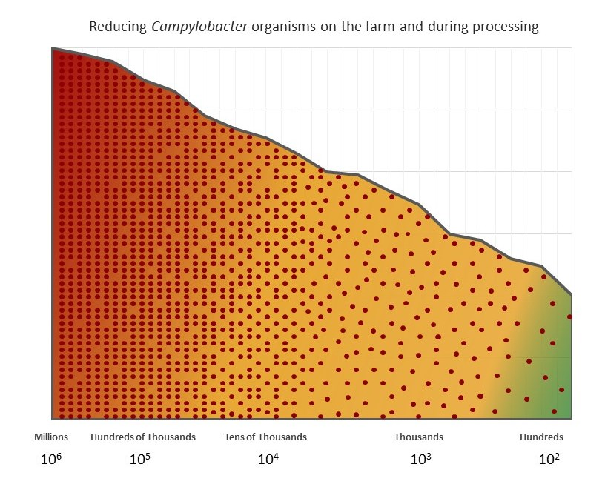
Notes:
It is sometimes hard to grasp the concept and reality of bacterial numbers. When, the numbers are in the millions or even in the billions, reducing the bacterial load by a hundred fold or a thousand fold, or even ten thousand fold will still be “not enough” to and prevent contamination or control infection.
But, if the bacterial load coming into the processing plant are reduced to the hundreds or the thousands, then the prevention during processing becomes much more effective in controlling contamination.
So, it’s “a numbers game!!”

Slide 16
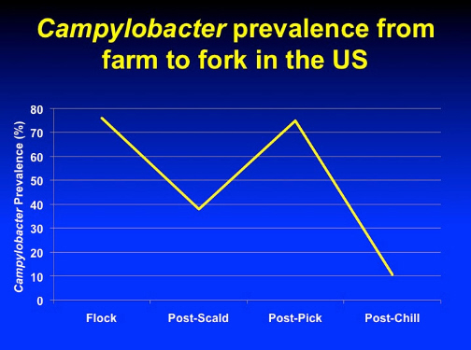
The key to reducing and eliminating Campylobacter is multiple intervention strategies. Each time a carcass is treated in a way that either physically removes Campylobacter or chemically kills Campylobacter, the numbers are reduced. By exposing the bacteria to numerous interventions, it is possible to lower Campylobacter from billions to hundreds to zero on many carcasses.
Notes:
The key to reducing and eliminating Campylobacter is multiple intervention strategies. Each time a carcass is treated in a way that either physically removes Campylobacter or chemically kills Campylobacter, the numbers are reduced. By exposing the bacteria to numerous interventions, it is possible to lower Campylobacter from billions to hundreds to zero on many carcasses

Slide 17
Efforts to reduce Campylobacter from poultry products…..
starts on the live production side
with interventions to make the bacteria numbers as low as possible…
which will help make
interventions at the processing plant more effective.

Slide 18
Interventions
On the Farm
Notes:
What can be done on the live production side to reduce the number of Campylobacter bacteria in the fecal material or intestinal content of broiler chickens coming into the processing plant? While the actual meat contamination can happen only in the processing plant, the process of reducing contamination starts before that—at the farm or production site.
Photos: Poultry Farm. By jlastras [CC BY-SA 2.0 (https://creativecommons.org/licenses/by-sa/2.0)], via Wikimedia Commons

Slide 19








Interventions
On The Farm
Biosecurity
Water Treatment
Probiotics
Competitive Exclusion
Litter Management
Vector Control
Feed Withdrawal
Notes:
Multiple steps can be taken on the live production side to help decrease Campylobacter carcass contamination.
These include interventions of strict biosecurity, water treatment, the use of probiotics, litter management, vector control, and feed withdrawal before processing. Let’s look at each of these more closely.

Slide 20

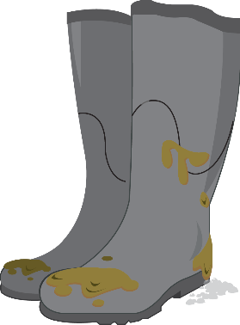
Interventions on the Farm
Strict Biosecurity
Personnel and equipment can spread bacteria on the farm.
  Actions to Take:
  Personnel: wash and sanitize hands, wear dedicated and clean footwear and use of footbaths
  Vehicles: monitor and control traffic, minimize visitors and vehicles onto the farm
  Equipment sanitation
  Avoid moving equipment between farms unless it is thoroughly cleaned and disinfected.
Notes:
Biosecurity
Personnel and equipment can spread bacteria on the farm. Improved biosecurity can produce a measurable reduction of Campylobacter prevalence in poultry populations. Suggested biosecurity practices that can have direct impact on Campylobacter prevalence in poultry include:
Ensure all personnel wash and sanitize hands often and use dedicated footwear for each poultry barn.
Ensure the anteroom is clean and sanitized frequently and that footbaths are properly maintained.
Monitor and control traffic and minimize visitors onto the farm.
Keep poultry away from other domestic animals, including livestock, pets or other poultry. (Fecal contamination from other animals can be a major source for Campylobacter introduction to poultry).
Implement vector control processes, including fly, rodent, insect and wildlife control.
Avoid moving equipment from house to house unless it is thoroughly cleaned and disinfected. Items such as, litter tillers and transportation crates can easily spread Campylobacter to other locations.

Slide 21
Interventions on the Farm
Water Treatment
Bacteria in the intestine can contaminate the product during processing.
  Actions to Take:
Water acidification using organic acids can reduce bacterial counts in the bird’s intestines
  formic acid, acetic acid, lactic acid,
  propionic acid
It also increases the efficacy of chlorination
Notes:
Water Treatment
Water acidification, using organic acids like formic acid, acetic acid, lactic acid, and propionic acid can reduce colonization, reduce bacterial count in the intestines, and reduce transmission of Campylobacter between infected and susceptible birds. Campylobacter count has been reduced when water was acidified during feed withdrawal before processing. It is important to note that water acidification can also increase the efficacy of chlorination. Combining water acidification and chlorination can have an impact on Campylobacter transmission, colonization and prevalence in the intestinal tract of poultry.

Slide 22

Interventions on the Farm
Probiotics-Competitive Exclusion
Campylobacter in the intestines
spreads via feces.
  Supplying the intestine with large numbers of beneficial bacteria can help outcompete pathogens for colonization space in the gut.
  Actions to Take:
  Competitive exclusion products
    Complex/Multispecies probiotics
    Defined Single Microorganism probiotics
  Competitive exclusion products have had variable results
Notes:
Competitive Exclusion
The idea of using competitive exclusion is to supply the intestine with large numbers of beneficial bacteria that can outcompete pathogens for colonization space in the gut. In poultry, competitive exclusion products have shown variable results when it comes to reducing Campylobacter prevalence and load in the intestine. 1) Complex probiotic products include diverse species of beneficial bacteria. Products like Broilact© (Nimrod Veterinary Products Ltd., Upper Rissington, U.K) uses a preparation of freeze-dried bacteria collected from the intestine of a normal adult fowl. Products like PoultryStar© (Biomin, Herzogenburg, Austria), contain multiple probiotic species, such as, Enterococcus faecium, Pediococcus acidilactici, Bifidobacterium animalis, Lactobacillus salivarius, and Lactobacillus reuteri; 2) The other type of product is defined single microorganism competitive exclusion products. As its name suggests it contains a single species of beneficial bacteria. Complex products tend to affect Campylobacter prevalence and bacterial load more than single microorganism products. Still there is inconsistency in probiotics results in general.¹

Slide 23

Interventions on the Farm
Litter Management
Campylobacter in poultry feces can survive in the environment.
  Actions to Take:
Combination of aluminum sulfate, sodium bisulfite, and magnesium sulfate
    Reduces litter pH and litter moisture (~50%)
Effective in preventing chickens from getting colonized by natural Campylobacter exposure for up to 6 weeks.
Notes:
Litter Management
Litter acidification and moisture reduction helps to reduce the bacterial count of Campylobacter on the farm. Two commercially available chemicals commonly used for litter acidification are aluminum sulfate and sodium bisulfate. Combinations of these two chemicals with magnesium sulfate have been shown to be effective, not only in reduction of litter pH, but also in in reducing the moisture of litter (~50%). Recent studies have also found that the treatment of litter with a combination of these three products was highly effective in preventing chickens from getting colonized by natural Campylobacter exposure for up to 6 weeks (unpublished data).

Slide 24


Interventions on the Farm
Vector Control
Insects or animals can spread bacteria
on the farm.
  Actions to Take:
  Keep poultry away from other domestic animals, including livestock, pets or other poultry.
  Fecal contamination from other animals can be a major source for Campylobacter introduction to poultry.
  Implement vector control processes, including fly, rodent, insect and wildlife control.
Notes:
Vector Control
Rodents, flies and other insects, wildlife species, and domestic animals can serve as disease vectors.
Keep poultry away from other domestic animals, including livestock, pets or other poultry. (Fecal contamination from other animals can be a major source for Campylobacter introduction to poultry).
Implement vector control processes, including fly, rodent, insect and wildlife control.
Increased Campylobacter in the summer has been linked to increased populations of vectors.

Slide 25

Interventions on the Farm
Feed Withdrawal
Bacteria in the intestine can contaminate the product during processing.
  The goal of feed withdrawal is to supply the processing plant with birds that have an empty intestinal tract by the time they are on the evisceration shackles
  Actions to Take:
  The timing of feed withdrawal is critical
  The target is 10-12 hours from feed withdrawal until the birds hang on the evisceration shackles.
    Catching, loading, transportation and holding time should be included in the timing
Notes:
Feed Withdrawal
The goal of feed withdrawal is to supply the processing plant with birds that have an empty intestinal tract by the time they are on the evisceration shackles. This reduces the possibility of the intestine breaking during the evisceration process leading to fecal contamination of the poultry carcass. The timing of feed withdrawal is the critical part of this process; the goal is to have the bird’s intestine empty but also not to have it empty for too long. If the intestine is empty for too long, it will start digesting itself and become friable and easier to break, which will end up increasing the problem we were trying to avoid in the first place. The target is 10-12 hours from the time of feed withdrawal until the birds hang on the evisceration shackles. Catching, loading, transportation and holding time in the processing plant shed should be accounted for when planning the withdrawal timing. This can be a challenge.
Feed withdrawal coupled with water acidification and proper chlorination can be a powerful tool to reduce Campylobacter load in the intestine, particularly in the crop.¹⁵

Slide 26
Interventions
at the Processing Plant
Notes:
The processing plant is an extremely important place for carcass contamination reduction. In processing plants, poultry pass through multiple steps, each representing an opportunity to increase or decrease Campylobacter prevalence and concentration. All plants should evaluate their own processing protocols to evaluate the effect of each step of processing to reduce contamination levels (both prevalence and concentration) of Campylobacter.
Photos: Chicken processing. By Alice Welch/USDA.

Slide 27
The processing plant is an extremely important place for reducing carcass contamination.
In processing plants, poultry pass through multiple steps, each representing an opportunity to increase or decrease Campylobacter prevalence and concentration.
All plants should evaluate their own processing protocols to evaluate the effect of each step of processing to reduce contamination levels (both prevalence and concentration) of Campylobacter.

Slide 28
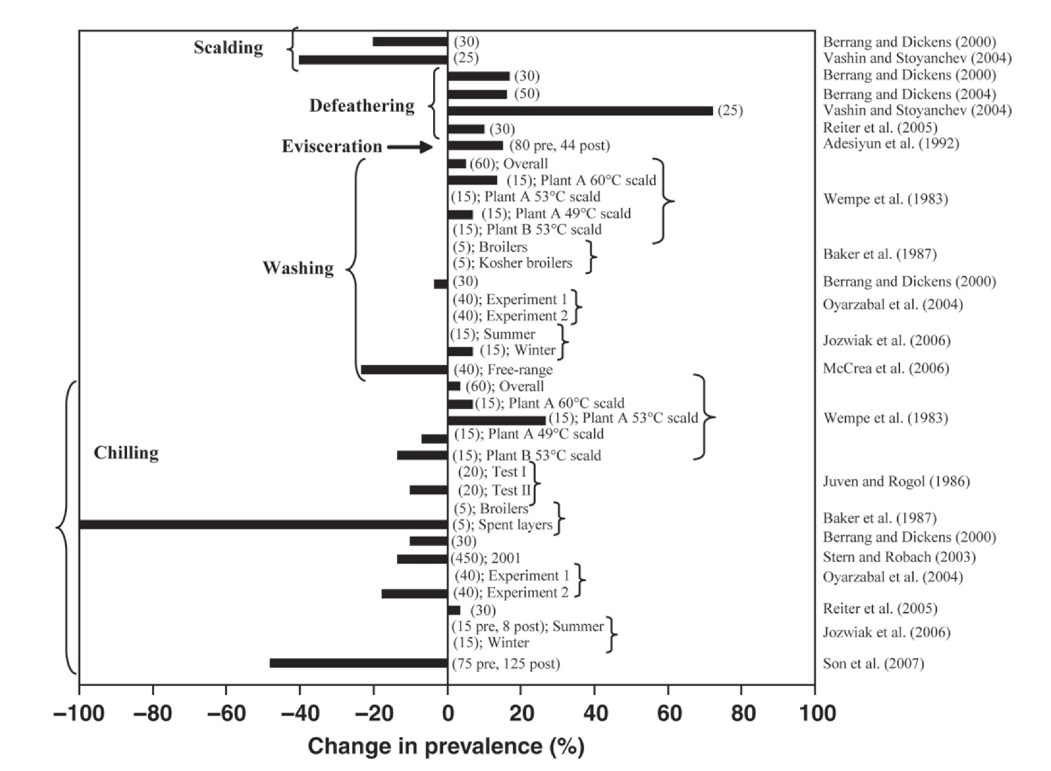
Interventions with potential to lower Campylobacter level
Interventions with potential to increase Campylobacter level
Scalding
Defeathering
Evisceration
Washing
Chilling
Notes:
The following diagram, adapted from Guerin et al, shows the change in prevalence (or corresponding increase or decrease in contaminated birds) at various stages of the processing line. The bars on the left hand side in green, indicate processes (or interventions) with higher potential to lower the level of contamination, the bars on the right hand side, in red, indicate processes that have higher potential to increase the level of contamination. In general, the scalding, washing and chilling steps represent opportunities to control and reduce the prevalence and concentration of Campylobacter on poultry carcasses. On the other hand, the defeathering and evisceration steps represent areas of risk of increased contamination, both in percent positive carcasses and concentration per unit. However, each processing plant is different, and understanding the unique risks and opportunities in each plant is essential for customizing a strategic and targeted intervention plan.

Slide 29











Interventions
At the processing plant
Flock Prevalence
Scalding
Defeathering
Evisceration
Chillers and Post-Chill Processes
Sanitization and pH

Slide 30





Interventions at the Processing Plant
Flock Prevalence
Bacteria levels vary with birds
and flocks.
Two different measurements can be taken to evaluate the
level of carcass contamination by Campylobacter:
Percent of positive carcasses
out of 100 processed carcasses how many are positive for Campylobacter. This is also known as prevalence.
Campylobacter concentration
how much bacteria is there on the carcasses that are positive – is it 100 organisms or 100 million organisms.
Notes:
The processing plant is an extremely important place for carcass contamination reduction. Two different measurements can be taken to evaluate the level of carcass contamination by Campylobacter:
Percent of positive carcasses, which means out of 100 processed carcasses how many are positive for Campylobacter. This is also known as prevalence.
Campylobacter concentration, which means how much bacteria is there on those positive carcasses, is it 100 or is it 100 million.
In processing plants, poultry pass through multiple steps, each representing an opportunity to increase or decrease Campylobacter prevalence and concentration. All plants should evaluate their own processing protocols to evaluate the effect of each step of processing to reduce contamination levels (both prevalence and concentration) of Campylobacter. This will allow for the identification of critical control points and facilitate targeted and customized intervention plan to be developed for each plant.

Slide 31
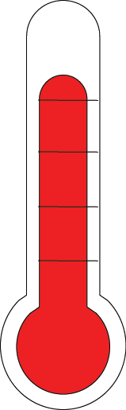
Interventions at the Processing Plant
Scalding
130ºF
Campylobacter in the intestines
can contaminate carcasses.
  Actions to Take:
  Scalding at temperatures above 130°F kills Campylobacter
  Scalding can reduce Campylobacter levels 40%
  Countercurrent or multi-tank scalding are
  more effective
Notes:
Scalding
In most cases, scalding is an opportunity to reduce prevalence and concentration of Campylobacter. Triple tank counter-current scalders with temperature above 130ºF (55ºC) seem to produce the most reduction in prevalence and concentration (up to 40% reduction in prevalence).

Slide 32


Interventions at the Processing Plant
Defeathering
Bacteria in the feces can be on poultry skin and feathers.
  Defeathering is a high risk area for bacterial spread due to fecal material coming out of cloaca from pressure of the picker fingers on the abdomen.
  Actions to Take:
There are limited opportunities for intervention in the defeathering step
Ensure proper maintenance and sanitization of feather picking equipment
Notes:
Defeathering
Most studies that sampled carcasses before and after the defeathering process have shown an increase in Campylobacter prevalence and concentration during this step. It is generally agreed upon that the process of defeathering represents a high risk of contamination due to fecal material coming out of cloaca due to pressure from the picker fingers on the abdomen. Other than properly adjusting the picker fingers, there is limited opportunities for intervention in the defeathering step. Ensuring the proper maintenance of feather picking equipment and proper sanitization of equipment can help.

Slide 33
Interventions at the Processing Plant
Evisceration and Wash Station
Bacteria in the intestine can contaminate the product.
Evisceration is a high risk area for bacterial spread.
  Actions to Take:
  Use efficient equipment for mechanical evisceration, especially to remove the crop and prevent bile soiling
  Avoid cross contamination
  Wash the insides and outsides of carcasses
  Sanitize equipment and area often
Notes:
Evisceration and Washing Station
Evisceration (removal of internal organs) is another risk step, where there is an increased chance for fecal contamination due to breaking of intestine and the release of intestinal content. Cropping (removal of the crop) is another step of potential carcass contamination. Properly timed feed withdrawal coupled with properly adjusted machines and water acidification could reduce the risk of contamination on the evisceration line. An additional intervention on the evisceration line is the inside out washing stations. Multiple washing stations are strategically placed on the evisceration line, including a final wash immediately before going to the chillers, to remove any fecal contamination. Research data shows mixed results from washing stations; some studies show an increase in prevalence, others show a decrease. But, in general, it can be a powerful intervention step to reduce Campylobacter prevalence and concentration on the evisceration line.

Slide 34
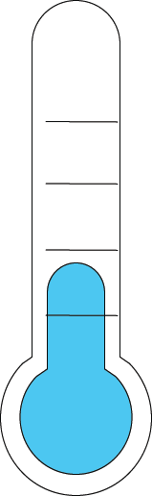

Interventions at the Processing Plant
Chillers and Post-Chill Processes
Contamination can occur during
any processing step.
  Actions to Take:
  Post-chill antimicrobial rinses or dips reduce bacterial numbers
  Counter-current and multi-tank chillers are
  more effective
  Water chillers are generally more effective
  than air chillers
Notes:
Chillers and Post-Chill Processes
Chillers are the last opportunity for interventions before deboning. Some studies show decrease and others show increase in prevalence in water immersion chillers. However, the general trend is decreased prevalence post chillers. Most studies, on the other hand, show a decrease in concentration of Campylobacter post chillers. Similar to scalding, counter-current and multi-tank chillers are more effective in reducing the prevalence and concentration of Campylobacter. While cross contamination is a risk with water immersion chillers, the data indicates this method can be more effective than air chillers in reducing the concentration of Campylobacter. Post-chill antimicrobial rinses with potable water and dips in antimicrobial solutions can be used to further reduce the level of Campylobacter contamination in poultry meat.

Slide 35
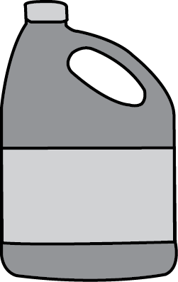

Interventions at the Processing Plant
Sanitization and Proper pH
Poor sanitation can impact the level
of contamination.
  Actions to Take:
  Scalding water, washing water or chilling water should all be sanitized
  Monitor and ensure pH and concentration of sanitizing solution
  Use FDA approved sanitation products
Notes:
Sanitization and Proper pH
Water in the processing plant is essential in reducing contamination. Scalding water, washing water or chilling water should all be sanitized. Monitoring disinfectant concentration and pH in each step is necessary to maintain potency of used product.¹
The following are FDA approved chemicals that can be used for water sanitation and carcass decontamination: acidified sodium chloride (ASC), calcium hypochlorite, cetylpyridinium chloride (CPC), chlorine gas, chlorine dioxide, 1,3-dibromo-5,5-dimethylhydantion (DBDMH), a solution of citric and hydrochloric acids, a blend of citric, phosphoric, and hydrochloric acids, ozone, sodium hypochlorite, peracetic acid (PAA), or trisodium phosphate (TSP).

Slide 36
Summary
No single step can reduce Campylobacter contamination completely.
Targeting high risk steps and combining multiple strategies can be effective in reaching carcass decontamination goals.
Multiple interventions on both the production side and on the processing side need to be combined to reduce the percentage and level of carcass contamination.

Slide 37
Reduce the numbers
Reduce illness
We all play a part

Slide 38


Acknowledgements
This project was supported by
Agriculture and Food Research Initiative Competitive Grant
No. 2012-67005-19614
from the U.S. Department of Agriculture
National Institute of Food and Agriculture
This presentation was prepared by
the Center for Food Security and Public Health
and Iowa State University Extension.
Authors and Reviewers: Mohamed El-Gazzar, DVM, MAM, PhD, DACPV; Yuko Sato DVM, MS, DACPV; Orhan Sahin, DVM, MS, PhD, DACVM; Glenda Dvorak DVM, MPH, DACVPM – Iowa State University College of Veterinary Medicine
For more information visit www.campypoultry.org

