Slide 1


Setting Up the Clean-Dirty Line
Notes:
During an animal health emergency, vehicles, equipment, or people entering and exiting the farm can transfer disease organisms. Designating clean and dirty areas on response sites helps to reduce disease transmission onto or off of a site.

Slide 2


Hide
Notes:
This Just In Time training module will discuss principles for setting up and crossing the clean-dirty line during a response.

Slide 3
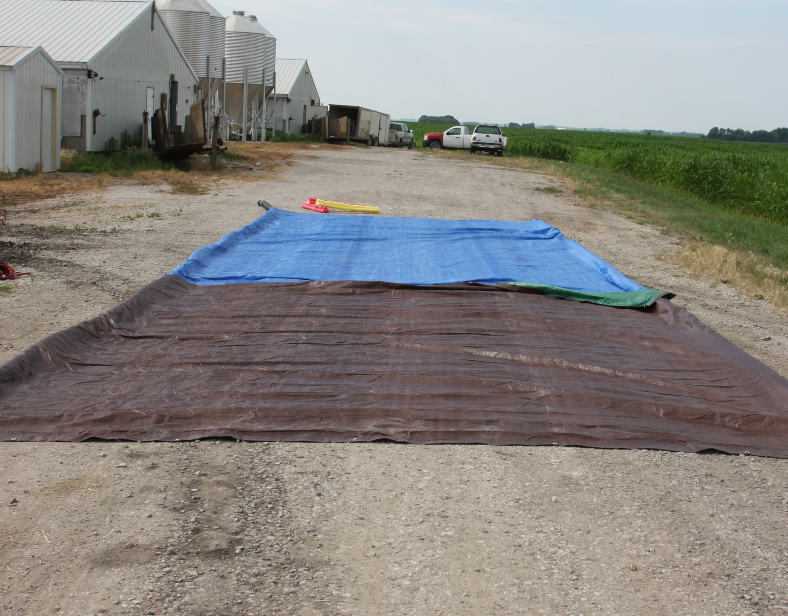
Example of
Clean-Dirty Areas and Line
DIRTY SIDE
CLEAN-DIRTY LINE
CLEAN SIDE
Notes:
During an animal health emergency, the dirty side is the area that is potentially contaminated with pathogens and contains sick (or exposed) animals. The clean side does not contain sick animals and is not contaminated with pathogens. The clean-dirty line separates these two sides and has set procedures for movement between the two areas.
Photo by CFSPH

Slide 4

Alternative Names
DIRTY SIDE
(Hot Zone)
CLEAN-DIRTY LINE
(Warm Zone)
CLEAN SIDE
(Cold Zone)
Notes:
Some responders will work on the dirty side (also called the hot zone), conducting activities such as sampling, depopulation, disposal, and cleaning and disinfection. Others will work on the clean side (often referred to as the cold zone) where planning, administration and other support duties occur.
Photo by CFSPH

Slide 5
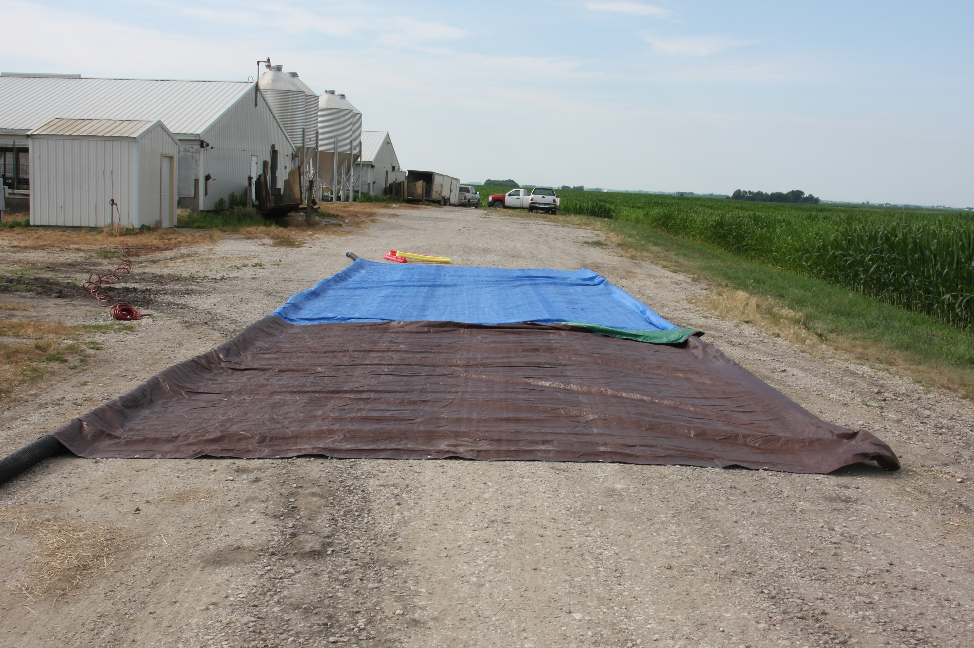
Clean and Dirty Line
DIRTY SIDE
CLEAN-DIRTY LINE
Entering
CLEAN SIDE
Notes:
Entry and exit for the response site always occurs at the clean-dirty line.
Those entering the site will don (put on) PPE on the clean side.
Photo by CFSPH

Slide 6
Exiting the Clean-Dirty Line
DIRTY SIDE
Exiting
CLEAN-DIRTY LINE
CLEAN SIDE
Notes:
Anything leaving the dirty side must be disinfected at the clean-dirty line.
Photo by CFSPH

Slide 7
Arrival at the Farm
Notes:
Arrival at the farm

Slide 8
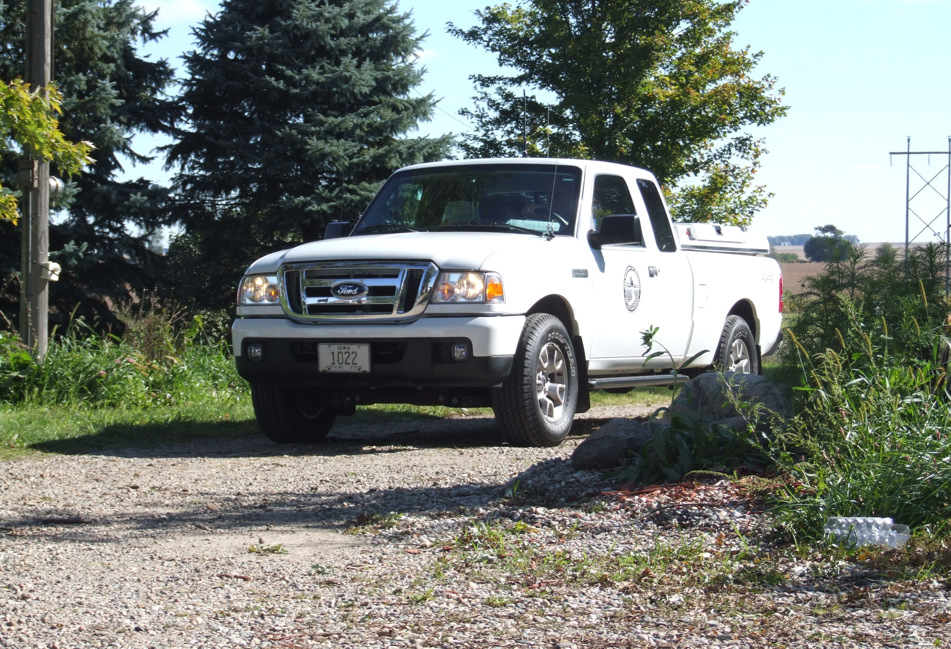
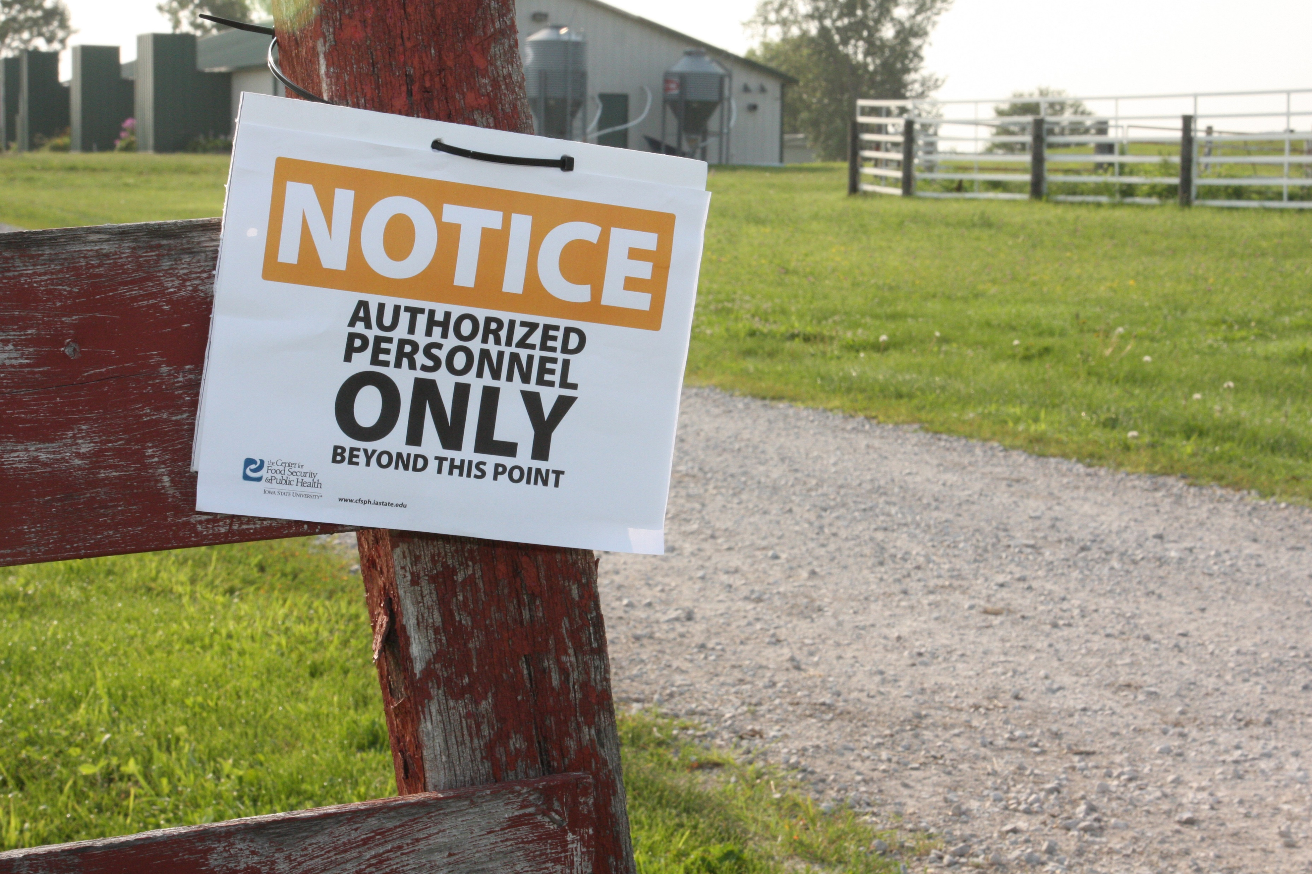
Arriving at the Farm
Notes:
Upon arrival, park on the clean side. Ideally, there will be a clearly marked, designated parking area. Never drive directly into animal areas.
Photos by CFSPH

Slide 9
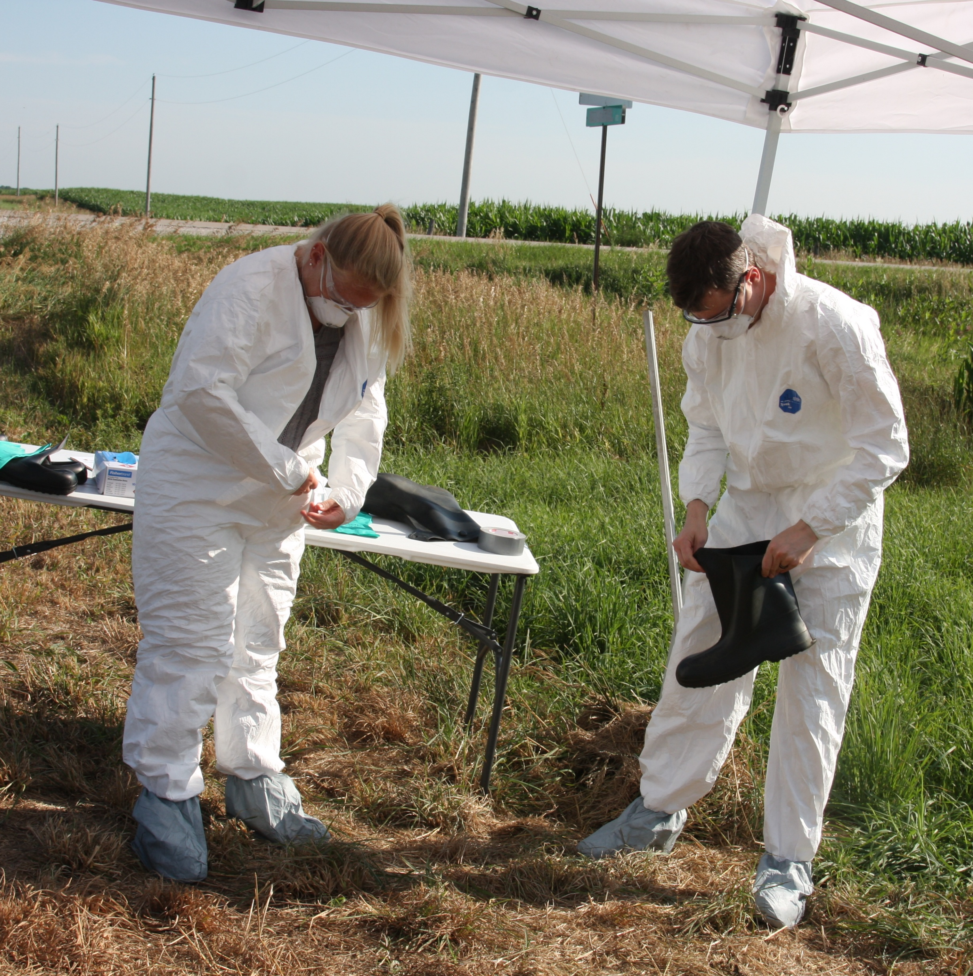
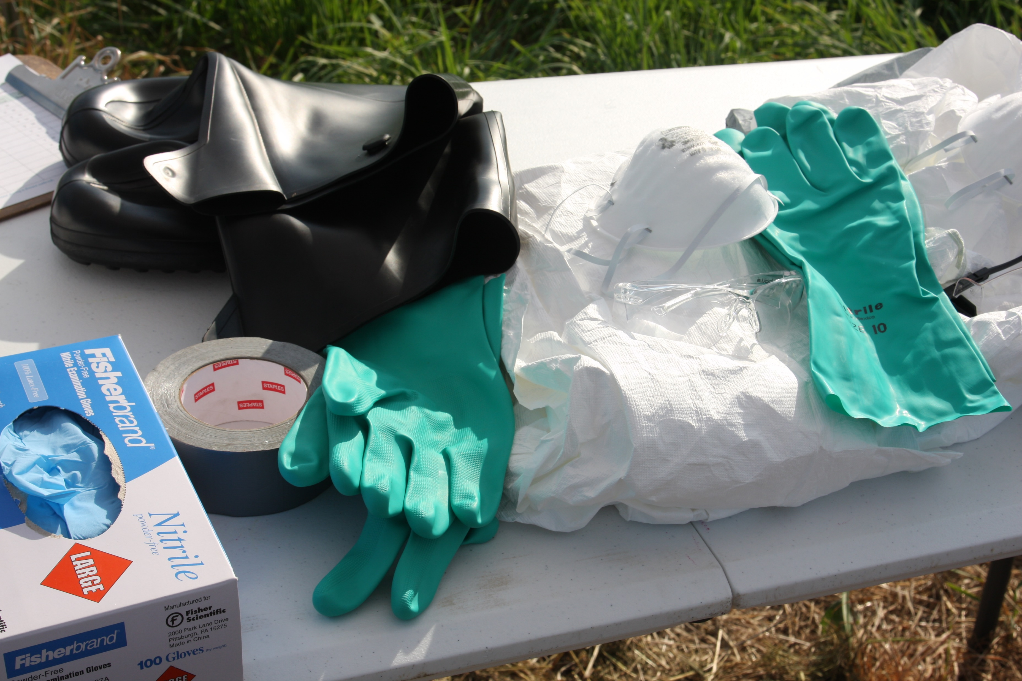
Personal Protective Equipment
Notes:
Put on required personal protective equipment. Level C PPE is used for most animal health emergencies. This includes tear-resistant or chemical-resistant coveralls, rubber boots, disposable boot covers, gloves, a face mask or respirator, and goggles.
Photos by CFSPH

Slide 10
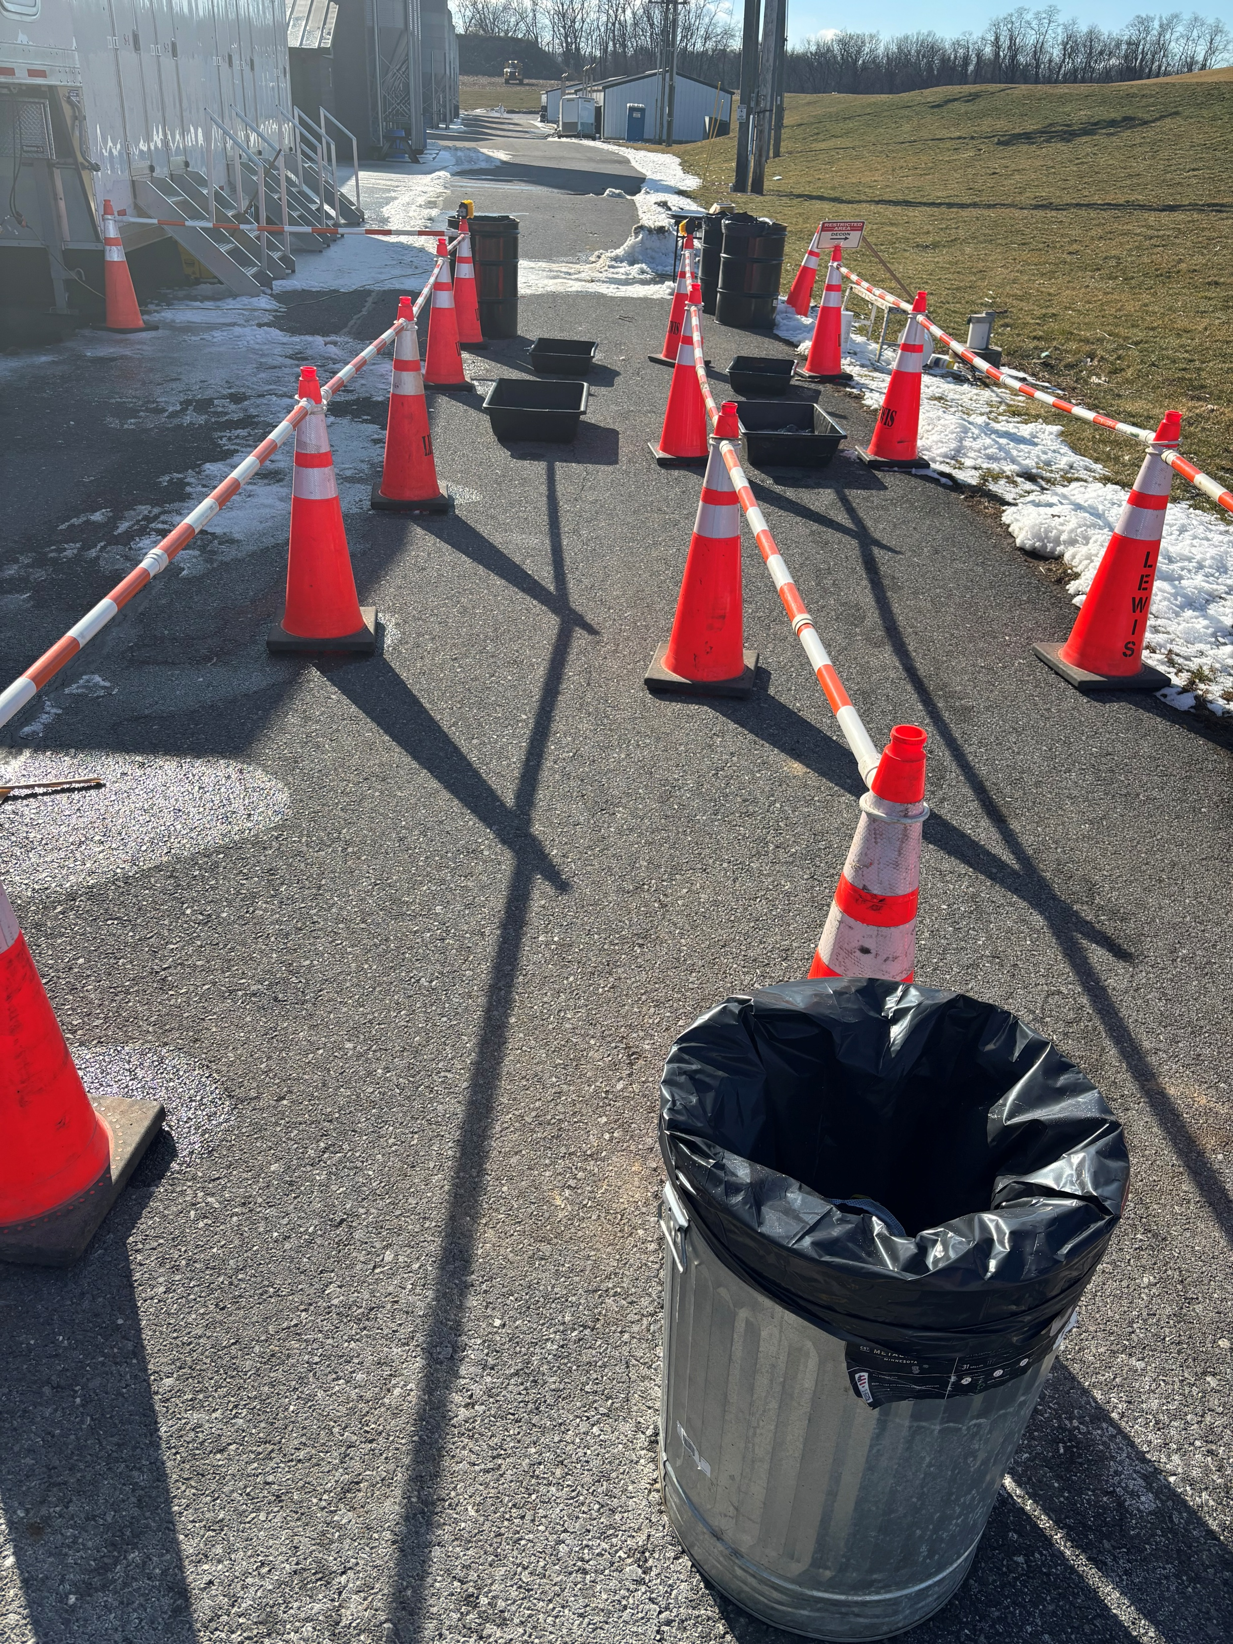
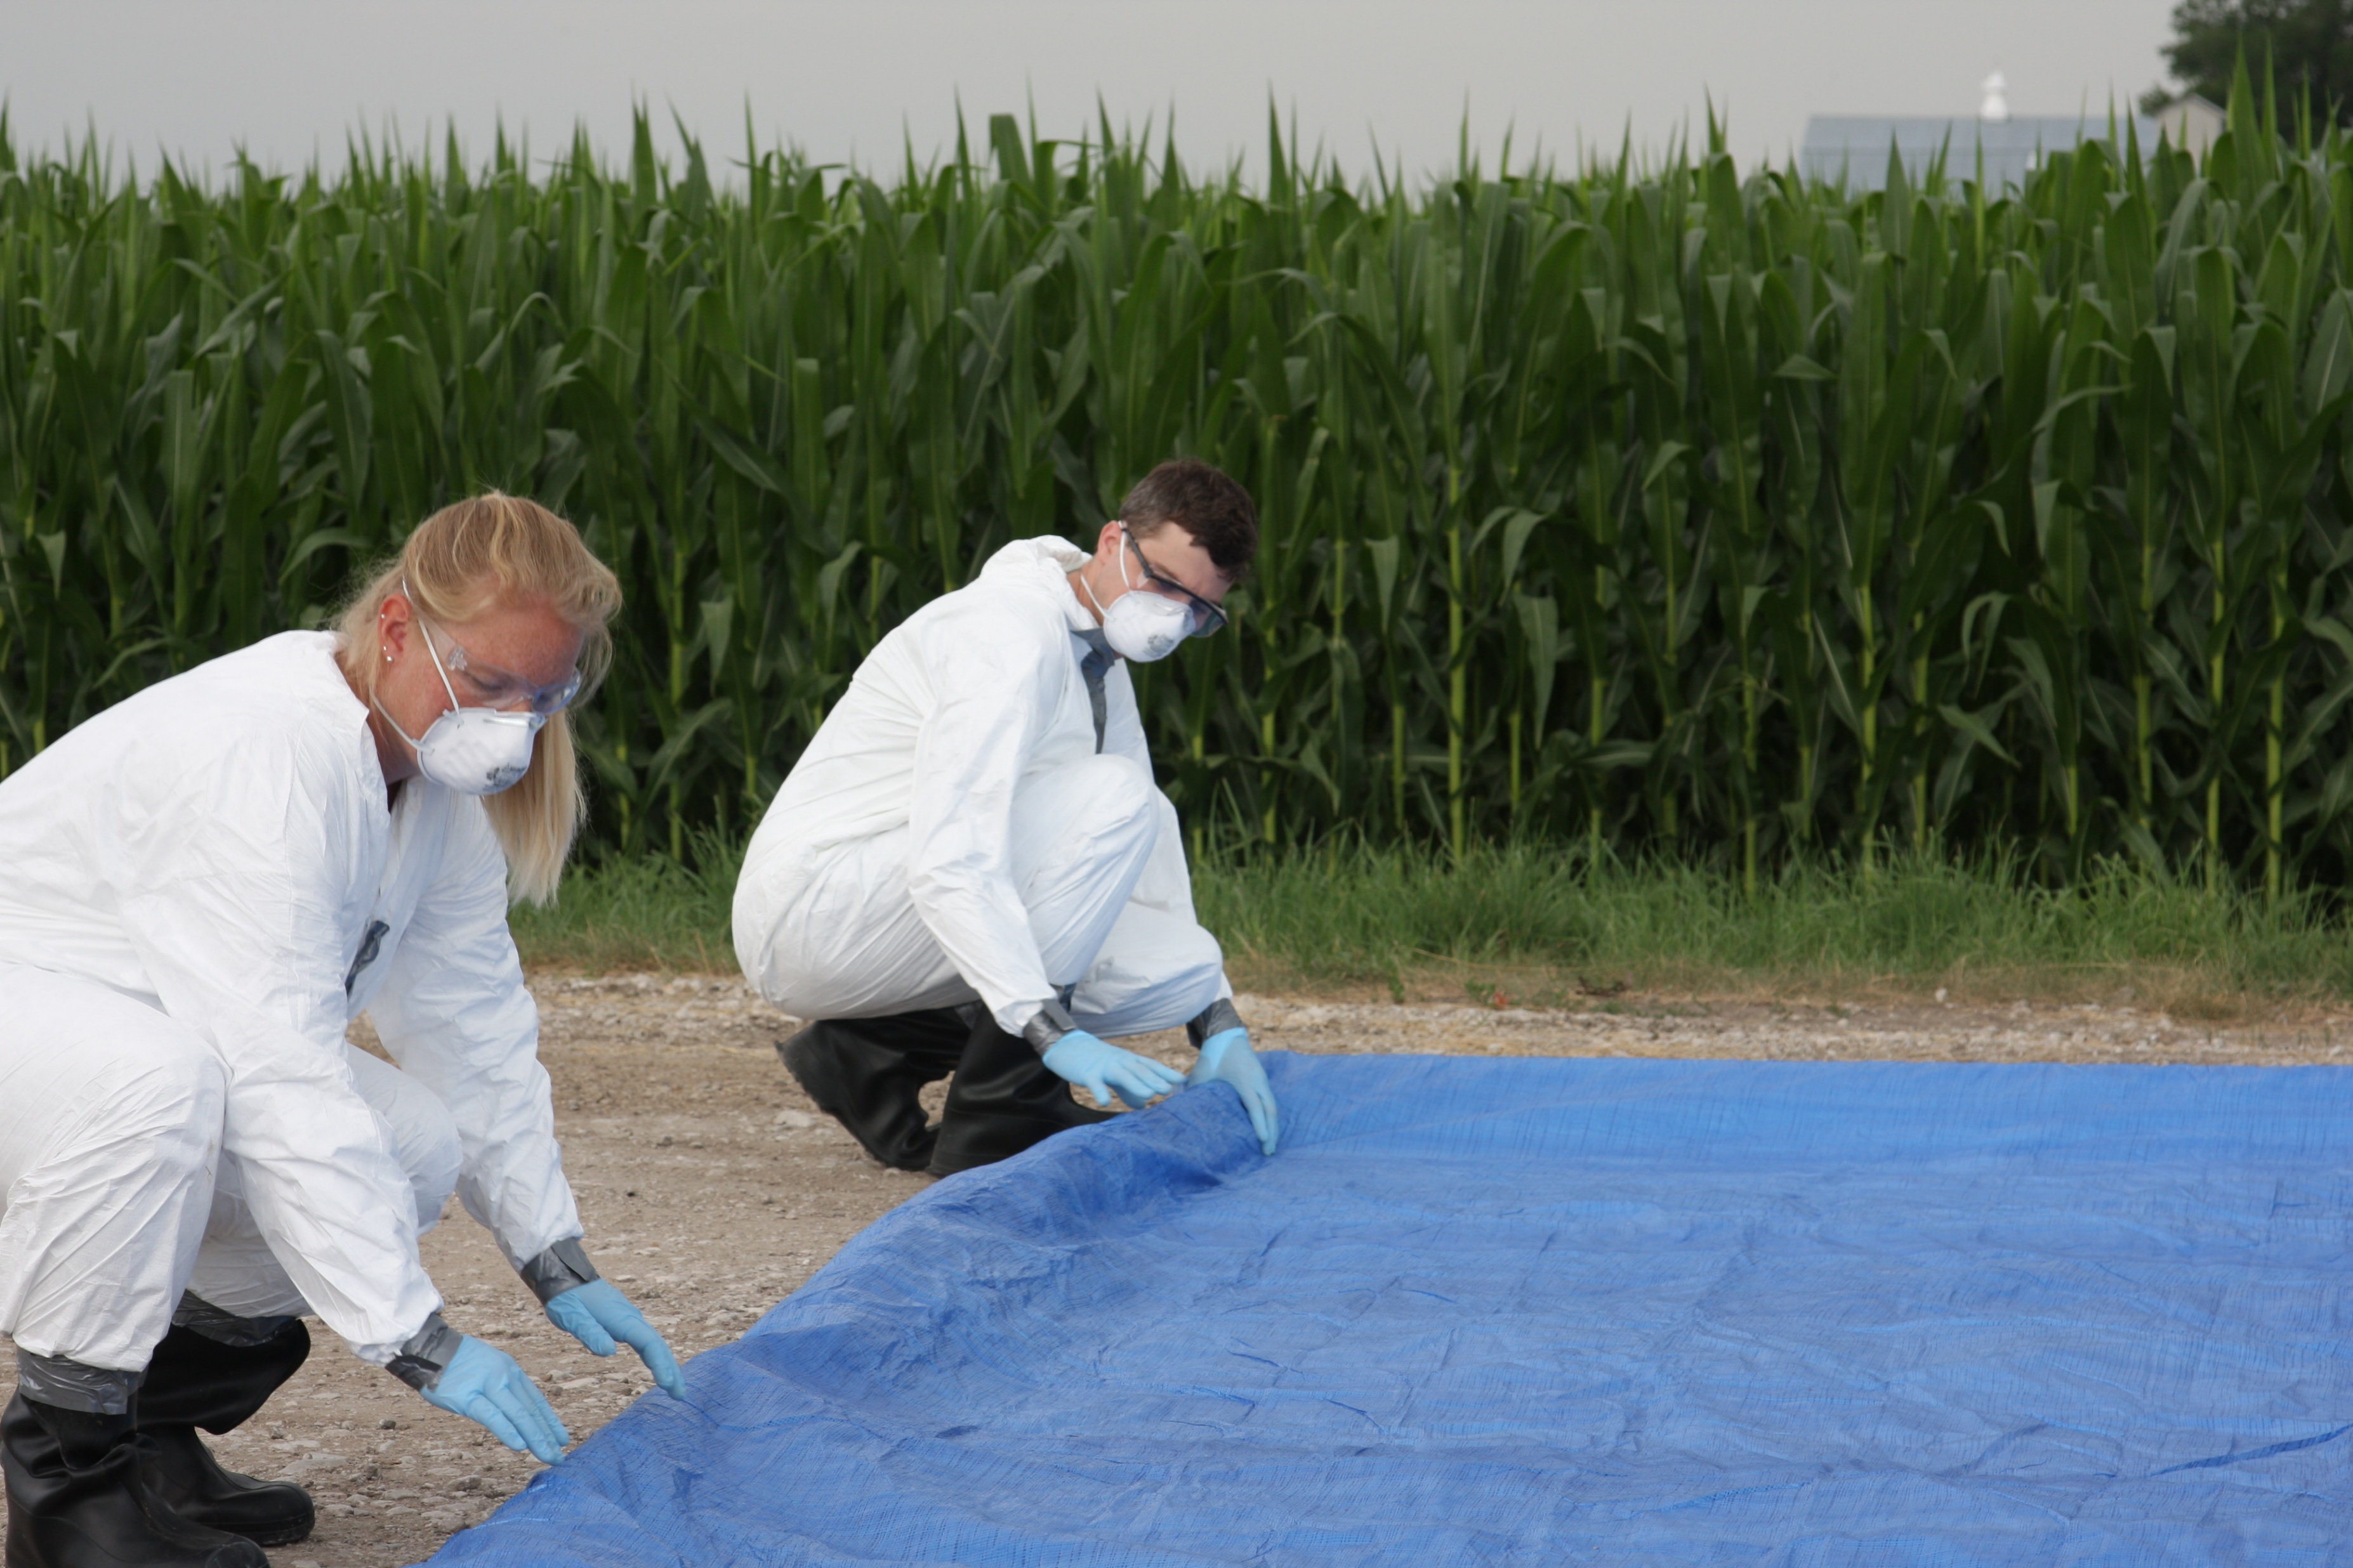
Clearly Mark the Clean-Dirty Line
Notes:
Identify and mark a location for the clean-dirty line. This should be an area located away from the infected animals or their housing, usually near the farm entrance.
Photo (left): CFSPH, (right) USDA from Samantha Beaty

Slide 11
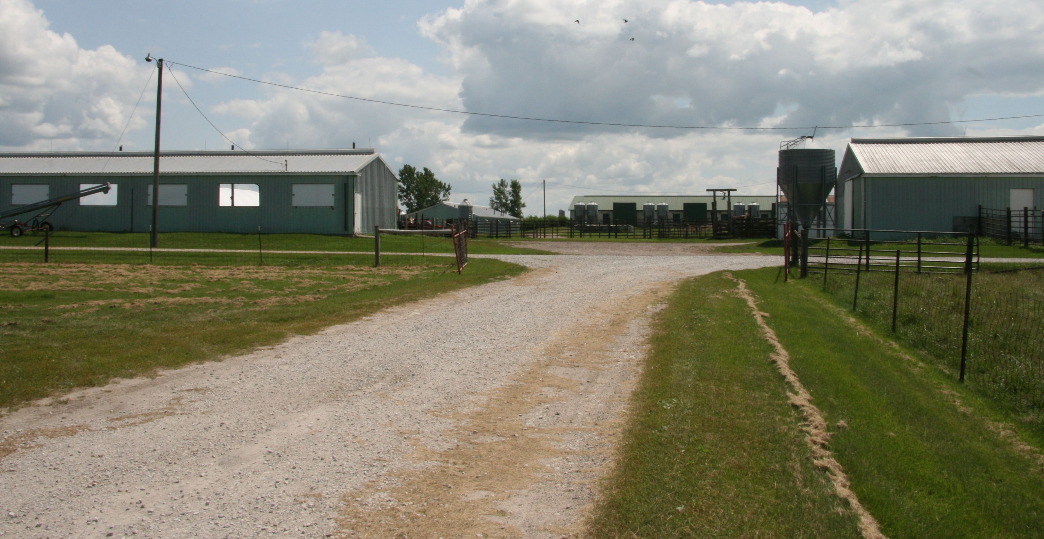
Location of the Clean-Dirty Line
Notes:
The area must be large enough to accommodate items going in and out of the site (e.g., people or vehicles). The area used should be flat or sloping toward the farm to keep any runoff (e.g. disinfectant solutions) on the site. It should also be located away from any waterways. A clean, paved area is preferred and should be sprayed with disinfectant solution before setting up the clean-dirty line. Well-drained gravel is acceptable; a tarp should be used to create a barrier and prevent mud during clean up.
Photo by Dani Ausen/CFSPH

Slide 12
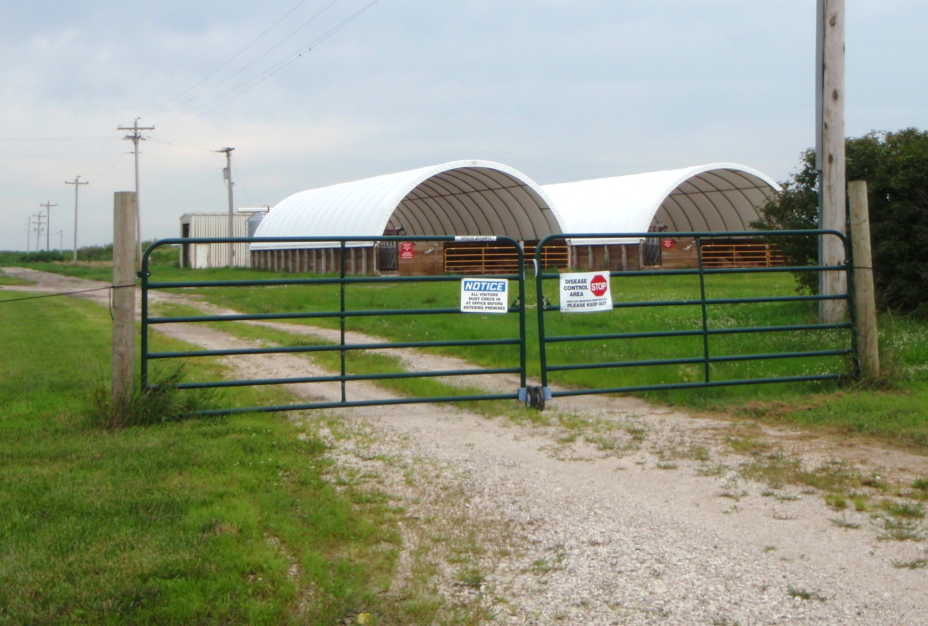
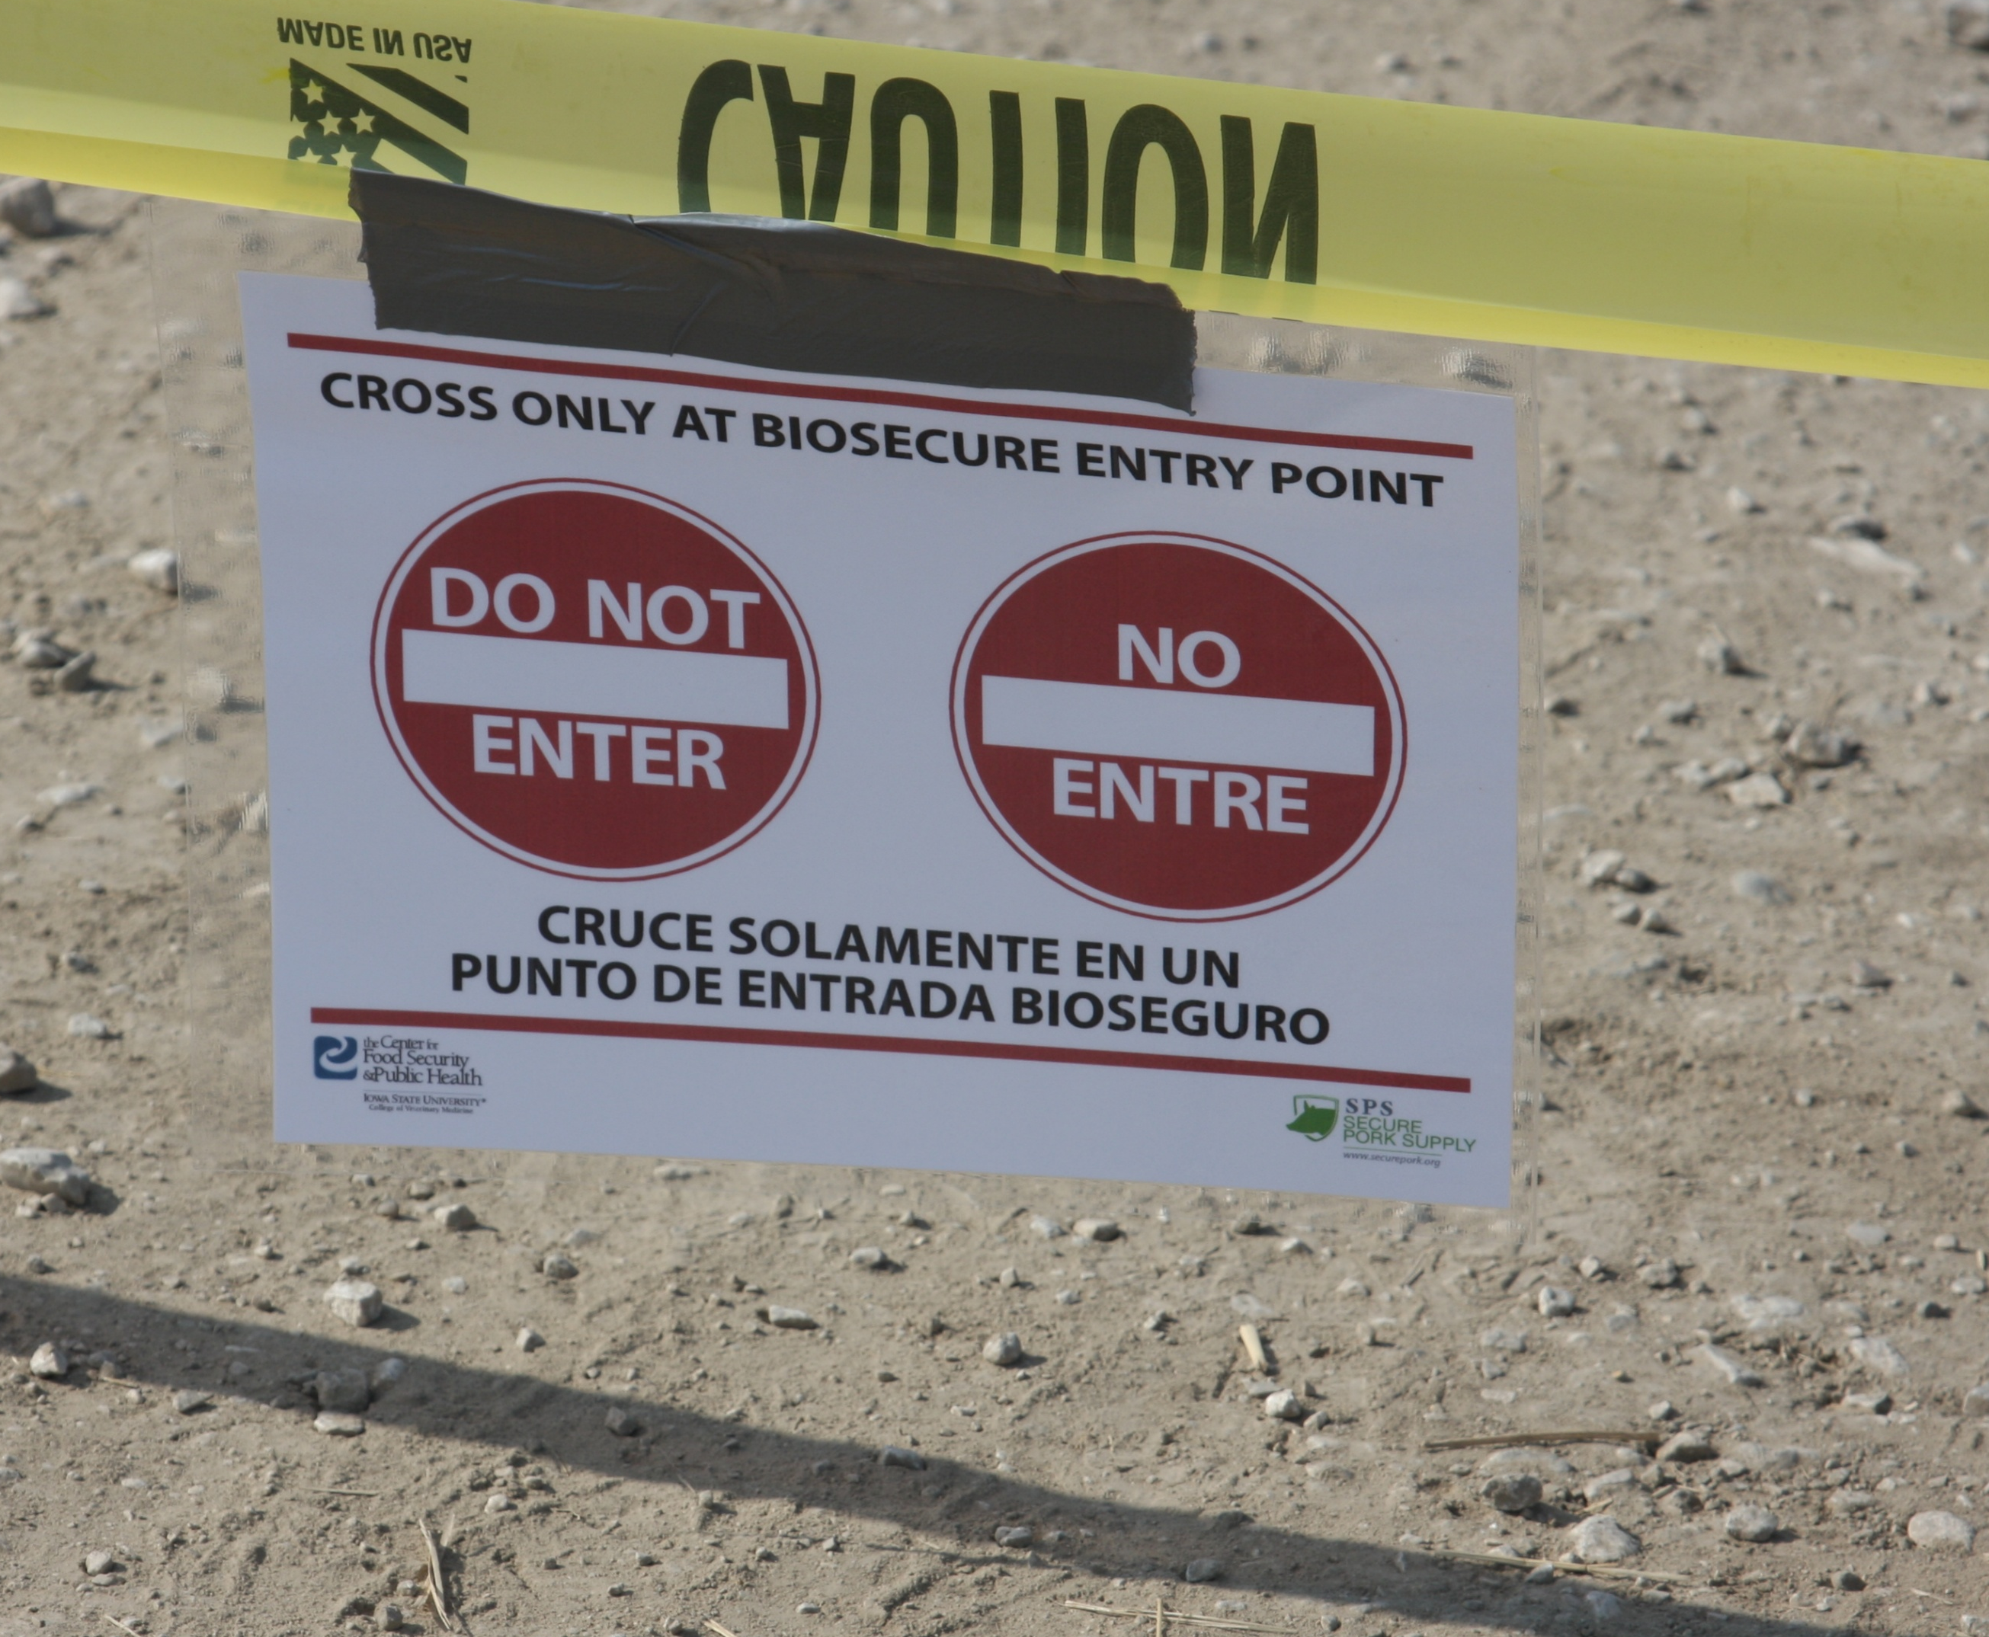
Marking a Clean-Dirty Line
Notes:
The clean-dirty line should be clearly visible and marked with tarps, paint, tape, or rope. Use of a physical barrier, such as a gate is best.
Photo by Dani Ausen/CFSPH

Slide 13
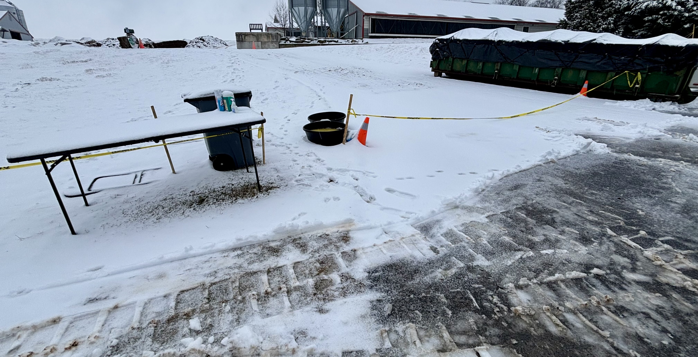
Marking the Clean-Dirty Line
Notes:
Even during inclement weather, it is important to clearly mark the clean-dirty line.
Photo by USDA from Samantha Beaty

Slide 14
Setting Up a Clean-Dirty Line
Notes:
Setting up a clean-dirty line

Slide 15


Setup Diagram for a Clean-Dirty Line
CLEAN SIDE
DIRTY SIDE
Notes:
The setup of the clean-dirty line should provide easy access to items needed for decontamination and disposal upon exit.

Slide 16





Clean and Dirty Line Item Setup
CLEAN SIDE
DIRTY SIDE
Notes:
Place the following items (at minimum) at the clean-dirty line:
A plastic container filled with disinfectant, and a scrub brush for footwear disinfection.
A garden sprayer filled with disinfectant for PPE and supply disinfection when exiting.
Several garbage bags (at least two) to discard disposable items or contain reusable items (e.g., respirators).
Two plastic buckets lined with garbage bags for a secondary level of containment of items upon departure from the dirty side of the line.
A hand sprayer filled with disinfectant

Slide 17
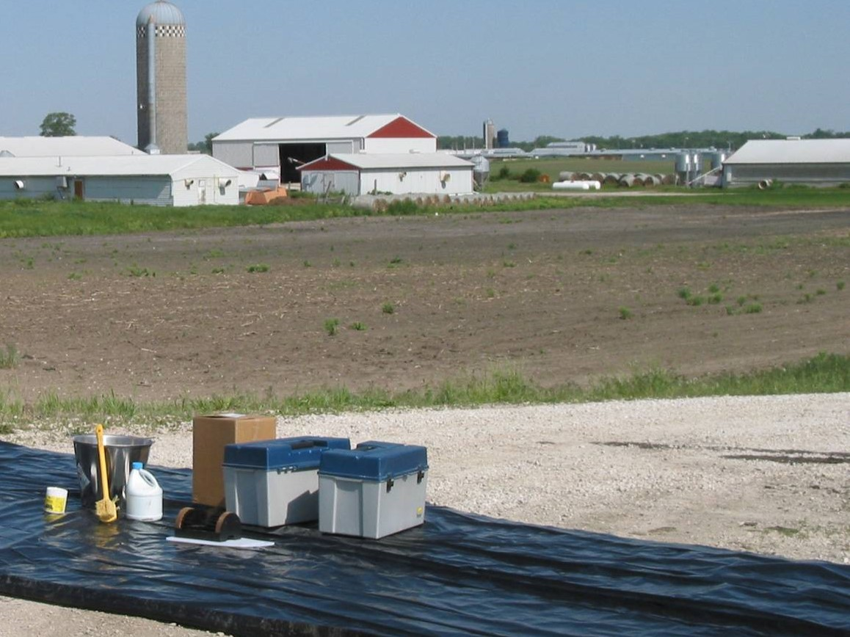
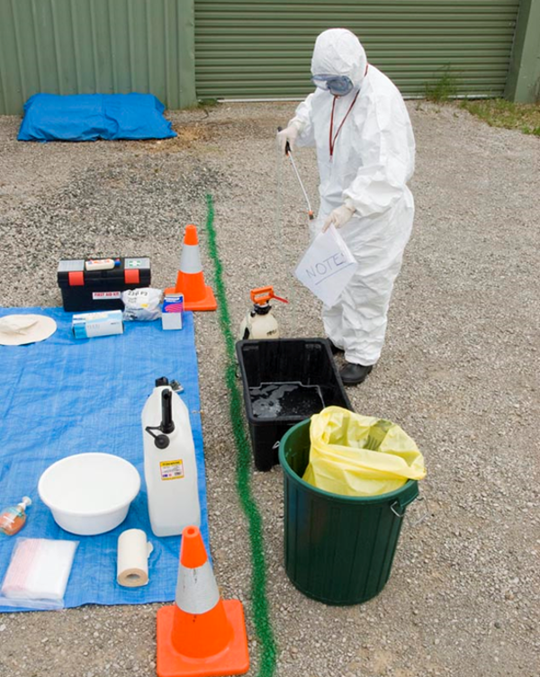
Examples of Clean and Dirty Lines
Notes:
The following are some examples of clean and dirty line setups.
Photo by New South Wales Department of Primary Industries and Regional Development

Slide 18
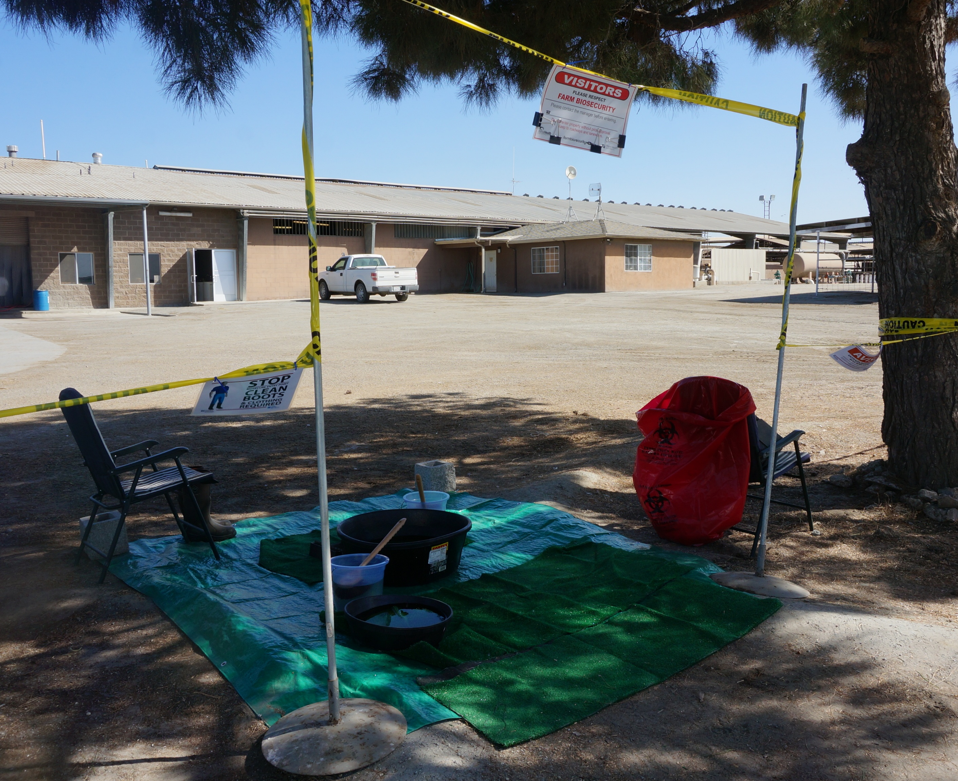
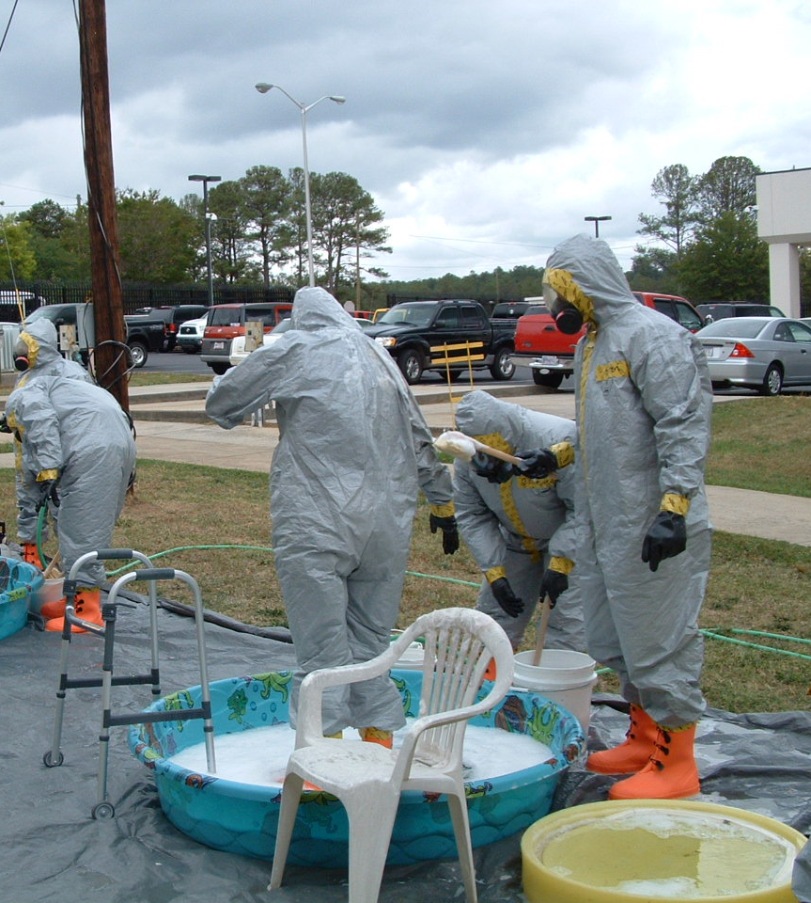
Examples of Clean-Dirty Lines
Notes:
Depending on the size of the response, there may or may not be assistance at the clean-dirty line.
Photos from CFSPH.

Slide 19
Entering at the Clean-Dirty Line
Notes:
Entering at the clean-dirty line

Slide 20
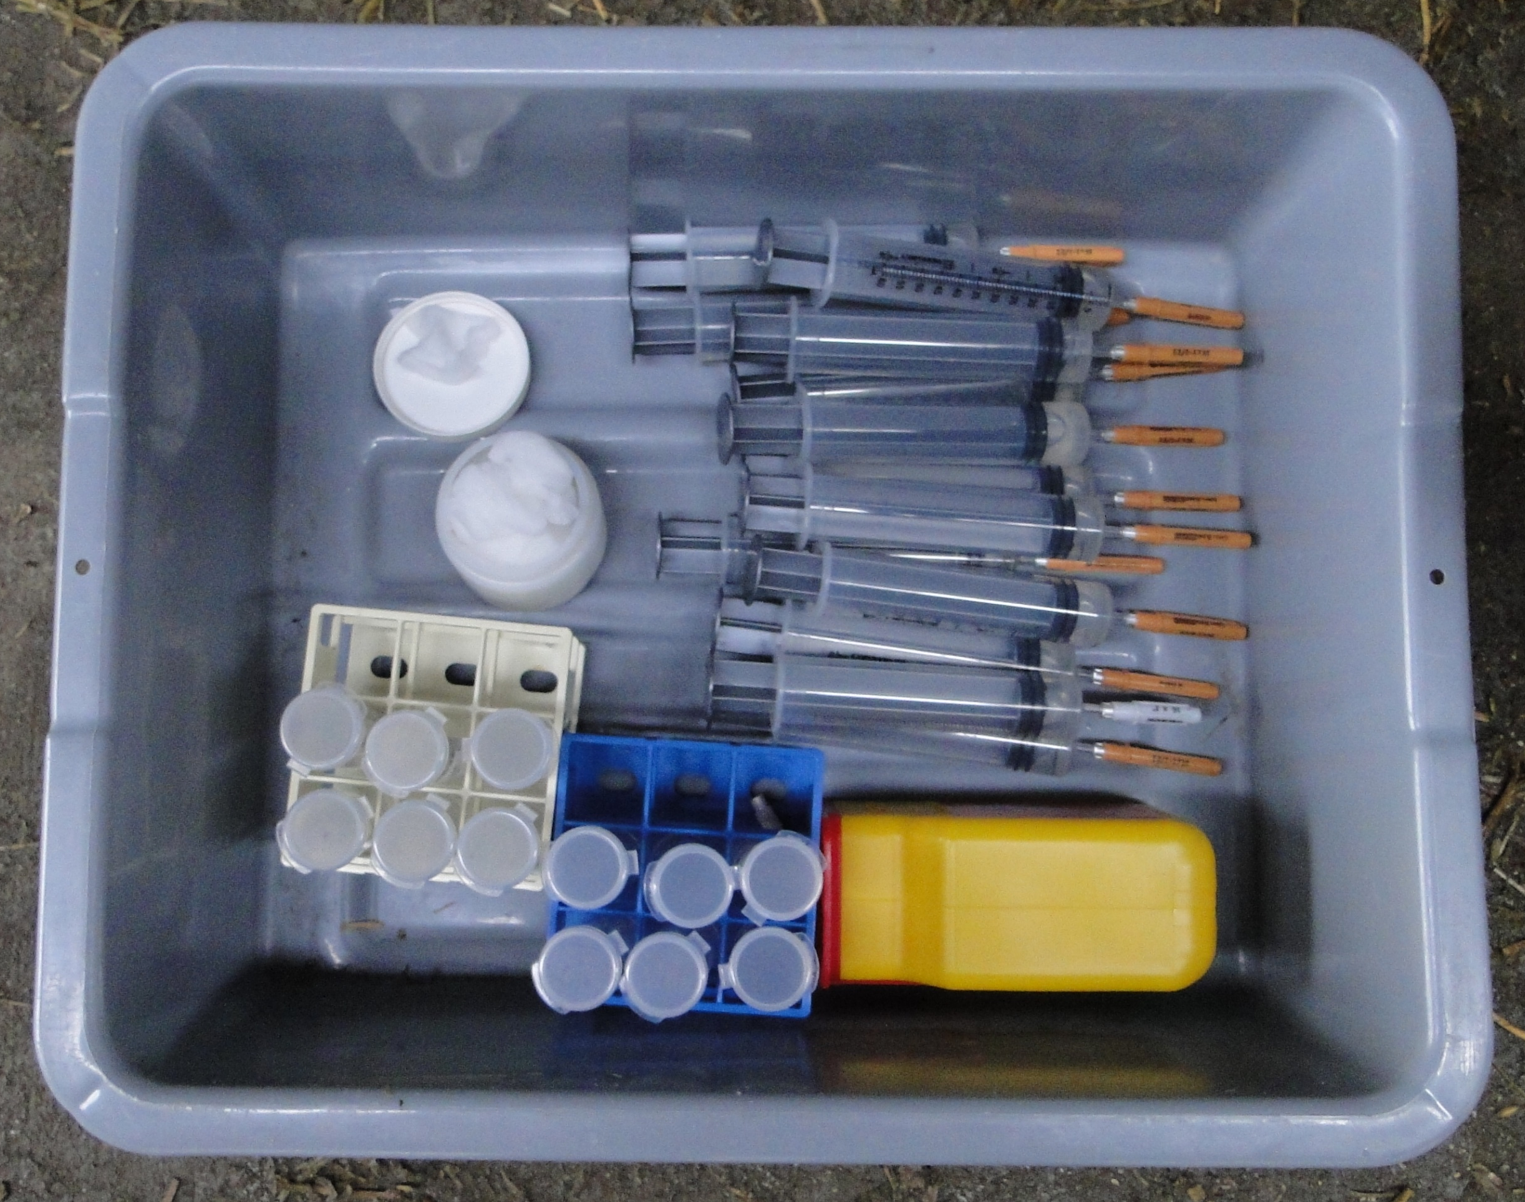
Sampling Supplies
Needles and syringes
Sample collection containers
Sharps container
Sampling containers
Permanent marker
Notes:
Gather any items needed for assigned duties. Pre-label any sampling supplies.
Photo from CFSPH

Slide 21
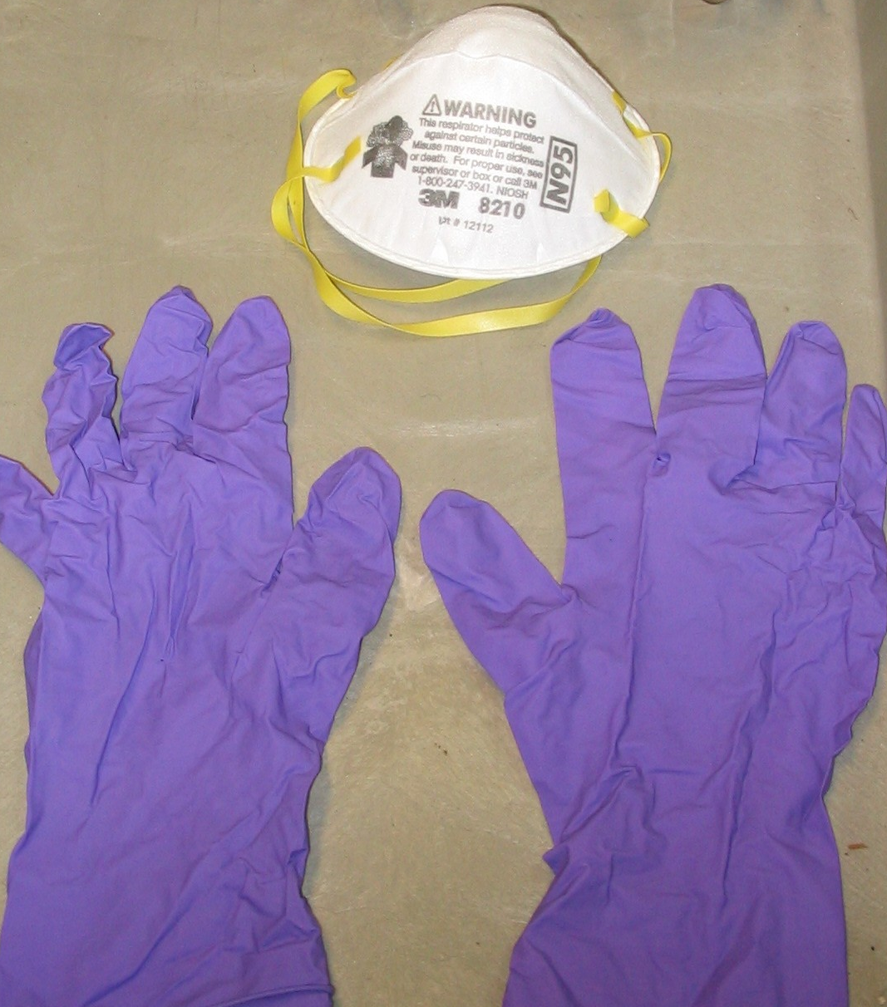
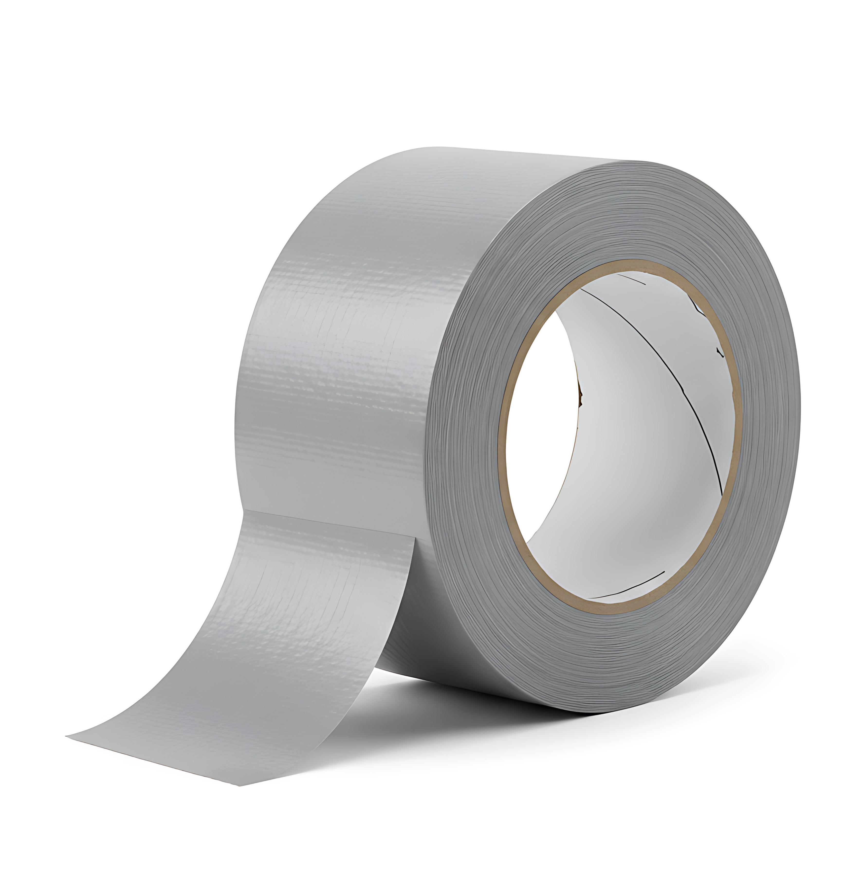
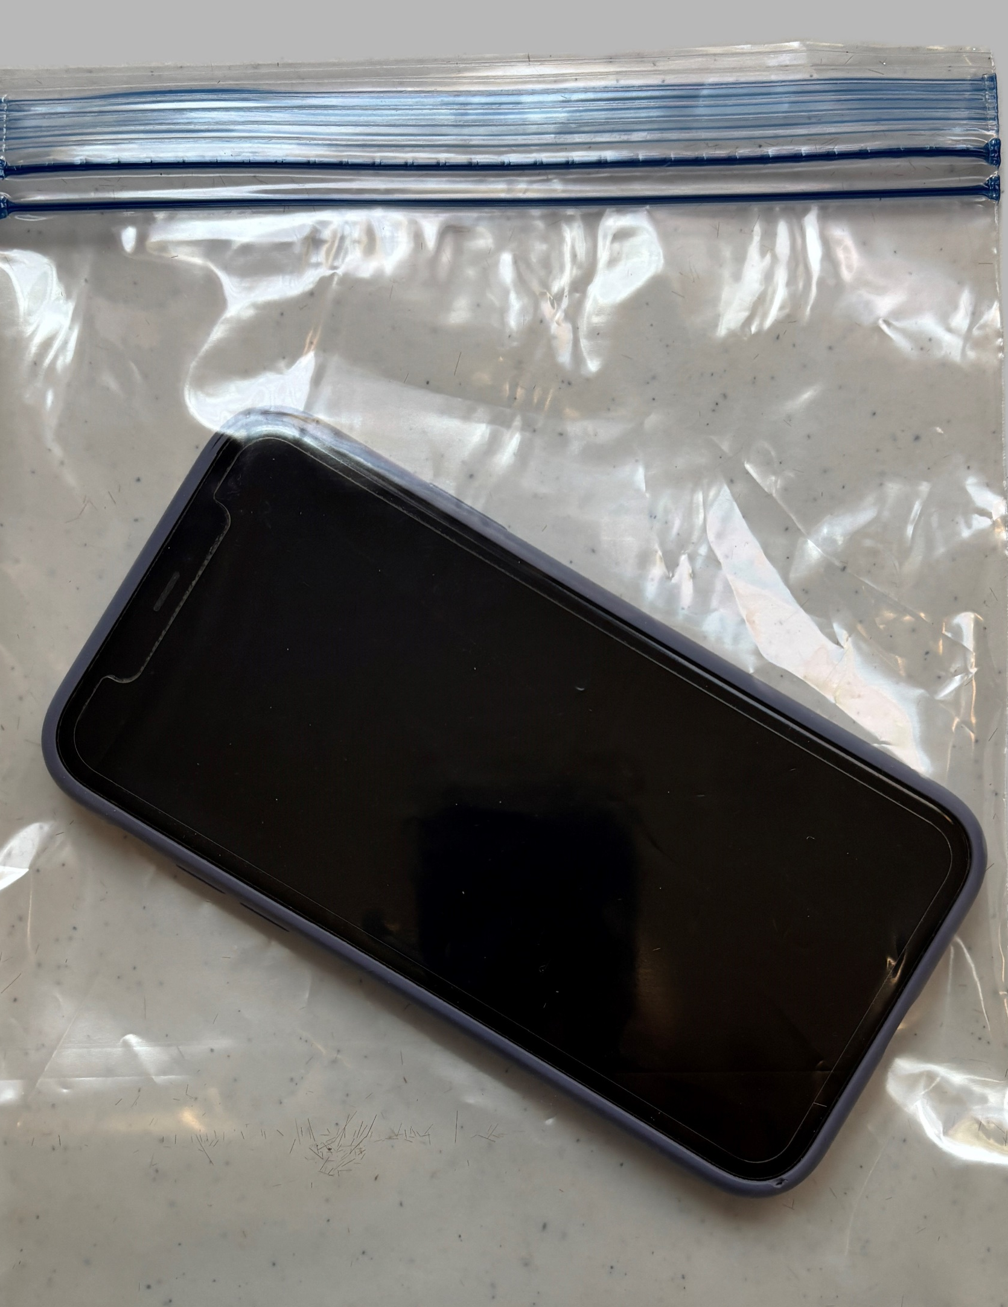
Other Supplies
Extra PPE in case of damage
Duct tape to repair rips
Cell phone in plastic bag
Notes:
Don’t forget to bring extra gloves, masks, and duct tape to repair any PPE rips or tears. Place all items in waterproof plastic bags to allow for disinfection upon exit. If a cell phone is needed, it should also be placed in a waterproof plastic bag.
Left and right photo by CFSPH; duct tape from Adobe Stock

Slide 22
Exiting at the Clean-Dirty Line
Notes:
Exiting at the clean-dirty line

Slide 23
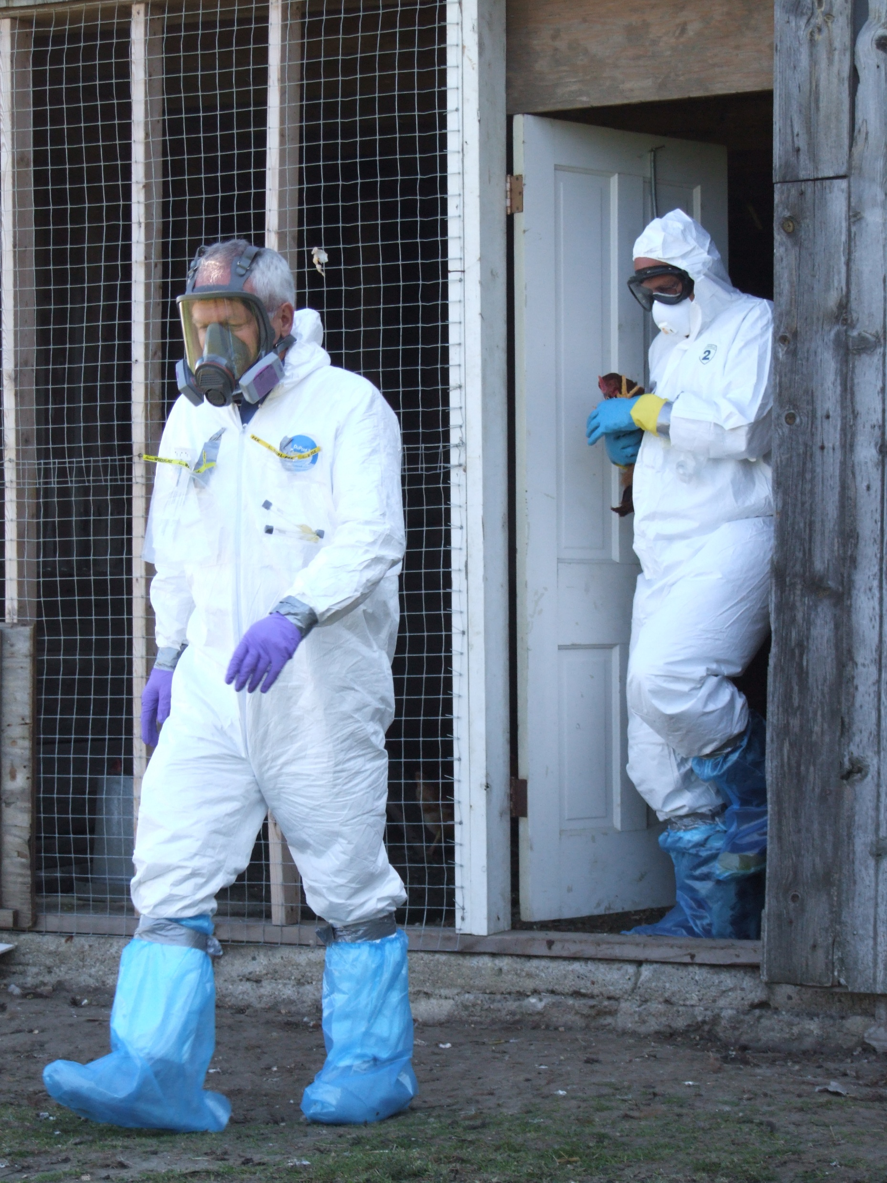
Exiting
All items taken on site, including PPE worn, must be disinfected
or disposed of
on the dirty side before exiting.
Notes:
All items taken on site, including PPE worn, must be disinfected or disposed of on the dirty side before exiting.
Photo from CFSPH/Jane Galyon

Slide 24
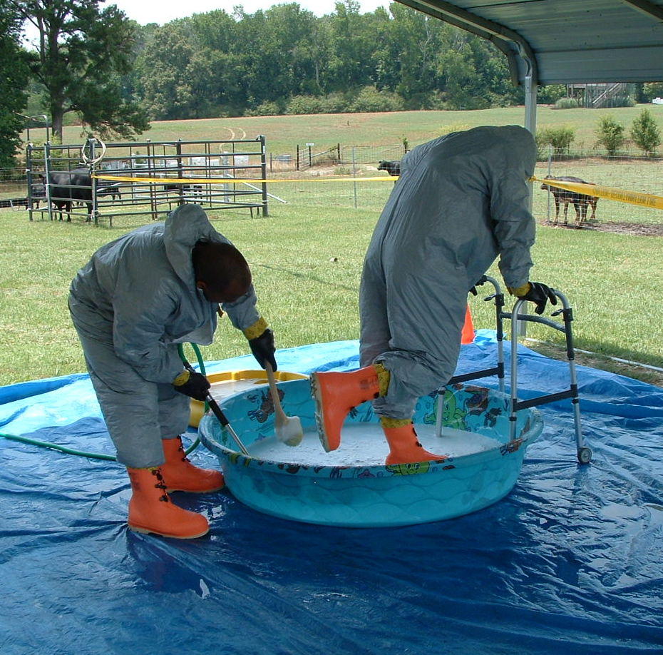
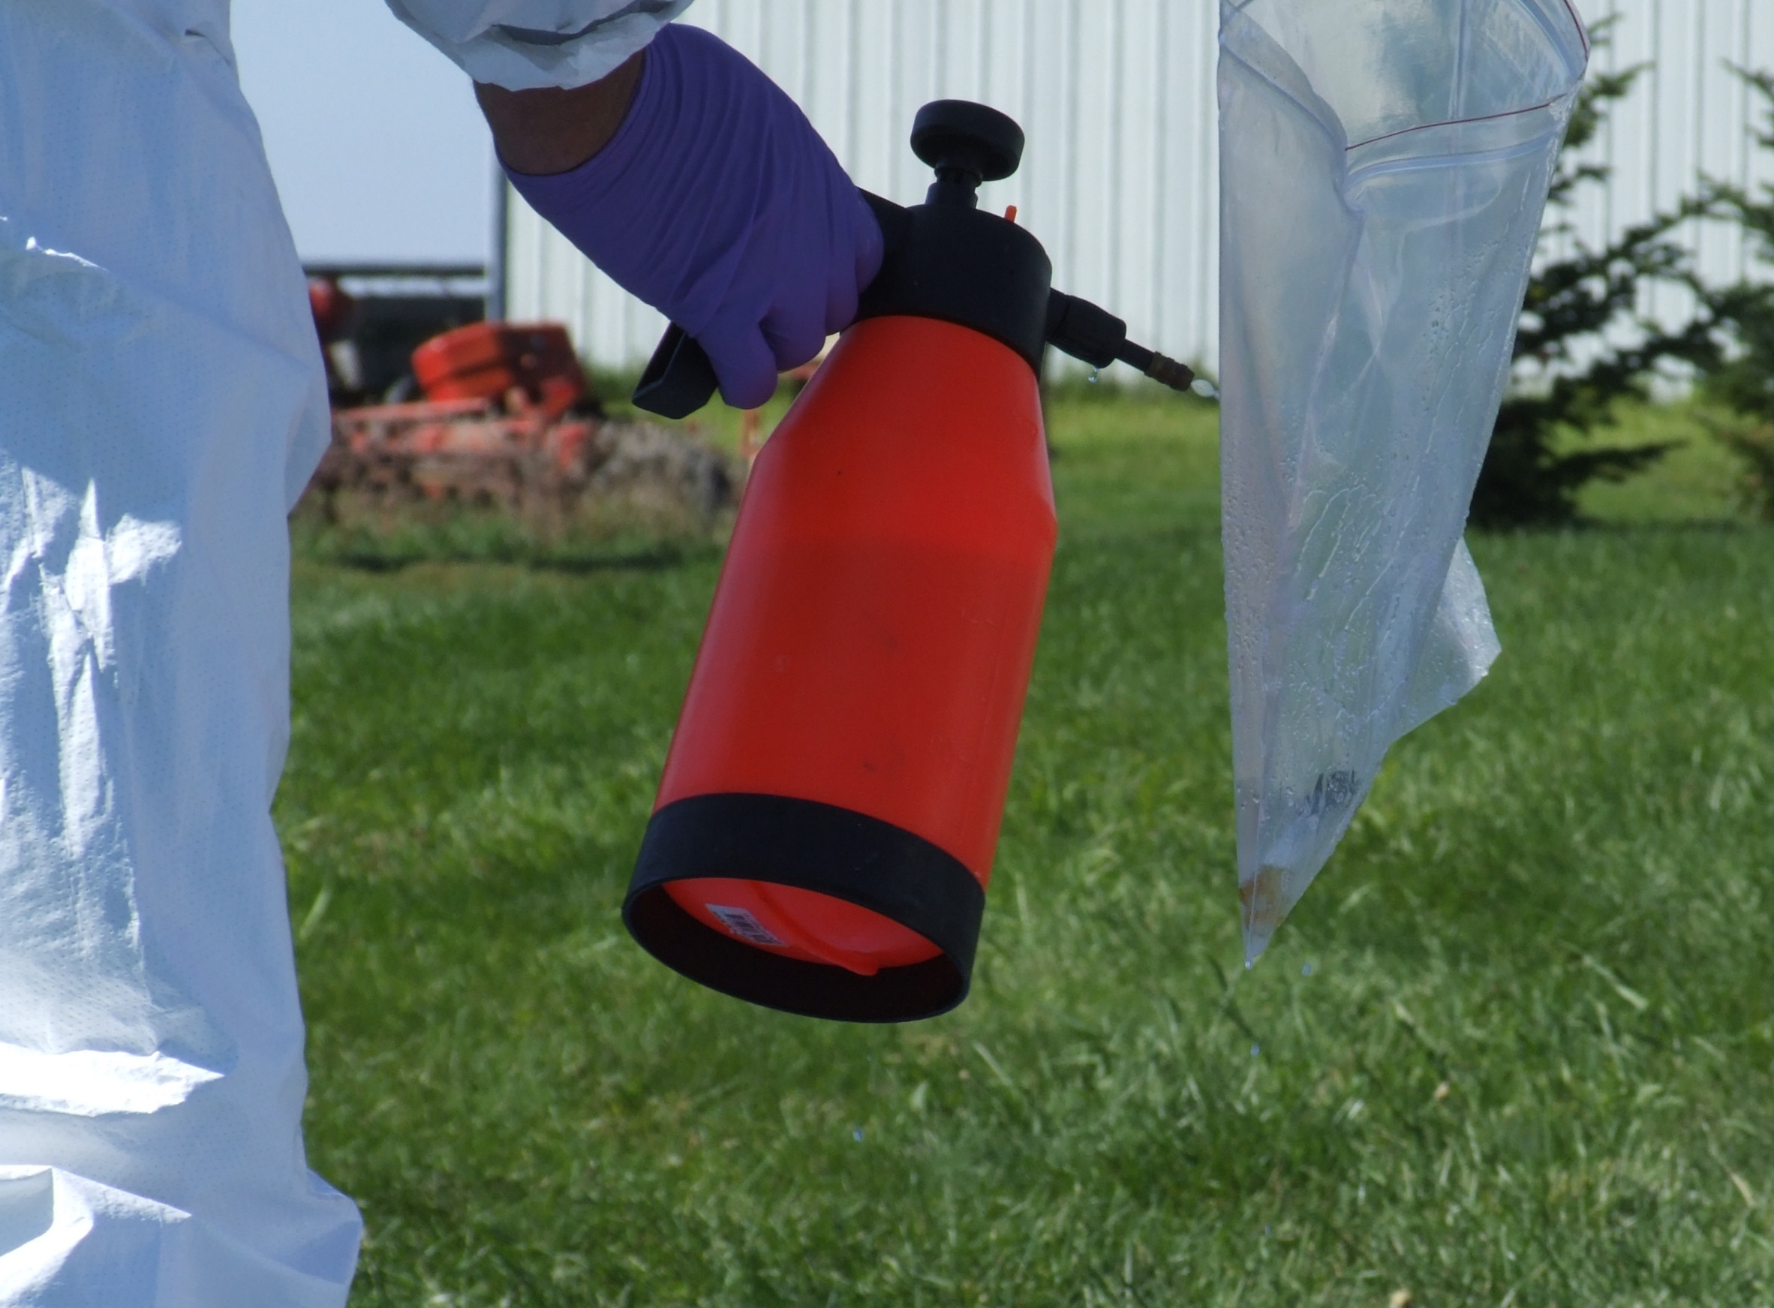
Disinfect PPE and Supplies
Notes:
Thoroughly scrub, clean and disinfect footwear, including the treads, in the footbath. Spray all surfaces of the PPE and other items taken onsite (i.e., supplies or samples in waterproof plastic bags) with the disinfectant-filled garden sprayer.
Photo from CFSPH/Tegwin Taylor and Jane Galyon

Slide 25
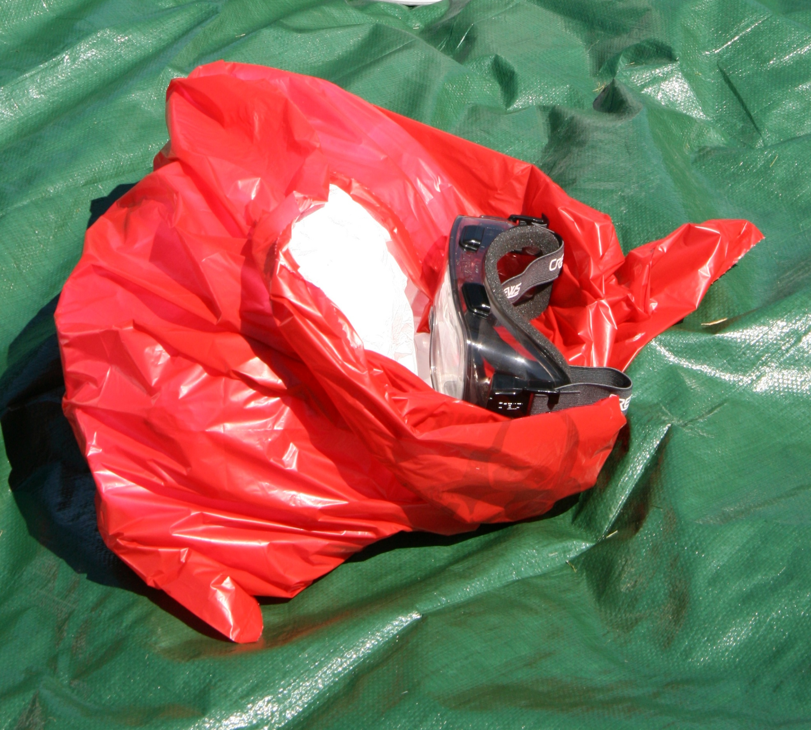
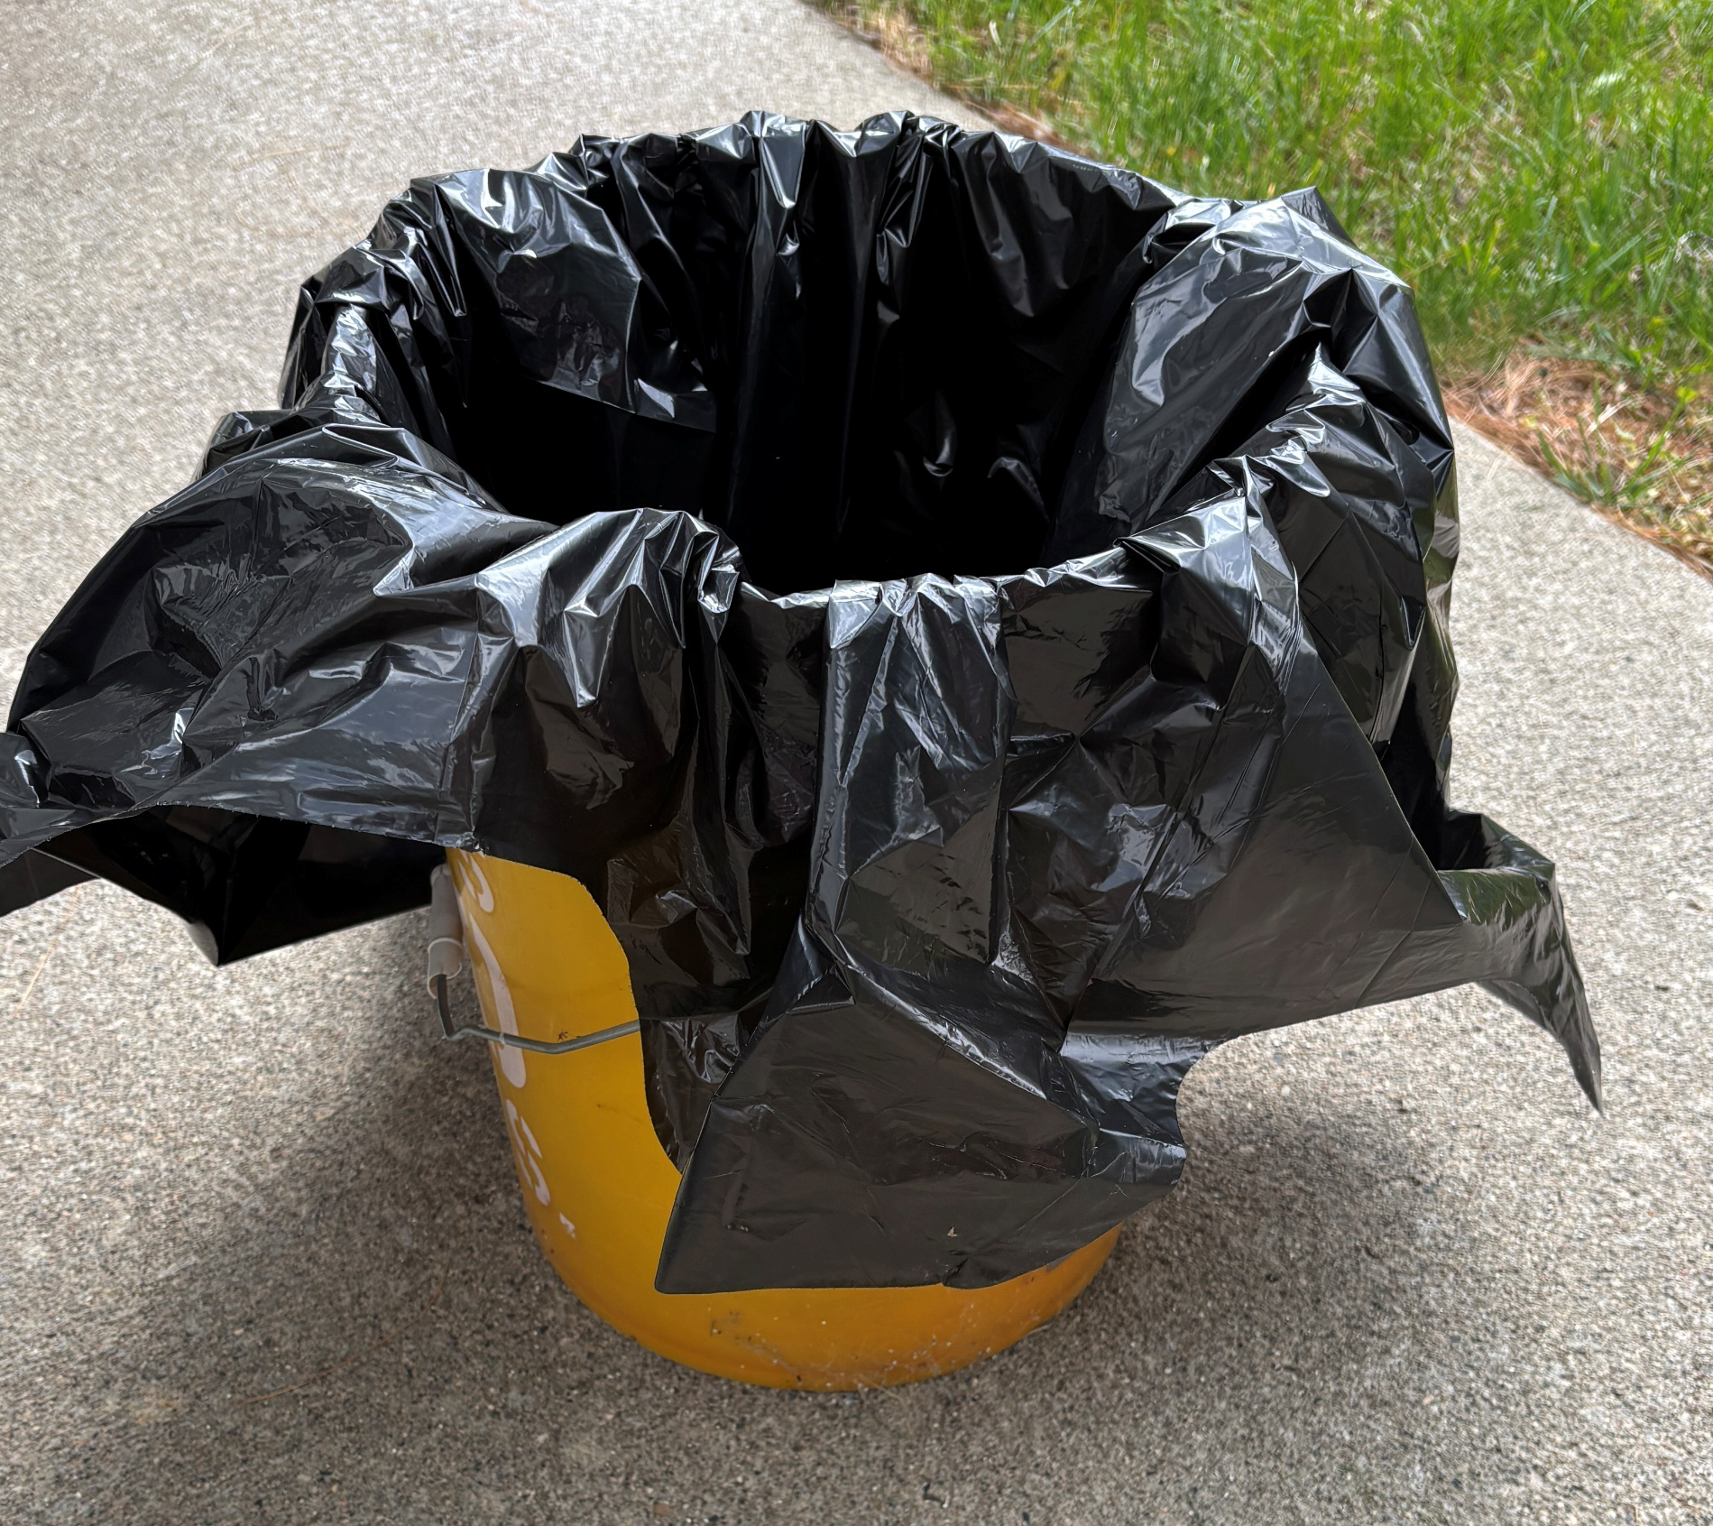
Bag and Disinfect Items
Notes:
Remove PPE and place disposable items, such as duct tape, masks, and your protective suit, in one garbage bag, and reusable items, like respirators and goggles, in another. Seal the garbage bags and spray the entire outer surface of each bag with disinfectant. Place each disposal bag into a second garbage bag placed in the lined plastic buckets. Seal this bag, disinfect the outer surface and place on the clean side of the line. Disinfect boot surfaces again and step onto the clean side.
Photos from CFSPH

Slide 26
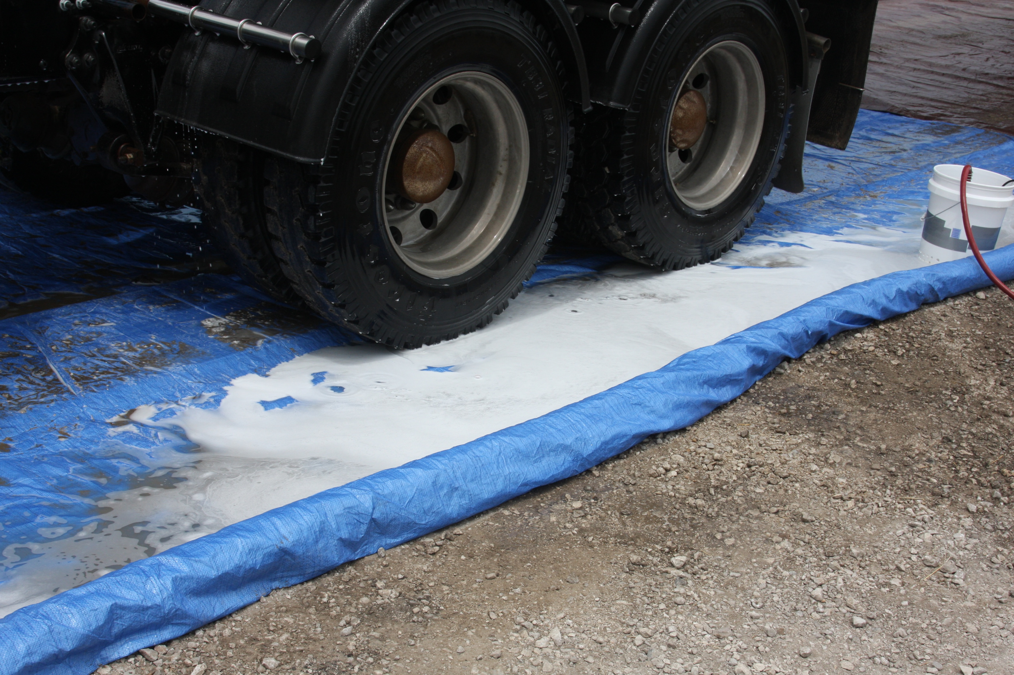
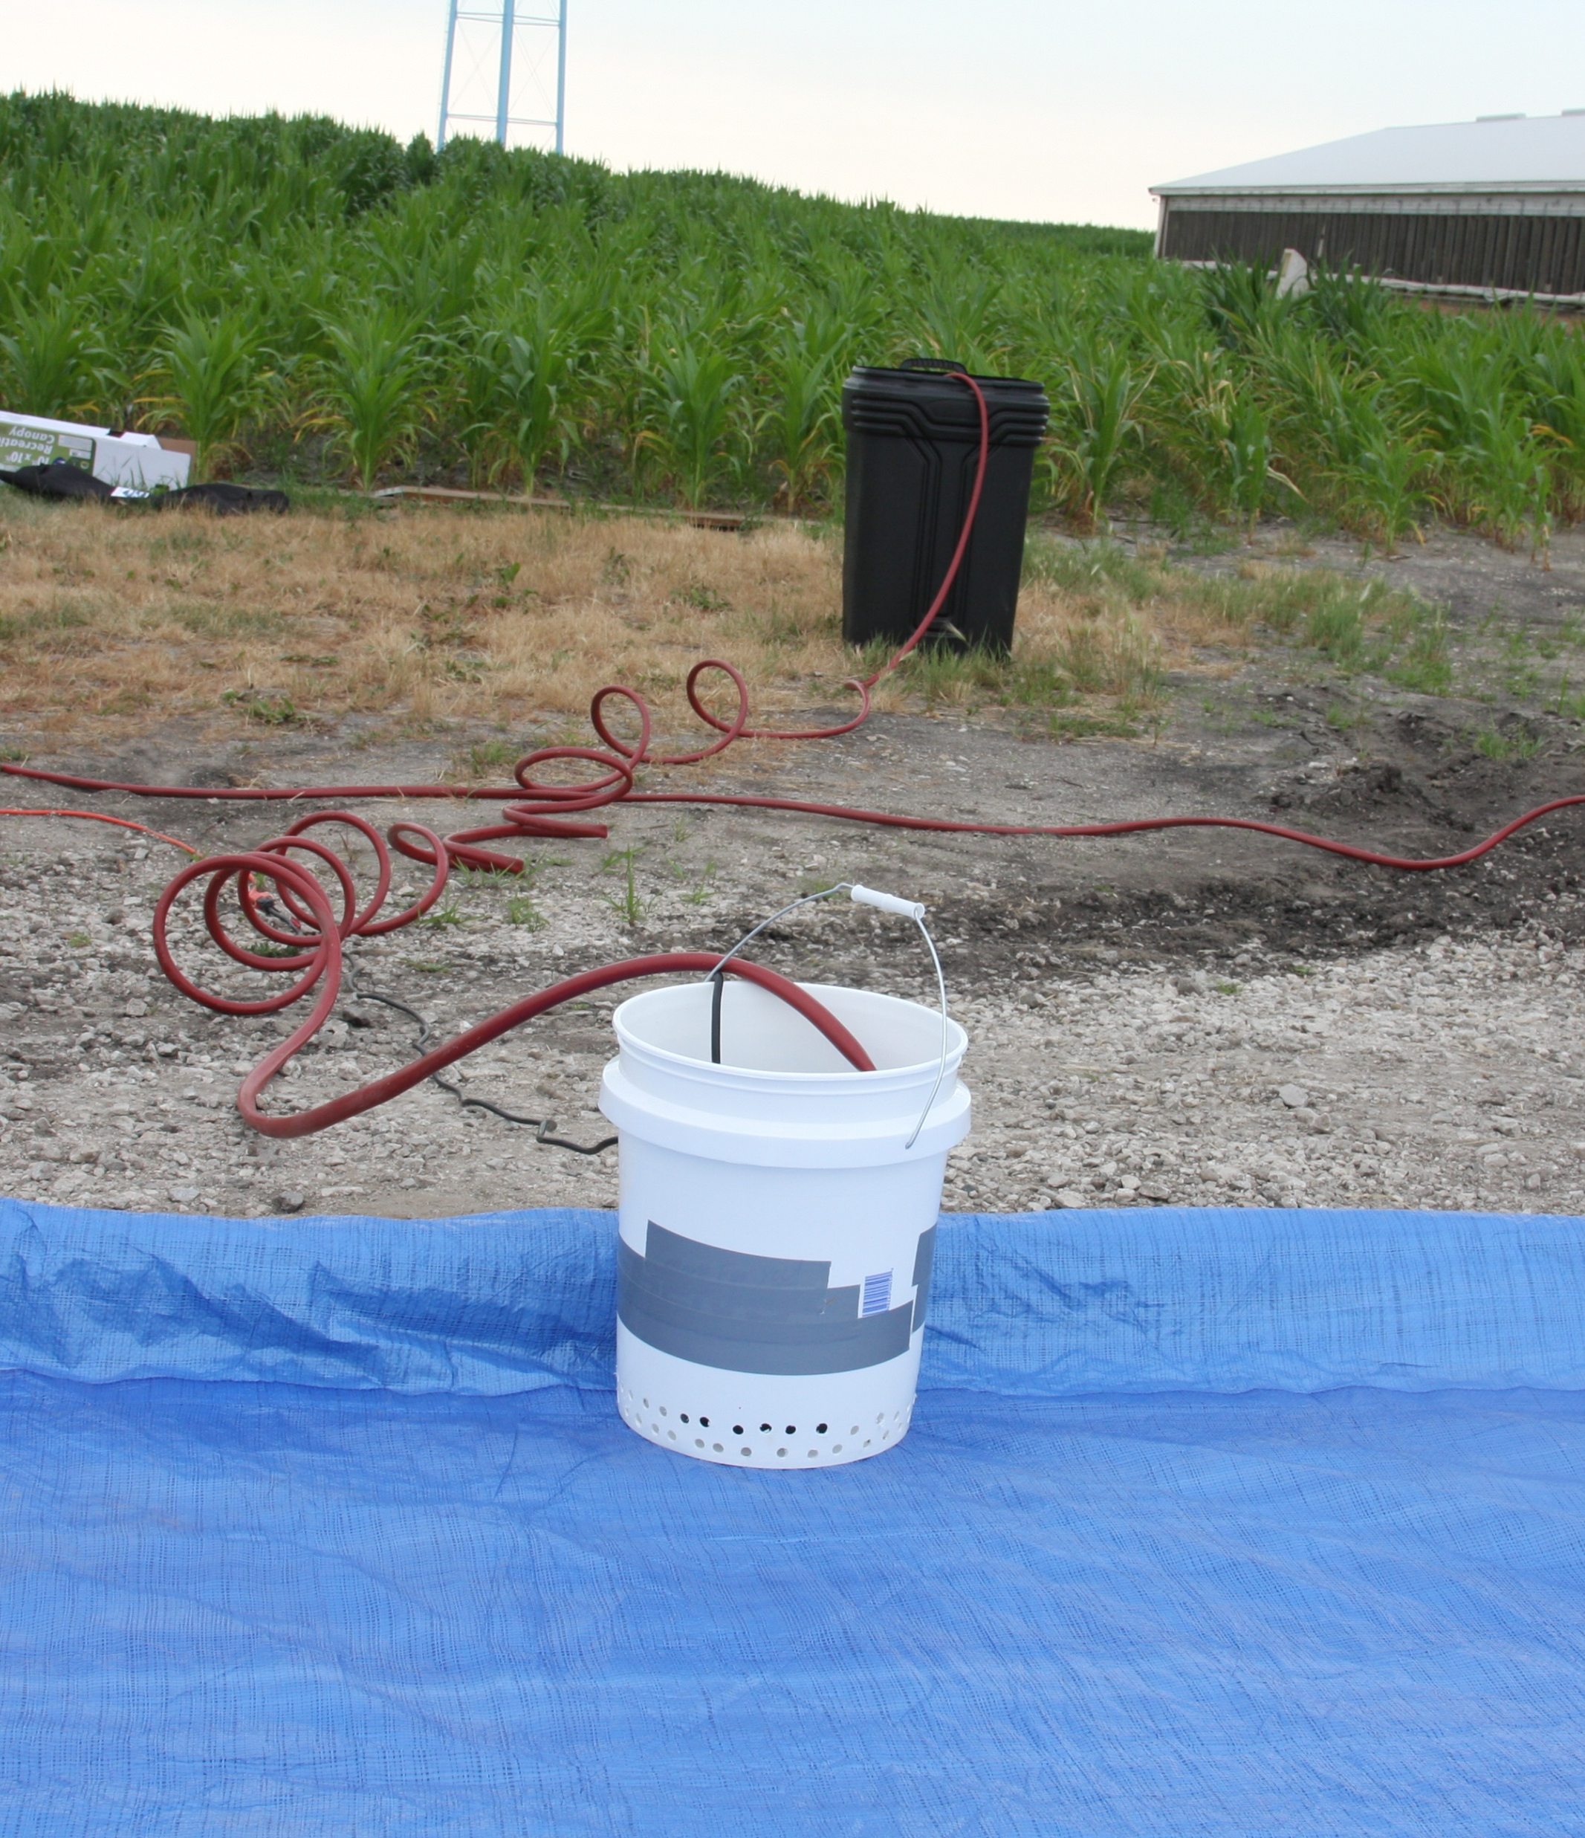
Contain Disinfectant Wastewater
Notes:
For vehicles exiting, wastewater from the disinfection process will need to be captured.
Photos from CFSPH

Slide 27
A Clean-Dirty Line
Remember
DIRTY SIDE
CLEAN-DIRTY LINE
CLEAN SIDE
Notes:
The clean-dirty line is set up at the farm entry point. No other farm entrances can be used to access animal areas during an animal health emergency.
Responders must follow steps for biosecure entry or exit every time they cross the clean-dirty line.
Photo from CFSPH

Slide 28

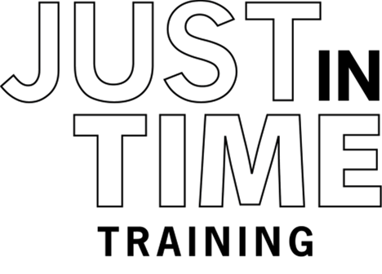

For More Information
Notes:
For more information on donning and doffing Level C PPE and setting up a vehicle clean-dirty area , follow this QR code to the Just in Time Training website.

Slide 29
Acknowledgements
Development of this material was made possible through a grant provided to
the Center for Food Security and Public Health at Iowa State University, College of Veterinary Medicine from
the U.S. Department of Agriculture (USDA) Animal and Plant Health Inspection Service through the National Animal Disease Preparedness and Response Program (NADPRP)
Notes:
Development of this material was made possible through a grant provided to the Center for Food Security and Public Health at Iowa State University, College of Veterinary Medicine from the U.S. Department of Agriculture Animal and Plant Health Inspection Service through the National Animal Disease Preparedness and Response Program.

