Slide 1



Personal Protective Equipment
PPE Overview
Notes:
Personal protective equipment, or PPE, is needed during animal health emergencies to prevent disease transfer from animals, locations, and responders.

Slide 2


Just in Time Training
Notes:
This Just-In-Time training module will overview the types and levels of PPE and highlights those frequently used in an animal disease emergency.

Slide 3
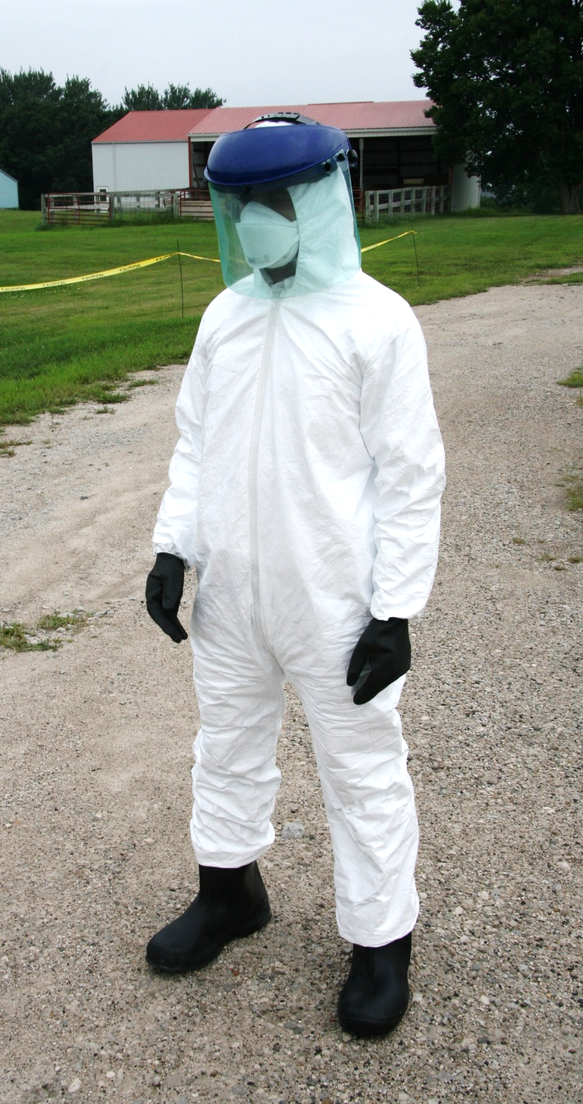
PPE
Personal Protective Equipment
special clothing and equipment worn
as a barrier
between an individual and a hazard
Notes:
Personal protective equipment is specialized clothing and equipment worn as a barrier between an individual and a hazard.
Photo from Andrew Kingsbury/CFSPH

Slide 4
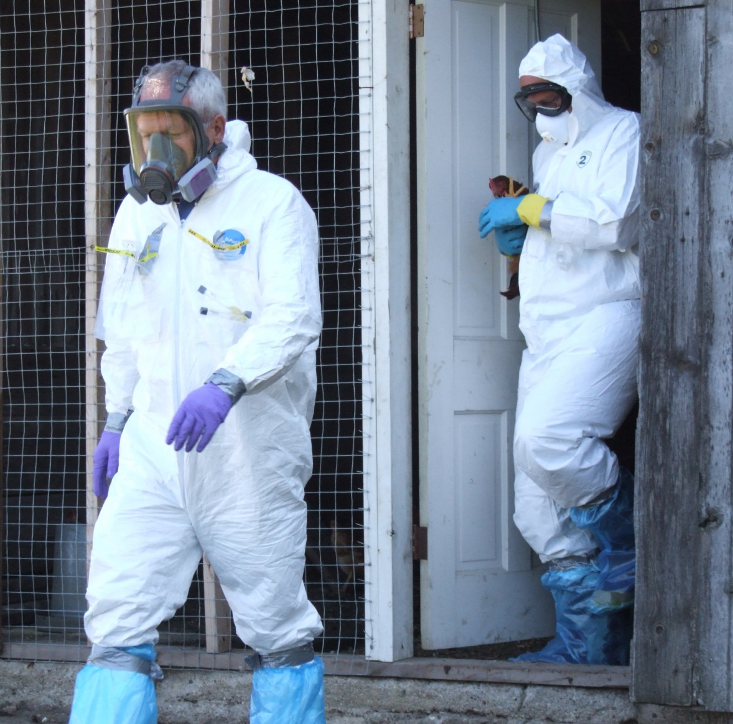
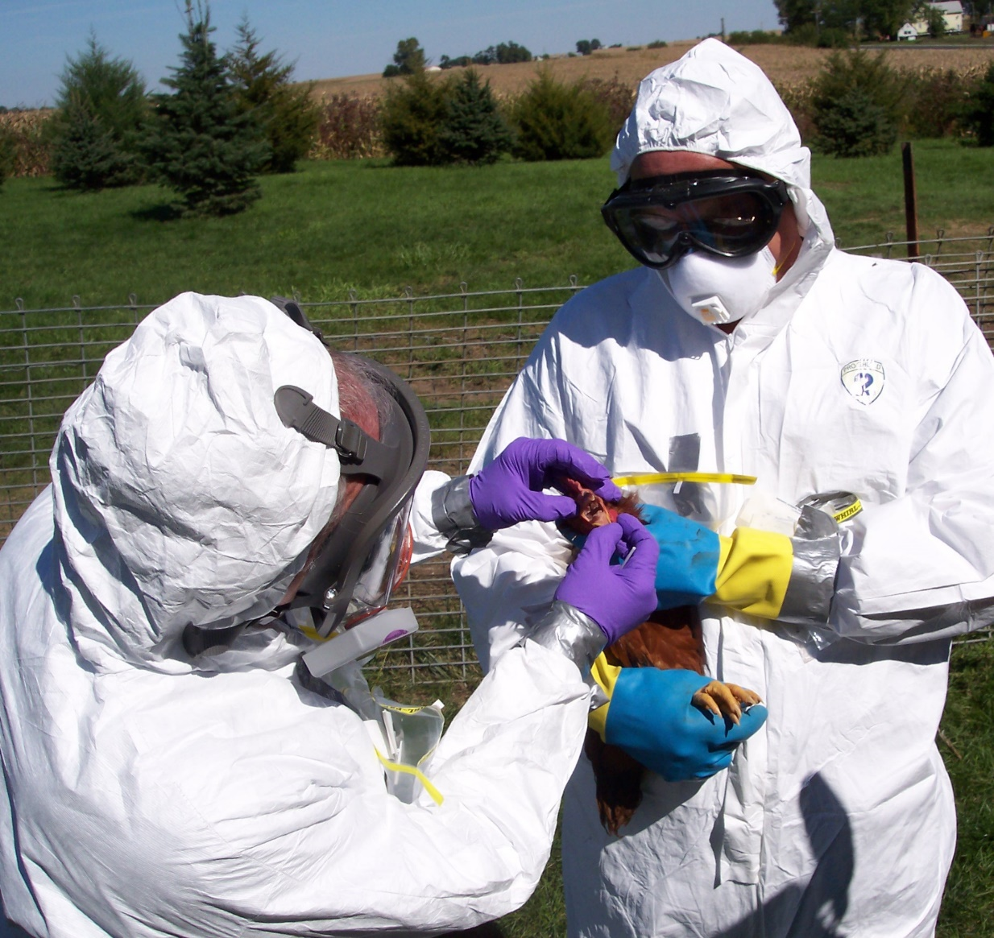
Biosecurity
During Animal Disease Emergencies
Responder Protection
Notes:
During animal disease emergencies, PPE serves two essential purposes:
Biosecurity: to prevent the spread of disease agents between animals and locations, and
Responder protection: to protect the responder against potential hazards, such as chemical exposure or zoonotic organisms that can infect people.
Photos from Jane Galyon/CFSPH

Slide 5


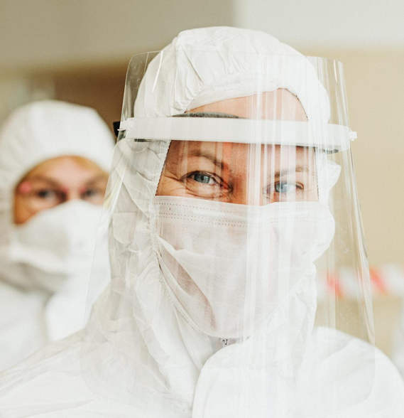
Types of PPE Protection
Skin
Respiratory
Eyes/Face
Notes:
PPE provides protective measures for the skin, respiratory system, eyes, and face.
Photos from Articulate Storyline

Slide 6
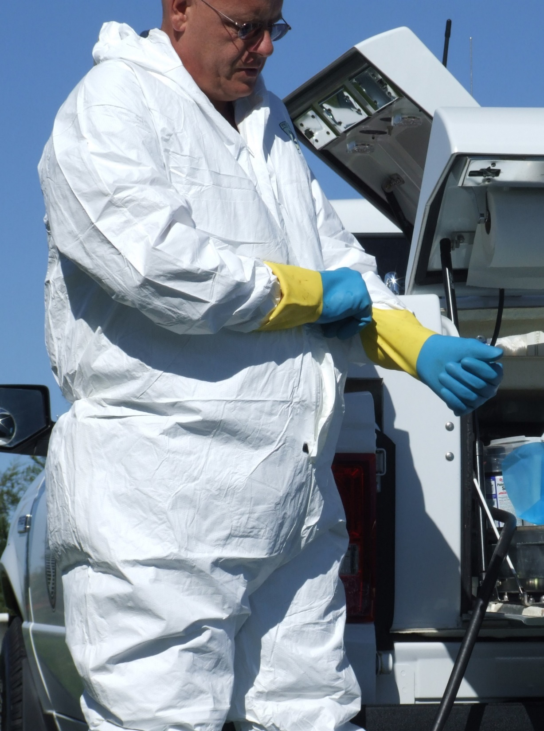
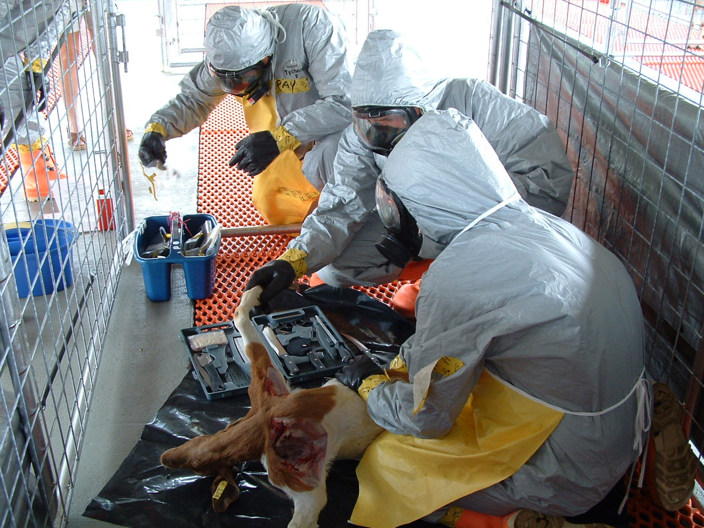
Skin Protection
Notes:
Skin protection will include items such as protective coveralls, aprons, gloves, and footwear, such as rubber boots. These items may need to be fluid-resistant or chemical-resistant.
Photo from Jane Galyon and Tegwin Taylor/CFSPH

Slide 7
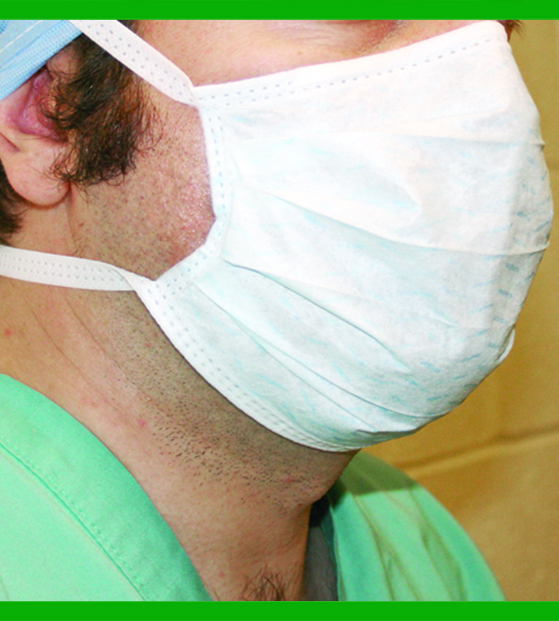
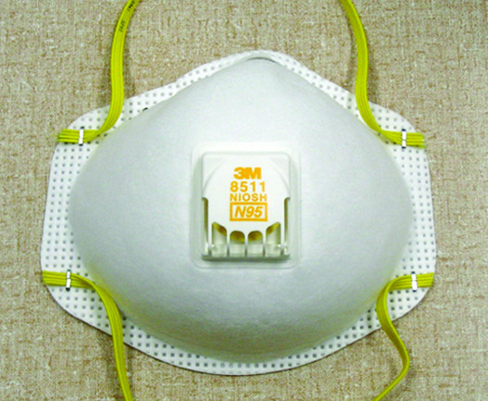
Respiratory Protection
Notes:
Respiratory protection can include dust or surgical masks, or disposable particulate filtering facepiece respirators, such as an N-95 mask.
Photos from Dani Ausen/CFSPH

Slide 8
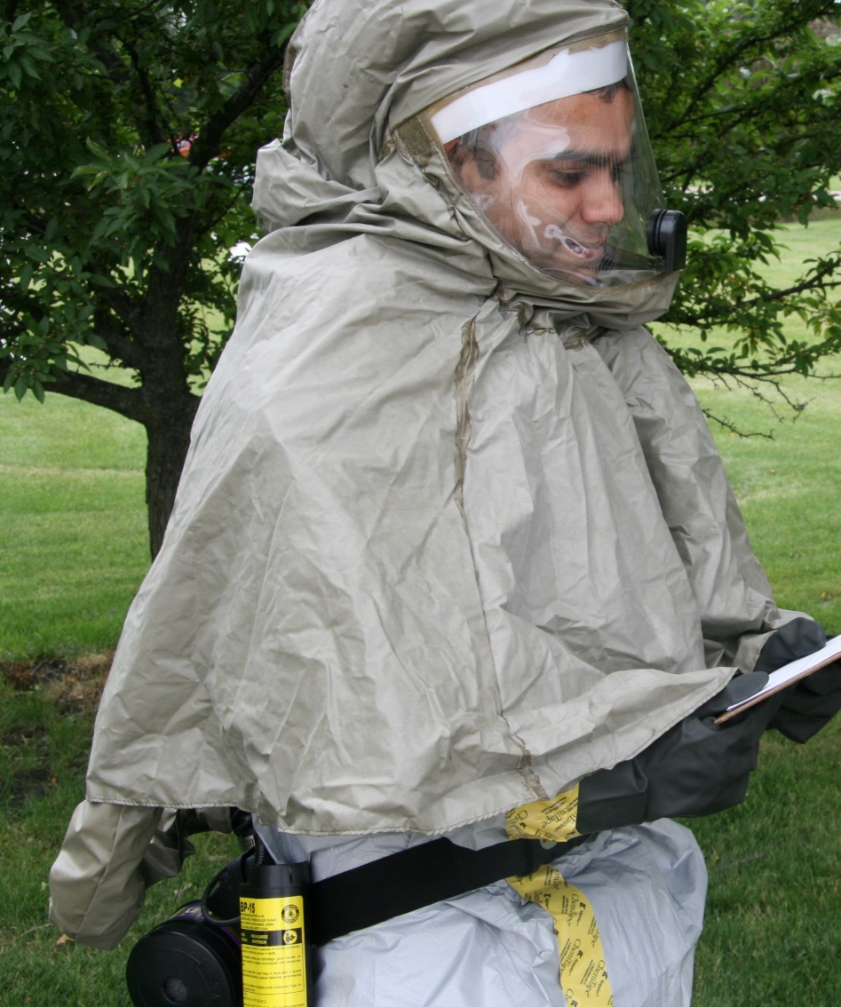
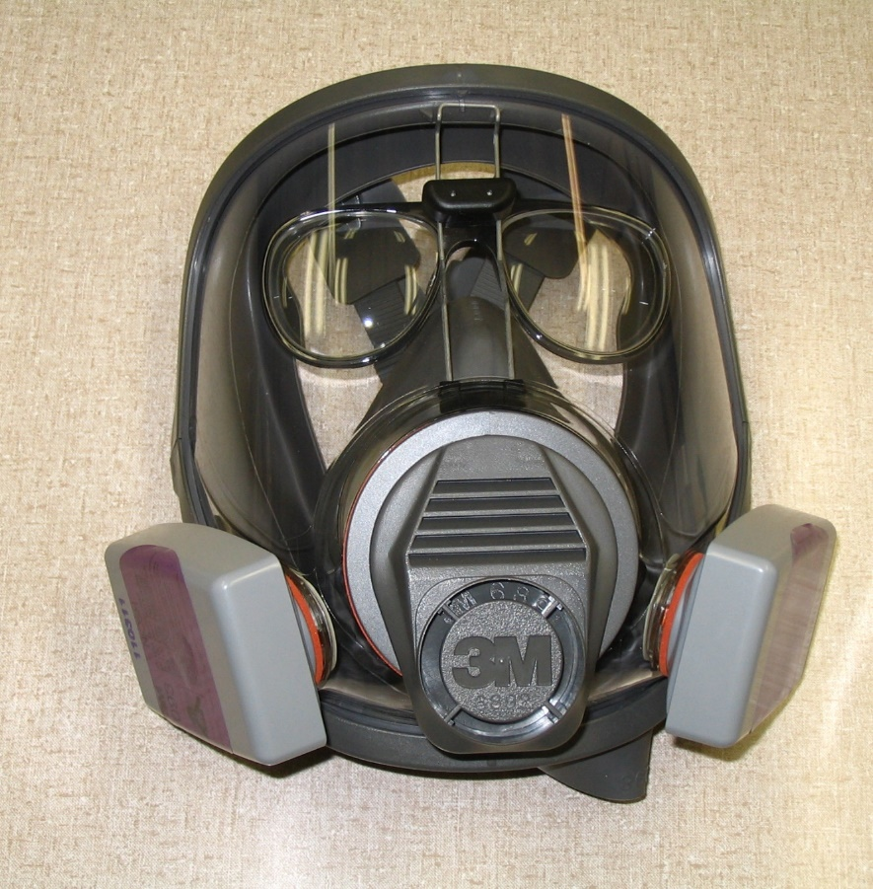
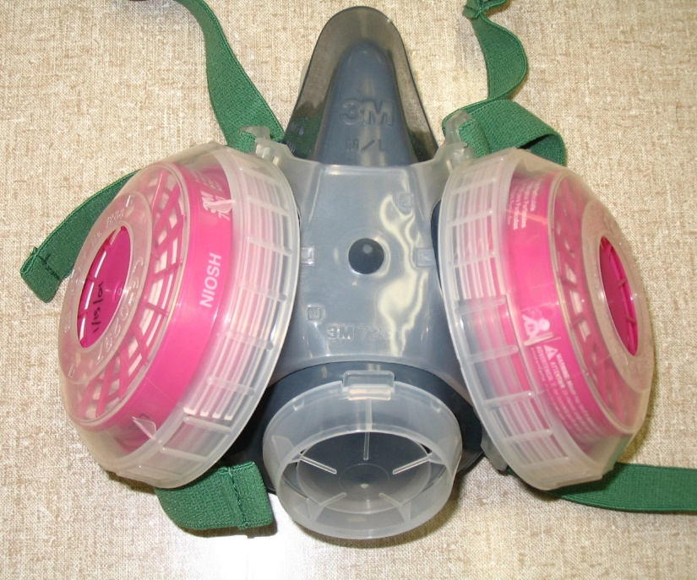
Respiratory Protection:
Higher Level
Notes:
Reusable, air-purifying respirators, which may be half-face or full face, provide additional protection and a self-contained breathing apparatus will be needed for higher protection levels.
Photos from Dani Ausen and Andrew Kingsbury/CFSPH

Slide 9
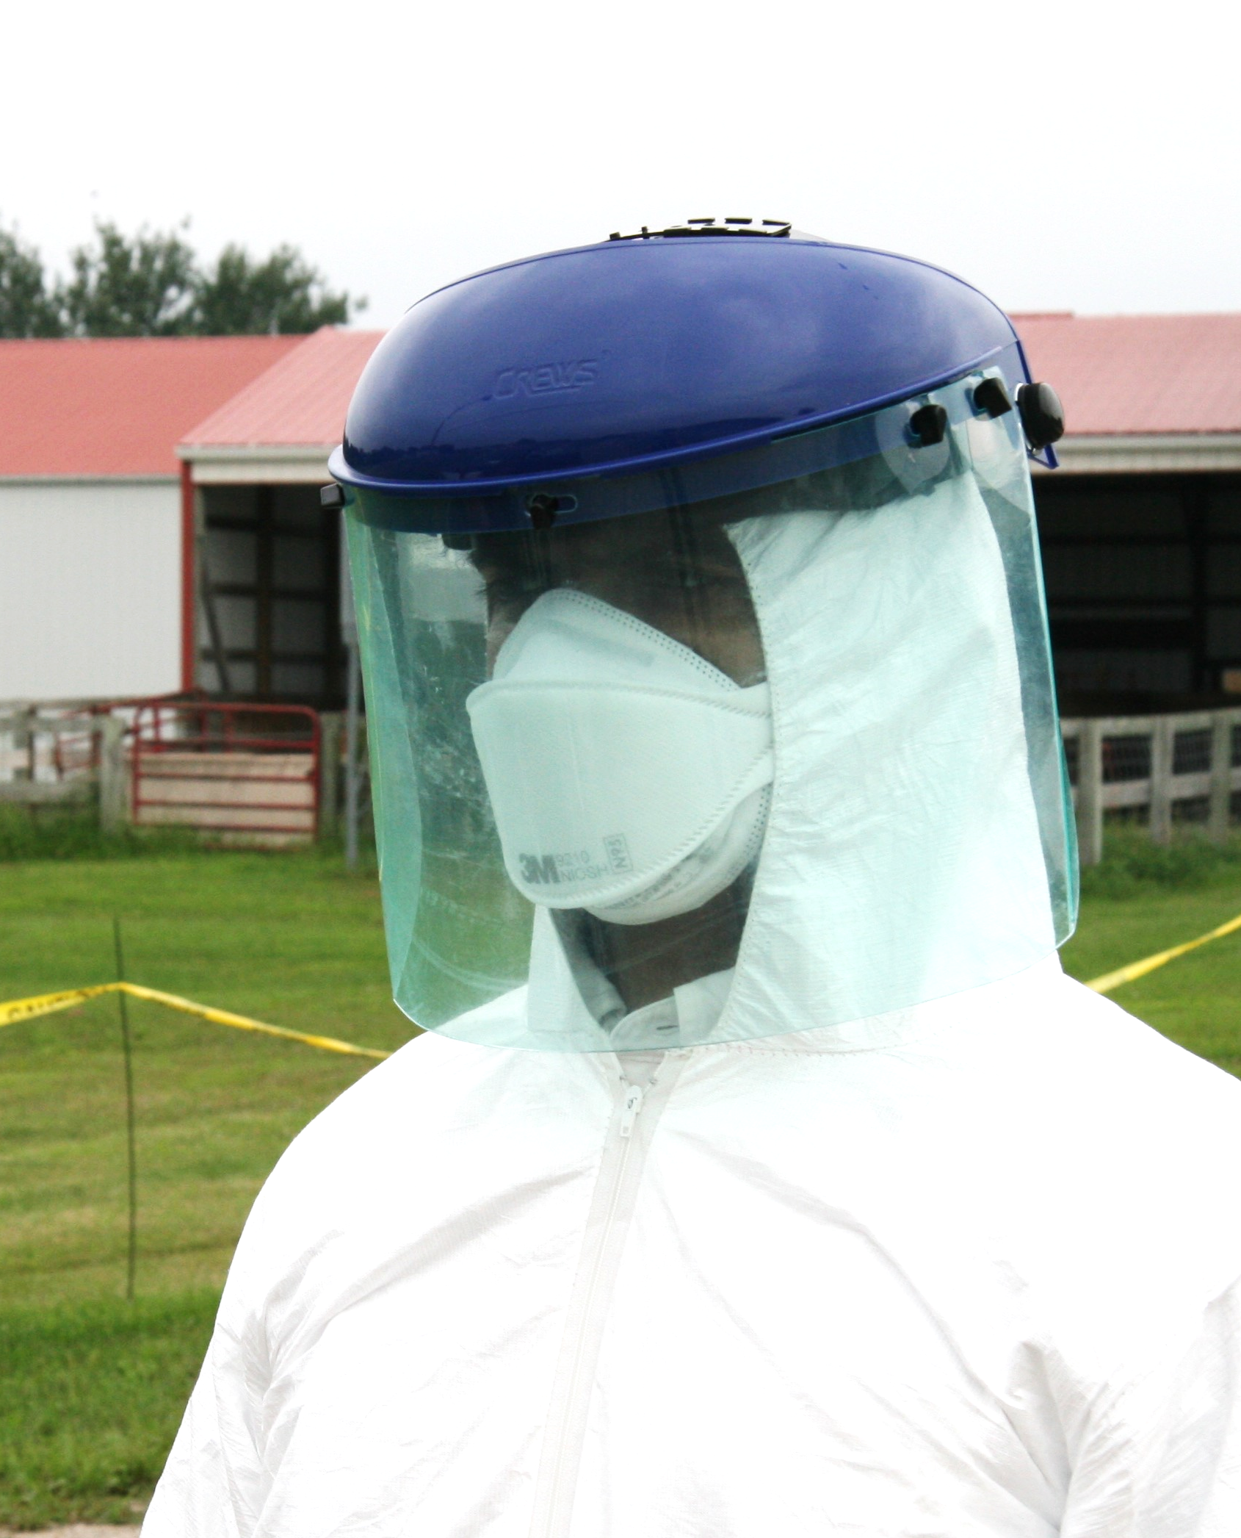
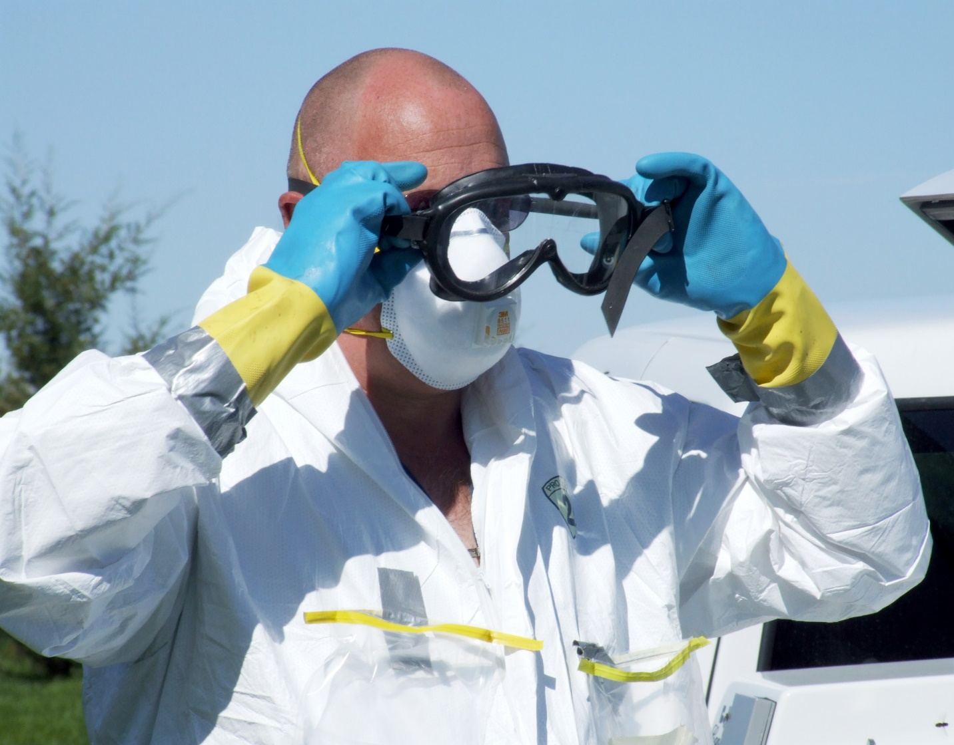
Eyes and Face Protection
Notes:
Protection of the eyes and face includes safety glasses or goggles, and in some instances, the addition of a face shield. In some settings, hearing protection, such as ear plugs or ear muffs may be needed.
Photos from Jane Galyon and Andrew Kingsbury/CFSPH

Slide 10
Levels of PPE
Levels of Protection
Increasing
Level of Risk
Level A
Level A
Highest level of protection
Level B
Level C
Level D
Level D
Lowest level of protection
Notes:
All these items are combined into four levels of PPE - Levels A, B, C, and D. Different levels of PPE may be needed depending on the situation, disease risks, and tasks performed. Level D is the lowest level of protection, while Level A is the highest.

Slide 11
Levels of PPE
Increasing
Level of Risk
Level A
Requires more specialized equipment (e.g., air-purifying respirators or SCBA)
Level B
Level C
Generally used for animal disease emergencies
Level D
Notes:
Levels A and B are used when expanded levels of protection are required, such as for certain disinfectant chemicals or highly zoonotic pathogens and involve the use of specialized equipment such as air-purifying respirators, a self-contained breathing apparatus, or encapsulating chemical protective suits.
Levels C and D are sufficient for most animal health emergency response activities and will be described next in this training video.

Slide 12
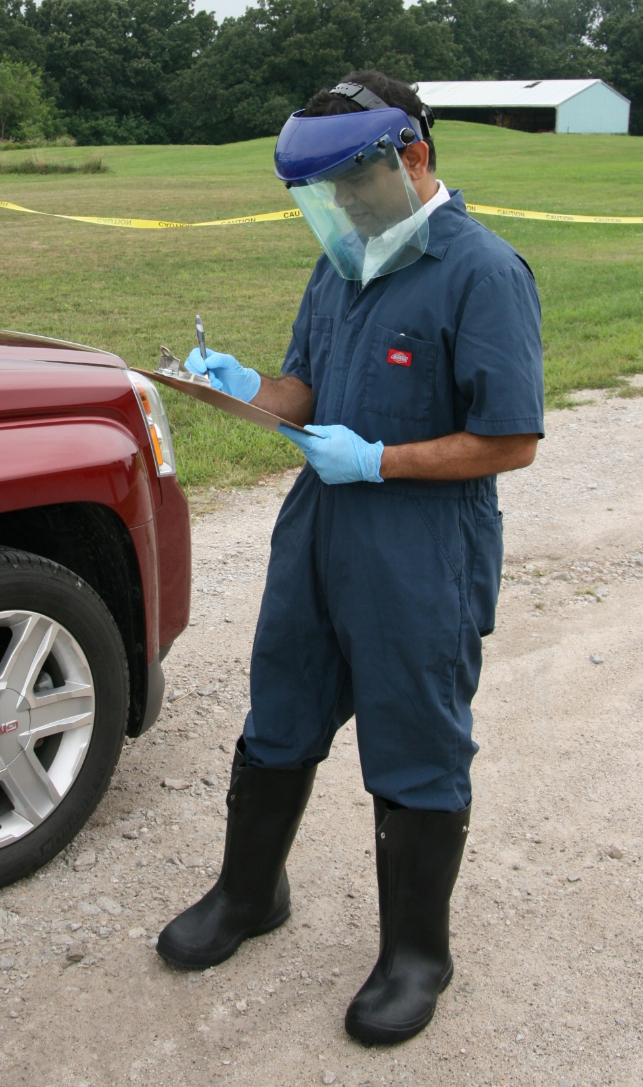
Level D
Level D
Worn when there is no risk
of skin contamination, respiratory threat or hazardous material contact
Cloth coveralls or street clothes
No to low respiratory protection
Optional:
  Gloves, goggles, face shields
Notes:
Level D is worn when there is no risk of skin contamination, respiratory threat, or hazardous material contact. It is generally worn by those onsite who will not have direct contact with animals, animal waste or products, or responders exiting the response site. It includes minimal skin protection, such as cloth coveralls or street clothing, and no to low respiratory protection, such as surgical or dust masks. Gloves, goggles, or face shields are optional, depending on the tasks performed.
Photo from Andrew Kingsbury/CFSPH

Slide 13
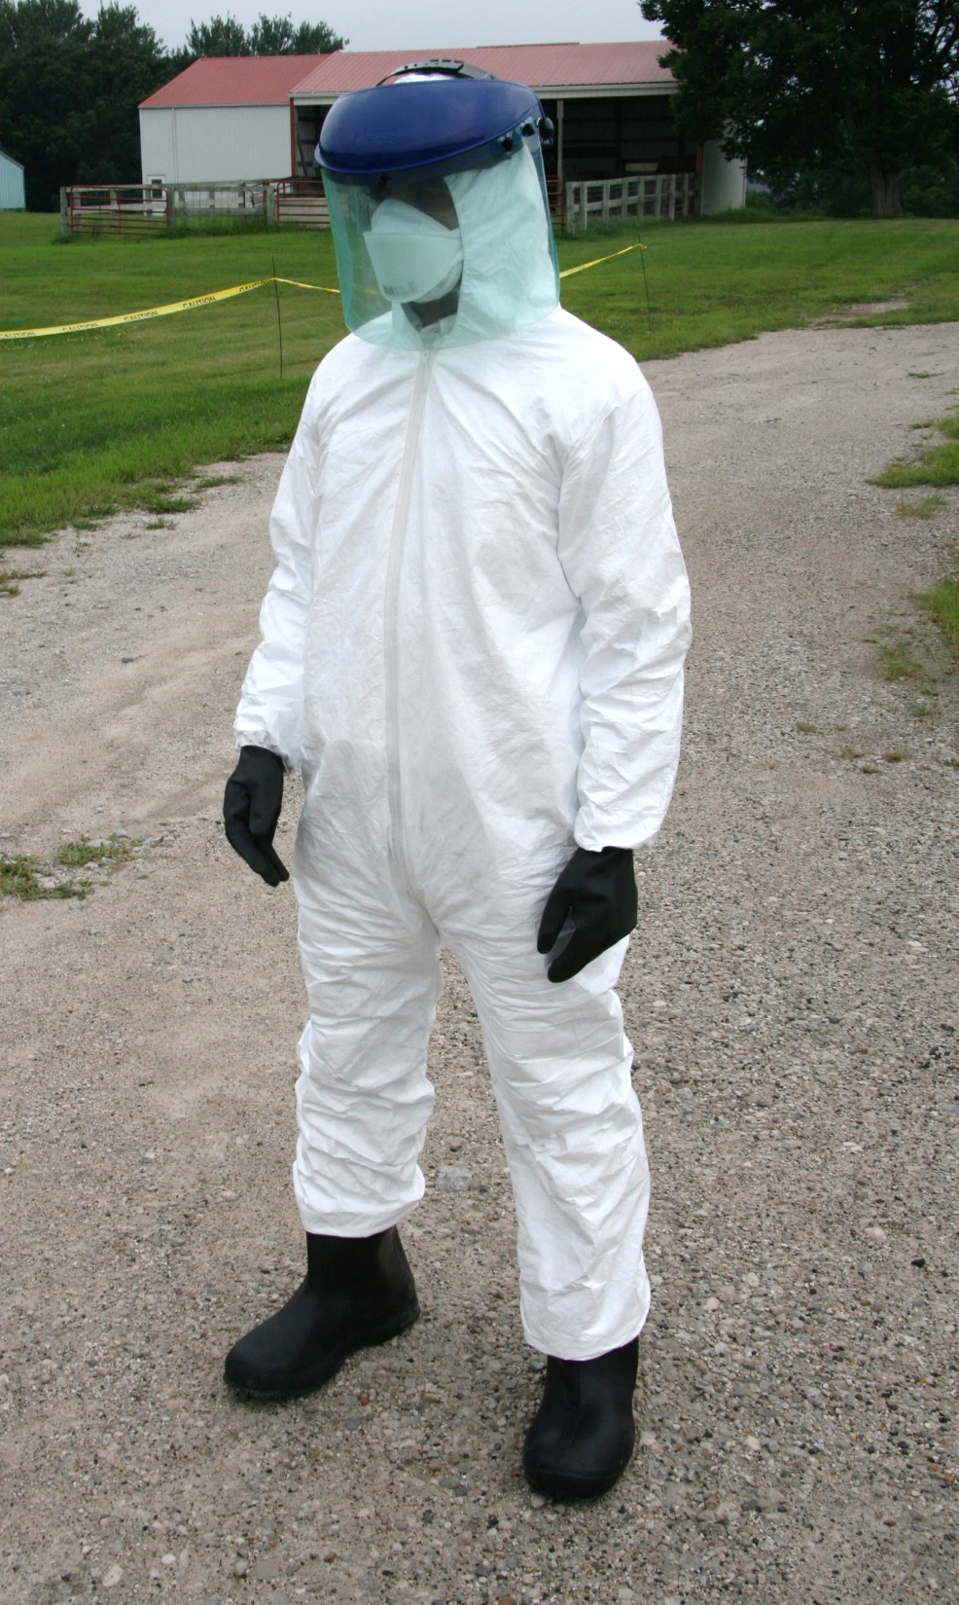
Level C
Level C
Worn when infectious agent, airborne substance or chemical exposure is known or expected
  Fluid-resistant or chemical-resistant coveralls
  Filtering or air-purifying respirator
  Goggles and face shield
  Chemical-resistant footwear and gloves
Notes:
Level C is used when an infectious agent, airborne substance or chemical exposure is known or expected. Responders working with or around animals, animal waste or products, such as milk or eggs, or other potentially contaminated items, should wear this level of PPE. It includes fluid-resistant or chemical resistant coveralls, filtering or air-purifying respirators, protection for the eyes and face, and chemical-resistant footwear and gloves.
Photo from Andrew Kingsbury/CFSPH

Slide 14
Determining Level of Protection
Incident Commander
Liaison
Officer
Safety
Officer
Public Information Officer
Operations Section
Planning Section
Logistics Section
Finance/ Administration Section
Notes:
During response situations, the Incident Commander or Safety Officer will determine the level of protection needed for tasks performed.

Slide 15
Key Points
Always verify the required level of PPE when you report to a response situation.
Only wear PPE for which you have been thoroughly trained, medically cleared to use, and fit tested to wear.
Notes:
Always verify the required level of PPE when you report to a response situation.
Only wear PPE for which you have been thoroughly trained, medically cleared to use, and fit tested to wear.

Slide 16



Additional
PPE Videos
Notes:
For more information on PPE use during animal health emergencies, including proper donning and doffing, and safety considerations, follow this QR code to the Just in time Training website.

Slide 17
Acknowledgements
Development of this material was made possible through a grant provided to
the Center for Food Security and Public Health at Iowa State University, College of Veterinary Medicine from
the U.S. Department of Agriculture (USDA) Animal and Plant Health Inspection Service through the National Animal Disease Preparedness and Response Program (NADPRP)
Notes:
Development of this material was made possible through a grant provided to the Center for Food Security and Public Health at Iowa State University, College of Veterinary Medicine from the U.S. Department of Agriculture Animal and Plant Health Inspection Service through the National Animal Disease Preparedness and Response Program.

