Slide 1



Personal Protective Equipment
Doffing PPE
Notes:
Proper removal of PPE (referred to as “doffing”) after on-farm tasks is critical during animal health emergencies to avoid the spread of disease from the response site.

Slide 2

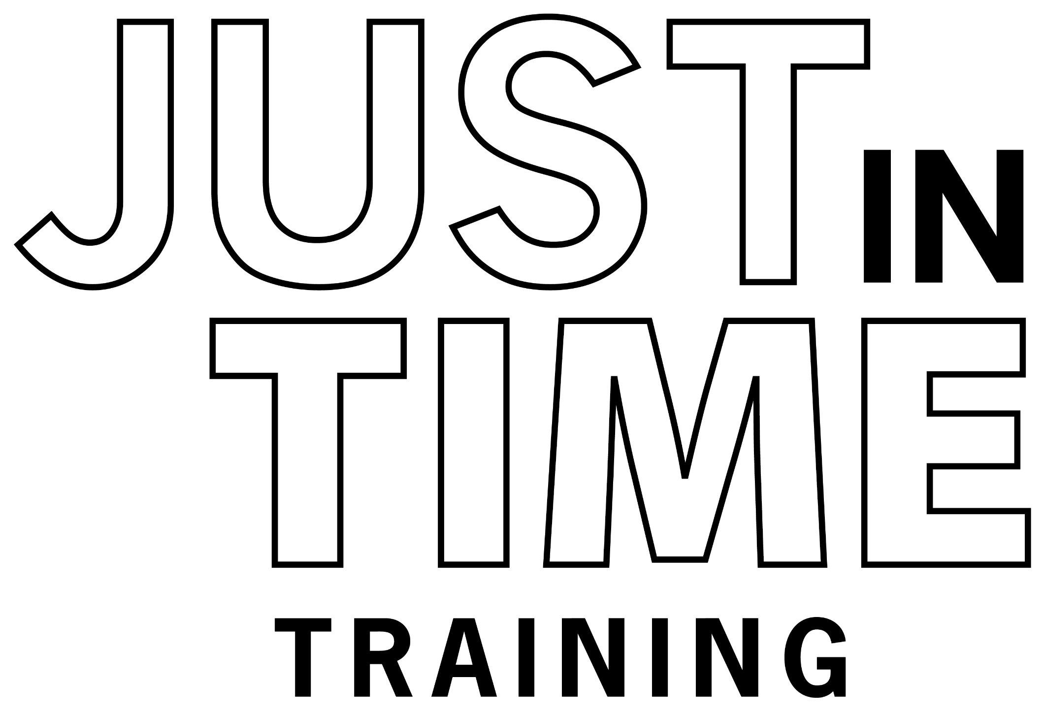
Just in Time Training
Notes:
This Just-In-Time training module will overview key steps in doffing, or taking off, Level C PPE when exiting an infected premises.

Slide 3
Importance of Proper Doffing
Prevent
unintended cross contamination, pathogen spread and responder exposure
Avoid touching outer surfaces of PPE items
Turn items inside out during removal to trap contaminants
Notes:
Improper doffing or removal of PPE can cause unintended pathogen spread and responder exposure. During the process, keep these tips in mind. Avoid touching outer surfaces to prevent cross-contamination of underlying clothing. Turn items inside out during removal to trap contaminants.

Slide 4
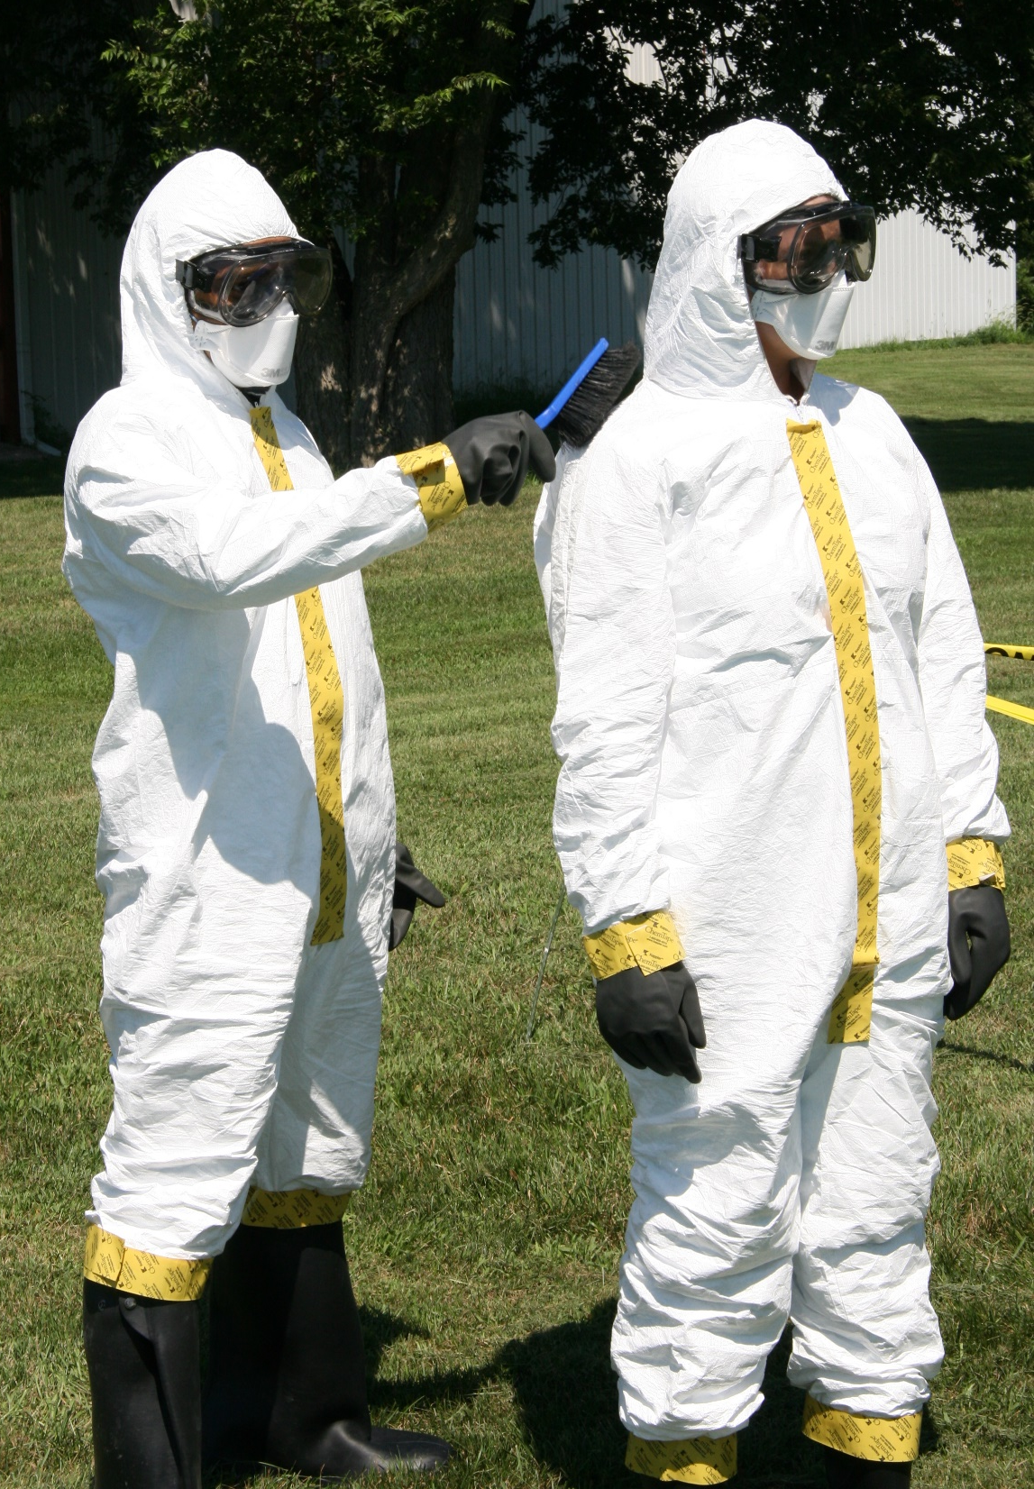
Remove Organic Debris
Doffing begins on the “dirty side” or in Hot Zone
Dry brush exterior of PPE and bottom of boots
Notes:
The PPE doffing process begins on the designated “dirty side” or in the Hot Zone for the site. Any organic material should be brushed off of the exterior surfaces of the PPE and the bottom of boots/boot covers. As with the donning procedure, safe and effective removal of PPE should be conducted using the buddy system. The buddy should remain in full PPE throughout the process.
Photo from Andrew Kingsbury/CFSPH

Slide 5
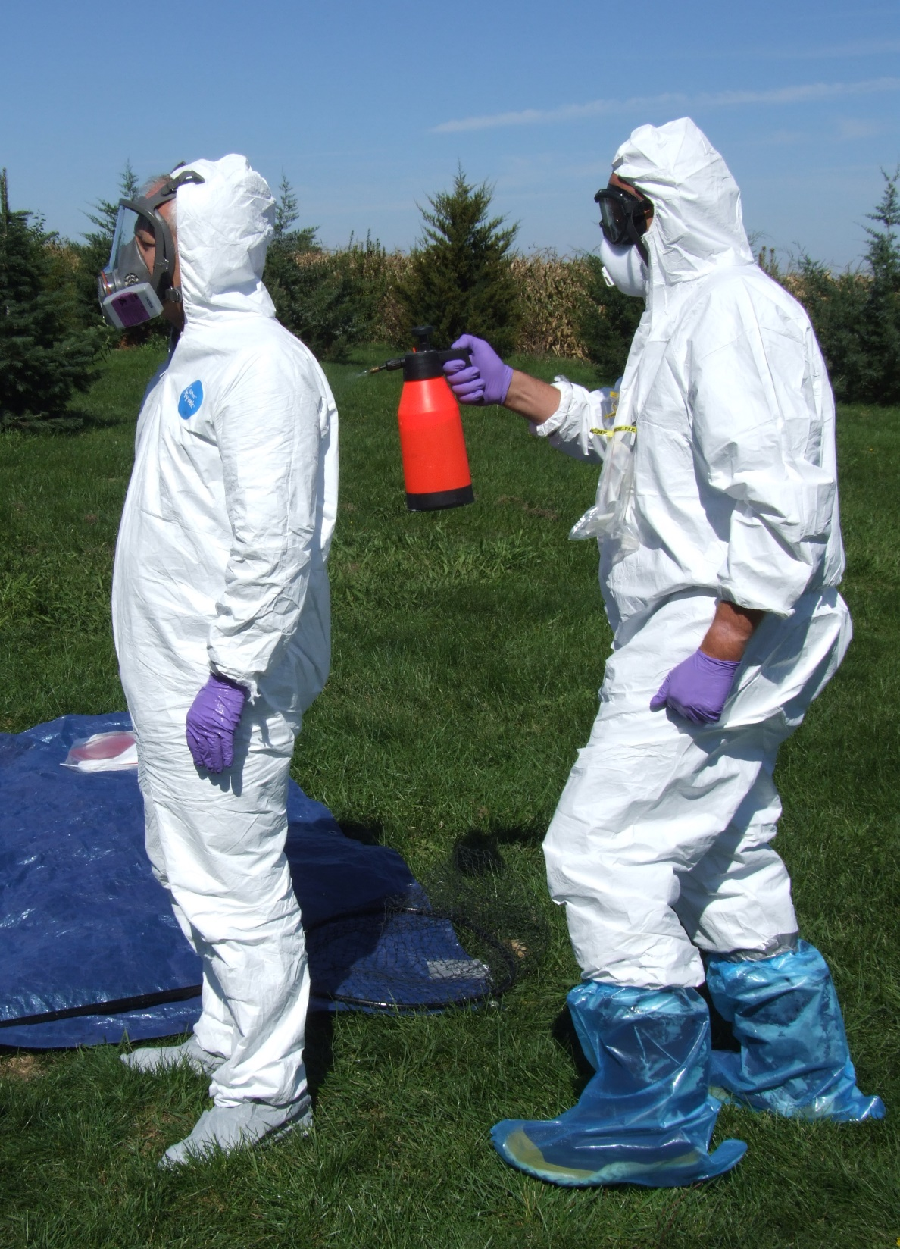
Decontaminate
Move to the decontamination area (Warm Zone)
Disinfect exterior surfaces
Notes:
Next, enter the Warm Zone. An approved disinfectant should be used to decontaminate all external surfaces of the PPE and any equipment used on site.
Photo from Jane Galyon/CFSPH

Slide 6
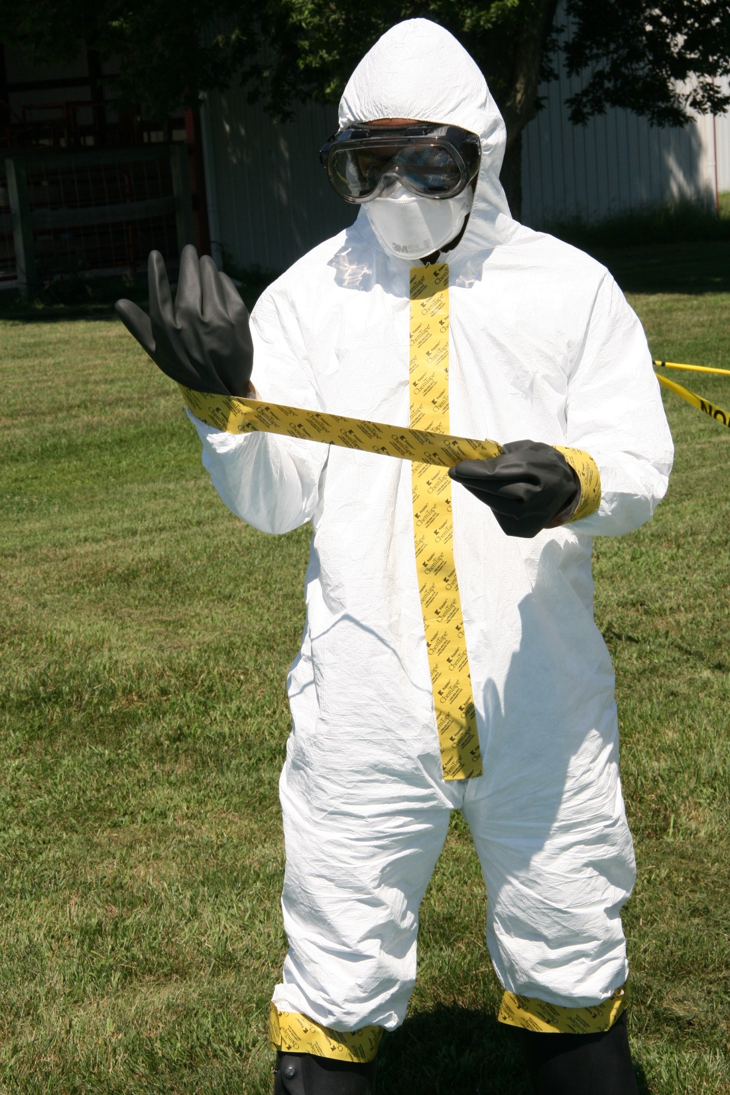
Doffing PPE
Remove all tape from coveralls
and facepiece
if applicable
Dispose of tape
Unzip coveralls
Notes:
Once completed, remove all tape from the coveralls, including the sleeves, boots, and zipper area (and facepiece, if applicable). Dispose of tape in provided containers. Unzip the protective coveralls.
Photo from Andrew Kingsbury/CFSPH

Slide 7
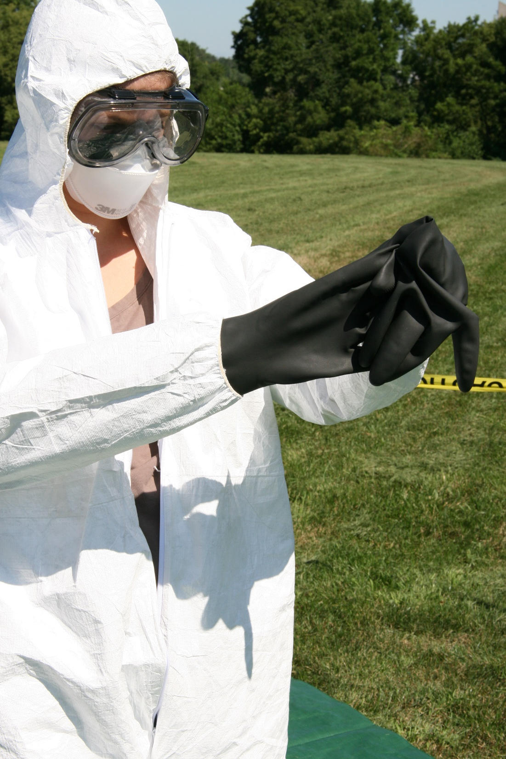
Remove Outer Gloves
Carefully
Use caution to avoid cross contamination
Turn inside out
Use inner surface to remove the second glove
Notes:
Carefully remove the outer layer chemical-resistant gloves by turning one inside out and then using the inner surface of that glove to remove the second glove. Place them in the appropriate disposal or disinfectant container.
Photo from Andrew Kingsbury/CFSPH

Slide 8
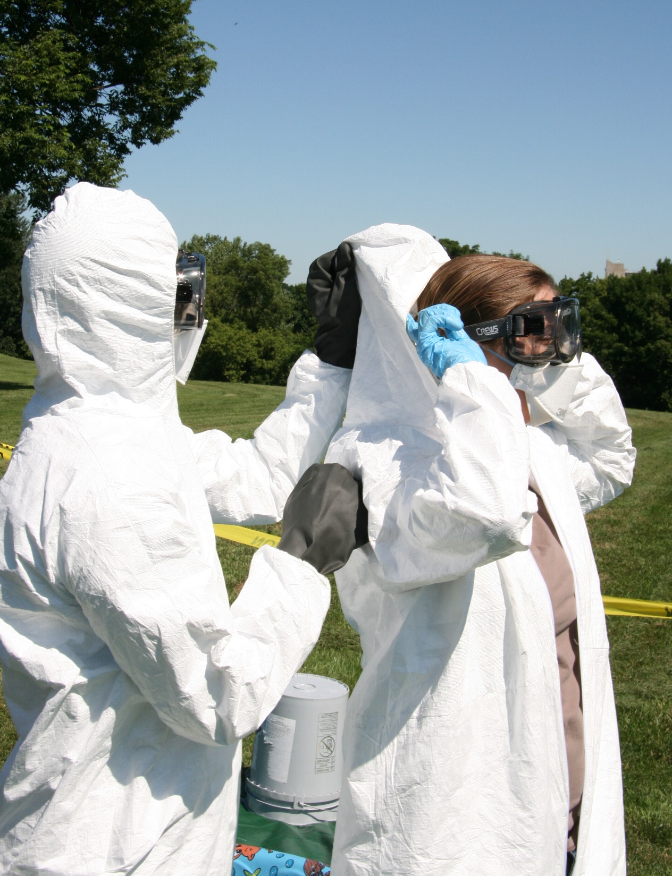
Doffing PPE:
From Top to Bottom
Remove hood
  Reach inside
  Carefully roll back
Avoid touching
the outer surface
Have buddy
in full PPE assist
Notes:
Remove the suit hood by reaching inside the hood and carefully rolling it back. Avoid touching the outer surface. This step is easiest with the assistance of a team member who, while still in full PPE, can grasp the outside of the hood.
Photo from Andrew Kingsbury/CFSPH

Slide 9
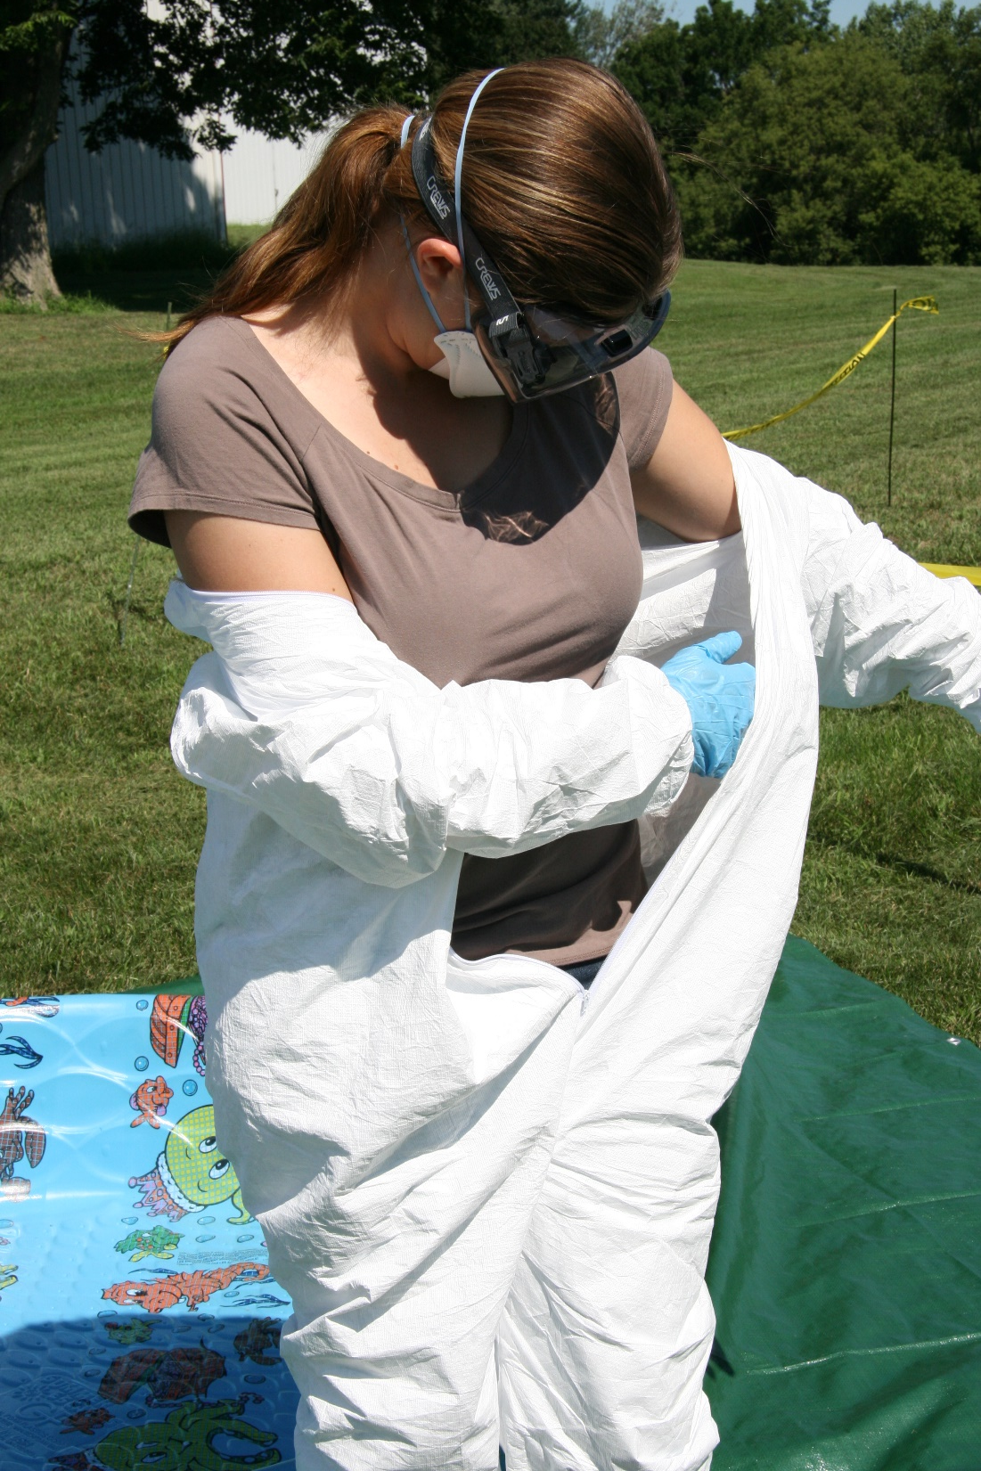
Begin Suit Removal
Pull coveralls
off the shoulders
Turn suit inside out while removing to avoid contamination
Notes:
Pull the protective coveralls off the shoulders and down the body. As you are pulling it down, turn it inside out to ensure any residual contamination is kept away from the body or underlying clothing.
Photo from Andrew Kingsbury/CFSPH

Slide 10
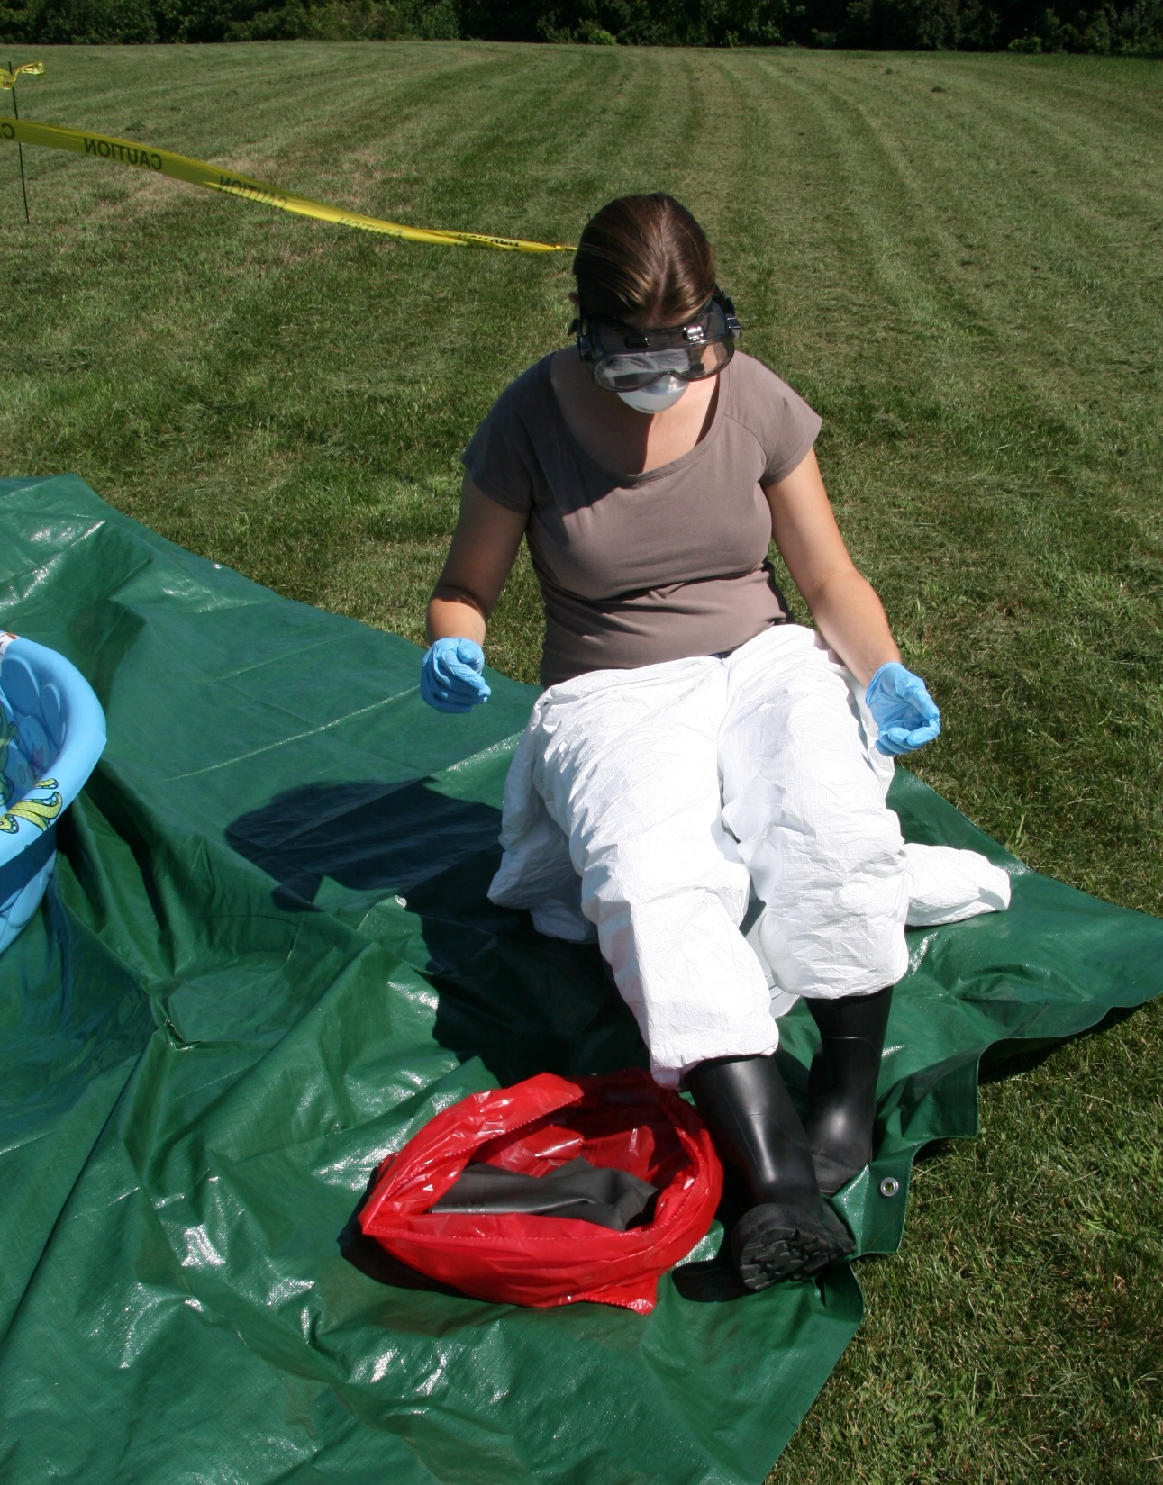
Remove Footwear
Carefully remove disposable
boot covers
Scrub rubber boots with disinfectant
Remove rubber boots
Notes:
Sitting on a stool or using other support, carefully remove disposable boot covers.
Scrub your chemical resistant boots with disinfectant, then remove them.
Photo from Andrew Kingsbury/CFSPH

Slide 11
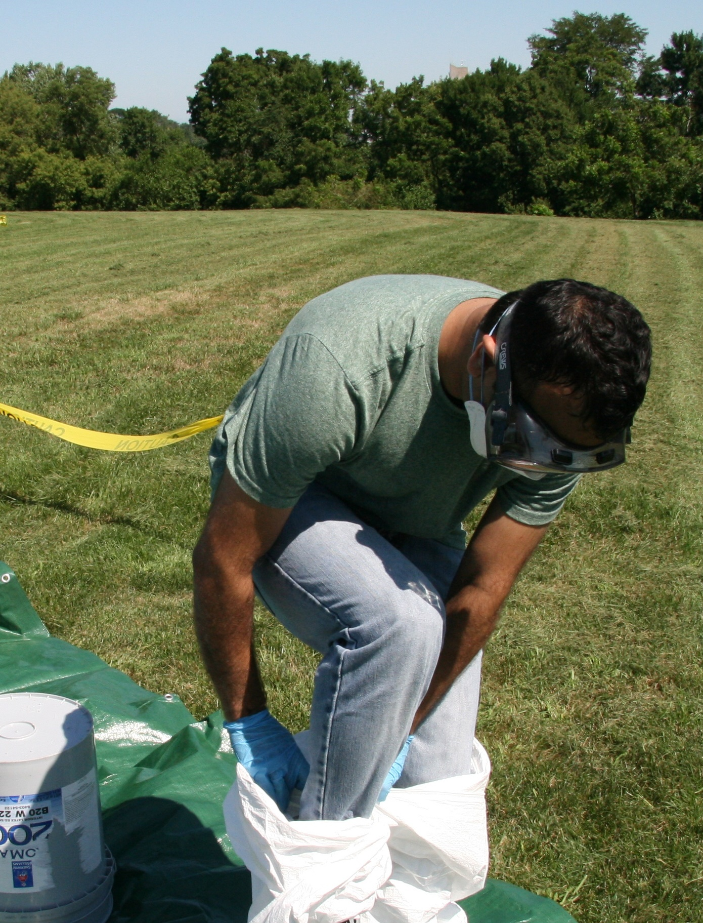
Remove Protective Coveralls
Carefully step out of the suit
Only touch inner surfaces
Dispose in provided container
Notes:
Carefully remove and step out of the protective coveralls.
Only touch the inner surfaces of the suit.
Dispose of the coveralls in a provided container.
Photo from Andrew Kingsbury/CFSPH

Slide 12
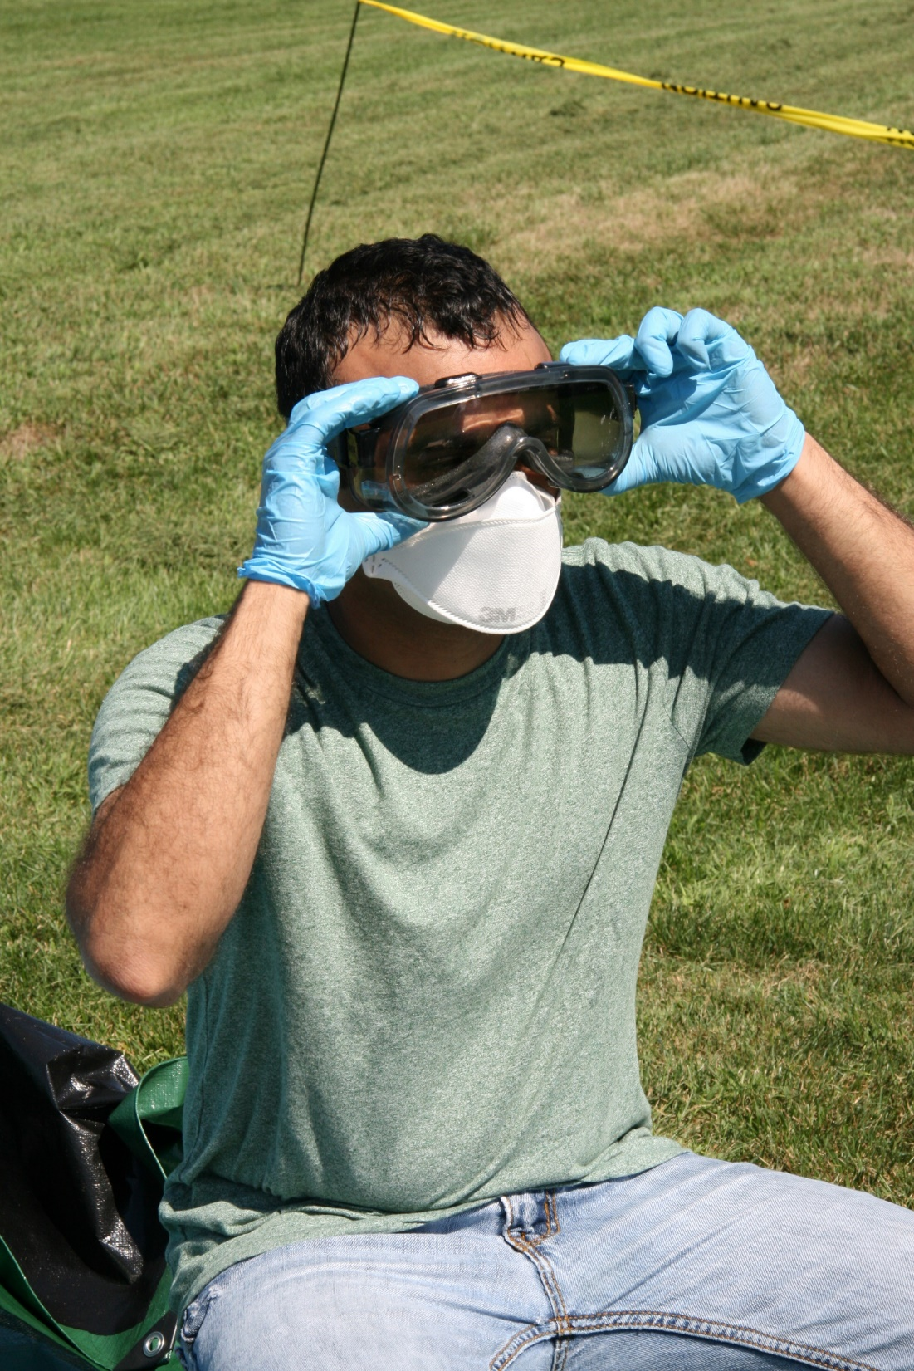
Remove Eye/Face Protection
Remove goggles and face shield
Remove respirator
Place both in the designated container for decontamination
Notes:
Remove your goggles and face shield, if worn. Remove your respirator. Place both in the designated container for decontamination.
Photo from Andrew Kingsbury/CFSPH

Slide 13
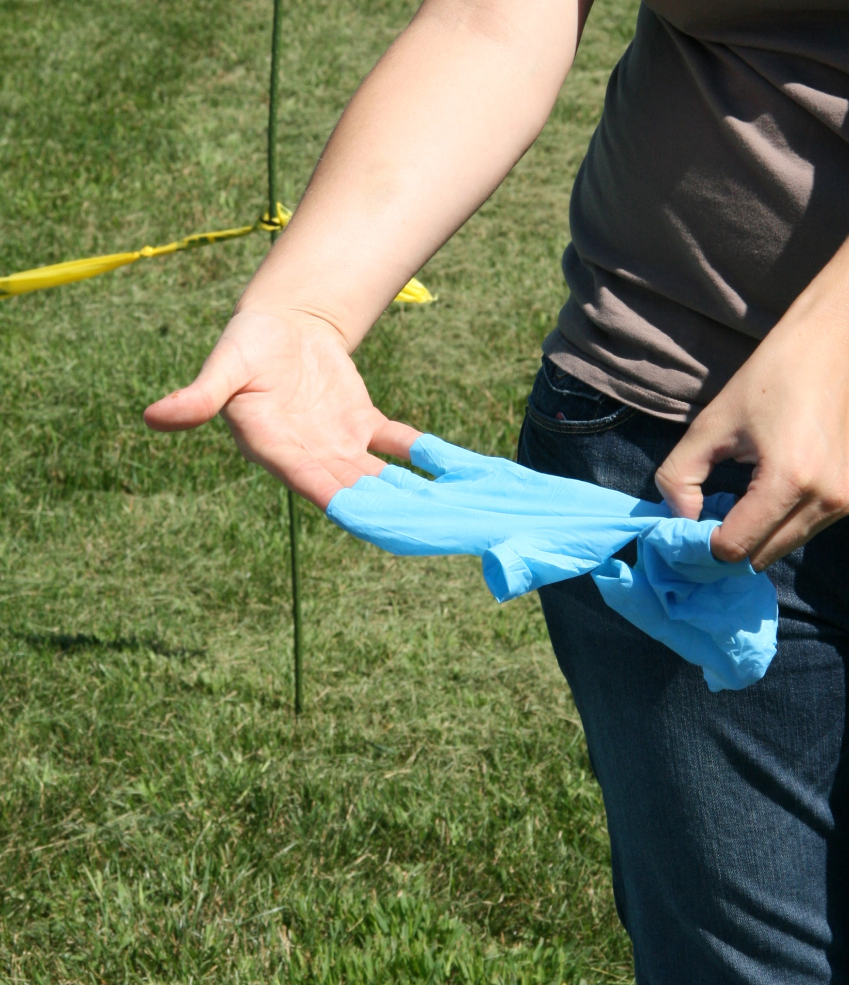
Remove Gloves
Remove inner gloves, using previously described
Dispose of gloves
in the designated container
Notes:
Remove inner gloves using the method previously described; turn them inside out to keep any residual contamination away from the body.
Dispose of gloves in a provided container.
Photo from Andrew Kingsbury/CFSPH

Slide 14
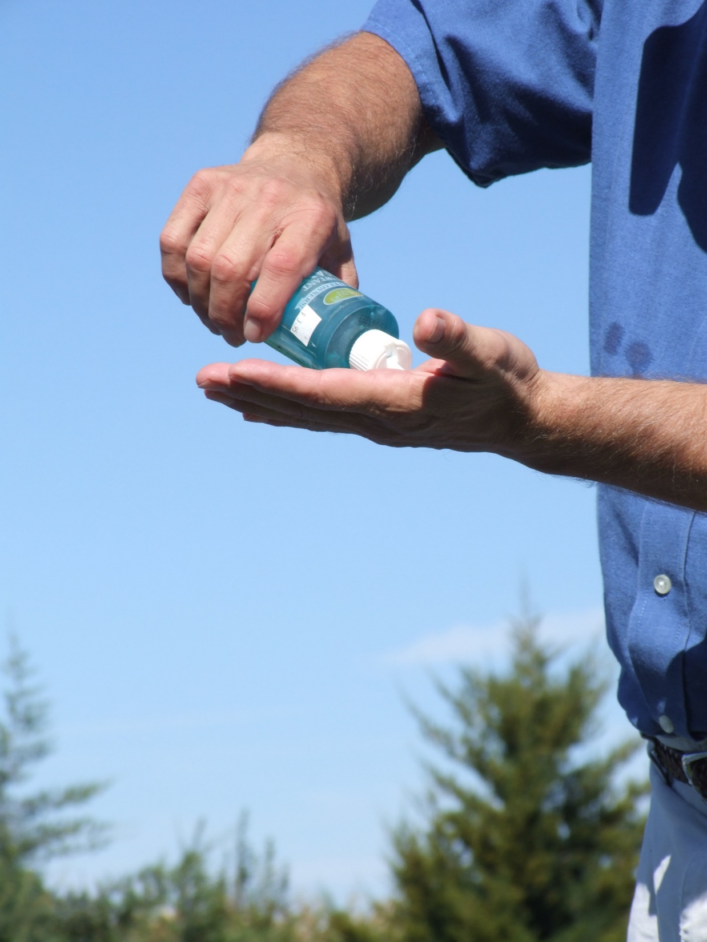
Final Steps
Wash hands
thoroughly
Blow your nose to clear respiratory passages
Shower and
launder clothing
Notes:
After doffing all PPE, sanitize and wash hands thoroughly, and inspect under your fingernails. Blow your nose to clear your respiratory passages.
As soon as possible, take a complete shower and launder any clothing.
Photo from Jane Galyon/CFSPH

Slide 15

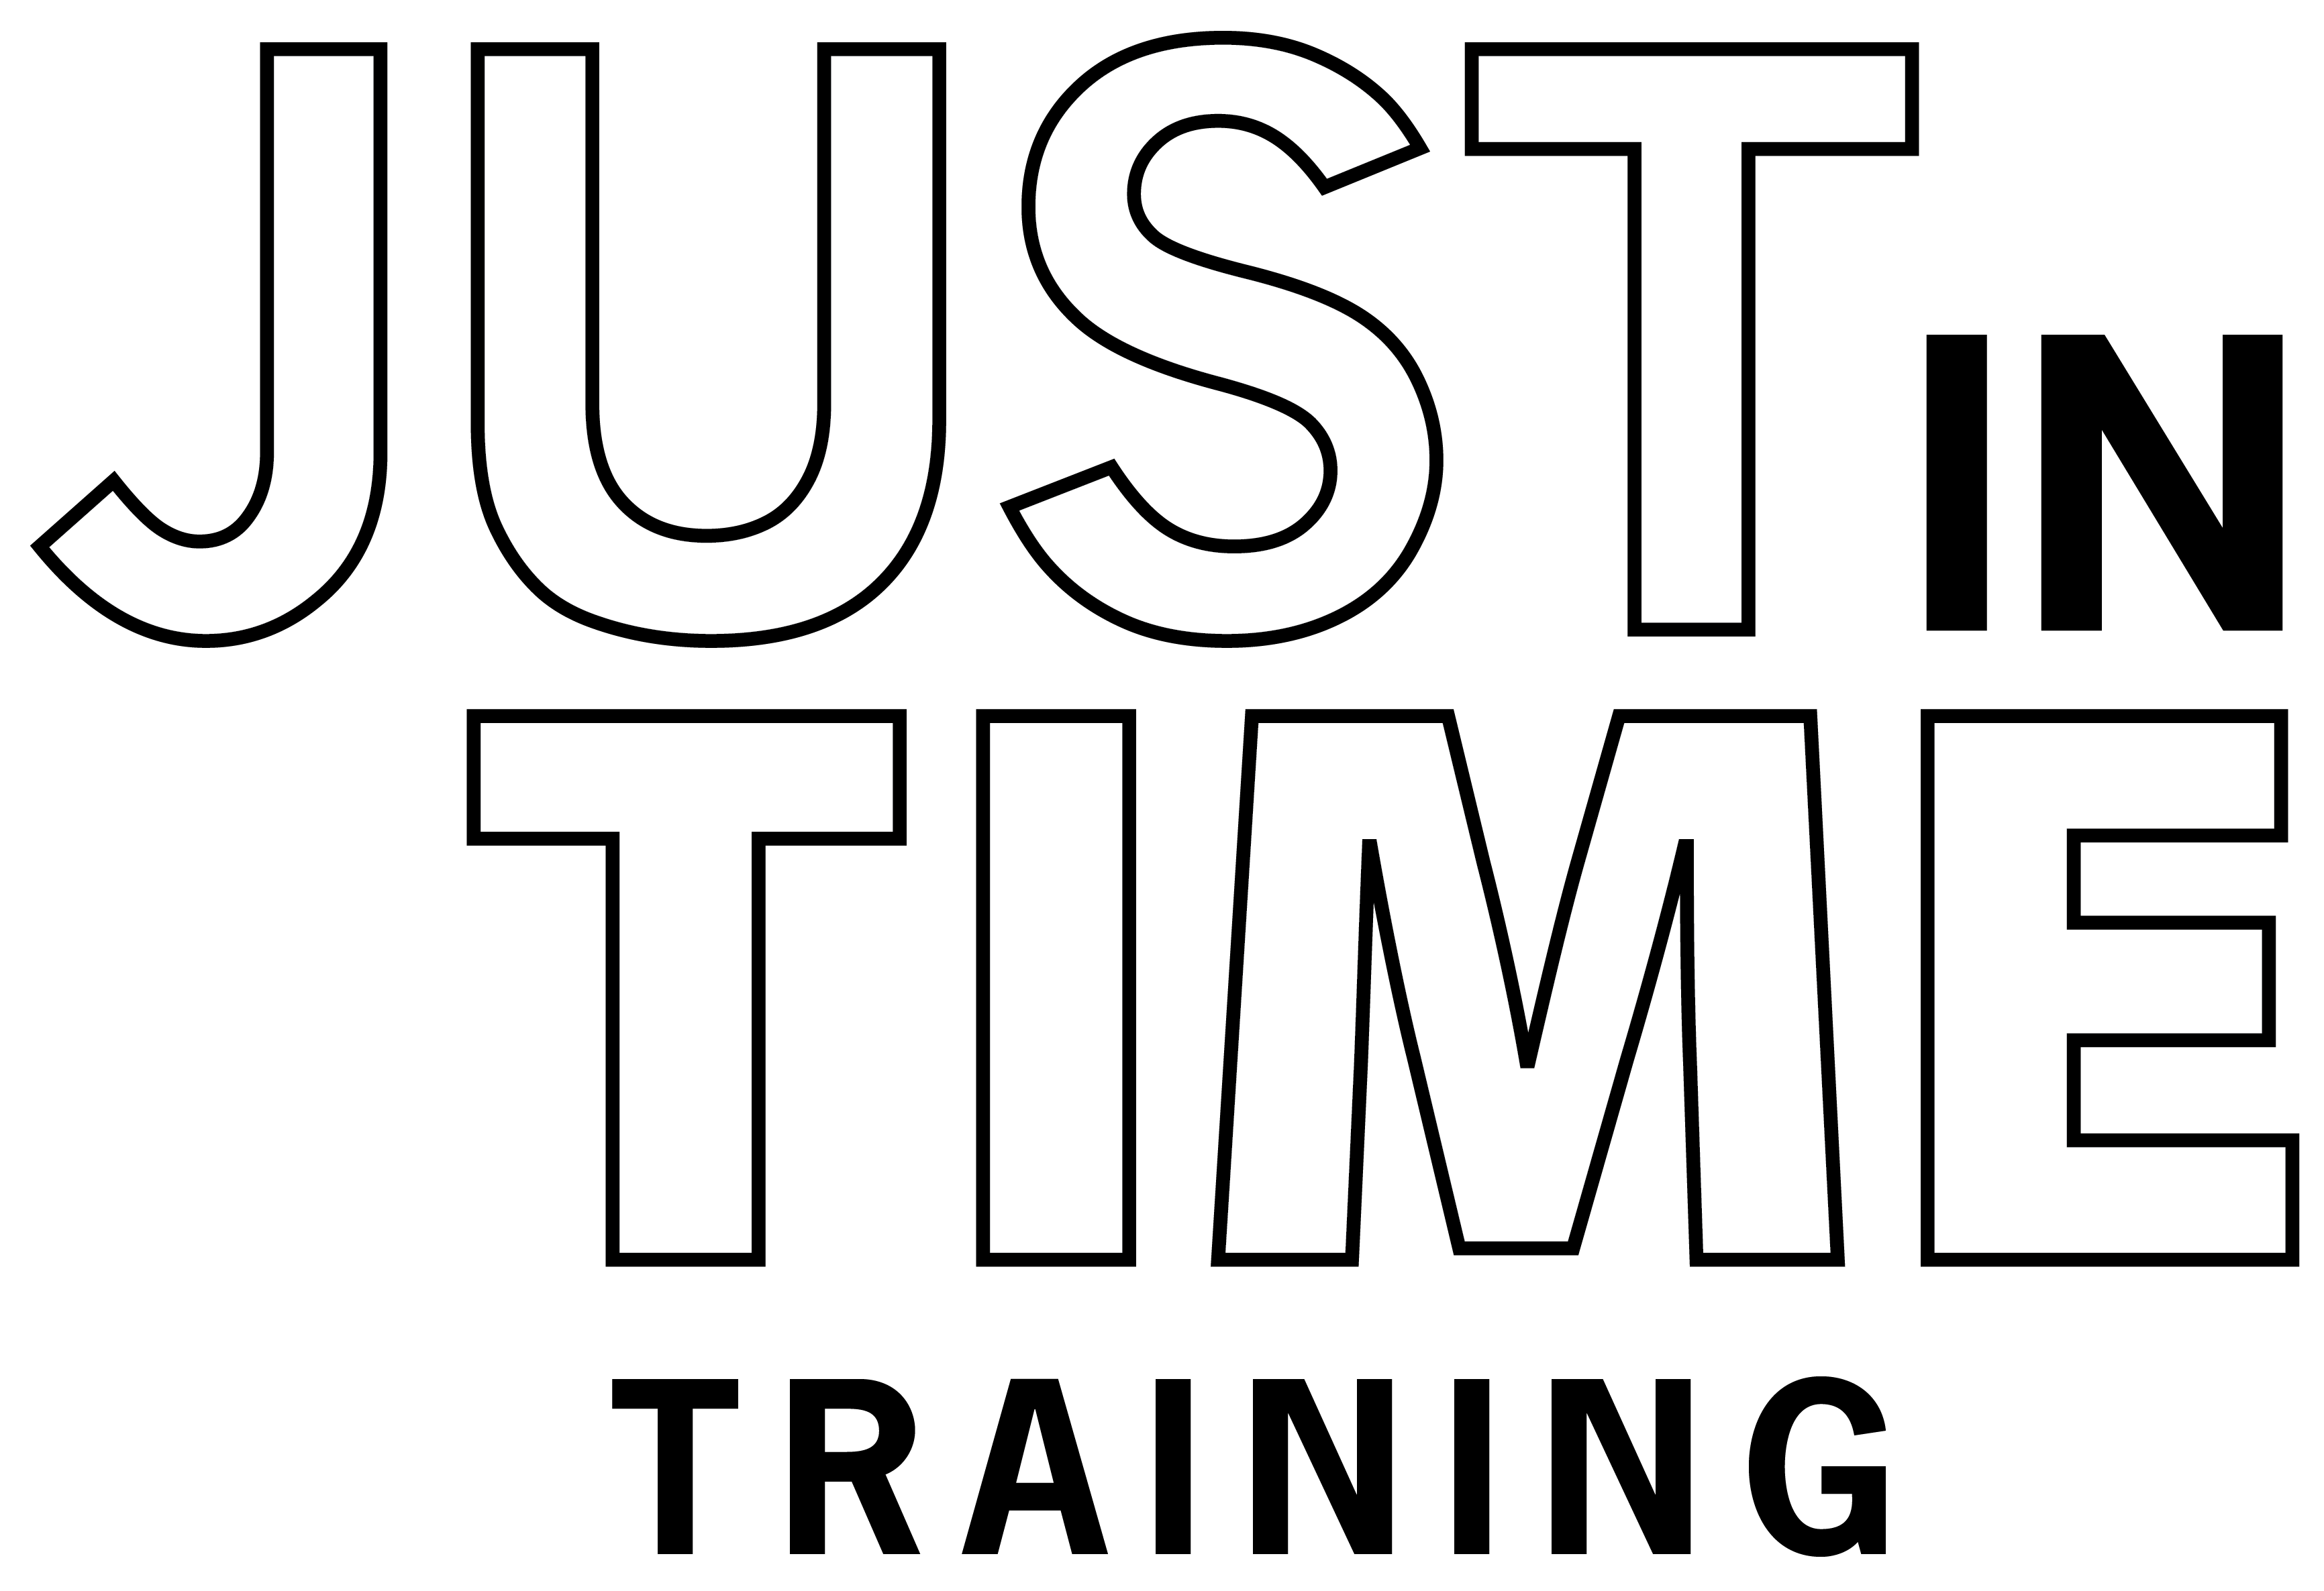

Additional
PPE Videos
Notes:
For more information on PPE use during animal health emergencies, including proper donning and safety considerations, follow this QR code to the Just in time Training website.

Slide 16
Acknowledgements
Development of this material was made possible through a grant provided to
the Center for Food Security and Public Health at Iowa State University, College of Veterinary Medicine from
the U.S. Department of Agriculture (USDA) Animal and Plant Health Inspection Service through the National Animal Disease Preparedness and Response Program (NADPRP)
Notes:
Development of this material was made possible through a grant provided to the Center for Food Security and Public Health at Iowa State University, College of Veterinary Medicine from the U.S. Department of Agriculture Animal and Plant Health Inspection Service through the National Animal Disease Preparedness and Response Program.

