Slide 1


The Incident Command System
An Overview
Notes:
During an animal disease emergency, the effective management of responders, activities, and resources is essential for an efficient response. This is achieved through the Incident Command System or ICS.

Slide 2


Just in Time Training
Notes:
This JIT presentation provides an overview of basic ICS structure and terminology. It serves as a supplement or review and is not intended to replace the training developed by the Federal Emergency Management Agency (FEMA).

Slide 3
What is ICS?
Notes:
What is ICS?

Slide 4
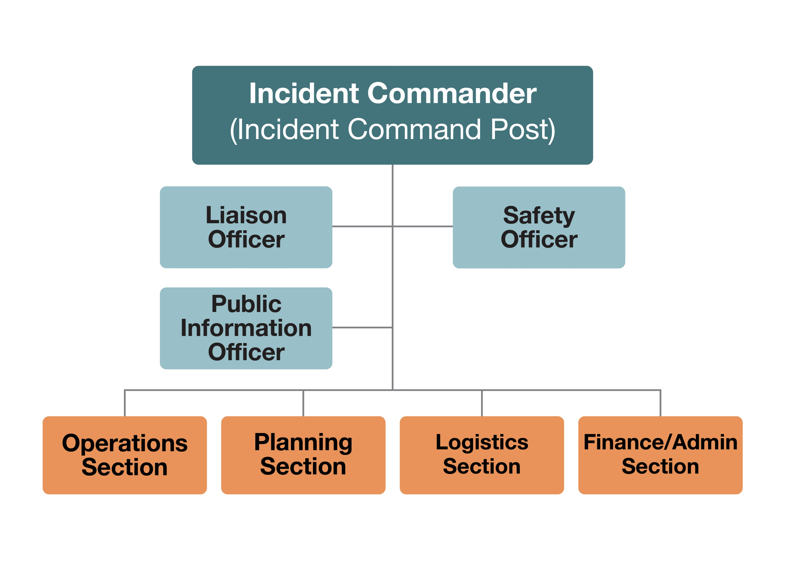
Incident Command System
Organization framework used
to manage and coordinate
emergency responses
Notes:
The Incident Command System is the on-site organizational hierarchy or framework used to manage and coordinate emergency responses.

Slide 5
Key aspects of ICS
Common Terminology
Incident Action Planning
Chain of
Command
Flexibility and adaptability
Notes:
Some key aspects of ICS are:
Common terminology. ICS provides a standardized management approach and common language for communication.
Chain of command. ICS designates supervisors and their responsibilities, and defines responder units to provide a clear understanding of the organization, roles, responsibilities, and chain of command during the response.
Incident action planning. ICS provides an orderly, systematic planning process that fosters communication and cooperation among disciplines and agencies. Response objectives are determined and help guide strategies, issue assignments, and develop plans, procedures, and protocols with measurable outcomes.
Flexibility and adaptability. The ICS system is modular and can quickly expand or contract in size and complexity for the response, adapt to manage and coordinate multiple sites or jurisdictions, ensuring efficient, effective incident management across all sites.
The use of the Incident Command System is mandated by the National Incident Management System (NIMS) for all emergency responses.

Slide 6
Basic ICS Structure
Notes:
Basic ICS Structure

Slide 7
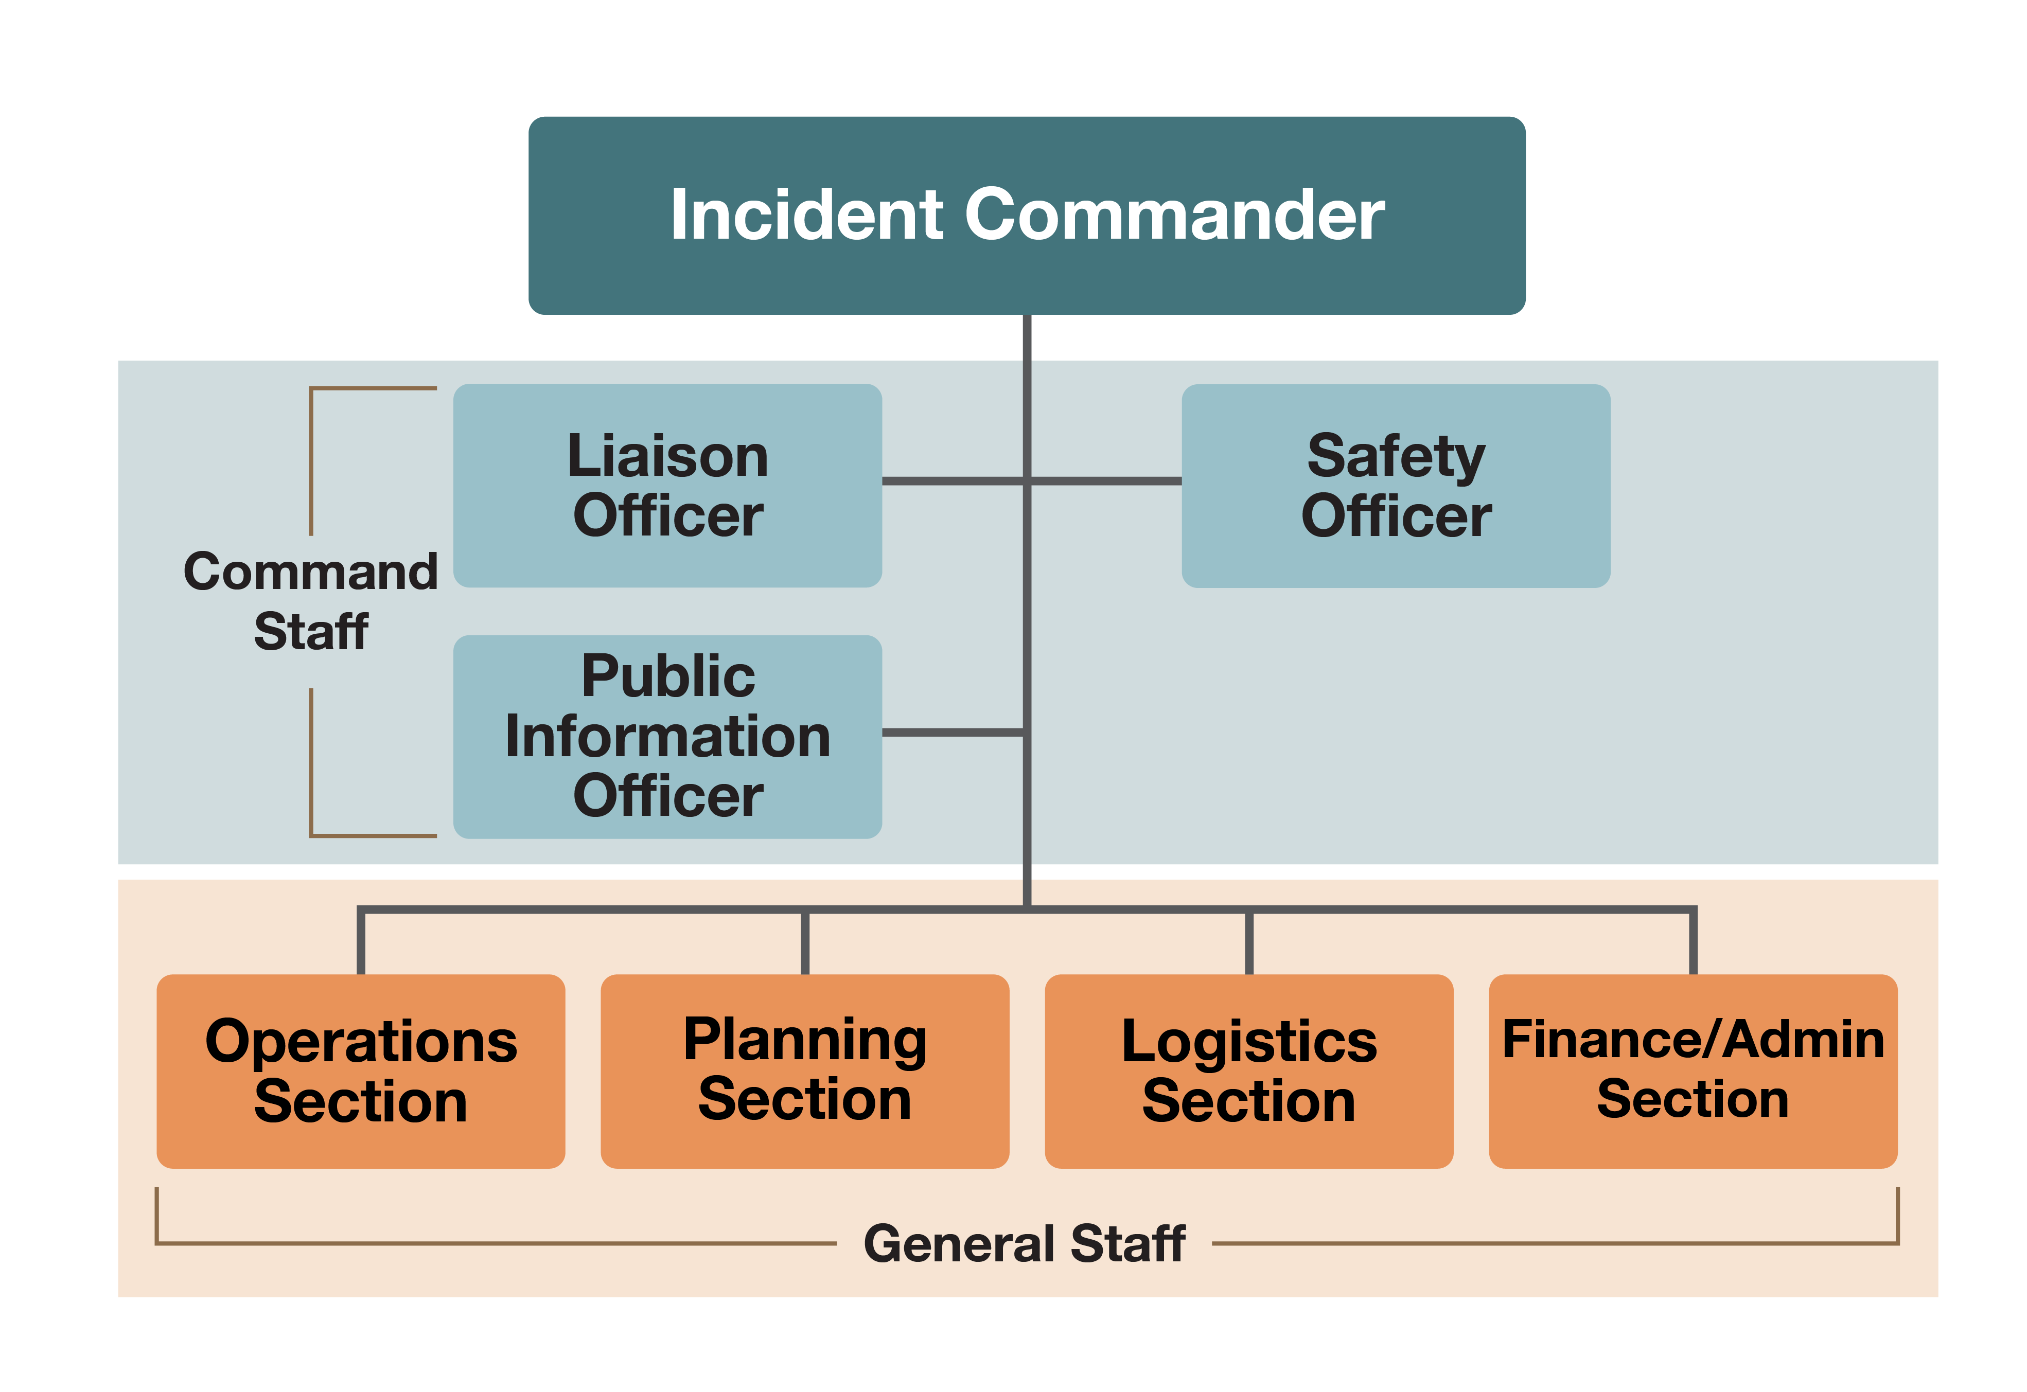
ICS Hierarchy
Notes:
The Incident Command System is a top-down system. It is normally organized into five main functional areas, each with specific duties. This is often referred to as the Incident Management Team (IMT).

Slide 8
Incident Command
Notes:
Incident Command

Slide 9
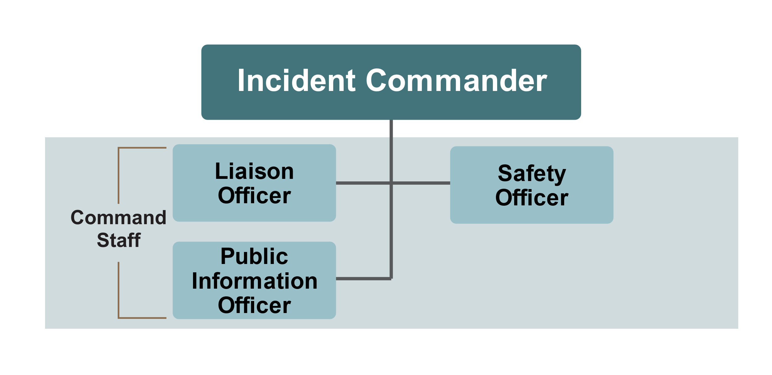
Command Staff
x
Notes:
Incident Command, includes the Incident Commander and their designated Command Staff.

Slide 10

Incident Commander
Overall responsibility for managing an incident
Sets incident objectives
Establishes response strategies and priorities
Only position always staffed
Responsible for incident objectives until delegated
Notes:
An Incident Commander (IC) is responsible for managing an incident. The Incident Commander sets incident objectives and establishes response strategies and priorities. This is the only ICS position that is always staffed. The Incident Commander is responsible for all incident objectives until delegated to Command or General Staff personnel.

Slide 11



The Command Staff
Safety Officer
Monitors/oversees working conditions
Develops procedures to keep personnel safe
Liaison Officer
Primary point of contact for supporting agencies and organizations
Reports to
the Incident Commander
Public Information Officer
Interfaces and provides information to various stakeholders regarding response activities
Notes:
During larger incidents, the Incident Commander may establish additional supervisory positions, known as the Command Staff.
The Safety Officer monitors and oversees working conditions of the incident and is responsible for developing procedures to keep personnel safe. The Safety Officer is allowed to stop any unsafe behavior or procedure.
The Liaison Officer serves as the primary point of contact for governmental and non-governmental agencies and organizations involved in incident response.
The Public Information Officer interfaces and provides information to the public, media, and industry stakeholders regarding response activities.

Slide 12

Unified Command
  For incidents involving
  multiple agencies or jurisdictions
Notes:
Some responses may use a modified incident command approach.
Unified Command allows agencies with different legal, geographical, and functional authorities and responsibilities to work together effectively. Command is shared among designated representatives from the involved agencies. For example, the State Animal Health Official and the Federal Animal Health Official may use unified command to coordinate information and eliminate duplication.

Slide 13
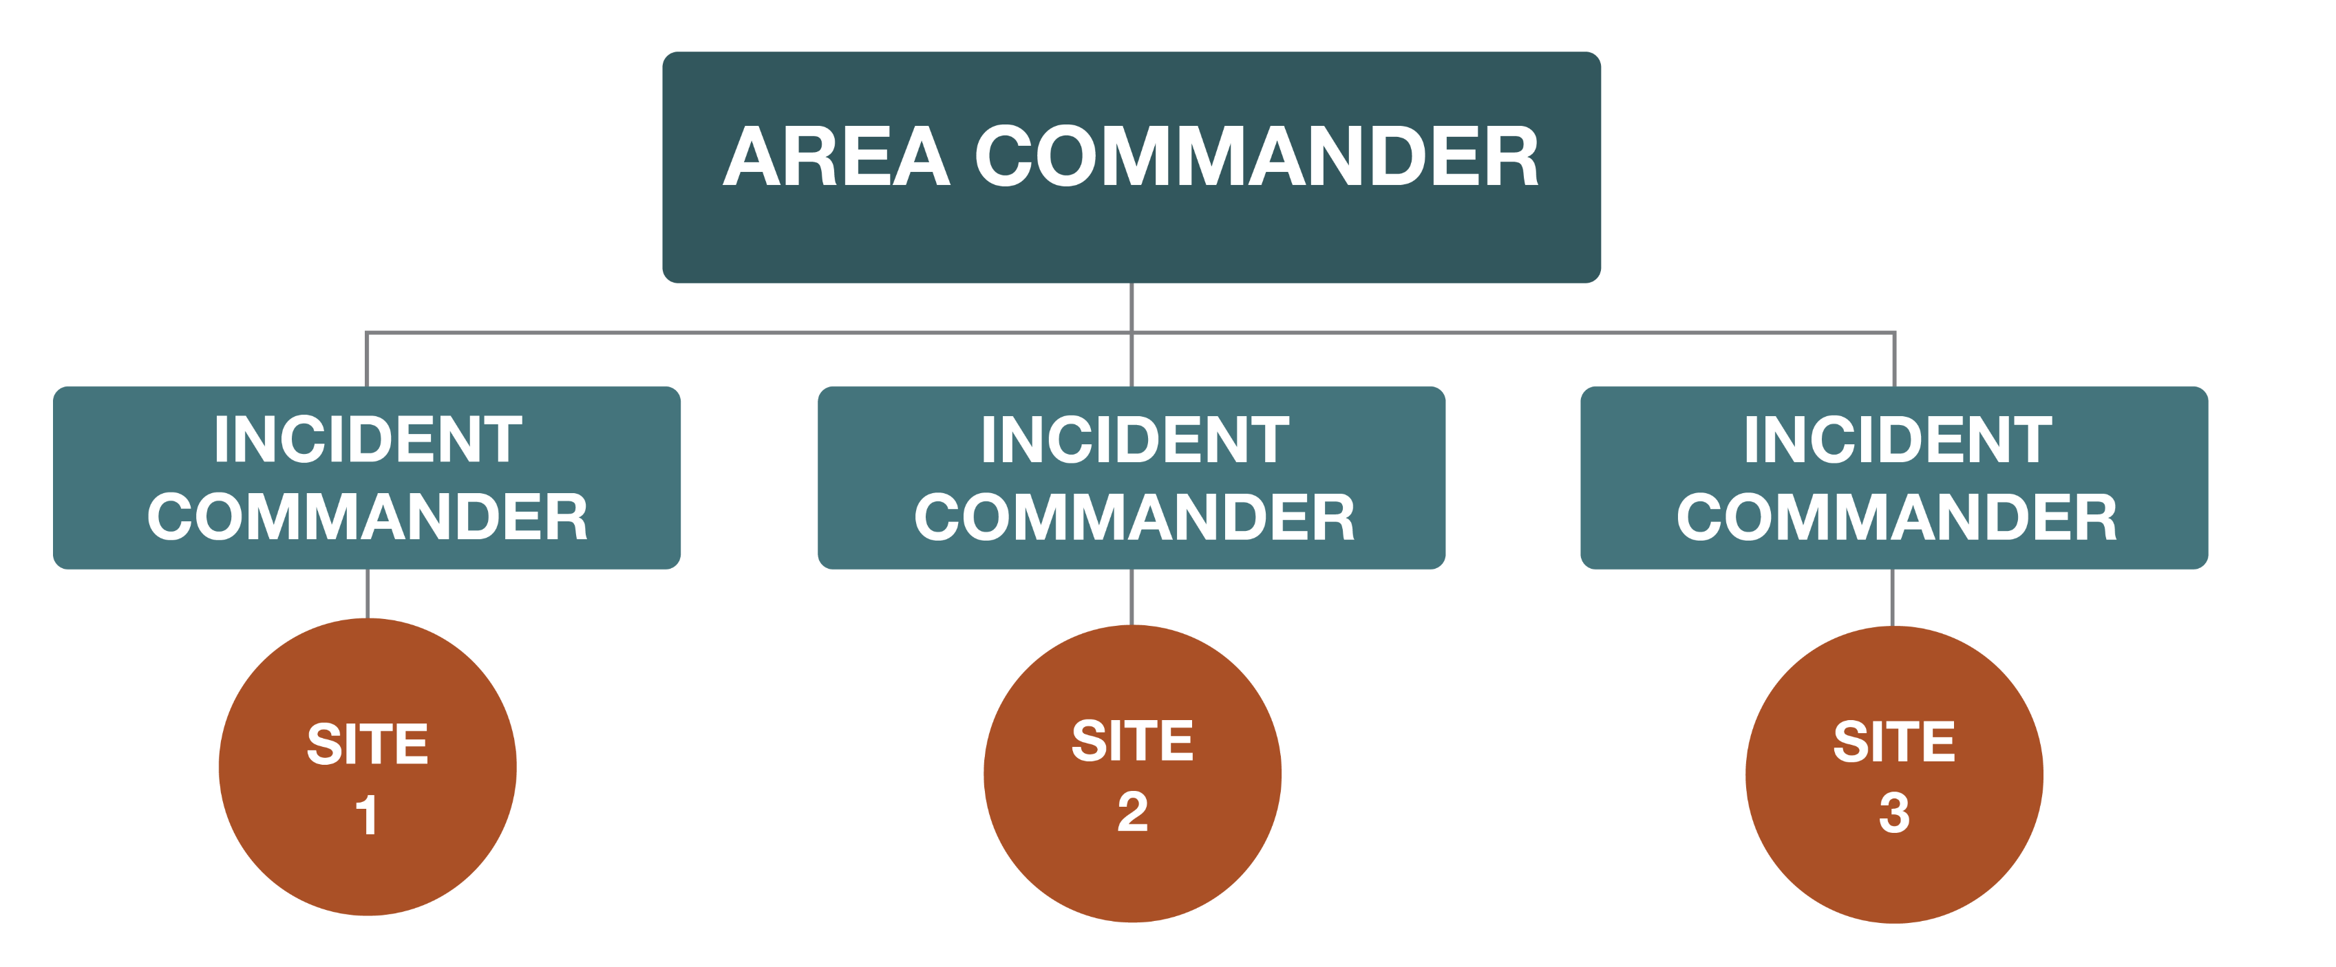
Area Command
For large, complex responses or multiple sites needing shared resources
Notes:
Area Command is used for large, complex responses or when multiple incidents place demands on shared resources. An Area Commander provides oversight, coordination, and strategic direction, while each site is managed by an Incident Commander and standard ICS structure.

Slide 14
General Staff
Notes:
The General Staff

Slide 15
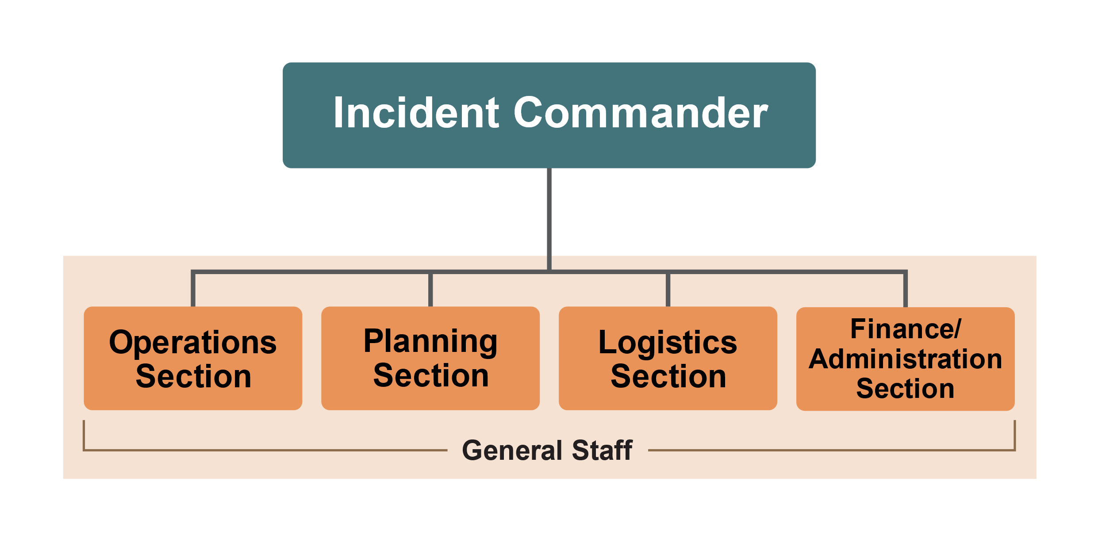
General Staff Sections
x
Notes:
The General Staff includes four management sections, each responsible for specific tasks, duties, and personnel during the response. Each is led by a Section Chief, for example, an Operations Section Chief, who reports to the Incident Commander. Depending on the size or scope of the response, each section may break into additional segments to further distribute or perform specific response tasks.

Slide 16


General Staff
Operations Section
Performs tasks to meet response goals
Led by Operations Section Chief (OSC)
  Develops and organizes tactical assignments
  Manages field personnel
  Directs all tactical resources
Planning Section
Supports planning process
Tracks resources
Collects and analyses information
Maintains documentation
Led by Planning Section Chief (PSC)
  Directs and develops the IAP
Reports to
the Incident Commander
Notes:
The Operations Section is responsible for performing various tasks needed to meet the response goals as outlined in the Incident Action Plan. The Operations Section Chief develops and organizes tactical assignments, manages field personnel, and directs all tactical resources.
The Planning Section supports the planning process by tracking resources, collecting and analyzing information, and maintaining documentation. The Planning Section Chief develops and directs the preparation of the Incident Action Plan.

Slide 17


General Staff
Logistics Section
Provides support, resources, and services to meet incident objectives
Led by a Logistics Section Chief (LSC)
Finance/Administration Section
Manages all financial aspects
Provides accounting, contracting, procurement, time recording and cost analysis services
Led by Finance and Administration Section Chief (FASC)
Reports to
the Incident Commander
Notes:
The Logistics Section provides support, resources, and needed services to meet the incident objectives. This may include supplies, facilities, transportation, communication, equipment maintenance, food, and medical services. This section is led by a Logistics Section Chief.
The Finance and Administration Section provides accounting, contracting, procurement, time recording, and cost analysis services. Personnel, led by a Finance and Administration Section Chief, manage all financial aspects associated with the incident.

Slide 18
Operational Planning
Notes:
Operational Planning

Slide 19

Incident Action Plan
All animal disease emergency responses will have an Incident Action Plan (IAP)
Should be in written form
Command and General Staff will determine and outline the actions needed for the response
Notes:
All animal disease emergency responses will have an Incident Action Plan (IAP). The IAP should be in written form. Command and General Staff will meet during each operational period (typically every 12 or 24 hours) to determine and outline the actions needed for incident response.

Slide 20
Incident Action Plan Goals
Outlines goals and procedures
Who is responsible for tasks
How communication will occur
Responder health and safety
IAP used to inform all response personnel
Notes:
At its most basic level, it should outline the goals and procedures required, identify who is responsible for various tasks, specify how communication will occur, and detail how responder health and safety procedures (e.g., care for injured personnel) will be implemented. The IAP informs all response personnel of the incident objectives for the designated operational period, the specific resources needed, actions to take, and other operational information (e.g., weather, challenges or constraints, safety issues).

Slide 21
Other ICS Terminology
Notes:
Other common terminology used during a response may include:

Slide 22



More ICS Terminology
Incident Command Post
Staging Area
Base
Camp
Notes:
The Incident Command Post (ICP) is where on-scene management occurs (i.e., location of the Incident Commander, Command and General Staff).
The Staging Area is the location used for all resources – equipment, supplies, personnel, or teams needed to perform response activities – wait for incident assignment. There may be multiple Staging Areas during a response.
The Base is where primary service and support activities, such as logistics or finance and administration, are performed. There is only one Base for each incident.
A Camp is the area where resources such as food, water, sleeping areas, and sanitary services are located. There may be multiple Camps for a response.

Slide 23
Key Points
ICS is used to organize, manage,
and coordinate emergency responses
Full ICS training available
on the FEMA website
  At minimum, complete ICS-100 and ICS-200
Know who your supervisor is
Notes:
The Incident Command System is used to organize, manage, and coordinate emergency responses. Full ICS training is available on the FEMA ICS Resource Center. At a minimum, all responders should complete ICS-100 and ICS-200. Once on-site, be sure you know who your immediate supervisor will be during the response.

Slide 24



Additional
JIT Videos
Notes:
Additional Just-In-Time trainings describing the roles and responsibilities of each General Staff section and the Operational Planning Period are available on the Just-in-Time Training website.

Slide 25
Acknowledgements
Development of this material was made possible through grants provided to the Center for Food Security and Public Health at Iowa State University, College of Veterinary Medicine, from
the U.S. Department of Agriculture (USDA) Animal and Plant Health Inspection Service (APHIS) National Animal Disease Preparedness and Response Program (NADPRP), and
the Michigan Department of Agriculture and Rural Development.
Notes:
Development of this training module was made possible through a grant provided to the Center for Food Security and Public Health at Iowa State University, College of Veterinary Medicine, from the U.S. Department of Agriculture Animal and Plant Health Inspection Service through the National Animal Disease Preparedness and Response Program and the Michigan Department of Agriculture and Rural Development.

