Slide 1


The Incident Command System
The Operations Section
Notes:
During an animal disease emergency, the Incident Command System (ICS) is utilized to coordinate personnel, tasks, and agencies, ensuring an efficient response.

Slide 2

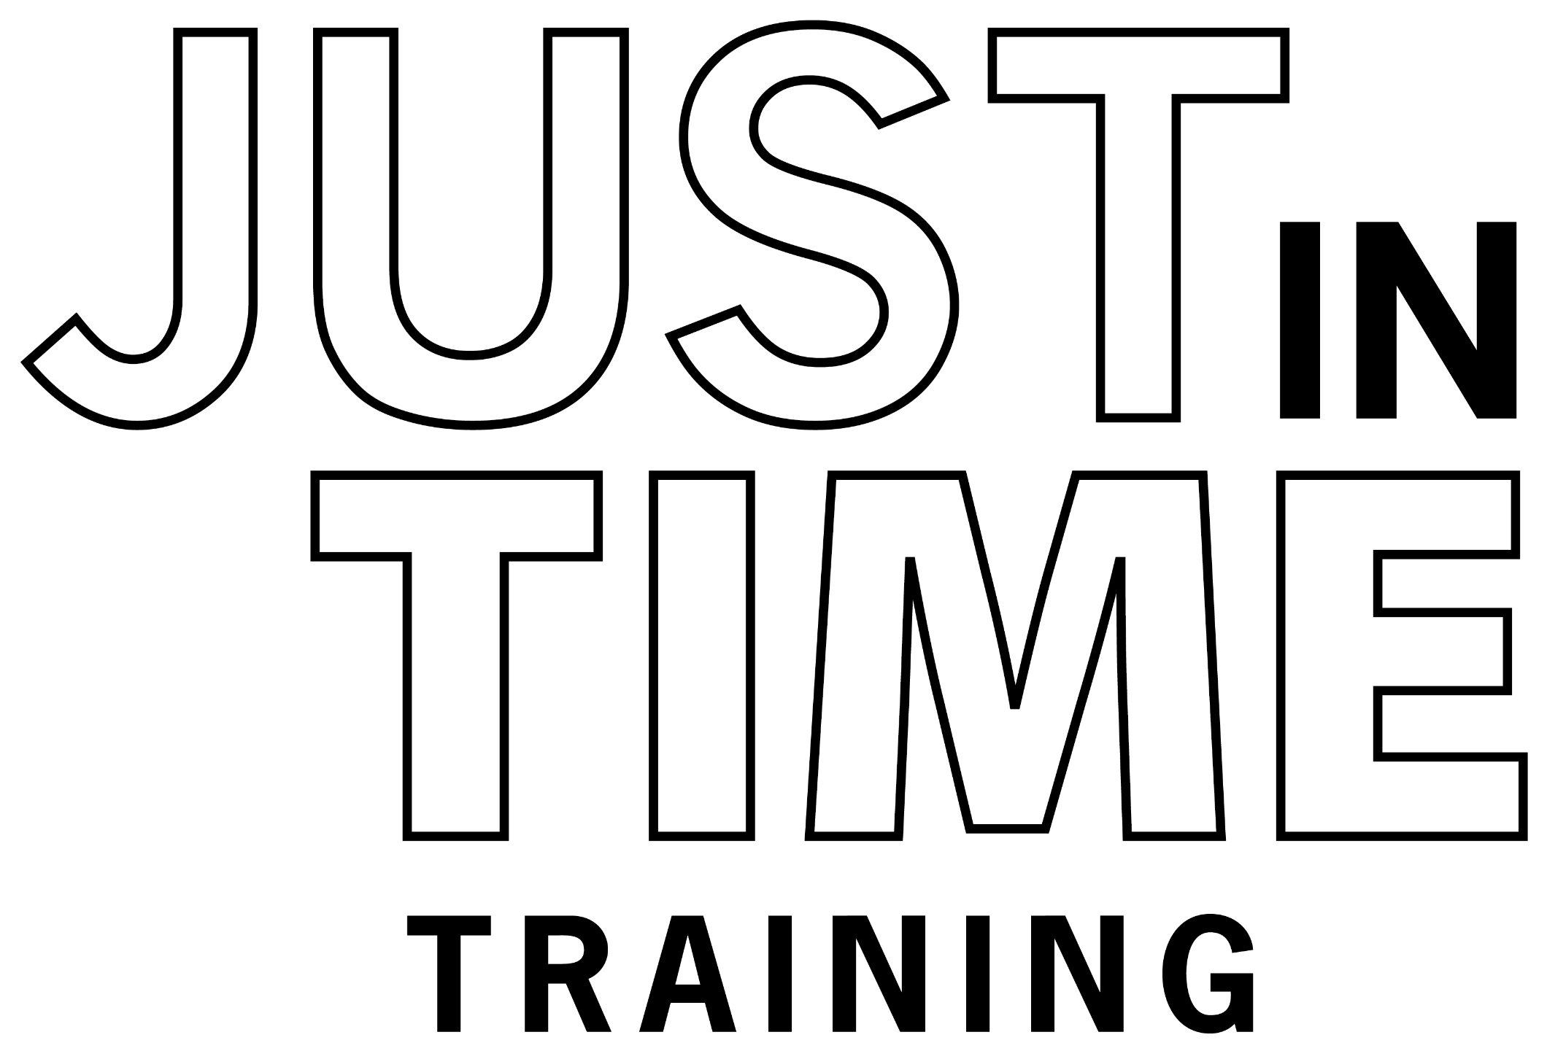
Just in Time Training
Notes:
This Just-in-Time presentation provides an overview of the roles and responsibilities of personnel within the Operations Section of ICS.

Slide 3
What is the
Operations Section of ICS?
Notes:
What is the Operations Section of ICS?

Slide 4
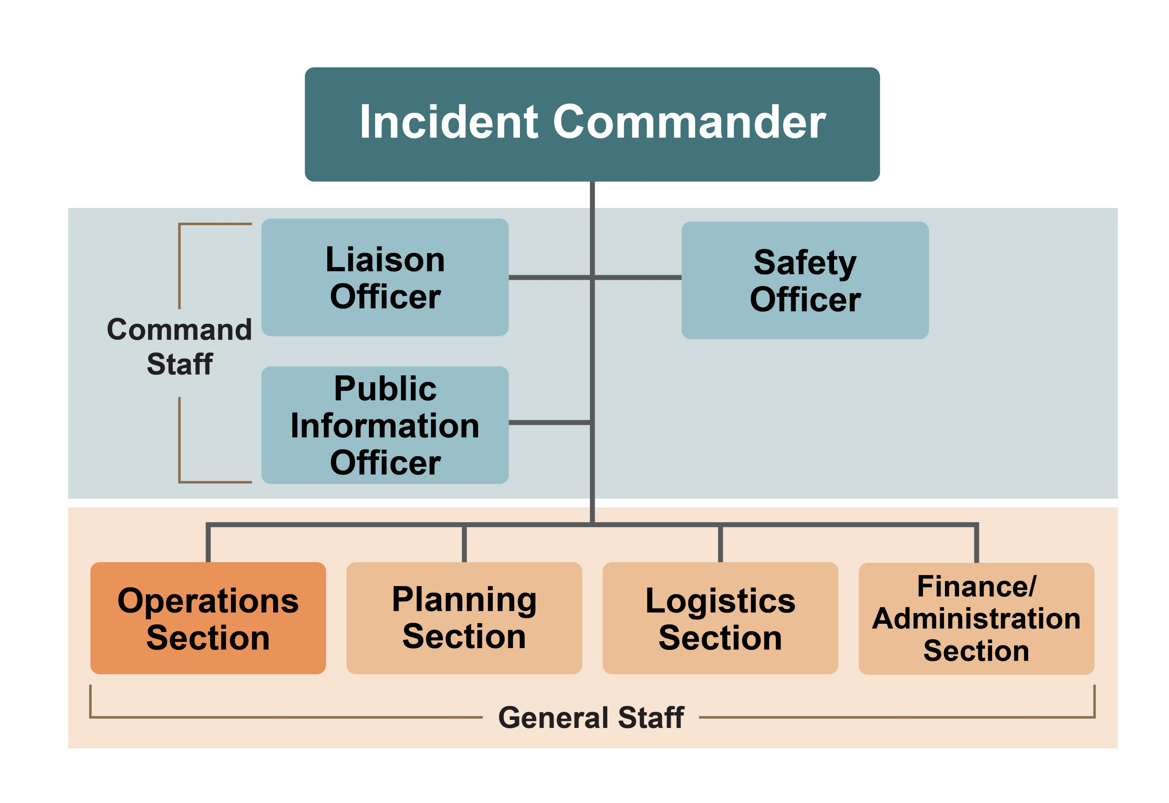
The Operations Section
Performs field-level tasks needed for response goals
Notes:
The Operations Section is a segment of the ICS General Staff. Personnel assigned to this section will be responsible for performing the field-level tasks needed to meet the response goals outlined in the Incident Action Plan.

Slide 5
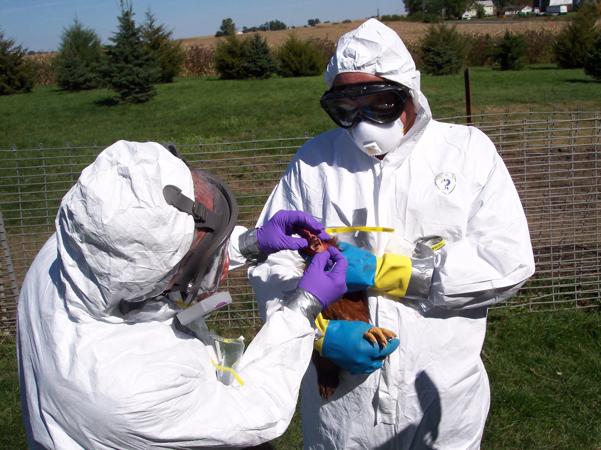
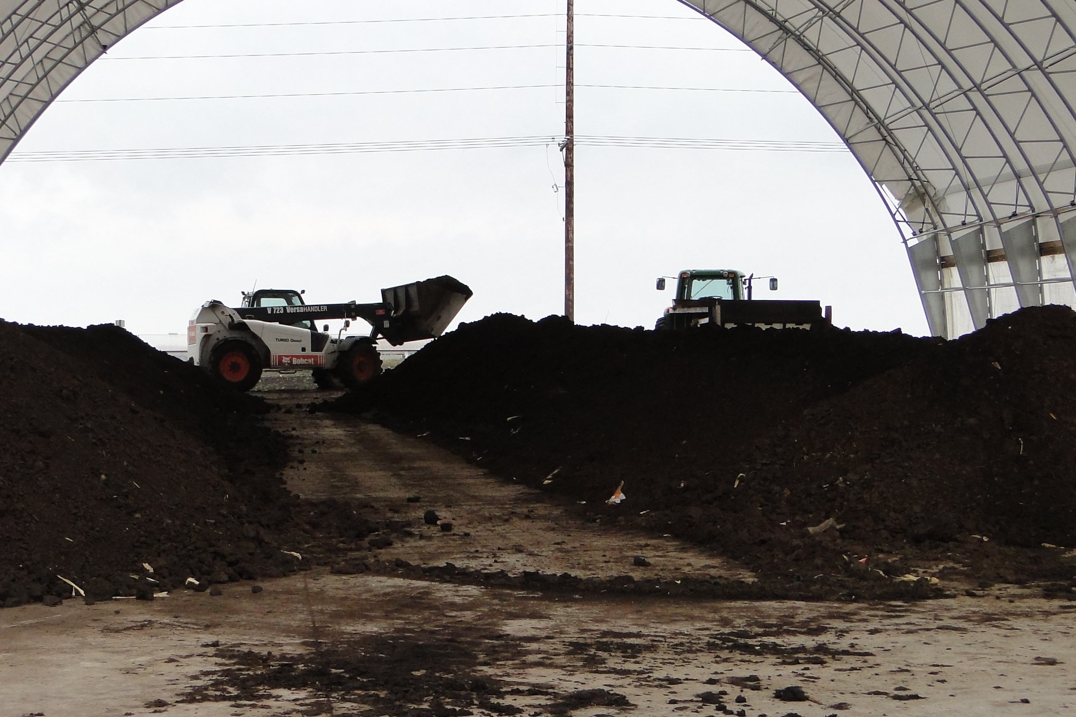
The Operations Section
Notes:
Most available resources are used for response tasks. This can be an individual responder, a piece of equipment and its operator, or a crew or team of individuals assigned to the Operations section.

Slide 6
Roles and Responsibilities
Notes:
Roles and Responsibilities

Slide 7

Operations Section Chief
Assigns and directs tactical personnel and resources
Determines resource needs
Monitors operational progress
during the response
Attends planning meetings
each operational period
Reports to the Incident Commander
Notes:
The Operations Section is managed and supervised by the Operations Section Chief (OSC), who reports to the Incident Commander.
The OSC assigns and directs all tactical personnel and resources for disease control and response strategies, determines additional resource needs, and monitors operational progress during the response.
The OSC attends planning meetings to help develop the strategies and tactics needed to complete the incident action plan for each operational period.

Slide 8
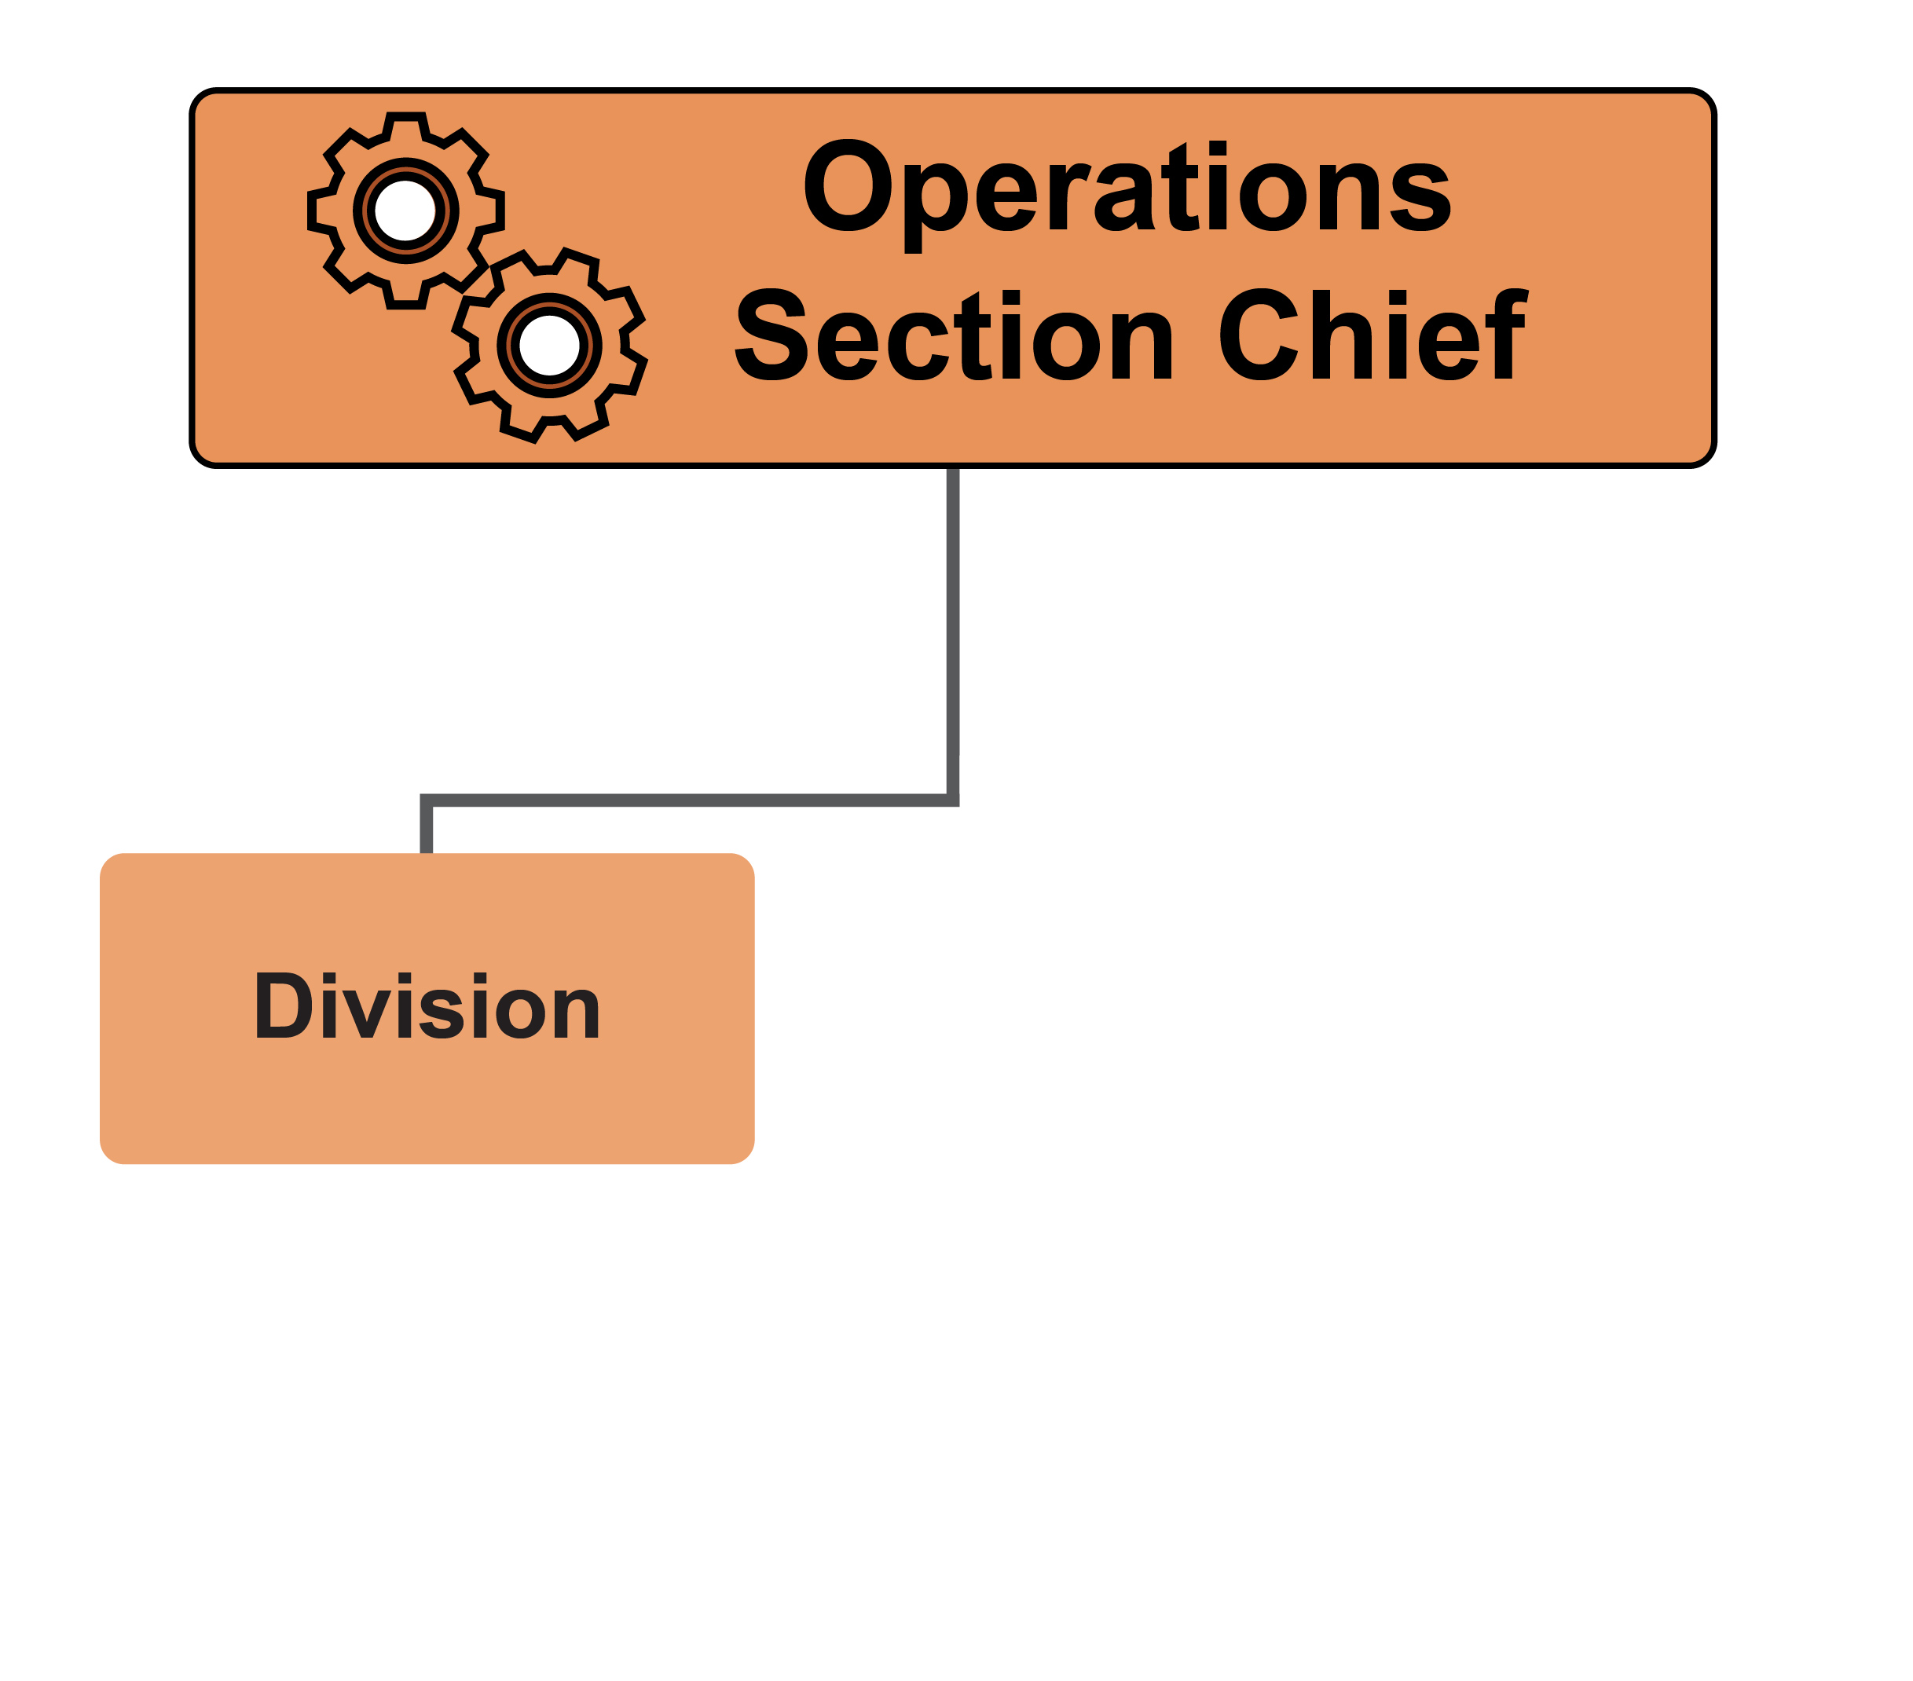
ICS Hierarchy
Division
Geographical area (e.g., town, county)
Division Supervisor
Notes:
The Operations Section can consist of various subsections depending on the size and scale of the response, the required tasks, and the number of personnel involved. Divisions divide Operations personnel or tasks by geographical areas (e.g., a town or county). Each Division is led by a Division Supervisor, who reports to the Operations Section Chief.

Slide 9
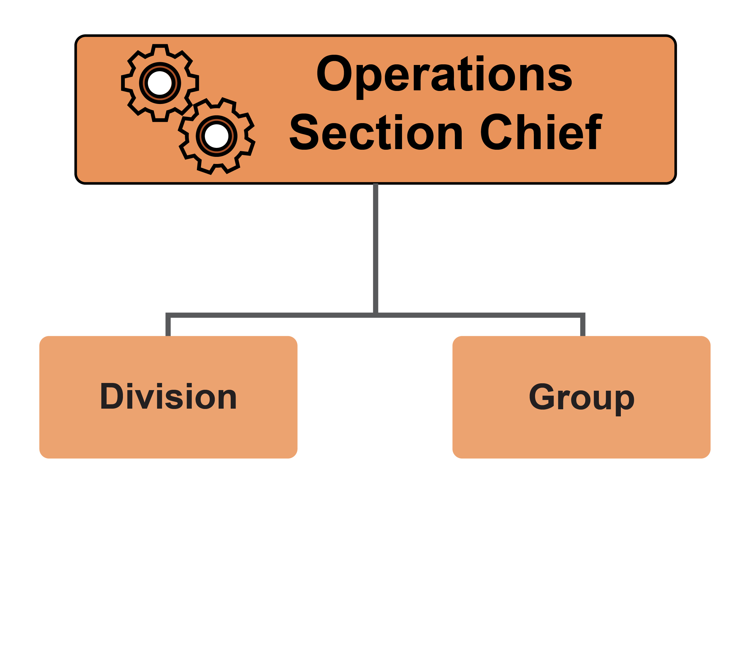
ICS Hierarchy
Group
Functional
area or task
Group Supervisor
Notes:
Groups divide personnel or tasks into functional areas or assigned tasks, such as disease diagnosis, biosecurity, or carcass disposal. Led by a Group Supervisor, these groups are not limited geographically and work wherever they are needed. Groups are normally labeled by the job they are assigned.

Slide 10
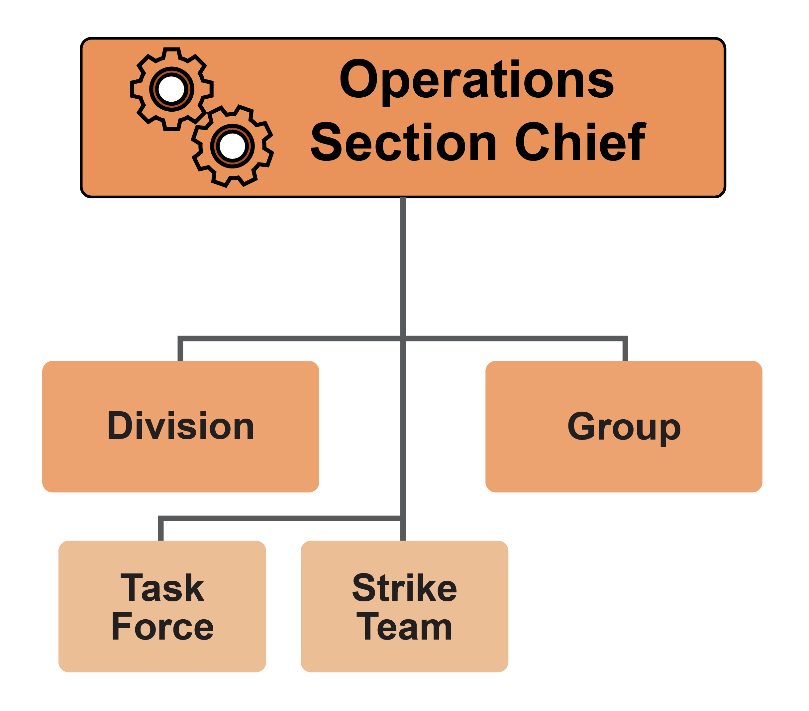
ICS Hierarchy
Crews with Specific Duties
Task Force:
mixed resources
Strike Team:
similar resources
Led by Leader
Notes:
The Operations Section organization can also include crews or teams with specific duties.
A Task Force involves a combination of mixed resources with a specific mission. For example, a Depopulation and Disposal Task Force, or a Cleaning and Disinfection or Biosecurity Task Force. Task Force members operate under the direct supervision of a Task Force Leader.
A Strike Team involves a group of similar resources (e.g., a surveillance strike team that conducts sampling on at-risk premises). Personnel are under the direct supervision of a Strike Team Leader.

Slide 11
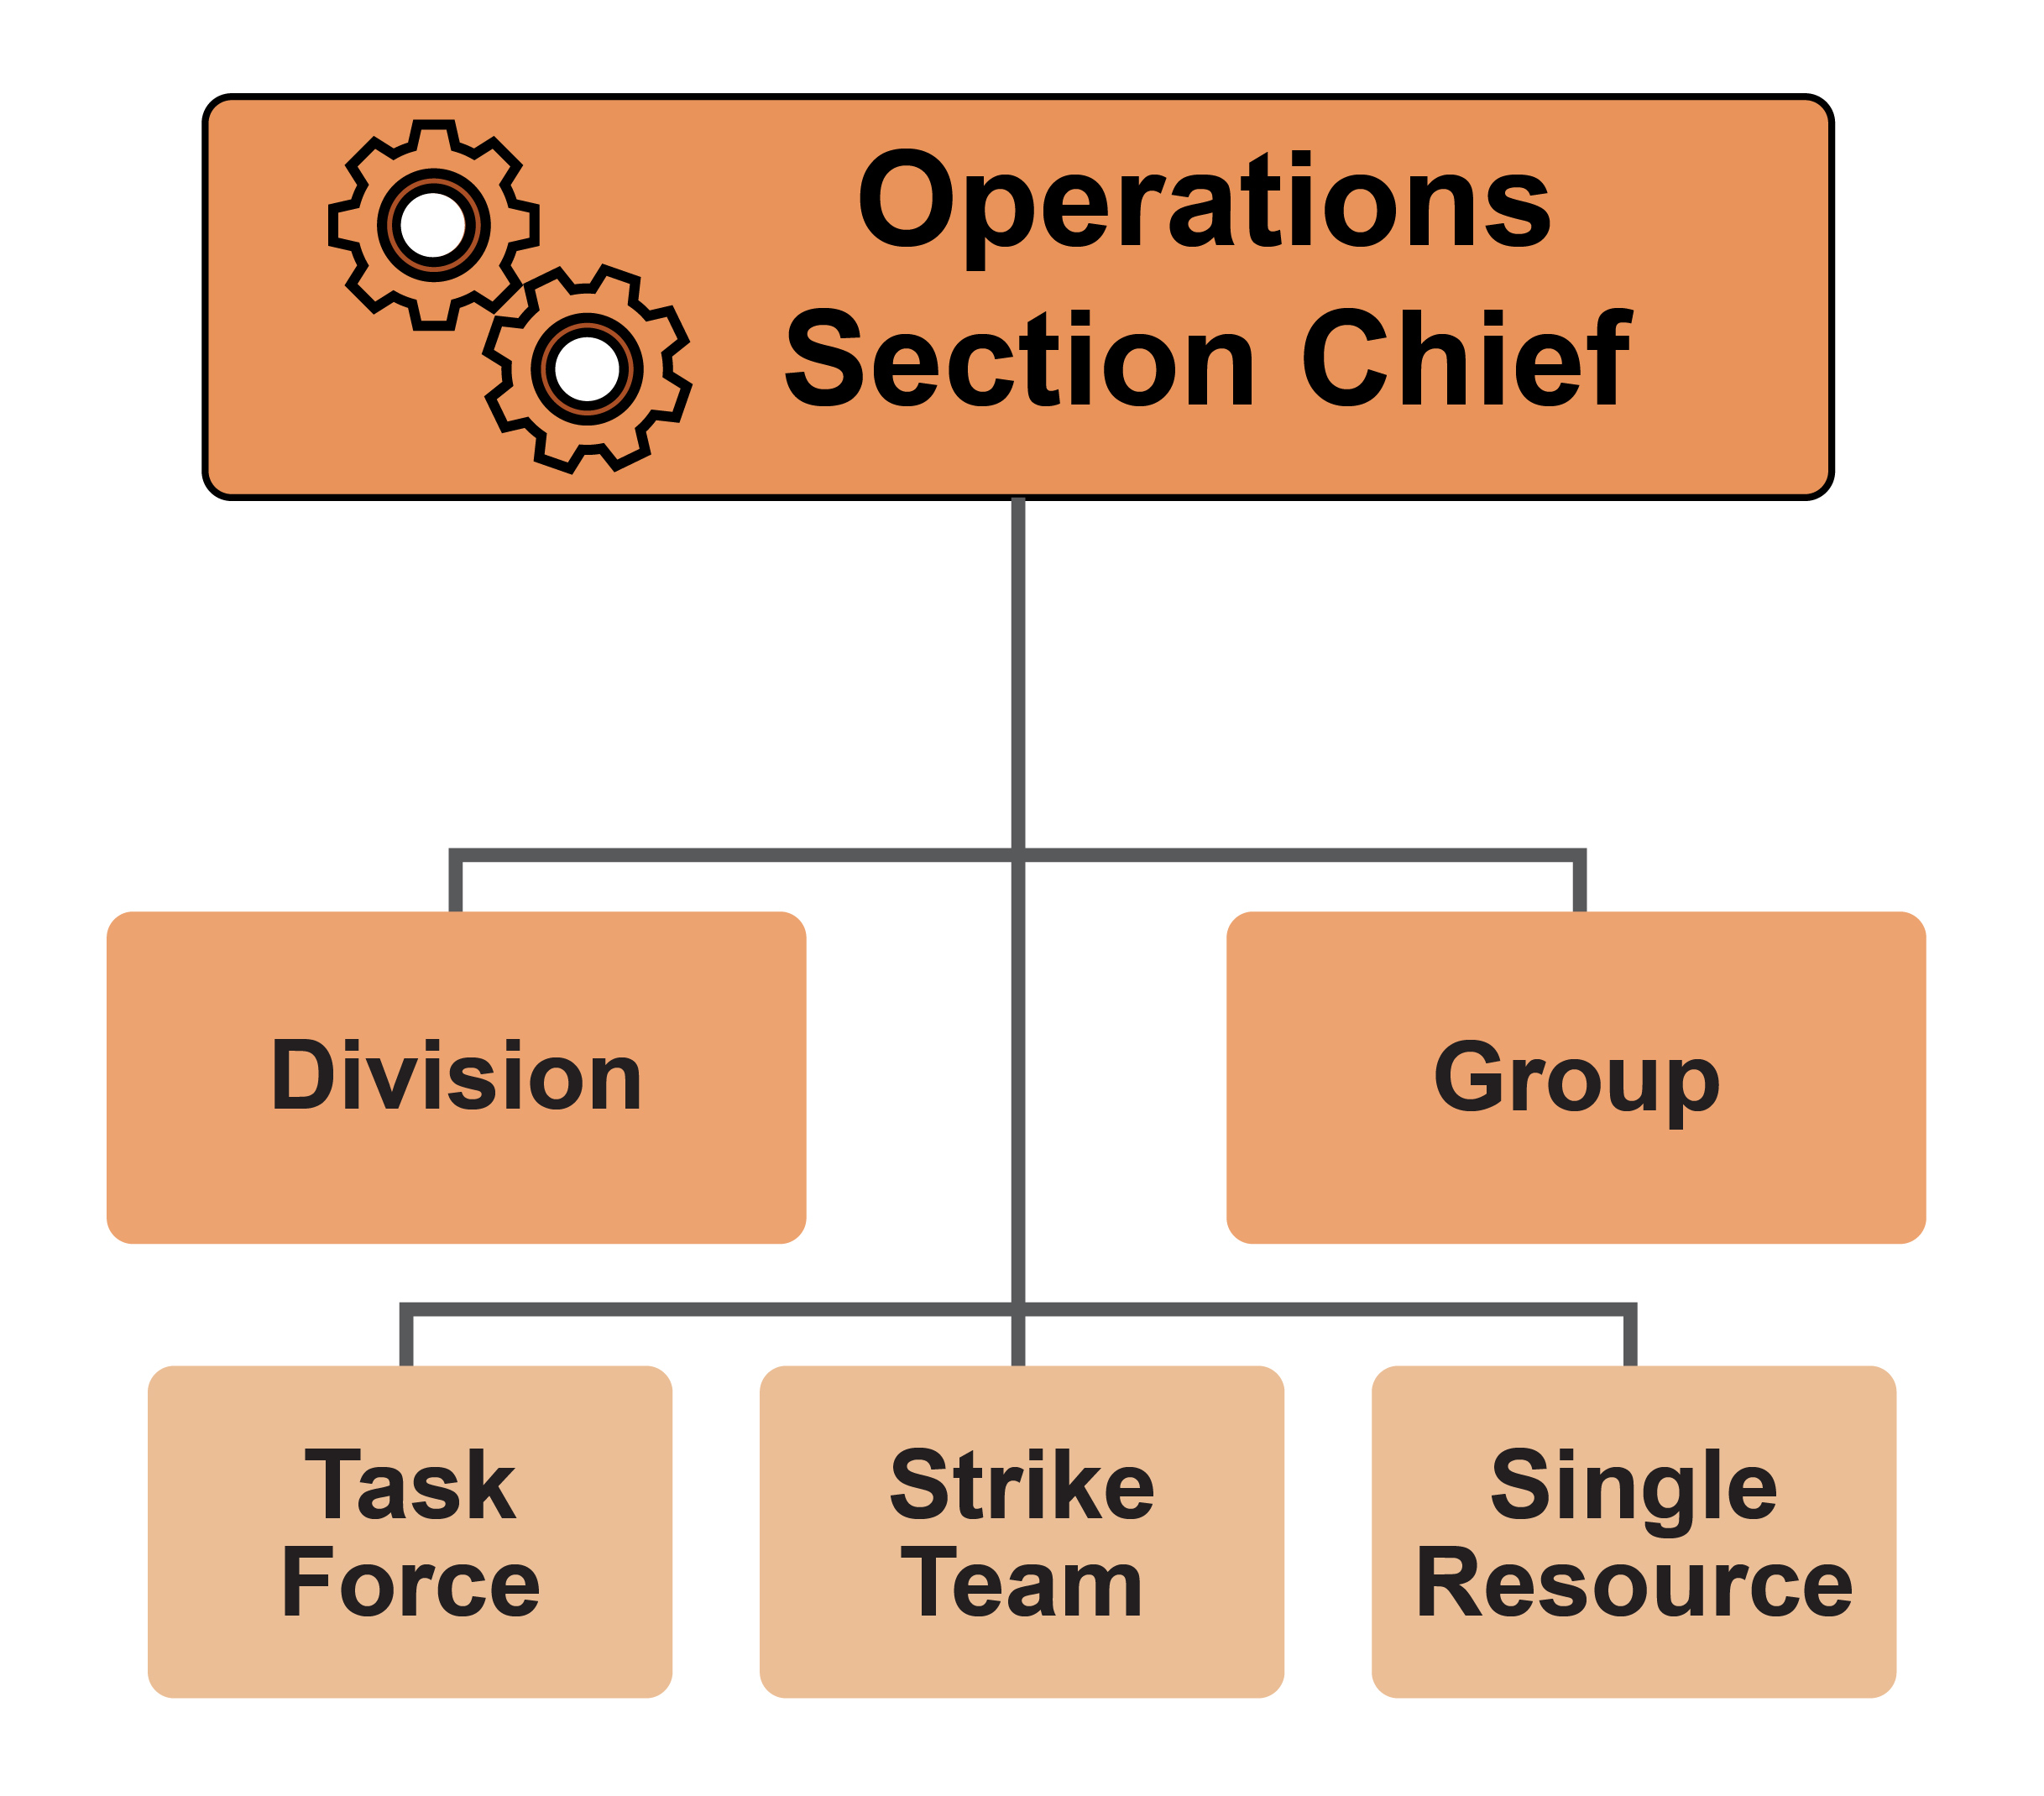
ICS Hierarchy
Single Resource
Individual
Piece of equipment
Crew or team
Notes:
Single Resources may be individuals, a piece of equipment and its personnel complement, or a crew or team of individuals with an identified supervisor.

Slide 12
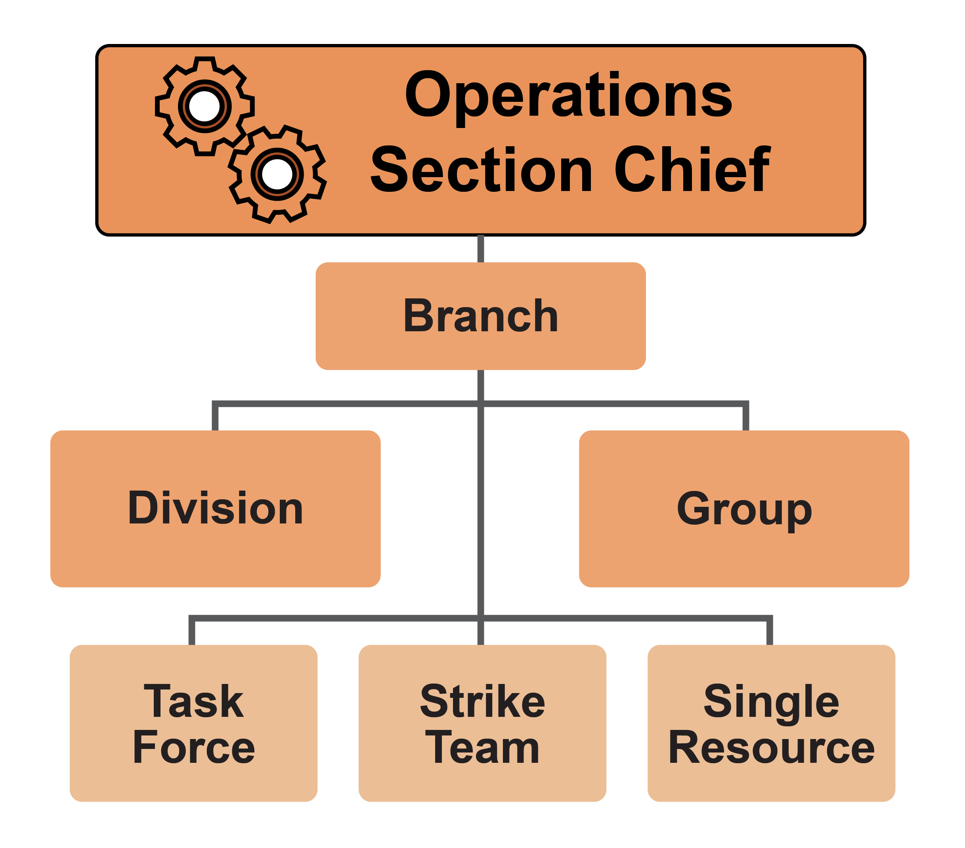
ICS Hierarchy
Branch
Organizes several Divisions or Groups
Branch Director
Notes:
A Branch may be used for larger responses to group several Divisions or Groups. Each Branch is led by a Branch Director, who may also designate Deputies to assist in management. A Branch can be either geographical or functional. Divisions and Groups are at an equal level in the organization and can be used together for an incident. Division or Group Supervisors report to Branch Directors or the OSC.

Slide 13
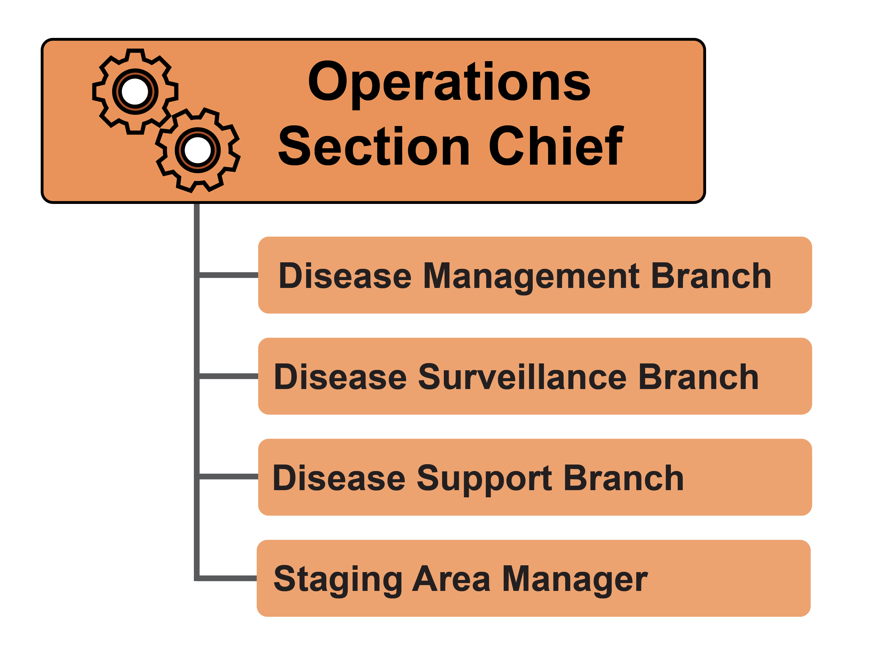
Operations Section
Operations personnel may have responsibilities
in one specific area or
multiple areas
for different operational periods
Notes:
For animal emergency responses, various tasks will fall within the Operations Section. These may include disease management, disease surveillance, disease support, and a staging area manager. Operations Section personnel may have responsibilities in one specific area or multiple areas for different operational periods (e.g., on different days). For example, a veterinarian may perform diagnostic work on one day, and euthanasia or mass depopulation tasks on subsequent days.

Slide 14
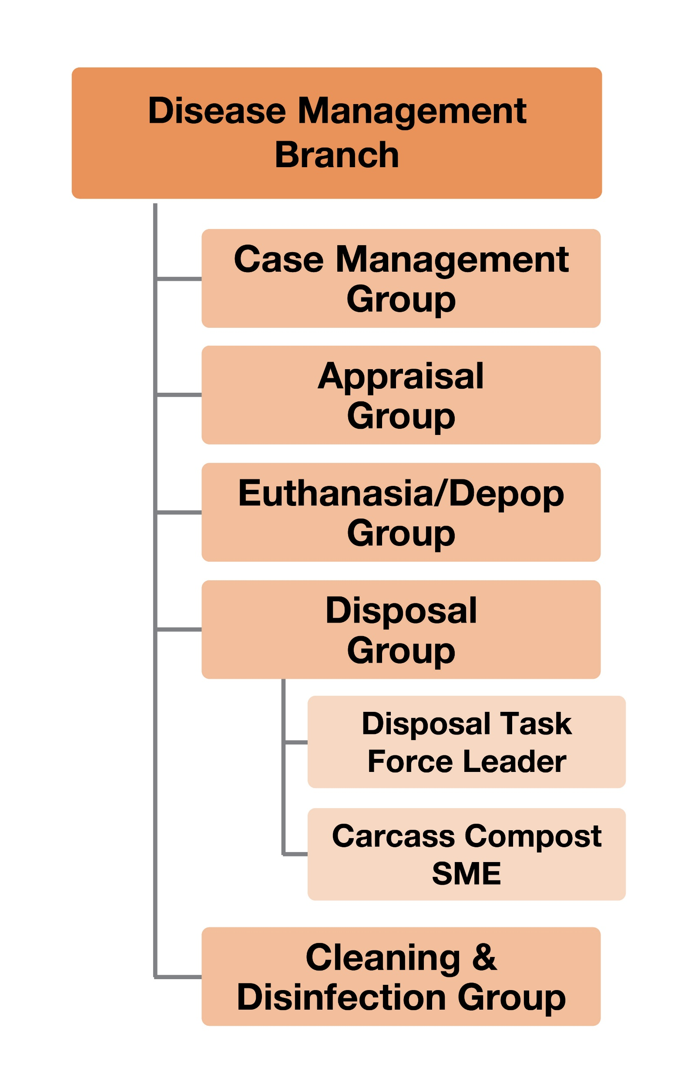
Disease Management Branch
Disease Management
Case management
Appraisal
Euthanasia or mass depopulation
Carcass disposal
Cleaning and disinfection
Vaccination
Notes:
Disease management tasks may include case management, appraisal, euthanasia or mass depopulation, carcass disposal, cleaning and disinfection, or vaccination (when applicable).

Slide 15
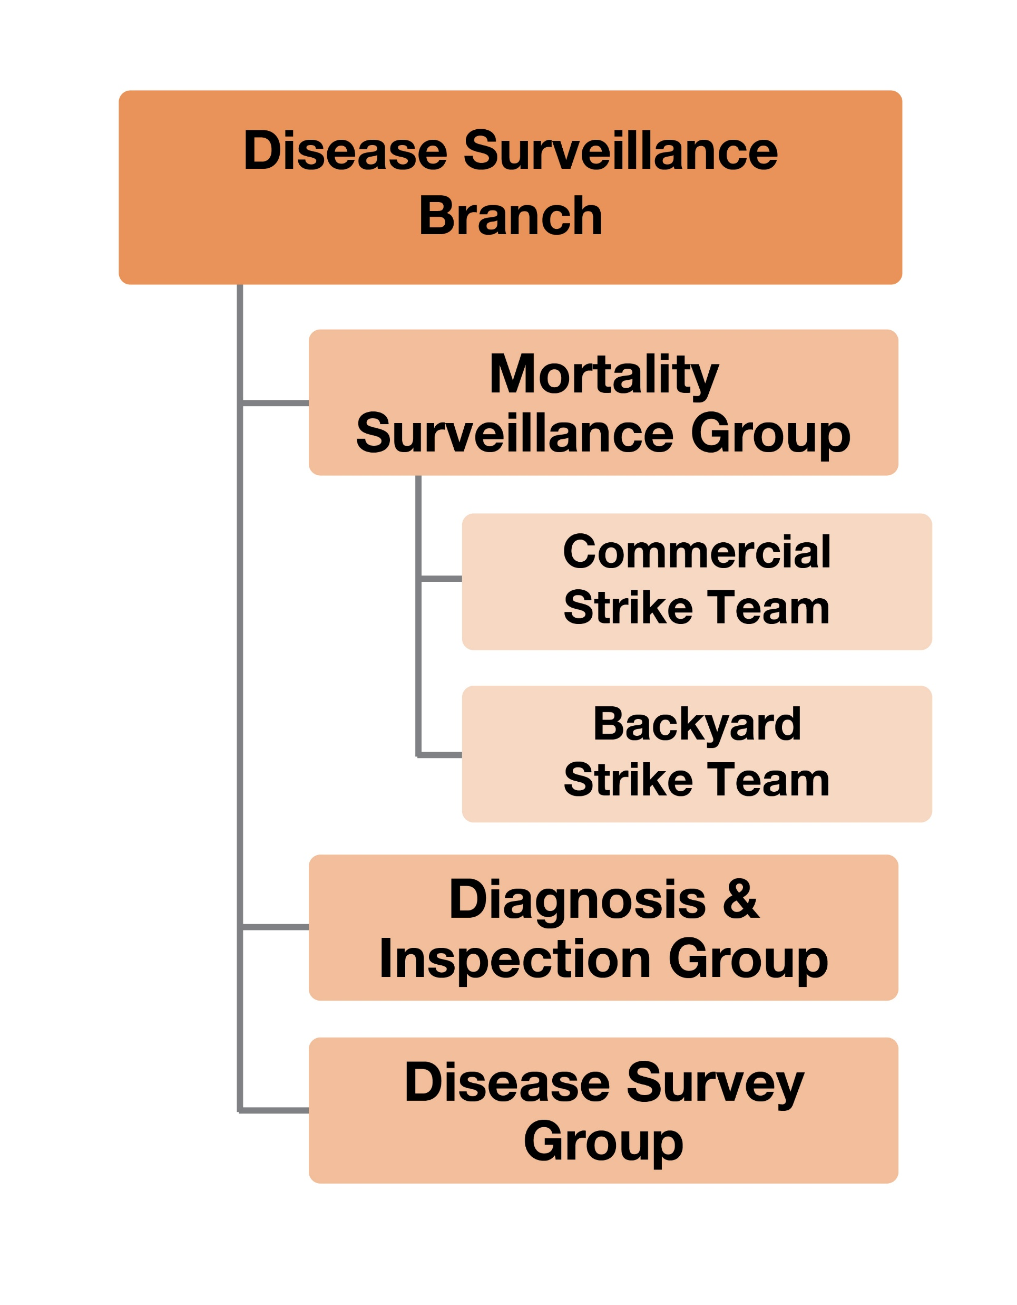
Disease Surveillance Branch
Disease Surveillance
Mortality surveillance
Diagnosis
Inspection
Epidemiology
Notes:
Disease surveillance tasks can include mortality surveillance, diagnosis, inspection, and epidemiology.

Slide 16
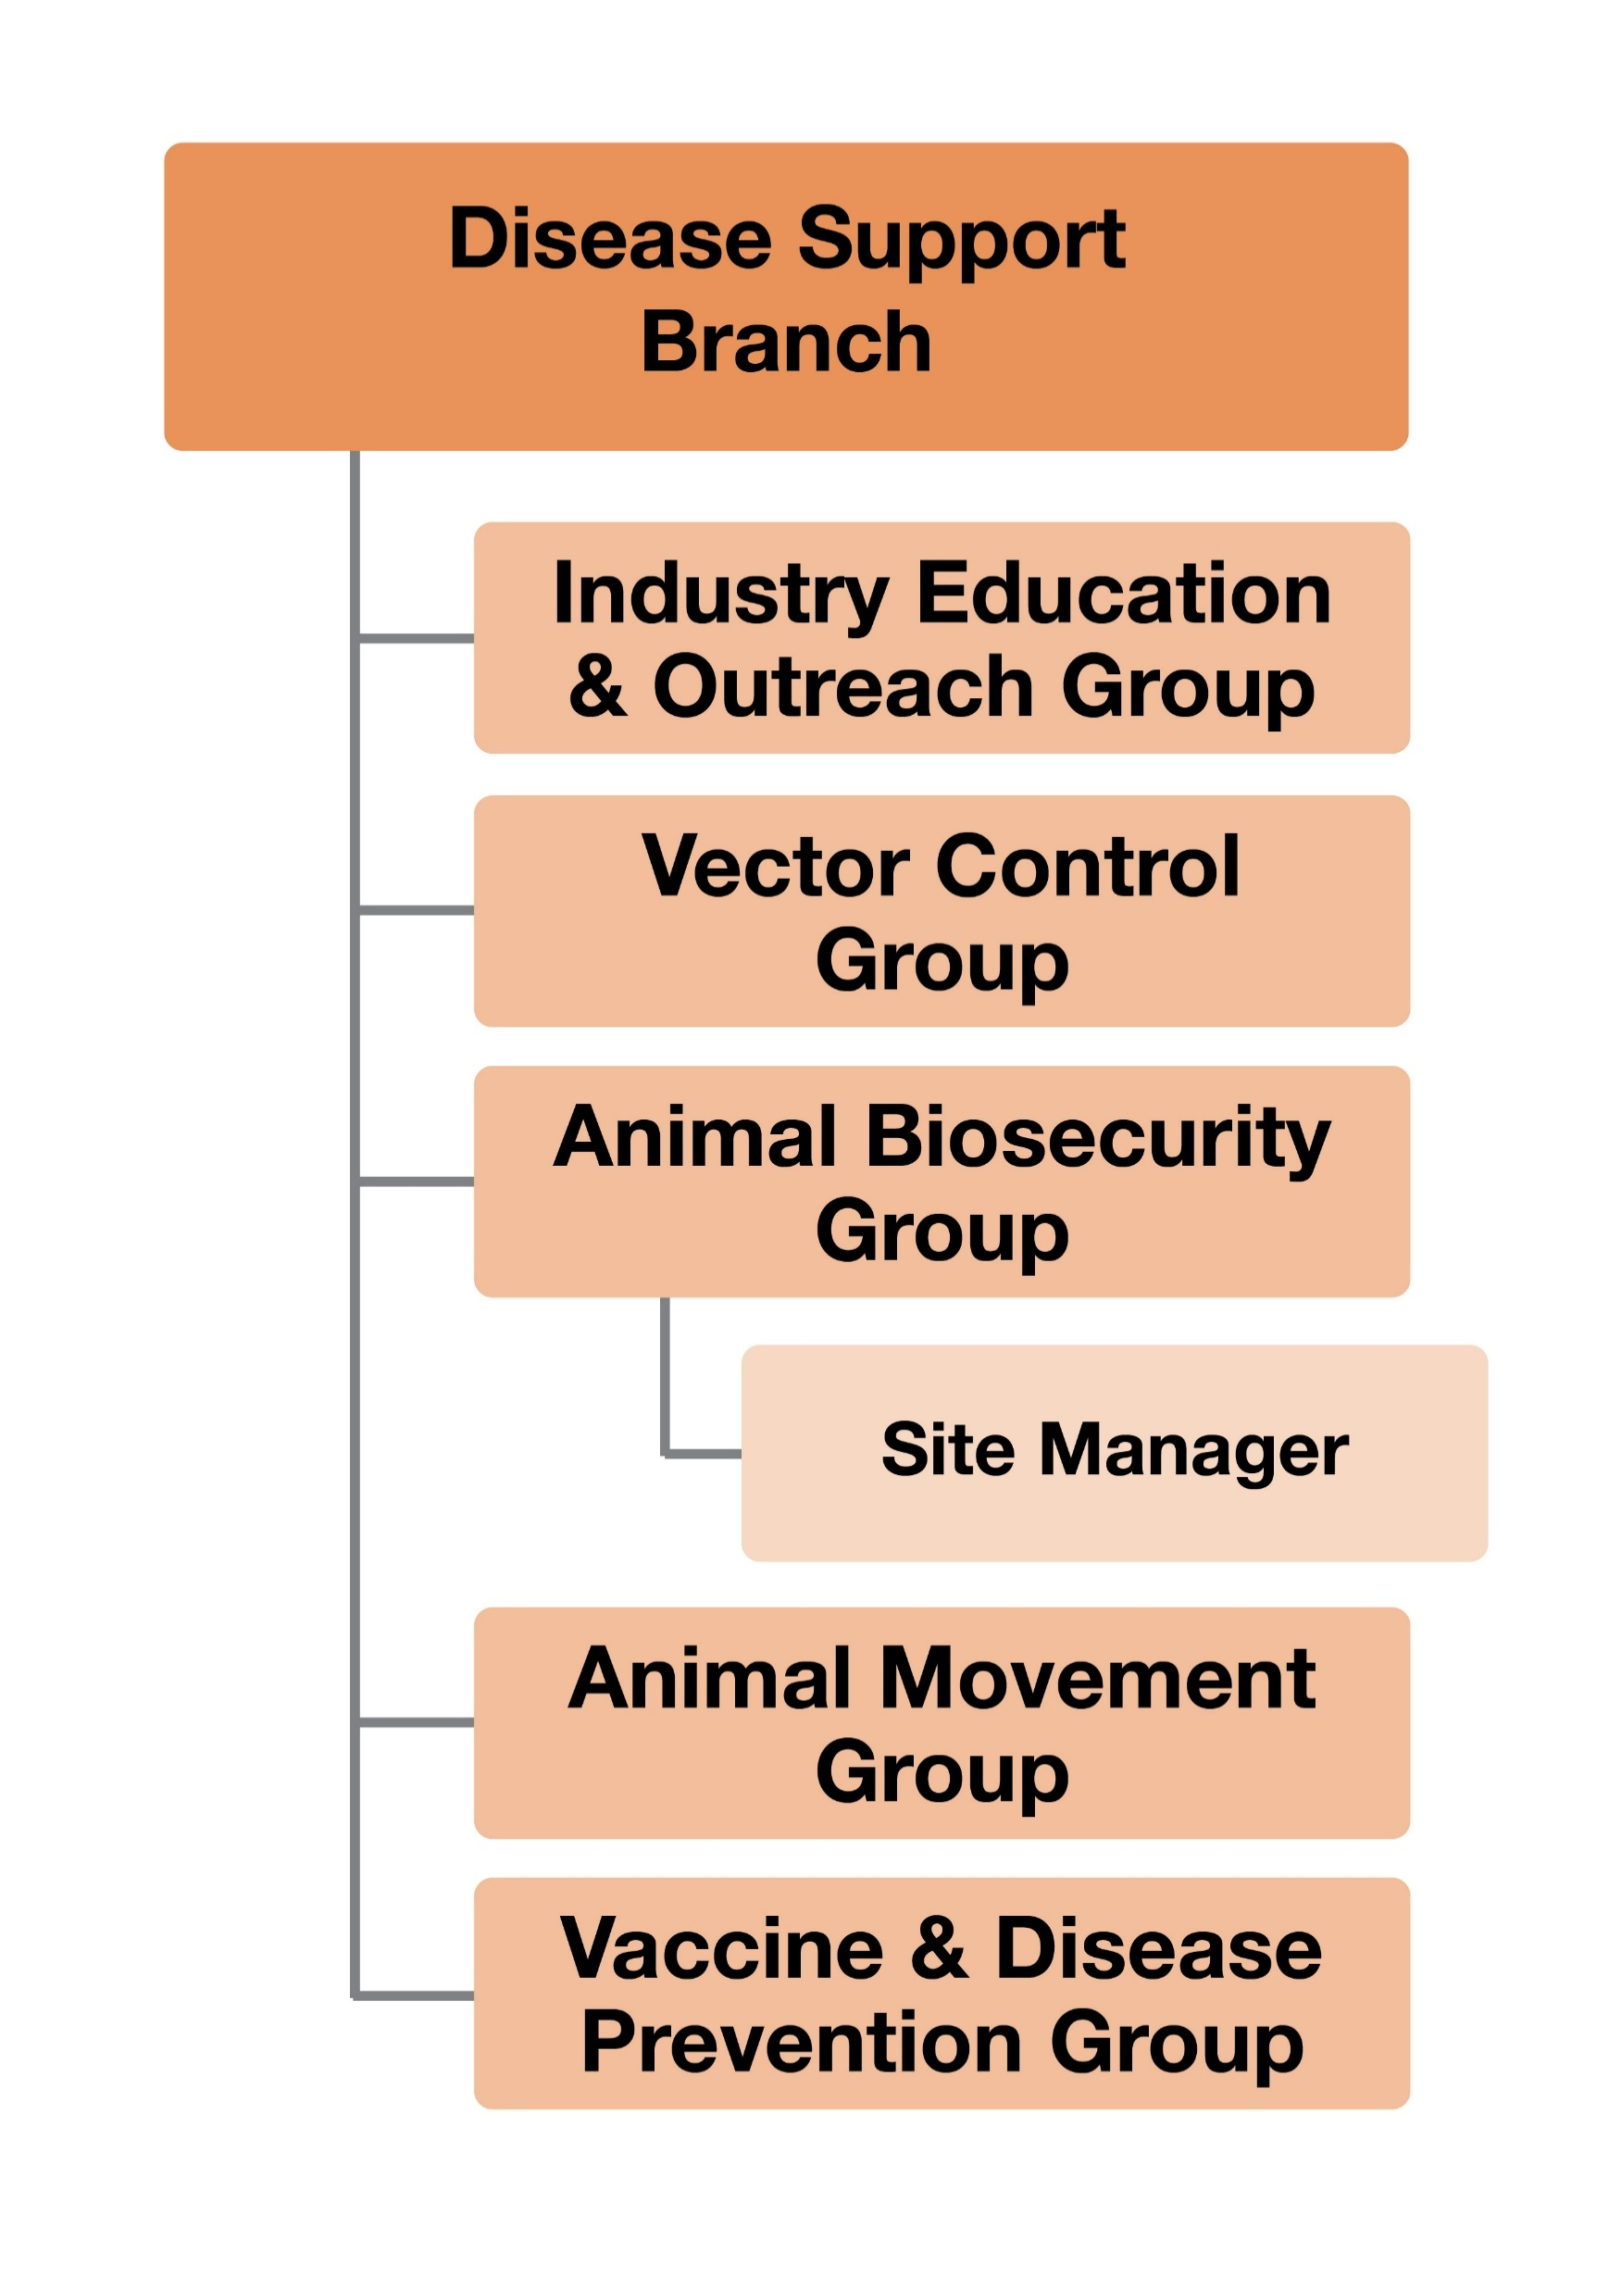
Disease Support Branch
Disease Support
Animal movement and permitting
Biosecurity
Education and outreach
Vector control
Notes:
Disease support functions address tasks such as animal movement and permitting, biosecurity, education and outreach, or vector control.

Slide 17
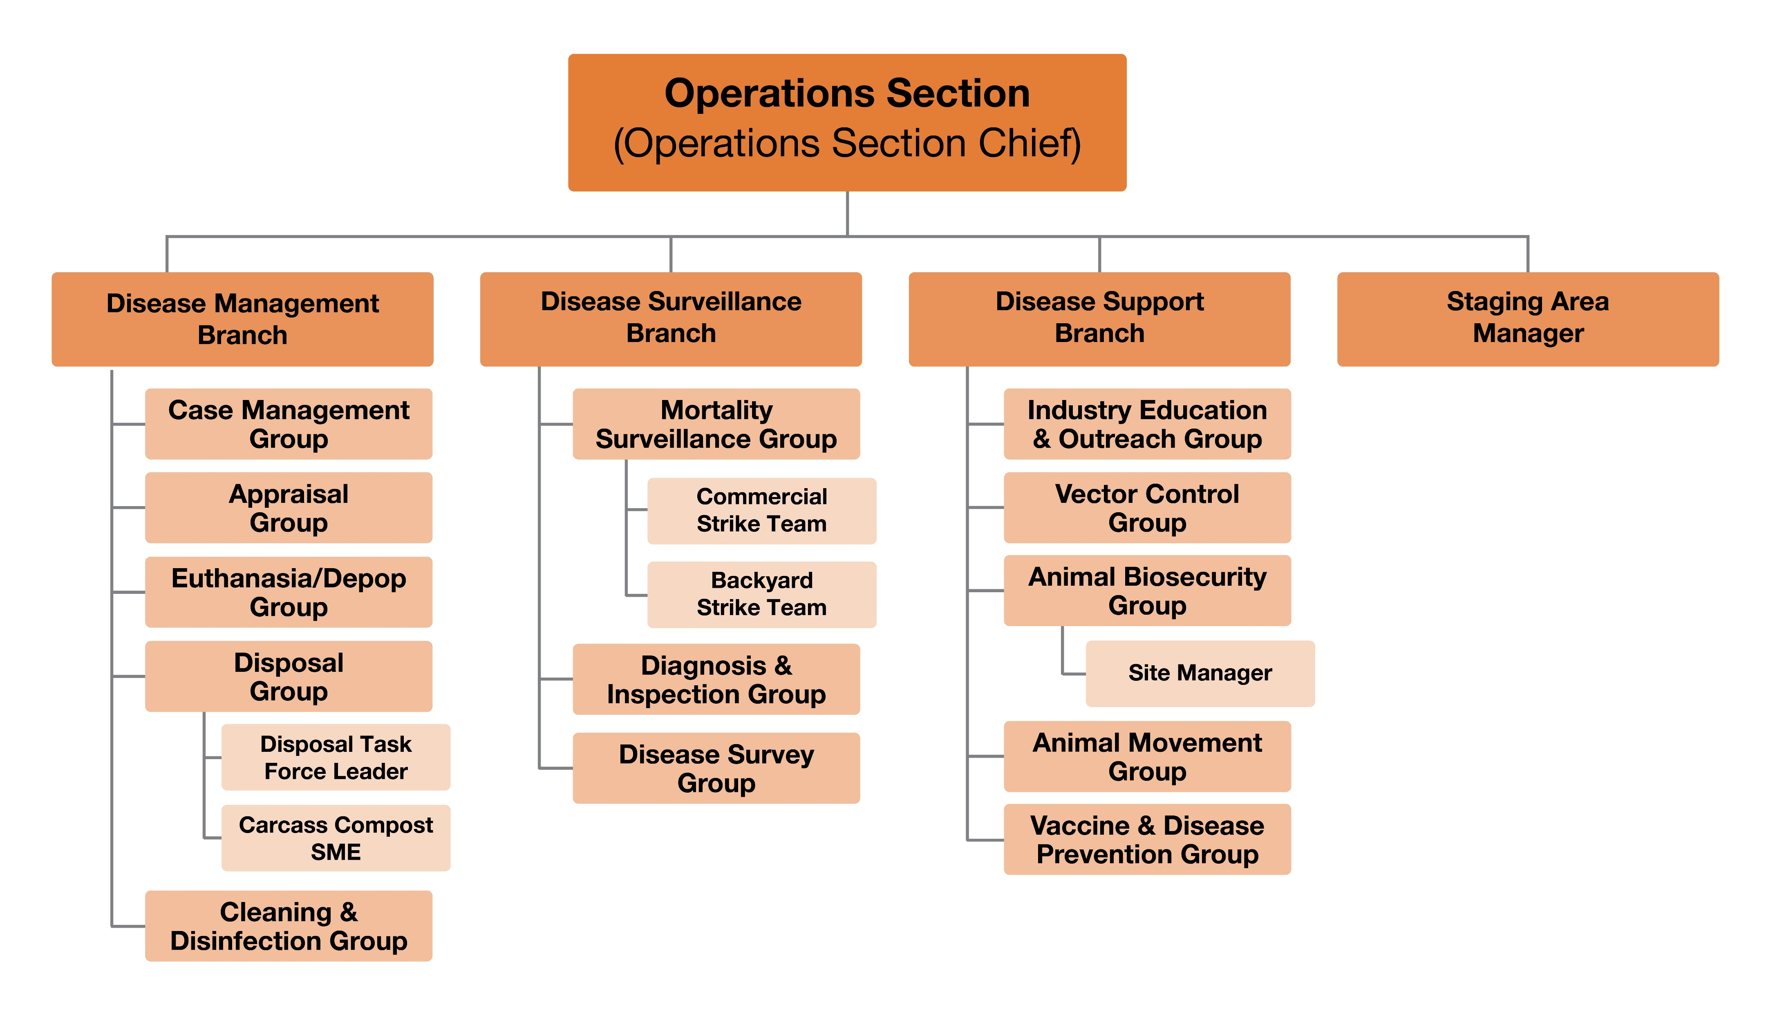
Operations Section Hierarchy
Notes:
The Operations Section also includes a designated Staging Manager, who tracks all resources – personnel, equipment, and teams – arriving at the Staging Area, and ensures they are ready for immediate assignment.
If a group within Operations is not staffed, the OSC is responsible for those functions and activities.

Slide 18
How Animal Industry Stakeholders Can Help
Notes:
How Animal Industry Stakeholders Can Help

Slide 19

Animal Industry
Critical role
Premises access, animal inventories
Supporting trace investigations
Humane animal care, handling, movement control
On-farm biosecurity
Provide equipment, supplies, facilities or specialized expertise
Expertise on production patterns, barn layout or animal flow
Notes:
Animal industry stakeholders play a critical role in nearly every Operations Section branch. Their expertise, equipment, facilities, and local knowledge make them valuable partners in carrying out tactical field operations. Animal industry roles may include:
Providing premises access and animal inventories.
Supporting trace investigations (movement logs, feed routes, personnel rosters).
Assisting with humane animal care and handling, movement control.
Implementing on-farm biosecurity measures
Providing equipment, supplies, facilities or specialized expertise for depopulation, disposal or cleaning and disinfection tasks, or operating transport vehicles.
Offering expertise on normal production patterns, barn layout or animal flow.

Slide 20
Animal Industry
Case Manager
Often part of the Operations Section
Primary point of contact
Provide information
Answer questions
Liaison between response teams and activities
Notes:
Case Managers, often part of the Operations Section, serve as the primary point of contact for owners and producers during an emergency response. They provide information, help answer questions, and serve as liaisons between producers and response personnel to coordinate actions such as depopulation and disposal, cleaning and disinfection, and, when applicable, indemnity and compensation claims.

Slide 21
Key Points
Operations Section performs a wide range of field-level tasks
Industry stakeholders can assist and support responses
Know who your supervisor is
Notes:
Personnel within the Operations Section perform field-level tasks needed to meet the response goals outlined in the Incident Action Plan. A wide range of tasks falls under the Operations Section, including disease management, surveillance, and support functions. Most response resources, including responders, are assigned to the Operations section.
Animal industry stakeholders play a critical role in assisting and supporting the Operations Section.
Depending on the size and scale of a response, the Operations Section may be divided into various groupings with standardized names. Be sure to understand your assigned role and who your supervisor is.

Slide 22

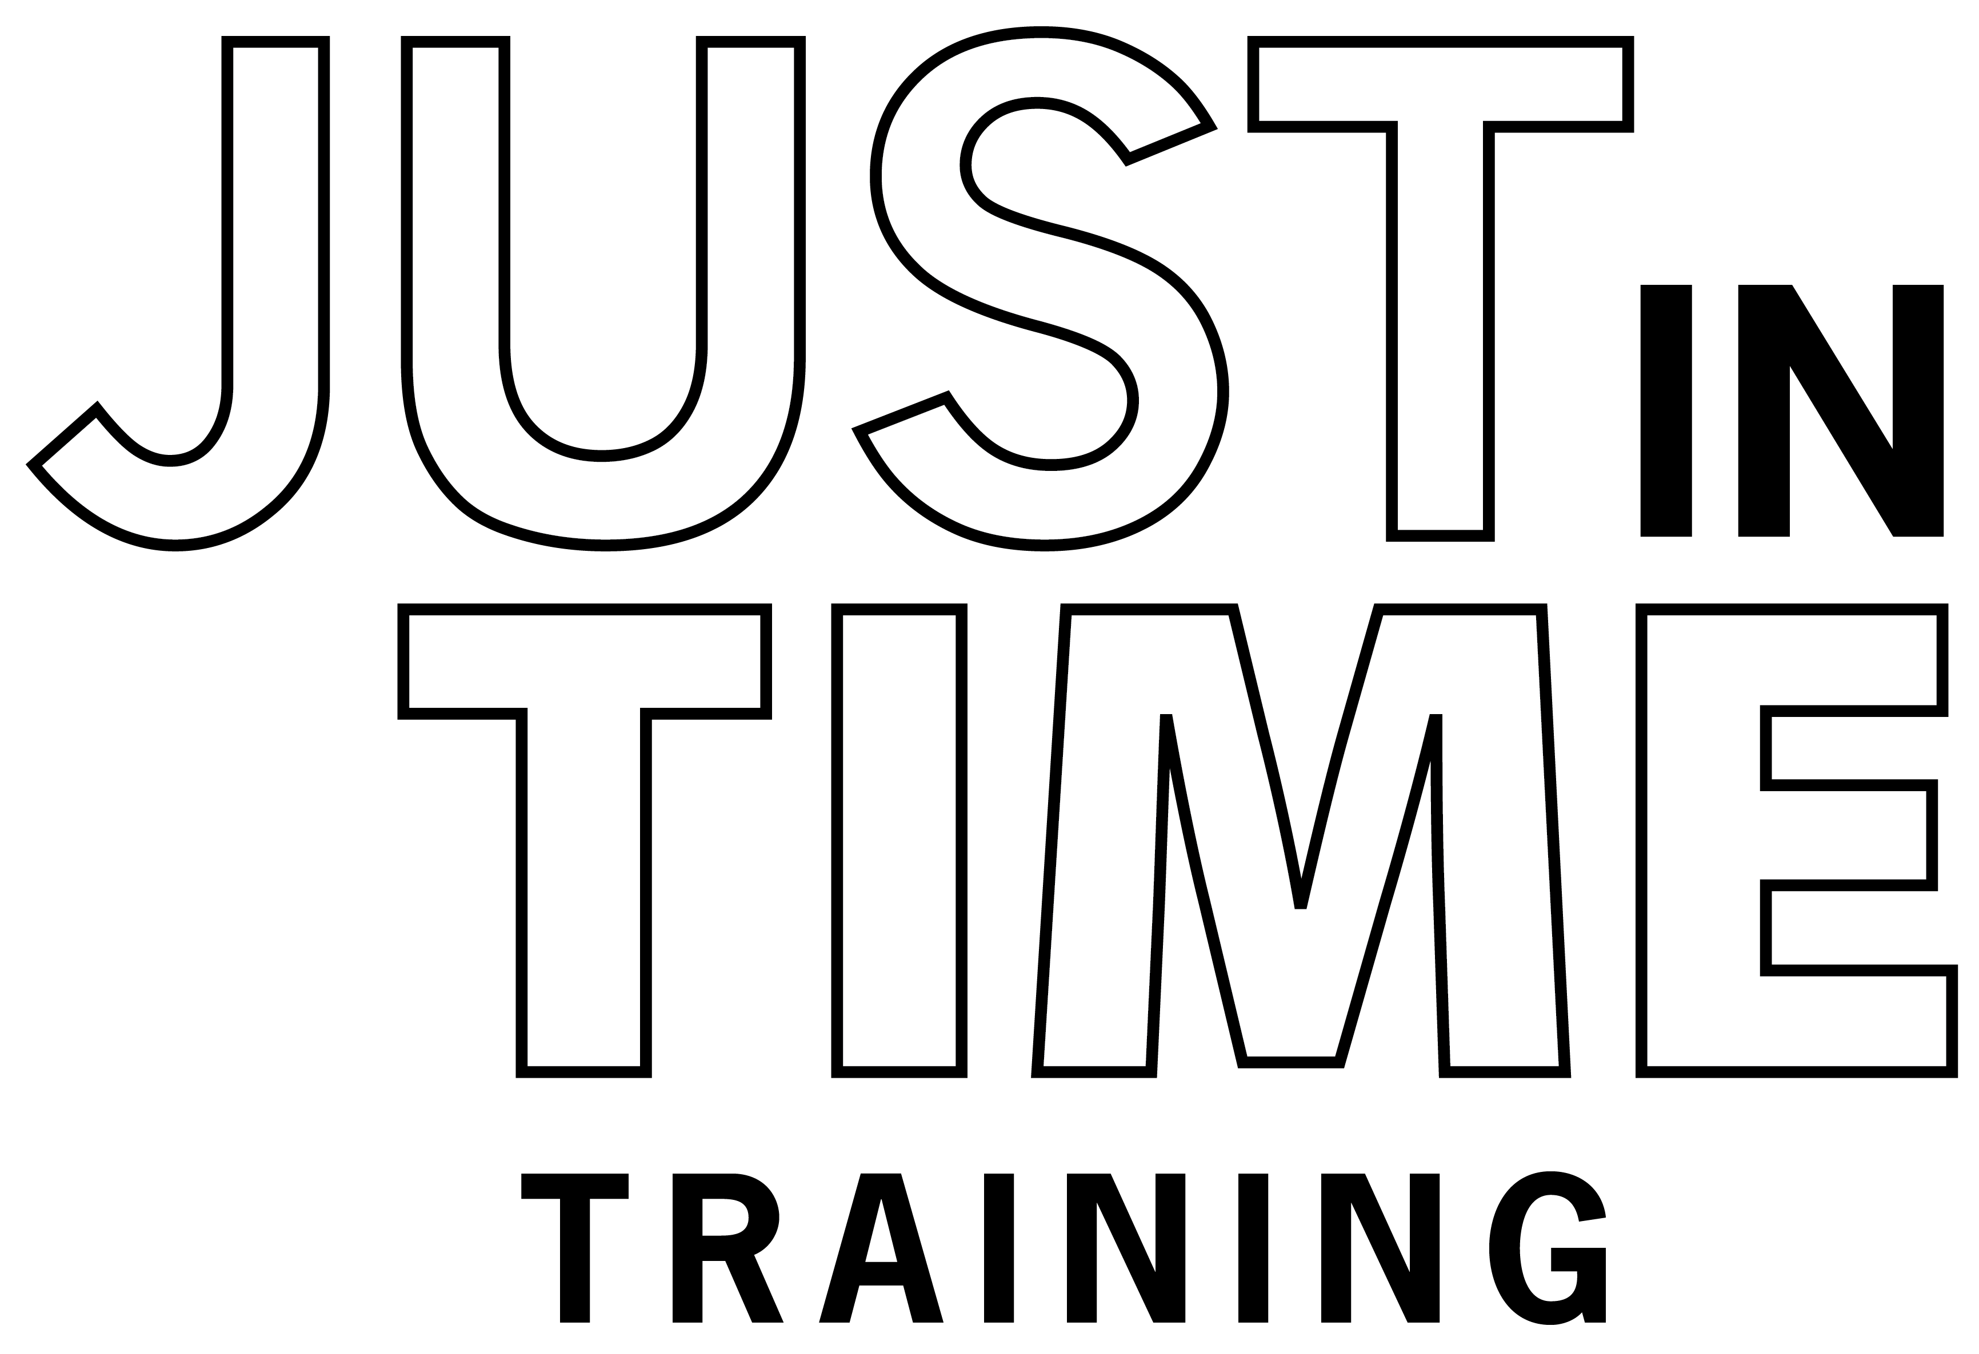

Additional
JIT Videos
Notes:
Additional Just-In-Time trainings describing the roles and responsibilities of each General Staff section and the Operational Planning Period are available on the Just-in-Time Training website.

Slide 23
Acknowledgements
Development of this material was made possible through grants provided to the Center for Food Security and Public Health at Iowa State University, College of Veterinary Medicine, from
the U.S. Department of Agriculture (USDA) Animal and Plant Health Inspection Service (APHIS) National Animal Disease Preparedness and Response Program (NADPRP), and
the Michigan Department of Agriculture and Rural Development.
Notes:
Development of this training module was made possible through a grant provided to the Center for Food Security and Public Health at Iowa State University, College of Veterinary Medicine from the U.S. Department of Agriculture Animal and Plant Health Inspection Service through the National Animal Disease Preparedness and Response Program and the Michigan Department of Agriculture and Rural Development.

