Slide 1



Animal Disease Emergency
Response
ADE Work Zones
Notes:
During an animal disease emergency, biosecurity work zones will be established to coordinate and control access and activities for the response site.

Slide 2
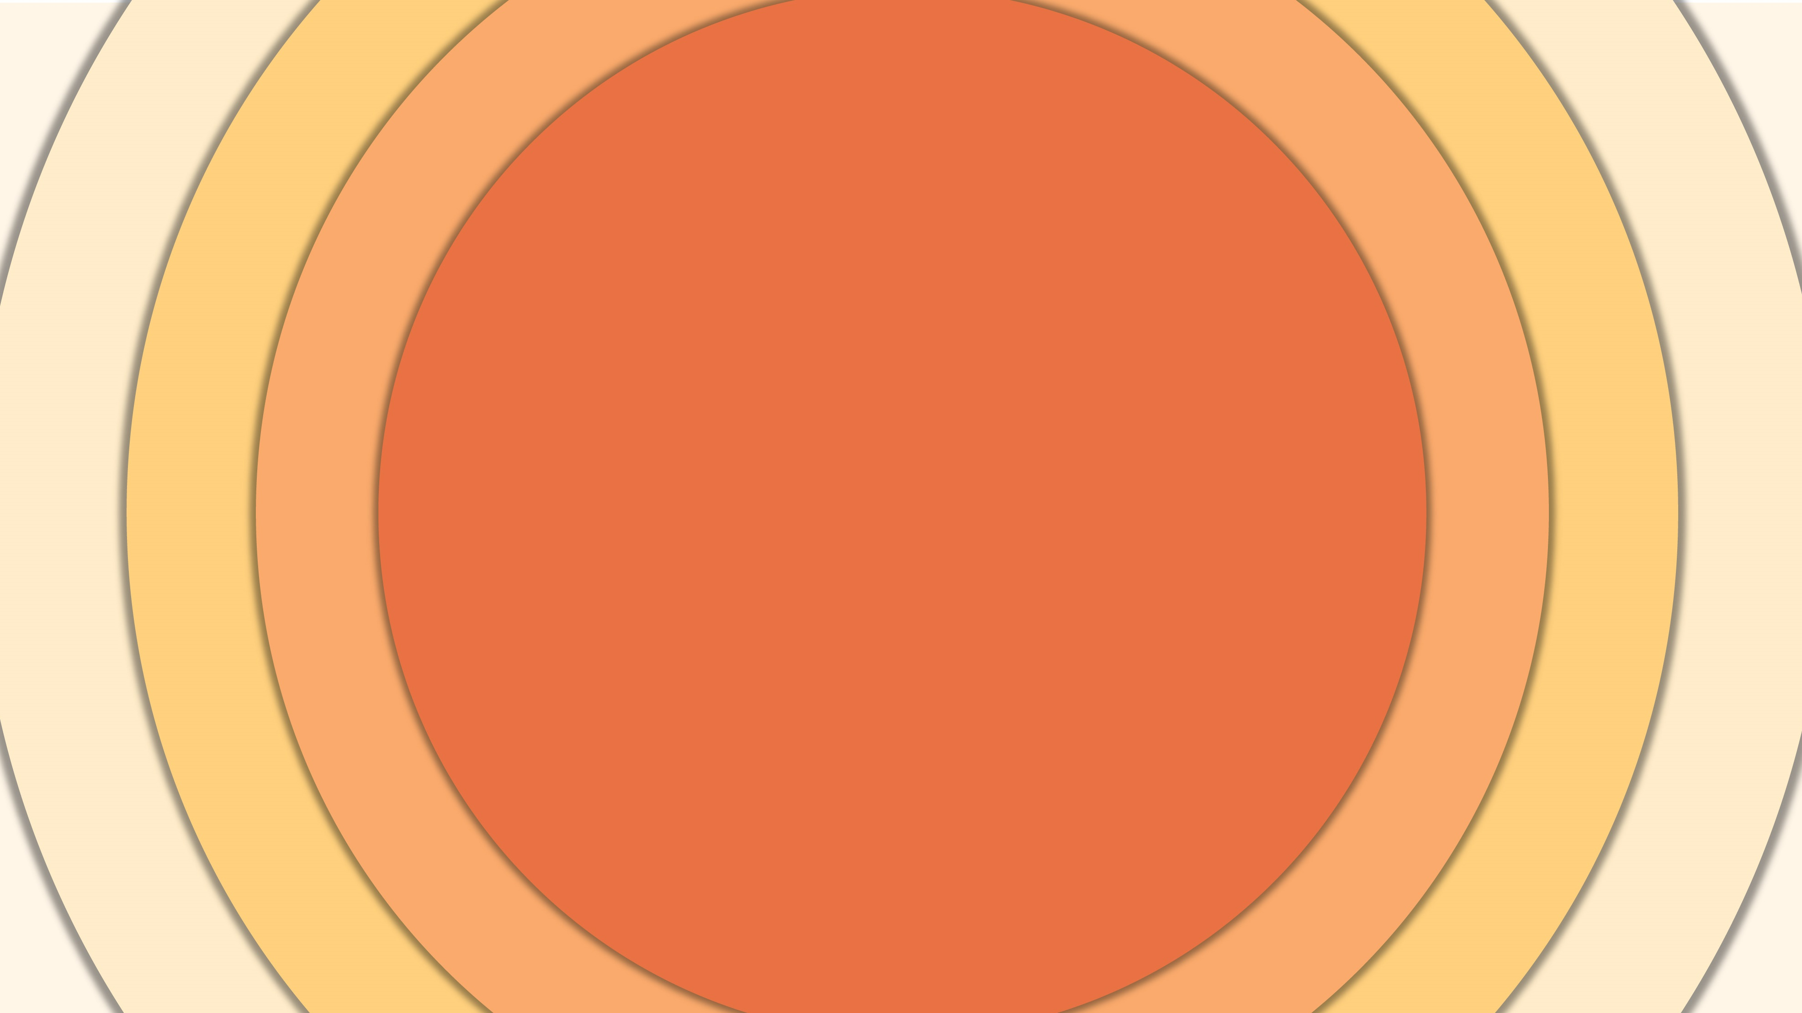

Just in Time Training
Notes:
This Just-In-Time training video will explain response work zones used during an animal health emergency and describe activities that occur in each area.

Slide 3
Why Work Zones Are Needed
Protect
responders
Prevent unintentional spread of pathogens
Applies to entry and exit
of personnel and vehicle traffic
Notes:
Work zones are established to protect responders and prevent the unintentional spread of the pathogen onto or off of an infected or suspected premises. These work zones apply to the entry and exit of personnel and vehicle traffic. Responders should understand the location and boundaries of each of these work zones upon arrival and follow the established protocols and biosecurity procedures for the response site.

Slide 4
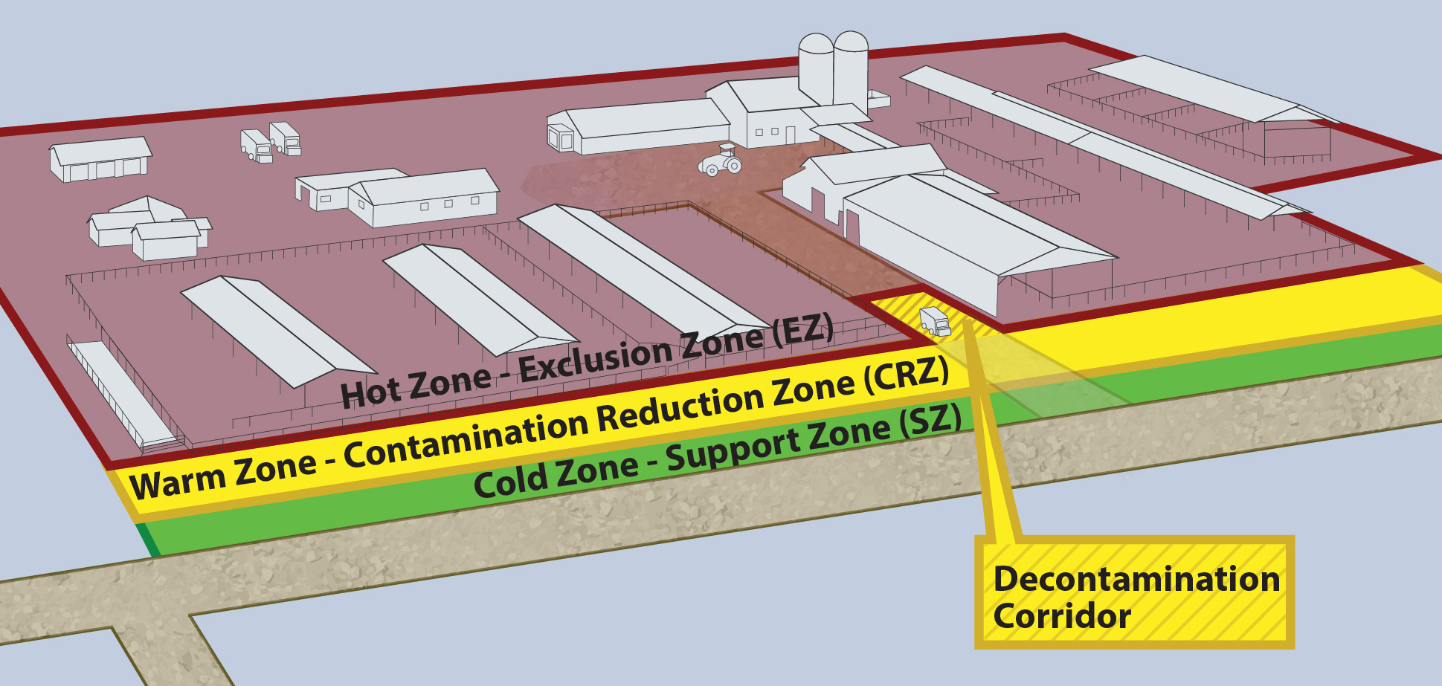
ADE Work Zones
Notes:
There are three work zones used during an animal disease emergency – these are generally referred to as….
Graphic illustration by CFSPH

Slide 5
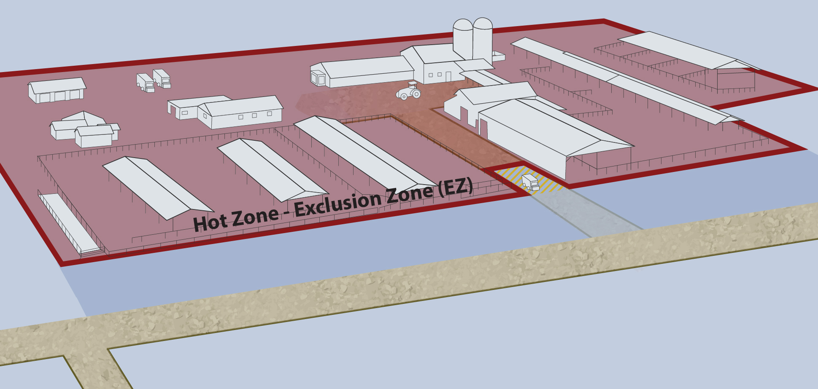
ADE Work Zones: Hot Zone
Notes:
the Hot Zone

Slide 6
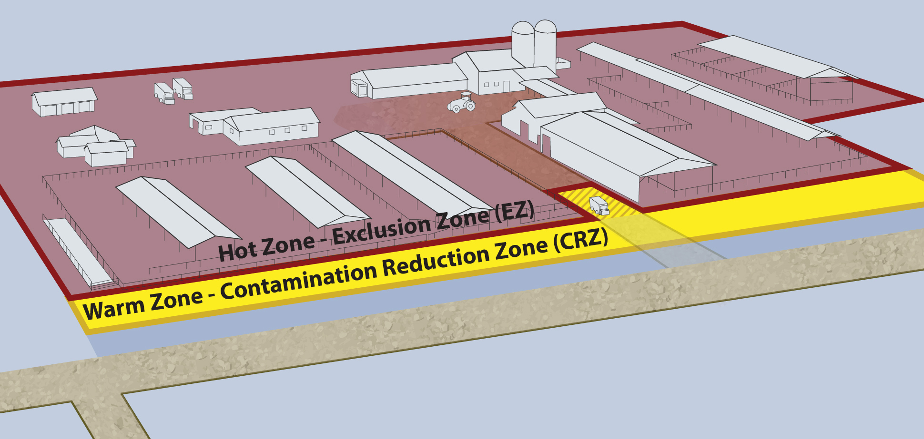
ADE Work Zones: Warm Zone
Notes:
the Warm Zone

Slide 7
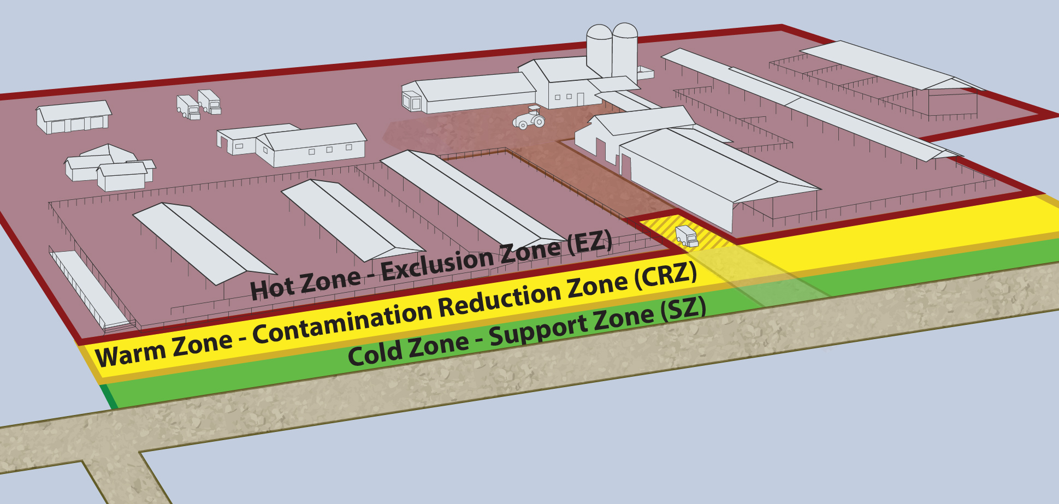
ADE Work Zones: All Zones
Notes:
and the Cold Zone. These three zones are determined by the presence or absence of biological or chemical hazards and activities performed.

Slide 8
Decontamination Corridor
Notes:
The Decontamination Corridor – which contains the clean-dirty line – is the designated area to control entry and exit for the site.

Slide 9
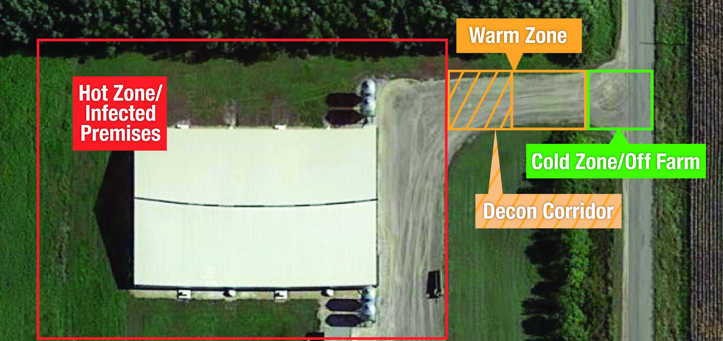
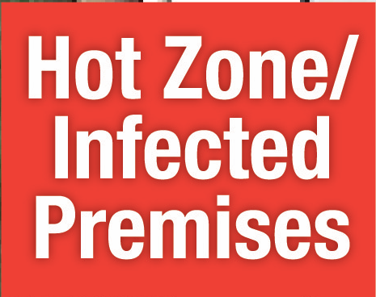
ADE Work Zones: Aerial View
Notes:
This photo shows how these work zones might be set up using an aerial image of a farm.

Slide 10
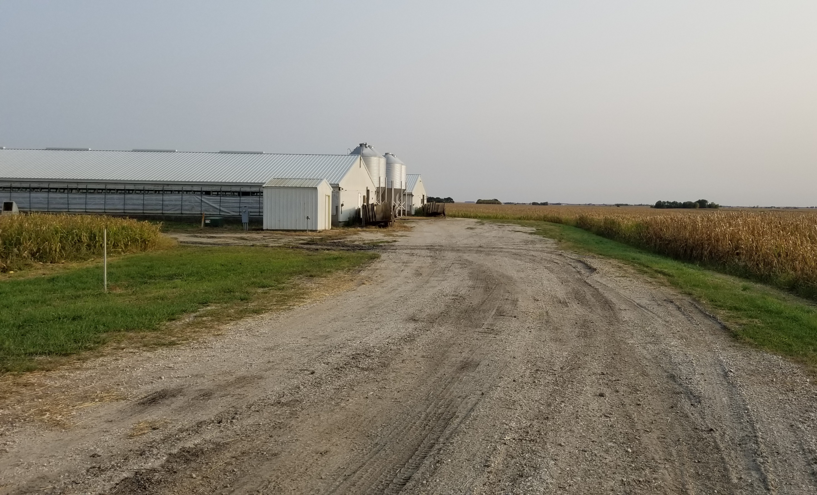
ADE Work Zones on a Farm
Notes:
Let’s look at each of these work zones more closely.

Slide 11
Hot Zone or Exclusion Zone (EZ)
Contaminated or unsafe area
High risk area
Entry restricted
Notes:
The Hot Zone, sometimes called the Exclusion Zone or the “dirty side”, encompasses a potential or known contaminated or unsafe area – for example, an infected premises. This is a high-risk area since it contains infected animals and associated housing, equipment, and vehicles. Access into the Hot Zone is strictly limited and tightly controlled. Entry and exit only occur through a designated control access point.
Graphic illustration by CFSPH

Slide 12
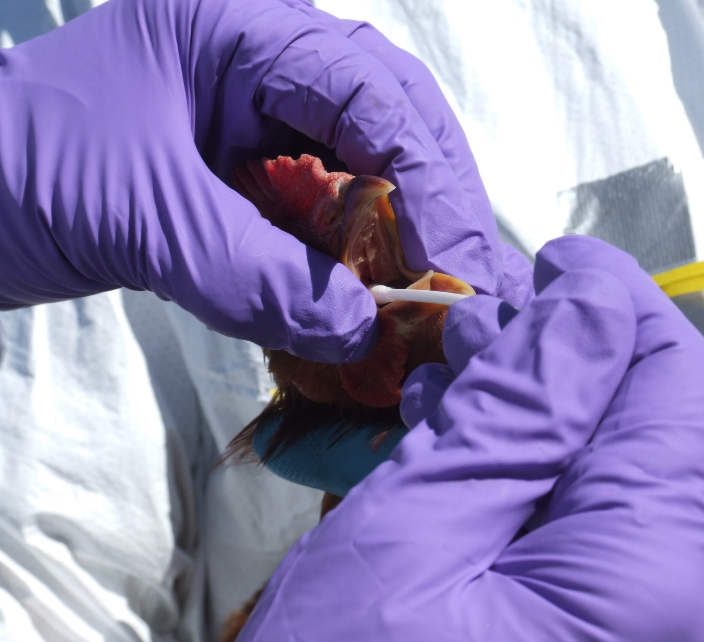
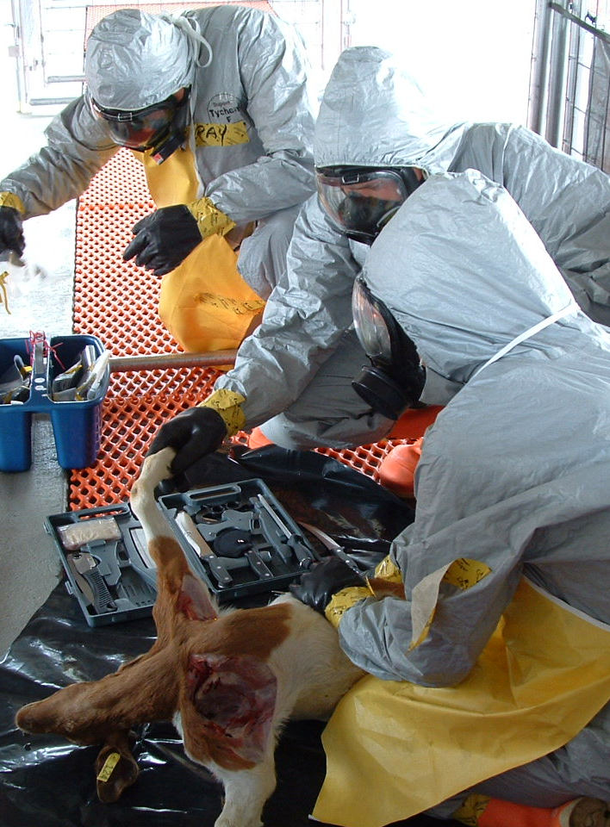
Hot Zone Activities
Notes:
All personnel working in the Hot Zone must wear appropriate PPE, as determined by the task to be performed or disease risk for the site. Activities occurring within the Hot Zone may include sampling, vaccination, depopulation, disposal, and cleaning and disinfection of the premises.
Photo from Jane Galyon and Tegwin Taylor/CFSPH

Slide 13
Warm Zone or Contamination Reduction Zone (CRZ)
High risk area
Potential pathogen and chemical disinfectant exposure
Notes:
Another high-risk area is the Warm Zone, or the Contamination Reduction Zone. In this area there is still potential for exposure to pathogens and chemical disinfectants.

Slide 14
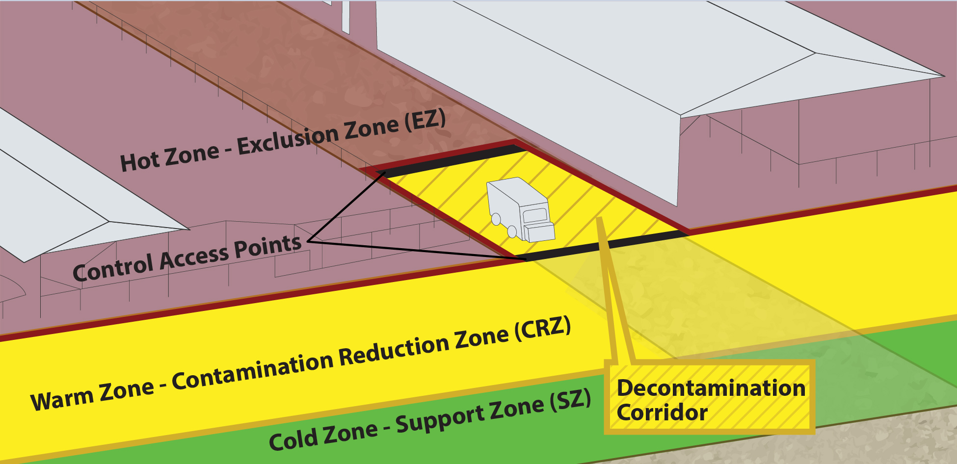
Work Zone Access
Through the Decontamination Corridor
In Warm Zone
Designated entry and exit point
Notes:
Access to the Warm Zone is also strictly limited and tightly controlled and occurs through the Decontamination Corridor - a designated area of entry or exit between the Hot Zone and the Cold Zone. This corridor identifies the boundaries of the clean-dirty line.
Graphic illustration by CFSPH

Slide 15
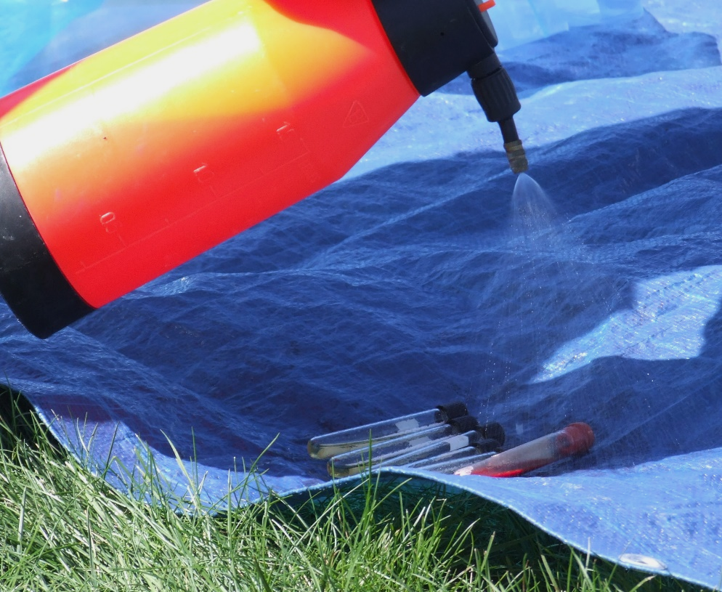
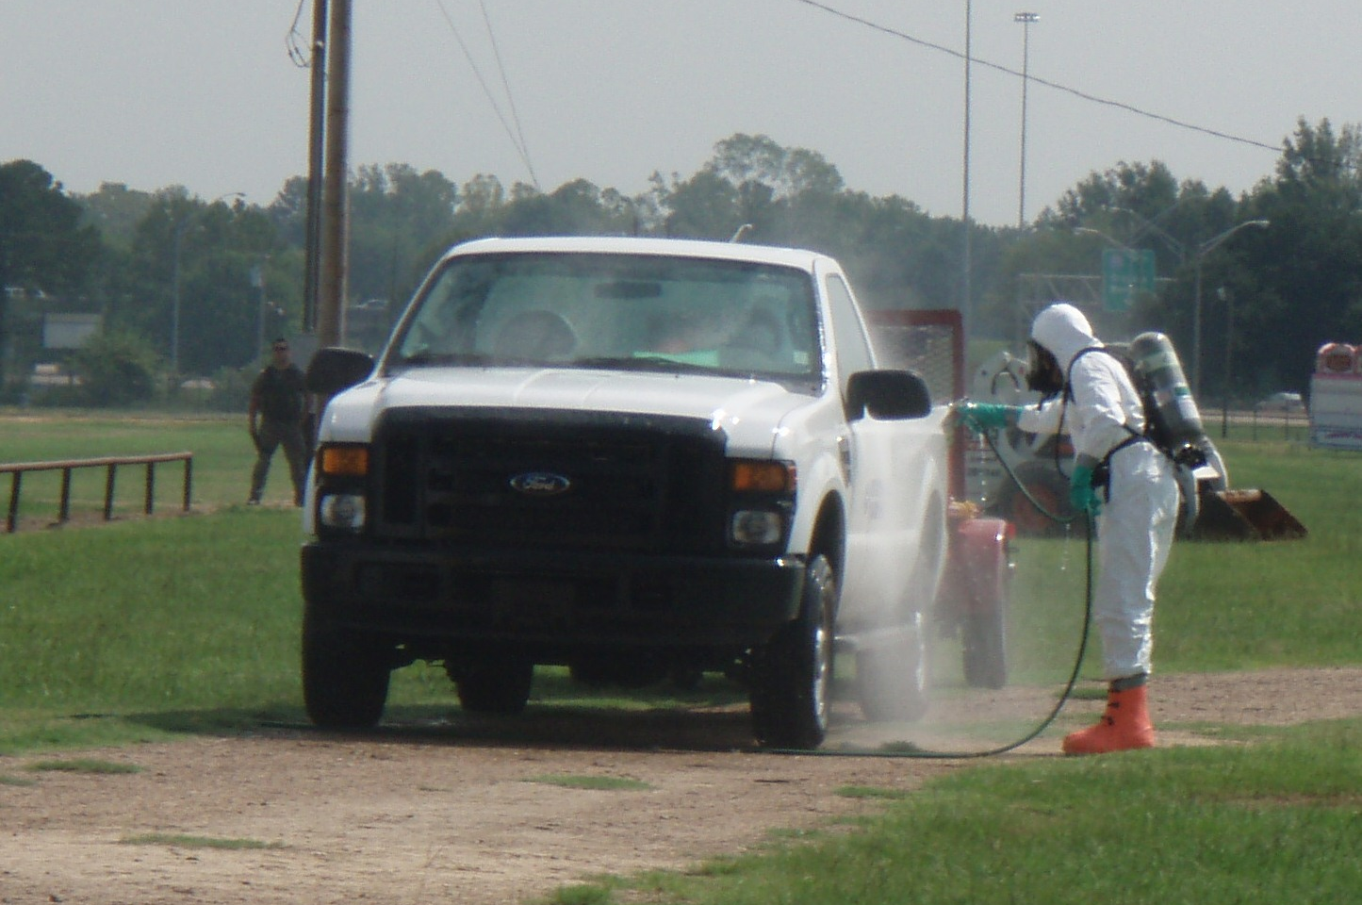
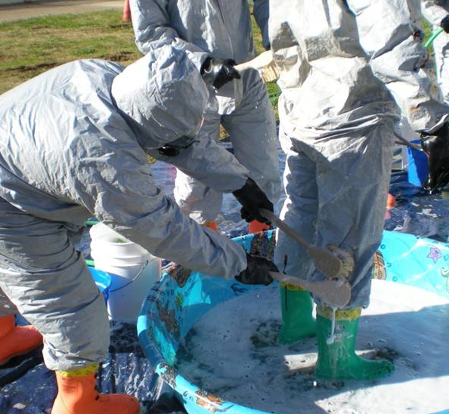
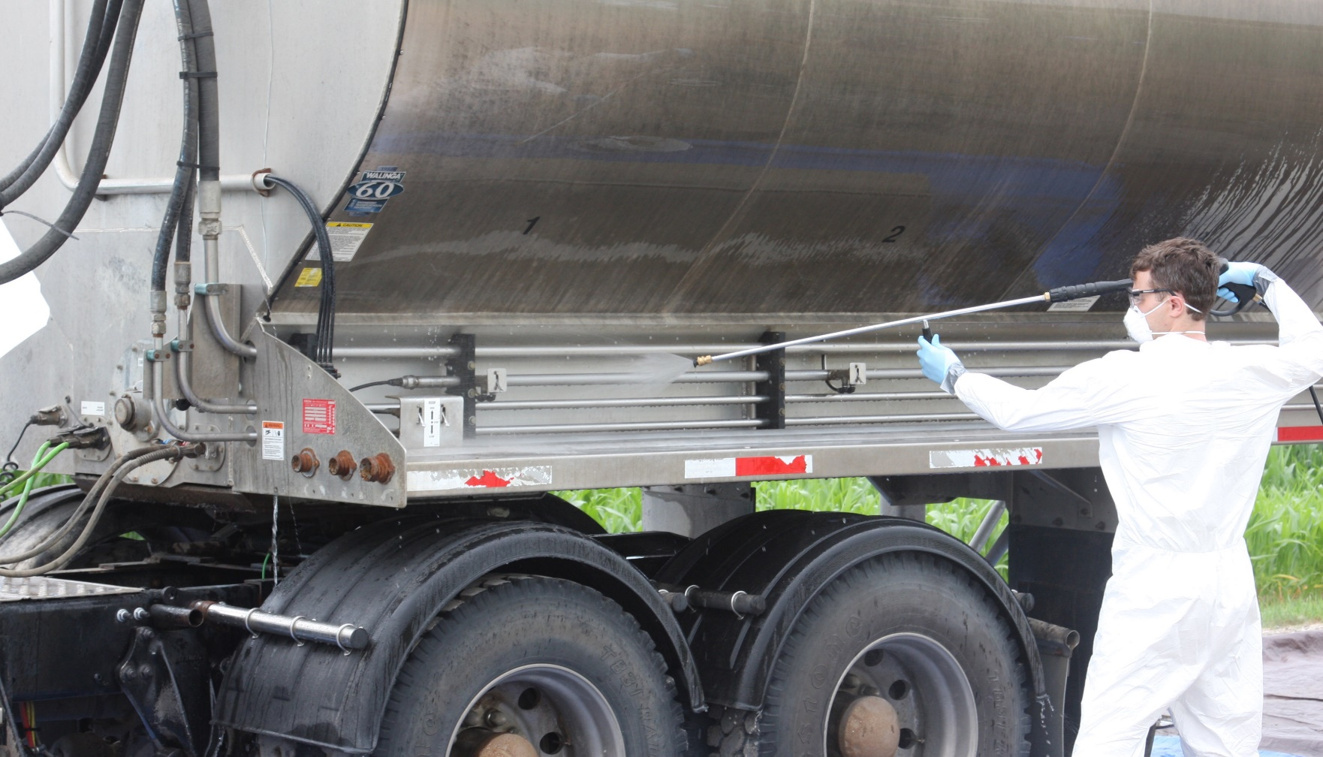
Warm Zone Activities
Notes:
All personnel in the Warm Zone must wear appropriate PPE. Any item leaving the Hot Zone, including PPE, must exit through the Decontamination Corridor and must be thoroughly disinfected or discarded in a biosecure manner.
Photo from Jane Galyon, Andrew Kingsbury and Tegwin Taylor/CFSPH

Slide 16
Cold Zone or Support Zone (SZ)
Clean, uncontaminated area
No hazards expected
Notes:
The Cold Zone is the clean, uncontaminated area of the site. Responders should not be exposed to hazardous conditions in this area.

Slide 17
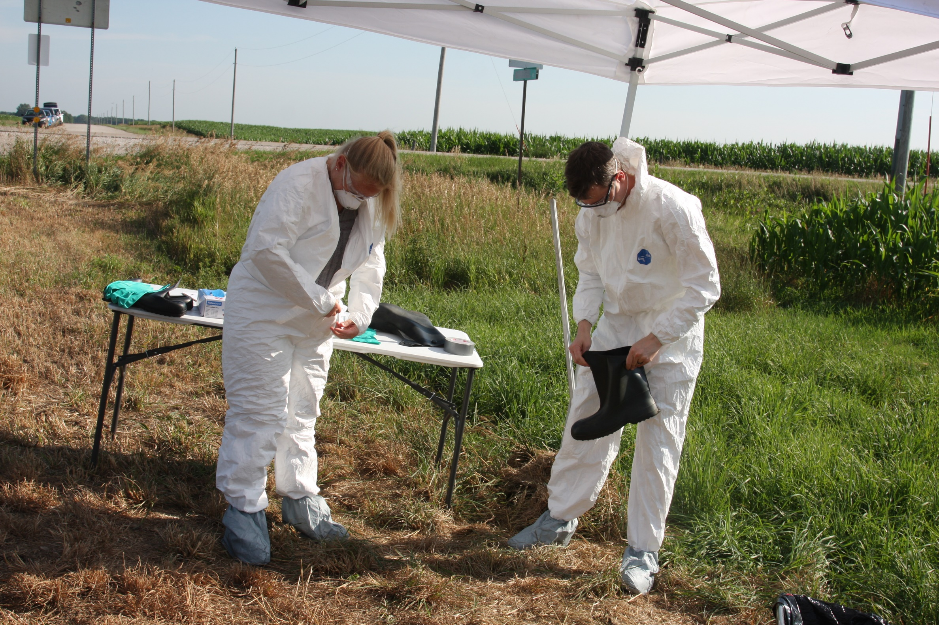
Cold Zone Activities
Planning and staging area
  Administration
  Clerical
  Support staff
Donning PPE
Notes:
It is the planning and staging area where administrative, clerical, and other support staff are based. Responders that need to enter the Hot Zone will don (put on) PPE in the Cold Zone.
Photo from Andrew Kingsbury/CFSPH

Slide 18
Know The Work Zones
Protect
responders
Prevent unintentional spread of pathogens
Be sure to know the location and boundaries
of work zones for your response site
Notes:
Work zones protect responders and prevent the unintentional spread of pathogens. Upon arrival to a response site, be sure to understand the location and boundaries for each of these work zones.

Slide 19

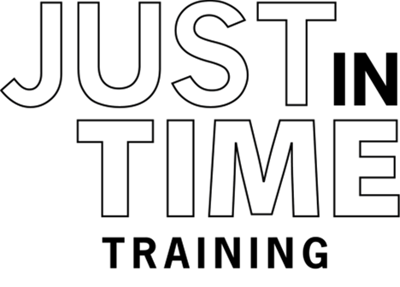

Additional
PPE Videos
Notes:
For more information on animal health emergency response activities, including proper donning and doffing of PPE, follow this QR code to the Just in time Training website.

Slide 20
Acknowledgements
Development of this material was made possible through a grant provided to
the Center for Food Security and Public Health at Iowa State University, College of Veterinary Medicine from
the U.S. Department of Agriculture (USDA) Animal and Plant Health Inspection Service through the National Animal Disease Preparedness and Response Program (NADPRP)
Notes:
Development of this material was made possible through a grant provided to the Center for Food Security and Public Health at Iowa State University, College of Veterinary Medicine from the U.S. Department of Agriculture Animal and Plant Health Inspection Service through the National Animal Disease Preparedness and Response Program.

