Slide 1
Animal Disease Emergencies
Understanding the Risk and Response
Notes:
A rapid response to an animal disease emergency is critical to protect animal health, the economics of producers and industry, food safety and public health.

Slide 2
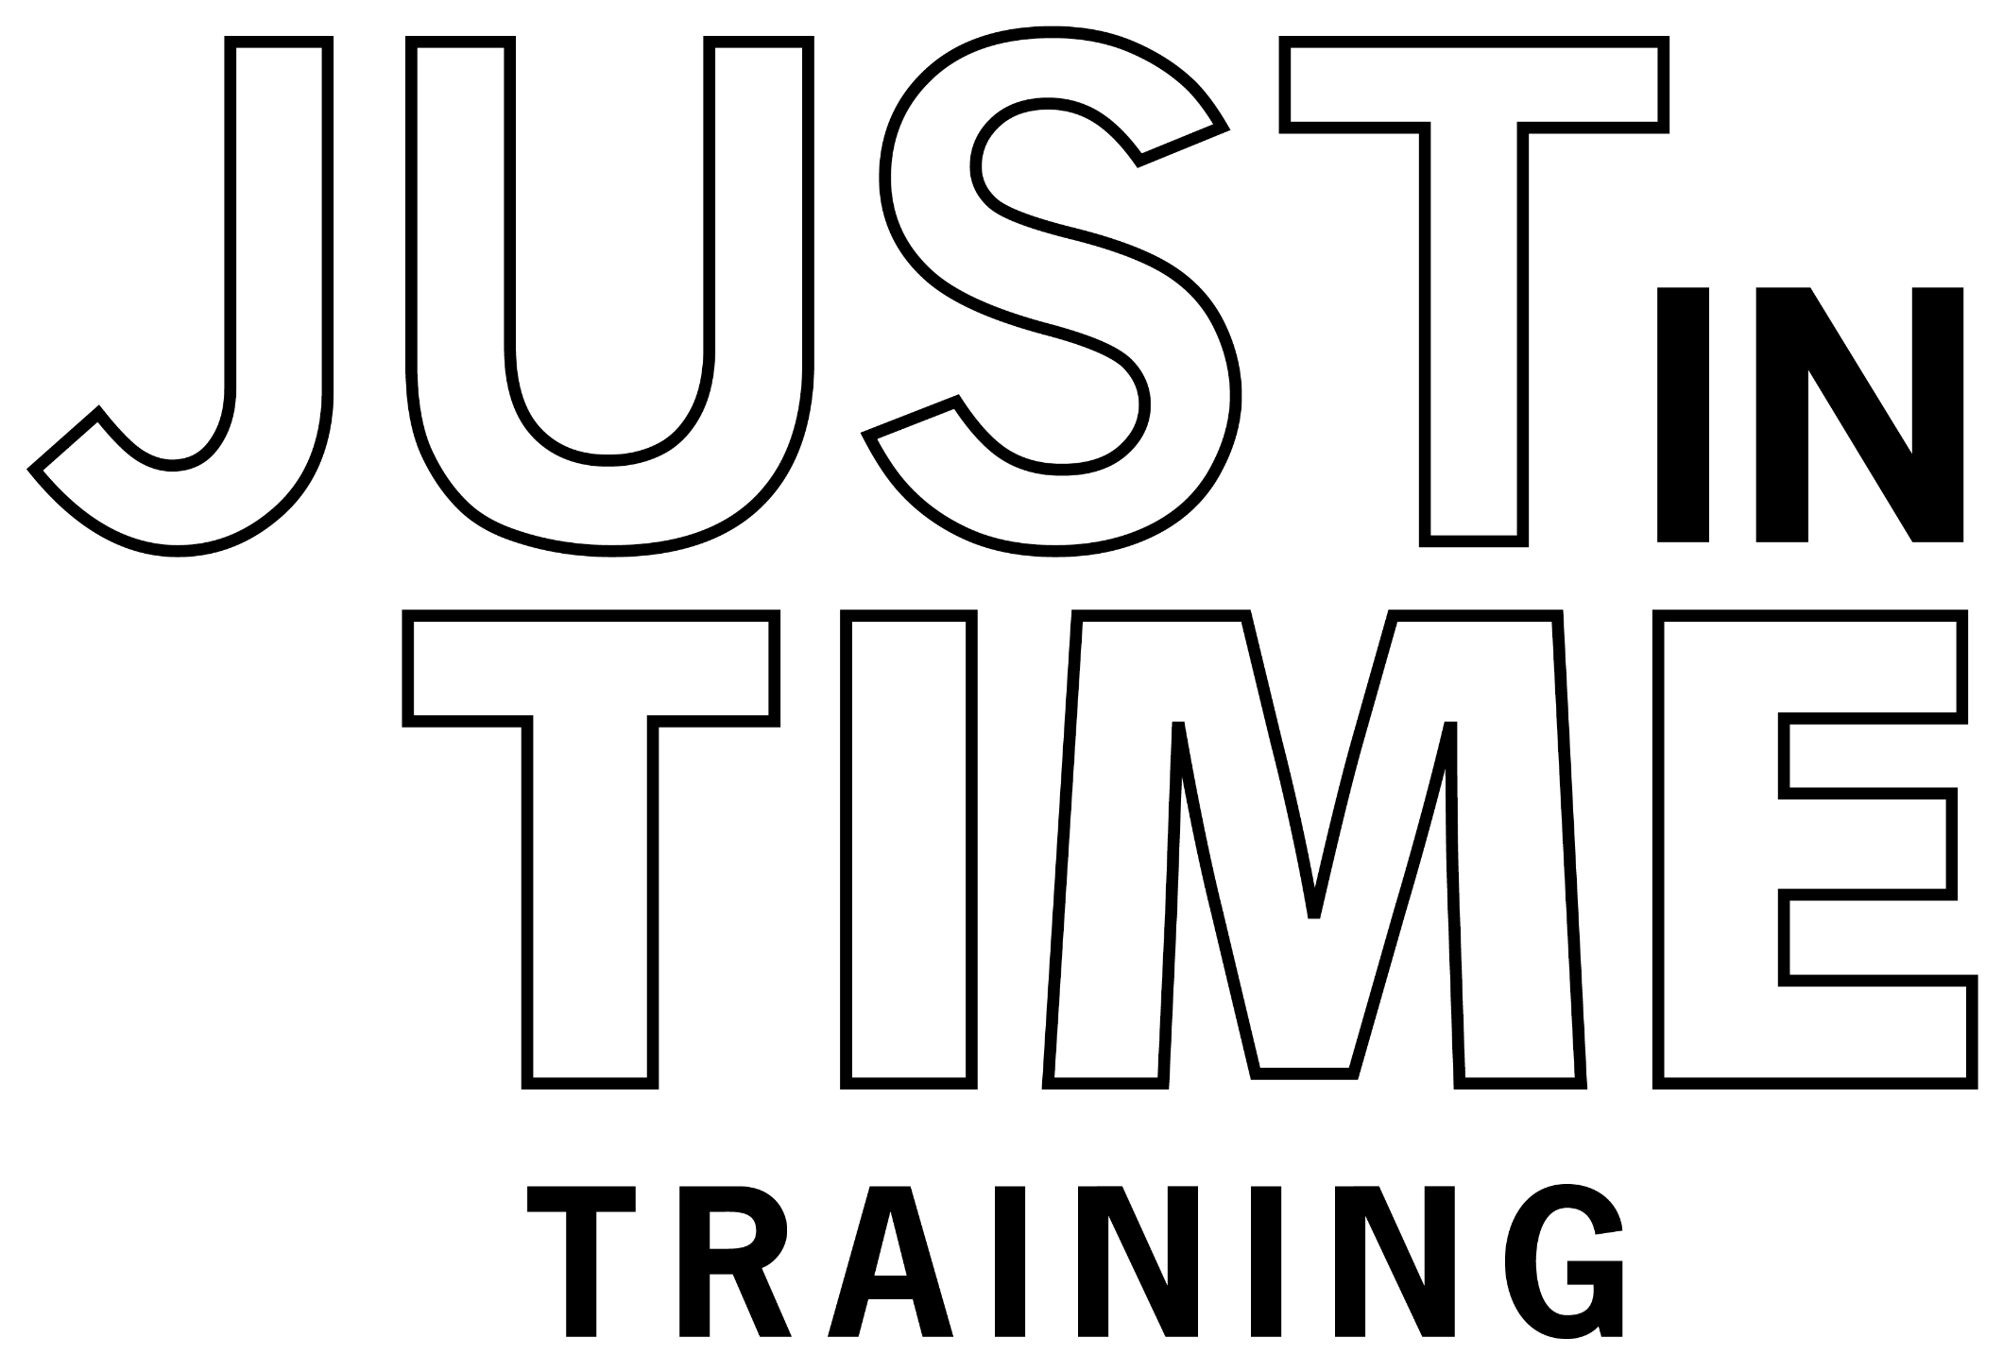
Just in Time Training
Notes:
This Just-in-Time training answers common questions on why responses to animal disease emergencies are necessary and briefly overviews steps in the process of a response.

Slide 3
What are Animal Disease Emergencies?
Notes:
What are Animal Disease Emergencies?

Slide 4
Animal Disease Emergencies (ADE)
High consequence microorganisms or pests
Spread rapidly
Cause severe illness or death
Serious economic impacts
Affect human health or food safety
Notes:
Animal disease emergencies, or ADE, involve microorganisms or pests of special concern for livestock and poultry due to their ability to spread rapidly, cause severe illness or death, and serious economic, human health, or food safety consequences.

Slide 5
Diseases of Concern
Foreign animal diseases (FAD)
Reportable diseases
Listings
State
National
International
Notes:
These diseases are also called foreign animal diseases (or FAD) or reportable diseases. Listings of high-consequence diseases are maintained at the state, national and international level and when suspected or identified require reporting to animal health officials and immediate action.

Slide 6
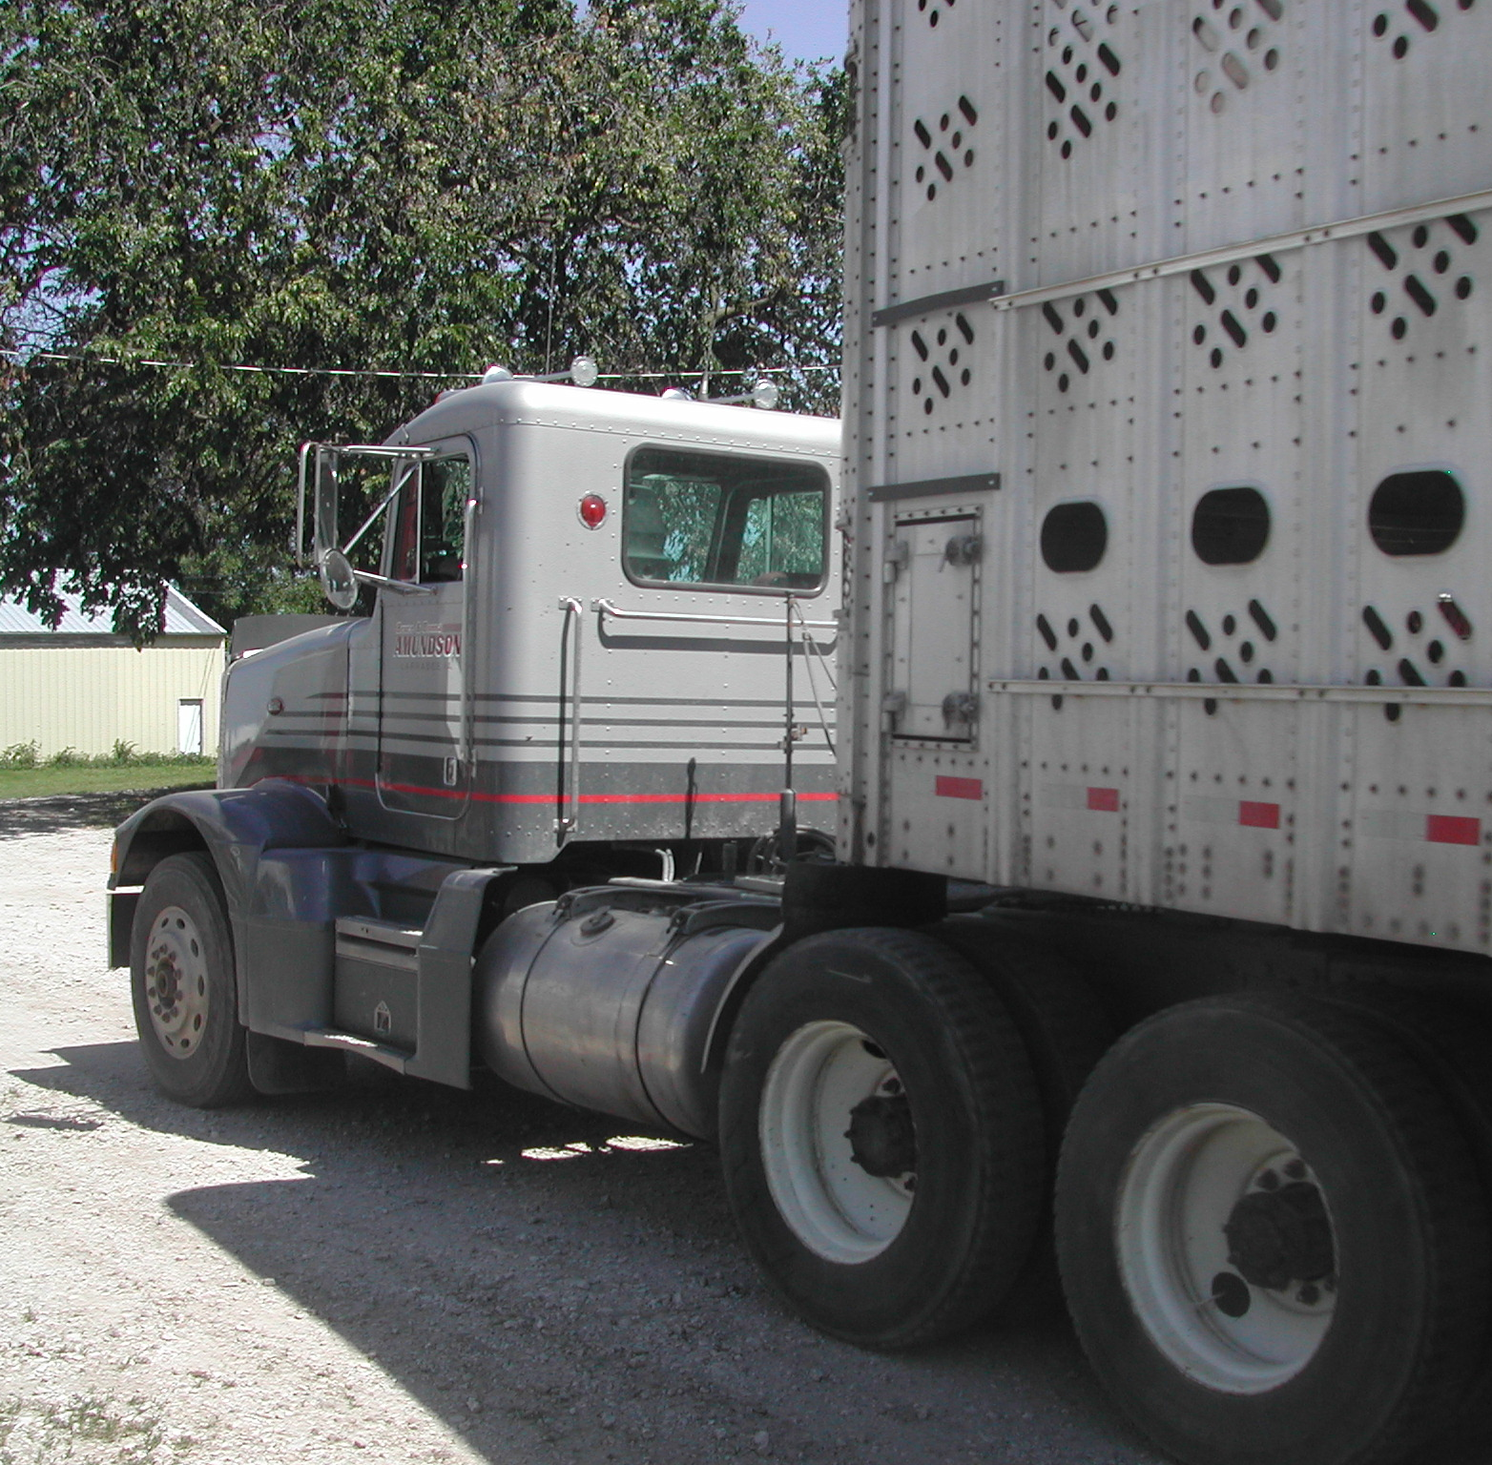
U.S. at Risk
Many not present in the U.S
Global movement of animals and products
Increases the risk of import or introduction
Notes:
Although many of these diseases are not present in the United States, the movement of animals and products globally means that U.S. livestock and poultry are always at risk.
Photo from Alex Ramirez/Iowa State University

Slide 7
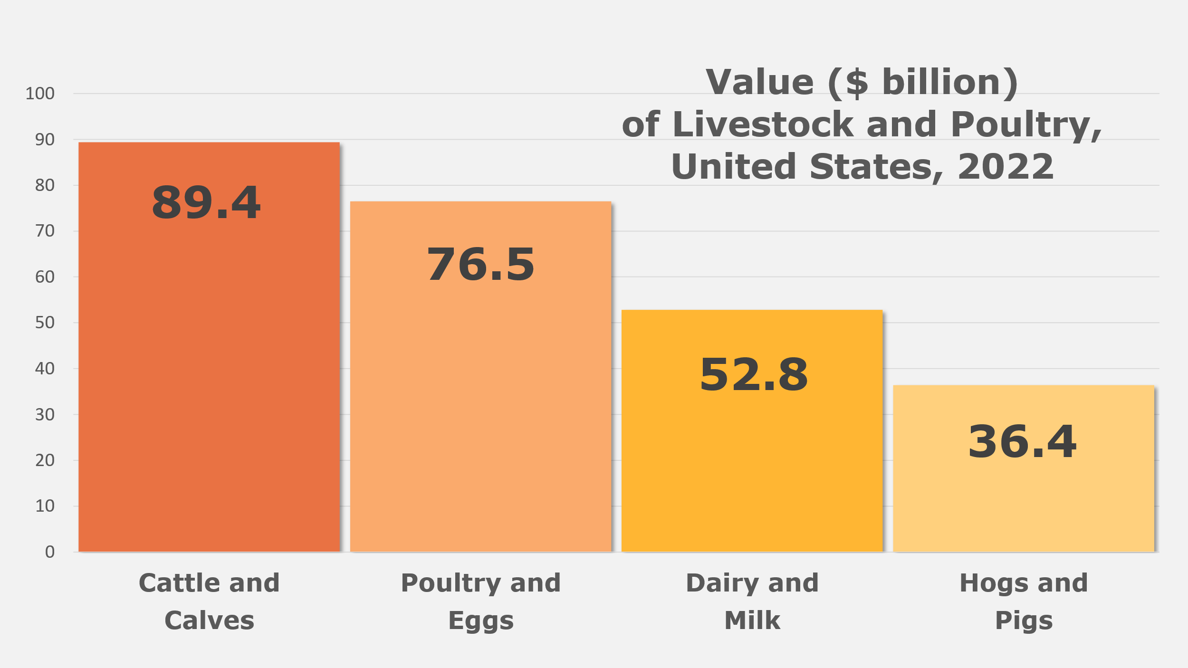
Animal Agriculture in the U.S.
Notes:
In the U.S., livestock and poultry are multibillion-dollar industries, providing food, jobs and income for producers and their communities.
Data from the 2022 Census of Agriculture

Slide 8
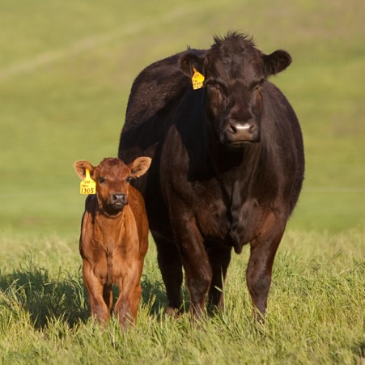
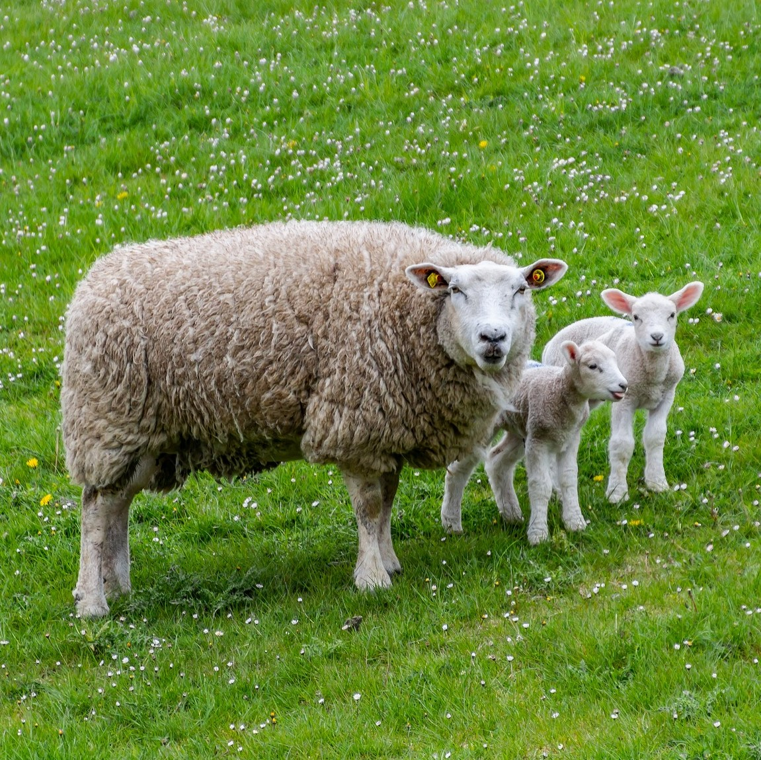
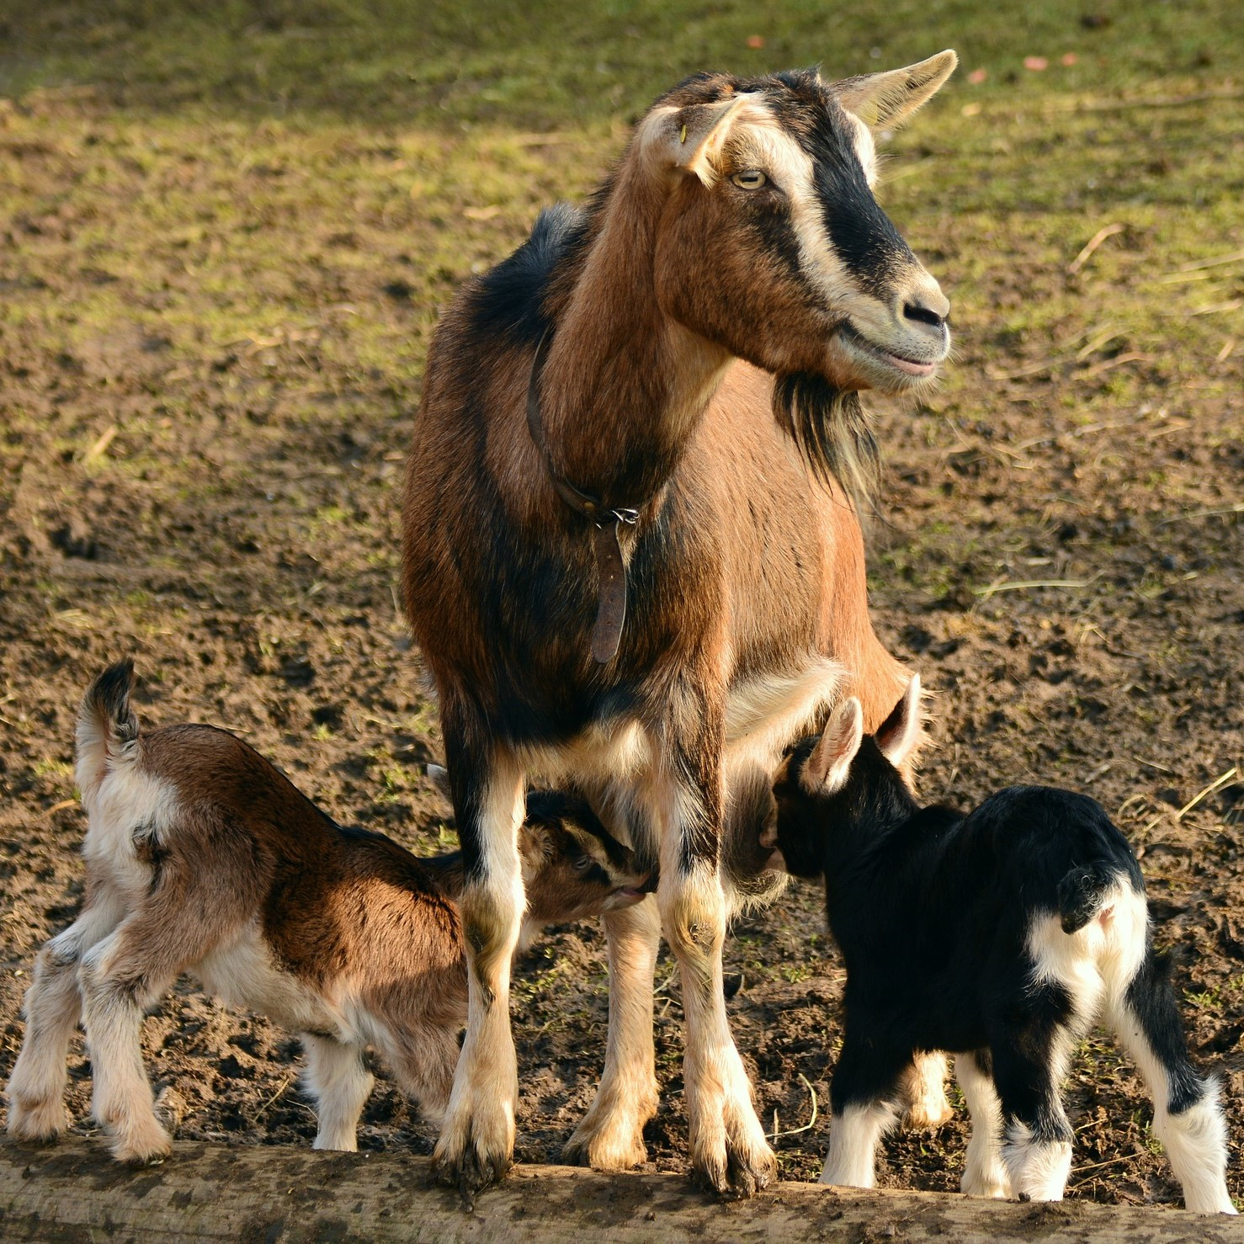
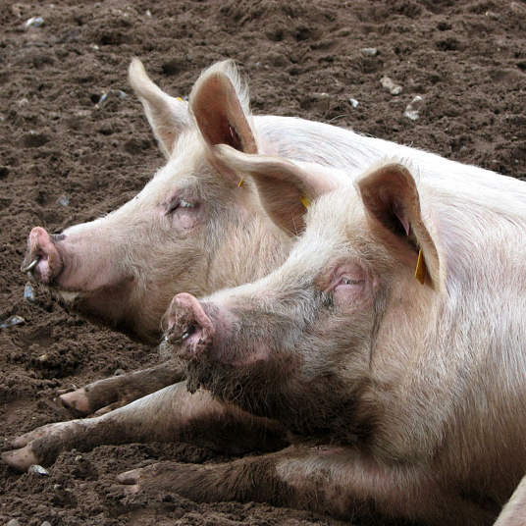
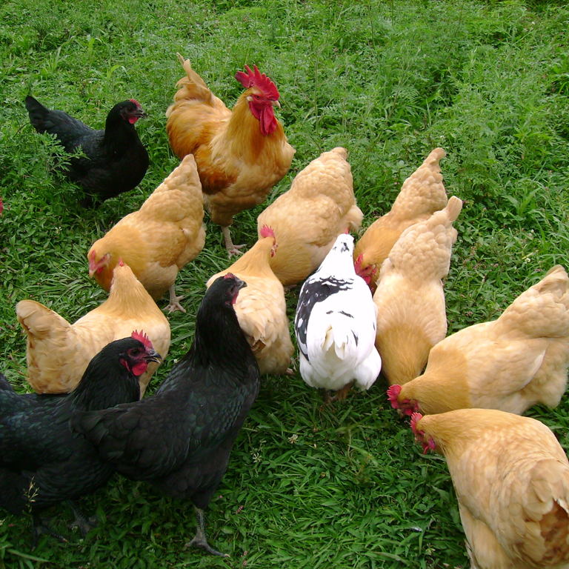
Impacts
Animal Health and Welfare
Economic
Human Health
Notes:
Therefore, the impact of high consequence diseases can have profound impacts on animal health and welfare, financial sustainability and trade, and sometimes human health.
They may cause high rates of illness and death in animals, loss of production or reproductive failure. Some diseases may severely debilitate animals and require rapid and humane euthanasia.
Substantial economic impacts can occur from the direct loss of animals or restricted trade until the situation is contained.
Some of these diseases can cause human illness and possibly food safety issues.
Any of these outcomes can have profound mental health impacts on producers as well as responders.
Photos: cow and calf, CFSPH; sheep and goats, Pixabay; horses and pigs, Wikimedia commons; chickens, USDA APHIS

Slide 9
Who Responds to ADEs?
Notes:
Who Responds to Animal Disease Emergencies?

Slide 10
Animal Health Agencies
State Animal Health Official
Animal and Plant Health Inspection Service (APHIS)
Notes:
Responses to animal disease emergencies in the U.S. involve the State Animal Health Official and their staff and the U.S. Department of Agriculture Animal and Plant Health Inspection Service (USDA-APHIS). Both have legal authority for their involvement.

Slide 11
Multi-Agency, Multi-Discipline Support
Public Health
Emergency Management
Public Works
Animal Health
Environmental Health
Public Safety
Wildlife Management
Notes:
When responses are large or occur at multiple locations within a state, responses will require collaborative efforts from other federal, state, and local agencies and responders, animal industry groups and non-governmental organizations.
Responders may also include a wide variety of other disciplines, including emergency management, environmental health, wildlife management, public safety (e.g., law enforcement), public works, and public health professionals.

Slide 12
Are There Response Plans for Animal Disease Emergencies?
Notes:
Are There Response Plans for Animal Disease Emergencies?

Slide 13
State Emergency Operations Plan
Agency roles and responsibilities
Actions needed
Notes:
A State’s Emergency Operations Plan outlines state agency roles and responsibilities, and actions needed for a variety of emergencies or disaster events, including animal disease emergencies.

Slide 14
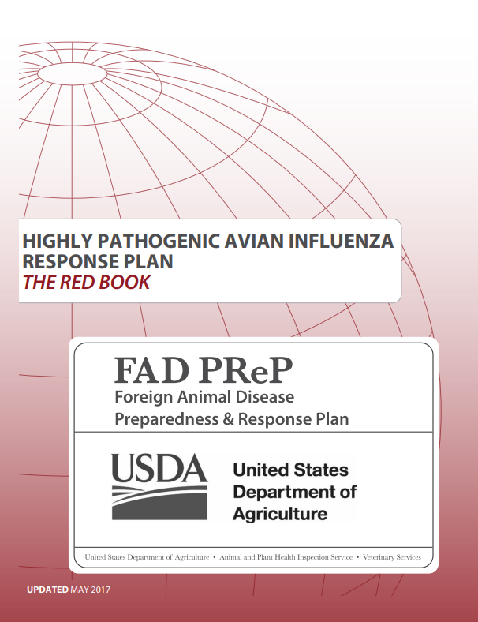
Federal Plans
Notes:
The USDA-APHIS has developed the Foreign Animal Disease Preparedness and Response Plan (FAD PReP) – an extensive collection of documents outlining goals, guidelines, and strategies for animal disease emergencies. These resources serve as a foundation for a coordinated national, regional, and local response. Response plans covering response tasks and standard operating procedures (SOPs) for several high-consequence diseases (e.g., avian influenza, foot and mouth disease) have been developed.

Slide 15
What Steps Are Taken During an ADE?
Notes:
What steps are taken during an animal disease emergency?

Slide 16
RESPONSE GOALS
DETECT
CONTAIN
CONTROL
Notes:
During a high consequence animal disease outbreak, the goal is to detect, contain, and control the disease as quickly as possible.
A series of steps are followed to ensure an efficient and effective response to return the area and the nation to a disease-free state as soon as possible. This will allow trade to resume and help the animal industry recover.

Slide 17
DETECT
Notes:
The detection of the disease often occurs on a farm when unusual or suspicious clinical signs in animals are noticed by the producer or the local veterinarian. Detection may also occur at a diagnostic lab or processing plant.
Photos by Renee Dewell/CFSPH, Shutterstock

Slide 18
Report to Animal Health Officials
Notes:
Disease suspicion is reported to the State or Federal Animal Health Officials.
Illustrations from CFSPH

Slide 19
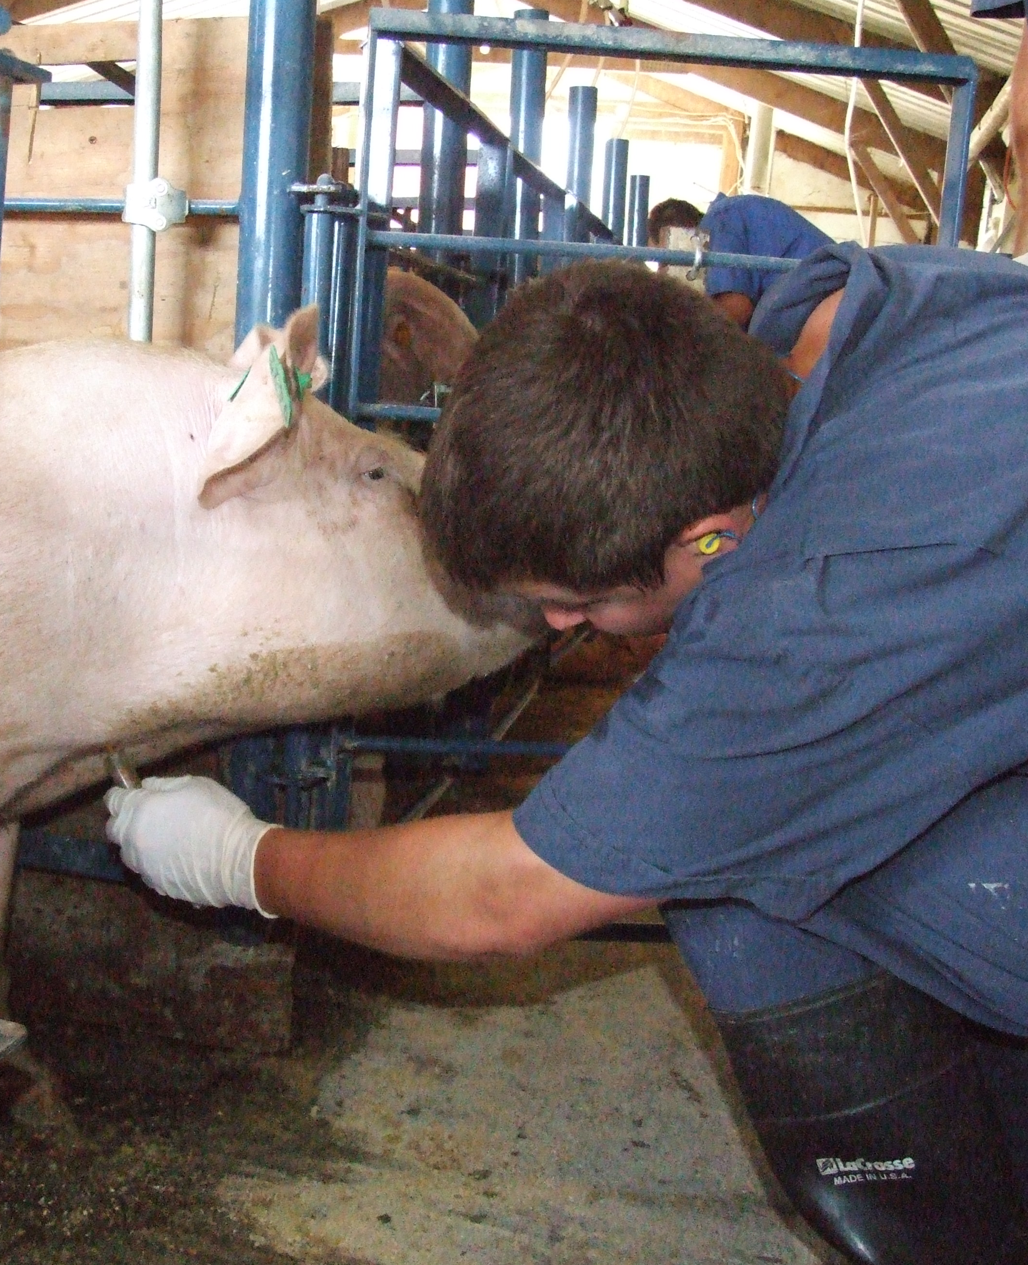
Foreign Animal Disease Diagnostician (FADD)
Investigation
Sample Collection
Notes:
They will send out a specially trained veterinarian, called a Foreign Animal Disease Diagnostician, or FADD, to investigate and collect samples for testing.
Illustrations from CFSPH

Slide 20
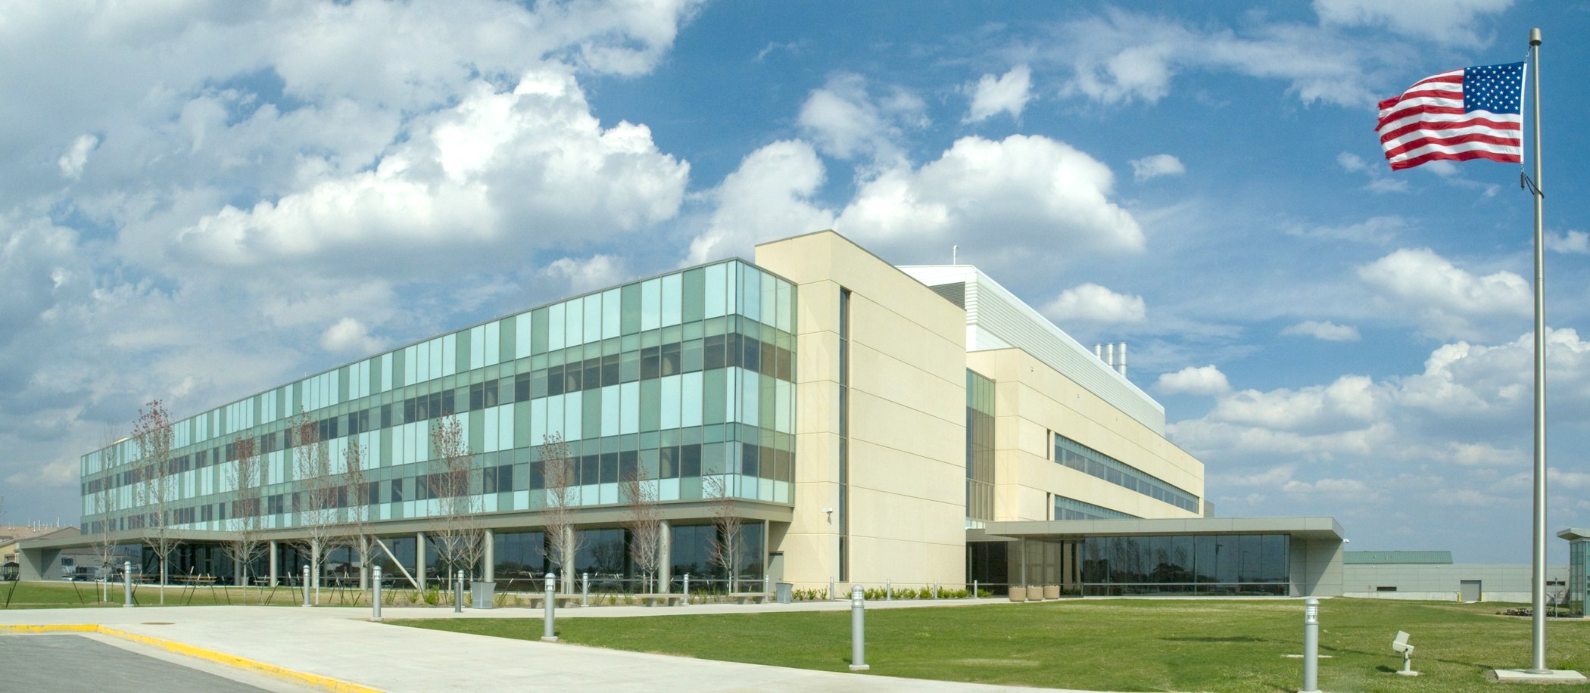
Diagnostic Testing
Notes:
These samples are sent to the USDA National Veterinary Diagnostic Laboratories (NVSL) for analysis.
Illustrations from CFSPH

Slide 21
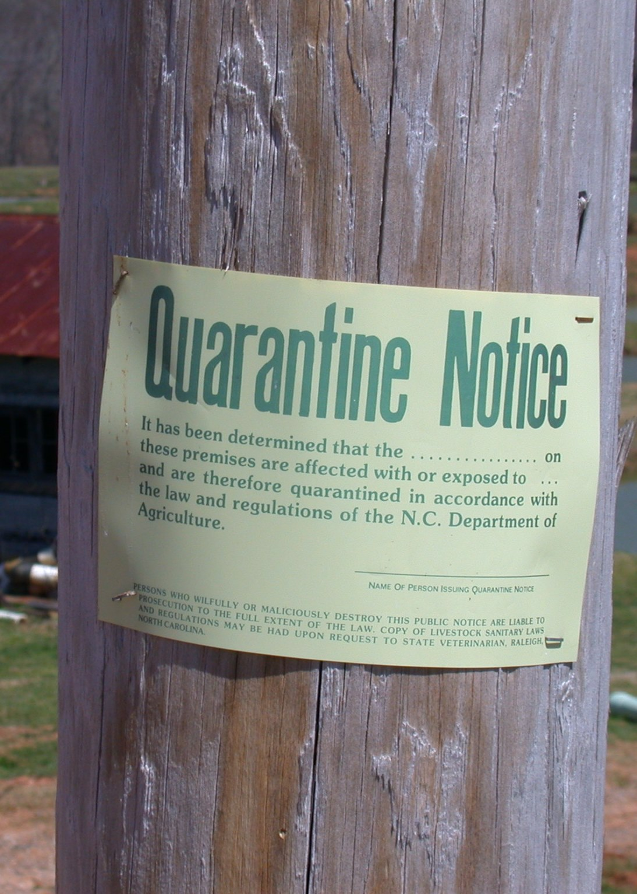
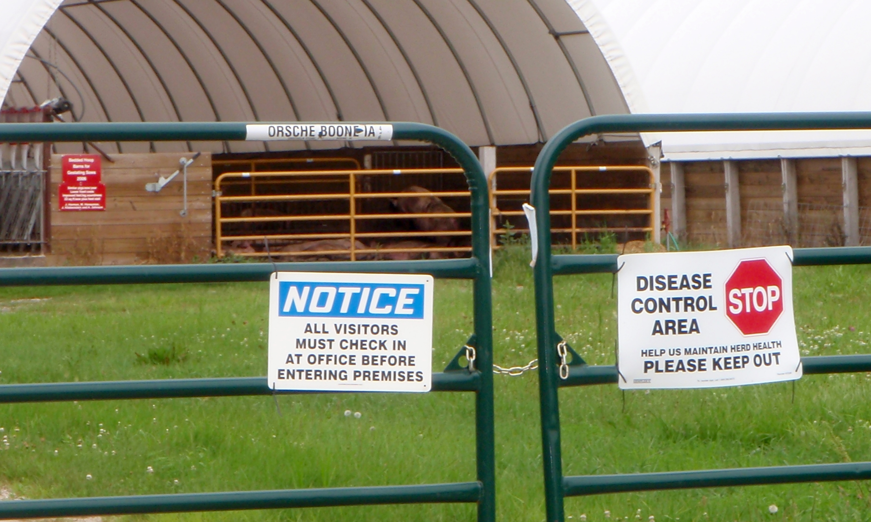
CONTAIN
Quarantine and movement restriction
Notes:
While waiting for laboratory results, specific steps will be taken so that the disease (should it be confirmed) does not spread further. Usually, the farm is quarantined and the movement of animals (or products) onto or off of the farm is restricted until test results are received.
Photos from CFSPH and ISU-VDPAM

Slide 22
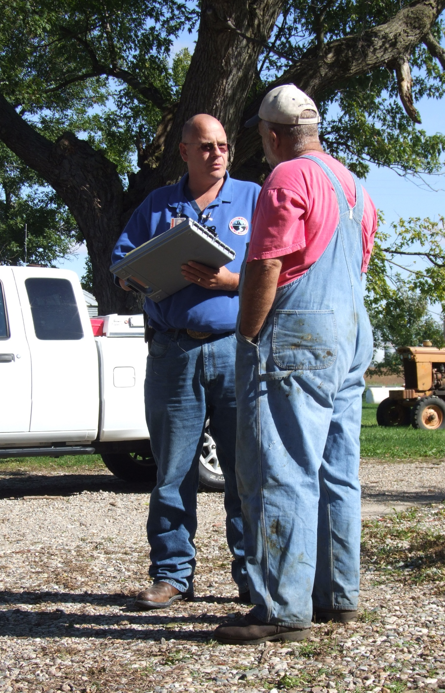
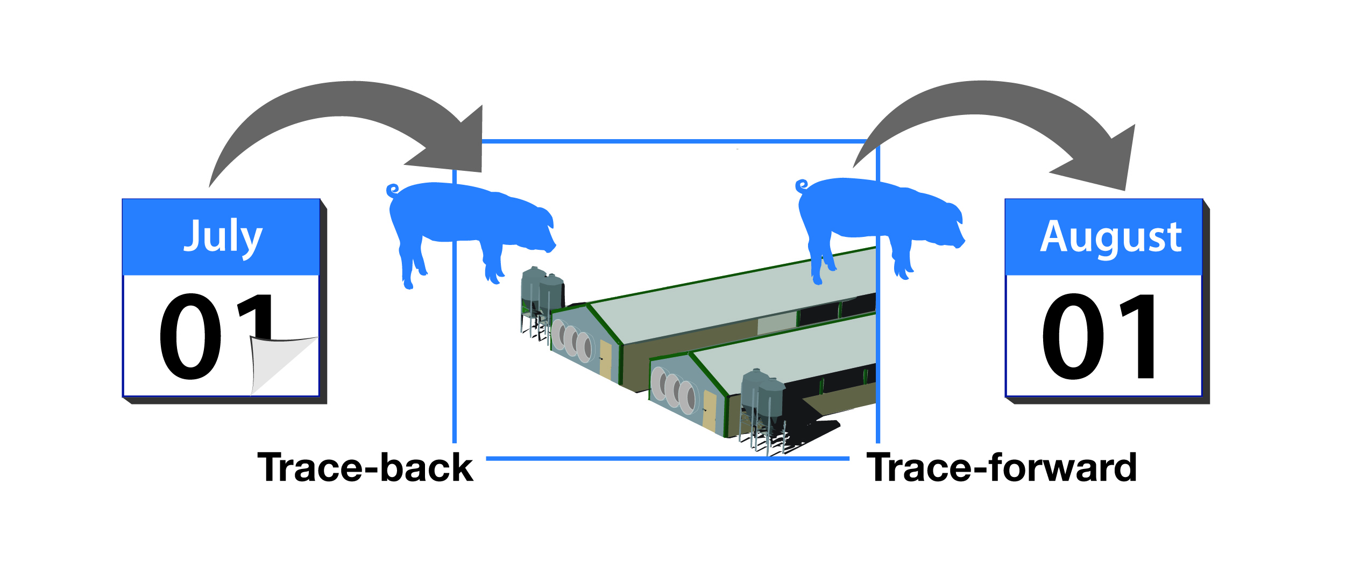
Surveillance
Notes:
Surveillance activities are initiated to determine any movements that may have occurred onto or off of the farm and identify any additional cases on neighboring or related farms. Gathering this information helps to determine the extent of the situation.
Photos from Jane Galyon/CFSPH; illustration by CFSPH

Slide 23
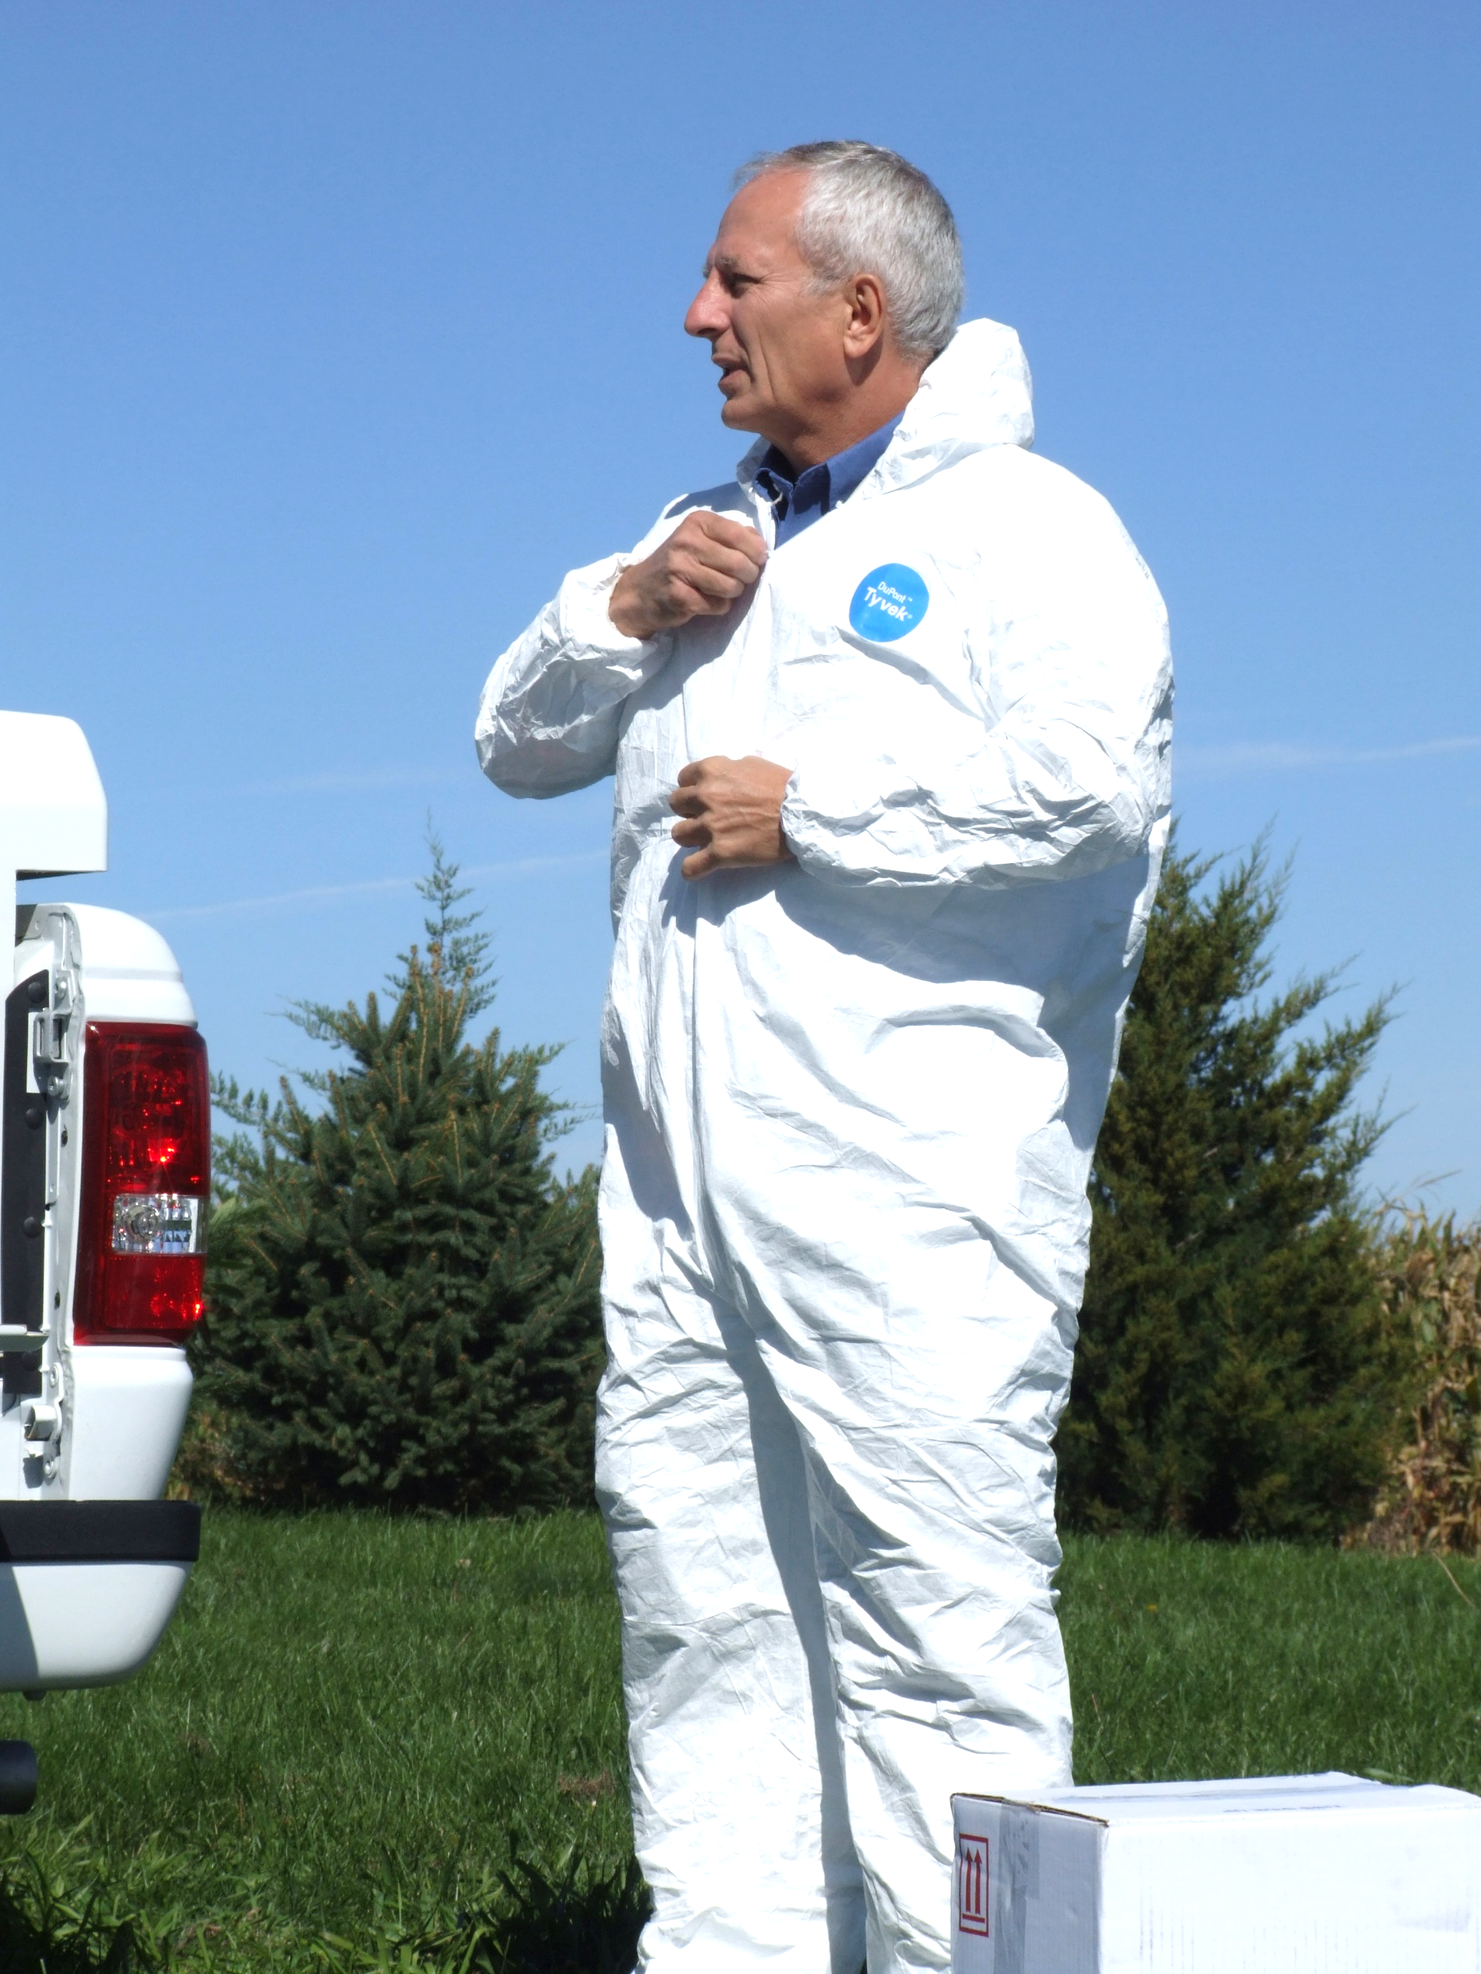
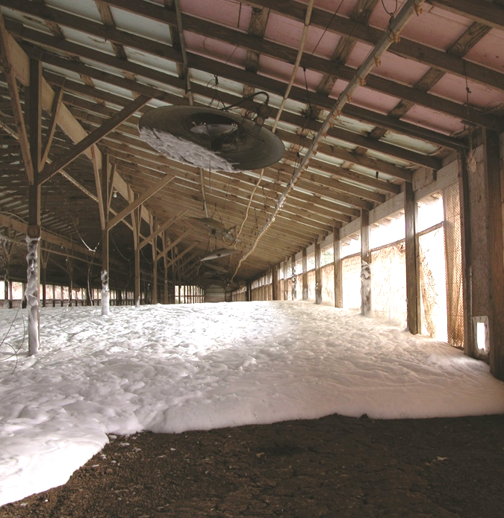
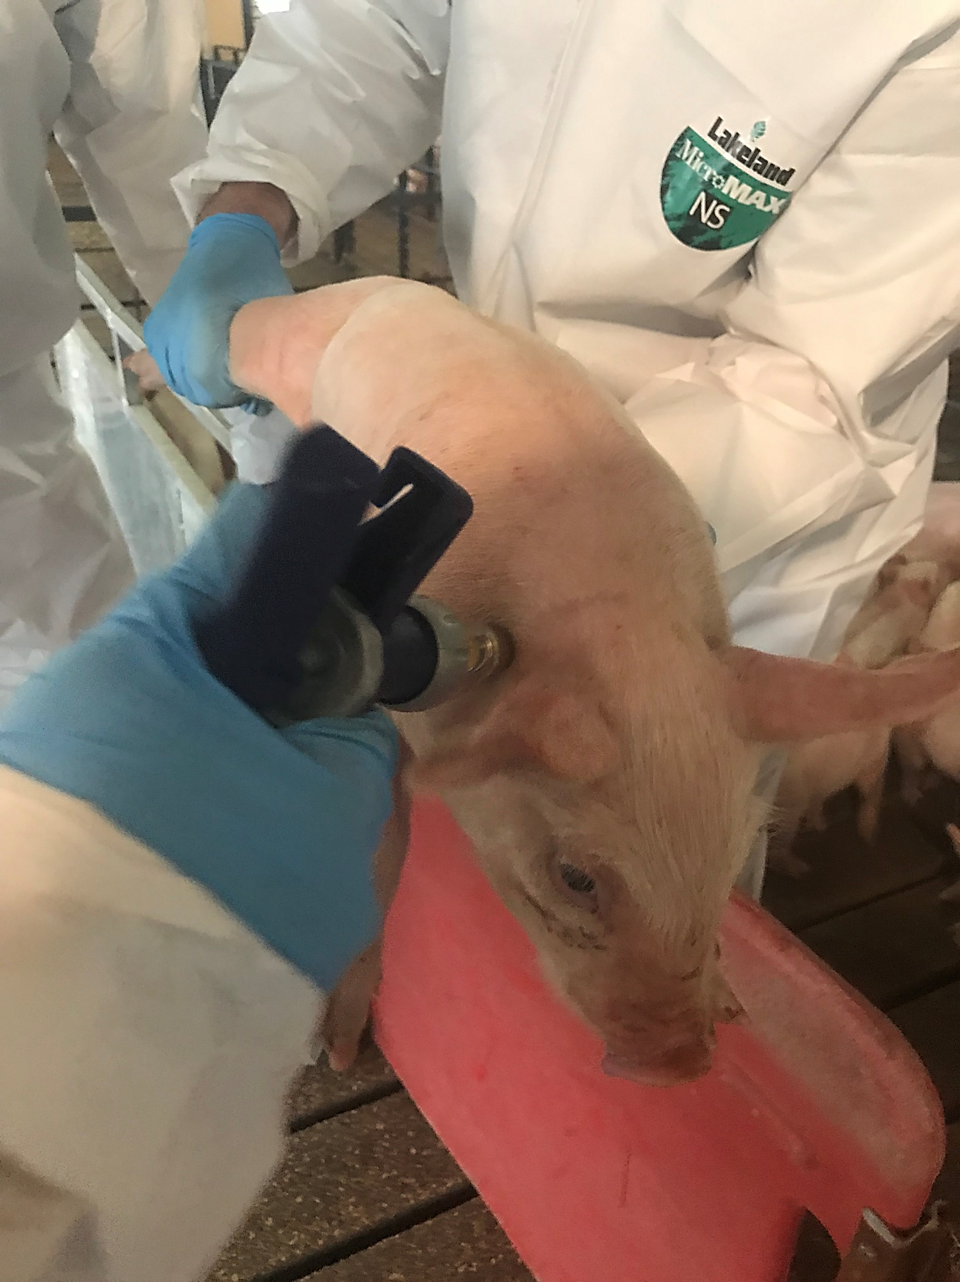
CONTROL
Notes:
Once diagnostic test results confirm a high-consequence or foreign animal disease, activation of the State response plan or USDA plans will occur. Control actions needed will be determined depending on the disease identified. These steps may include enhanced biosecurity procedures, stop-movement orders, the depopulation of animals (for humane or control purposes), or vaccination (when available or allowed).
Photos from Jane Galyon/CFSPH; Quinn; Alex Ramirez/CFSPH

Slide 24
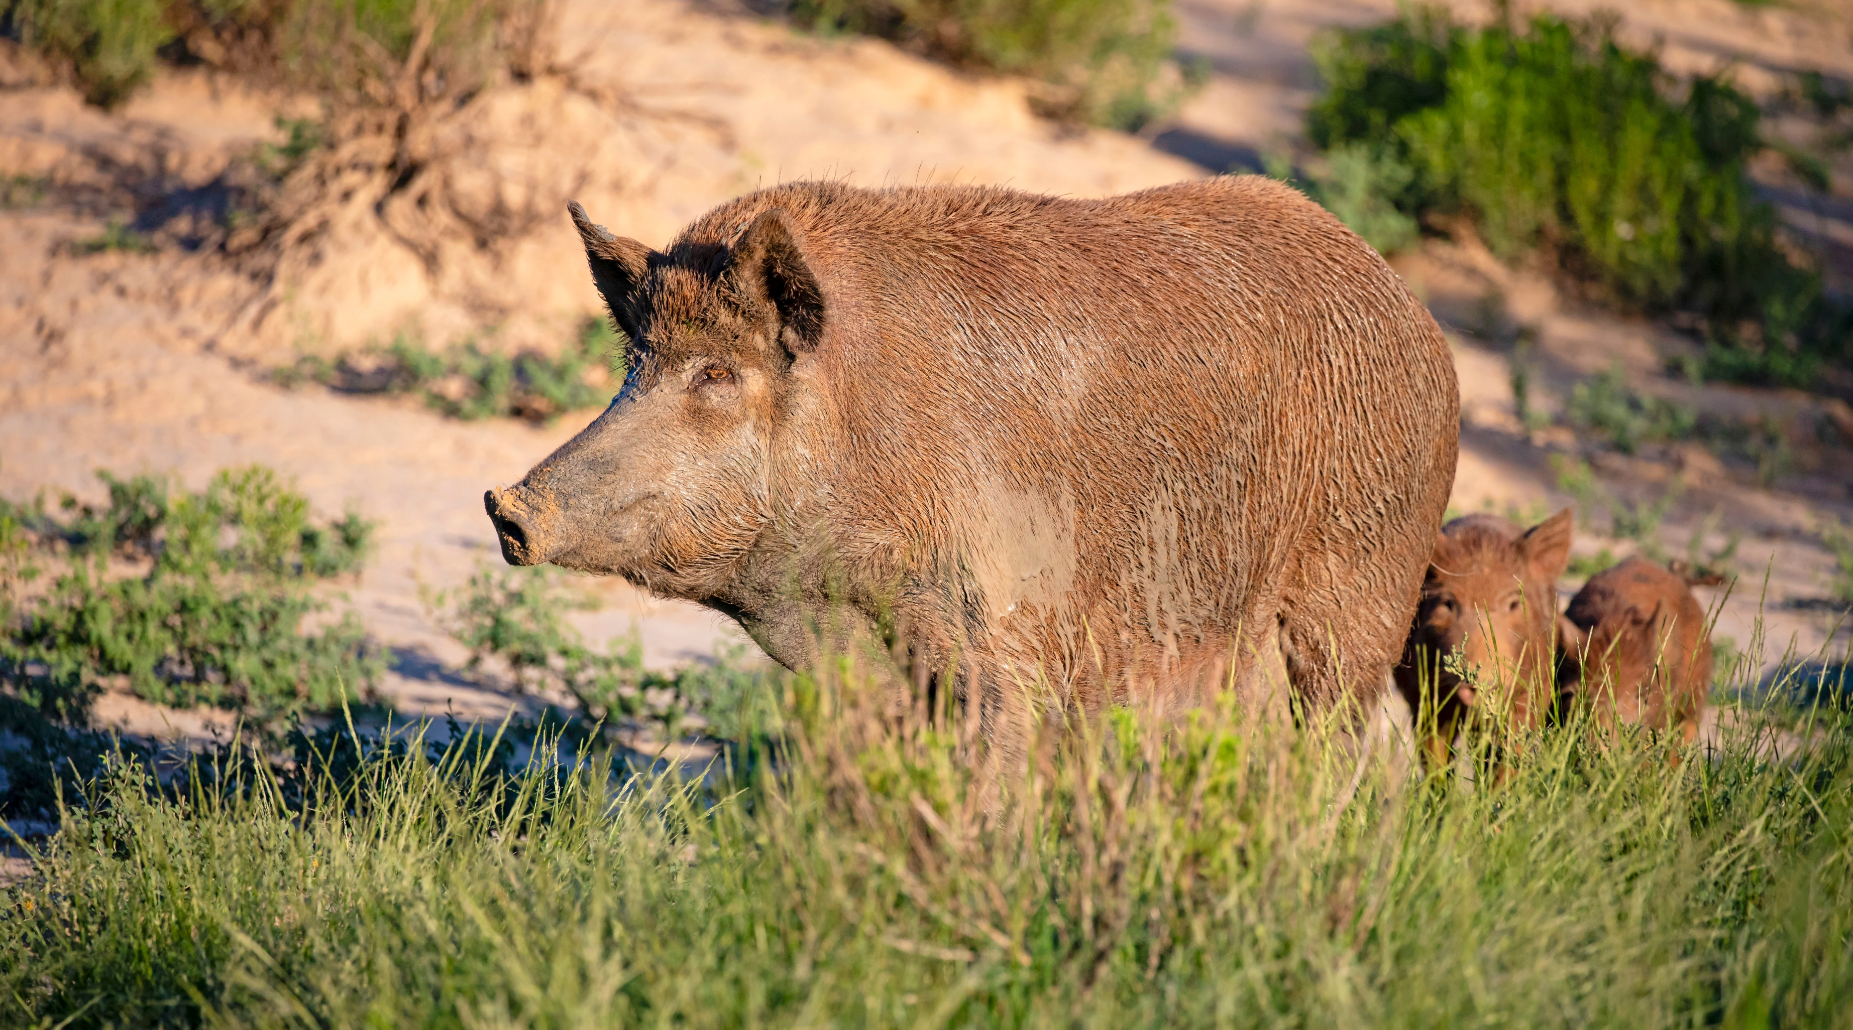
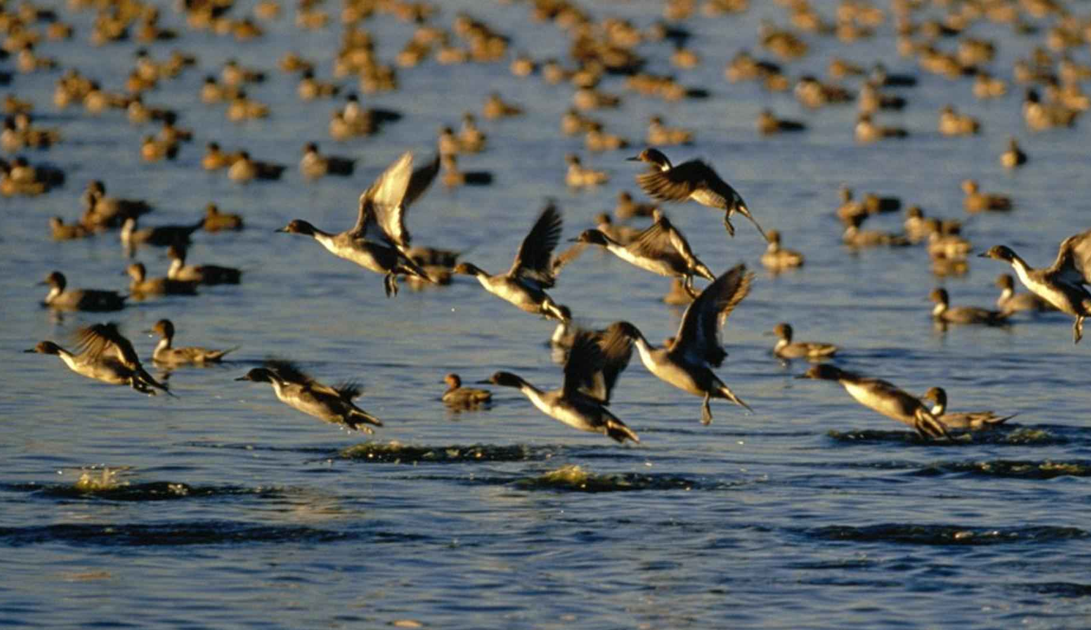
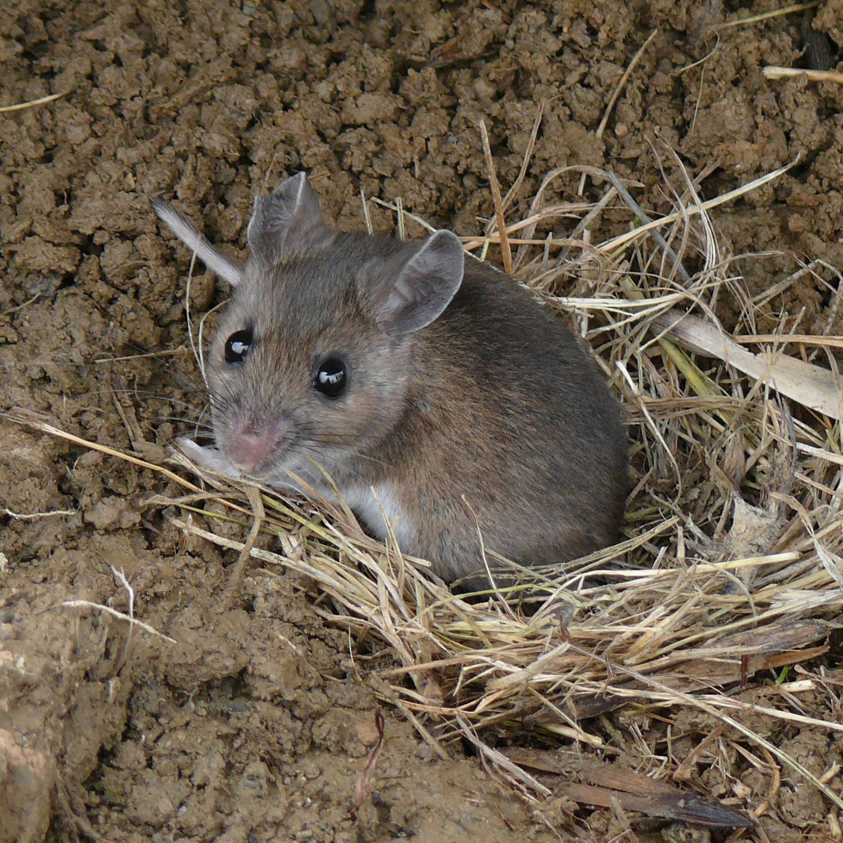
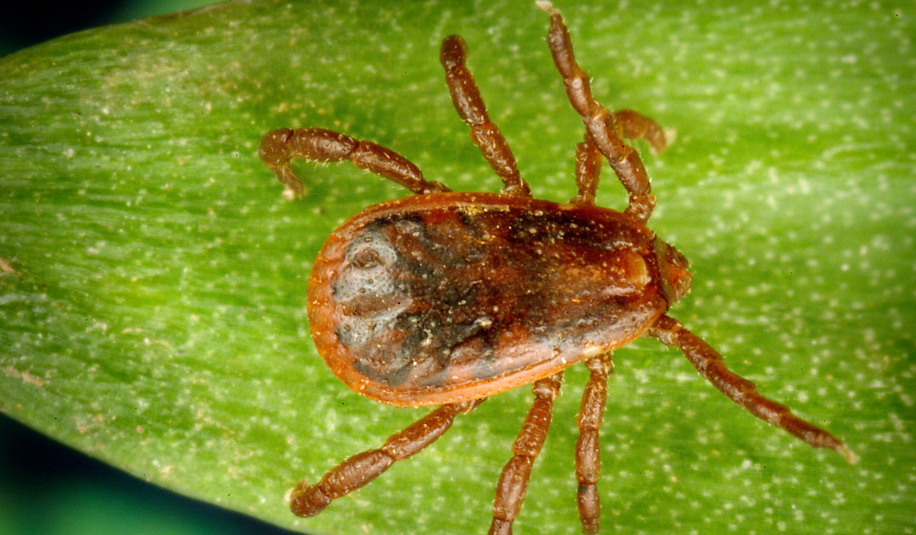
Wildlife and Arthropod Vectors
Notes:
Some high-consequence diseases are spread by various non-production animal species; in these cases, arthropod or wildlife vector control measures may be needed.
Photos: White tailed deer/Bob Nichols USDA; White footed mouse/Jim McCormac, Ohio DNR; feral swine/Shutterstock; Ducks/public domain image.com; Aedes mosquito/James Gathany CDC PHIL; Rhipicephalus sanguineus/James Gathany CDC PHIL

Slide 25
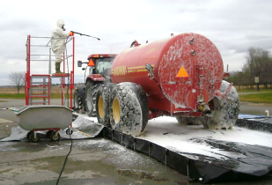
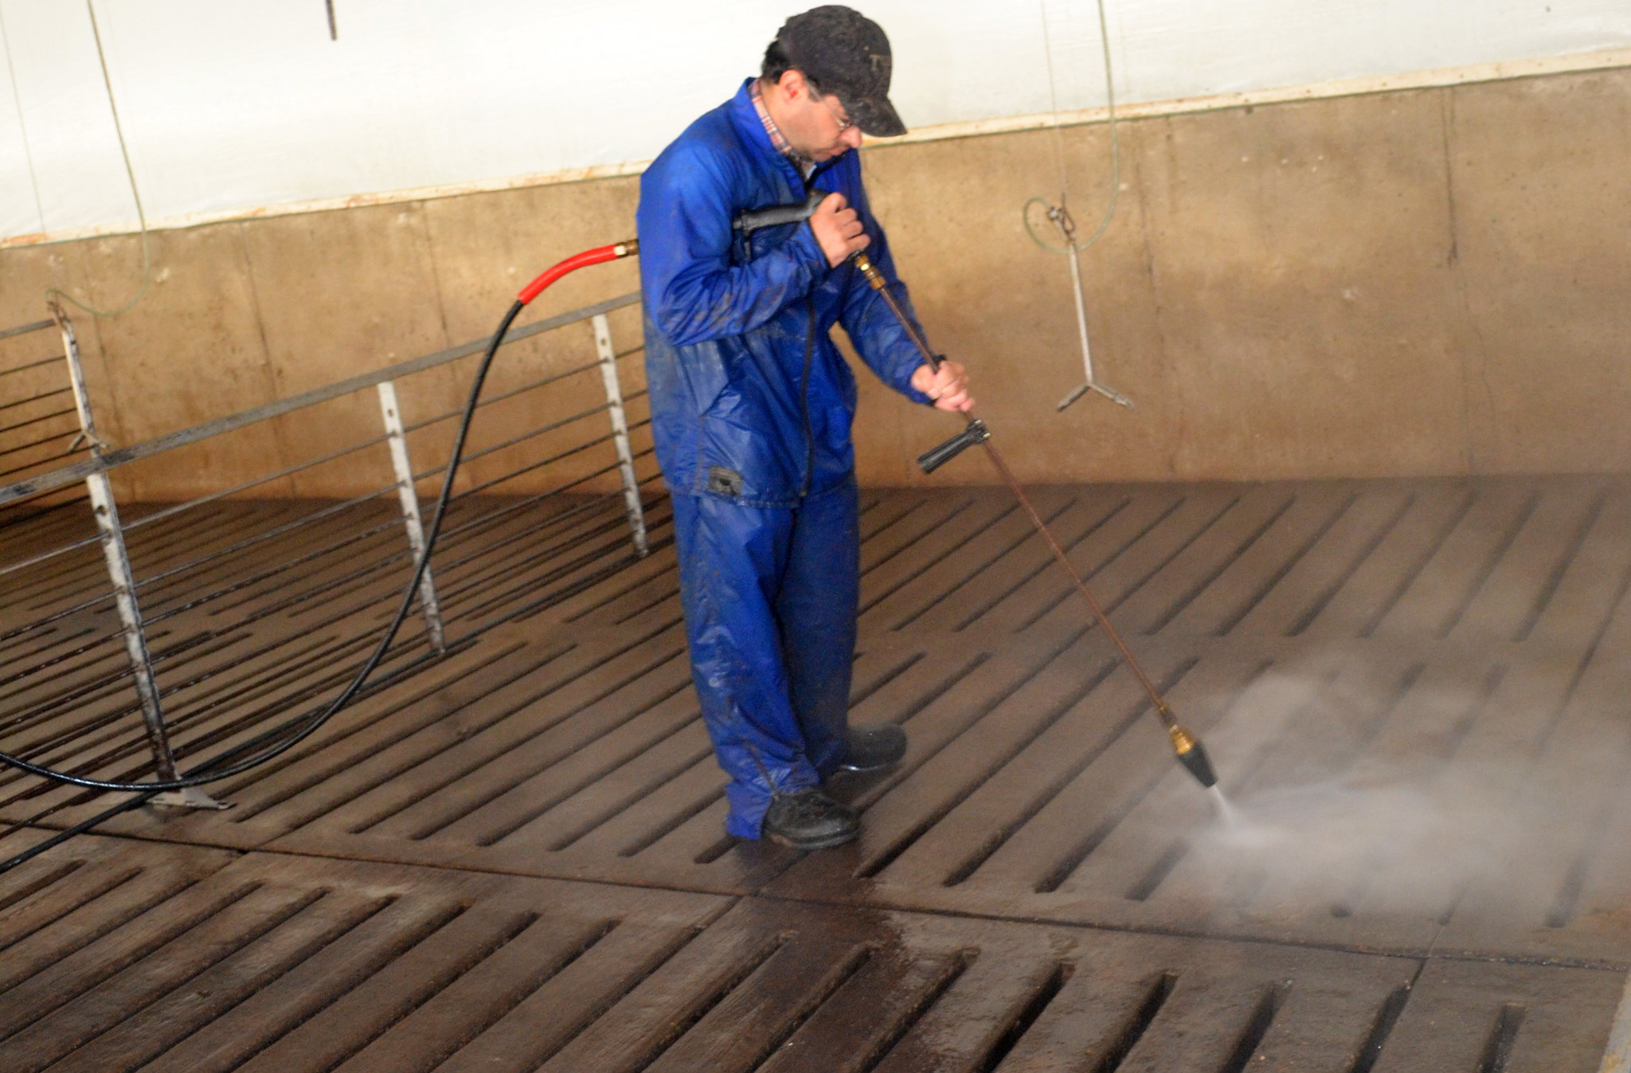
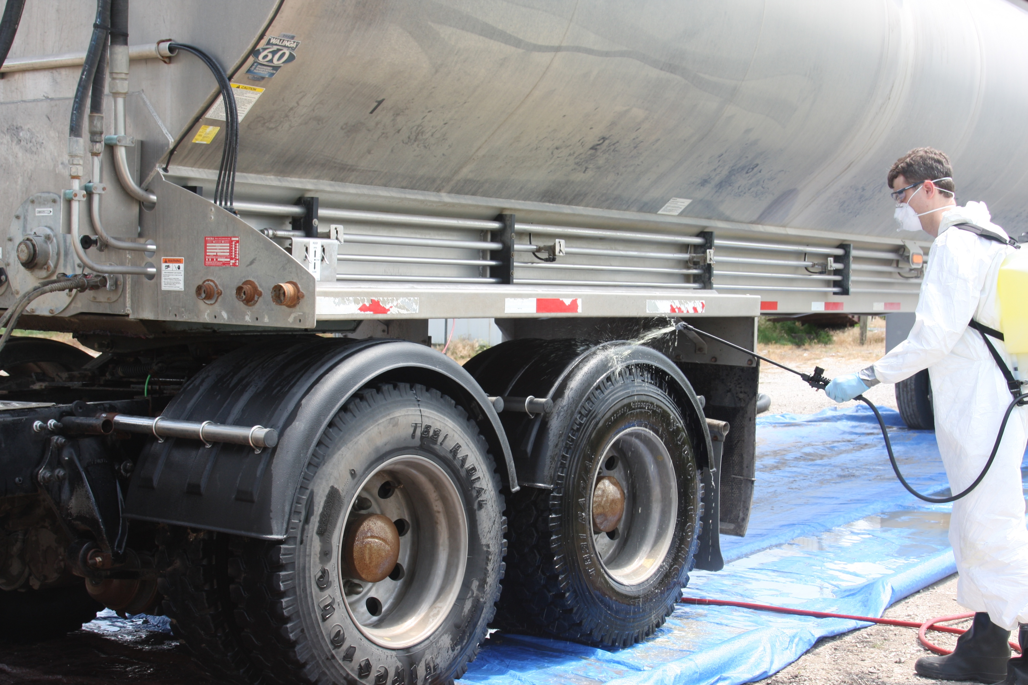
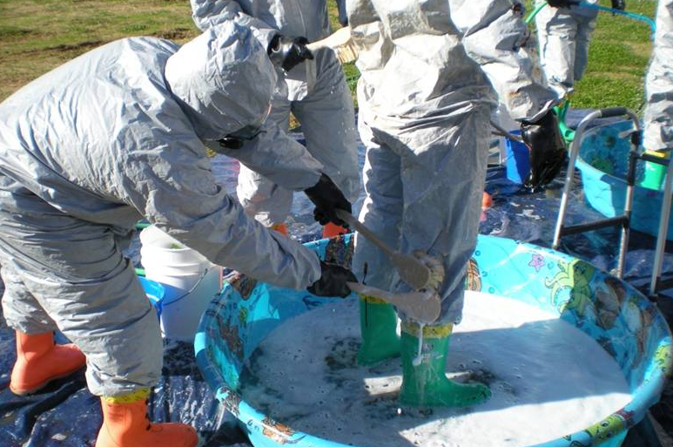
Cleaning and Disinfection
Notes:
Extensive cleaning and disinfection measures will be required for the site, as well as any vehicles, equipment, and responders participating in the response and entering the site.
Photos: barn cleaning, National Pork Board, Des Moines; truck cleaning, Dani Ausen/CFSPH, tractor cleaning, Buddy Gaither North Carolina Biosecurity Committee; PPE cleaning, Gordon Harman USDA APHIS

Slide 26
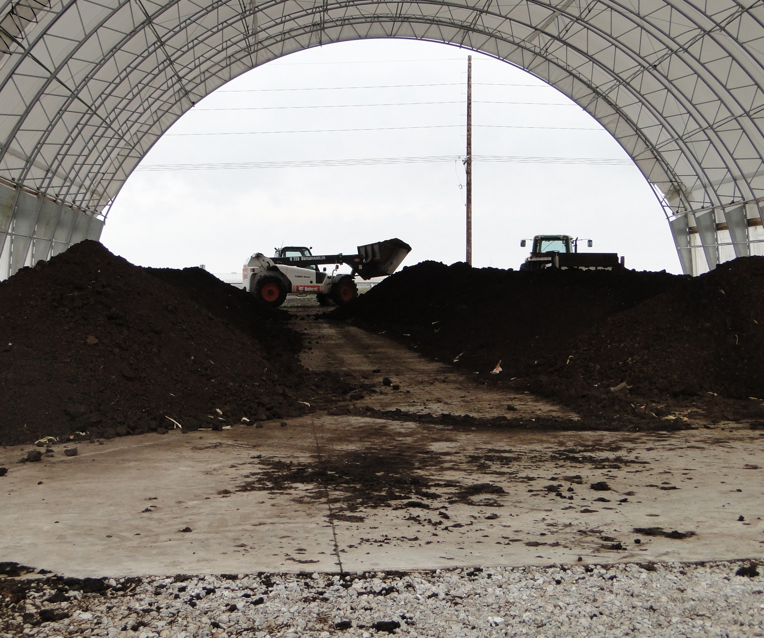
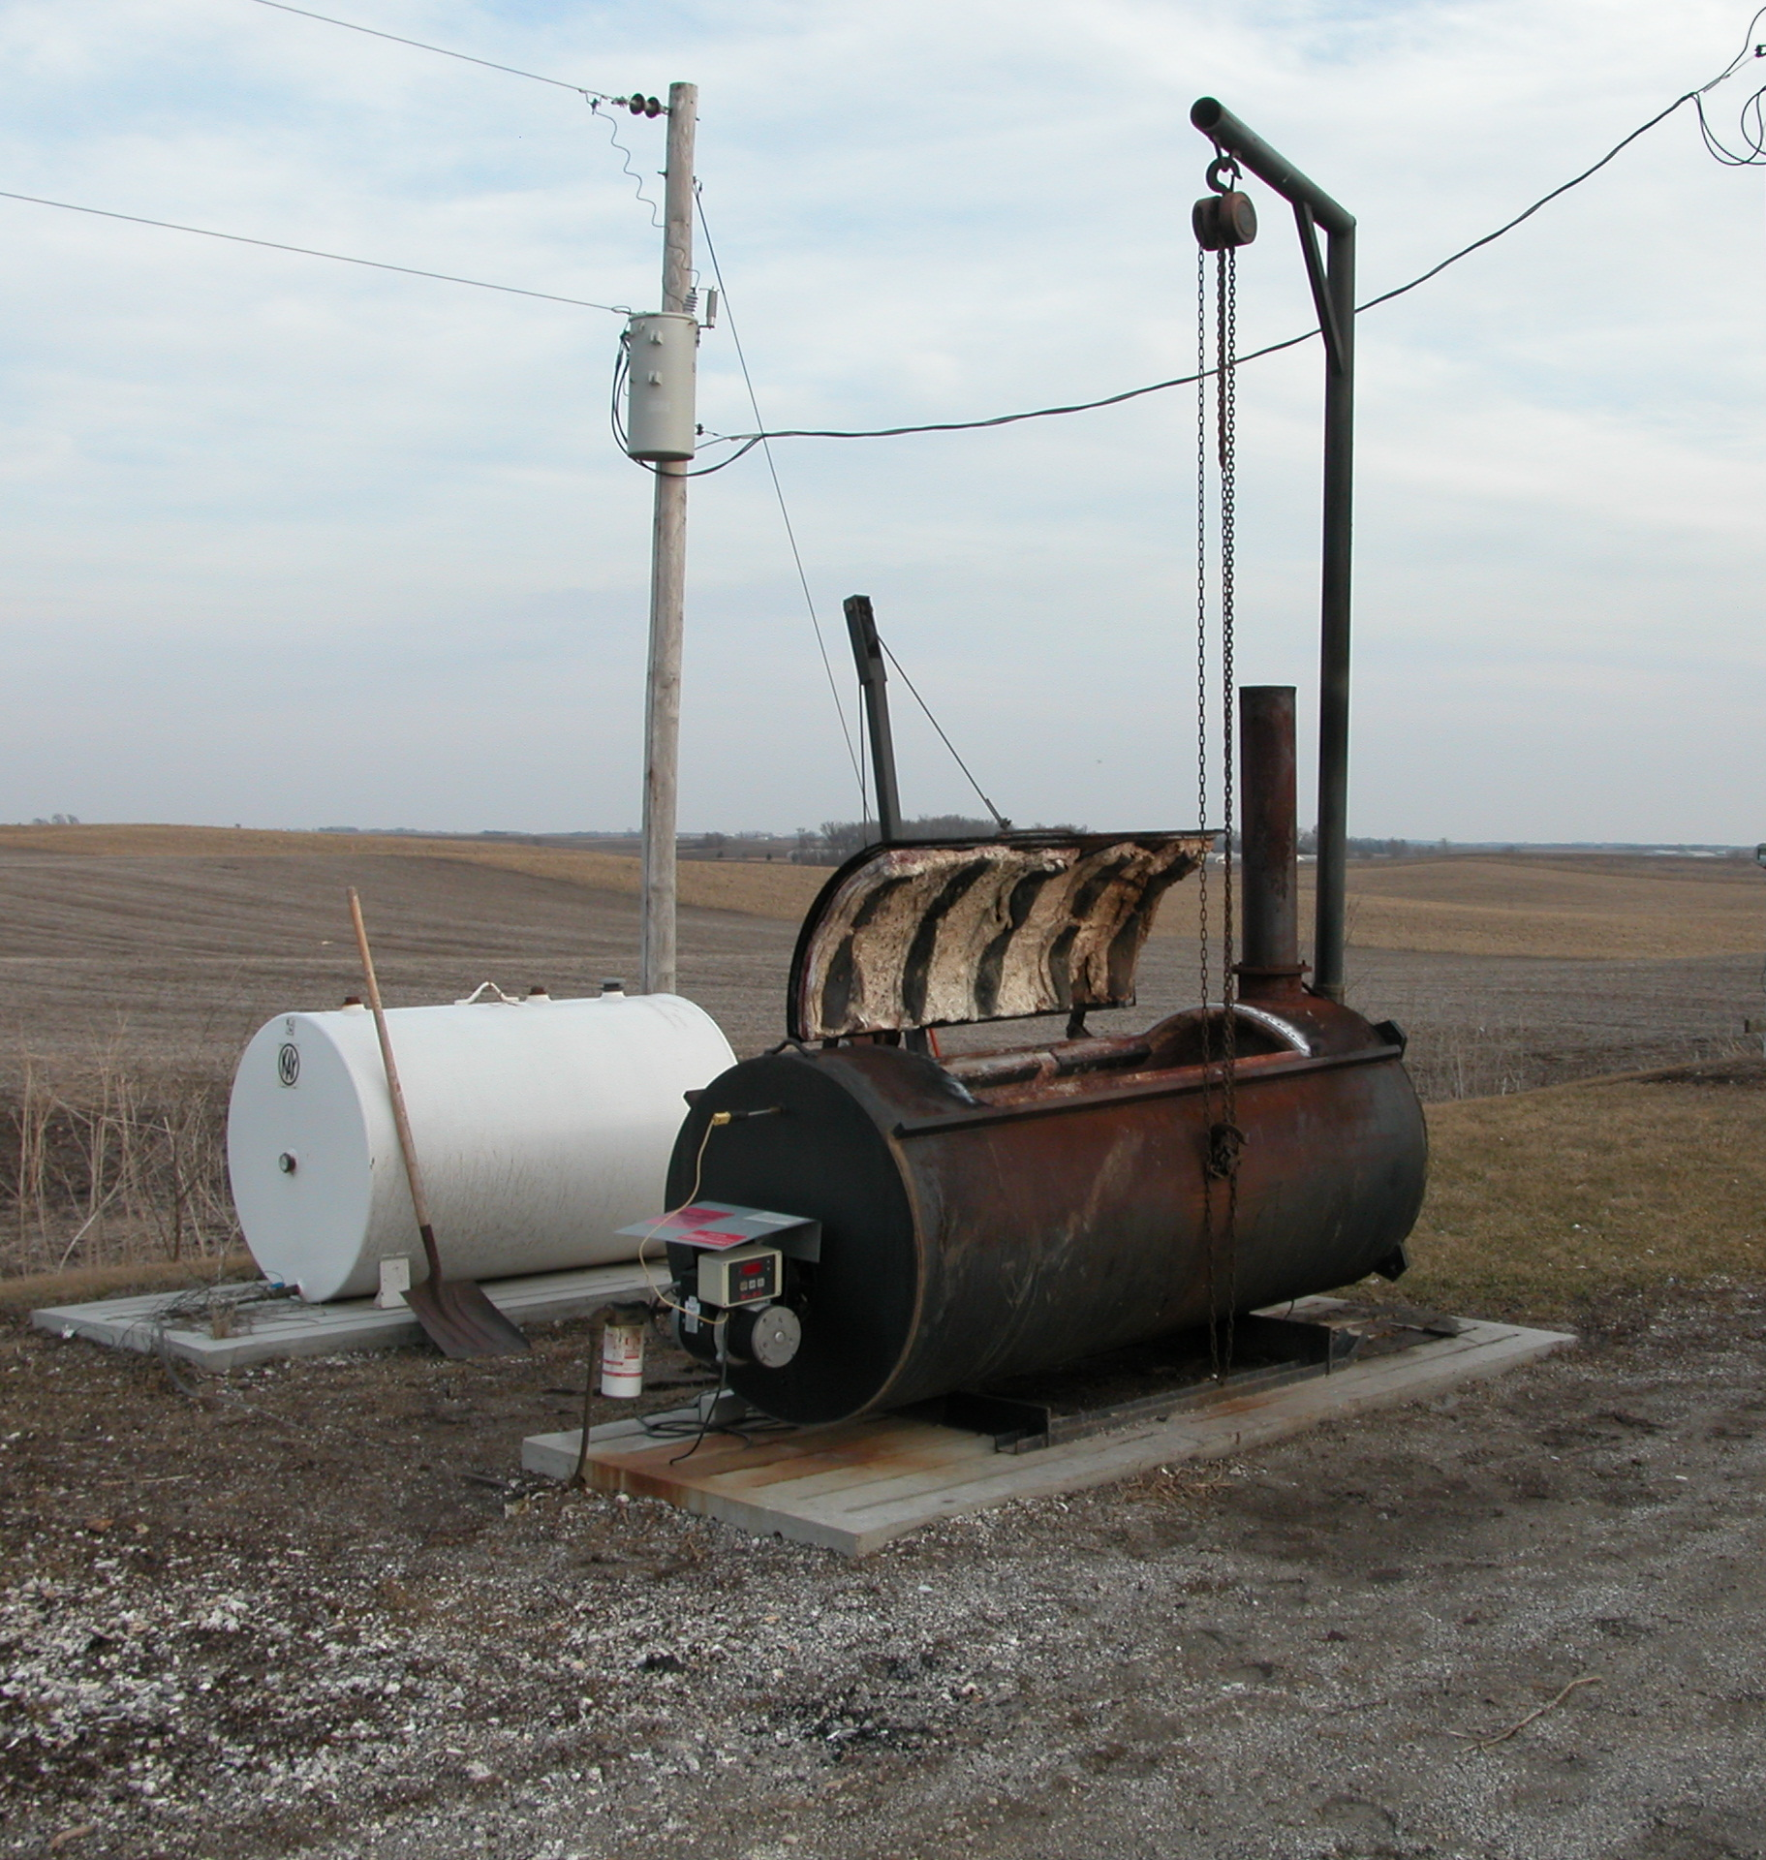
Waste and Carcass Disposal
Notes:
When infected animals die, either from the disease, euthanasia or depopulation, carcass disposal procedures, such as on-site composting or other methods will be part of the response activity.
Photos: incinerator, ISU VDPAM; compost piles, CFSPH

Slide 27
Key Points
Quick detection and action needed to prevent further spread and restore trade.
Support from various agencies and disciplines will be needed.
Notes:
In summary, animal disease emergency responses require quick detection and action to prevent further spread to other locations and animals. Response activities will require support to animal health officials from a wide range of agencies and disciplines. Efficient and effective control and containment procedures are needed to address animal health and welfare and restore trade. These actions also support quicker recovery to provide business continuity.

Slide 28
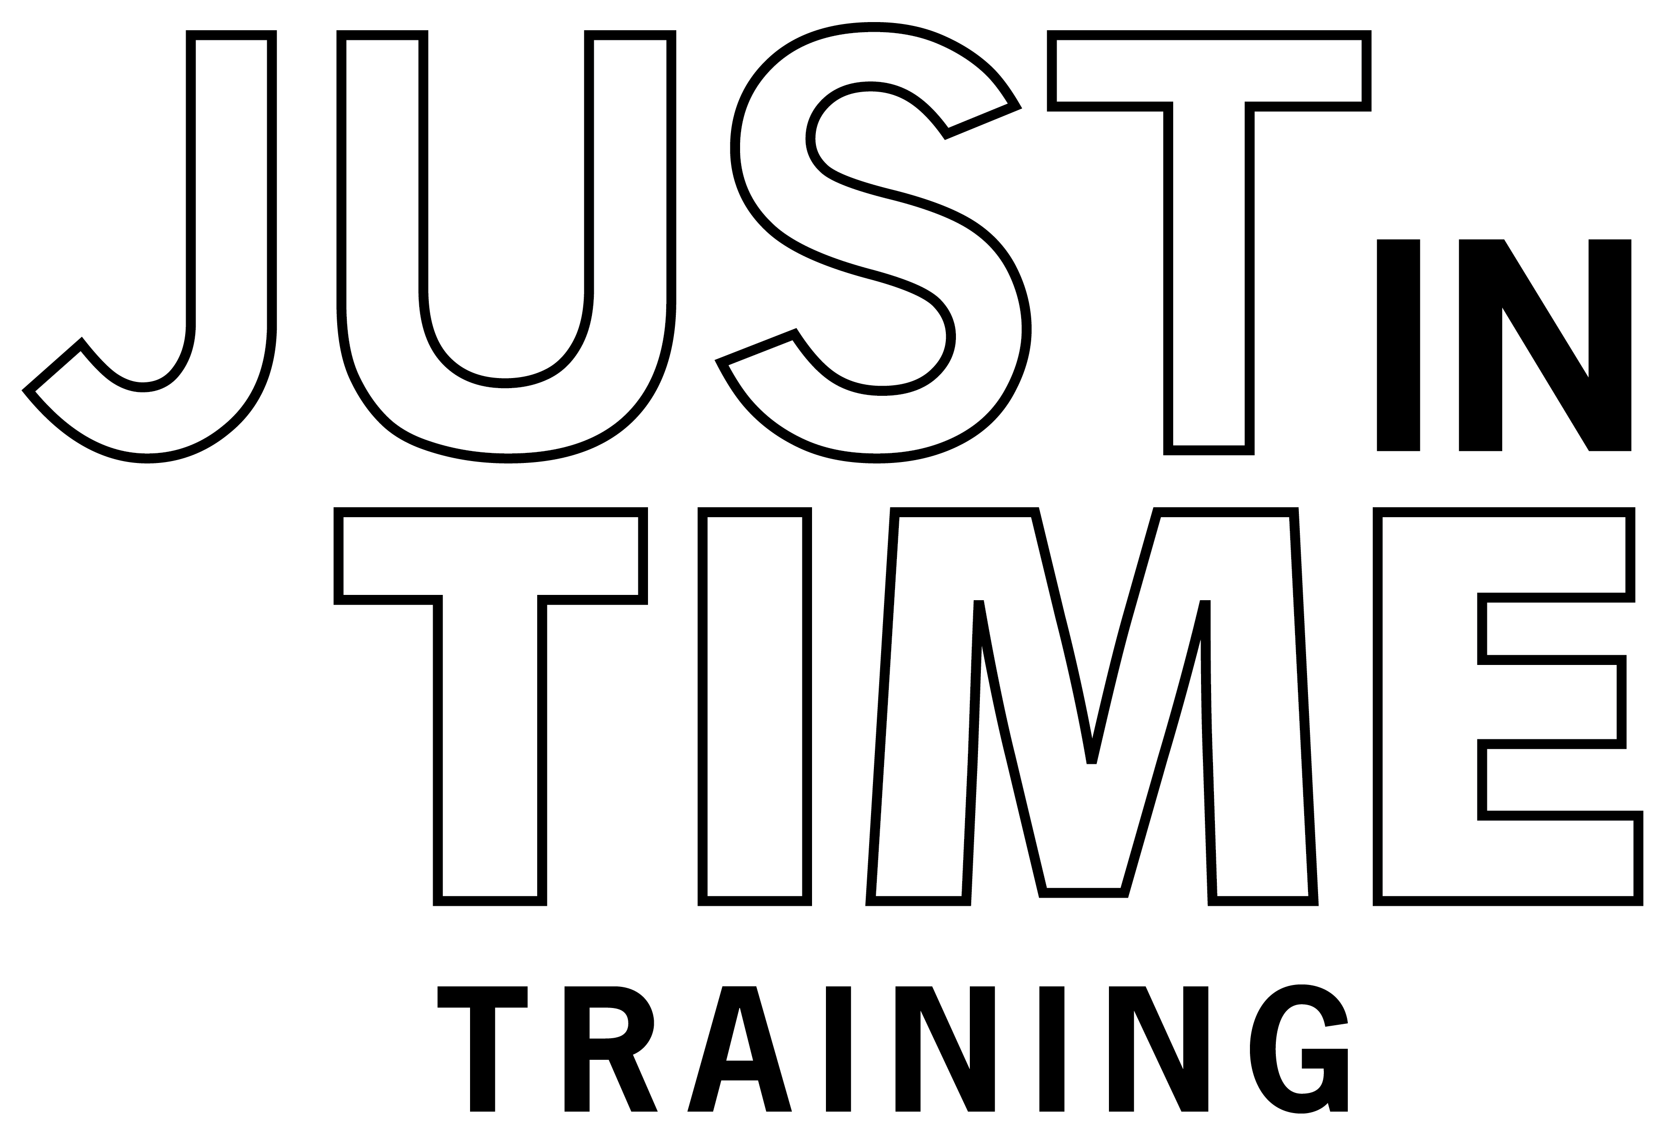
Additional ADE Videos
Notes:
For more information on animal disease emergency responses, follow this QR code to the Just in time Training website.

Slide 29
Acknowledgements
Development of this material was made possible through a grant provided to the Center for Food Security and Public Health at Iowa State University, College of Veterinary Medicine from the U.S. Department of Agriculture (USDA) Animal and Plant Health Inspection Service through the National Animal Disease Preparedness and Response Program (NADPRP)
Notes:
Development of this material was made possible through a grant provided to the Center for Food Security and Public Health at Iowa State University, College of Veterinary Medicine from the U.S. Department of Agriculture Animal and Plant Health Inspection Service through the National Animal Disease Preparedness and Response Program.

