Slide 1
Overcoming Language Barriers
During an Animal Health Emergency
Notes:
December 2015
During animal health emergency situations, communication among individuals involved will be essential. This includes relaying information between responders or conveying information with animal owners or producers, or animal health workers. In some instances, language barriers may impede communication. This Just-In-Time training will discuss ways to work around language barriers during an animal health emergency.

Slide 2
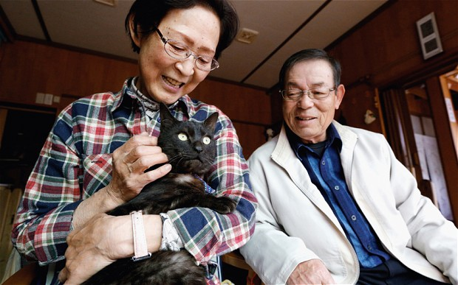
Language Barrier Issues
Animal owners
  Announcements, warnings
  Evacuation, sheltering
Livestock producers/workers
  Explaining response steps needed
    Quarantine
    Depopulation
    Biosecurity
  Animal health response tasks
    Animal handling
    Biosecurity procedures
    Safety precautions
Notes:
It is important to understand when language barriers may occur during an animal health emergency. While every situation varies, language barriers may involve animal owners or producers whose animals are affected by the emergency. There may be a need to convey instructions to follow (such as evacuation or sheltering directions), or to explain response measures needed (such as quarantine of a premises or depopulation of animals for disease control). Any of these situations will be stressful for the animal owner, making the need for effective communication across the language barrier that much more essential.
Another situation may involve the need for assistance from farm employees with response tasks such as animal handling or implementing biosecurity measures or safety precautions. In some situations, these employees may not speak or understand English, but their training and assistance may be essential.
Photo: Asian pet owners reunited with this pet cat following a disaster. http://www.telegraph.co.uk/news/worldnews/asia/japan/10824207/Cat-missing-since-Japan-tsunami-reunited-with-owners.html

Slide 3
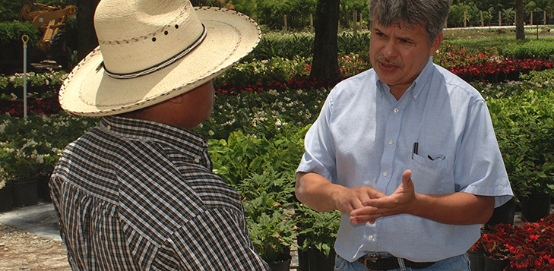
Language Barrier Issues
Diverse workforce
  47% foreign-born
  50% Hispanic
  31% less than 9th
  grade education
Spanish most common non-English language in
U.S. households
Notes:
The agriculture workforce has become increasingly diverse in language, culture and education. Many agricultural workers are immigrants who have limited English language skills. The majority are Hispanics from Latin America, particularly from Mexico; however a diverse number of other immigrants from Asian and European backgrounds may be included in language barrier situations. A 2012 survey indicated 47 percent of farm laborers and supervisors were foreign-born; 50% of workers and supervisors were Hispanic and 31 percent had less than a 9th grade education. Additionally, in U.S. homes, Spanish is the most spoken non-English language. Providing information and possibly training to these non-English speaking individuals will be challenging and require creative approaches to convey essential information during the response.
Source: The National Agricultural Workers Survey (NAWS) and USDA Economic Research Service
http://www.ers.usda.gov/topics/farm-economy/farm-labor/background.aspx#demographic
Photo: University of Florida Agricultural Extension Agent Cesar Asuaje talking with a Hispanic agriculture worker. http://blogs.ifas.ufl.edu/global/2015/10/05/worker-safety-training/

Slide 4
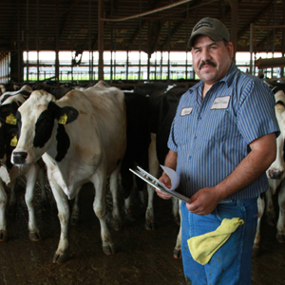
Overcoming Language Barriers
Find someone
that is bilingual
  Farm supervisor
  or crew leader
  Community member
  Interpreting service
  Other responding agencies
Notes:
There are some key strategies to addressing language barriers during animal health emergencies. One of the first steps is to identify an individual that speaks the language as well as English. This person can serve as an interpreter to convey your message. This might include a farm or crew supervisor, perhaps a respected community member or an interpreting service. Check with other agencies involved as well for bi-lingual responders.
Photo: A Hispanic dairy worker. http://umash.umn.edu/portfolio/multidisciplinary-network-to-address-agriculture-worker-health-and-safety-issues/

Slide 5


Visual Identification
Visual identification
  Colored vest
  Colored tape
  on outerwear
INTERPRETER
Notes:
Once identified, this person should be uniformed with some type of visual indicator, such as a colored vest or colored tape on their protective outerwear, for easy identification when an interpreter in needed.
Photo source: http://www.dupont.com/content/en_us/home/products-and-services/personal-protective-equipment/chemical-protective-garments/brands/tyvek-protective-apparel/products/tyvek-800-j/_jcr_content/openareapar/productanimation/images/image_2.img.png/1444396223698.png; http://www.fullsource.com/ml-kishigo-3704i/

Slide 6
Tips for Communicating
Remain calm and professional
Speak slowly and clearly
Avoid using acronyms or jargon
Use everyday language
Repeat important information
Be patient
Communicate with respect
Notes:
As with anyone you may interact with during a response, remain calm and professional. If the individual does understand some English, speaking slowly and clearly can help provide them time to assimilate words you are saying. Emergency response tasks can contain a number of acronyms or disciplinary jargon, such as PPE or C&D or donning and doffing. Try to avoid using these terms or explain them using everyday language. Repeat important information several times to emphasize the key points. Also be aware of cultural factors. For example, immigrants may be reluctant or apprehensive to communicate with governmental entities. Animal owners will be distraught following a emergency situation as well as from the loss of their pet or livestock. Be patient and communicate with respect to help build trust.

Slide 7
Tips for Communicating
Give information in small parts
Verify comprehension
before continuing
Frequently check for understanding
  Look for signs of confusion, agreement, or disagreement, apprehension
  Watch the eyes, facial expression, or body language
Notes:
Provide information in small increments to allow processing and comprehension of the information. Frequently check for understanding and verify before continuing with additional information. Watch the individuals eyes, facial expression or body language for signs of comprehension, confusion, agreement or disagreement.

Slide 8
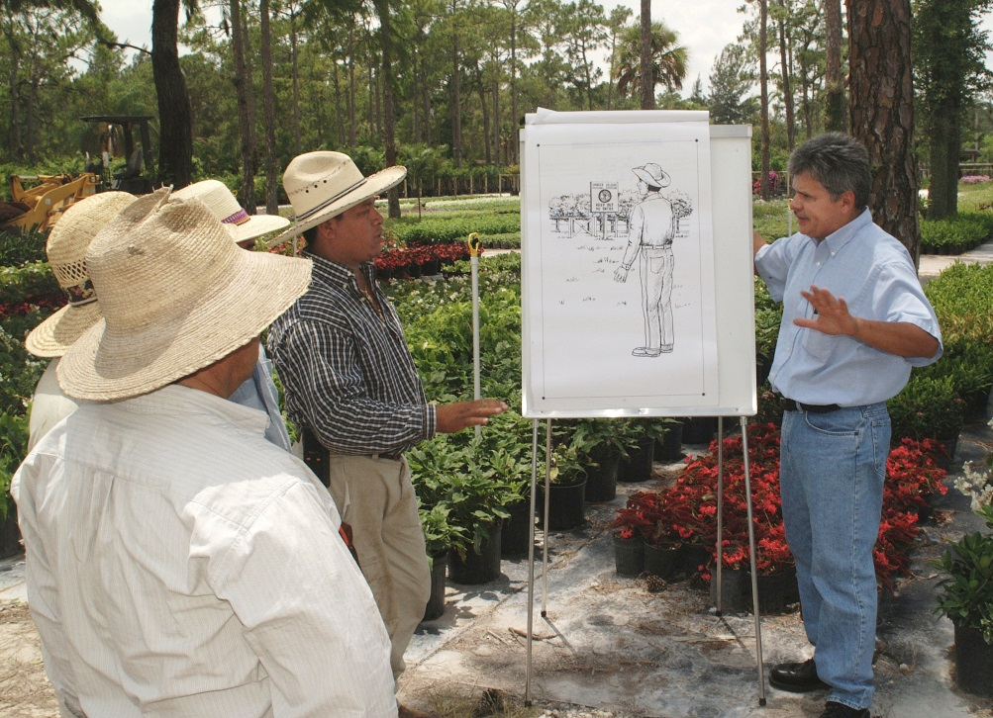
Additional Communication Tips
Information by
various methods
Verbal
Visual
  Translated signage
  or handouts in
  various languages
  Language boards
  Picture sets or drawings
    Premade or paper/pencil
Notes:
Whenever possible, provide information in various forms, including spoken and visual methods. Provide translated signage or handouts in the needed language whenever possible. Language boards can be helpful for communicating in the field, as can picture sets or drawings. These may be premade or drawn in the field.
Photo: University of Florida Agricultural Extension Agent Cesar Asuaje talking with Hispanic agriculture workers. http://news.ifas.ufl.edu/wp-content/uploads/2014/10/Cesar-Asuaje.jpg.

Slide 9
Resources
FEMA IS-242.B: Effective Communication. February 2014. https://training.fema.gov/is/courseoverview.aspx?code=is-242.b
Arcury TA, Estrada JM, Quandt SA. Overcoming Language and Literacy Barriers in Safety and Health Training of Agricultural Workers. J Agromedicine. 2010 Jul;15(3):236-248. http://www.ncbi.nlm.nih.gov/pmc/articles/PMC2914347/
Notes:
Information on overcoming language barriers during animal health emergencies is limited, however these resources address the topic for health and safety training, medical emergencies or law enforcement situations and can be applied to animal health.

Slide 10
Acknowledgments
Development of this presentation was by the Center for Food Security and Public Health at Iowa State University through funding from the Multi-State Partnership for Security in Agriculture
Authors: Glenda Dvorak, DVM, MPH, DACVPM; Logan Kilburn
Notes:
Information provided in this presentation was developed by the Center for Food Security and Public Health at Iowa State University College of Veterinary Medicine, through funding from the Multi-State Partnership for Security in Agriculture.

