Slide 1
Handling Conflict
During an Animal Health Emergency
Notes:
June 2016
During an animal health emergency response, interactions with animal owners, the media and the public will occur. Some of these situations may result in tension or conflict. This Just-In-Time training presentation will overview ways to handle and possibly avoid conflict situations during an animal health emergency.

Slide 2
Conflict Situations
Angry
Fearful
Distraught
Different backgrounds, values, beliefs
Anti-government or anti-authority
Non-cooperative
Belligerent
Threatening
Notes:
During any animal health emergency, conflict situations may arise. Animal owners may be angry with the situation, or fearful or distraught over the outcome. Differences in backgrounds, values or beliefs will occur. Some may have anti-government or anti-authority tendencies or philosophies, and the current situation may exasperate these feelings. Any of these situations may cause animal owners to be non-cooperative, belligerent or even threatening.

Slide 3
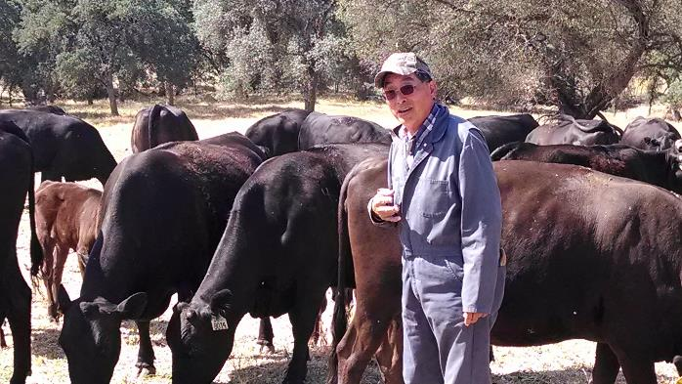
Before a Site Visit
Learn about the owner
What is the nature of the person?
What is their expected behavior?
Is there a real or perceived threat?
Are there any generation or cultural issues?
Notes:
The best way to handle these situations is to be proactive prior to the visit. First, learn as much as you can about the owner. What is the nature of the person and their expected behavior? Will they be cooperative or angered? Is there a real or perceived threat? Additionally determine if there are any generational or cultural issues. Different generations have different values. Certain religious sects or non-English speaking persons may have concerns based on their beliefs or culture of government or authority interaction.
[Photo: A cattle producer with his cows. Source: U.S. Department of Agriculture]

Slide 4
Before a Site Visit
Tap into local knowledge/acquaintances
Friend or neighbor
Local veterinarian, industry rep
Community leader
Consider having the acquaintance to come along if it will help diffuse the situation
Notes:
Tap into local personnel or acquaintances who may know the owner. In some cases, bringing along the acquaintance or community member may help to bridge the gap or diffuse the situation. This may include a friend, neighbor, the local veterinarians, respected community member, or an industry representative.

Slide 5
Heading to the Site
Avoid going alone
Travel in teams or with a partner
Call-in schedule
Carry a cell phone at all times
Notes:
Once you have some history about the owner, and are ready to head to the site, follow these guidelines for your safety: Never go alone, especially on the first visit, unless absolutely necessary. If possible travel in teams or at a minimum with a partner or “buddy”. If this is not feasible, use a call-in schedule with your supervisor. Establish a time when you will call-in, then be sure to implement it. Carry a cell phone and phone number list for supervisory personnel with you at all times.

Slide 6
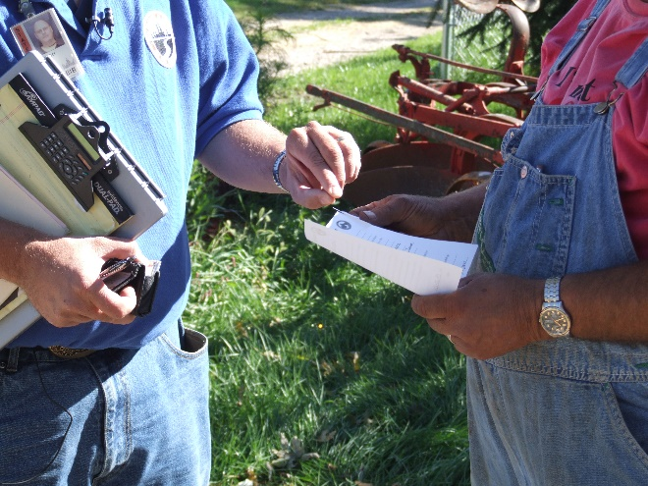
Upon Arrival
Professional and respectful
Introduce/identify yourself
Establish trust
Explain purpose of visit
Why you are there
Explain necessity of visit
Provide background of the situation
Express empathy for situation
The situation is hard for owner
Express goal to work cooperatively
Notes:
Upon arrival, handle all public interactions in a professional and respectful fashion. Introduce yourself and identify your agency or affiliation. Be aware you may be viewed as an intruder. Work to create or establish trust. Explain the purpose of your visit and why you are there. Provide the background of the situation (e.g., disease outbreak in the area). Explain the necessity of your visit or actions, such as to protect the animal health, public health, or food safety. Express your empathy for the owner and the situation. Realize the situation is hard for the animal owner. Listen with understanding and interest to their concerns. Express the goal to work cooperatively. If applicable, mention others who have cooperated or the benefit of cooperating. Sometimes it can help emphasize the larger goal and impact.
[Photo: Responder talking with a producer. Source: Jane Galyon/CFSPH Iowa State University]

Slide 7
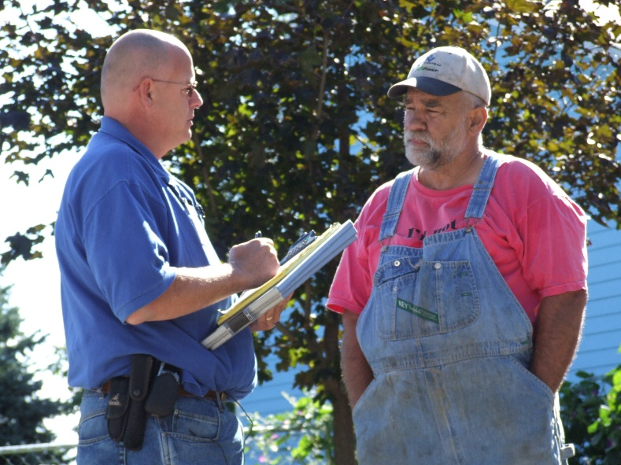
During the Visit
Conflict often due to misunderstanding
Listen and address owners concerns and questions
Listen without interrupting
Have a clear understanding of the concern
Notes:
The most common beginning of conflict is misunderstanding. Take time to hear and address the animal owners concerns and questions. Listen without interrupting and gain a clear understanding of the concern or issue the producer may have.
[Photo: Responder talking with a producer. Source: Jane Galyon/CFSPH Iowa State University]

Slide 8
During the Visit
Do not blame, judge or accuse
Focus on issue and goal of action
Be aware of nonverbal communication
Posture, facial expressions, eye contact, hand gestures
Notes:
Avoid blaming, or being judgmental or accusatory. Focus on the issue and the goal of the action. Effective communication also includes nonverbal elements. Be aware of your visual cues such as posture, facial expressions, eye contact or hand gestures. Listen without interrupting. Have a clear understanding of the issue or concern.

Slide 9
During the Visit
Be aware of your surroundings at all times
Conflict situations can escalate quickly; often without warning
Watch for any security or safety concerns
Personal safety is always a first priority
Watch for changes in behavior, language or posture
Notes:
During your visit, remain aware of your surroundings at all times, especially for any security or safety concerns. In these situations, personal safety is always a first priority. Conflict situations can escalate quickly and sometimes without warning. Watch for changes in behavior, language, posture

Slide 10
If You Are Threatened
Remain calm
Leave immediately
Do not elevate the situation or put your safety at risk
Contact your supervisor immediately
Some situations may require law enforcement
Notes:
If you are threatened, remain calm, avoid confrontation and leave immediately. Do not elevate the situation or put your safety at risk. Contact your supervisor immediately. Some situations may require State or Federal authorities, law enforcement or possibly legal action.

Slide 11
Following an Incident
Document the situation
Provide detailed information
Forward the information to your supervisor
Notes:
After a conflict situation occurs, document the event. Provide detailed information. Forward this information to your supervisor.

Slide 12
Strategies for Communication
Focus on the issue
Accept/respect opinions may differ
Don’t force compliance
Work to develop common agreement
If not possible, discuss situation with supervisor
Formal training prior to the response
Notes:
Strategies for communicating include: staying focused on the issue; accept and respect the opinions of the owner and realize they may differ; do not force compliance, instead work to develop a common agreement if possible. If these strategies are not successful, leave and discuss the situation with your supervisor. To help with communication or conflict resolution, consider receiving formal training in these areas.

Slide 13
Resources
Effective Communication
https://training.fema.gov/emiweb/downloads/is242.pdf
Conflict Resolution Skills
http://www.edcc.edu/counseling/documents/Conflict.pdf
Conflict Resolution http://www.wfm.noaa.gov/workplace/ConflictResolution_Handout_3.pdf
Notes:
The following resources provide communication and conflict resolution information. In this presentation, we briefly reviewed how to communication and handle conflict with animal owners during an animal health emergency. For more information on this topic, consult these additional resources.

Slide 14
Acknowledgments
Development of this presentation was by the Center for Food Security and Public Health at Iowa State University through funding from the Multi-State Partnership for Security in Agriculture
Authors: Glenda Dvorak, DVM, MPH, DACVPM; Logan Kilburn
Notes:
Information provided in this presentation was developed by the Center for Food Security and Public Health at Iowa State University College of Veterinary Medicine, through funding from the Multi-State Partnership for Security in Agriculture.

