Slide 1
Wildlife Management and Vector Control
During Livestock or Poultry
Disease Outbreaks
Notes:
June 2015
During an animal disease emergency, such as a foreign animal disease of livestock or poultry, controlling the spread of the disease to other animals or locations is essential. For some of these disease situations, wildlife or arthropod vectors may contribute to the spread of disease. In these situations, response efforts to manage or control these potential sources will need to be addressed. This Just-In-Time training presentation will provide a general overview of wildlife management and vector control principles as they relate to disease outbreak situations in domestic livestock or poultry.

Slide 2
Example FADs
Arthropod Vectors
 | Relevant Wildlife |  |  | Domestic Livestock |  |  |  |  | Transmission Route
Disease | Bird | Feral Swine | Deer | Cattle | Horses | Pig | Poultry | Sheep/Goat | Direct Contact | Indirect/Fomites | Ingestion | Inhaled/Aerosol | Vector-borne | Zoonotic
African swine fever |  |  |  |  |  |  |  |  |  |  |  |  | ticks | No
Avian influenza |  |  |  |  |  |  |  |  |  |  |  |  |  | Yes
Classical swine fever |  |  |  |  |  |  |  |  |  |  |  |  |  | No
Foot-and-mouth disease |  |  |  |  |  |  |  |  |  |  |  |  |  | No
Rift Valley fever |  |  |  |  |  |  |  |  |  |  |  |  | mosquitoes | Yes
Swine vesicular disease |  |  |  |  |  |  |  |  |  |  |  |  |  | Yes
Vesicular stomatitis |  |  |  |  |  |  |  |  |  |  |  |  | biting midges | Yes
Notes:
Many livestock and poultry diseases of economic concern have a wildlife and/or arthropod vector component. Depending on the production method used, domestic livestock or poultry may have interaction with a variety of wildlife species or arthropod vectors. These interactions become an important consideration in disease control response efforts. The following table shows a few examples of foreign animal diseases that affect domestic livestock and poultry (light blue) and relevant wildlife species (orange). The green columns show how the diseases can be spread, and the dark orange, those that involve an arthropod vector. It also shows that some of these diseases are considered zoonotic – or able to also affect people. A full reference table is available on the Just-In-Time website.
Table adapted from USDA FAD PReP Guidelines: Wildlife Management and Vector Control for a Foreign Animal Disease Response in Domestic Livestock.

Slide 3
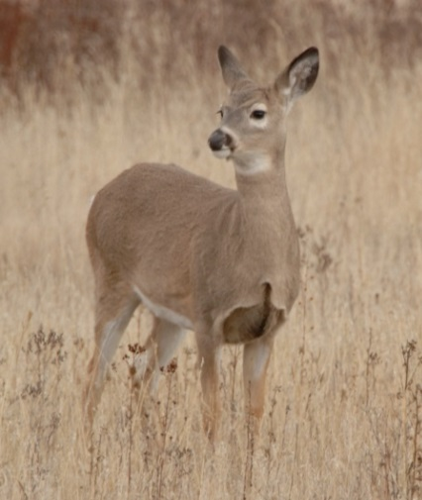
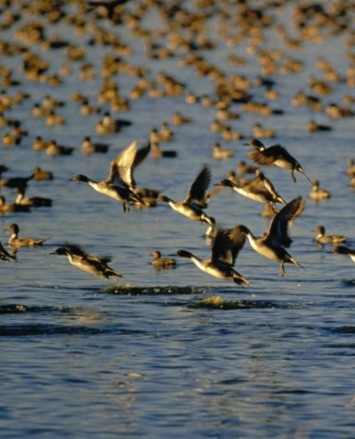
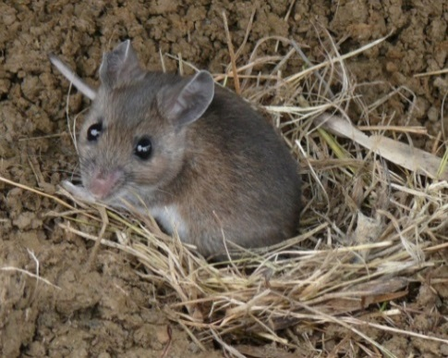
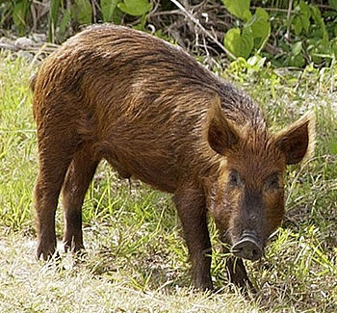
Wildlife
Free-ranging
Native or feral
Wildlife can
  Be infected
  Serve as a reservoir
  Further spread pathogen
Indicator of disease
Notes:
Wildlife species can include any number of free ranging native mammals or birds, as well as feral domestic animals. These animals may interact with domestic livestock and poultry kept outdoors on pastures or through shared water sources. Scavenger species, such as rodents or birds, may enter production houses in search of food and nesting locations, and can be carriers of disease.
Depending on the disease of concern, wildlife species may become infected and ill with the disease, spreading it to other species; or they may become infected, without illness, but serve as a source (or a reservoir) to spread the disease agent to other locations and animals, including livestock or poultry. However, in other diseases, wildlife may simply be a reflection that the disease is already occurring in domestic livestock or poultry in the area.
For example, feral swine are susceptible to and can serve as a reservoir of classical swine fever and African swine fever viruses that can also infect domestic swine or as seen more recently wild waterfowl can be a source and a reservoir for avian influenza viruses that affect domestic poultry.
Transmission of disease between wildlife and livestock, can occur directly (such as from nose-to-nose contact or exposure to body fluids/tissues, such as feces, urine or blood) or it can occur indirectly through contaminated environments (e.g., soil) or shared feed and water sources.
[Photos: (top left): deer from Bob Nichols/USDA; (top right): ducks flying over a water source from www.public-domain-image.com; (bottom left): mouse from Jim McCormac/Ohio DNR; (bottom right): feral pig from Wikimedia Commons.]

Slide 4
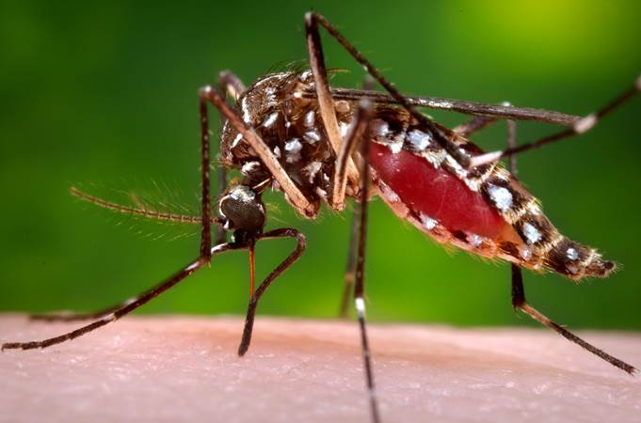
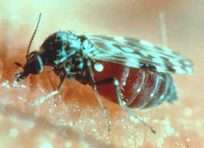
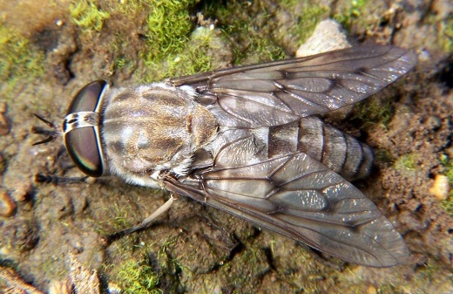
Arthropod Vectors
Living organism that carries disease agent between animals
Arthropods
  Mosquitoes
  Ticks
  Biting midges
  Flies
Bite or body part
Notes:
While a vector is technically defined as any living organism that can carry disease causing agents between animals, disease carrying vectors are most commonly thought of as arthropods (members of the insect and arachnid families), such as mosquitoes, ticks, biting midges, or flies.
Vectors can transmit disease agents over relatively large distances, significantly complicating disease control efforts. Arthropods can transfer disease causing organisms through a bite while feeding on an animal, or sometimes simply by carrying the disease agent on their body, such as on the legs of certain fly species. Many animal diseases that are spread by arthropod vectors affect domestic livestock, as well as wildlife species.
[Photos: (top left) mosquito (Aedes aegypti) from James Gathany/CDC Public Health Image Library; (top right) tick (Rhipicephalus sanguineus) from James Gathany/CDC PHIL; (bottom left) biting midge (Culicoides sonorensis) from Ed Schmidtmann/USDA ARS; (bottom right) horse fly (Tabanus) from Dennis Ray/Wikimedia Commons]

Slide 5
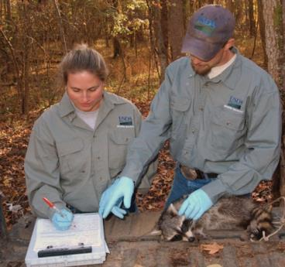
Agencies Involved
Wildlife
  State and local
  wildlife management agencies
  USDA APHIS
  Wildlife Services
    National Wildlife
    Disease Program
Arthropod vectors
  Public health
  if human impact
Notes:
For situations involving free-ranging wildlife, State fish and wildlife management agencies have primary authority and responsibility. However, the U.S. Department of Agriculture (USDA) has statutory authority in the Animal Health Protection Act to implement disease control and eradication actions for wildlife under certain conditions, such as when it impacts livestock or poultry. The Wildlife Services’ National Wildlife Disease Program is the primary emergency response contact point within USDA APHIS. Arthropod vector control is generally addressed by county or municipal governments, but public health departments may become involved when vector control issues affect human health.
[Photo: Two USDA APHIS Wildlife Services employees gathering data on a raccoon. Source: USDA-APHIS]

Slide 6
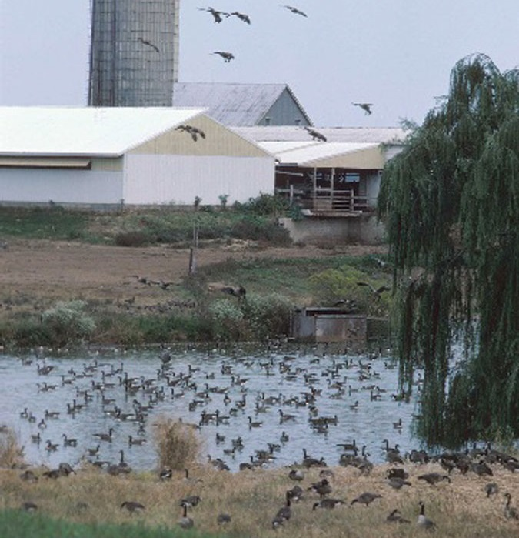
Assessment
Determine if wildlife or arthropod vectors involved
  Species present
  Infected or carrier
  Potential spread
  of disease agent
  Level of interaction
Determine risk
to livestock or poultry
Notes:
When responding to an animal disease emergency involving wildlife or arthropod vectors, assessment of the role and impact of these species will be needed. This will help determine any activities needed to prevent or stop further disease spread and transmission to additional animals or locations from these sources. Factors to consider include if the species are present in the Control Area, are they infected with (or carriers) of the disease agent, what is the potential for them to spread the disease agent, and what is the level or likelihood of interaction with domestic livestock.
[Photo: Geese populating a pond near a farm. Source: USDA Natural Resources Conservation Service (NRCS)]

Slide 7
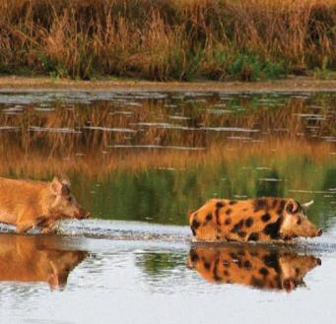
Disease Surveillance
Determine absence,
presence and potential spread
Diagnostic sampling
  Live capture
  Observation
  Carcass collection
Animal movement into and out of Control Area can pose challenges
Notes:
Assessment efforts will require various level of surveillance to determine the absence, presence, or potential spread, of the disease by a given wildlife or arthropod vector population. Diagnostic sampling of wildlife may be necessary during surveillance activities. Disease samples can be obtained by a number of different methods including, but not limited to, live capture, observation, and carcass collection. These efforts may be dictated by the availability of resources and the feasibility of sampling wildlife. In particular it is important to survey the animal population to assess if the disease has spread between wildlife and domestic livestock or poultry populations, and if so the extent to which it has spread. Because wildlife species are likely to move into and out of the Control Area, this may pose challenges to developing an effective surveillance and control plan.
[Photo: Feral swine moving across a waterway. Source: USDA APHIS]

Slide 8
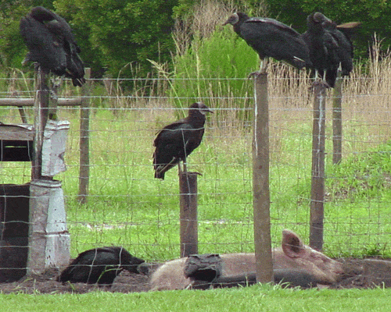
Wildlife Management
Measures to minimize spread to domestic livestock
Species present or involved
Population density and distribution
Habitat
Social organization
Notes:
Once the level of involvement of wildlife and/or arthropod vectors in the disease outbreak is determined, measures to minimize spread to domestic livestock or poultry must be determined. The decision to implement control measures in wildlife will be based not only on the risk assessment and surveillance, but also the feasibility of conducting successful control measures. For wildlife management and control, factors such as the animal species involved, the distribution of animals, population density, habitat, and social organization will influence not only the role that wildlife play, but also the management and control method needed to prevent the further spread and transmission of disease. In all cases, wildlife management must be conducted within local laws and regulations.
[Photo: Turkey vultures roosting by an outdoor pig pen. Source: USDA APHIS Wildlife Services]

Slide 9
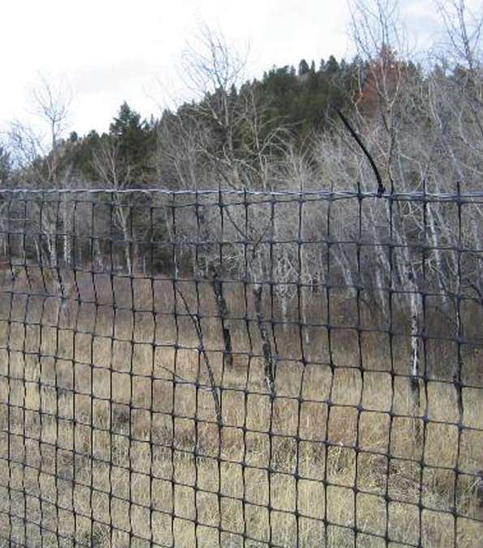
Wildlife Management
Removal and relocation
Dispersal
Habitat alteration
Natural or
artificial barriers
Wildlife able to evade and disperse
Notes:
The management and control of wildlife may involve the manipulation of the wildlife population or their habitat. This may include the removal or relocation of individual animals to lower the risk of transmission to domestic animals or the dispersal of wild populations. Alterations to a species habitat can be used to reduce attractiveness of certain areas for wildlife, eliminate food sources, or attract wildlife away from livestock or poultry locations. It can also be used to create buffer zones between infected and uninfected animals. Deterrence measures, such as natural or artificial barriers (fencing) can also be used to prevent interaction or to contain wildlife. Throughout response efforts, monitoring and surveillance should continue to determine the effectiveness of the program. Wildlife's ability to evade detection and disperse broadly can pose challenges to management efforts.
[Photo: Wire fencing used to prevent entry of wildlife. Source: USDA Forest Service]

Slide 10
Short-term and Long-term Goals
Short term
  Contain, control outbreak in livestock
Long term
  Control or eliminate disease from wildlife species
  May require extended management
Consider consequences
  Ecosystem and environment
  Trade implications
Notes:
In the short term, the foremost objective is to contain and control the outbreak in domestic livestock. However, longer-term objectives may focus on controlling or eliminating the disease from wildlife species. In some disease situations, the presence of a disease in wildlife can have international trade implications for livestock based on the role wildlife play in the transmission and maintenance of the disease. Demonstrating freedom from the disease in wildlife populations may be required for the resumption of trade. Additionally, the persistence of a disease in wildlife (or an arthropod vector) can pose a continual threat to livestock and poultry. Regardless of the management method used, short-term and long-term consequences must be evaluated. Assessment of any unintended consequences need to be considered, including impacts on wildlife populations and their ecosystems, environmental damage, as well as the public opinion or perception.

Slide 11
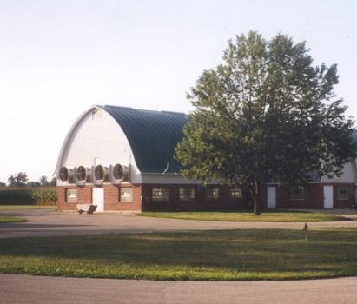
Vector Control
Understand life cycle
  Life stages
  vary in habitat
  and ability to
  transmit disease
Minimize contact
with vector
  Keep animals away from vector habitat
  Shelter during peak vector times
Notes:
As mentioned previously, some important economic diseases of livestock and poultry, have an arthropod vector source in its transmission.
Vector control and elimination measures are an important consideration and component for many animal disease outbreak responses. Vector control begins with an understanding of the arthropod’s life cycle and the transmission potential. Insect life stages vary in their habitat and ability to transmit disease. Specific control measures will be needed based on the life stage. For instance the egg laying grounds for flies are different than that of mosquitoes and midges; one control method may not work of all. Limiting livestock and poultry exposure to arthropod vectors or their habitats can reduce infection risk. Excluding access of livestock (or wildlife) to vector habitat areas or avoiding exposure during peak vector activity times are examples.

Slide 12
Vector Control
Source reduction
  Habitat reduction/ elimination
  Parasitic or
  predatory insects
Control adults
  Chemical control
    Fogging, knockdown
    Baits, fly traps
    Supplemental measure
Controlling the egg and larval stages
is usually more efficient
than controlling adults
Notes:
Reducing the source of the arthropod vectors consists of eliminating potential insect breeding areas and larval habitats. Generally, this involves removing standing water sources, such as tree holes or old tires, agitating any standing water sources, such as stock tanks or water troughs, or mowing vegetation to reduce habitat. Some insects require manure or organic material for development, so cleaning animal feeding areas, yards and barns can minimize these vectors. Sometimes biological agents or natural predators for a particular arthropod vector may be used to control the larval stages of other insects. Examples include bacterial toxins (e.g., Bacillus thuringiensis), mosquitofish, parasitic wasps, or dung beetles that feed on arthropod larvae.
Control for adult insects often involves the use of chemical insecticides. Some products are used in vector habitat areas, while others may be applied directly to animals. Fogging or knockdowns products may work to a limited extent. Baits and fly traps may also aid efforts. However, none of these should be used as the sole method of control, only as a supplemental measure. Controlling the egg and larval stages of the arthropod vector is generally more efficient than controlling adults. When using chemical pesticides, proper precautions must be taken when handling or applying them. It is a violation of State and Federal Law to use a pesticide in a manner that differs from the product label. Use only according to label directions.

Slide 13
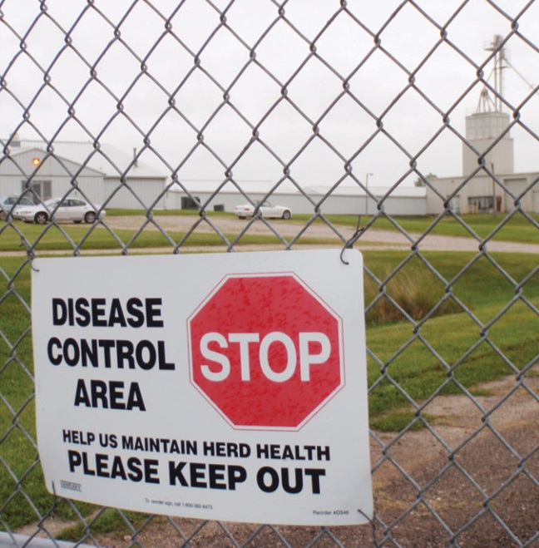
Other Response Activities
Many disease control
activities implemented
during response
  Quarantine and
  Movement Control
  Cleaning and Disinfection
  Personal Protective Equipment
Other JIT presentations available
  http://www.cfsph.iastate.edu/Emergency-Response/ just-in-time-training.php
Notes:
During wildlife management and vector control activities, many other disease control procedures will need to be implemented as part of an FAD response. These include quarantine and movement control, cleaning and disinfection, as well as use of personal protective equipment. Just-In-Time training presentations on these topics are available on the JIT training website.
[Photo: A disease control area warning sign. Source: A Ramirez, Iowa State University]

Slide 14
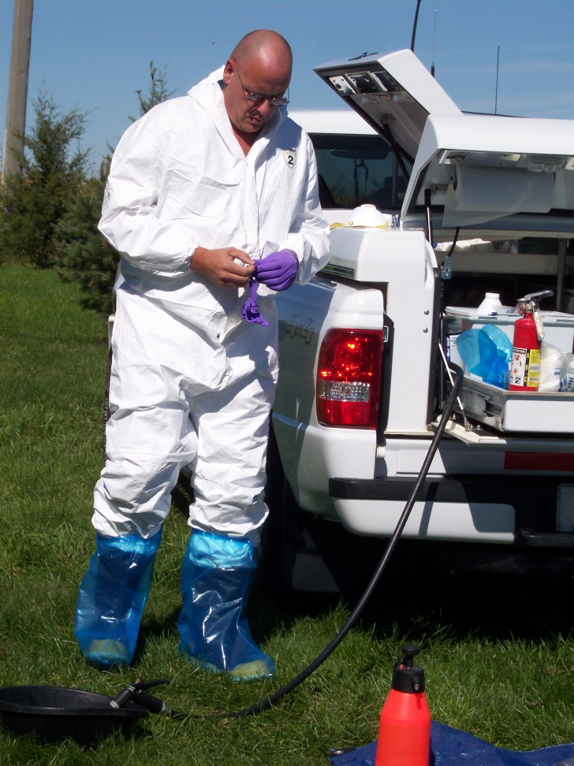
Safety
Safety is a priority
Handling and
restraint of wildlife
  Trained, experienced
  personnel
Vector control
chemicals
Zoonotic disease
Notes:
Safety should be a priority in all aspects of the outbreak response. Wildlife management and control measures may require the handling and restraint of animal, and the potential risk for injury. For the safety of the animals as well as the responder, handling and restraint of wildlife should only be performed by trained personnel who have extensive experience and certification to perform these activities. Vector control methods may involve chemical exposure. Additionally, many of the diseases carried by wildlife and/or arthropods can affect people also. It is essential responders be aware of any safety issues associated with wildlife management and vector control activities and take the proper precautions.
[Photo: A responder donning personnel protective equipment. Source: D Ausen, Iowa State University]

Slide 15
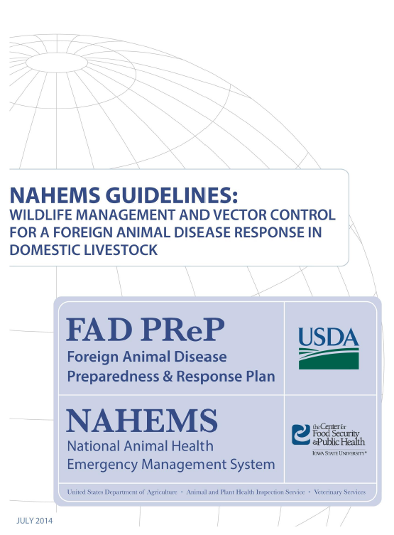
Additional Resource
FAD PReP/NAHEMS Guidelines:
Wildlife Management and Vector Control for an FAD Response in Domestic Livestock
http://www.aphis.usda.gov/fadprep
Notes:
This presentation provided a brief overview of the potential involvement of wildlife and arthropod vectors in livestock or poultry disease outbreaks. It also described efforts that may be required to manage and control the spread of the disease through these populations. Additional information on wildlife management and vector control for a foreign animal disease in domestic livestock can be found in the USDA National Animal Health Emergency Management Guidelines available on the USDA website (http://www.aphis.usda.gov/fadprep).

Slide 16
Acknowledgments
Development of this presentation was by the Center for Food Security and Public Health at Iowa State University through funding from the Multi-State Partnership for Security in Agriculture
Authors: Abbey Smith; Glenda Dvorak, DVM, MPH, DACVPM
Notes:
Information provided in this presentation was developed by the Center for Food Security and Public Health at Iowa State University College of Veterinary Medicine, through funding from the Multi-State Partnership for Security in Agriculture.

