Slide 1
Euthanasia and Mass Depopulation
During Animal Health Emergencies
Overview and Considerations
Notes:
December 2013
During an animal health emergency, the euthanasia of large numbers of animals (or mass depopulation) may be necessary. This action, most commonly used during highly contagious disease outbreaks, can help minimize the spread of disease between animals in efforts to protect the nations’ agricultural and national economy and safeguard the health of the public. Following large-scale disaster events, euthanasia efforts may be needed to end the suffering of severely ill or injured animals. This Just-in-Time presentation will provide an overview of considerations for euthanasia and mass depopulation measures that may be needed for an animal health emergency response.

Slide 2
Definitions
Euthanasia
  “Good death”
  As painless and stress free as possible
Mass depopulation
  Large numbers of animals
  Safely, quickly and efficiently destroyed
Moral obligation to ensure welfare
Notes:
The terms” euthanasia” and “mass depopulation” may be used interchangeably in this presentation, but it is important to be aware of the difference in these terms as defined by the United States Department of Agriculture’s Animal Plant Health Inspection Service (USDA APHIS) and the American Veterinary Medical Association (AVMA). Euthanasia, taken from the Greek meaning “good death”, is the process of transitioning an animal to death as painlessly and stress-free as possible. It usually applies to an individual animal. Mass depopulation on the other hand is a method used in animal health emergencies by which large numbers of animals are destroyed quickly and efficiently with as much consideration given to the welfare of the animals as is feasible. Individuals handling and caring for animals have a moral obligation to ensure the welfare of the animals under their care. Situations involving disease or injury can reduce an animal’s quality of life or result in pain in suffering of the animal. When effective medical treatment is not available or a viable option, euthanasia of the animal is indicated. While there are many different methods of euthanasia, our discussion in this presentation will be limited to those methods applicable to large scale animal health emergencies.

Slide 3
Goals of Euthanasia
Humane treatment at all times
Acceptable method
  Quick, efficient and humane
Minimize negative psychological impact
  Animal owners and caretakers,
  responders, public
Prevent disease spread
Prevent adulterated animal products from entering food chain
Notes:
The goals of euthanasia are to (a) provide humane treatment of animals at all times until they are euthanized; (b) select and use an acceptable form of euthanasia to be executed as quickly, efficiently, and humanely as possible; (c) minimize the negative emotional and psychological impact on animal owners, caretakers, and the public; (d) prevent or mitigate disease spread, and (e) prevent adulterated or potentially adulterated meat products from entering the food chain.

Slide 4
Considerations
Guidelines
Method Selection
Procedure
Personnel
Animal Welfare
Public Perception
Notes:
There are a number of factors that must be considered before any mass depopulation effort is taken. These include following established euthanasia guidelines for selecting an appropriate method, ensuring animal welfare issues are addressed throughout the process, having appropriately trained personnel for the procedure, determining appropriate site selection, and remaining cognizant of public perception at all times. We will discuss each of these factors next.

Slide 5
Euthanasia Guidelines
American Veterinary Medical Association
  Guidelines on Euthanasia (2013)
FAD PReP/NAHEMS Guidelines:
  Mass Depopulation and Euthanasia
World Organization for Animal
Health (OIE)
  Terrestrial Animal Health Code (Ch. 7.6)
    Killing Animals for Disease Control Purposes
Notes:
When the decision is made to depopulate, planned actions should follow current recommendations for appropriate methods and approaches. Euthanasia methods must be appropriate to the species involved, legal for use in the jurisdiction and implemented according to current professional standards. Guidelines can be found in the following documents: the American Veterinary Medical Association Guidelines for Euthanasia and the U.S. Department of Agriculture Foreign Animal Disease Preparedness and Response Plan Guidelines on Mass Depopulation and Euthanasia. For events involving international trade, the World Organization for Animal Health (OIE) “Killing Animals for Disease Control Purposes” found in the OIE Terrestrial Animal Health Code can be helpful.

Slide 6
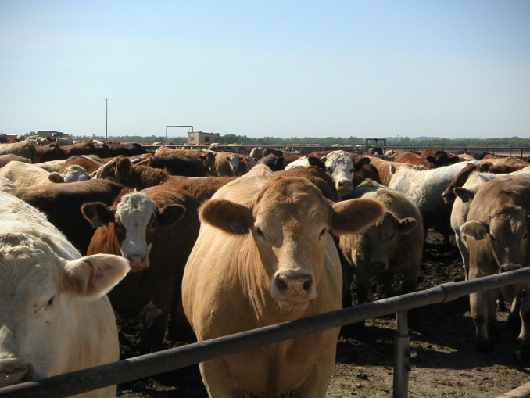
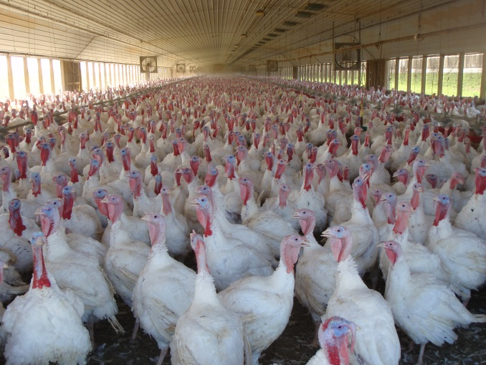
Method Selection
Species
Number of animals
Handling and restraint
Technical skill
Cost
Residues
Personnel safety
Regulations
Notes:
Different euthanasia methods are recommended based on the animal species involved. Much of this relates to the size and quantity of animals as well as the temperament of the animals. Additionally, the animals’ comfort level with humans and the ability of the animal(s) to be handled and/or restrained will factor into method selection. Most euthanasia methods require a high level of technical skill. Having an ample number of trained team members available will be an important consideration for euthanasia method selection. The potential for chemical residue in the carcasses often eliminates the use of chemical euthanasia methods. Measures to ensure personnel safety during all euthanasia procedures must also implemented. In some instances, method selection may require consideration of the cost of the procedure. Laws regarding acceptable methods of euthanasia vary from state to state, so the state’s legal authority should be consulted when selecting a depopulation method. [The top photo shows a feedlot of cattle. Source: Renee Dewell, Iowa State University/CFSPH; The bottom photos shows a flock of chickens. Source: Center for Food Security and Public Health]

Slide 7
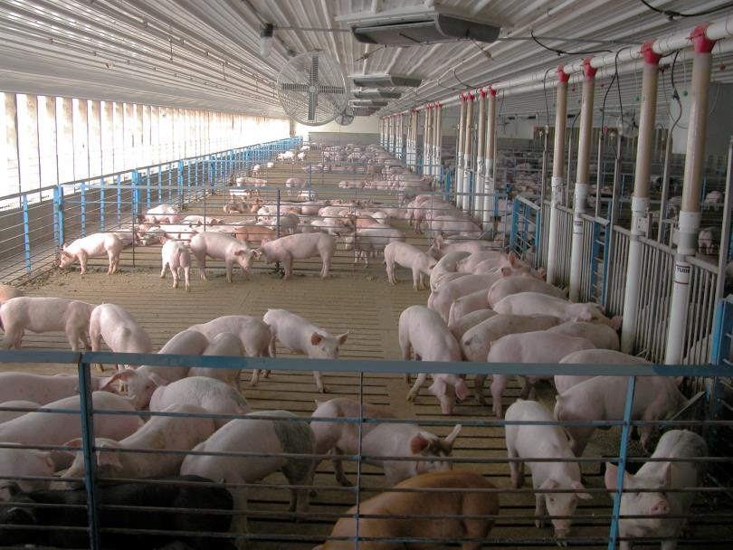
Procedure Considerations
Humane treatment
  Quickly rendered
  unconscious
  Minimize pain
  and stress
Skilled personnel
Confirmation of death
  Back-up method
Site selection
Notes:
Regardless of the method selected, all animals must be handled humanely throughout the entire euthanasia process. Humane euthanasia requires that animals be rendered unconscious quickly and with the least amount of pain and stress as possible. The ability to carry this out will be determined by the euthanasia method used as well as the skill, training and expertise of the team. In all cases, worker familiarity with the species is important. If euthanasia is not performed directly by a veterinarian, there should be close observation and supervision by veterinary personnel. Each animal should be checked at the conclusion of the procedure to ensure death has occurred. A backup method of euthanasia must be available if the primary euthanasia method fails. The location of the euthanasia procedures, especially for large animal species, must take into consideration the removal of carcasses for disposal.
[This photo shows a group of finisher pigs. Source: Alex Ramirez, Iowa State University, VDPAM]

Slide 8
Animal Welfare
Calm, gentle handling
Non-slip surfaces
Indoors – consider access for removal and disposal
Non-ambulatory animals euthanized where they are
JIT Guidelines for handling/restraint
  http://www.cfsph.iastate.edu/Emergency-Response/just-in-time-training.php
Notes:
Euthanasia measures should take place in such a way as to minimize an animal’s stress and pain, therefore, appropriate animal handling and restraint is critical. Calm, gentle handling will help minimize animal stress and ensures the safety of euthanasia workers and others in the area. For animals accustomed to being handled, gentle restraint in a familiar environment can have a calming effect on animals. Animals should be handled on non-slip surfaces, as quietly as possible; loud noises and shouting should be avoided. Animals that cannot be handled or moved may be euthanized in their customary housing with consideration given to access for removal of carcasses for disposal. Non-ambulatory animals should be euthanized where they are. Just-In-Time presentations overviewing guidelines for the handling and restraint of various species are available.

Slide 9
Public Perception
Conduct indoors or away from public view
Treat animals humanely at all times
Media may help convey information
  Necessity of depopulation
  Updates
Public Information Officer (PIO) should coordinate to treat the situation proactively
Notes:
Any response requiring the euthanasia of large numbers of animals will attract considerable attention from the media and public. When possible euthanasia sites should be conducted indoors away from public view. Animals should be treated humanely at all times. The media may be helpful in raising public awareness of the necessity of depopulation. Appropriately crafted media messages will help. A public information officer can provide these messages, as well as information and regular updates to the media and general public (i.e., stakeholders) to treat the situation proactively.

Slide 10
Euthanasia Methods
Physical
Chemical
Notes:
Next, lets overview the particular methods of euthanasia that may be used for animal health emergency situations. Both physical and chemical means of euthanasia may be utilized in mass depopulation situations.

Slide 11
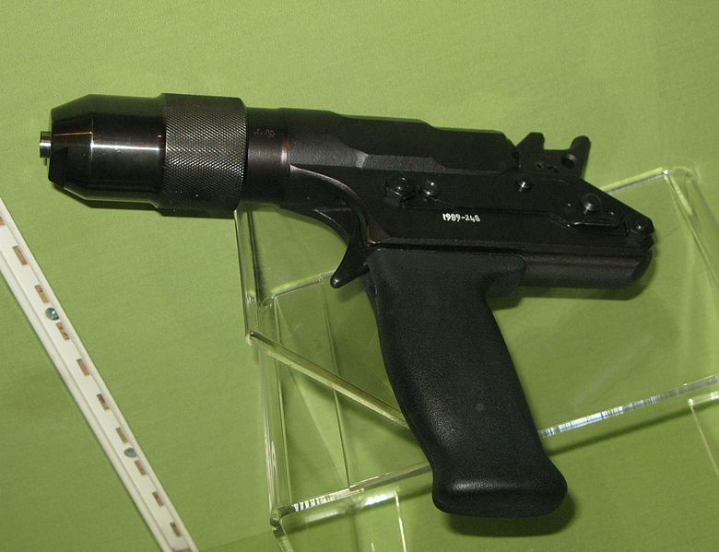
Physical Euthanasia Methods
Captive bolt
Gunshot
Special circumstance
  Electrocution (swine)
  Cervical dislocation,
  decapitation (poultry)
Adjunct physical methods
  Exsanguination and pithing
Notes:
Physical methods of euthanasia most commonly used for larger livestock species (i.e., cattle, other ruminants, horses, swine), includes captive bolt or gunshot. Both require adequate restraint, as proper placement of the device is critical. Animals should be within a few feet of the firearm operator, however gunshot from further distances may be considered in extenuating circumstances, such as stranded or starving sick animals on rangeland. Older types of captive bolts require an adjunct method of euthanasia (e.g., exsanguination or pithing) to ensure death. Newer models are more powerful and may not require adjunct methods to ensure death. Gun shot can cause immediate insensibility and a humane death. Using guns for euthanasia requires highly skilled and trained individuals. Close coordination with law enforcement agencies in the jurisdiction is essential. Additionally, a qualified individual (other than the person with the firearm, such as the Safety Officer) should be onsite during all firearm-related euthanasia activities. Additional methods that may be used either under special circumstances or as adjunct euthanasia methods for unconscious animals may include electrocution, cervical dislocation, decapitation and the adjunct methods of exsanguination and pithing. Electrocution (1000 volt) is largely impractical for mass euthanasia except for young swine where portable electrocution units have been developed; its use should be under highly controlled conditions. Cervical dislocation can be used for poultry and involves separation of the cervical vertebrae from the skull. This method requires a high degree of technical proficiency. Decapitation can be used in poultry and induces a rapid loss of consciousness; however, the handling and restraint that is required to carry out decapitation may be distressful for animals. Exsanguination and pithing should only be used as adjunct methods of euthanasia; these methods should only be used on unconscious animals to ensure death of the animal. Exsanguination may cause large volumes of blood to be put into the environment and may be a biosecurity concern especially with infectious or zoonotic disease.
[This photo shows a captive bolt gun typically used for livestock euthanasia. Photo source: Wikimedia Commons]

Slide 12
Chemical Euthanasia Methods
Injectable drugs
  Barbiturates/
  barbituric acid derivatives
  Documentation of
  controlled substances
Gas
  Anesthetic gases
  Carbon monoxide
  Carbon dioxide
Adjunct injectable chemical methods
Notes:
Chemical methods of euthanasia can include the use of certain injectable drugs, such as barbiturates and barbituric acid derivatives, which cause central nervous system depression, followed by cessation of cardiac and/or respiratory function. The drugs are injected directly into the vascular system; there is rapid loss of consciousness and minimal pain associated with venipuncture. Disadvantages of using injectable drugs is the need for physical restraint of the animal. Many injectable chemical euthanasia drugs are classified as “controlled substance” requiring use only under the supervision of an individual holding a U.S. Drug Enforcement Administration (DEA) license and the maintenance of careful records of the amounts used.
Overdoses of inhaled anesthetic gases have been used for euthanasia in small animals, but are rarely practical on a large scale. Carbon monoxide and carbon dioxide has been used for mass euthanasia in several species, particularly in poultry. Adjunct chemical methods such as the use of potassium chloride or magnesium salts should only be used on unconscious animals to ensure death.
[This photograph shows a veterinarian drawing up chemical euthanasia in a single-use syringe. Photo source: Andrew Kingsbury, Iowa State University]

Slide 13
Methods of Euthanasia
Physical methods
  Quick, painless, humane, practical
  Require technical skill, highly trained personnel
Chemical methods
  Pet livestock, companion animals
  Impractical for mass depopulation of livestock
    Chemical residues
    Large volume of drugs required
    Increased handling to inject drugs
    Cost of chemicals
Notes:
When properly used physical methods of euthanasia are quick, painless, humane and practical. Physical methods are used when chemical euthanasia is inappropriate due to chemical residue concerns or impractical due to volumes of chemical needed for euthanasia. Physical methods of euthanasia however require highly trained personnel in order to carry out activities in a safe and humane manner.
Chemical euthanasia methods are most commonly used in situations involving pet livestock and companion animal species. Chemical methods for euthanasia are often not practical in mass euthanasia for livestock. Impracticality is due to carcass disposal issues, residue potential if carcasses must be rendered, the large volume of drugs that may be required to euthanize, the increased amount of animal handling required to inject drugs and the cost of chemical drugs.
Regardless of the method used, limit personnel to only those necessary for the procedure and/or handling and restraint of the animals.

Slide 14
Unacceptable Methods of Euthanasia
Manually applied blunt trauma
Injection of any chemical not labeled for use as a euthanasia agent
Injection of air into blood vessel
Electrocution with a
120 or 220 volt electrical cord
Notes:
There are a number of methods that are considered unacceptable for the euthanasia of animals. These include any manually applied blunt trauma to the head, such as a large hammer; the injection of any chemical substance not labeled for use as a euthanasia agent; the injection of air into a blood vessel; or electrocution with a 120 or 220 volt electrical cord.

Slide 15
Euthanasia methods by species
Notes:
Next we will overview the most common methods used for mass depopulation for particular livestock species during animal health emergencies.

Slide 16
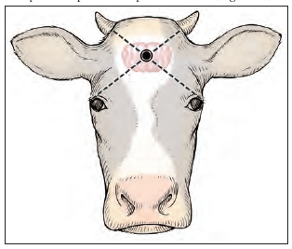
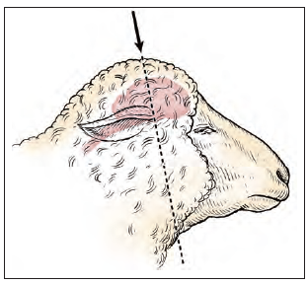
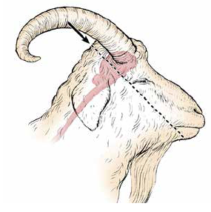
Bovine, Sheep, Goat Euthanasia
Primary methods
  Captive bolt
  Gun shot
Adjunct methods
  KCL,
  Magnesium salts
  Exsanguination, pithing
Companion livestock
  Injectable drugs
    Barbiturates
Notes:
Methods of euthanasia considered practical and humane for domestic bovines, sheep and goats in mass depopulation efforts include penetrating or non-penetrating captive bolt and gunshot. Adjunct methods, as previously mentioned, may be necessary if death does not result from the primary method. Under certain circumstances companion livestock (such as 4-H animals) may be euthanized by chemical injection (e.g., barbiturates). Personnel present during euthanasia procedures should take appropriate safety precautions to avoid injury from the animal when it falls following euthanasia administration.
[These photos show the proper placement of a captive bolt or gunshot for a quick, painless euthanasia of ruminant species. Note the target area is NOT directly between the eyes. (Top) Anatomic site for gunshot or placement of a captive bolt in cattle (Middle) in sheep (Bottom) in goats. Source: AVMA Guidelines for the Euthanasia of Animals: 2013 Edition, and Shearer JK, Ramirez A. Procedures for humane euthanasia. Iowa State University College of Veterinary Medicine. Available at: http://vetmed.iastate.edu/humaneeuthanasia/en/euthanasia-downloads#Index]

Slide 17
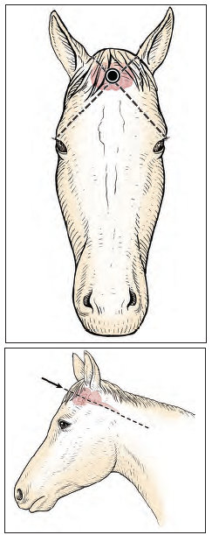
Equine Euthanasia
Primary methods
  Sedation then barbiturate
  Captive bolt
  Gunshot
Adjunct method
Safety issues
Notes:
Practical and humane methods of euthanasia for equids should begin with sedation of the animalm, followed by captive bolt, gunshot, or intravenous administration of barbiturates. Euthanasia using injectable chemicals is generally performed on companion equine, especially if the owner insists on being present during the procedure. Placement of a jugular catheter is recommended. Adjunct methods may be necessary if death does not result from the primary method. When euthanizing equids, consideration must be given to the unpredictability of the animal falling or thrashing. Most methods of euthanasia for equids will result in some degree of exaggerated muscular activity after the animal falls. Personnel present during euthanasia procedures should take appropriate safety precautions to avoid injury from the animal when it falls following euthanasia administration.
[Photos: These graphics shows the proper placement for captive bolt or gunshot euthanasia in a horse. Again note the target area is NOT directly between the eyes. Source: AVMA Guidelines for the Euthanasia of Animals: 2013 Edition and Shearer JK, Ramirez A. Procedures for humane euthanasia. Iowa State University College of Veterinary Medicine. Available at: http://vetmed.iastate.edu/humaneeuthanasia/en/euthanasia-downloads#Index]

Slide 18
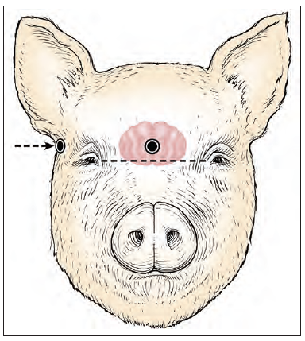
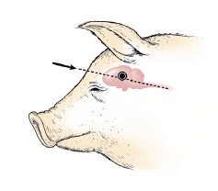
Swine Euthanasia
Primary methods
  Captive bolt
  Gunshot
  Gas: Carbon dioxide (CO₂)
    Only for smaller swine
Adjunct methods
Companion livestock
  Injectable drugs
Notes:
Methods of euthanasia considered practical and humane for swine include captive bolt or gunshot. With appropriate field equipment, carbon dioxide administration can be considered a humane euthanasia method for young swine. Adjunct methods should be available if death does not result from the primary method used.
[Photo: This graphic shows the proper placement of a captive bolt or gunshot for euthanasia in swine. Note the target area is slightly above the level of the eyes. Source: Source: AVMA Guidelines for the Euthanasia of Animals: 2013 Edition and Shearer JK, Ramirez A. Procedures for humane euthanasia. Iowa State University College of Veterinary Medicine. Available at: http://vetmed.iastate.edu/humaneeuthanasia/en/euthanasia-downloads#Index]

Slide 19
Poultry Euthanasia
Methods
  Inhaled anesthetics
    Carbon dioxide (CO₂)
    Water-based foam
  Injectable anesthetics
  Cervical dislocation
  for smaller birds
  Decapitation NOT recommended if other means available
Notes:
Methods of euthanasia considered practical and humane for poultry, include gas inhalation and cervical dislocation. Decapitation should only be used when other means are not available. Gunshot for wild birds and injectable agents for pet birds have also been used under special circumstances. Inhaled anesthetics, such as carbon dioxide gas or foam are most commonly used for mass euthanasia of poultry. This method results in faster euthanasia and requires substantially less handling of the birds by personnel, thereby minimizing stress. Safety measures for personnel, such as respirator equipment should be worn, as this method can be fatal to humans also. It has the added benefit of adding moisture to the carcasses if subsequent composting is anticipated. The addition of a disinfectant to the foam can aid in the decontamination of the immediate environment. Cervical dislocation by highly skilled personnel is considered reasonable for smaller birds or if small numbers of poultry are being euthanized.
[Photo: This photo shows water-based foam being applied in a floor-housed broiler system. Source: Eric Benson, University of Delaware]

Slide 20
Confirmation of Death
Death must be confirmed on each individual animal
Parameters
  Lack of heartbeat
  Lack of respiration
  Lack of corneal reflex
    The eyelid is not closed when the cornea/eyeball surface is touched
  Presence of rigor mortis
Notes:
Regardless of the species of animal or method of euthanasia used, it is essential that death is confirmed on each individual animal. Parameters to use to determine death in the animal, include lack of a heartbeat, lack of respiration or breathing, lack of corneal reflex (or movement of the eyelid when the cornea (eye surface) is touched lightly) or the presence of rigor mortis (stiffening of the body after death).

Slide 21
Personnel
Training
Safety
Psychological Impact
Notes:
In addition to the concern for the welfare of the animal, the safety and welfare of response personnel is essential. Mass depopulation procedures will require highly skilled individuals. These responders should receive training on particular safety issues associated with the animal species and euthanasia method used for the situation. Awareness of the psychological impacts is also very important.

Slide 22
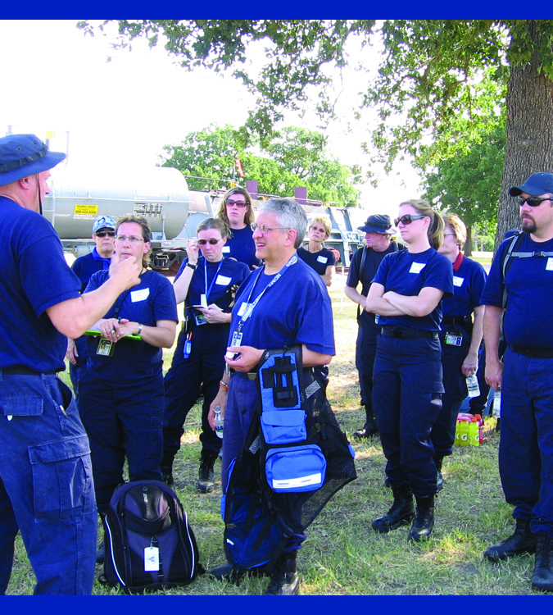
Personnel Training
Animal handling
Approved euthanasia
method to be used
Safety issues
PPE
Biosecurity
Cleaning and disinfection procedures
Notes:
For mass depopulation efforts, individuals trained and experienced in euthanasia as well as handling the species involved should be utilized. Information about the particular animal species, as well as the approved euthanasia method chosen should be provided. Additionally, safety issues and concerns must be disclosed. During disease outbreak situations, training on personal protective equipment, biosecurity considerations and approved cleaning and disinfection procedures must be conducted.
[This photo shows a National Veterinary Response Team (NVRT) team consulting on-site. Source: Kristi Rodas-Niesen/Renee Dewell, NVRT 3 Member]

Slide 23
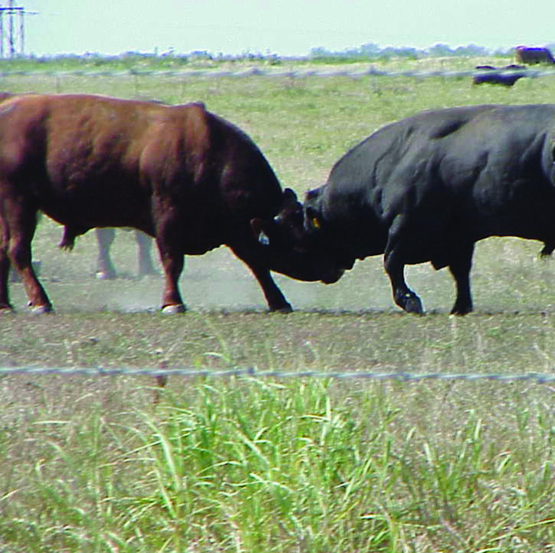
Safety
Specific considerations
  Size, weight,
  Temperament
    Dangerous animals
    Animal familiarity with humans
  Restraint methods available
  Euthanasia method and/or
  equipment available
Notes:
Safety of response personnel during euthanasia activities is paramount. Depending on the animal species, the risk of injury may be great. Consideration of the animals size, weight and temperament must be considered. The animals familiarity and comfort with humans as well as the restraint methods available will be important considerations for the safety of personnel. Animals that are generally regarded as being dangerous (e.g. bison, bulls, sows with litters, large boars, tusked boars and all cervid species) will require additional precautions and more experienced teams. [This photo shows two bulls reflecting potentially dangerous large animals. Source: Reneé Dewell, Iowa State University ]

Slide 24
Psychological Impact:
Responders
Compassion fatigue
Post-traumatic stress disorder (PTSD)
Recognition in self
and others
Psychological first aid
Counselors and mental health experts should
be available
Notes:
It is important to recognize that mass depopulation activities will be psychologically distressing to all involved parties – responders carrying out the euthanasia, individuals witnessing mass depopulation, animal owners and caretakers, their families and their communities – will all be affected and impacted by the loss of animals. Compassion fatigue and post-traumatic stress disorder (PTSD) are recognized impacts for personnel working in animal disaster situations. Responders should be trained to recognize signs of stress in themselves and others, as well as basic psychological first aid, until counselors or mental health experts become available. Euthanasia personnel should be made aware of any mental health counselors available on-site. Critical to reducing stress on those carrying out euthanasia activities is training in implementing euthanasia quickly, humanely and effectively. The more confidence a worker feels in their ability to euthanize, the less stress they experience. Workers are encouraged to take frequent breaks, have regular meals, get adequate sleep and engage in after-hours stress relieving activities to help prevent fatigue and stress. If evidence of undue stress is observed, these individuals should be shifted to less traumatic roles in the animal emergency response effort and encouraged to talk with mental health counselors. Additional information on the psychological impact for responders can be found in the “Responder Psychosocial Impacts” Just-In-Time training presentation. [This photo shows a lamb being euthanasia by a veterinarian via intracardiac lethal injection. Photo source: Center for Food Security and Public Health, Iowa State University]

Slide 25
Psychological Considerations: Owners and Stakeholders
Owners should
not be present
If present, brief owners on
  Chosen euthanasia method
  Safety
  Counseling services
Public Information Office in charge of communications
Notes:
Mass euthanasia can be emotionally traumatic to those whose animals are being depopulated. It is usually suggested that owners, the owner’s family and any employees not be present for mass depopulation, especially if the family includes young children or if they have a strong emotional bond with the animals. If owners chose to remain on the premises, they should be provided with a complete explanation of what to expect including the euthanasia method chosen and why it was selected; safety considerations including the need to confine domestic pets and other animals not intended to be killed and information on mental health and counseling services available to them during this animal health crisis. Helping animal owners and caretakers understand the necessity of the depopulation action can help them accept the situation. Often euthanasia is needed to relieve animal suffering, minimize economic impact or protect the health of the public. [This photo shows a veterinarian talking with a producer on-site. Photo source: Danelle Bickett-Weddle, Iowa State University ]

Slide 26
References and Resources
AVMA Guidelines for the Euthanasia of Animals
  https://www.avma.org/KB/Policies/Documents/euthanasia.pdf
FAD Prep/NAHEMS Guidelines
Mass Depopulation and Euthanasia
  http://www.cfsph.iastate.edu/pdf/fad-prep-nahems-guidelines-mass-depopulation-and-euthanasia
Procedures for Humane Euthanasia. Iowa State University College of Veterinary Medicine
  http://vetmed.iastate.edu/humaneeuthanasia/en/euthanasia-downloads#Index
World Organization for Animal Health (OIE) Terrestrial Animal Health Code
  Killing of Animals for Disease Control Purposes
  http://www.oie.int/fileadmin/Home/eng/Health_standards/tahc/2010/en_chapitre_1.7.6.htm
Notes:
Additional detail on euthanasia and mass depopulation of livestock for animal health emergency situations can be found in these documents.

Slide 27
Acknowledgments
Development of this presentation was by the Center for Food Security and Public Health at Iowa State University through funding from the Multi-State Partnership for Security in Agriculture
Authors: Katie Steneroden, DVM, MPH, PhD, DACVPM
Reviewer: Glenda Dvorak, DVM, MPH, DACVPM
Notes:
Information provided in this presentation was developed by the Center for Food Security and Public Health at Iowa State University College of Veterinary Medicine, through funding from the Multi-State Partnership for Security in Agriculture.

