Slide 1
Quarantine
Structure and Terminology
Notes:
June 2013
During animal health emergency situations, such as foreign animal disease (FAD) outbreaks, animals and premises may need to be quarantined and movement control measures may be needed to contain the pathogen for eradication and recovery. This Just-In-Time training presentation will focus on quarantine structure and terminology that may be used during animal health emergencies.

Slide 2
Purpose of Quarantines
Restrictions on entering
and leaving premises
Stops movement of
  Infected animals
  Contaminated animal products
  Fomites
Protects agricultural resources
Notes:
A quarantine is the act of imposing restrictions on entering and leaving a premises, area, or region where disease is suspected or has been discovered. In the case of an FAD outbreak, a quarantine stops the movement of infected animals, contaminated animal products, and fomites (such as vehicles or equipment) between premises of different infection statuses. By isolating potentially exposed and confirmed infected animals, and contaminated sites and objects, quarantine areas work to protect agricultural resources near the infected location as well as resources of the community, state, region, and nation.

Slide 3
Quarantine Terminology
Terminology for
  Zones
  Areas
  Premises
Determines necessary activities and level of biosecurity
Designations from Incident Commander
Outlined in USDA NCAHEM
  Premises and Zones Ready Reference Guide
Notes:
When a quarantine is put into place, common terminology will be used and is necessary to ensure appropriate activities and levels of biosecurity are implemented. Quarantine terminology may include zone, area, and premise designations. The terminology overviewed in this presentation has been outlined in the U.S. Department of Agriculture (USDA), National Center for Animal Health Emergency Management (NCAHEM), Premises and Zones Ready Reference Guide (April 2012). Appropriate designations during an FAD outbreak, will be determined by the Incident Commander.

Slide 4

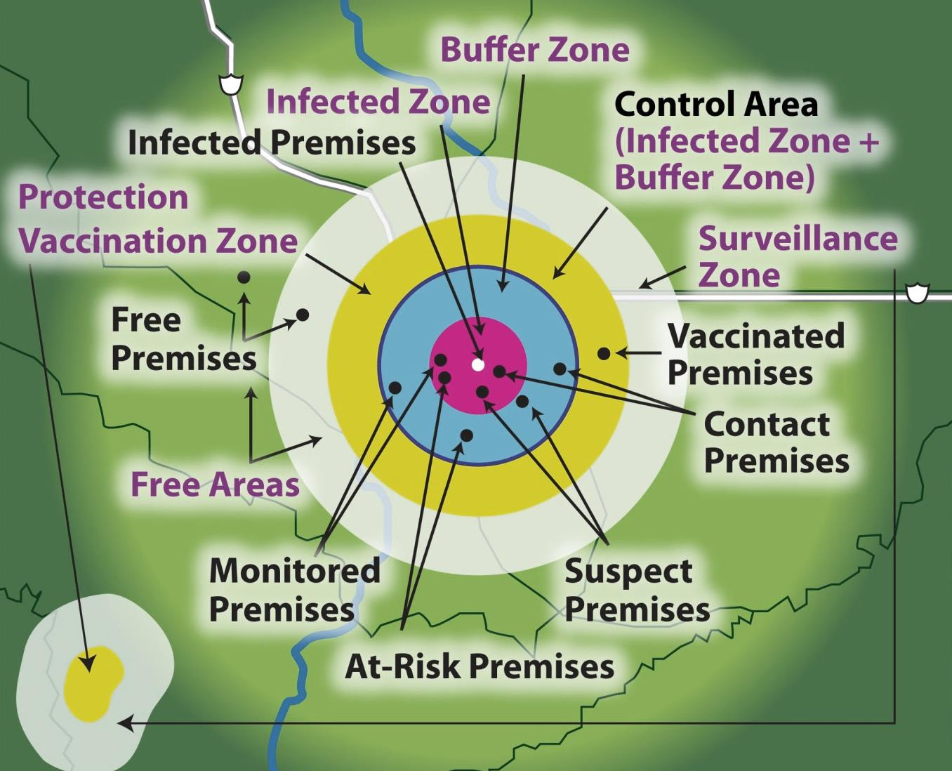



Zones, Areas, and Premises
Notes:
This figure shows the various Zones, Areas, and Premises terms that may be used during a animal health quarantine situation. We will discuss each of these on the following slides. [This graphic depicts the various quarantine zones, areas and premises that may be used during an animal health emergency. Source: USDA APHIS NCAHEM]

Slide 5
Quarantine premises
Infected Premises
Contact Premises
Suspect Premises
At-Risk Premises
Monitored Premises
Free Premises
Vaccinated Premises
Notes:
Any animal disease outbreak will begin with the suspicion or detection of the disease on a particular premises. Based on the suspicion or confirmation of a disease at a location, a premises will be designated as a Infected Premises, Contact Premises, Suspect Premises, At-Risk Premises, Monitored Premises, Free Premises, or Vaccinated Premises.

Slide 6
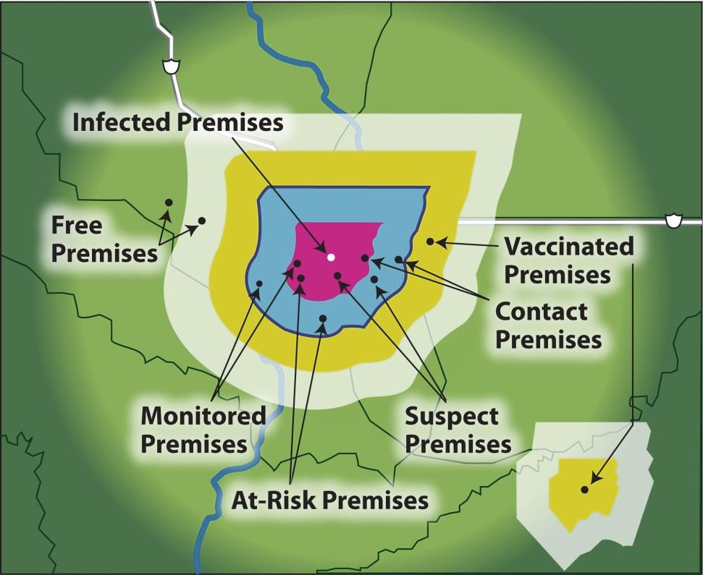


Infected Premises
Presumptive or confirmed positive
Movement onto,
out of, or within
prohibited
Exceptions
  Approved permit
  Equipment/vehicles with appropriate biosecurity measures
Notes:
An Infected Premises is a location where a presumptive positive case or confirmed positive case exists based on laboratory results, compatible clinical signs, case definition, and international standards. In general, the movement of animals, animal products (e.g., milk, eggs), animal semen or embryos, and various fomites, such as vehicles or equipment onto, out of, or within an Infected Premises will be prohibited, unless a specific permit is approved by Incident Command and appropriate biosecurity measures are used. [This graphic depicts the various quarantine zones and premises that may be used during an animal health emergency. The Infected Premises is represented by a white circle in the center of the image. Source: USDA APHIS NCAHEM]

Slide 7
Contact Premises
Susceptible animals possibly exposed
  Animals
  Animal products
  Fomites
  People
Movement onto,
out of, or within
prohibited
Exceptions
  Approved permit
  Appropriate biosecurity measures
Notes:
A Contact Premises is a location with susceptible animals that may have been exposed to the foreign animal disease, either directly or indirectly. This may include exposure to animals, animal products, fomites, or people from an Infected Premises. The movement of animals, animal products, animal semen or embryos, and various fomites onto, out of, or within a Contact Premises will be prohibited, unless a specific permit is approved by Incident Command and appropriate biosecurity measures are used. [This graphic depicts the various quarantine zones and premises that may be used during an animal health emergency. The Infected Premises is represented by a white circle in the center of the image. In this graphic, the Contact Premises are indicated in the white oval. Source: USDA APHIS NCAHEM]

Slide 8
Suspect Premises
Susceptible animals reported to have clinical signs compatible with FAD
Movement onto,
out of, or within
prohibited
Exceptions
  Approved permit
  Appropriate biosecurity measures
Notes:
A Suspect Premises is a location under investigation due to the presence of susceptible animals reported to have clinical signs compatible with the foreign animal disease. This designation is intended to be short-term, and the premises will later re-designated following investigation. The movement of animals, animal products, animal semen or embryos, and various fomites onto, out of, or within a Contact Premises will be prohibited, unless a specific permit is approved by Incident Command and appropriate biosecurity measures are used. [This graphic depicts the various quarantine zones and premises that may be used during an animal health emergency. The Infected Premises is represented by a white circle in the center of the image. In this graphic, the Suspect Premises are indicated in the white oval. Source: USDA APHIS NCAHEM]

Slide 9
At-Risk Premises
Susceptible animals, none exhibit signs compatible with FAD
Movement onto,
out of, or within
may be allowed with proper biosecurity
Permit may be required
Notes:
At-Risk Premises are locations that have susceptible animals; however, none of these animals exhibit signs compatible with the foreign animal disease. The movement of animals, animal products, animal semen or embryos, and various fomites onto, out of, or within an At-Risk Premises may be allowed with proper biosecurity measures; a permit from Incident Command may be required. [This graphic depicts the various quarantine zones and premises that may be used during an animal health emergency. The Infected Premises is represented by a white circle in the center of the image. In this graphic, the At-Risk Premises are indicated in the white oval. Source: USDA APHIS NCAHEM]

Slide 10
Monitored Premises
Do not have
  Positive case of FAD
  Susceptible
  animals that have been exposed
  Susceptible
  animals exhibiting clinical signs
Movement in, out, and within is allowed with permit, proper biosecurity practices
Notes:
Monitored Premises are those that have objectively demonstrated that they do not have a positive case of the FAD or they do not have susceptible animals that have been exposed to or exhibiting clinical signs compatible with the FAD. By demonstrating that this location is not an Infected Premises, Contact Premises, or Suspect Premises, it can be then be designated as a Monitored Premises. Movement of animals, animal products, animal semen or embryos, and various fomites into, out of, or within Monitored Premises will be allowed but may require a permit and proper biosecurity practices. [This graphic depicts the various quarantine zones and premises that may be used during an animal health emergency. The Infected Premises is represented by a white circle in the center of the image. In this graphic, Monitored Premises are indicated in the white oval. Source: USDA APHIS NCAHEM]

Slide 11
Vaccinated Premises
Emergency vaccination has been performed
Notes:
A Vaccinated Premises is an area where emergency vaccination has been performed. This premises designation can be paired with other designations. [This graphic depicts the various quarantine zones and premises that may be used during an animal health emergency. The Infected Premises is represented by a white circle in the center of the image. In this graphic, Vaccinated Premises are indicated in the white oval. Source: USDA APHIS NCAHEM]

Slide 12
Free Premises
Outside Control Area
Not considered an
  Infected Premises
  Contact Premises
  Suspect Premises
Notes:
Sites that are found outside the Control Area and that are not considered an Infected Premises, Contact Premises or Suspect Premises, are designated a Free Premises. Movement of animals, animal products, animal semen or embryos, and various fomites into, out of, or within Free Premises will be allowed but may require a permit and proper biosecurity practices. [This graphic depicts the various quarantine zones and premises that may be used during an animal health emergency. The Infected Premises is represented by a white circle in the center of the image. Free Premises are indicated in the white oval. Source: USDA APHIS NCAHEM]

Slide 13
Quarantine zones
Infected Zone
Buffer Zone
Surveillance Zone
Vaccination Zone
Notes:
The identification of a presumptive positive or confirmed positive case will lead to the establishment of particular response zones. This should occur as soon as possible after identification of these cases. Designation of these zones will be necessary to implement effective quarantine and movement controls and ensure appropriate activities and levels of biosecurity are used. Response zones will change based on surveillance and epidemiological findings as the response progresses. Quarantine zone designations that will be used during an animal disease emergency, include the Infected Zone, Buffer Zone, Surveillance Zone, and Vaccination Zone. The size of these zones will be determined by many factors, including jurisdictional areas, physical boundaries, disease epidemiology, the environmental factors, including climate, and characteristics of premises within the particular zone.

Slide 14
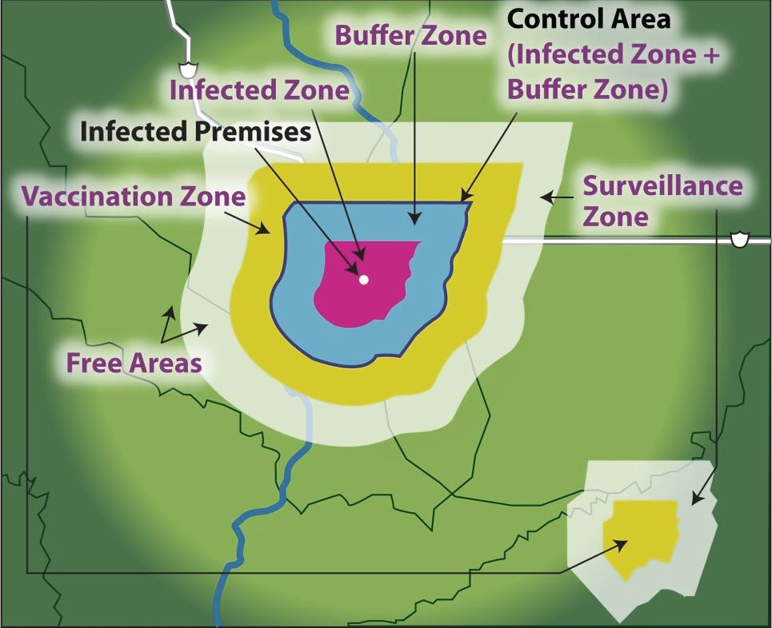
Infected Zone
Immediately surrounds
Infected Premises
At least 3 km
(1.86 mi) beyond the perimeter of presumptive or confirmed
Infected Premises
Notes:
The Infected Zone (shown in pink) is the area that immediately surrounds an Infected Premises. The perimeter of this zone should be at least 3 kilometers (or approximately 1.86 miles) beyond the perimeter of the presumptive or confirmed Infected Premises. Exact distances will depend on the disease agent present and epidemiological circumstances. The Infected Zone boundaries may be redefined as the response efforts progress. [This graphic depicts the various quarantine zones that may be used during an animal health emergency. The Infected Premises is represented by a white circle in the center of the image. In this graphic, the Infected Zone is indicated by pink shading around the Infected Premises. Source: USDA APHIS NCAHEM]

Slide 15
Buffer Zone
Immediately surrounds
Infected Zone or
Contact Premises
At least 7 km
(4.35 mi) beyond perimeter of Infected Zone
Notes:
The Buffer Zone (shown in blue) is an area that immediately surrounds the Infected Zone or a Contact Premises. The perimeter of this zone should be at least 7 kilometers (or approximately 4.35 miles) beyond the perimeter of the Infected Zone. This zone may also be redefined as the disease outbreak response continues. [This graphic depicts the various quarantine zones that may be used during an animal health emergency. The Infected Premises is represented by a white circle in the center of the image. In this graphic, the Buffer Zone is indicated by light blue shading around the pink Infected Zone. Source: USDA APHIS NCAHEM]

Slide 16
Vaccination Zone
Containment Vaccination Zone
  Within the
  Control Area
Protection Vaccination Zone
  Outside the
  Control Area
Notes:
The Vaccination Zone (shown in yellow) can be classified as either a Containment Vaccination Zone or a Protection Vaccination Zone based on the goal of the vaccination activities. A Containment Vaccination Zone is typically found with the Control Area – or the area encompassing the Infected and Buffer Zones), whereas a Protection Vaccination Zone is typically found outside of a Control Area. This zone designation can be secondary with another zone designation. [This graphic depicts the various quarantine zones that may be used during an animal health emergency. The Infected Premises is represented by a white circle in the center of the image. In this graphic, the Vaccination Zone is indicated by yellow shading around the Control Area. Source: USDA APHIS NCAHEM]

Slide 17
Surveillance Zone
Surveillance Zone
  Outside of and along border of Control Area
  At least 10 km (6.21 mi) wide
Notes:
The Surveillance Zone (shown in grey) is the zone outside of and along the border of the Control Area. The perimeter of this zone should be at least 10 kilometers, or approximately 6.21 miles, wide, but may be much larger. [This graphic depicts the various quarantine zones that may be used during an animal health emergency. The Infected Premises is represented by a white circle in the center of the image. In this graphic, the Surveillance Zone is indicated by light grey shading around the yellow Vaccination Zone. Source: USDA APHIS NCAHEM]

Slide 18
Quarantine areas
Control Area
Free Area
Notes:
Area designations are also made for the response, and include the Control Area and the Free Area. The size of these areas are determined by many factors, including jurisdictional areas, physical boundaries, disease epidemiology, environment factors, including climate, and characteristics of designated premises and response zones.

Slide 19
Control Area
Infected Zone and Buffer Zone
At least 10 km (6.21 mi)
beyond perimeter
of closest
Infected Premises
Notes:
The Control Area consists of the Infected Zone (pink) and the Buffer Zone (blue). The perimeter of this area should be at least 10 kilometers (approximately 6.21 miles) beyond the perimeter of the closest Infected Premises. The Control Area boundaries may be redefined as the response efforts progress. [This graphic shows the Control Area, which encompasses the Infected (pink) and Buffer Zones (blue). The Infected Premises is represented by a white circle in the center of the image. Source: USDA APHIS NCAHEM]

Slide 20
Free Area
Free Area
  Area not included in Control Area
Notes:
The Free Area consists of the area that is not included in the Control Area. [This graphic shows the Free Area, which lies outside the Control Area. The Infected Premises is represented by a white circle in the center of the image. Source: USDA APHIS NCAHEM]

Slide 21

Zones, Areas, and Premises
Notes:
This figure reviews how each of the quarantine Zones, Areas, and Premises designations for an animal disease emergency relate. [Graphic depicts the various quarantine zones, areas and premises that may be used during an animal disease emergency. Source: USDA APHIS NCAHEM]

Slide 22
Resources
USDA Foreign Animal Disease Response: Ready Reference Guide
  http://www.aphis.usda.gov/animal_health/emergency_management/downloads/zone_area_premises_designations.pdf
Notes:
During an animal disease emergency, response zones, areas and premises will be designated. It is important for responders to be familiar with these terms and the limitations imposed by each designation. For additional information on animal disease emergency response structure, consult the USDA Foreign Animal Disease Response: Ready Reference Guide.

Slide 23
Acknowledgments
Development of this presentation was by the Center for Food Security and Public Health at Iowa State University through funding from the Multi-State Partnership for Security in Agriculture
Authors: Sarah Weiland
Reviewers: Glenda Dvorak, DVM, MPH, DACVPM
Notes:
Information provided in this presentation was developed by the Center for Food Security and Public Health at Iowa State University College of Veterinary Medicine, through funding from the Multi-State Partnership for Security in Agriculture.

