Slide 1
Checkpoint Set-Up and Operation
Notes:
June 2013
During animal disease emergencies the establishment of vehicle checkpoints may be necessary to monitor, screen, and guide animal transport vehicles. This Just-In-Time training presentation will overview the set-up and operation considerations for a vehicle checkpoint during animal disease emergency situation.

Slide 2
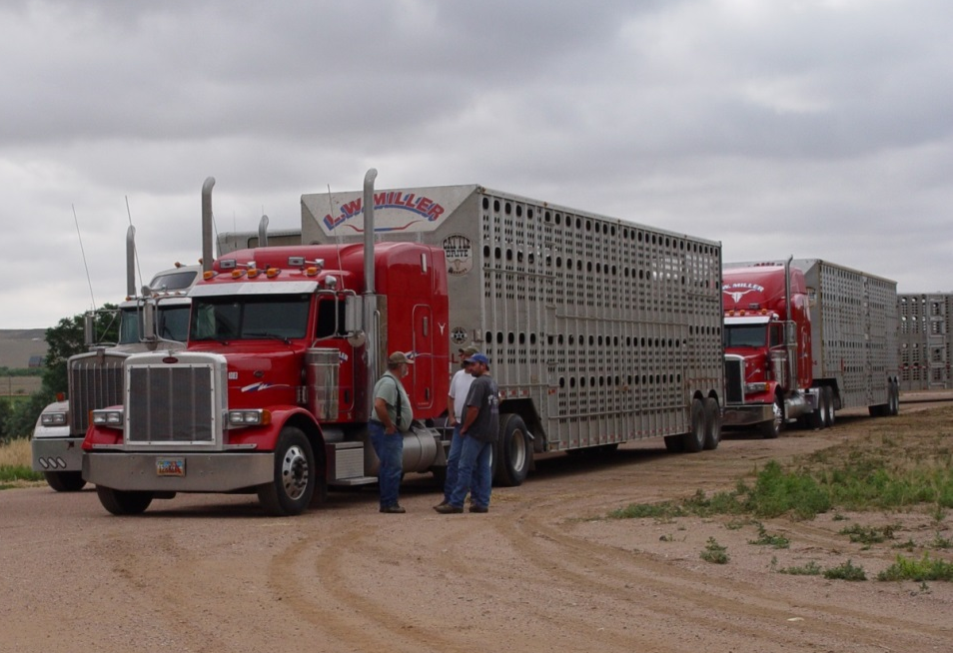
Vehicle Checkpoints
Identify vehicles with infected or susceptible animals
Restrict entry into disease areas
Redirect vehicles
Restrict vehicles with exposed or infected animals
Notes:
Vehicle checkpoints serve an important function during an animal disease outbreak situation. This process helps identify transport shipments that may contain infected or susceptible animals, blocks entry and redirects unaffected vehicles away from outbreak locations, and restricts the movement of vehicles with infected or potentially infected animals. Vehicle checkpoints also help to establish controlled entry and exit points at infected or suspect premises or state borders. [This photo shows several livestock truck and trailers lined up. Source: Renee Dewell, Iowa State University]

Slide 3
Checkpoint Set-Up
Location
Equipment and Supplies
Personnel
Notes:
When setting up a vehicle checkpoint, several factors must be considered and determined prior to use for procedures to proceed smoothly. These include identifying site locations, obtaining equipment and supplies that will be needed, as well as gathering a sufficient number of personnel to man the checkpoint.

Slide 4
Location
Public road or property
Well-traveled, easy-access
Flat, straight section
Large enough area
Allow vehicle movement and spacing
Vehicle holding area
Cleaning and disinfection area
Away from animal production sites
All-weather
Access to water, sewer, and electricity
Notes:
Let’s first look at location. Vehicle checkpoints should be located on a public road or property. The site should be a well-traveled, easy-access location to ensure all incoming agricultural traffic driving on that road will go through the checkpoint. Secondary routes may need to be blocked to divert traffic to the checkpoint. The area should be large enough to allow for the volume of traffic and staff activities. Room for vehicle movement and spacing will be important to minimize potential transmission of disease between vehicles awaiting screening. Checkpoint locations should include holding areas for large vehicles. Cleaning and disinfection areas may also be needed.
The checkpoint should be located away from any animal production sites and should be useable for a variety of weather situations. Access to water, sanitary sewer, and electricity will be needed. Vehicle checkpoint site locations should be identified prior to an emergency situation.

Slide 5
Equipment/Supplies
Road supplies
Traffic cones and barricades
Signage
Inform drivers
Reflective vests
Lighting
Maps
Animal supplies
Pens or shelter
Handling equipment
Shade or fans, or water spray
General supplies
Tables, chairs
Shelter
Communication devices
Water
Notes:
A wide variety of equipment and supplies will be needed for vehicle checkpoint operation. Road signs and traffic control equipment such as traffic cones and barricades will be needed to guide vehicles through the checkpoint, holding and C&D areas. Standards for installing and maintaining traffic control devices for public roadways are outlined in the Manual on Uniform Traffic Control Devices (http://mutcd.fhwa.dot.gov/pdfs/2009r1r2/mutcd2009r1r2edition.pdf) and should be followed. This document is published by the Federal Highway Administration (FHWA) under the Code of Federal Regulations (CFR), Section 23, Part 655, Subpart F. Personnel working near the road or barricades will need reflective safety vests. All traffic control devices and signs should be lighted or reflective for night use. If vehicle control activities will be conducted at night, lighting for the checkpoint area should be set up. Generators, drop service, or batteries will be needed to keep the lighting working at all times. Checkpoint sites should have maps of the area, as these can be useful to help drivers that are being rerouted navigate their detour route.
In addition to traffic control equipment, supplies for the handling and welfare of any animals diverted will be necessary. Pens or housing for animals may be needed if animals are to be off-loaded. In these situations, equipment to herd or move the animals should be available. In hot weather situations, fans or water spray will be needed to keep the animals cool while moving through the checkpoint line.
Additionally, general supplies, such as tables, chairs, water for workers, and sanitation facilities should be available. A means of communication, such as portable radios or cell phones, as well as computers to transmit document related information will also be needed.

Slide 6
Checkpoint Personnel
At bare minimum – 2 people
Animal health
Veterinarians/technicians, extension specialists
Provide animal and movement knowledge
Law enforcement
Police departments, military, conservation officers
Containing and moving vehicles, enforcing laws
Cleaning and disinfection
Trained in cleaning procedures
Fire departments and HazMat Teams
Support
Road crews, public works
Set up, screening procedures, animal assistance
Notes:
A sufficient number of personnel should be staffed at the vehicle checkpoint to handle the anticipated volume of traffic and minimize delays at the checkpoint. All checkpoints, at a bare minimum, should have two people to allow for backup in the case of emergency or injury.
Personnel staffed at the checkpoint may include individuals with training and expertise in animal health, law enforcement, cleaning and disinfection, as well as support personnel.
The animal health personnel can be made up of local veterinarians and technicians, state veterinary response corps members, or extension specialists, all of whom are helpful in animal knowledge and proper animal movement paperwork.
Law enforcement personnel present at the checkpoint can include local and state police departments, military police, National Guard, conservation officers, and park rangers. These officers will assist in containing and moving vehicles, and enforcing any laws associated with the checkpoint.
Cleaning and disinfection personnel will be needed, and should be trained in proper cleaning and disinfection techniques for the given disease situation and when these techniques need to be used. Groups that may have this training and be of assistance include fire departments and HazMat Teams.
Road crews or public works departments may also be helpful for setting up checkpoint locations

Slide 7
Checkpoint Operation
Basic Steps
Notes:
While each vehicle checkpoint will have unique goals for a particular situation, a few basic steps apply to most situations.

Slide 8
Checkpoint Operation
Identify vehicles
Flaggers and screeners
Allowed to proceed
Returned to point of origin
Moved to temporary holding area
Cleaning and disinfection
Animals off-loaded
State veterinarian will specify
Vehicles, commodities, animals for screening
Notes:
First, the checkpoint will serve to identify vehicles with infected or susceptible animals. Monitoring and screening of vehicles and transport documentation will help determine the level of disease risk for the animals on the transport vehicle.
The checkpoint should have individuals serving as flaggers – which identify vehicles and direct them to the checkpoint screening area – and screeners – who review checkpoint criteria or compliance with movement control orders. Additionally, staff will be needed to direct or guide the vehicle to the temporary holding area when warranted. Depending on the criteria for the checkpoint, vehicles will either be allowed to proceed to their destination, directed to return to their point of origin, or diverted to a temporary holding area for additional procedures, which may include cleaning and disinfection procedures, or off-loading of the animals. Due to the dynamic nature of an animal disease emergency, the defining criteria of a movement control order is likely to change. These changes will need to be communicated to checkpoint personnel in a timely and efficient manner.
The state veterinarian, who will issue the movement control order, will specify the types of vehicles, commodities and animals that will need to be stopped and screened based on the particular incident. This will vary based on the disease of concern and the animals susceptible to the disease. [Inspecting a livestock trailer. Photo source: http://www.craigdailypress.com/photos/2009/aug/08/22213/]

Slide 9
Operation Considerations
Documentation
Communication
Cleaning and Disinfection
Animal Welfare
Waste Management
Personnel Training
Notes:
Additional procedures that will be needed at the checkpoint, include documentation, communication, cleaning and disinfection measures, attention to animal welfare and waste management. All personnel should receive training prior to working at the checkpoint.

Slide 10
Documentation
Date/time at checkpoint
Checkpoint location
Vehicle and driver information
Owners name
Vehicle contents
Point of origin
Destination
Health papers and shipping documents
Action taken
Allowed to proceed
Returned to point of origin
Diverted to temporary holding area
Notes:
Records of vehicles entering the area will help animal health officials track and trace the movement of animals – including origin and destination – to determine areas of concern and help to determine the level of risk of exposure for the animals. It also allows contact of owners in case of outbreak changing criteria. Accurate record keeping at the checkpoint will be essential. Documentation may include:
Date/time arrived at checkpoint
Location (highway, mile marker) of checkpoint
Vehicle make and model, license number, state of licensure, vehicle US DOT number
Driver’s license number and state, contact information (address and phone) for the driver
Point of origin (place where animals were loaded), including contact name, address and phone number, and premise ID# if possible
Types of health papers/shipping documents examined, include issuing state and any document number on the form
Description of the vehicle contents
Animal: species and number
Feed type (e.g., hay, grain)
Equipment (e.g., livestock panels)
Final destination of the load, contact name, address and phone number
Animal (or commodity) owner name, address and phone number
The driver should provide a signature on the information sheet.
It is also important to record if the vehicle was diverted to a temporary holding area to off-load, returned to its point of origin or allowed to proceed to its intended destination.
In addition to transport vehicles and load information, documentation of resources used for traffic control, such as labor charges, equipment rental, cost of expendable equipment will be needed for reimbursement.

Slide 11
Communication
Checkpoint to Incident Command
Two-way radios
Cell phones
Computers
Industry stakeholders
Media
General public
Notes:
Each vehicle checkpoint should have a means of communication with Incident Command. This may be via two-way radios or cell phones. Computers will also be needed to record and transmit document related information.
Communication with the industry, associated/affiliated industries, such as trucking companies, and public regarding the vehicle checkpoint will be essential. DOT message boards can be used to relay the necessary information and can improve patience with the checkpoint process. A public awareness campaign explaining the situation can increase compliance with checkpoint procedures. Information sheets for distribution can aid in ensuring uniform information dissemination. Provide an explanation for the traffic control measures, how to obtain a permit for animal movement, alternative routes, if allowed, basic biosecurity measures. Additionally, media coverage can aid in informing drivers of the checkpoint necessity and procedures.

Slide 12
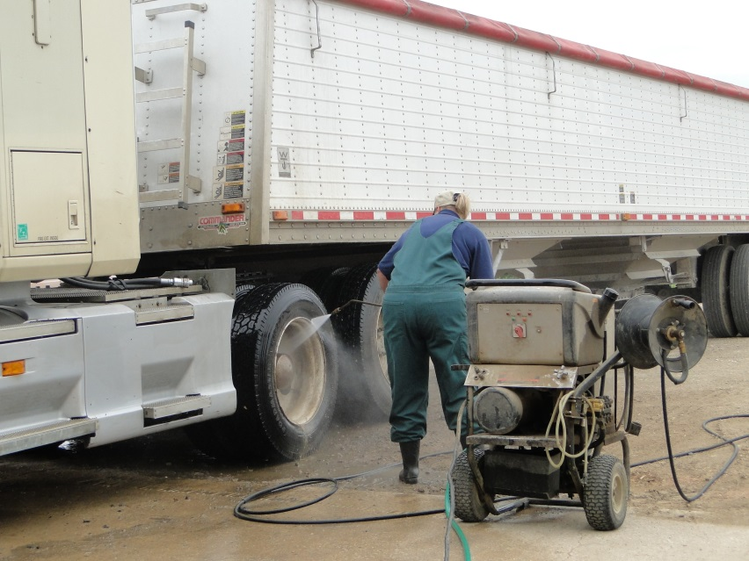
Cleaning and Disinfection
Disinfectants
Determined by disease
Equipment
Brushes
Buckets
Berming material
Personnel
Disinfect between vehicles
Notes:
Cleaning and disinfection may be a necessary step before transport vehicles can leave a checkpoint location. This infection control measure can reduce the risk for disease spread to additional areas. Most situations will involve spot C&D, such as undercarriage and tire washes. If more intense C&D is required, set-up should be established in a holding area at the checkpoint. Any material falling or leaking from stopped vehicles must be scooped up, absorbed and the area cleaned and disinfected.
Equipment and supplies needed for a C&D station will include an effective disinfectant product as well as cleaning equipment such as brushes and buckets. Selection of disinfectant product will be dependent on particular disease being addressed. A running water source will be needed. Equipment such as berming materials (e.g., 4x4, sand tubes) and sump pump may be needed to redirect or contain wastewater generated.
The C&D station should be manned by personnel knowledgeable in cleaning and disinfection, and biosecurity procedures. Any personnel in contact with vehicles should wash or disinfect their hands between vehicles and disinfect footwear before leaving the location. For more information on vehicle and personnel C&D see the C&D Just-In-Time training presentations (http://www.cfsph.iastate.edu/Emergency-Response/just-in-time-training.php).
[Photo shows a feed truck having its tires cleaned and disinfected. Photo source: Danelle Bickett-Weddle, Iowa State University]

Slide 13
Personal Protective Equipment
Goggles or face shield
Disposable or washable coveralls
Gloves
Over boots
Extra sets available
Notes:
Any personnel working the C&D station will need personal protection equipment such as water proof footwear and outerwear. PPE at C&D stations not only protects personnel from possible zoonotic diseases but also from the chemical disinfectant exposure and getting wet. Masks and googles may be needed with mixing and applying disinfectant solutions. Gloves can protect hands. For more information on Personal Protective Equipment, see the PPE Just-In-Time training presentation.

Slide 14
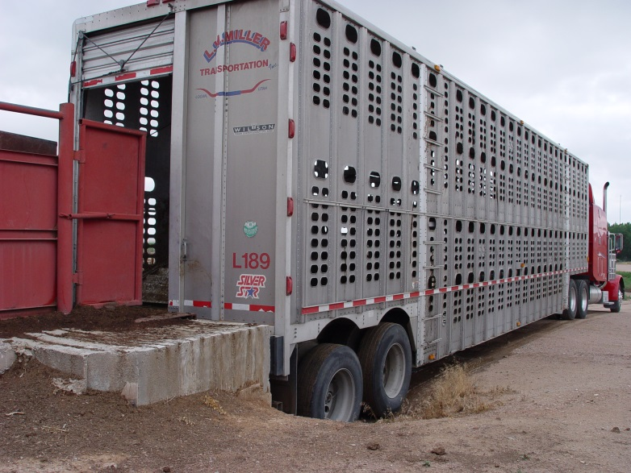
Animal Welfare
Weather is critical factor
Truck movement cools animals
Stopping reduces this effect
Can negatively affect animal health
Keep traffic moving as quickly as possible
Portable fans and misters may aid to keep animals cool
Notes:
Animal welfare must be addressed at traffic checkpoint locations. One of the critical factors to consider is weather, particularly heat and humidity. Animals being transported in hot weather are dependent on the airflow created by a moving truck in order to keep cool. If trucks are stopped for an extended amount of time, the airflow is compromised and heat can begin to negatively affect the health and safety of these animals. It is important to keep checkpoint traffic moving as quickly and smoothly as possible, especially in hot weather. Swine are particularly sensitive to high temperatures and can succumb fairly quickly if mitigating actions are not taken. Portable fans and misting devices may be used to help keep the animals cool and comfortable. [This photo shows a semi truck with an animal hauling trailer. Source: Renee Dewell, Iowa State University]

Slide 15
Waste Management
All waste is considered contaminated
Feces, urine, bedding material
Personal protective equipment
Remove waste immediately and put in solid container for disposal
Do not dispose of any waste where it will harm environment
Provide sharps container for contaminated needles
Notes:
Any waste generated at a checkpoint should be considered contaminated and disposed of properly. This primarily includes feces, urine, bedding material and any unwashable personal protective equipment. As previously mentioned any runoff water, detergent, and disinfectant must be contained or handled in such a manner to avoid environmental harm or impact. If veterinary activities such as drawing blood or collecting tissue samples are conducted at the checkpoint site, sharps such as needles or scalpel blades should be placed in an appropriate sharps container and dispose of according to proper biological waste disposal requirements.

Slide 16
Training
Incident Command System (ICS)
Quarantine terminology
State import regulations
State response plan
Basic biosecurity
Safety issues
Screening criteria
Notes:
All personnel working at a vehicle checkpoint should be familiar with the Incident Command System, and Quarantine terminology. Additionally, personnel must have a basic understanding of the state import regulations, the state response plan, basic biosecurity, safety issues, and the screening criteria for the checkpoint. More information on the Incident Command System, quarantine structure and terminology, and biosecurity can be found in the corresponding Just-In-Time presentations. (http://www.cfsph.iastate.edu/Emergency-Response/just-in-time-training.php)

Slide 17
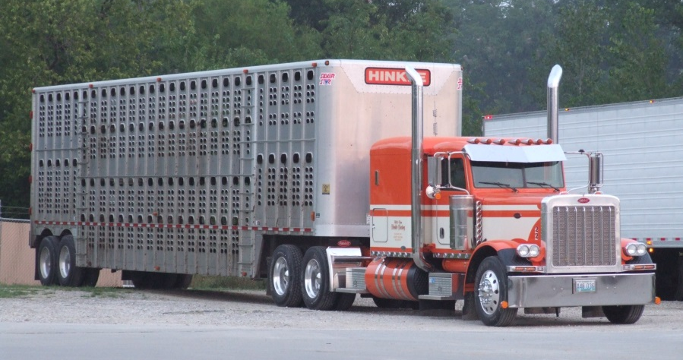
Lessons Learned from Previous Checkpoint Exercises
Industries were grateful for protection
Producers were more confident in herd’s protection
Species industries will shut down themselves
Well informed public
Notes:
In a recent exercise testing vehicle checkpoint procedures for an interstate situation, many lessons were learned. First it was determined that the various species industry groups were grateful for the protection provided by vehicle checkpoint procedures. The process helped industries feel more confident in the role these actions had in keeping disease out of their state. As a result of this confidence, industry groups indicated they would aid in controlling vehicle and animal movement within their group. [This photo shows a semi truck with an animal hauling trailer. Source: Veterinary Diagnostic and Production Animal Medicine, Iowa State University]

Slide 18
Memorandums of Understanding
For multi-jurisdictional collaboration
Authorities
Who will be in charge
Responsibilities
Individual state and collaborative tasks
Support
Checkpoint specifics and logistics
Communication
Disease dependent criteria
Financial accountability
Limitations and termination of agreement
Notes:
When checkpoint locations are set up between two jurisdictions (e.g., states or counties), the coordination of efforts between the two will be necessary. Memorandums of Understanding, or MOUs, should be established to outline terms of agreement between the two jurisdictions, such as authorities, responsibilities, support, communication, financial accountability, limitations and termination of the agreement.

Slide 19
Resources
Graham JL, Hutton J, Cao S, Fagel M, Wright W. 2008. National Cooperative Highway Research Program (NCHRP) Report 525, Volume 13: A guide to traffic control or rural roads in an agricultural emergency.
http://www.nap.edu/catalog.php?record_id=14184
Emergency Agriculture Movement Control Checkpoint Selection Guidance. Multi-State Partnership for Security in Agriculture.
http://www.nasda.org/File.aspx?id=4076
Traffic Control – Agricultural Response Monograph No. 001. Nebraska Department of Agriculture
http://www.nda.nebraska.gov/homeland_security/monograph_001.pdf
Notes:
The establishment of checkpoint stations during an animal health emergency may be needed to identify affected vehicles, animals and commodities in efforts to control any disease spread and protect animal health. For more information on checkpoint set up and operation during an animal health emergency response, consult these resources.

Slide 20
Acknowledgments
Development of this presentation was by the Center for Food Security and Public Health at Iowa State University through funding from the Multi-State Partnership for Security in Agriculture
Authors: Abbey Smith; Glenda Dvorak, DVM, MPH, DACVPM
Notes:
Information provided in this presentation was developed by the Center for Food Security and Public Health at Iowa State University College of Veterinary Medicine, through funding from the Multi-State Partnership for Security in Agriculture.

