Slide 1
Vaccination During Animal Disease Emergencies
Overview
Basic Mechanics
Notes:
June 2012
During animal health emergency situations – whether a natural disaster or infectious disease outbreak response – vaccination procedures may be part of the response activities. Responders should have a basic understanding of vaccination principles to ensure effective efforts. This Just-In-Time training presentation will overview pertinent principles of animal vaccination, including vaccination delivery and handling.

Slide 2
Vaccines in Animals
Disease prevention intervention
Regulated by the U.S. Department of Agriculture, Center for Veterinary Biologics
  Veterinary biologics for commercial use must be produced at a USDA-approved establishment, and be demonstrated to be pure, safe, potent, and efficacious
Notes:
Vaccination is an important intervention in disease prevention. Just as in humans, it serves to stimulate an animals immune system against a particular disease-causing organism, thereby minimizing the impacts (e.g., illness, shedding) of that particular disease. In the United States, vaccines (and other veterinary biologic products) produced in or imported into the country are regulated by the U.S. Department of Agriculture, Center for Veterinary Biologics. Veterinary biologics for commercial use must be produced at a USDA-approved establishment and be demonstrated to be pure, safe, potent, and efficacious.

Slide 3
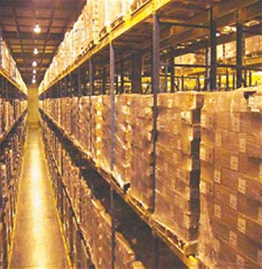
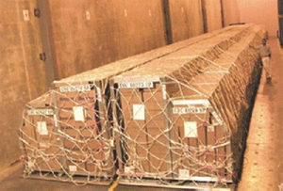
National Veterinary Stockpile
Established through HSPD 9
Countermeasures for damaging animal diseases
Deployment
within 24 hours
Notes:
In 2004 – through Homeland Security Presidential Directive 9 – the National Veterinary Stockpile was established to protect the nation’s food supply by maintaining sufficient amounts of countermeasures – including vaccines for certain diseases. The NVS intends to stockpile vaccines for animal diseases that would be most damaging to animal agriculture, human health and the U.S. economy. These materials would be capable of deployment within 24 hours to assist States, Tribes and Territories in responding to damaging animal disease outbreaks.

Slide 4
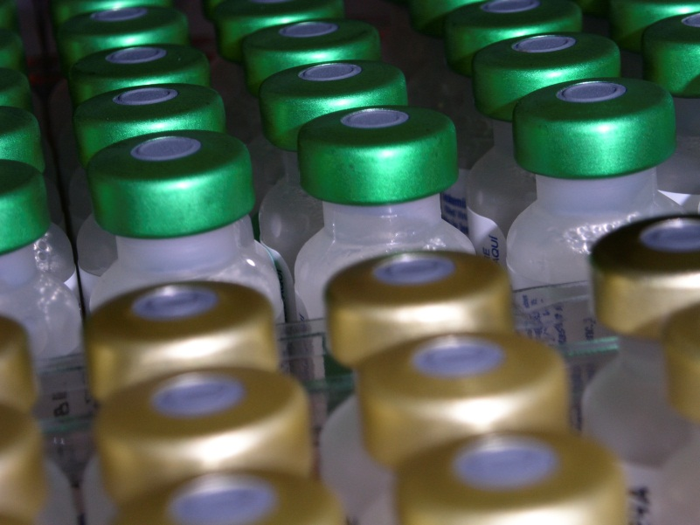
Types of Vaccines
Types
  Modified live vaccines (MLV)
  Killed inactivated vaccines
Withdrawal times
Use determined by
  Disease
  Species
  Vaccine availability
  Approval for use
Notes:
Vaccines can be one of two forms. Modified live vaccines (MLV) contain organisms derived or modified from the original pathogen or from a closely related pathogen. As these vaccines contain live organisms, they must be handled carefully. Killed vaccines contain part or all of an inactivated pathogen. Both types of vaccines serve to stimulate the animals body into producing antibodies to the particular stimuli injected. Particular vaccines used will be determined by the disease of concern, species affected, and whether or not a vaccine is approved for use and available. Vaccines used in food animals are subject to mandatory withdrawal times before the animal can enter the food chain. Withdrawal times begin once a vaccine is administered. The withdrawal time for a particular vaccine will be specified in the vaccine product license. [Image: This photo shows the tops of multiple vaccine vials. Source: iStockphoto.com]

Slide 5
Vaccine Administration
Single use disposable syringes
Automatic multi-dose syringes
Bottle-mount syringe (automatic self-filling syringe)
Parenteral
  Intramuscular
  Subcutaneous
Intranasal
Needle-free injection
Ocular
Oral
Spray/topical
Notes:
Vaccines may be packaged as single-dose or multiple-dose vials. Delivery can occur by single use syringes, which are then discarded , automatic multi-dose syringes, or bottle-mount (or draw-off) multi-dose syringes. Automatic multi-dose vaccines are appropriate for vaccinating large number of livestock, such as cattle being run through a chute. Needles should be changed between each animal if there is concern about transmission of disease between animals. Bottle-mount syringes are similar to automatic multi-dose syringes in that they are appropriate for vaccinating large numbers of livestock. This type of syringe attaches directly to the vaccine vial via a length of flexible tubing, making repeating puncture of the vaccine vial unnecessary.
Vaccine administration can occur by several methods. The majority are parenteral vaccines, or those that are delivered intramuscularly or subcutaneously. Other methods of administration include intranasal, needle-free injection, ocular, oral and spray or topical methods. Vaccine administration is determined by label instructions for the licensed vaccine and each licensed vaccine is intended only for delivery by the routes stated on its label. Always consult the vaccine insert for the appropriate dose and route of delivery for a particular vaccine.

Slide 6
Vaccine Handling
Notes:
Regardless of the administration method used, proper handling of vaccines during transport, storage, reconstitution (when appropriate) and between administrations is critical to ensuring their safety and efficacy. Always refer to the vaccine manufacturer’s recommendations for specific handling requirements.

Slide 7
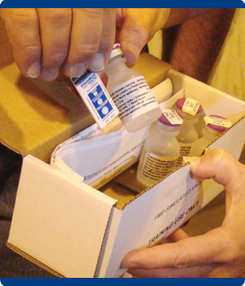
Maintaining a Cold Chain
Stays within
appropriate
temperature range
If not…
  Loss of potency
  or effectiveness
  Changes not
  visually apparent
Refrigeration, freezing
  Avoid freeze-thaw cycles
Avoid light
Notes:
A cold chain is the system used to ensure that vaccines stay within an appropriate temperature range from the manufacturer to the point of administration. Excessive heat or cold can damage a vaccine and reduce its potency or render it completely ineffective. Most vaccines do not have any readily detectable changes to their appearance that would indicate that they have been damaged or stored improperly. Devices are available for shipment with vaccines to indicate that temperatures have either exceeded or dropped below recommended ranges. Some vaccines are intended to be refrigerated, while others may be frozen. Do not freeze vaccines that are intended to be refrigerated. If vaccines may be frozen, repeated freeze-thaw cycles should be avoided. In addition, some vaccines are sensitive to light, so it is best to store them in their boxes until ready for use. [Image: This photo shows a heat indicator being removed from a package of recently shipped vaccine. Source: Randy Schawang, David City, Nebraska]

Slide 8
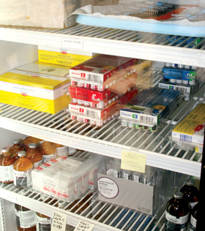
Vaccine Storage Units
Dedicated appliances
to store vaccines
Avoid door, drawer
Limit door opening
Monitor temperatures
Secure power supply
Notes:
Refrigerators or freezers used to store vaccines should be dedicated to that purpose and should not house food or drink. To avoid temperature fluctuations inside the unit, limit the number of times the door is opened, and do not leave the door open longer than necessary. Vaccines should not be kept in the doors of refrigerators or freezers or in the vegetable drawers of household refrigerators. Temperatures inside the storage unit should be measured with a calibrated internal thermometer and recorded at least daily. Ensure a secure power supply and avoid plugging into a power strip or an outlet that is controlled by a wall switch, as these circuits may inadvertently be shut off. [Image: This is a photo of vaccines stored in a refrigerator. Source: Andrew Kingsbury, Iowa State University]

Slide 9
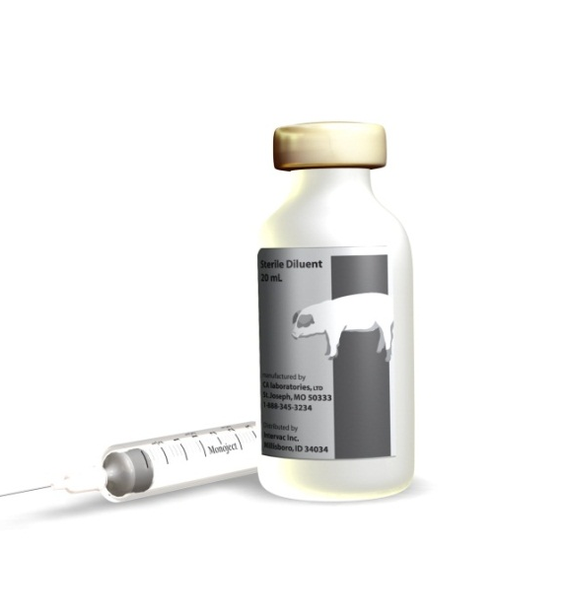
Diluents
May be stored separate from vaccine
Guidelines for reconstitution
Diluents are NOT interchangeable
  Between vaccine types
  Between manufacturers
  Between lots
Notes:
Many vaccines arrive from the manufacturer as a lyophilized (dried powder) component with an accompanying sterile diluent. The dried vaccine must then be reconstituted with the diluent provided by the manufacturer for that specific vaccine. Diluents are not interchangeable between vaccine types or manufacturers. Even different lot numbers of the same vaccine are not interchangeable. [Image: This is a graphic of a vial of sterile diluent for a lyophilized vaccine. Graphic illustration by: Travis Engelhaupt, Iowa State University]

Slide 10
Maintaining Sterility in
Multi-Dose Vials
Do not remove rubber stopper
Antiseptic before piercing
New needle before piercing
Do not submerge vial into melted ice/water
Label when opening/reconstituting
Notes:
Some vaccines may be packaged in multi-dose vials. To ensure each dose is safe and effective, it is important to prevent contamination of the bottle and store it as recommended by the manufacturer between uses. Use sterile technique to withdraw each dose of vaccine from the vial. Never remove the rubber stopper from the bottle top. Wipe the rubber stopper with an alcohol swab or appropriate antiseptic before piercing. Use a new sterile needle each time the rubber stopper is pierced. Clearly mark multi-dose vials with the date and time they were first opened or reconstituted and the user’s initials.

Slide 11
Receiving Vaccines
Inspect immediately upon arrival
  Signs of physical damage
  Expiration date
  Sufficient diluent included
  Cold chain maintained
Notes:
Vaccine shipments should be inspected immediately upon arrival. Check the shipping container and contents for signs of physical damage. Ensure that the vaccines are not expired or close to their expiration date. Make sure that lyophilized vaccines have been shipped with sufficient diluent for their reconstitution. If cold chain monitors were included in the shipment, check them to determine if the vaccines have been exposed to temperatures outside the recommended range during transport.

Slide 12
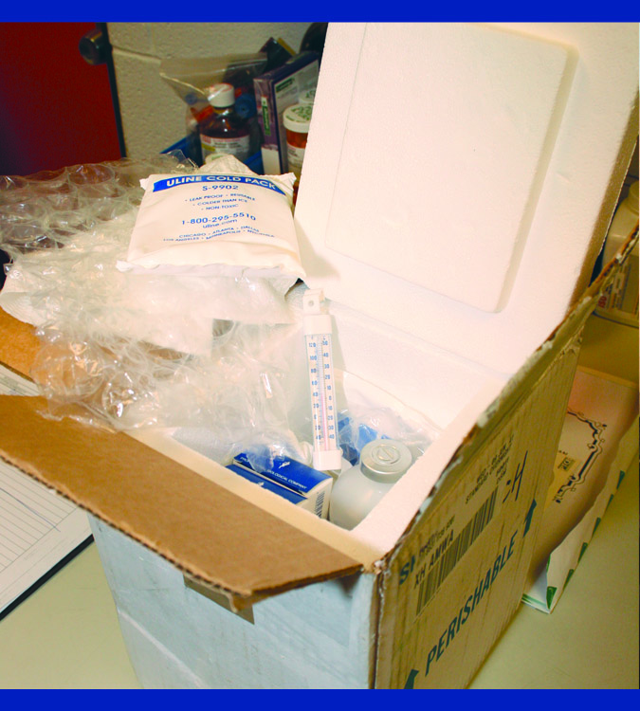
Transporting Vaccines
Maintain cold chain
Diluents should travel
with corresponding
vaccines
Note packing time
Check for damage
Expiration date
Notes:
When vaccines must be transported, ensure that the cold chain is maintained during shipping though appropriate packaging and insulation. Use freezer packs, dry ice, barriers such as bubble wrap, packing peanuts, or packing paper to maintain chilled temperatures. Monitor to ensure appropriate temperature is maintained. Care should be taken to prevent accidental freezing of vaccines that are meant to be maintained at refrigeration temperature. Diluents should travel with their corresponding vaccines at all times. Once at the needed destination, re-nspect all vaccine shipments immediately upon arrival. Examine the shipping container and contents for signs of physical damage. Make sure vaccines are not expired or close to their expiration dates. Minimize the number of times a vaccine is transported.

Slide 13
If the Cold Chain is Broken
Any indication that a proper temperature has not been maintained:
  Mark the vaccine “DO NOT USE”
  Contact supervisor or other authority for further instructions
  Do NOT immediately discard the vaccine unless directed to do so
Notes:
If there is any suspicion or indication that a vaccine has been subject to temperature excursions beyond the acceptable range either during shipment or storage, clearly mark the vaccine “DO NOT USE” and immediately return it to proper storage conditions. DO NOT IMMEDIATELY DISCARD THE VACCINE, as vaccine supplies may be short in the event of an outbreak. Contact your supervisor, an APHIS VS official within Incident Command, or a Center for Veterinary Biologics program official for instructions on how to proceed.

Slide 14
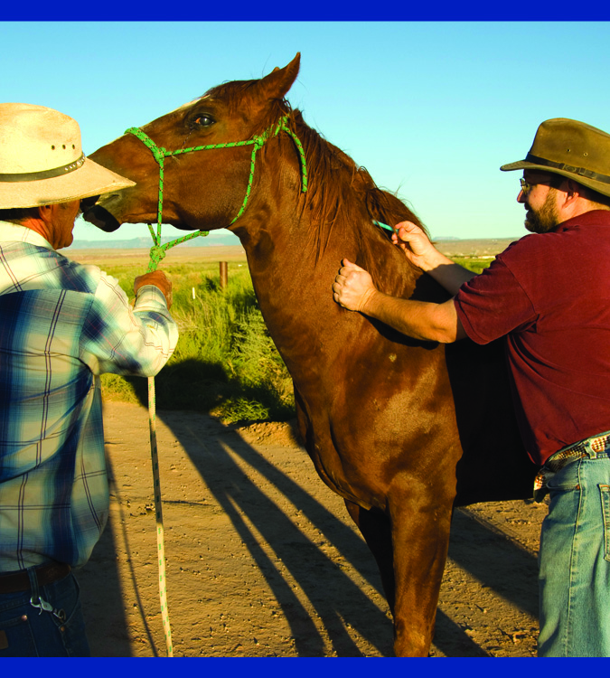
Vaccination Strategies During an Outbreak
Dependent upon
  Scope of the outbreak
  Objectives
  Population at risk
  Nature of the disease
  Resource availability
  Geographic considerations
  Trade restrictions
  Resource availability
Suppressive vs. targeted vaccination
Depopulation
Notes:
Vaccination strategies address efforts to effectively confine a disease outbreak while conserving vaccine, supplies, personnel hours, animals, and expenditure related to containment efforts. Vaccination strategies may be suppressive, in which the goal is to slow or stop pathogen transmission by decreasing the probability that an animal will become infected and/or reduce the shedding of pathogens from infected animals; or they may be targeted, in which specific populations of animals or uninfected areas are targeted. The vaccination strategy that is most appropriate for a given situation will depend on the disease of concern, the animal species, and number of animals. Additionally, trade requirements or restrictions can determine the use (or not) of vaccines, as can the availability (or lack of) resources, including vaccine and personnel. In some cases, depopulating animals without vaccinating may be the fastest way for a disease-free country to resume trade without restrictions, or in instances where vaccinated animals cannot be distinguished from naturally infected animals.

Slide 15
Preventing Disease Transmission During Vaccination
Notes:
As with other procedures where many animals are handled in a short period of time, any mass vaccination program has the potential to spread diseases from animal to animal or from premises to premises, if appropriate precautions are not taken. Although the animals intended for vaccination may not be infected with or exposed to the specific disease, other pathogens may be present. Personnel engaged in vaccination activities need to follow appropriate biosecurity measures to ensure they are not transmitting diseases from one animal population to another by way of equipment, clothing, hands, or vehicles.

Slide 16
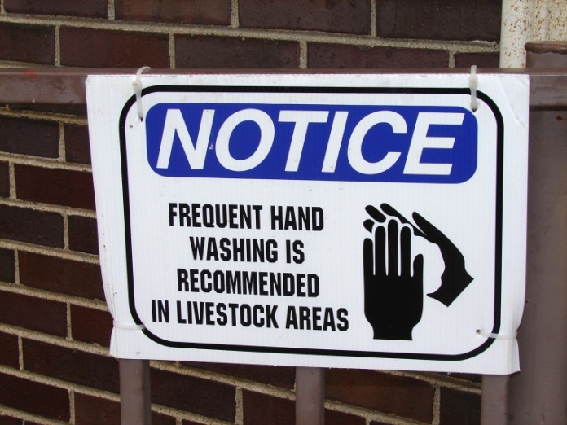
Preventing Disease Transmission During Vaccination
Biosecurity
  Wash hands
  Wear gloves
  Use new needle
  Disinfect reusable equipment
  Dispose of trash on-site
  Wear disposable shoe covers/boots
Notes:
General biosecurity guidelines for emergency personnel should be followed. Wash hands or change examination gloves between animals, barns, or pens. Use a new, sterile, disposable needle when concerned about spreading disease between animals within a group, and use disposable equipment whenever possible. Dispose of any trash on site; disinfect reusable equipment between animals and locations; properly clean and disinfect multi-dose syringes; scrub boots in a disinfectant footbath before entering and after leaving facilities; and follow all farm decontamination procedures for vehicles, equipment, and personal protective equipment. Wear disposable shoe covers or protective boots and remove debris from boots on site. [Image: This is a photo of a sign reminding personnel that frequent handwashing is a recommended biosecurity measure in livestock areas. Source: Danelle Bickett-Weddle, Iowa State University]

Slide 17
Record Keeping
Individual and/or group animal IDs
Name, address of animal owner
Species, age, sex, breed of animals
Date of vaccination
Route, location of vaccination
All vaccine information
  Include withdrawal time
Notes:
Accurate and accessible record keeping is crucial to the success of any vaccination effort. Sufficient data must be recorded to determine which animal or herd was vaccinated on a specified date against a particular disease(s), as well as to trace the vaccine source and lot number.
Minimum information on a vaccination record should include:
the individual or group animal identification numbers (e.g., Radio Frequency Identification (RFID), brand, tattoo, ear notches, or ear tags),
owner’s name and mailing address,
animals’ signalment (species, age, sex, and breed),
vaccination date,
vaccination administration route and location,
and all vaccine information, including brand or manufacturer, product name or number, lot number, and expiration date.
Additionally, any withdrawal time information should be recorded for food-producing animals. For an emergency vaccination effort, instructions will be provided as to what information will be needed. A copy of the vaccination records may be kept with both the herdsman and a regional vaccine coordinator in the event of a highly contagious foreign animal disease outbreak.

Slide 18
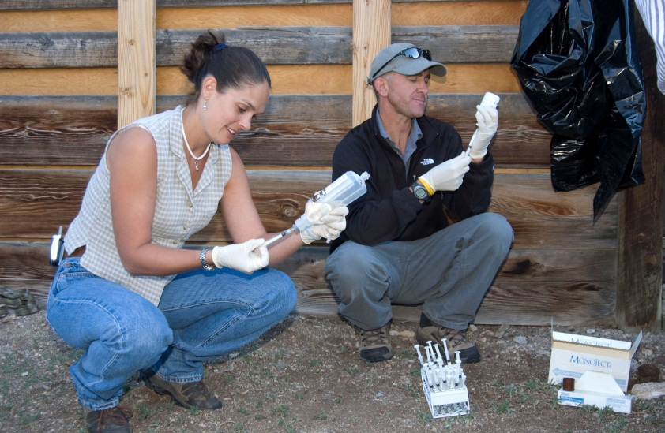
Personal Safety When Vaccinating
Needle sticks
Vaccine exposure
Sharps disposal
Animal hazards
  Livestock handling, restraint
Environmental hazards
Notes:
Responder safety is the highest priority. Next we will review personal safety measures to keep in mind when vaccinating animals. Needlestick injuries are one of the most common hazards when vaccinating. To avoid injury and minimize risk, do not recap needles. Some modified live vaccines can infect personnel and many killed vaccines use adjuvants which can cause severe tissue reactions. If a vaccine exposure is suspected, seek medical attention. Properly dispose of used needles in an approved sharps container. Use care and proper handling and restraint techniques when working around animals, and have sufficient assistance available when restraining animals for vaccination. Also beware of direct and indirect environmental hazards, such as falling due to slippery surfaces. Heat stress or cold-related illness may also occur due to temperature extremes. Be sure to comply with all incident-specific requirements regarding assigned outerwear, PPE, and equipment. [Image: This photo depicts personnel wearing protective gloves preparing vaccine for administration. Source: United States Department of Agriculture, Animal and Plant Health Inspection Service]

Slide 19
Resources
USDA Foreign Animal Disease Preparedness (FAD PReP) Guidelines: Vaccination for Contagious Diseases
  http://www.aphis.usda.gov/animal_health/emrs/nahems.shtml
Notes:
For more information on vaccination issues during an animal health emergency response, consult the USDA FAD PReP Vaccination for Contagious Diseases Guidelines.

Slide 20
Acknowledgments
Development of this presentation was by the Center for Food Security and Public Health at Iowa State University through funding from the Multi-State Partnership for Security in Agriculture
Authors: Molly Peebles, BS
Reviewer: Glenda Dvorak, DVM, MPH, DACVPM
Notes:
Information provided in this presentation was developed by the Center for Food Security and Public Health at Iowa State University College of Veterinary Medicine, through funding from the Multi-State Partnership for Security in Agriculture.

