Slide 1
Carcass Disposal
Overview
Notes:
June 2012
During an animal health emergency, there may be a need for animal carcass disposal measures. Catastrophic natural disasters or large-scale disease outbreaks can result in a large number of dead animals. In these situations, the timely and safe disposal of animal carcasses and related materials will be necessary to prevent the spread of disease. This Just-In-Time training presentation will overview potential methods of animal carcass disposal, as well as factors to consider for each disposal method.

Slide 2
Method Selection
Animal species
Number of animals
Space and equipment needed
Pathogen and its ability to persist or spread
Environmental issues
Soil characteristics
Water sources
Air quality
Public health issues
Regulations
Notes:
There are a number of possible animal carcass disposal methods. The method selected is dependent on a number of factors. The first consideration is the animal species involved and the number of animals to be disposed. These parameters will determine the overall biomass for disposal, and the amount of space and equipment that will be needed to implement carcass disposal measures. Additionally, the cause of death is consideration. In cases involving infectious diseases, the pathogen(s) of concern and its ability to persist in the environment or spread to additional locations may determine the disposal method that can be used. Equally important are the site characteristics (e.g., soil type, slope, porosity) and environmental concerns (e.g., potential for runoff to nearby water sources or ground water contamination, or air quality impacts). Any public health issues, including possible disease spread and responder safety, must also be considered when selecting a method. Finally, local, state and federal regulatory constraints may determine the method allowed and the mode of operation for disposal procedures.

Slide 3
Carcass Disposal Methods
Burial
Subsurface Disposal/Landfills
Incineration
Composting
Rendering
Notes:
The carcass disposal method used for an emergency response situation will be determined by the Incident Commander. It is likely that more than one disposal method will be utilized. Carcass disposal methods may include burial, subsurface disposal or the use of landfills, incineration, composting, and rendering. Let’s take a closer look at each of these methods.

Slide 4
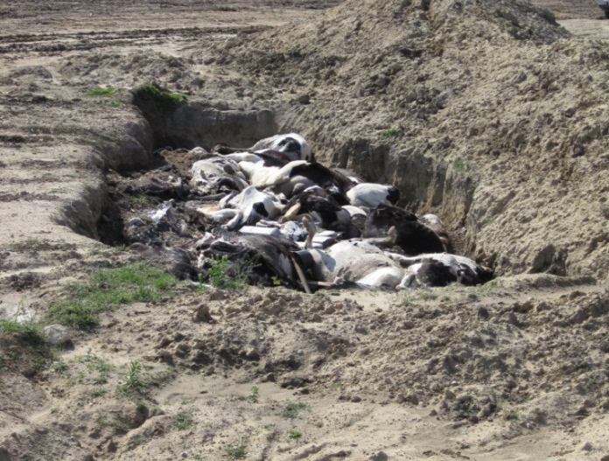
Burial
Excavated trench or pit
Decomposition and heat
Puncture/vent carcasses
Minimize accumulation of gases
Displacement and shift of soil
Soil characteristics critical
Notes:
Burial is a common method used for dead animal disposal. Carcasses are placed in an excavated trench or pit, and then covered with soil or backfill. The decomposition of the carcasses generates heat, which can destroy microorganisms. Eventually buried materials are degraded and broken down into minerals and organic material. The length of time required for carcass decomposition will vary and is generally dependent on the species and size, and the total number of carcasses, as well as the soil composition, temperature and moisture. The process can take weeks to years. An important consideration when using burial methods is the development of gases during the decomposition process. This can lead to bloating of the carcasses, and subsequent displacement of the dirt covering layer. Therefore, carcasses, especially those of large animals, should be punctured or vented prior to burial to minimize the bloating process and the accumulation and entrapment of gases. Additionally, as the carcass mass decomposes over time, settlement of the site will occur. Additional backfill may be required to restore the natural land surfaces. [Photo from Environmental Health Services, Department of Public Health, Kings County, California]

Slide 5
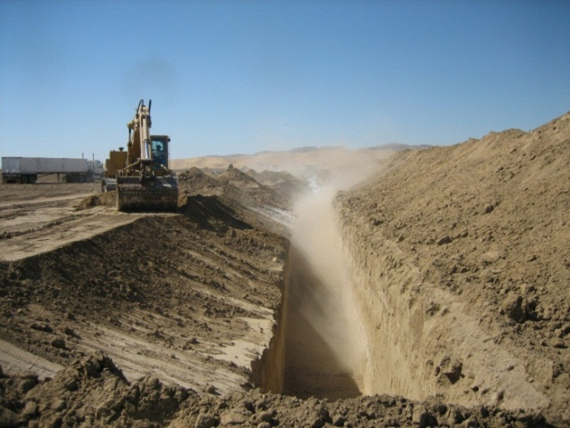
Burial: Construction and Design
Trench area
4-8’ deep x 6’ wide
Site size/area
Depends on species, age/size, quantity
42 cubic feet per
1 adult bovine OR
5 pigs/sheep OR
40 chickens
Liners to minimize seepage
Notes:
The total excavation area required for burial is determined by the species and total number of carcasses to be buried. Trenches may vary from 4-8 foot in depth and are typically about 6 feet wide, so that at least two large animal carcasses may be placed side by side in the pit. Carcasses are layered (no more than 2 foot thick) with alternating layers of soil (up to 3 feet thick). A 2001 APHIS guideline recommends 42 cubic feet (1.2 cubic yards) of space to bury 1 adult bovine, OR 5 pigs or 5 sheep OR 40 chickens. It is estimated that for every additional 3 feet of trench depth, the number of carcasses can be doubled. Mass burial pits have similar dimensions but are generally trapezoid shaped and are sealed with specially constructed liners and drainage systems to prevent leachate seepage. During any excavation procedures, caution must be used to avoid any underground lines or other hazards.

Slide 6
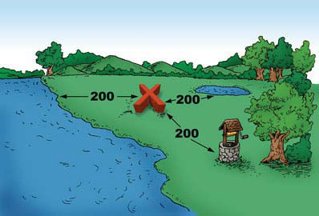
Regulations and Monitoring
Consult State regulations
Sites highly regulated
Depth, width, length, max size
Environmental impact
Groundwater monitoring
Surface water sources
Air quality/odor
Record site GPS location
Notes:
Burial methods have strict regulatory requirements that must be met, and care must be taken to protect the environment as well as the public from negative effects. Burial methods can only be used where allowed by permit, and when depths of soil and water table are adequate. State regulations vary in terms of specific criteria required for a suitable burial site. Carcass burial may NOT be permitted in some states. States that do allow it, may have regulations outlining burial factors such as site location, distance from waterways, trench or pit dimensions and capacity, as well as monitoring requirements. Burial sites will require long term monitoring, management and environmental testing. Measures to handle gas and leachate may be needed. The installation of groundwater monitoring wells and water sample collection and testing may also be necessary. Coordination with state and federal natural resource departments is essential. Global position system (GPS) of burial site should be recorded. [Photo from Cornell Waste Management Institute http://cwmi.css.cornell.edu/naturalrendering.htm]

Slide 7
Burial: Considerations
Quick, easy, inexpensive
Equipment generally readily available
Takes large areas of land
Difficult in cold weather conditions
Environmental impacts
Water sources
Odor
Scavengers
Public opposition
Notes:
One advantage of using a burial method for carcass disposal is that it is a relatively quick, easy and inexpensive, if adequate land space is available. Additionally, the equipment needed, such as backhoes, bulldozers, and dump trucks, is generally easy to obtain. Disadvantages of the disposal method include the need for large areas of land, as well as the potential for detrimental environmental effects to water sources or air quality. Burial methods are more difficult to use in wet or frozen weather conditions. Predators or scavengers, or unauthorized persons, may be a problem when using burial methods. Conditions that limit access, such as fencing or signage, should be established. Following burial activities all vehicles, heavy machinery and equipment must be thoroughly cleaned and disinfected to avoid disease spread. Public opposition to burial methods may limit their use.

Slide 8
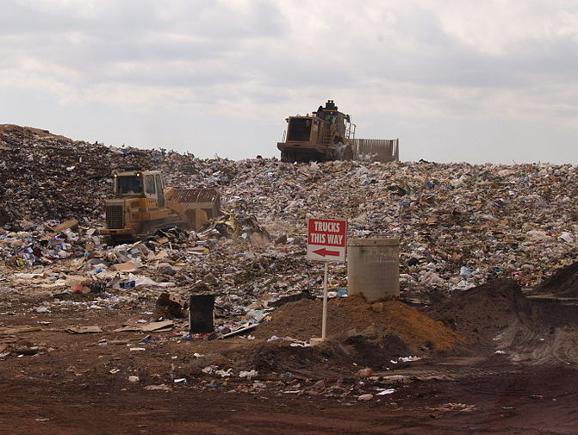
Landfills
Public and privately owned
Licensed
Existing site
Leachate and gas collection systems
Minimal environmental risk
Highly regulated
Resources Conservation and Recovery Act (RCRA)
Carcass degradation may take longer
Notes:
Another option for carcass disposal involves the use of existing licensed commercial landfills. Landfill sites may be privately owned or operated by municipalities. With this method, similar to burial, carcasses are layered between compacted soil and solid waste materials. Landfills are usually located at sites specifically selected to minimize potential risks to groundwater, surface water and other environmentally sensitive areas. Additionally, landfill design incorporates liners, leachate containment systems and gas collections systems to minimize environmental impacts. Landfills are highly regulated, and those used for carcass disposal must be in compliance with Federal criteria, and meet design and operating standards outlined in Subtitle D of the Resource Conservation and Recovery Act (RCRA) [ Title 40 Code of Federal Regulations – Parts 239-299]. Smaller or older landfills (the type most likely to be found in rural areas) may not met these criteria. Carcass decomposition in landfills will have widely varying temperatures which can slow biochemical reactions in the carcasses. Therefore, carcass degradation at a landfill may take longer as compared to burial methods.

Slide 9
Landfills: Considerations
Immediately available
Minimal environmental risk
May have limited capacity
Owner acceptance and terms of use
Transportation
Biosecurity
Cost
Public opposition
Notes:
One advantage of using preexisting landfill locations is the immediate availability of a well designed disposal site. Depending on space available, the landfill may have the ability to dispose of large quantities of carcasses; however, landfill owners may not accept carcasses. If carcasses are accepted, terms of use must be negotiated. When using landfill locations, the transportation of carcasses to landfill sites will be needed. This will involve not only the logistics of obtaining a sufficient number of large trucks suitable for transporting carcasses, but also planning to ensure biosecurity measures (e.g., avoiding leakage and disease transfer off-site). Carcass processing is likely to require additional staff at the landfill site due to the extended hours of operation that will be needed. Public perception and opposition may present issues for obtaining approval for disposal on publically owned landfills. Security and traffic control will be needed. All vehicles used for carcass transport must be cleaned and disinfected.

Slide 10
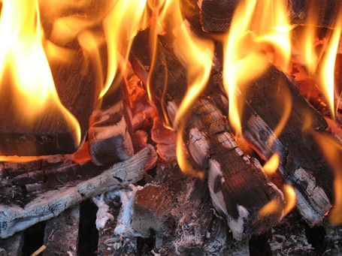
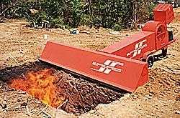
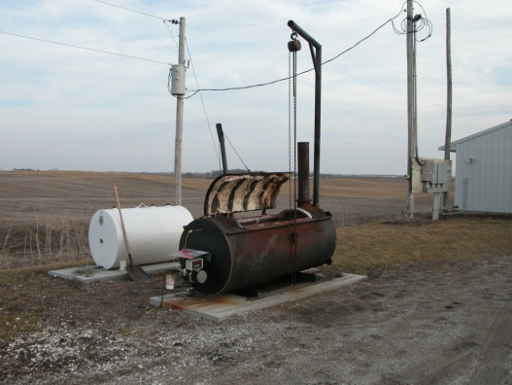
Incineration
Thermal destruction
High-temp combustion
Various fuel sources
Methods
Open-air burning
Fixed-facility incineration
Air-curtain incineration
Notes:
Another common method of carcass disposal is incineration. This involves the use of high-temperature combustion to destroy animal carcasses and associated animal materials. The objective is to convert dead animal carcasses to inert gases and sterile ash as well as deactivate pathogens. Three methods of incineration exist for the disposal of animal carcasses. These include open-air burning (or pyres), fixed-facility incineration, and air-curtain incineration. Various fuel sources (e.g., diesel fuel, propane, and furnace or waste oils) may be used to start and accelerate combustion. Gasoline or other highly explosive accelerants should NEVER be used.
Open-air burning consists of burning carcasses on combustible heaps (called pyres) or in open fields. Carcasses are placed on a fire bed with hay, straw, dry timbers or other kindling materials, which are then fueled and burned. Open air burning is considered an uncontrolled method since neither fuel or air inputs can be controlled. As a result, the process can be very smoky as well as odorous, and the volume of ash generated can also be significant. Open-air burning is prohibited in many states and is generally an option of last resort. If allowed, only properly trained and credentialed persons should conduct open air burning. The risk of unintended fires, as well as hydrocarbon emissions are concerns with this method. Additionally, the public perception of open-air burning is overwhelmingly negative.
As an alternative, fixed-facility incineration takes place in a completely contained environment and is usually highly controlled. The process is typically fueled by diesel, natural gas or propane. Fixed-facility incineration has a more evenly distributed combustion temperature and burns carcasses more effectively and completely. Some larger animal production facilities have on-site incinerators – as do veterinary schools and diagnostic laboratories; small on-farm incinerators may not have sufficient continuous capacity to handle large emergency losses. Compared to other thermal methods, fixed-facility incineration is usually the most expensive as it requires an enormous amount of fuel, but it is a highly efficient process that produces minimal residue as carcasses and associated materials are reduced to inert ash. The throughput of fixed-facility incinerators depends on chamber size. If capacity becomes overburdened, carcasses will need to be stored (e.g., refrigerated room, freezer) until the system is able to accept more. Small incinerators may reach 110 lbs. per hour; most are unable to hold large carcasses, such as cattle. Most large incinerators are fitted with after burners that further reduce emissions by burning smoke exiting the primary incineration chamber. State air quality requirements must be followed.
Air-curtain incineration is another thermal method that uses a combination of forced air and fuel (diesel or wood) to burn carcasses and associated material. Burning does occur outside, however a manifold with large capacity fans driven by diesel engines is used to deliver high velocity air down into a burn pit. The introduction of this high volume of air greatly increases the incineration temperature and accelerates carcass combustion. This method can work up to six times faster than open-air burning; however the process is extremely fuel intensive. Air curtain incinerators are mobile and this can serve to reduce biosecurity risks associated with carcass transport. Wood for fuel, however, may need to be transported long distance for use in the incinerator. Systems vary by size and placement is limited by terrain and other environmentally limiting factors. These incinerators can produce significant noise and should be located away from residential areas and the general public to avoid producing a noise nuisance. Air-curtain incineration is considered the most practical and environmentally acceptable incineration option. It is also the most rapid thermal disposal method. [Middle photo from Iowa State University, VDPAM; Bottom photo - sample air curtain incinerator, from Concept Products Corporation]

Slide 11
Incineration: Considerations
Complete combustion
Limited capacity
Air pollution
Transportation
Biosecurity
Regulations
State approval for process
Licensing
Trained personnel
Public opposition
Notes:
The advantage of using incineration methods is their ability to result in complete combustion of carcasses and associated materials. These methods, however, are very fuel intensive procedures, and can result in environmental pollution due to air emissions. Some incineration methods may be possible on-site; others may require transport of carcasses to off-site locations, which raises concerns of transporting carcasses safely without biosecurity issues. Any vehicle used for carcass transport must be cleaned and disinfected. Additionally, firefighting officials should be notified and involved in planning and procedure. Ample fire retardant equipment and protective gear should be available to personnel assisting with this response task. State approval is required for open-air burning, and fixed-facility incinerators must also be licensed by the state.

Slide 12
Composting: Design
Carcasses layered with organic material
Microorganisms → heat → pathogen destruction
Indoor or outdoor
Bin or static windrow (pile)
Requirements
Carbon:nitrogen ratio
25:1 to 40:1
Biofilter layer
Notes:
Composting is a carcass disposal method that involves the placement of carcasses beneath organic materials, which promotes decomposition at elevated temperatures and destroys pathogens present in the carcasses. Carcasses can be composted whole or to speed the process can be ground and mixed with co-compost prior to pile formation to improve microbial activity and decomposition. Whole carcasses should be lanced or vented to minimize bloating of the carcass and the accumulation of decomposition gases.
Composting requires sources of nitrogen, carbon, oxygen and moisture for optimal tissue breakdown. Carcasses serve as the nitrogen source, while the addition of plant material (referred to as co-compost) serves to meet the carbon requirement. A carbon:nitrogen ratio of 25:1 to 40:1 is optimal. There are many possible carbon sources to be used in carcass composting, such as (e.g., saw dust, wood chips, ground, cornstalks, ground straw, corn silage, peanut hulls, mulch, or poultry litter). Each varies in its carbon content as well as ability for leechate absorption. Silage consistently produces the highest temperatures most quickly, and is the best material for composting cattle carcasses that may harbor disease. Cornstalks, straw, sawdust, wood shavings are considered nutrient poor co-compost materials, but are suitable for composting mortalities from non-disease incidents (e.g., fire, flood). Emergency bovine composting may require 10-12 cubic yards of cover materials per 1000# carcass. The recommended height for a pile is 5-7 feet.
A biofilter, or thick layer of co-compost organic material, placed over the compost pile helps to absorb odors and decomposition gases. It also helps to maintain proper moisture, pH, and nutrients to enhance the decomposing microbial activities occurring in the pile. It also serves to reduce the likelihood of pathogen release due to wind, insects or scavenging animals. If excess leachate is a concern, an impermeable pad may need to be constructed below the compost pile. [Image: This image shows a representation of a compost pile. Source: Natural Rendering, Cornell Waste Management Institute]

Slide 13
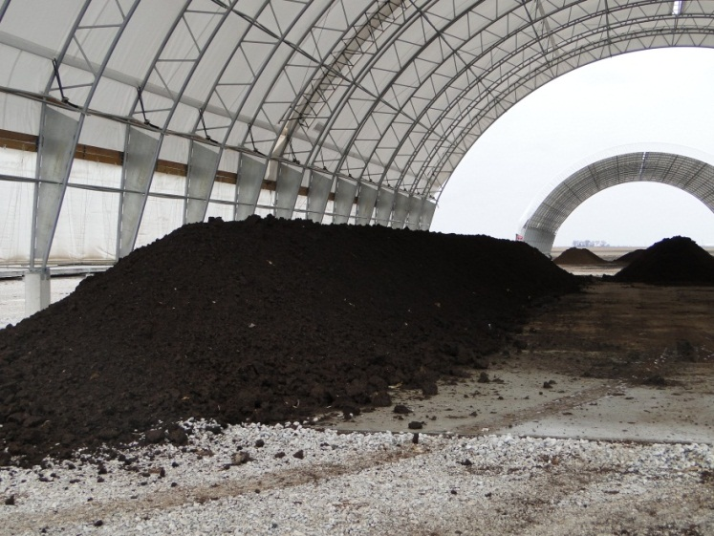
Composting: Process
Two phases
Active phase
Aeration essential
Curing phase
Monitor frequently
Aeration
Odor, vector control
Notes:
The composting process consists of two phases – an active phase and a curing phase. During both phases the nitrogen, carbon, oxygen, and water ratios, as well as temperature, should be monitored frequently (e.g., daily).
The first phase – or active phase – is an aerobic (oxygen dependent) process. Adequate aeration during this phase is vital, as is maintenance of the moisture content throughout the pile. The moisture content of the pile should remain around 50%. Compost aeration can be achieved mechanically by use of large fans or frequent pile turning. Piles can be more passively aerated by constructing a porous compost pile that allows air to enter naturally via diffusion or aided by wind. This phase of the process generates a high temperature and results in a large reduction of biodegradable solids. The volume and weight of the pile may decrease as much as 50 percent. The desired core temperature of the composting pile is between 135-140ºF. Depending on size of carcass biomass – this temperature should optimally be maintained for a length of time – between 3-12 weeks. The porosity of the pile will also decrease, and the lack of air spaces will make oxygen less available.
The second phase – or curing phase – involves lower temperatures (77-86ºF) and slower biochemical reactions. Aeration during this phase is not as critical. Bulk density is reduced by 25%. Time to complete the second phase is dependent on carcass size and can vary from 10-240 days. The finished product – called “humus” – appears dark brown to black, and is free of unpleasant odor when turned. Overall, the decomposition rate of intact carcasses in properly managed compost piles is about 2.2# per day.
Composting may take place indoors or outside. Indoor composting has been widely used by the poultry industry for bird mortalities. Indoor composting is less affected by weather events, ambient temperatures and seasonality and more protected from wind, scavengers and drying conditions. Challenges involve space limitations, and restricted space for movement of heavy equipment. Indoor composting also requires prolonged management, maintenance and monitoring.
Outdoor composting involves placement of carcasses in compost piles that are long, narrow windrows or trapezoidal shaped and above ground or in bins. Outdoor composting is typically used for larger carcasses. Site selection is critical. Select well-drained locations, located outside the flood plain and away from any ground and surface water sources. The composting process is very sensitive to environmental moisture, therefore, outdoor compost piles should be covered with a tarp or roof to minimize excess pile wetness and prolonged composting times. Covering carcasses with sufficient co-composting material also minimizes the attraction of flies and scavengers. [Images: Both photos show compost piles. From Danelle Bickett-Weddle, Iowa State University]

Slide 14
Composting: Considerations
On-site process
Adaptable process
Nutrient rich end product
Transport of co-compost material
Predators and scavengers
Notes:
Composting is an on-site process that reduces biosecurity risks associated with transporting carcasses to additional locations. However, off-site carbon sources may still need to be obtained. Another benefits of composting is the end result of nutrient rich materials (“humus”) that can be spread on cropland. [Note: This will not be allowed for cases of certain foreign animal diseases]. Composting is an adaptable process, and pile length can be increased to accommodate additional carcasses. More information on the use of the composting process for animal carcass disposal can be found in the corresponding “Carcass Disposal-Composting” Just-In-Time presentation.

Slide 15
Rendering
Off-site process
Transport of carcasses
Heat conversion into
Meat and bone meal
Fat/Tallow
Water
Dry rendering
Batch or continuous process
Tell renderer cause of death
Notes:
Rendering is an offsite process that uses heat to convert carcasses and associated disposal material into meat and bone meal, fat or tallow, and water. During rendering, disposal materials are placed in sealed containers and subjected to pressurized steam. Some pre-processing of carcasses may be required. Carcasses are often mechanically crushed into small cubes of tissues, then loaded into cooking cylinders and subjected to heating. Final temperature of the cooker should reach 250-275ºF for at least 15 minutes. In the US, only the dry rendering process [wet rendering is not used in the US] is used; this can occur as batch or continuous procedures. Continuous rendering is often preferable to decrease the risk of spreading infectious disease. During batch rendering – each time a rendering vessel is opened, for discharge of rendered product or refilling, airborne particles may be released and threaten biosecurity.
Rendering plants may be independent or integrated with existing packing or poultry processing plants. Some can efficiently transport and process one million or more pounds of raw animal per day. It is important to share with the rendering facility the cause of death of the animals. This is especially important when chemicals have been used to euthanize animals (e.g., depopulation) as there may be issues with chemical tissue residue. Rendering will most likely not be used if barbiturates have been used for chemical euthanasia.

Slide 16
Rendering: Considerations
Facilities have procedures for biosecurity, wastewater, byproducts
Process closely regulated
Transport of carcasses to site
Biosecurity
Leak proof containers
Coordination
Temporary storage may be needed
Notes:
Rendering facilities typically have established biosecurity procedures, as well as procedures to handle wastewater and other byproducts generated during rendering process. Rendering facilities are closely regulated to maintain environmental safety. Only rendering facilities that comply with applicable regulations should be considered. Biosecure transport of carcasses must be arranged. Leak-proof transport trucks must be used. Carcass transport coordination is essential, so not to overwhelm the facility. Plans for temporary storage may be needed if carcasses cannot be rendered right away.

Slide 17
Alkaline Hydrolysis
NaOH or KOH hydrolysis
Sterile aqueous product
Advantages
Highly automated
No emissions, minimal odor
Disadvantages
Effluent disposal
Lack of availability
Notes:
Other carcass disposal methods are being studied, but most are too expensive at this time and also require specialized training. Alkaline hydrolysis, however, is a relatively new process that may be used in an animal emergency event. Alkaline hydrolysis uses sodium or potassium hydroxide – under heat and pressure –to hydrolyze (or digest) animal carcasses. The end result is a sterile aqueous solution of protein, sugars, soaps, and minerals. This process uses a highly automated tissue digester operating at high pressures. The process can occur on-site (e.g., transport of digester to location) or at fixed-facility locations. This method is low cost, but is limited by its low capacity. It is also time consuming. However, it is one of only two technologies that can destroy BSE (the other is fixed facility incineration). Alkaline hydrolysis releases no emissions into the atmosphere and generates minimal odor; however, the effluent that is produced must be treated and disposed of and this can be a challenge. The other main challenge of this process is the minimal availability of this process currently in the United States.

Slide 18
Carcass Disposal Considerations
Site location
Soil topography and area
Slope, permeability
Proximity to water sources, public areas
Subsequent use of site
Regulations
Environmental impacts
Water source contamination
Air quality
Scavengers
Notes:
Regardless of the carcass disposal method selected, consideration of the following factors must occur:
Site location may determine the carcass disposal method allowed. Soil topography (e.g., slope, permeability) as well as hydrological properties (e.g., proximity to surface or ground water sources and/or public areas) are important considerations. Additionally, the subsequent use of the site and any local, state or federal regulations associated must be determined.
Environmental concerns are also important to consider and address. The primary concern is potential contamination of ground and surface water sources with carcass leachate. Air quality issues (including odor) may also be of concern. Control of scavenging animals is of paramount importance. Insects, birds and animals that come into contact with diseases carcasses can become vectors, spreading the disease outside the site or containment area. Measures to protect wildlife and domestic animals from exposure to any associated infectious materials is also important. Appropriate environmental regulatory agencies should be included in carcass disposal planning and procedures.

Slide 19
Carcass Disposal Considerations
Biosecurity
Personal protective equipment
Movement control
Cleaning and disinfection
Site security
Unauthorized persons
Log book
Warning or restriction signs
Site security personnel
Notes:
Biosecurity measures for carcass disposal is of utmost importance to protecting against spread of infection as well as reducing risks to environmental and public health. Issues to address include the appropriate use of Personal Protective Equipment, implementing movement control procedures for personnel and vehicles and the implementation of cleaning and disinfection procedures for vehicles and equipment used during carcass disposal procedures. Site security will also be important. Threats to site security may include any number of unauthorized persons (e.g., vandals, animal rights persons, angered landowners, curious public). Access to the disposal site should be limited to only those necessary to the response procedures. A log book should be maintained to record vehicles and individuals entering and exiting the disposal site. Warning or restriction signs should be posted in an obvious location at the perimeters and entrances to the disposal site to discourage unauthorized visitors. It may be necessary to have designated personnel responsible for maintaining site security and guarding perimeters, or even to involve law enforcement to protect the security of the disposal site.

Slide 20
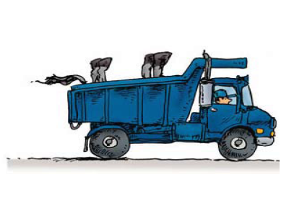
Carcass Disposal Considerations
Transporting infected materials
Closed, leak-proof
Liquid collection/absorption system
Required permits
Applicable laws/regulations
Safety Issues
Physical and psychological
Regulations
Public perception
Notes:
Some disposal methods will require transport of carcasses to the disposal location. Vehicles used to transport carcasses and associated materials must be closed and leak-proof. Liquid collection and/or absorption systems should also be implemented. Compliance with all applicable laws and regulations should always be maintained. Obtain any required permits for hauling dead animals. All carcass transport vehicles should be subject to thorough cleaning and disinfection. Additional information on transport of carcasses can be found in the Off-site Carcass Disposal Just-In-Time training presentation.
Safety issues for responders will vary with the method of carcass disposal being performed. Incineration methods have a risk of fire-related injuries. All carcass disposal methods will have physical (e.g., fatigue) and psychological impacts on responders. Depopulation and disposal of large numbers of animals can be mentally stressful. The disposal procedures will also require long- work hours and physical demands on responders. Weather conditions (e.g, high temperatures) can lead to heat stress and dehydration.
All methods of carcass disposal have regulatory requirements that must be followed. Some methods of carcass disposal may not be permitted in some states, others may outline specific criteria and procedures for use of a particular carcass disposal method. Be sure to obtain any special permits or licenses required, especially for methods of incineration. All applicable environmental and public health laws and regulations (such as fire codes) should be determined and followed.
A major disease outbreaks and response will attract considerable media attention and interest. The public’s perception of carcass disposal procedures is of utmost importance. Media may be helpful in raising public awareness – with appropriate messages. However, disposal sites should be protected from media personnel and the public. Care should be taken to limit photography/video and minimize unauthorized persons.

Slide 21
Disposal of Other Products
Milk, wastewater, feed, grain, manure, bedding, wool
Similar options as for carcasses
Site selection guidelines apply
Land application following treatment for manure, litter, slurry
Notes:
In addition to carcasses, other products, such as milk, wastewater, feed, grain, manure, bedding, wool and other materials may also require disposal during an animal disease emergency. All carcass disposal options – except rendering – can be used. Equipment or supplies, such as syringes used for vaccination or diagnostic sample collection, personal protective equipment, and trash, must also be properly disposed and may be regulated as solid or hazardous waste or medical and infectious waste. [Image: This is a photo of manure slurry. Source: Leo Timms, Iowa State University]

Slide 22
Resources
USDA Foreign Animal Disease Preparedness (FAD PReP) Guidelines: Disposal
http://www.aphis.usda.gov/animal_health/emrs/nahems.shtml
USDA Foreign Animal Disease Preparedness Standard Operating Procedures (SOP): Disposal
http://www.aphis.usda.gov/emergency_response/tools/aphis_role_emergency_tools.shtml
Notes:
For more information on carcass disposal issues during an animal health emergency response, consult the USDA FAD PReP Guidelines and Standard Operating Procedures on Disposal.

Slide 23
Acknowledgments
Development of this presentation was by the Center for Food Security and Public Health at Iowa State University through funding from the Multi-State Partnership for Security in Agriculture
Authors: Molly Peebles, BS; Glenda Dvorak, DVM, MPH, DACVPM
Notes:
Information provided in this presentation was developed by the Center for Food Security and Public Health at Iowa State University College of Veterinary Medicine, through funding from the Multi-State Partnership for Security in Agriculture.

