Slide 1
Carcass Disposal
On-Site Burial
Notes:
December 2013
During animal health emergencies, such as catastrophic natural disasters or large-scale disease outbreaks, the disposal of a large number of dead animals in a timely, safe, biosecure, aesthetically acceptable, and environmentally responsible manner will be necessary. This Just-In-Time training presentation will overview principles of on-site burial as one method of carcass disposal during animal health emergencies.

Slide 2
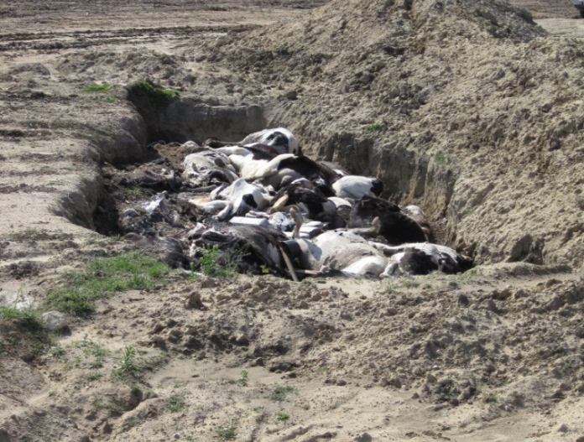
On-Site Burial
Excavated trench or pit
Decomposition
Heat
Length of time required varies
Species and size
Total volume
Soil characteristics
Settlement of the burial site
Additional backfill
Notes:
Burial is a common method used for dead animal disposal. This method involves the placement of carcasses into an excavated trench or pit, which is then covered with soil or backfill. The decomposition of the carcasses generates heat, which can destroy microorganisms. Eventually buried materials are degraded and broken down into minerals and organic material. The length of time required for carcass decomposition will vary and is generally dependent on the species and size, and the total number of carcasses, as well as the soil composition, temperature and moisture. The process can take weeks to years. [Photo from Environmental Health Services, Department of Public Health, Kings County, California]

Slide 3
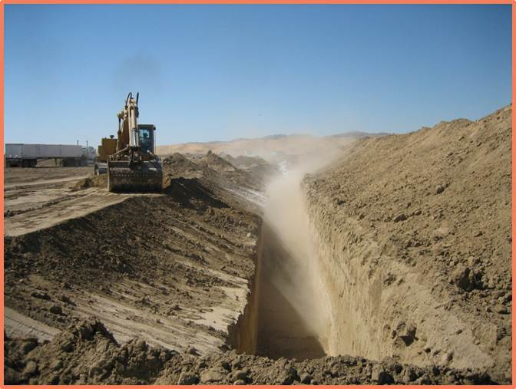
Burial Types
Trench burial
Daily mortalities
Trapezoid or vertical pits
Inexpensive
Convenient
Mass burial
Large numbers of animal mortalities
Trapezoid pits with liners
More expensive and time consuming
Notes:
There are two types of burial that may be used – trench burial and mass burial. Both follow the same basic principles and are generally performed on-site. Trench burial is used more for daily mortalities and fewer number of carcasses which requires a smaller pits. This method is relatively inexpensive and conveniently carried out on or near areas where euthanasia occurs. Mass burial is used for large numbers of animal mortalities. This method also uses trapezoid shaped pits, however, because of the large numbers of carcasses disposed of in mass burial sites pits are sealed with liners (usually clay) and drainage systems to manage and dispose of gas and leachate generated during decomposition to prevent environmental contamination. Mass burial sites are also held to stricter regulations and require more planning for development prior to disposal. Mass burial sites tend to be more costly and development is dependent on adequate land space availability; however this method is still considered a convenient method of carcass disposal. When proper procedures are used, burial can be a safe and effective method of carcass disposal. If managed improperly, carcasses may not decompose properly. [This photo shows a site being prepared for burial. Source: Danelle Bickett-Weddle, Iowa State University]

Slide 4
Site Selection
Soil properties
Texture and permeability
Construction of the site
Slope of land
Depth of water table and bedrock
Location of the site
Proximity to water sources or public areas
Accessibility
Projected future use of the site
Notes:
Before burial begins, determination of a suitable site is necessary. Considerations for the placement of burial pits or trenches must include soil properties, such as texture and permeability; the slope of the land; depth of the water table; and proximity to surface and ground water sources or public areas, such as roadways or homes. Ideally, the soil should be relatively impermeable and dense, such as a clay-sand mixture (which has low porosity and a small fine grain texture). The site should be one that is easily accessible. The projected future use of the site is also an important consideration.

Slide 5
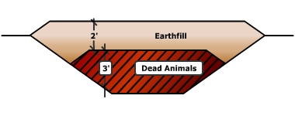
Construction and Design
Site size/area
Depends on species, age/size, quantity
Trapezoid shape pits
42 cubic feet per:
1 adult bovine OR
5 pigs/sheep OR
40 chickens
Liners to minimize seepage
Caution during excavation
Notes:
Burial pits are excavated in a trapezoid shape, with the narrower side making up the base. The total excavation area required will be determined by the species and total number of carcasses to be buried. A 2001 APHIS guideline recommends 42 cubic feet (1.2 cubic yards) of space to bury 1 adult bovine, OR 5 pigs or 5 sheep, OR 40 chickens. It is estimated that for every additional 3 feet of trench depth, the number of carcasses can be doubled. Pits may be sealed with specially constructed liners and drainage systems to prevent leachate seepage. During any excavation procedures, caution must be used to avoid any underground lines or other hazards.
[This diagram shows the cross section of burial pit. Source: U.S. Department of Agriculture at http://www.aphis.usda.gov/emergency_response/tools/on-site/htdocs/osbtc/dispop/intro0110.html ]

Slide 6
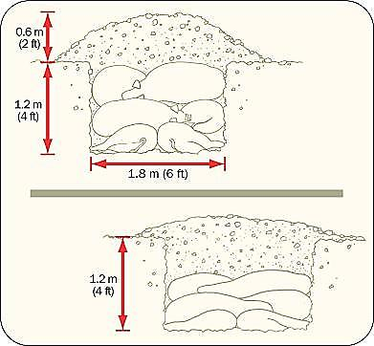
Construction and Design
Trench size
4-8 feet deep
6 feet wide
Two large carcasses side by side
May include liners
Clay may be used as a base layer
Vent large carcasses
Settlement during decomposition
May need additional backfill
Notes:
Trenches or pits may vary from 4-8 foot in depth and are typically about 6 feet wide, so that at least two large animal carcasses may be placed side by side in the pit. Carcasses are layered (no more than 2 foot thick) with alternating layers of soil (up to 3 feet thick). Pits are then topped with approximately 4 feet of soil, again a relatively impermeable soil type must be used. Cover material is generally obtained from the excavation process and can then be reused as backfill to cover the carcasses. An important consideration when using burial methods is the development of gases during the decomposition process. This can lead to bloating of the carcasses, and subsequent displacement of the dirt covering layer. Therefore, carcasses, especially those of large animals, should be punctured or vented prior to burial to minimize the bloating process and the accumulation and entrapment of gases. Additionally, as the carcass mass decomposes over time, settlement of the site will occur. Additional backfill may be required to restore the natural land surfaces. This diagram shows burial dimensions. Source: Ontario Ministry of Agriculture and Food at http://www.omafra.gov.on.ca/english/engineer/facts/09-029.htm

Slide 7
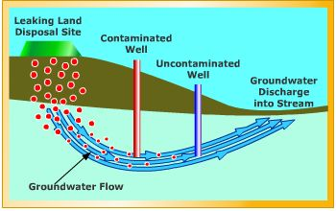
Environmental Impacts
Air quality
Odor
Water quality
Leachate
Gases
Methane, carbon dioxide, hydrogen sulfide
Scavengers
Notes:
Burial procedures can have environmental impacts if not conducted appropriately. These impacts can include issues affecting air quality, water quality, soil integrity and other environmental factors. During the decomposition process, carcasses produce a significant amount of waste in the form of leachate and gases such as methane, carbon dioxide, hydrogen sulfide. The quantity of these byproducts produced will relate to the volume of carcass material buried. These by-products are not only of no value, but remain at the burial site for a considerable amount of time, leading to potential contamination. This can also limit possibilities for the site to be used for future projects. The installation of groundwater monitoring wells and water sample collection and testing may be necessary. Control of scavenging animals is of paramount importance in controlling the spread of disease from the site. Insects, birds and animals that come in contact with the diseases carcasses can become vectors, spreading disease outside of the area. Materials that limit access, such as fencing or signage, should be considered. This illustration demonstrates the seepage of disposal by-products into groundwater and subsequently surface water sources. Source: U.S. Department of Agriculture at http://www.aphis.usda.gov/emergency_response/tools/on-site/htdocs/images/Figure_7.jpg

Slide 8
Comparison With Other Disposal Methods
Advantages
Quick, easy, inexpensive
Equipment generally readily
On-site; limited transportation
Disadvantages
Large areas of land
Difficult in wet and cold weather conditions
Environmental impacts
Public opposition
Notes:
One advantage of using a burial method for carcass disposal is that it is relatively quick, easy, and inexpensive, when adequate land space is available. Additionally, the equipment needed, such as backhoes, bulldozers, and dump trucks, is generally easy to obtain. Burial procedures are often carried out on or near the location where euthanasia of the animal occurs thereby minimizing transportation needs and reducing the further spread of potentially infectious material and breaks in biosecurity.
Disadvantages of the disposal method include the need for large areas of land, as well as the potential for detrimental environmental effects to water sources or air quality. Burial methods are more difficult to use in wet or frozen weather conditions. Public opposition to burial methods may limit their use.

Slide 9
Regulations and Monitoring
Consult State regulations
Sites highly regulated
Depth, width, length, max size
Environmental impact
Groundwater monitoring
Surface water sources
Air quality/odor
Record site GPS location
Notes:
Burial methods have strict regulatory requirements that must be met, and care must be taken to protect the environment as well as the public from negative effects. Appropriate environmental regulatory agencies and stakeholders should be included in planning for disposal site selection. Burial methods can only be used where allowed by permit, and when depths of soil and water table are adequate. State regulations vary in terms of specific criteria required for a suitable burial site. Carcass burial may NOT be permitted in some States. States that do allow it may have regulations outlining burial factors such as site location, distance from waterways, trench or pit dimensions and capacity, as well as monitoring requirements. Burial sites will require long term monitoring, management and environmental testing. Measures to handle gas and leachate may be needed. Coordination with State and Federal natural resource department is essential. Global position system (GPS) of burial site should be recorded.

Slide 10
Biosecurity
Biosecurity
Personal protective equipment (PPE)
Movement control
Cleaning and disinfection
Site security
Unauthorized persons
Log book
Warning or restriction signs
Site security personnel
Notes:
Biosecurity measures for carcass disposal is of utmost importance to protecting against spread of infection as well as reducing risks to environmental and public health. Issues to address include the appropriate use of Personal Protective Equipment, implementing movement control procedures for personnel and all vehicles and the implementation of cleaning and disinfection procedures for vehicles, heavy machinery, and equipment used during carcass disposal procedures. Site security will also be important. Threats to site security may include any number of unauthorized persons (e.g., vandals, animal rights persons, angered landowners, curious public). Access to the disposal site should be limited to only those necessary to the response procedures. A log book should be maintained to record vehicles and individuals entering and exiting the disposal site. Warning or restriction signs should be posted in an obvious location at the perimeters and entrances to the disposal site to discourage unauthorized visitors. It may be necessary to have designated personnel responsible for maintaining site security and guarding perimeters, or even to involve law enforcement to protect the security of the disposal site. [Please Do Not Enter sign from Center for Food Security and Public Health, Iowa State University]

Slide 11
Personnel Safety
Safety Issues
Physical demands
Long hours
Response activities
Psychological impact
Weather conditions
Notes:
Safety issues for responders will vary with the method of carcass disposal being performed. All carcass disposal methods will have physical demands and psychological impacts on responders. Depopulation and disposal of large numbers of animals will be mentally stressful. Additionally, weather conditions during the response can have physiological health impacts.

Slide 12
Resources for Carcass Disposal
USDA Foreign Animal Disease Preparedness (FAD PReP) Guidelines: Disposal
http://www.aphis.usda.gov/animal_health/emrs/nahems.shtml
Carcass Disposal: A Comprehensive Review. USDA and Kansas State University
https://krex.k-state.edu/dspace/handle/2097/662
Notes:
This presentation provided a brief overview of on-site burial animal carcass disposal processes. For more information on carcass disposal issues during an animal health emergency response, consult the USDA FAD PReP Guidelines on Disposal and the Kansas State University Carcass Disposal Comprehensive Review.

Slide 13
Acknowledgments
Development of this presentation was by the Center for Food Security and Public Health at Iowa State University through funding from the Multi-State Partnership for Security in Agriculture
Authors: Melissa Lang BS; Glenda Dvorak, DVM, MPH, DACVPM
Notes:
Information provided in this presentation was developed by the Center for Food Security and Public Health at Iowa State University College of Veterinary Medicine, through funding from the Multi-State Partnership for Security in Agriculture.

