Slide 1
Carcass Disposal
Off-Site Locations
(Rendering and Landfills)
and Transportation Biosecurity
Notes:
December 2012
Catastrophic natural disasters or large-scale disease outbreaks can result in a large number of dead animals. In these situations, the disposal of animal carcasses and related materials in a timely, safe, biosecure, aesthetically acceptable and environmentally responsible manner will be necessary to prevent the spread of disease. This Just-In-Time training presentation will discuss two off-site methods of carcass disposal – rendering and landfills - as well as discuss biosecurity issues associated with the transport of carcasses to these off-site locations.

Slide 2
Off-Site Carcass Disposal
Rendering Facility or Landfills
Use depends on
  Animal species
  Quantity of carcasses
  Pathogen of concern
    Persistence
    Ability to spread
  Regulations
    Local, state, federal
Notes:
The use of rendering facilities or landfills may be necessary for carcass disposal when on-site methods, such as burial or burning, are not feasible or are not permitted. Additionally, determination for the use of the off-site methods will depend on the species of animal involved, the number or quantity of carcasses in need of disposal, the pathogen of concern and its ability to persist in the environment or spread to additional locations, as well as any local, state, or federal regulations on carcass disposal methods.

Slide 3
Rendering
Notes:
Let’s first look at rendering as an off-site carcass disposal method for animal health emergencies.

Slide 4
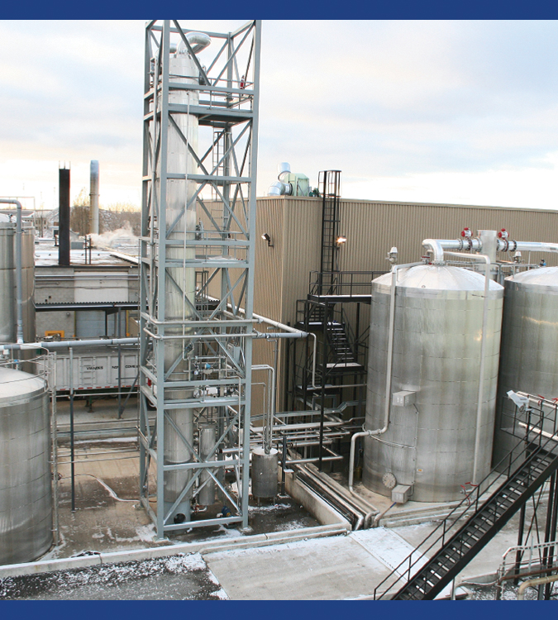
Rendering
Heat conversion of
animal carcasses
into useable products
  Meat and bone meal
  (protein-based solids)
  Melted fat (tallow)
  Water
200 rendering plants
throughout US and Canada
Notes:
The rendering process uses heat to convert carcasses into protein-based solids (meat and bone meal), melted fat (or tallow) and water. These end products may be used for additional purposes such as an ingredient for certain animal feeds, for the manufacturing of soaps, or for use as fertilizer. Rendering plants may be independent or integrated with existing packing or poultry processing plants. Some can efficiently transport and process one million or more pounds of raw animal per day. Rendering is considered an environmentally safe method of carcass disposal and permitted for use in many states within the U.S. The number of rendering plants has declined in the last 30 years. In the United States and Canada, there are approximately 200 rendering plants. Some areas no longer have local rendering plants, necessitating long distance transport in specially designed trucks. The National Renderers Association (www.renderers.org) maintains a list of rendering plants. [This photo shows a rendering plant. Source: David Meeker, National Renderers Association]

Slide 5
Rendering Process
Continuous rendering system
  One vessel used for entire process
  Processes are simultaneous
  Little to no manual operation
Moisture converted to steam
  Temperature between 240-275°F
  Destroys harmful pathogens
Notes:
The rendering process may be performed using a continuous or batch process. Batch processing is not generally recommended for carcass rendering during animal disease emergencies since this process can result in the release of contaminated fat particles during the transfer of material between processing vessels. With continuous rendering, a single cooking vessel is used for the entire process. The breakdown of the carcasses and the heating process occur simultaneously. During the heating process, temperatures can reach 240-275 ºF. As a result, moisture from the carcass is converted to steam which can destroy most harmful pathogens. The time required to complete the rendering process depends greatly on the temperature and air pressure inside the system. The average cooking time (after processing for the cooker) is about 3-1/2 hours. Most continuous rendering systems require little to no manual operation; they are generally equipped with automatic controls for both time and temperature.

Slide 6
Rendering: Considerations
Disposal of final product
  Landfill
  Burial
Coordinate transport to facilities
Surge capacity
Biosecurity and wastewater procedures
Process closely regulated
Notes:
If rendering is chosen as a disposal method during an animal health emergency, careful consideration and planning are critical. A plan for the final disposal of the product generated must be developed. Once the carcasses have been rendered, the end product is generally considered biosecure. Landfilling or burial may be options. Biosecure transport of carcasses in leak-proof containers must be arranged. Carcass transport coordination is also essential, so as not to overwhelm the facility. Many rendering plants may be operating at or near capacity as part of normal business operations and the surge capacity may be limited. Plans for temporary storage may be needed if carcasses cannot be rendered right away. Rendering facilities typically have established biosecurity procedures in place to minimize risk of pathogen transmission. Some may have procedures in place for dealing with wastewater and other byproducts generated during rendering process. It is important to share with the rendering facility the cause of death of the animals. This is especially important when chemicals have been used to euthanize animals (e.g., depopulation) as there may be issues with chemical tissue residue. Rendering will most likely not be used if barbiturates have been used for chemical euthanasia. Rendering facilities are closely regulated to maintain environmental safety. Only rendering facilities that comply with applicable regulations should be considered. There are restrictions on the rendering of sheep, goats, cattle, and farm-raised deer or elk in some areas due to concerns about the transmission of the spongiform encephalopathies, the most notable of which is BSE (Bovine Spongiform Encephalopathy), associated with cattle.

Slide 7
Landfills
Notes:
Another off-site carcass disposal method that may be an option during animal health emergencies is the use of a pre-existing landfill. In many states, disposal of animal carcasses in landfills is an allowed option.

Slide 8
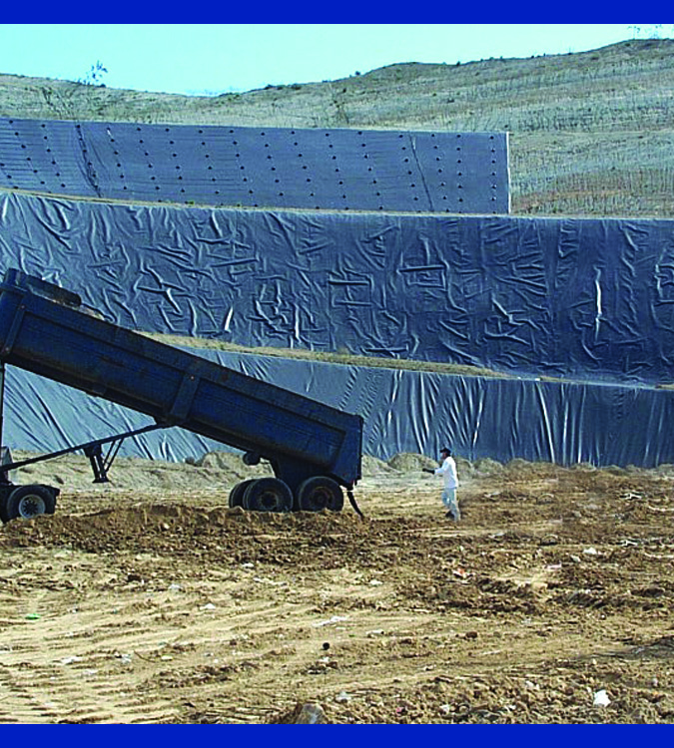
Landfills
Public and
privately owned
  EPA’s I-WASTE tool
Existing site
  Liners
  Leachate and gas
  collection systems
  Minimal environmental risk
Carcass degradation may take longer
Notes:
Landfill sites may be privately owned or operated by municipalities. Approximately 1,600 solid waste landfills currently operate in the U.S. (A listing of landfills can be obtained from the EPA’s I-WASTE tool at www2.ergweb.com/bdrtool/)
Similar to burial methods, carcasses are layered in the landfill between compacted soil and solid waste materials. Landfills are usually located at sites specifically selected to minimize potential risks to groundwater, surface water and other environmentally sensitive areas. Additionally, landfill design generally incorporates liners, leachate containment systems and gas collections systems to minimize environmental impacts. Smaller or older landfills (the type most likely to be found in rural areas) may not met these criteria. Carcass decomposition in landfills will have widely varying temperatures which can slow biochemical reactions in the carcasses. Therefore, carcass degradation at a landfill may take longer as compared to burial methods. Long term management of the waste material will be required. [This photo shows a truck dumping in a landfill area. Source: David Meeker National Renderers Association]

Slide 9
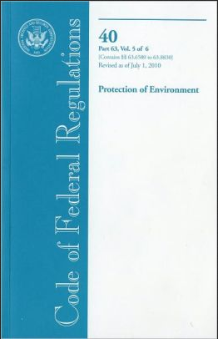
Landfill: Regulations
Highly regulated
  Resources Conservation and Recovery Act (RCRA)
    Title 40 Code of Federal Regulations
    Parts 239-299
Notes:
Landfills are highly regulated, and those used for carcass disposal must be in compliance with Federal criteria, and meet design and operating standards outlined in Subtitle D of the Resource Conservation and Recovery Act (RCRA) [ Title 40 Code of Federal Regulations – Parts 239-299].

Slide 10
Landfills: Considerations
Immediately available
Minimal environmental risk
May have limited capacity
Owner acceptance and terms of use
Transportation
  Biosecurity
  Cost
Public opposition
Notes:
One advantage of using preexisting landfill locations is the immediate availability of a well designed disposal site. Depending on space available, the landfill may have the ability to dispose of large quantities of carcasses; however, it is generally at the landfill operator’s discretion as to whether or not carcass materials will be accepted. Public perception and opposition may present issues for obtaining approval for disposal on publically owned landfills. Many smaller or medium sized landfills may decline carcasses and will not participate in emergency disposal operations because of lack of personnel, equipment and stockpiled soil to rapidly cover the sudden influx of carcasses. When possible, a pre-catastrophe agreement with the landfill management/ownership for use of a landfill if necessary during an animal health emergency should be obtained. When using landfill locations, the transportation of carcasses to landfill sites will be needed. This will involve not only the logistics of obtaining a sufficient number of large trucks suitable for transporting carcasses, but also planning to ensure biosecurity measures (e.g., leakage or pathogen transfer). Security and traffic control may be needed. Carcass processing is likely to require additional staff at the landfill site and extended hours of operation. Training for landfill employees on the biosecurity measures necessary to prevent the spread of an FAD may be needed.

Slide 11
Transportation
Notes:
Since rendering plants and landfills are both off-site processes, transportation of the infected animal carcasses to these locations will be necessary.

Slide 12
Carcass Transport: Planning
Training & guidelines
  Supervisors, operators, drivers
Obtain transport vehicles
Determine travel route
  Direct as possible
Supplies
  Cleaning and disinfection
  Personal protective equipment
Permits & official documents
  Federal, state & local
Notes:
The transportation of carcasses off-site will require thoughtful planning to ensure good biosecurity measures are used to prevent further spread of disease. All personnel involved with the loading, transport and unloading of animal carcasses, including supervisors, equipment operators, and drivers, should be trained and provided guidelines for biosecurity procedures, the use of personal protective equipment, methods for handling carcasses, and the completion of required transportation documentation. With off-site transport of carcasses, obtaining a sufficient number of large trucks suitable for transporting carcasses is often a limiting factor. Careful planning is also necessary as carcasses must be transported in a timely manner so that excessive decay has not set in. Careful route selection as well as alternate route plans should be established in case of a transport emergency. The route should be as direct as possible with few stops to ensure an efficient transportation operation. Vehicles must be cleaned and disinfected before they leave the affected premises and again after the material has been unloaded at the disposal site. Large quantities of cleaning and disinfecting supplies and personal protective equipment will be needed for the biosecurity movement of trucks and personnel. Each state or local government may have different documents that are required for the movement of infectious substances.

Slide 13
Transport Containers
Liquid tight
  Seal holes & cracks
  Layers of duct tape & plastic
Lining material
  Polyethylene plastic
  Sufficient material on all sides
Absorbent material
  Wood shavings
Notes:
Biohazardous waste must be transported in closed, leak-proof containers or trucks. Additional or secondary containment may be necessary. Containers must be liquid tight and equipped with an absorption or liquid collection system. Containers for hauling the carcasses should be double lined. Polyethylene plastic is commonly used for lining containers. The liners should be laid in the container so that there is sufficient material overlap on all sides so it can be folded over to “wrap” the carcass material. Approximately one foot of wood shavings, or other absorbent material, should be distributed on the floor of the container with a heavier concentration near the rear door, to absorb any liquid in the container.

Slide 14
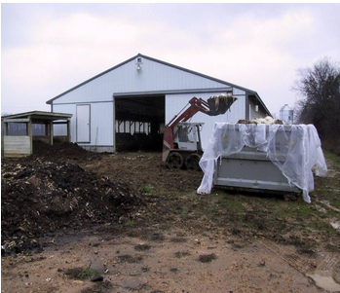
Loading the Containers
Fill container
  One foot from top
  Maximum weight limit
Spray with disinfectant
Wrap and seal load
Cover the container
Check for leaks
Clean and disinfect
before leaving the site
Notes:
Before loading the carcasses, closely examine the container. Look for any breaches, holes, large cracks, or sharp edges. It may be possible to seal small holes with several layers of duct tape or caulking. If any holes or cracks are too large to seal, do not use the container. Fill the container approximately one foot from the top of the container or until it reaches its maximum weight limit. Seal the load by folding the inner plastic lining over itself and securing the liner with duct tape and then fold the outer liner over itself and secure it using duct tape. If the container does not have a lid, use tarpaulin covers and additional polyethylene sheeting to fully cover the container. Tarpaulin covers are often torn in transit, so multiple liner layers to cover the tarpaulin will be needed. Load the container using a skid steer or front end loader. Carcasses should not be placed on the ground prior to loading in the container (to minimize disease transmission). Load contents evenly into the container. It will be difficult to rearrange carcasses once they have been loaded. Secure the edges of the plastic to the exterior walls and ends of the container with duct tape to prevent the plastic from slipping during the loading process.
Attention to personnel safety will be necessary. Equipment and the general work areas will likely be slippery due to the accumulation of blood, grease, excrement from the carcasses. Clean and or degrease the work area and all equipment when necessary to reduce the risk of injury. Personnel, including truck drivers, should wear personal protective equipment when working with carcasses. Truck drivers should remain within the vehicle while the truck is loaded with all windows and doors closed. After loading, inspect the container for leaks or dripping, and ensuring the integrity of the lid or cover before departing the loading area. Before the container is transported offsite, the outside of both the truck and trailer should be cleaned and disinfected. [This photo shows carcasses being loaded into a transport container. Source: U.S. Department of Agriculture]

Slide 15
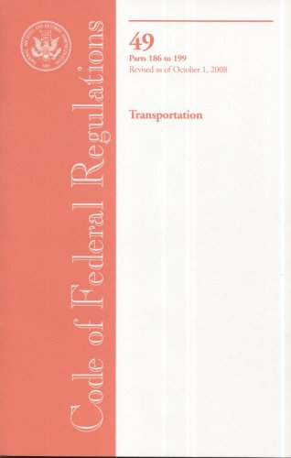
Regulations
Environmental Protection Agency
Department of Transportation
  DOT Hazardous Materials Program Definitions and General Procedures
    49 CFR Part 105
Notes:
The transportation of contaminated disposal materials from affected premises to off-site locations requires that special procedures be followed. Compliance with all applicable laws and regulations should be maintained. Regulations for the handling and transport of infectious materials on public roads are outlined by the Environmental Protection Agency and the U.S. Department of Transportation (DOT Hazardous Materials Program Definitions and General Procedures in the Code of Federal Regulations, 49 CFR Part 105). The carcasses may be considered a hazardous waste and require special permitting from regulatory agencies. A number of official documents (e.g., movement permit, certificate of disinfection) will be required by federal, state, and local authorities for the movement of infectious substances, and must accompany any trucks that are transporting these materials. Depending on State law, special escort vehicles may also be required.

Slide 16
Transport Process
Use designated routes
Avoid unplanned stops
Have drivers take breaks on long distance trips
Two-way communication at all times
Notes:
When transporting carcasses or byproducts, travel on the routes designated. Do not make any unplanned stops, unless for an emergency. Ensure the truck is fully fueled and when travelling long distances, have drivers take occasional breaks. Do not exceed the posted speed limits. Ensure you have a means to contact the drivers in case you need to re-route the vehicle. Two-way communications should be maintained throughout transit.

Slide 17
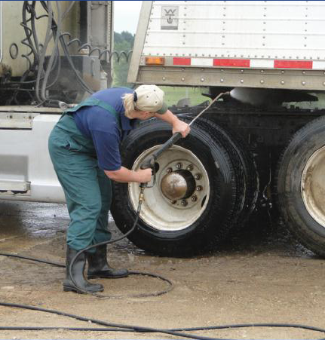
Unloading
Unloading procedures specified by facility
Unload close to the disposal site
Check for leaks
and cover integrity
Clean and disinfect after unloading
  Interior, exterior, undercarriage
  Tools and equipment
  Dispose of PPE
Notes:
Drivers must follow the unloading methods specified by the facility. Before unloading, check again for any leaks and the integrity of the lid or cover. Unloading of the vehicle should be conducted at or as close to the disposal site as practical. All biosecurity measures used to contain the pathogenic organism when loading must continue until disposal is complete. After unloading a container, the vehicle interior, exterior, and undercarriage must again be cleaned and disinfected. After delivering the last load of their shift, drivers should remove and properly dispose of PPE at the designated location and follow personnel cleaning and decontamination procedures outlined for the response situation. If facilities are available, drivers should shower and change into clean clothes before leaving their shift. Workers should also clean and disinfect any tools or equipment at the facility used during the loading process.

Slide 18
Resources for Off-Site Disposal and Transport
USDA Foreign Animal Disease Preparedness (FAD PReP) Guidelines: Disposal
  http://www.aphis.usda.gov/animal_health/
  emergency_management/nahems_guidelines.shtml
Carcass Disposal: A Comprehensive Review. USDA and Kansas State University
  http://fss.kstate.edu/FeaturedContent/
  CarcassDisposal/CarcassDisposal.htm
Notes:
This presentation provided a brief overview of the off-site animal carcass disposal processes of rendering and landfilling as well as biosecurity considerations for the transport of carcasses to these locations. For additional information on these topics, see any of these resources.

Slide 19
Acknowledgments
Development of this presentation was by the Center for Food Security and Public Health at Iowa State University through funding from the Multi-State Partnership for Security in Agriculture
Authors: Melissa Lang; Glenda Dvorak, DVM, MPH, DACVPM
Notes:
Information provided in this presentation was developed by the Center for Food Security and Public Health at Iowa State University College of Veterinary Medicine, through funding from the Multi-State Partnership for Security in Agriculture.

