Slide 1
Carcass Disposal
Composting
Notes:
June 2012
During an animal health emergency, there may be a need for animal carcass disposal measures. Catastrophic natural disasters or large-scale disease outbreaks can result in a large number of dead animals. In these situations, the disposal of animal carcasses and related materials in a timely, safe, biosecure, aesthetically acceptable and environmentally responsible manner will be necessary to prevent the spread of disease. This Just-In-Time training presentation will overview principles of composting as one method of carcass disposal during animal health emergencies.

Slide 2
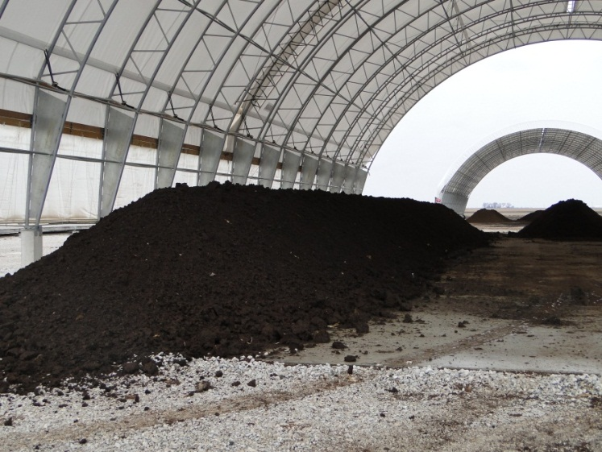
Composting
Carcasses layered
with organic material
  Thermophilic microbes
  Heat generation
  Accelerates biological
  decomposition
  Destroys pathogens
Relatively safe and simple
Nutrient rich, organic byproduct
  ‘humus’
Notes:
Composting is a carcass disposal method that uses naturally occurring microbes (bacteria and fungi) to decompose carcasses. The process generates elevated temperatures which destroys disease-causing organisms present in the carcasses. [Note: the decomposing bacteria are thermophilic – meaning they are able to grow and thrive in temperatures higher than 130ºF]. Composting is a relatively safe and simple method of disposal when compared to other carcass disposal methods. When done correctly, composting has the potential to result in a beneficial, nutrient rich, organic byproduct – called “humus” - that can be spread on cropland. [Note: This will not be allowed for cases of certain foreign animal diseases]. [Image shows an indoor compost pile that has been converted to ‘humus’. From Danelle Bickett-Weddle, Iowa State University]

Slide 3
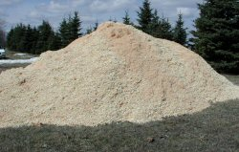
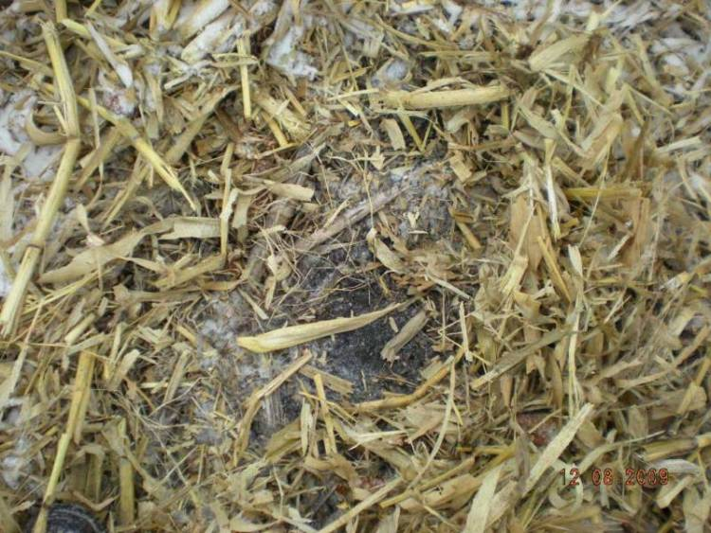
Compost Components
Nitrogen
  Carcasses, manure
Carbon
  Plant co-compost
    Sawdust, ground cornstalks,
    peanut hulls, mulch,
    poultry litter, leaves
  3-5 yards^{3/}1000# carcass
Carbon: Nitrogen ratio
  25:1 to 40:1 ideal
Notes:
Composting requires sources of nitrogen, carbon, moisture and oxygen for optimal tissue breakdown. Carcasses serve as the nitrogen source, while the addition of plant material (referred to as co-compost) serves to meet the carbon requirement. A proper balance of carbon and nitrogen is important for optimal microbial growth and rapid degradation of carcasses. A carbon:nitrogen ratio of 25:1 to 40:1 is considered optimal. Anything above or below this ratio will slow decomposition rates.
There are many possible carbon sources to be used in carcass composting. Co-compost materials may include sawdust or wood chips, ground cornstalks or corncobs, corn silage, peanut hulls, and mulch. Each varies in its carbon content as well as ability for fluid absorption and bulk-adding properties. Silage consistently produces the highest temperatures most quickly, and is the best material for composting cattle carcasses that may harbor disease. Cornstalks, straw, sawdust, wood shavings are considered nutrient poor co-compost materials, but are suitable for composting mortalities from non-disease incidents (e.g., fire, flood). Sawdust is particularly good for absorbing excess liquid released by decaying carcasses and is often used as a compost pile base layer. Wood chips or ground corncobs help to keep a compost pile porous, enabling the diffusion of oxygen into the pile and decomposition gases out of the pile. Poultry barn litter – a mixture of wood shavings and poultry manure – is the most common co-compost materials used for turkey and broiler carcasses. Mixing two or three types of co-compost materials can provide a better balance of properties. In general, one can expect to use 2-3 pounds of carbon source per pound of carcass. Composting may require 3-5 cubic yards of cover materials per 1000# carcass.

Slide 4
Moisture
Moisture – 40-60%
  Crucial for microbial growth
  < 40%
    Slower degradation
  > 60%
    Fills air pockets, less oxygen/air flow
    Slower degradation
Notes:
The moisture content of the pile is another crucial element for the composting process. Lack of sufficient water will impact the survival of the decomposing bacteria. Moisture should be in the range of 40-60%. Lower levels of moisture will still allow for degradation but at a slower rate while higher levels of moisture will fill in air pockets in the compost pile and decrease oxygen presence and air flow, also resulting in slower degradation. The compost should be moist but not soggy. If moisture can be squeezed from a handful of compost material, it is too damp.

Slide 5
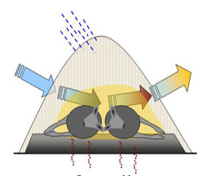
Oxygen
Maintains aerobic
environment
5% ideal
Dependent on
pile porosity
  Encourage natural air flow
Aeration
  Forced: use of fans
  Active: mechanical turning
  Passive: air exchange within pile
Notes:
For successful composting, oxygen is also necessary to maintain an aerobic environment for the rapid growth of the decomposition microbes. A 5% oxygen level is ideal. If oxygen levels drop too low, anaerobic (low oxygen) bacteria will become more prevalent. This can result in greater production of odorous gasses. The oxygen available for composting is dependent upon the porosity of the pile. Aeration of compost materials may be forced, active or passive. Forced aeration involves a mechanized method using large fans and ductwork. Active aeration uses mechanical turning of the composted material. It is important to avoid pathogen dispersion by these methods. Passive aeration involves air exchange – either by diffusion or aided by wind – within the composting material. Fresh air is pulled into the lower portion of the pile as heat takes gases out of the upper portion of the pile. Properly shaped piles using gas-permeable co-compost materials will allow natural diffusion of air into the pile and gaseous decomposition products out of the pile. Using course textured materials (such as wood chips or chopped corn stalks) on the bottom layer encourages natural air flow. (Photo from Dr. Tom Glanville, Iowa State University, Department of Agricultural and Biosystems Engineering)

Slide 6
Composting Process
1st phase – aerobic
  Oxygen dependent
  High temperature (135-140ºF)
  3-12 weeks
  ~50% reduction in biodegradable solids
2nd phase – curing
  Lower temperature (77-86ºF)
  10-240 days
  Aeration less critical
  Bulk density reduced 25%
Notes:
The composting process consists of two phases – an active phase and a curing phase. The first phase – or active phase – is an aerobic (oxygen dependent) process. Adequate aeration and moisture during this phase is vital to maintain uniform temperature and promote rapid degradation of carcasses. Timely aeration and moisture additions will allow active composting to continue in repeated heat cycles for months and minimize total composting time.
This phase of the process generates high temperatures. Heat is an important byproduct of the bacterial activity occurring in the pile, which helps to kill disease-causing microorganisms and results in a large reduction of biodegradable solids. The volume and weight of the pile can decrease as much as 50 percent. The degradation process will decrease pile porosity and subsequently, limit available oxygen due to the lack of air spaces. Co-compost material will also settle during the degradation process. This may result in cracks or openings in the piles allowing scavenger or insect invasion. Extra co-compost material should be kept on hand to add to the pile to handle these situations.
The desired core temperature of the compost pile is between 135-140ºF. Depending on the size of carcass biomass – this temperature should optimally be maintained for a length of time. For small- and medium-sized carcasses, the active composting periods may be up to three months before the pile is turned. However for a large carcass, the active composting phase may be up to six months. Following the active composting phase, additional time (days to weeks) may be needed for small- and medium-sized carcasses to complete decomposition, while large carcasses may require months. Phase I, ends when the soft tissues are degraded and the bones are clean.
Following the first phase, the partially composted material is moved to a secondary bin or location for the curing phase. This mechanical movement also serves to break up the pile, redistribute excess moisture and introduce a new oxygen supply. Caution should be taken when turning piles during a disease outbreak situation, as this may increase the risk of generation and release of airborne particulates that carry infectious microbes.
The second phase – or curing phase – generates lower temperatures (77-86ºF) and slower biochemical reactions. Aeration during this phase is not as critical. Bulk density is reduced by 25%. Time to complete the second phase is dependent on carcass size and can vary from 10-240 days. The finished product – called “humus” – appears dark brown to black, and is free of unpleasant odor when turned. Overall, the decomposition rate of intact carcasses in properly managed compost piles is about 2.2# per day.
Each compost batch should undergo a minimum of three heat cycles (with temperatures over 130ºF) before final utilization as “finished” compost). It is important to monitor the nitrogen, carbon, oxygen, and water parameters, as well as temperature, frequently (e.g., daily) throughout the process.

Slide 7
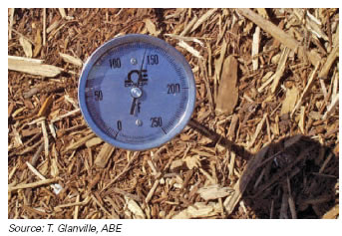
Temperature
Temperature range
  120-150ºF
  Monitor frequently
Inconsistent
throughout pile
  “cool zone” on surface
Ambient temperature can influence decomposition
Notes:
The temperature of the compost pile is a major factor to consider as it plays a role in destroying pathogens. It should be noted that temperature will not be consistent throughout the pile. The surface or external area of the pile – referred to as “cool zone” – will be cooler than the core. Creating a thick layer of compost materials helps to retain heat which is favored by the aerobic microorganisms in addition to promoting rapid decay and sufficient airflow.
Typical internal temperatures can range from 120ºF-150ºF. Long stem thermometers should be used to record the internal temperature of the pile so that necessary measures can be taken should it fail to meet recommended standards. To assure that recommended times and temperatures are reached, carcasses should be composted within 24 hours of the animal’s death and should not be allowed to freeze as extra time and heat will be required for thawing before decomposition can begin. Also, while a well constructed compost pile will not be greatly influenced by weather conditions, warmer weather can result in faster carcass decomposition; conversely, it may take longer in colder conditions. (Photo from Tom Glanville, Iowa State University)

Slide 8
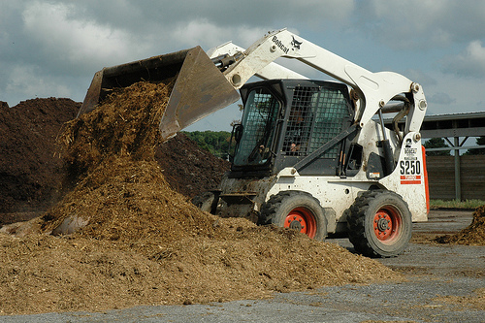
Mixing
Accelerates decomposition
When core
temperature
  > 140ºF
  <90ºF
  Form new
  windrow
  or transport to
  second bin
Notes:
The process of mixing, or turning over the compost pile may not be essential, however, it does help to accelerate decomposition by breaking up the pile and redistributing any pockets of moisture that will have formed. Turning should occur when the compost pile temperature exceeds 140ºF or drops below 90ºF. Acceleration of the decomposition process may also be achieved by grinding the remaining carcass tissue to increase surface area for bacterial digestion. The ground material is then mixed with co-compost material, and formed into a new windrow or pile. Testing compost piles for bacterial activity may be advised before the material is mixed or transported away from its current location. (Photo from Michigan State University)

Slide 9
Compost Design
Notes:
Next, lets look at elements of compost design.

Slide 10
Location
Indoors
Less affected by
  Weather, ambient temperature, wind, scavengers
Space limitations
Vehicle movement
Prolonged management and monitoring
Outdoors
Large animal
Cover to protect
  Weather
  Scavengers
Site location
  Away from public areas, animal areas, water sources
  Vegetated site
  Clay/impermeable base
Notes:
Composting may take place indoors or outside. Indoor composting has been widely used by the poultry industry for bird mortalities. Indoor composting is less affected by weather events, ambient temperatures and seasonality. The compost piles are more protected from wind, scavengers and drying conditions, providing ease of control over temperature and moisture levels. Challenges involve space limitations, restricted space for moving heavy equipment, and decreased naturally occurring moisture and air flow. Indoor composting also requires prolonged management, maintenance and monitoring.
Outdoor composting is typically used for larger carcasses. Site selection is critical. Select well-drained locations that are located away from public areas, animal production areas (water troughs, stock tanks), and ground and surface water sources. The site should be well vegetated to reduce the environmental impact. The vegetation will soak up pile leachate and keep it from draining into the water table or running off into surface water. Choosing a site where the soil contains some clay can provide a less permeable surface to place the pile. On-farm traffic patterns, equipment access, animal housing, feedstuff storage and movement, and adequate space are additional considerations. The composting process is very sensitive to environmental moisture, therefore, outdoor compost piles should be covered with a tarp or roof to minimize excess pile wetness and subsequent prolonged composting times. Covering carcasses with sufficient co-composting material also minimizes the attraction of flies and scavengers. Outdoor placement does have the advantage of being more adaptable for additional carcasses, as well as improved accessibility to the pile – usually from all sides.

Slide 11
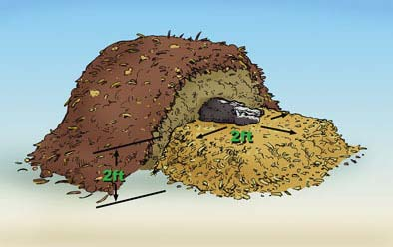
Basic Design
Base layer (18-24”)
  Porous
  Absorbent
Carcasses
  Whole or ground
  Caution if zoonotic
Notes:
The basic design of a compost pile starts with a base layer, which is made of a dry, carbon-rich, absorbent material, that is placed on top an impermeable material, such as soil or liner, to decrease ground water contamination. The base layer serves to provide sufficient air flow while protecting the surrounding environment by absorbing excess water and leachate, as well as being necessary for timely decomposition. This layer should be thick enough (at least 18 inches thick) and strong enough to support the weight of the carcass without being significantly compacted. The heavier the carcass, the thicker the base layer should be. Examples of excellent base materials are ground hay or straw, sawdust, nut hulls, or finished compost.
Next the carcass(es) are placed on the base layer at least 9 inches away from the edge. Tractors or skid loaders with buckets or forks on the front are common methods of moving large quantities or large sized carcasses during the compost process. Carcasses can be composted whole or to speed the process can be ground and mixed with co-compost prior to pile formation to improve microbial activity and decomposition. Whole carcasses should be lanced or vented to minimize bloating of the carcass and the accumulation of decomposition gases. If a zoonotic disease is suspected, lancing of carcasses should be avoided or minimized. Whole carcasses should be positioned so they do not touch each other; too many carcasses in one spot leads to localized wet spots and poor decay. [Image: This image shows a representation of compost pile layers. Source: Natural Rendering, Cornell Waste Management Institute]

Slide 12
Basic Design
Layer with co-compost (4-6”)
  5-7 feet high total
  12 inches on sides
Biofilter layer on top
  Weather dependent
    Cool weather-silage
    Warm weather-cornstalks
  Porous materials
    Absorbs moisture and promotes air flow
Notes:
Carcasses are then covered with 4-6 inches of co-compost material and surrounded by at least 12 inches of moistened, well mixed co-composting material. Incomplete coverage can lead to insect and scavenger problems. Layering of carcasses and co-compost materials continues until the bin or pile is 5-7 feet. In a properly operating compost process, new material added to the bins reaches temperatures of 120-150ºF within 24-48 hours.
For the co-compost cover layer, silage is better in cool weather as it can insulate heat 10-30ºC higher than most other materials; ground cornstalks are twice as permeable as silage and have a higher potential for heat loss, so work well in warmer weather. Using strong, porous structural materials, for the outer most cover layer, will serve aid in absorbing excess moisture from the surroundings before it deeply penetrates the pile and prevent leachate from seeping out and contaminating the environment. At the same time, it will still promote the desired air flow pattern of oxygen in and ammonia gas out.
To reduce odor and predator access even further, place a covering – or biofilter- layer of absorbent co-composting material over the entire compost pile. This can serve to deodorize gases released from active pile, maintain proper moisture, pH, nutrients and temperature, and enhance microbial activities of the pile. Thermometers should be inserted throughout the pile to monitor and confirm pile temperature.

Slide 13
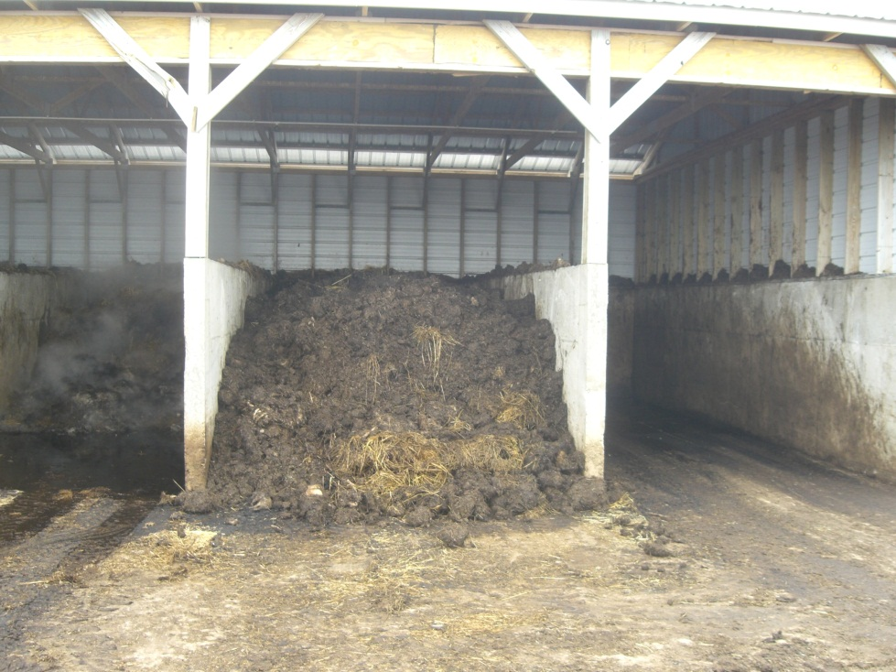
Pile Types: Bins
Construction
  Treated lumber
  or concrete
  3 sided, doors,
  drop-board front
  Size dependent on
  carcass size and
  equipment used
Secondary bins
  For mixing or storing co-compost
Decreases scattered material
Retains heat well
Notes:
Whether indoor or outdoor locations are selected, compost piles can be formed in bins, in open piles, in overlapping piles, or in windrows. Bins are most commonly constructed from treated lumber or concrete. They may be 3 sided, or equipped with doors or drop-board fronts to allow for easier access. Generally, multiple bins are constructed, to allow for movement and mixing of the pile during the composting process. These secondary bins can also be used for holding extra co-compost material for easy addition to composting piles when needed.
Carcass placement follows the basic design previously described – base layer, carcasses, co-compost. Carcass size will influence the overall area necessary for bin construction. Bin width must also be large enough to provide the farm machinery used easy access for loading and turning the pile. Carcasses should be placed at least 9-12 inches from the edge of the bin. Bin composting is beneficial because it decreases the risk of materials being scattered by the wind or predators and is particularly good at retaining heat to encourage rapid decay. [Photo from North Dakota State University]

Slide 14
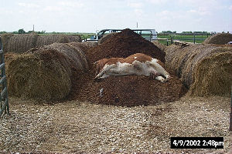
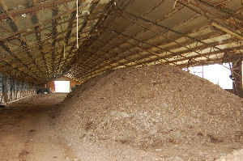
Pile Types: Open and Windrows
Size dependent
on carcass
  Place carcasses
  away from pile edge
  Thick cover layer
Management important
  Check temperature,
  monitor pile
  Add extra cover
  when necessary
Notes:
A conventional pile or windrow composting system is a better method for large animal carcasses. Piles and windrows are generally constructed in the open on compacted soil or a concrete floor. Walls and roofs are not generally used – thereby making ease of access to the pile easier.
Windrow composting involves making smaller but longer piles on the ground. The overall size of the windrow will be dependent on the size of the carcass it is encasing. Small and medium-sized carcasses can be placed in layers in windrows, but large carcasses need to be placed in a single layer.
The cover layer should be thicker than when using a bin since windrows are more prone to erosion from weather and invasion from scavengers. [Top photo shows open pile setup (cover layer is yet to be placed) from Saquib Mukhtar, Texas A&M via eXtension; Bottom photo shows an indoor composting windrow, from Josh Payne, Oklahoma State University via Iowa State University Extension]

Slide 15
Distributing Compost
FAD may make compost unsafe
for cropland
Soft tissue should be decomposed
Large bones should be buried
Nutrient levels should be tested
Reuse as compost cover material
Notes:
One of the benefits of composting is the end result of nutrient rich material that can be spread on cropland. Certain considerations need to be made before this is done. The practice of spreading the compost on fields is dependent on carcass disease status and decomposition effectiveness. The carcasses of animals euthanized because of certain foreign animal diseases cannot be spread onto fields because of the constant risk they are assumed to hold. Other diseases inflicting animals may require that the compost pile reach specified temperatures in a recommended period of time if they are to be used as a recycled fertilizer. Decomposition is also not considered complete until the flesh and other soft tissue is fully broken down. If large bones are still present in the compost pile, as is frequently the case with large animals, they should be buried before distributing the compost material. This will help avoid damaging tillage equipment and attracting scavengers. Since different cropland has different nutrient requirements, a sample of the compost product should be tested for nutrient presence and levels. Another option of utilizing the nutrients from the final product of composting is to reuse it as a cover material. This will only be effective if moisture levels are adequate and the same compost product is not reused too many times.

Slide 16
Considerations
Notes:
Now let’s look at some final considerations regarding composting as an animal carcass disposal method.

Slide 17
Composting Considerations
On-site process
Adaptable process
Nutrient rich end product
Transport of co-compost material
Regulations
Notes:
Composting is an on-site process that reduces biosecurity risks associated with transporting carcasses to additional locations. However, off-site carbon sources may still need to be obtained. Composting is an adaptable process, and pile length can be increased to accommodate additional carcasses. Another benefits of composting is the end result of nutrient rich materials (“humus”) that can be spread on cropland. [Note: This will not be allowed for cases of certain foreign animal diseases]. States may vary in their acceptance of composting procedures, or may regulate the composting parameters. Be sure to check for any local, state, or federal regulations associated with animal carcass composting before beginning procedures.

Slide 18
Record Keeping
Start date of each compost batch
Date and quantity of dead animal(s) or additions
Internal temperature of each active compost batch
  Measured, at minimum, weekly
Date compost material aerated
Notes:
Management of compost piles is important. Frequent checks are needed to monitor temperature and the condition of the compost pile. Maintenance may be needed and addition of extra cover materials, if parts of carcasses become exposed, excess moisture accumulates or odor develops.
Record keeping is also essential when composting. Information recorded should include:
The start date of each compost batch, the date and quantity of dead animal(s) or additions, and the date the compost material was aerated. Additionally, the internal temperature of each active compost batch should be measured, at a minimum, once a week and recorded.

Slide 19
Biosecurity
Responders must
  Wear appropriate PPE
  Follow movement control procedures
Vehicle cleaning and disinfection
Site security
Public perception
Notes:
During an animal disease emergency situation, biosecurity measures when composting will be of the utmost importance to protect against the spread of disease as well as reduce any risks to environmental, public and responder health. All responders should wear appropriate personal protective equipment when handling and working with carcasses. Any movement control procedures – for personnel or vehicles – must be followed. Any equipment or vehicles used for carcass disposal activities must be cleaned and disinfected following their tasks.
Site security will also be important. Access to the disposal site should be limited to only those necessary to the response procedures. A log book should be maintained to record vehicles and individuals entering and exiting the disposal site. Warning or restriction signs should be posted in an obvious location at the perimeters and entrances to the disposal site to discourage unauthorized visitors. The public’s perception of carcass disposal procedures is of utmost importance. Media may be helpful in raising public awareness – with appropriate messages. However, disposal sites should be protected from media personnel and the public. Care should be taken to limit photography/video.

Slide 20
Resources
USDA Foreign Animal Disease Preparedness (FAD PReP) Guidelines: Disposal
  http://www.aphis.usda.gov/animal_health/emrs/nahems.shtml
USDA Foreign Animal Disease Preparedness Standard Operating Procedures (SOP): Disposal
  http://www.aphis.usda.gov/emergency_response/tools/aphis_role_emergency_tools.shtml
Notes:
For more information on carcass disposal issues during an animal health emergency response, consult the USDA FAD PReP Guidelines and Standard Operating Procedures on Disposal.

Slide 21
Acknowledgments
Development of this presentation was by the Center for Food Security and Public Health at Iowa State University through funding from the Multi-State Partnership for Security in Agriculture
Authors: Jessica Kennicker, BS
Reviewer: Glenda Dvorak, DVM, MPH, DACVPM
Notes:
Information provided in this presentation was developed by the Center for Food Security and Public Health at Iowa State University College of Veterinary Medicine, through funding from the Multi-State Partnership for Security in Agriculture.

