Slide 1
Animal Welfare
During Animal Health Emergencies
Poultry
Notes:
June 2016
During animal health emergency situations – whether a natural disaster or infectious disease outbreak response – animal welfare issues must be considered and addressed. This Just-In-Time training will overview some of the pertinent animal welfare considerations for poultry during animal health emergencies.

Slide 2
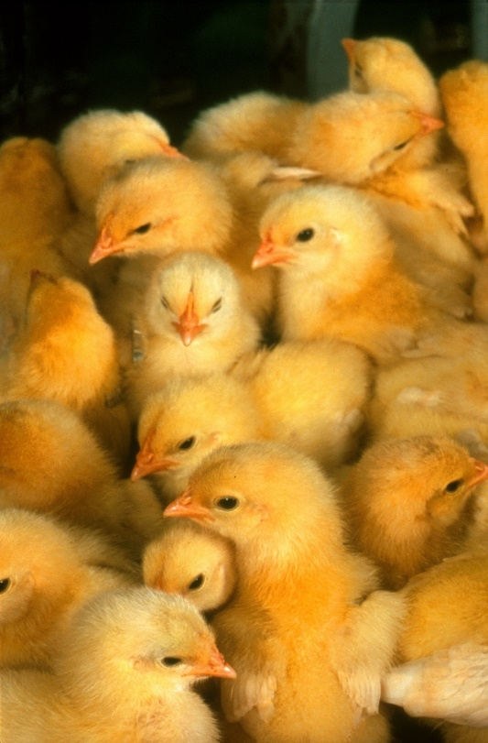
Animal Welfare
Ethical responsibility
Ensuring animal well being
  Physical and mental
Consideration of
  Health
  Behavior
  Biological function
Continuously evaluate
Notes:
Animal welfare is the ethical responsibility of ensuring the well-being of animals. It refers to the physical and mental state of the animal and includes consideration of the animal’s health, behavior and biological function. [Definition source: AVMA and American College of Animal Welfare] Responders should continuously evaluate animal welfare issues throughout the response and refine situations as needed. [Photo: This photo shows a group of young chicks. Source: United States Department of Agriculture]

Slide 3
The Five Freedoms
Define ideal states of welfare
Framework for analysis of welfare
  Freedom from hunger and thirst
  Freedom from discomfort
  Freedom from pain, injury, and disease
  Freedom to express normal behavior
  Freedom from fear and distress
Notes:
The “five freedoms” are internationally recognized ideal states of the welfare of animals. These principles can provide responders valuable guidance and a framework for determining and assessing animal welfare situations during animal health emergencies. The five freedoms include freedom from hunger and thirst, freedom from discomfort, freedom from pain, injury and disease, freedom to express normal behavior, and freedom from fear and distress.

Slide 4
Freedom from
Hunger and Thirst
Daily requirements vary
with species and age
Monitor feed/water intake
 | Water (per 100 birds per day) | Feed (per 100 birds per day)
Layer Chickens | 5 gallons | 17 pounds
Broiler Chickens | 5 gallons | 10 pounds
Turkeys | 12 gallons | 40 pounds
Notes:
Freedom from hunger and thirst addresses the provision of ready access to fresh water and diet to maintain health. During animal health emergencies, poultry quarantined or housed in temporary shelters will require food and water. When possible a commercial feed appropriate for the age and species of bird should be feed. Feed given should be of the proper ration for the stage of production birds are in. Feed consumption will vary with the age of the bird, as well as production type (e.g., broilers vs. layers). Approximate daily feed and water needs for poultry are shown on this slide. Clean, potable water should be supplied. When possible, waterers should be elevated to minimize waste from getting into the water. Water consumption for poultry will increase with hot weather conditions. Feed consumption will increase with extreme cold temperatures. Younger birds may have additional nutritional requirements. Poultry may not eat in stressful situations. Feed and water intake should be monitored daily. Since poultry are housed in large numbers, several water and feed sources should be available to reduce exclusion among the birds.
Water and feed requirements from the AVMA Emergency Preparedness and Response Guide at https://ebusiness.avma.org/login.aspx?rid=03&sid=193.

Slide 5
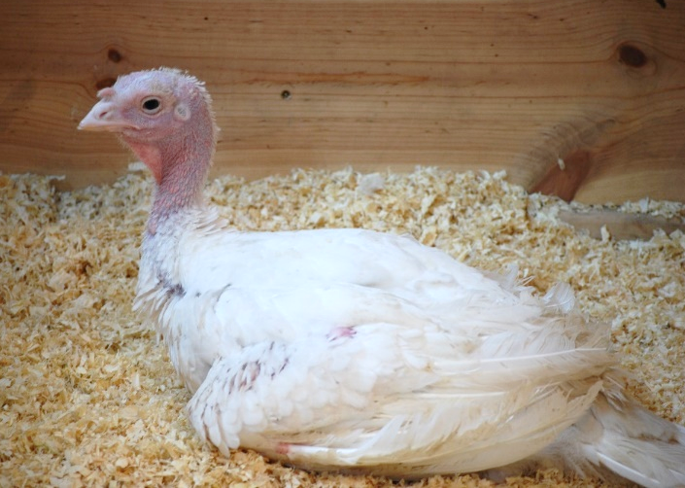
Freedom from
Discomfort
Appropriately sized confinement space
  Indoor housing
  Protection from elements
  Ventilation
  Temperature
Clean litter
  Wood shavings, paper by-products,
  hulls, ground corncobs, chopped straw
Avoid overcrowding
Waste Management
Notes:
Freedom from discomfort involves providing an appropriate environment, including shelter and a comfortable resting area. Most poultry, with the exception of backyard flocks, are housed indoors in a variety of cage types or on a bedded floor. Shelter for birds should provide protection from the elements, including inclement weather and predators. Housing should be large enough to accommodate the number of birds contained; multiple housing units may be needed. If birds are housed in cages, no bedding is required. If birds are housed on the floor, bedding or litter should be used to cover the floor. This litter can be made of a variety of materials, such as wood shavings, paper by-products, rice hulls, peanut hulls, ground corncobs, or chopped straw. Litter choices may depend on the region of the country. Overcrowded conditions should be avoided to reduce stress to the animals as well as decrease the potential of disease transmission. Ventilation and temperature must be controlled as they can contribute to both animal discomfort and mortality if not properly set and maintained. Proper air flow through the building should be ensured. Poultry are very temperature sensitive. Environmental temperature should be monitored to ensure proper settings. Extremes in temperatures can lead to animal mortalities. Animals should be routinely monitored for signs of heat stress in the summer or hypothermia in the winter. If signs are noted, prompt treatment should be initiated. If environmental conditions are cold, deep bedding will help birds withstand cold weather. Waste generated from the birds and litter should be disposed of properly and not allowed to pile up, causing problems.
[Photo: Turkey housed indoors. Source: Pam Zaabel/Iowa State University]

Slide 6
Freedom from
Pain, Injury, Disease
Examine upon entry/exit
  Illness
  Injury
  Nutritional well-being
Treat appropriately
  Medical, surgical
  Euthanasia
Monitor
May have delay in showing signs
Notes:
Animal welfare considerations should also address freedom from pain, injury and disease. Birds entering and exiting the shelter should be examined upon arrival by a veterinarian for any signs of disease or injury. Before placing poultry in the housing area, check for any items that might cause physical injury (e.g., nails, sharp objects, hazardous materials). When illness, injury, or other conditions threatening an animal’s welfare are noted, appropriate actions should be taken. This may include medical treatment or some situations may warrant humane euthanasia to end suffering. Be aware there may be a delay between the time of actual injury and the animal showing signs. Monitoring animal health before, during, and after sheltering is essential. Euthanasia may also be necessary to stop the spread of disease. When euthanasia is necessary, only approved methods should be used. The AVMA has guidelines on acceptable humane euthanasia methods for various animal species. When performing euthanasia procedures, it is of the upmost importance to ensure all activities are conducted in a humane manner, from animal restraint to methodology.

Slide 7
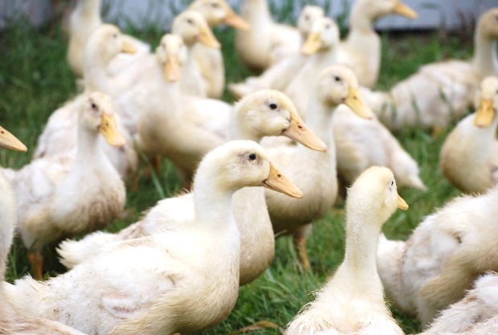
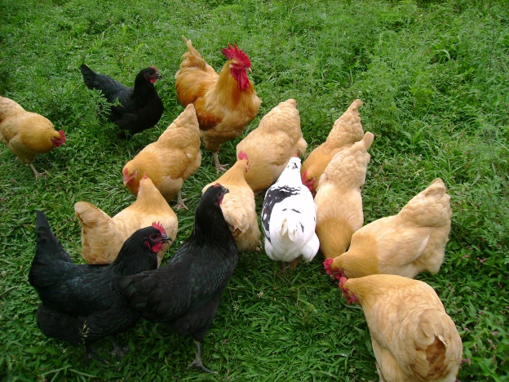
Freedom to
Express Normal Behavior
Flock animals
  Hierarchy
Natural behavior
  Preening, dust bathing
  Foraging
  Nesting, perching
Separate birds by
  Farm of origin
  Pre-established groups
Notes:
Another animal welfare state is the freedom to express normal behavior, both individually and in groups. Animal behavior can be abnormal in times of stress, such as animal health emergencies. New surroundings coupled with an increase in handling and transport may increase stress on animals and alter the way an animal acts. Poultry tend to gather in groups and stay together as a flock. Poultry have the natural behavior to preen their feathers or dust bathe as grooming rituals, forage for food, nest for egg laying, or perch on various surfaces. Birds should be grouped based by their farm of origin and whenever possible, any pre-established groupings. Mixing of flocks should be avoided.
[Photo: (Top) Pre-established group of ducklings. Source: Pam Zaabel/CFSPH, Iowa State University; (Bottom): A pre-established group of chickens. Source: United States Department of Agriculture]

Slide 8
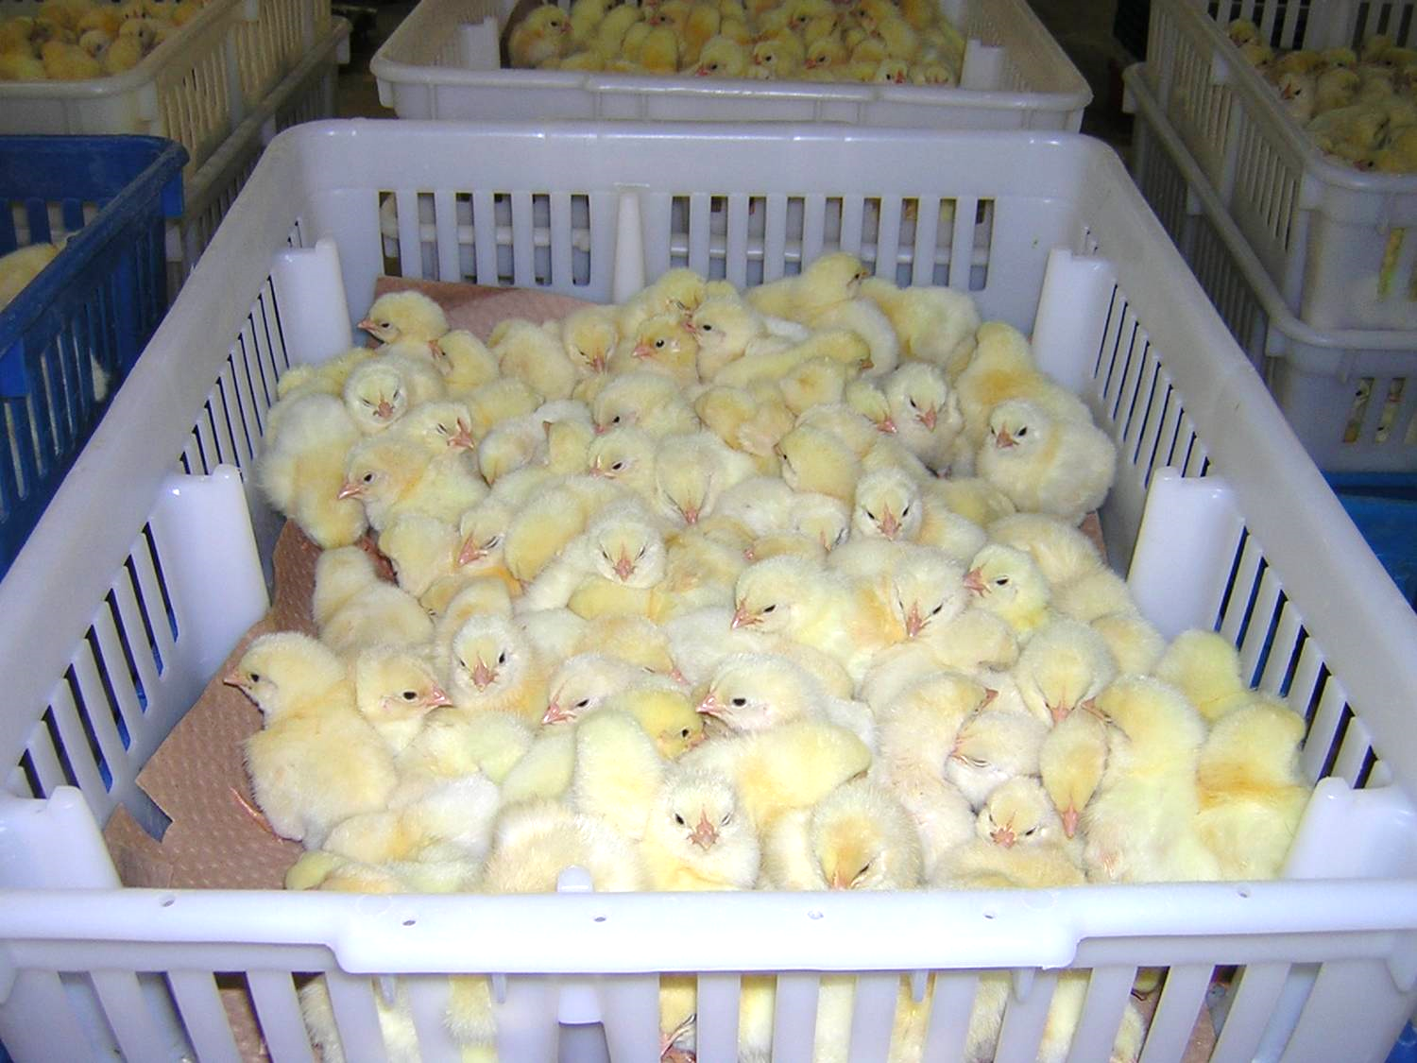
Freedom from
Fear and Distress
Humane handling
  Experienced handlers
Humane euthanasia
Avoid startling or
sudden movements
  “Pile ups” can cause
  injury or suffocation
  of birds on the bottom
Safe transport
  Avoid overcrowding
Notes:
Finally, the freedom from fear and distress addresses the conditions and treatment which avoids mental suffering, and includes humane handling and, when needed, humane euthanasia. Appropriate handling can minimize stress and leads to better overall health and welfare. Only experienced handlers should with poultry should handle these animals in animal emergency situations, so animals are under the least amount of stress as possible. When moving poultry, use gentle movements. Sudden movements can panic the entire flock. This can result in “piling up” and potential injury or suffocation of the birds on the bottom of the pile.
If poultry are to be transported from one site to another, only transport vehicles appropriate for the species should be used and should not be overcrowded.
[Photo: A group of chicks being transported in a basket. Source: United States Department of Agriculture]

Slide 9
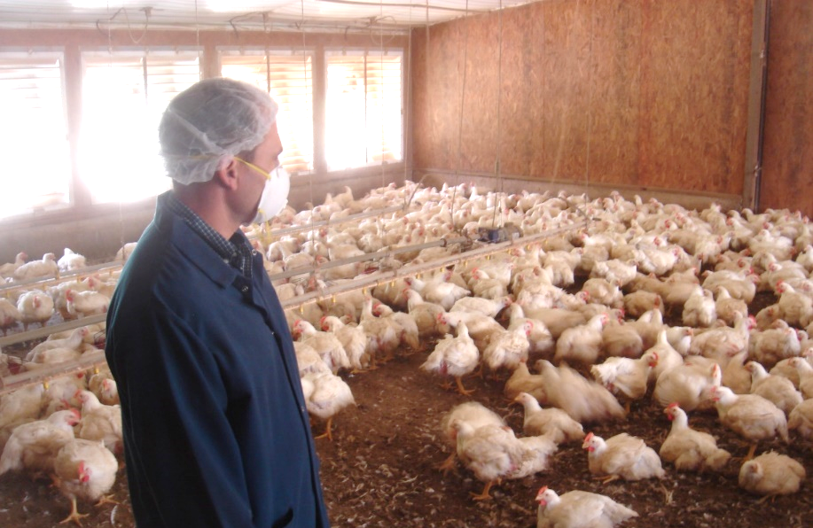
Responders:
Mental Health and Animals
Response stress
  Can affect
  responder
  mental health
  May affect
  animal welfare
    Responder apathy
    Responder fatigue
    Uncompleted tasks
    Carelessness of tasks
    Forgetting overall welfare needs
Notes:
In times of emergency, stress is on the rise for all involved; emergency responders are no exception. Their mental health can be adversely affected by long hours, emotional stress, and the seriousness of the disaster. When responders begin to succumb to these factors, it can adversely affect animal welfare. This may manifest itself in responder apathy, fatigue, uncompleted tasks, carelessness of tasks, and forgetting the overall welfare needs of the animals involved. Know how to recognize signs of stress and fatigue in yourself and others. Take appropriate actions to reduce stress. [Photo: Veterinarian interacting with poultry in a stressful situation. Source: Don Ritter]

Slide 10
Resources
American Veterinary Medical Association
  The veterinarian’s role in animal welfare
    www.avma.org/products/animal_welfare/welfare.pdf
  AVMA Guidelines on Euthanasia
    www.avma.org/issues/animal_welfare/euthanasia.pdf
USDA Animal Welfare Information Center
  http://awic.nal.usda.gov
OIE Animal Welfare Guidelines
  Terrestrial Animal Health Code
    www.oie.int
American College of Animal Welfare
  www.acaw.org
Notes:
In this presentation, we briefly reviewed some of the poultry animal welfare considerations during an animal health emergency. For more information on this topic, consult these additional resources.

Slide 11
Acknowledgments
Development of this presentation was by the Center for Food Security and Public Health at Iowa State University through funding from the Multi-State Partnership for Security in Agriculture
Authors: Abbey Smith, BS; Glenda Dvorak, DVM, MPH, DACVPM
Notes:
Information provided in this presentation was developed by the Center for Food Security and Public Health at Iowa State University College of Veterinary Medicine, through funding from the Multi-State Partnership for Security in Agriculture.

