Slide 1
Animal Welfare
During Animal Health Emergencies
Notes:
October 2010
During animal health emergency situations – whether a natural disaster or infectious disease outbreak response – animal welfare issues must be considered and addressed. This Just-In-Time training will overview some of the pertinent animal welfare considerations during animal health emergencies.

Slide 2
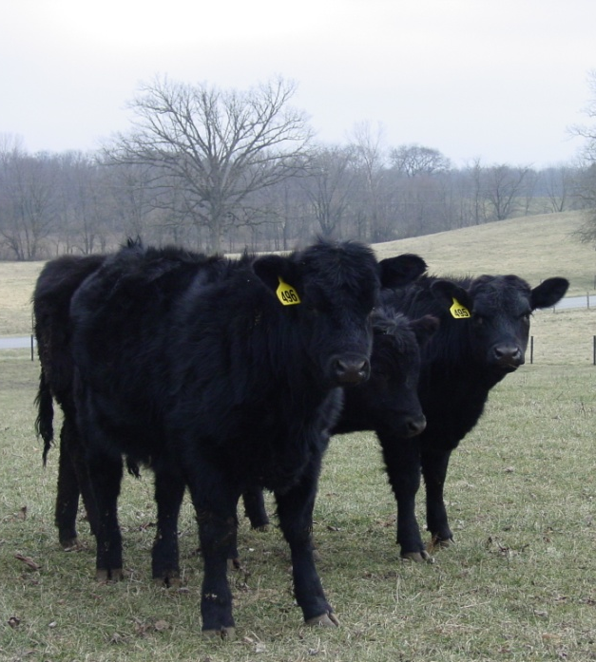
Animal Welfare
Ethical responsibility
Ensuring animal well being
Physical and mental
Consideration of animal’s
  Health
  Behavior
  Biological function
Notes:
Animal welfare is the ethical responsibility of ensuring the well-being of animals. It refers to the physical and mental state of the animal and includes consideration of the animal’s health, behavior and biological function. [Definition source: AVMA and American College of Animal Welfare] (Photo courtesy of Dr. Danelle Bickett-Weddle, Iowa State University)

Slide 3
The Five Freedoms
Define ideal states of welfare
Framework for analysis of welfare
  Freedom from hunger and thirst
  Freedom from discomfort
  Freedom from pain, injury and disease
  Freedom to express normal behavior
  Freedom from fear and distress
Notes:
The internationally recognized ‘five freedoms’ define the ideal states of the welfare of animals, but provide valuable guidance and a framework for determining and assessing animal welfare situations. The five freedoms are freedom from hunger and thirst (by providing ready access to fresh water and a diet to maintain health a vigor), freedom from discomfort (by providing an appropriate environment, including shelter and a comfortable resting area), freedom from pain, injury and disease (by prevention or rapid diagnosis and treatment), freedom to express normal behavior (by providing sufficient space, proper facilities and company of the animal’s own kind), and freedom from fear and distress (by ensuring conditions and treatment which avoid mental suffering, such as humane handling and humane euthanasia).

Slide 4
Welfare During Emergencies
Animals
  Behavior, health, comfort, euthanasia
Environment
  Transport, fencing, restraint, food/water
Human Interaction
  Experience, proper training,
  mental health
Notes:
Let’s look at these aspects as they apply to animal health emergency situations. Note that animal welfare issues should be continuously evaluated throughout the response and when indicated, refined or replaced as necessary. Animal welfare evaluations during emergency situations can be broken into three broad categories. First, welfare must be looked at from the animals’ perspective. Aspects such as behavior, comfort, health, and humane euthanasia must be addressed. Secondly, facilities in which animals are transported and held must be evaluated. Transport vehicles, fencing, restraint, and food and water need to be adequate. Finally, the way in which responders and handlers interact with the animals should be addressed. Experience and training are vital in protecting the welfare of animals. Responder mental health can also affect animal welfare factors. These will be explained further in the next slides.

Slide 5
Animal Considerations
Behavior
Health
Comfort and Maintenance
Euthanasia
Notes:
Welfare factors addressing animal considerations include behavior, health, comfort and maintenance and euthanasia issues.

Slide 6
Animal Considerations: Behavior
Can deviate from normal behavior
  Heightened awareness and panic
  New surroundings
  Increased handling/transport
  Species specific
Unpredictable actions
  May injure self or others
  Be watchful and prepared
Notes:
Knowledge and understanding of normal behavioral patterns (e.g., herd versus solitary behavior) may help to determine and anticipate the reactions of animals in emergency situations, as well as aid in minimizing levels of stress. Animal behavior can be abnormal in times of stress. The resulting heightened sense of awareness can easily cascade into panic. If one animal in herd panics the rest of the animals may follow suit. New surroundings coupled with an increase in handling and transport may alter the way animals act. The resulting unpredictable actions may be harmful not only to the animal but also other animals in the group as well as responders. Behavioral responses to stressful situations will vary among species. Therefore, it is important to be watchful and prepared for unpredictable animal behavior, regardless of the species you are working with and make efforts to minimize stress on the animals being handled.

Slide 7
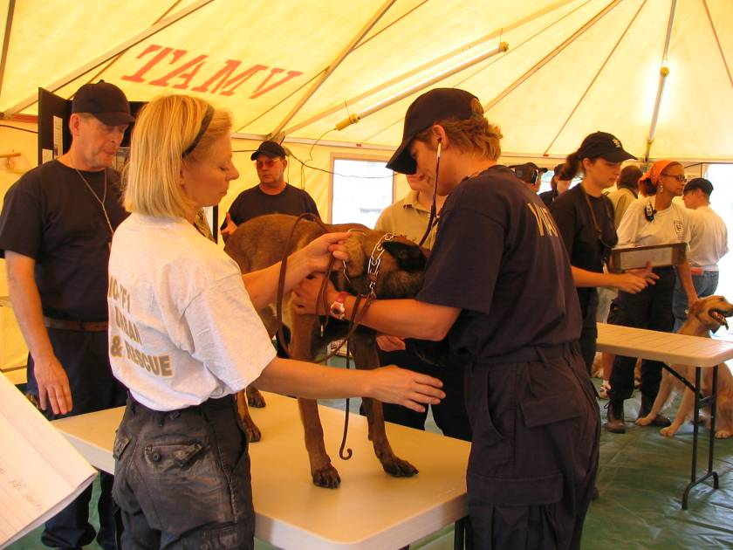
Animal Considerations:
Health
Monitor at all times
  Illness
  Injury
  Parturition
  Nutritionally
May have delay in showing signs
  Stress analgesia
Treat appropriately
  Medically, surgically, or euthanasia
Notes:
Health monitoring of the animals must be conducted throughout the response. Routine non-invasive monitoring will reveal subtle signs of illness in the individual and the herd. Signs of injury should also be looked for. In addition, monitoring of pregnant, or potentially pregnant, animals is essential. Some animals may show a delay between the time of actual injury and showing signs due to a phenomenon known as stress analgesia. Therefore, you must be extra aware of animal health before, during, and after transport and sheltering. The sooner illnesses and injuries are seen, the less suffering an animal will endure. When illnesses, injuries, and other situations threatening to the animal’s welfare are noted, the appropriate actions should be taken. The appropriate action may range from medical treatment to surgical treatment to euthanasia. (Photo courtesy of Dr. Danelle Bickett-Weddle)

Slide 8
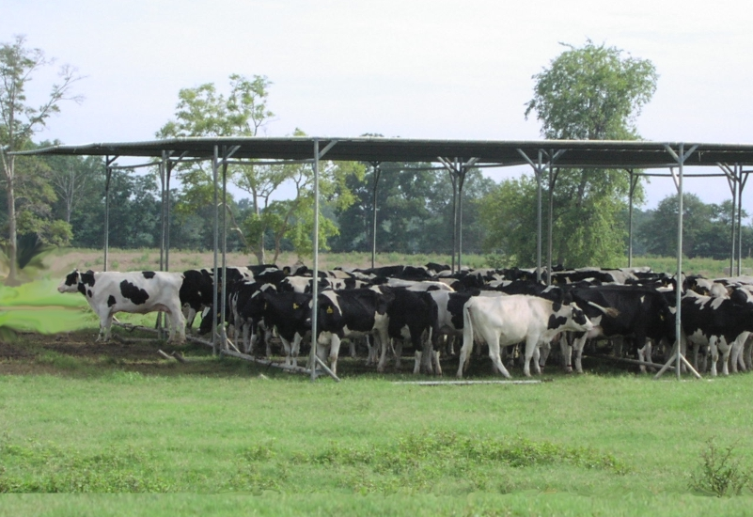
Animal Considerations:
Comfort and Maintenance
Density
  Avoid overcrowding
Stalls
  Bedding, manure
Temperature
  Excessive heat, cold
Maintenance needs
  Milking lactating animals
  Exercise for horses
Notes:
Welfare consideration must address the comfort and maintenance for the animals being housed or sheltered. Animal density of animals should be assessed; these will vary with species. Overcrowding situations should be avoided to allow for reduced stress to the animals as well as decreased disease transmission. Stalls should be suited to the sheltered species and should be regularly maintained by providing bedding and removing manure. Environmental temperature should be monitored to ensure proper settings. Extremes in temperatures can lead to animal mortalities. Animals should be routinely monitored for signs of heat stress in the summer or hypothermia in the winter. If signs are noted, prompt treatment should be initiated. Some animals that will be housed during animal health emergencies will have specific maintenance needs to address. Lactating animals, such as dairy cattle, will need to be milked; some equines may require exercising. (Photo courtesy of Dr. Danelle Bickett-Weddle)

Slide 9
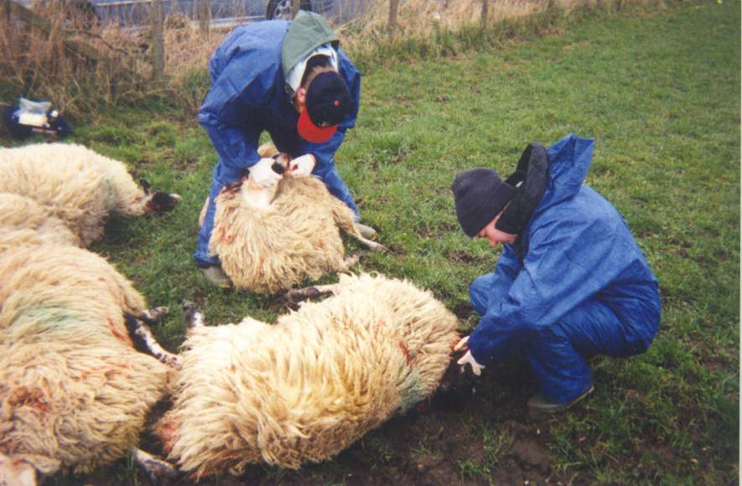
Animals:
Euthanasia
Can be necessary
  Stop disease spread
  Minimize suffering
Proper method
and technique
  AVMA euthanasia
  guidelines
Ensure the kill
Third person observer
Evacuate vs. euthanize
  Potential for future suffering
Notes:
In some animal health emergency situations, euthanasia may be necessary to stop the spread of disease or minimize suffering. When euthanasia is necessary, only approved methods should be used also with proper technique. The AVMA has guidelines on acceptable humane euthanasia methods for various animal species. When performing euthanasia procedures, it is of the upmost importance to ensure all activities are conducted in a humane manner, from animal restraint to methodology. Incomplete euthanasia can lead to profound suffering and must to be avoided. In times of mass depopulation, a third person observer may be necessary to ensure that euthanasia is being performed properly and that animal welfare remains a concern throughout the process. At times, the difficult decision of whether to evacuate or euthanize a healthy animal may have to be made. When this situation arises, it is important to weigh the potential for future suffering. (Photo: Foam euthanasia product courtesy of Dr. Dan Wilson, North Carolina)

Slide 10
Environmental Considerations
Transport
Facilities
Separation of Groups
Notes:
Next let’s look at some of the environmental considerations relating to animal welfare issues. These include transport, facilities, quarantine, and the separation of groups.

Slide 11
Environment:
Transport
Identification
  Consistent with Incident Action Plan
Grouping
  Familiar animals, no mixing
Proper handling
  Prevent panic with quiet handling
Safe equipment
  Ramps, trucks, crates
Increased panic = unpredictability
Notes:
If animals are to be transported from one site to another location (e.g., animal evacuations) certain welfare aspects need to be addressed, monitored, and implemented. There are many issues to consider when transporting animals. Adequate identification of the animals is vital to a successful evacuation. Grouping of some species of animals may be helpful in preventing chaos during transport. However, only familiar animals should be grouped together while mixing should be avoiding. Proper handling is key and movement of animals should be done with the least amount of stress possible. This is accomplished by ensuring that only properly training responders handle animals. Ramps, shoots, trucks, crates and other equipment used in transporting animals should be safe so that animals do not injure themselves. Anytime unfamiliar people move animals to unfamiliar places panic may be increased, which can lead to unpredictable actions. Therefore, one must remain cautious when transporting animals.

Slide 12
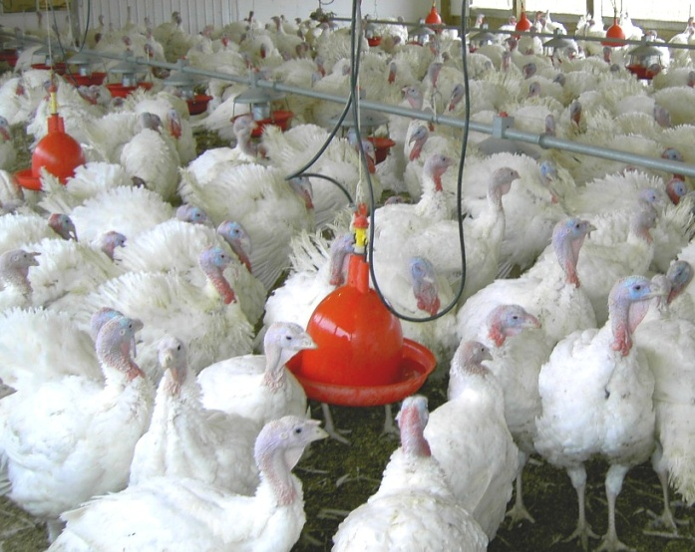
Environment:
Facilities
Food, water
Fencing
  Keep animals in
  Keeps wildlife out
Stalls
  Adequate space
  Separation
Environmental concerns
  Temperature
  Ventilation
Foreign objects
  Metal and other hazardous material
Notes:
Facilities will play a large role in animal evacuations and quarantines. Whether using a makeshift facility as temporarily housing or using an animal’s existing shelter for quarantine, several elements needs to be considered. Food and water will be essential for the health and well-being of the animal. Fencing of the are will be needed to prevent the escaping as well as keeping wildlife and predators out. In addition to keeping the animal confined, stalls must allow for enough space for the animal to be comfortable and must provide enough separation from other animals, especially with dealing with intact males. Ventilation and temperature must be controlled as they can contribute to both animal discomfort and mortality if not properly set and maintained. The site should be scanned for foreign objects before animals are housed there. Foreign objects may include things like metal scraps or other hazardous materials that may injure the animal. Finally, sites must possess equipment that is used to maintain animals. A prime example of this is having adequate milking equipment when housing dairy animals. (Photo courtesy of the USDA).

Slide 13
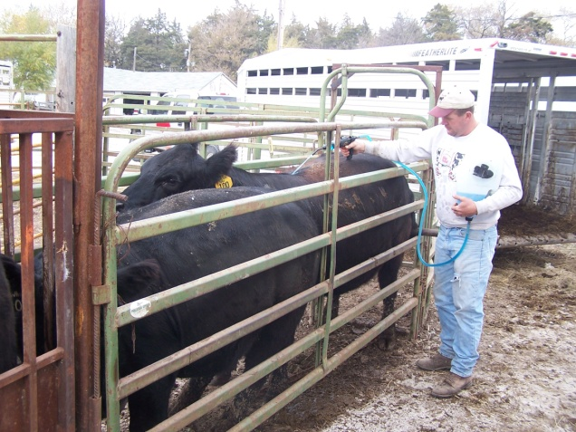
Environment
Separation of Groups
Consideration
when sheltering
  Species dependent
    Cattle vs. Horses
  Sex dependent
    Intact males
  Life Stage dependent
    Neonates, pregnant animals
  Health and at-risk status
    Sick vs. healthy vs. exposed
Notes:
An important consideration when moving and sheltering animals is to separate them out into the appropriate groups. Separation, or lack thereof, can directly affect welfare. Different species will have different grouping requirements. Horses may require individual housing while cattle can usually be grouped together. The sex of the animal also needs to also be considered, as it is usually inappropriate to house intact males together or with females. Life stage is another important consideration. Neonates need to be housed with their mothers for most species, such as beef cattle. Likewise, pregnant animals will need special housing and grouping. Finally, grouping by health status is vital to maintain herd health status. Sick animals should be kept away from healthy ones and exposed animals need to be completely separated from both sick and healthy animals. (Photo courtesy of Dr. Buss)

Slide 14
Human interaction
Handling
Mental Health
Notes:
Human interaction with animals also plays into animal welfare issues. Humane handling of animals at all times is essential. This may become an issue during the strain and stress of emergency response situations.

Slide 15
Human Interaction:
Handling
Proper handling minimizes stress
Responders with experience
  Need to know species
Recognize unique situations
  Do not hesitate to consult expert
Notes:
Proper handling is key when dealing with animal welfare during emergency response situations. The animals are already stressed when being moved or handled. Appropriate handling minimizes the level of stress and leads to better overall health and welfare. Responders that are responsible for moving animals need to have experience handling the species they are working with. Experience lends itself to proper handling and keeps both the animal and the responder safe. Responders also need to recognize situations that require moving unique animals (e.g., elk, bison) and consult an expert who has experience with the species.

Slide 16
Human Interaction:
Mental Health and Animals
Response stress can affect mental health of responders
May affect animals welfare
  Responder apathy
  Responder fatigue
  Uncompleted tasks
  Increased carelessness of tasks
  Forgetting overall welfare needs
Notes:
In times of emergency, stress is on the rise for all involved. Emergency responders are no exception. Their mental health can be adversely affected by long hours, emotional stress, and the seriousness of the disaster. When responders begin to succumb to these factors, it can adversely affect animal welfare. This may manifest itself in responder apathy, fatigue, uncompleted tasks, carelessness of tasks, and forgetting the overall welfare needs of the animals involved.

Slide 17
Summary
Animal welfare during emergencies
  Five Freedoms
  Animal considerations
  Environment
  Human Interactions
Notes:
In this presentation, we briefly reviewed some of the animal welfare considerations during an animal health emergency. Using the five freedoms, evaluation of animal welfare issues during the response can easily be assessed. Aspects involved include the various animal and environmental considerations as well as issue involving human interaction.

Slide 18
Resources
American Veterinary Medical Association
  The veterinarian’s role in animal welfare
    www.avma.org/products/animal_welfare/welfare.pdf
  AVMA Guidelines on Euthanasia
    www.avma.org/issues/animal_welfare/euthanasia.pdf
USDA Animal Welfare Information Center
  http://awic.nal.usda.gov
OIE Animal Welfare Guidelines
  Terrestrial Animal Health Code
    www.oie.int
American College of Animal Welfare
  www.acaw.org
Notes:
For additional information on animal welfare issues in general, and as they pertain to animal health emergencies, consult these additional resources.

Slide 19
Acknowledgments
Development of this presentation was by the Center for Food Security and Public Health at Iowa State University through funding from the Multi-State Partnership for Security in Agriculture
Authors: Dan Taylor, DVM, MPH, Glenda Dvorak, DVM, MPH, DACVPM
Reviewers: Suzanne Millman, PhD; Jan Shearer, PhD
Notes:
Information provided in this presentation was developed by the Center for Food Security and Public Health at Iowa State University College of Veterinary Medicine, through funding from the Multi-State Partnership for Security in Agriculture.

