Slide 1
Animal Welfare
During Animal Health Emergencies
Livestock
Notes:
June 2014
During animal health emergency situations – whether a natural disaster or infectious disease outbreak response – animal welfare issues must be considered and addressed. This Just-In-Time training will overview some of the pertinent animal welfare considerations for livestock during animal health emergencies.

Slide 2
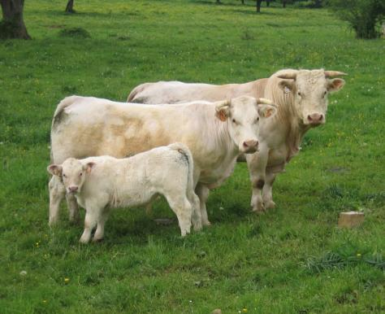
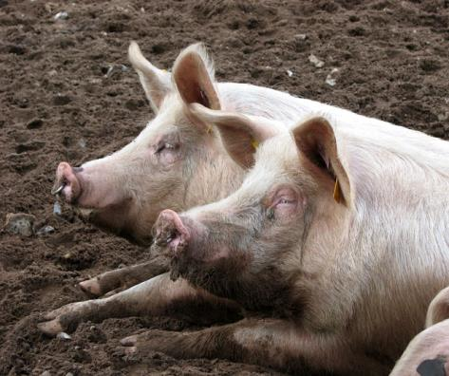
Animal Welfare
Ethical responsibility
Ensuring well being
  Physical and mental
Consideration of
  Health
  Behavior
  Biological function
Continuously evaluate
Notes:
Animal welfare is the ethical responsibility of ensuring the well-being of animals. It refers to the physical and mental state of the animal and includes consideration of the animal’s health, behavior and biological function. [Definition source: AVMA and American College of Animal Welfare] Responders should continuously evaluate animal welfare issues throughout the response and refine situations when indicated. [Photo: (Top) Bull, cow and calf. Source: Sunny Ripert/Flicker Creative Commons at https://www.flickr.com/photos/sunfox/17620516/; (Bottom) Pigs resting in the mud. Source: EvelynSimak/www.geograph.org.uk_CreativeCommons]

Slide 3
The Five Freedoms
Define ideal states of welfare
Framework for analysis of welfare
  Freedom from hunger and thirst
  Freedom from discomfort
  Freedom from pain, injury, and disease
  Freedom to express normal behavior
  Freedom from fear and distress
Notes:
The “five freedoms” are internationally recognized ideal states of the welfare of animals. These principles can provide responders valuable guidance and a framework for determining and assessing animal welfare situations during animal health emergencies. The five freedoms include freedom from hunger and thirst, freedom from discomfort, freedom from pain, injury and disease, freedom to express normal behavior, and freedom from fear and distress.

Slide 4
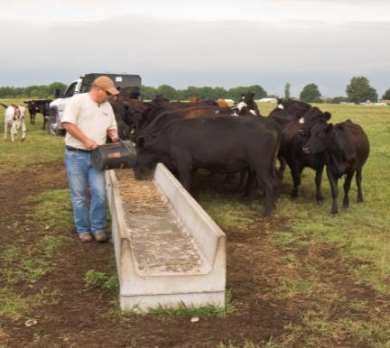
Freedom from
Hunger and Thirst
Daily requirements
vary with species and age
Monitor feed/water intake
 | Water (per head per day) | Feed (per head per day)
Cattle | 6-9 gallons | 8-20 pounds hay
Pigs | 1-3 gallons | 3 pounds grain
Sheep Goats | 3 quarts | 3 pounds hay
Notes:
Freedom from hunger and thirst addresses the provision of ready access to fresh water and diet to maintain health. During animal health emergencies, livestock will require food and water. Daily requirements will vary with species and age of the animal. Cattle will require forage, such as grass or hay. Cattle will consume 8-20 pounds of hay per head per day and 6-9 gallons of water per head per day, depending on age. Pigs will require 1-3 gallons of water and 3 pounds of grain per head per day. Sheep and goats will need 3 quarts of water and 3 pounds of hay per head per day. Water consumption for animals will increase with hot weather conditions. Feed consumption will increase with extreme cold temperatures. Younger animals may have additional nutritional requirements. Animals may not eat in stressful situations. Feed and water intake should be monitored daily. If animals are stabled in large groups, several water sources and feed sources should be available to reduce territoriality and exclusion among the animals. For specifics on nutritional requirements of various species during animal health emergencies, see the AVMA Emergency Preparedness and Response Guide at https://ebusiness.avma.org/login.aspx?rid=03&sid=193. [Photo: Cattle being fed. Source: Bob Nichols/USDA; Data source: Preparing the Farm and Farm Animals for Disaster. http://www.nal.udsa.gov/awic/pubs/IACUC/dis.htm ]

Slide 5
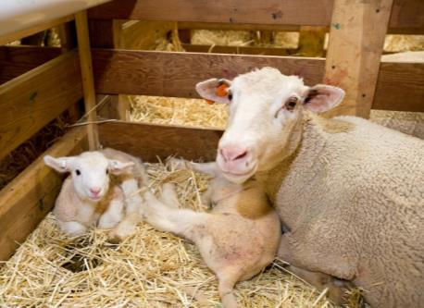
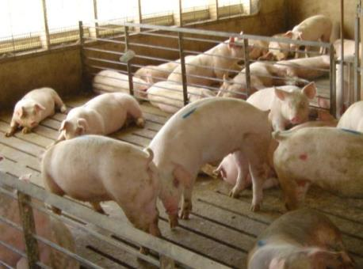
Freedom from
Discomfort
Appropriately sized confinement space
  Stalls or outdoor pens
  Protect from elements
  Appropriate temperature
  for time of year
  Ventilation
Bedding
  Saw dust
  Wood chips
  Straw
Waste management
Notes:
Freedom from discomfort involves providing an appropriate environment, including shelter and a comfortable resting area. If animals are housed indoors, sufficient ventilation and temperature control within the building are critical in order to prevent discomfort or even mortality. Any sheltering facility should provide protection from the elements, including inclement weather and predators. Housing areas should be large enough to accommodate laying down and turning around. Stalls should be bedded with saw dust, wood chips, or straw and cleaned daily for hygienic purposes. Attention to ventilation will be important to maintain adequate air flow throughout the building. If animals are housed outdoors, adequate wind protection and shade should be provided. Be sure to account for the seasonal temperature changes and provide fans, shade, and heaters, if needed. Heat stress is a significant concern for pigs. Overcrowded conditions should be avoided to avoid stress to the animals as well as to decrease potential for disease transmission. Before placing animals in the housing area, check for any items that might cause physical injury (e.g., nails, sharp objects, hazardous materials). Lactating diary cattle will need milked routinely to ensure comfort and prevent health impacts. Dairy breeds of goats will also require milking. [Photo: (Top) Ewe and lambs. Source: Stephen Ausmus/USDA ARS; (Bottom) Pigs in an indoor facility. Source: Alex Ramirez/Iowa State University]

Slide 6
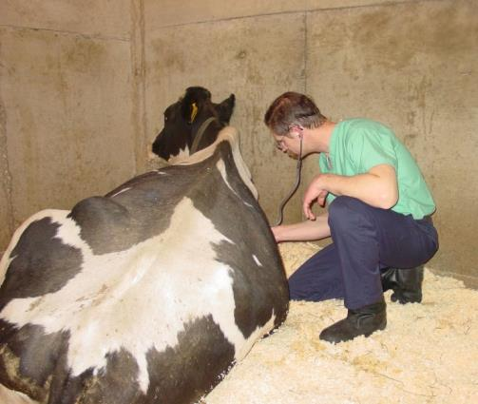
Freedom from
Pain, Injury, and Disease
Examine upon entry/exit
  Illness
  Injury
  Nutritional well-being
Treat appropriately
  Medical, surgical
  Euthanasia
Monitor
May have delay in showing signs
  Stress analgesia
Notes:
Animal welfare should also address freedom from pain, injury and disease. Animals entering and exiting the shelter should be examined upon arrival by a veterinarian for any signs of disease or injury. When illness, injury, or other conditions threatening an animal’s welfare are noted, appropriate actions should be taken. This may range from medical treatment to surgical treatment; some situations may warrant humane euthanasia. Be aware some animals may show a delay between the time of actual injury and showing signs due to a phenomenon known as stress analgesia. Therefore, awareness and monitoring of animal health before, during, and after transport and sheltering is essential.
[Photo: Examination of a cow. Source: Danelle Bickett-Weddle/CFSPH Iowa State University]

Slide 7
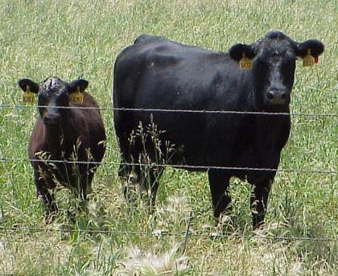
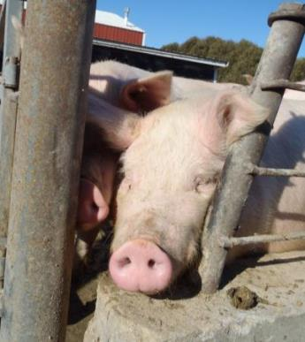
Freedom to
Express Normal Behavior
Livestock
  Herd animals
  Prey animals
  Anxious when isolated
  Pigs: Inquisitive nature and strong natural urge
  to escape
  Goats: Difficult to
  keep confined
Notes:
Another animal welfare state is the freedom to express normal behavior, both individually and in groups. Animal behavior can be abnormal in times of stress, such as animal health emergencies. New surroundings coupled with an increase in handling and transport may raise stress on animals and alter the way an animal acts. Livestock are herd animals, tending to gather in groups. Animals that become separated from the group can become agitated and dangerous in its attempts to rejoin the herd or group. Swine will establish a social order within their group, with one animal becoming the dominant individual for the group. The removal or addition of new animals will require re-establishment of the social order, usually through fighting. Swine also have an inquisitive nature and spend much of their time in forage-related activities, such as rooting, grazing and exploring with their snout. They also like to chew on objects, including each others ears or tails at times. Livestock species are also prey animals, so they will have a natural heightened flight response in stressful situations. Pigs have a strong natural urge to escape. Small gaps between pens, alleys, ramps, side gates, chutes, or anywhere else may encourage a pig to try to escape. Goats are also notoriously difficult to keep confined, so appropriate fencing options must be considered. [Photo: (Top) Cow and calf. Source: Renee Dewell/CFSPH, Iowa State University; (Bottom): A pig trying to escape. Source: Alex Ramirez, Iowa State University]

Slide 8
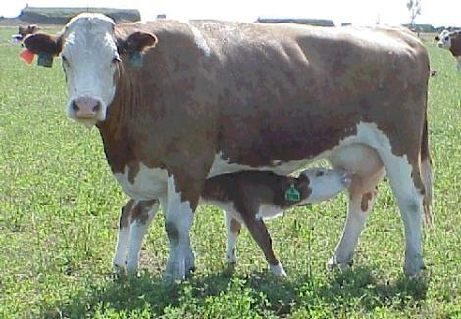
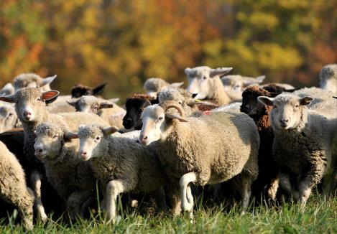
Freedom from
Fear and Distress
Recognize normal vs. abnormal
  Elevated stress –
  unpredictable
  Experienced
  handlers
Safe transport
  Avoid overcrowding
  Familiar groups
Group by species, age,
gender, farm of origin,
pregnant animals
Notes:
Finally, the freedom from fear and distress addresses the conditions and treatment which avoids mental suffering, including humane handling and humane euthanasia. Appropriate handling can minimize stress and leads to better overall health and welfare. Disaster situations or animal health emergencies, will elevate the stress of livestock. Animals in stressed situations can become unpredictable and should be handled calmly. Knowledge and understanding of normal and abnormal livestock behavioral patterns can help determine and anticipate reactions seen in emergency situations. Only trained individuals experienced with livestock should handle these animals in animal emergency situations. If livestock are to be transported from one site to another location welfare issues must be addressed. Only transport vehicles appropriate for the species should be used and should not be overcrowded. Ramps, trucks, and other equipment used in transporting livestock should be safe so that the animals do not injure themselves. Separation of animals can directly affect animal welfare. In order to protect the well being of all animals during an emergency situation, livestock should be separated according to species, age, and gender. Animals should be grouped based on farm of origin and pre-established herds. Mixing herds should be avoided. Young livestock should not be separated from their mothers; the strong maternal instinct can make the mother stressed and difficult to handle if she feels her young is being threatened. [Photo: (Top) A flock of sheep. Source: United Nations at Flickr.com Creative Commons; (Bottom) Cow and calf. Source: Renee Dewell/CFSPH Iowa State University]

Slide 9
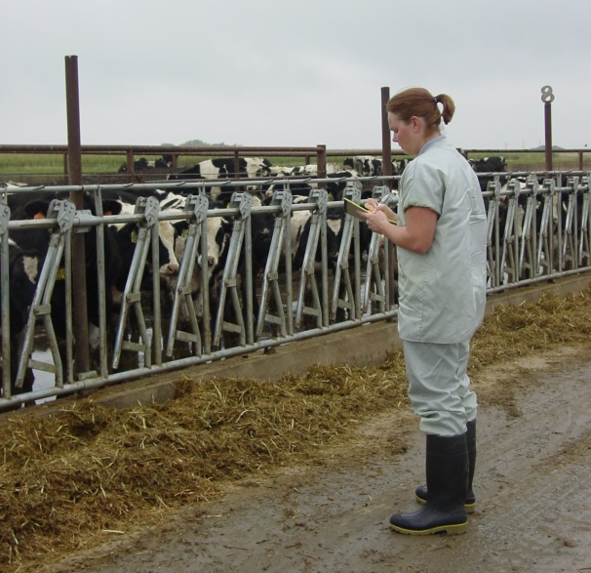
Responders:
Mental Health and Animals
Response stress
  Can affect responder
  mental health
  May affect animal welfare
    Responder apathy
    Responder fatigue
    Uncompleted tasks
    Carelessness of tasks
    Forgetting overall welfare needs
Notes:
In times of emergency, stress is on the rise for all involved; emergency responders are no exception. Their mental health can be adversely affected by long hours, emotional stress, and the seriousness of the disaster. When responders begin to succumb to these factors, it can adversely affect animal welfare. This may manifest itself in responder apathy, fatigue, uncompleted tasks, carelessness of tasks, and forgetting the overall welfare needs of the animals involved. Know how to recognized signs of stress and fatigue in yourself and others. Take appropriate actions to reduce stress. [Photo: Veterinarian interacting with horses in a stressful situation. Source: Jessica Kennicker, Iowa State University]

Slide 10
Resources
American Veterinary Medical Association
  The veterinarian’s role in animal welfare
    www.avma.org/products/animal_welfare/welfare.pdf
  AVMA Guidelines on Euthanasia
    www.avma.org/issues/animal_welfare/euthanasia.pdf
USDA Animal Welfare Information Center
  http://awic.nal.usda.gov
OIE Animal Welfare Guidelines
  Terrestrial Animal Health Code
    www.oie.int
American College of Animal Welfare
  www.acaw.org
Notes:
In this presentation, we briefly reviewed some of the livestock animal welfare considerations during an animal health emergency. For additional information on this topic, consult these additional resources.

Slide 11
Acknowledgments
Development of this presentation was by the Center for Food Security and Public Health at Iowa State University through funding from the Multi-State Partnership for Security in Agriculture
Authors: Dawn Bailey, BS; Glenda Dvorak, DVM, MPH, DACVPM
Notes:
Information provided in this presentation was developed by the Center for Food Security and Public Health at Iowa State University College of Veterinary Medicine, through funding from the Multi-State Partnership for Security in Agriculture.

