Slide 1
Animal Welfare
During Animal Health Emergencies
Equine
Notes:
June 2014
During animal health emergency situations – whether a natural disaster or infectious disease outbreak response – animal welfare issues must be considered and addressed. This Just-In-Time training will overview some of the pertinent animal welfare considerations for equine during animal health emergencies.

Slide 2
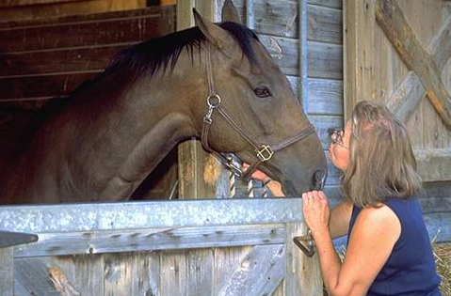
Animal Welfare
Ethical responsibility
Ensuring animal well being
  Physical and mental
Consideration of
  Health
  Behavior
  Biological function
Continuously evaluate
Notes:
Animal welfare is the ethical responsibility of ensuring the well-being of animals. It refers to the physical and mental state of the animal and includes consideration of the animal’s health, behavior and biological function. [Definition source: AVMA and American College of Animal Welfare] Responders should continuously evaluate animal welfare issues throughout the response and refine situations when indicated. [Photo: This photo shows a woman and her horse. Source: U.S. Department of Agriculture]

Slide 3
The Five Freedoms
Define ideal states of welfare
Framework for analysis of welfare
  Freedom from hunger and thirst
  Freedom from discomfort
  Freedom from pain, injury, and disease
  Freedom to express normal behavior
  Freedom from fear and distress
Notes:
The “five freedoms” are internationally recognized ideal states of the welfare of animals. These principles can provide responders valuable guidance and a framework for determining and assessing animal welfare situations during animal health emergencies. The five freedoms include freedom from hunger and thirst, freedom from discomfort, freedom from pain, injury and disease, freedom to express normal behavior, and freedom from fear and distress.

Slide 4
Freedom from
Hunger and Thirst
Water
  5 gallons water/1000 pound animal
Feed
  1-2% of body weight
  Hay or grass pastures
    10-20 pounds hay/1000 pound animal
  Possibly grain
Monitor all feed and water intake
Notes:
Freedom from hunger and thirst addresses the provision of ready access to fresh water and diet to maintain health. During animal health emergencies, equids housed in temporary shelters will require food and water. Equids should be fed between 1% and 2% of their body weight in roughage per day and 1.5 quarts of water to every pound of grain/forage. For the average 1000 pound horse this translate to 10-20 pounds of roughage and 4-8 gallons of water per day. Feed will depend on availability. Ideally, a high quality grass hay, such as Bermuda, orchard grass or timothy, should be provided. This amount may be reduced in situations where grass pasture is available. It should be increased in situations involving extreme cold temperatures. Grain may not be necessary, except for juvenile animals, lactating mares or severely underweight animals. Feed and water intake should be monitored daily. Equids may not eat in a stressful animal health emergency situation. If horses are stabled in large groups, several water sources and feed sources should be available to reduce territoriality and exclusion among the animals.

Slide 5
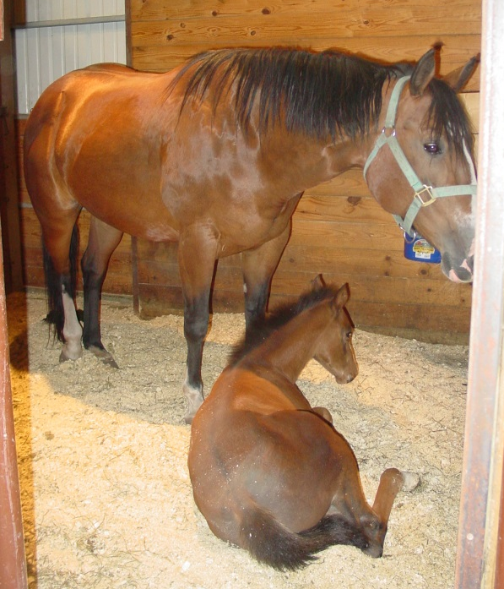
Freedom from
Discomfort
Appropriately sized confinement space
  Stalls or outdoor pens
  Protection from elements
  Appropriate temperature
  for time of year
  Ventilation
Bedding
  Saw dust
  Wood chips
  Straw
Waste management
Notes:
Freedom from discomfort involves providing an appropriate environment, including shelter and a comfortable resting area. Any sheltering facility should provide protection from the elements and an appropriate temperature for the time of year, whether it be shade in the summer or warmth in the winter. If horses are housed individually, housing areas should be large enough to accommodate laying down and turning around. Stalls should be bedded with saw dust, wood chips, or straw and cleaned daily for hygienic purposes. Attention to ventilation will be important to maintain adequate air flow throughout the building. Horses should be exercised at least once a day for health and well-being. If animals are housed outdoors, adequate wind protection and shade should be provided. Be sure to account for the seasonal temperature changes and provide fans, shade, and heaters, if needed. If housing animals in groups, larger pens with ample room for movement will be needed. Overcrowded conditions should be avoided to avoid stress to the animals as well as to decrease potential for disease transmission. [Photo: Mare and foal in a bedded stall. Source: Danelle Bickett-Weddle, Iowa State University]

Slide 6
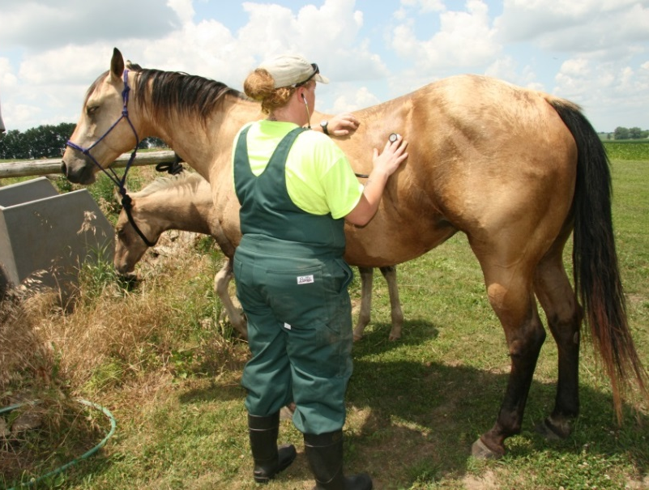
Freedom from
Pain, Injury, Disease
Examine upon entry/exit
  Illness
  Injury
  Nutritional well-being
Treat appropriately
  Medical, surgical
  Euthanasia
Monitor
May have delay in showing signs
  Stress analgesia
Notes:
Animal welfare should also address freedom from pain, injury and disease. Animals entering and exiting the shelter should be examined upon arrival by a veterinarian for any signs of disease or injury. When illness, injury, or other conditions threatening an animal’s welfare are noted, appropriate actions should be taken. This may range from medical treatment to surgical treatment; some situations may warrant humane euthanasia. Be aware some animals may show a delay between the time of actual injury and showing signs due to a phenomenon known as stress analgesia. Therefore, awareness and monitoring of animal health before, during, and after transport and sheltering is important. [Photo: Veterinarian examining a horse. Source: Jessica Kenniker/CFSPH Iowa State University]

Slide 7
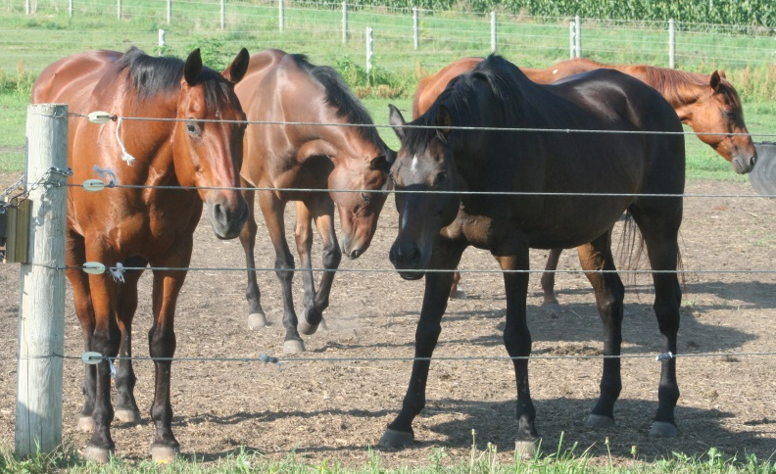
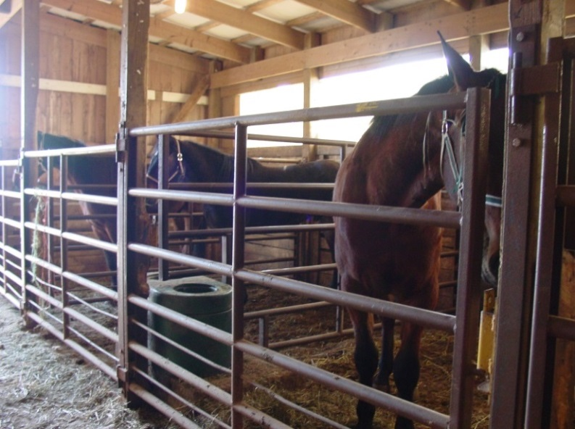
Freedom to
Express Normal Behavior
Herd animals
  Social nature
  Stressed if separated from herd mates
Separate animals based on
  Farm of origin
  Gender
  Pregnant mares, mare and foals
Notes:
Another animal welfare state is the freedom to express normal behavior, both individually and in groups. Animal behavior can be abnormal in times of stress, such as animal health emergencies. New surroundings coupled with an increase in handling and transport may raise stress on animals and alter the way an animal acts. Equids are herd animals by nature, and may become anxious when separated from herd-mates. Horses housed in temporary shelters should be grouped based on farm of origin, pre-established herds, gender, mares with foals, and pregnant mares. Avoid separating animals from groupings they are familiar with. An equine animal may injure itself or responders when trying to get back to its herd. [Photos: (Top) Horses being contained in a fenced pasture in a group. Source: Patricia Futoma, Iowa State University; (Bottom) Horses in stalls in an emergency shelter. Source: Danelle Bickett-Weddle, Iowa State University
]

Slide 8
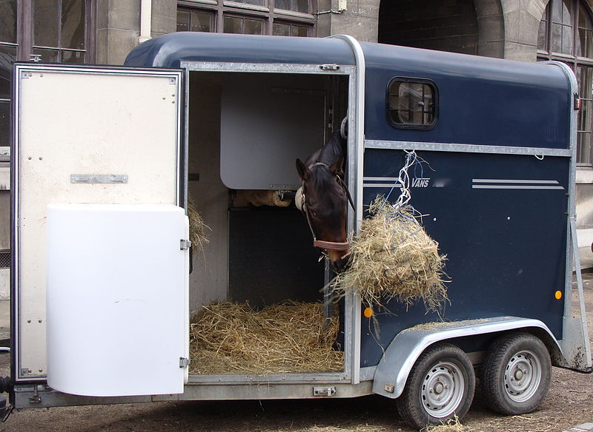
Freedom from
Fear and Distress
Elevated stress
Stressed animals
are unpredictable
Experienced
handlers
Safe transport
  Avoid overcrowding
  Familiar groups
Notes:
Finally, the freedom from fear and distress addresses the conditions and treatment which avoids mental suffering, including humane handling and humane euthanasia. Appropriate handling can minimize stress and leads to better overall health and welfare. Disaster situations or animal health emergencies will elevate the stress of equine animals. Animals in stressed situations can become unpredictable and should be handled calmly. Knowledge and understanding of normal and abnormal equine behavioral patterns can help to determine and anticipate reactions seen in emergency situations. Only trained individuals experienced with horses should handle horses in animal emergency situations. If horses are to be transported from one site to another location welfare issues must be addressed. Only transport vehicles appropriate for the species should be used and should not be overcrowded. Ramps, trucks, and other equipment used in transporting horses should be safe so that the horses do not injure themselves. Animals should be kept in familiar groups. [Photo: Horse in trailer. Source: Wikimedia Creative Commons at http://commons.wikimedia.org/wiki/File:Horse_trailer2.JPG]

Slide 9
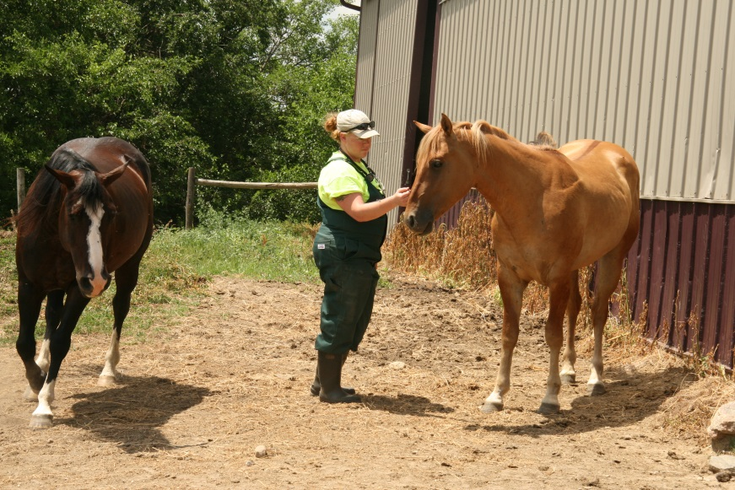
Responders:
Mental Health and Animals
Response stress can affect mental health of responders
May affect animals welfare
  Responder apathy
  Responder fatigue
  Uncompleted tasks
  Carelessness of tasks
  Forgetting overall welfare needs
Notes:
In times of emergency, stress is on the rise for all involved; emergency responders are no exception. Their mental health can be adversely affected by long hours, emotional stress, and the seriousness of the disaster. When responders begin to succumb to these factors, it can adversely affect animal welfare. This may manifest itself in responder apathy, fatigue, uncompleted tasks, carelessness of tasks, and forgetting the overall welfare needs of the animals involved. Know how to recognize signs of stress and fatigue in yourself and others. Take appropriate actions to reduce stress. [Photo: Veterinarian interacting with horses in a stressful situation. Source: Jessica Kennicker, Iowa State University]

Slide 10
Resources
American Veterinary Medical Association
  The veterinarian’s role in animal welfare
    www.avma.org/products/animal_welfare/welfare.pdf
  AVMA Guidelines on Euthanasia
    www.avma.org/issues/animal_welfare/euthanasia.pdf
USDA Animal Welfare Information Center
  http://awic.nal.usda.gov
OIE Animal Welfare Guidelines
  Terrestrial Animal Health Code
    www.oie.int
American College of Animal Welfare
  www.acaw.org
Notes:
For more information on animal welfare issues during an animal health emergency response, consult the following resources.

Slide 11
Acknowledgments
Development of this presentation was by the Center for Food Security and Public Health at Iowa State University through funding from the Multi-State Partnership for Security in Agriculture
Authors: Abbey Smith, BS; Glenda Dvorak, DVM, MPH, DACVPM
Reviewers: Katie Steneroden, DVM, MPH, PhD, DACVPM
Notes:
Information provided in this presentation was developed by the Center for Food Security and Public Health at Iowa State University College of Veterinary Medicine, through funding from the Multi-State Partnership for Security in Agriculture.

