Slide 1
Temporary Housing
Poultry
Notes:
June 2013
The temporary sheltering of poultry may be a necessary action during an animal health emergency situation. This Just-In-Time training presentation will focus on issues to address when planning for and implementing temporary sheltering situations for poultry species.

Slide 2
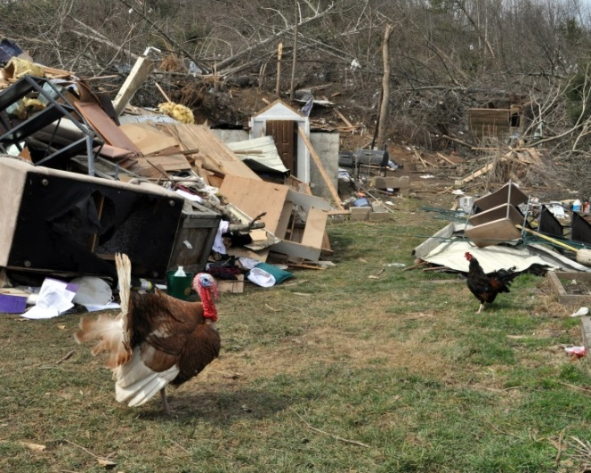
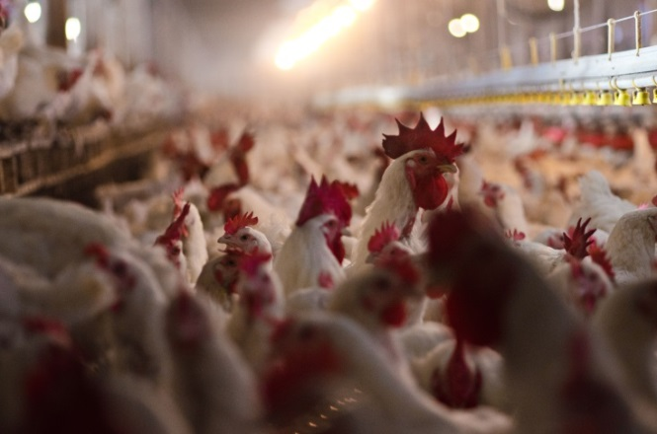
Situations
Natural Disasters
  Displacement
  Rescue
Animal Health
Emergency
  Quarantine
  In-transit
Notes:
The temporary sheltering of poultry may be needed for a variety of animal health emergencies. Following a natural disaster, birds may become displaced, and require rescue and subsequent sheltering until returned to their owner. During emergencies involving highly contagious animal diseases, infected premises may be quarantined. Birds in these situations will require continued care until the disease is contained or eliminated, or animals are depopulated in efforts to control the outbreak. Also during these outbreak situations, poultry in-transit may include potentially exposed birds in need of off-loading for quarantine purposes, or unexposed birds in need of off-loading to avoid entering quarantine zones. Either of these situations will require temporary sheltering facilities and subsequent care of the birds. [Top photo shows a turkey and chicken displaced following a tornado. Source: FEMA Photo Library; bottom photo shows a commercial poultry operation. Source: Lance Cheung/USDA]

Slide 3
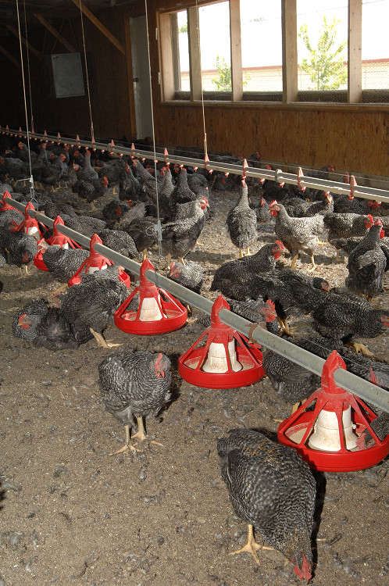
Assessment and Planning
Location and facilities
Animal requirements
  Food, water, bedding
Supplies
  Cleaning
  Administrative
Waste management
Security
Personnel
Notes:
The establishment of temporary housing facilities for poultry will take careful assessment and planning. A number of factors must be addressed prior to the arrival of the birds. These include identifying locations and facilities for the temporary shelter, determining ways to meet animal requirements, such as food, water and bedding and establishing procedures for sanitation and security. A variety of supplies for the care and maintenance of the birds – such as feeders, waterers and cleaning equipment as well as office supplies for documentation paperwork will be needed. Additionally, personnel to care for the birds must be identified and trained. Ideally, all of these factors would be determined prior to any sheltering situation. Planning for these factors will be affected by the length of time the birds will need to be housed. Depending on the situation, this may be as short as a few days or as long as several weeks. [This photo shows chickens inside a poultry house with the floor covered in litter (bedding), adequate ventilation and access to feeders. Source: USDA APHIS Image Gallery]

Slide 4
Facilities
Location
Facility Setup
Facility Access
Biosecurity
Notes:
Let’s first look at several considerations when establishing temporary shelter facilities for poultry. These include location, facility setup, facility access, and biosecurity.

Slide 5
Location
Size and number of locations
  Quantity of animals
  Infected or non-infected
  Level of biosecurity
Possible locations
  Fairgrounds
  Abandoned barns
  Empty confinement buildings with adequate ventilation
Notes:
The size and number of locations needed for temporary sheltering will depend on the quantity of animals anticipated as well as the number of species involved. Another consideration will be whether or not the birds to be housed are considered exposed/or infected with a highly contagious or zoonotic disease. This will be an important determination as a more isolated location and enhanced biosecurity measures will be needed in these situations. Possible temporary shelter sites may include county fairgrounds, abandoned barns, or confinement buildings with adequate ventilation.

Slide 6
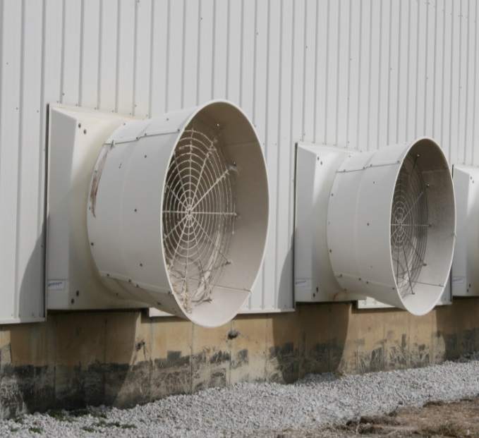
Facility Setup
Containment
  Safety
  Protect from elements
    Elements
    Predators
  Ease of feeding,
  watering, waste removal,
  monitoring
Isolation
Adequate space
Ventilation
Check for sharp objects
Notes:
Once a location is determined, containment measures will need to be addressed. This will involve the set up of temporary fencing or pens to contain the birds. Containment areas should be secure enclosures that will safely contain the birds and exclude predators, as well as allow for easy feeding, watering, waste removal, and examination of the birds. The enclosure should provide protection from the elements, including precipitation and wind. Shade should be provided in hot weather, and heat will be needed for colder temperatures. Animal density will be an important consideration. The sheltering area must have adequate spacing to allow the animals movement and room to rest. Overcrowding situations should be avoided to reduce stress to the animals as well as decrease disease transmission. The spacing requirements for poultry will vary with the age and size of birds. For planning purposes, an average of half to one square foot per bird should be provided. Ventilation in the shelter will be necessary to maintain adequate air flow throughout the building and to remove carbon dioxide, ammonia, and other waste gases. Isolation areas must be available to allow for the separation of ill animals if needed. Before placing animals in the housing area, check for any items that might cause physical injury (e.g., nails, sharp objects, hazardous materials). [This photo shows building ventilation fans. Source: Andrew Kingsbury, Center for Food Security and Public Health]

Slide 7
Facility Access
All-weather surface road
  Two lane
  One way traffic flow
Unload animals at distance
from the shelter
All vehicles and personnel
sign in and out
Notes:
Ideally access to the facility should be an all-weather surface road, which is wide enough for two lanes of traffic. Establishing a one-way flow of traffic can aid in the “check-in” and unloading process. Incoming vehicles should not be allowed direct access into the shelter. Birds should be unloaded a reasonable distance from the shelter to minimize the risk for disease transfer. All personnel and vehicles entering and exiting the site should be recorded in a log book.

Slide 8
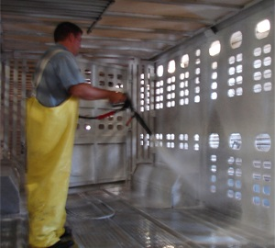
Biosecurity
Disease can spread quickly
Disinfect all vehicles
Disinfect equipment
and footwear
Vector control
  Arthropods, rodents,
  wild birds
Notes:
The implementation of biosecurity measures will be essential. Diseases can spread rapidly when animals are under increased stress, increased density and close proximity. All vehicles coming in contact with animal enclosures should be disinfected before leaving the area. Any equipment used with the birds, including footwear, should be disinfected prior to leaving the facility. Efforts to minimize insects, rodents and wild birds within the facility should be made. [This photo shows a responder cleaning out a trailer. Source: Danelle Bickett-Weddle, Iowa State University]

Slide 9
Animal Requirements
Food and Water
Bedding
Temperature
Waste Management
Veterinary Care
Isolation Areas
Notes:
Birds housed at the temporary shelter will require basic amenities of food, water, and bedding, as well as housing at adequate temperatures with waste management procedures. The care of the birds will also require in most instances veterinary care and the establishment of isolation areas.

Slide 10
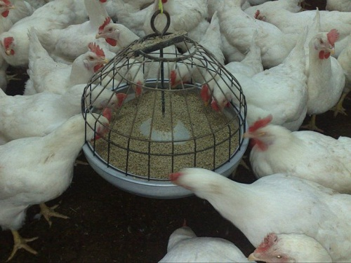
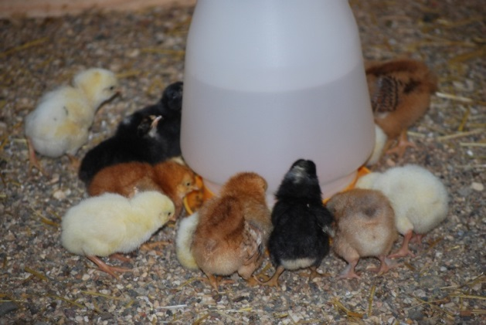
Animal Care
Food
  Commercial feed
  Cracked corn
Water
  Supplemental
  vitamins
 | Feed/day/ 100 birds | Water/day/100 birds
Layers | 17 lbs | 5 gallons
Broilers | 10 lbs | 5 gallons
Turkeys | 40 lbs | 12 gallons
Notes:
When possible a commercial feed appropriate for the age and species of bird should be feed. Feed given should be of the proper ration for the stage of production birds are in. Feed consumption will vary with the age of the bird, as well as production type (e.g., broilers vs. layers). Approximate daily feed and water needs for poultry are shown on this slide. In an emergency situation, coarsely ground grains, such as cracked corn, can support the birds for 7 to 10 days; however, birds receiving grain only should have daily vitamin supplementation in their water. Layer birds will need an additional source of calcium if laying eggs. Feed grade limestone or oyster shell should satisfy this need. Appropriate feeders should be used based on size and species of bird.
Clean, potable water should be supplied. When possible, waterers should be elevated to minimize waste from getting into the water. If troughs or round founts are used, they should be cleaned out daily. If the potability of the water is questionable, sodium hypochlorite (or bleach) at 1 to 2 ppm (2 teaspoons per 5 gallons) can be added. Water consumption for the birds will increase dramatically (up to 50 % more) when house temperatures increase to over 80ºF. [The left photo shows young chicks drinking from a waterer. Source: Pam Zaabel, Iowa State University; the right photo shows chickens eating from a feeder. Source: USDA]

Slide 11
Environment
Bedding
  Softwood shavings
  Sawdust
  Rice hulls
  Pulverized paper
Temperature
Age (weeks) | Temp ºF(ºC)
1 | 90 ºF (32 ºF)
2 | 85 ºF (29 ºF)
3 | 80 ºF (27 ºF)
4 | 75 ºF (24 ºF)
5+ | 70 ºF (21 ºF)
Notes:
If birds are to be maintained in a temporary enclosure for more than a few days, absorbent bedding should be provided and replenished as necessary. Products such as softwood shavings, sawdust, rice hulls, or pulverized paper may be used. If environmental conditions are cold, deep bedding will help birds withstand cold weather.
Poultry are very temperature sensitive. Attention to temperature requirements of the birds is important. Young birds will need a relatively high temperature (e.g., 90ºF). Mature birds can be kept at temperatures between 55-90 ºF, but 70 ºF is ideal. Birds are sensitive to overheating. In hot weather, fans may be needed to blow cooling air over the birds.

Slide 12
Waste Management
Prompt removal
  Keep environment clean
  Prevent disease spread
Procedures for
  Waste removal and disposal
  Cleaning and disinfection
Clean pens daily
  Disinfect equipment after use
Equipment and supplies
  Shovels, buckets, hoses, scrub brushes, trash cans
  Detergent, disinfectant, disposable gloves
Separate equipment
for isolation
Notes:
The prompt removal of animal waste ensures hygienic conditions for the animals and reduces the risk for disease transmission between animals. The management of waste generated by the birds housed at the shelter will be essential. Locations for waste disposal will need to be identified and cleaning and disinfection procedures will need to be determined. A variety of equipment, such as shovels, buckets, hoses, and scrub brushes should be obtained. Trash cans with liners (or trash bags) should be placed throughout the animal housing areas. Detergent and broad spectrum disinfectants will also be needed for clean up activities. Disposable gloves should be available to protect personnel from direct contact with fecal material during cleaning procedures. Dust masks may be needed. Pens should be cleaned daily. Any equipment (e.g., shovels, rakes) used for waste management should be cleaned and disinfected after each use. In areas housing isolated animals, dedicated cleaning equipment should be used and disinfected afterwards.

Slide 13
Arrival of Birds
Transport in wire or plastic cages
Unload manually or mechanically
Gentle handling will minimize stress
Open coops in housing area to release the birds
Keep flocks separate
Notes:
Poultry are generally transported in wire or plastic cages or coops designed for that purpose. Unloading of these cages will require manual or mechanical transfer of the coops to the temporary housing area. Once in the area, coops should be opened to release the birds into the housing area. Gentle handling of the coops will minimize stress on the birds. Poultry from different flocks should not be mixed. When possible, incoming birds should be kept separate from the those already present in the shelter to avoid mixing and potential disease transfer.

Slide 14
Housing the Animals
Segregate by
  Flock
  Species
  Appropriate density
  Owner
Animal identification
  Leg band
Keep records
Notes:
Birds kept at the temporary shelter can range from large commercial flocks, to smaller groups of birds owned by citizens (often referred to as “backyard” flocks). When feasible, animals from the same farm or owner should be housed together or next to each other; this will help to maintain ownership identity. All animals should have some form of identification (e.g., leg band). Birds from different flocks should not be mixed. Intake, release and identification forms will be necessary to keep the proper documentation of birds held at the facility. Records of initial stocking densities and animal ownership should be maintained.

Slide 15
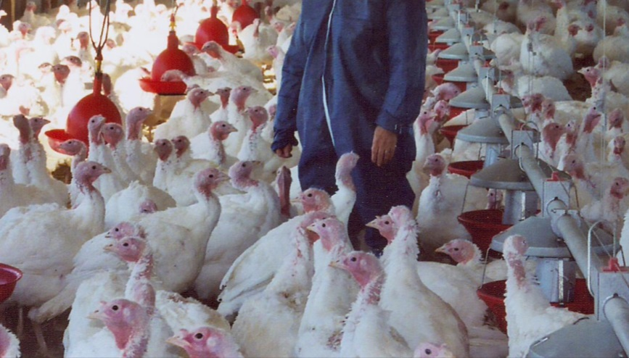
Monitoring
Veterinary examination
on entry and exit of shelter
Monitor daily for
  Illness
  Injury
  Stress
  Overheating
Isolate sick animals
  Treatment or euthanasia
Post disease recognition information
Notes:
All birds should be examined by a veterinarian upon arrival and before leaving the shelter. While at the shelter, animals should be monitored at least daily for illness, injury or stress. Any animal that is showing signs of illness should be immediately isolated away from other animals in the shelter. Prompt veterinary assessment should be made. Treatment or euthanasia should be conducted as necessary. Dead animals should be removed immediately to reduce cannibalism. Documentation of the identity and numbers of birds euthanized, as well as the method and place of disposal should be kept. Posting disease recognition information (e.g., signs of illness in poultry) can aide personnel promptly identify sick or stressed birds. [This photo shows farm personnel monitoring a flock of turkeys. Source: Lara Durben, Minnesota Turkeys Growers Association]

Slide 16
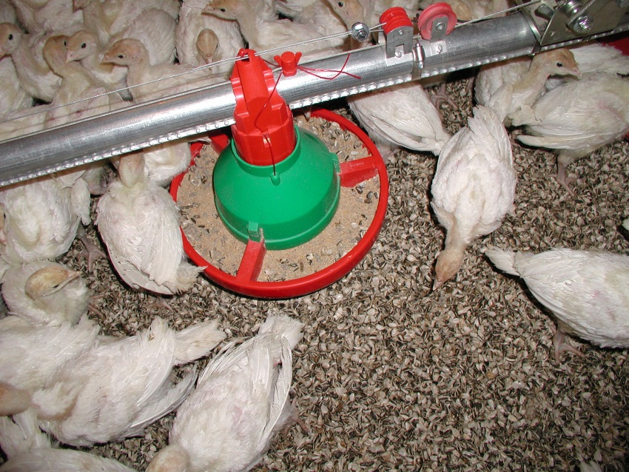
Leaving the Shelter
Veterinary examination
Dim lighting
Transfer to
appropriate cages
Do not overcrowd
Reduce densities
in hot weather
Provide protection in cold or wet conditions
Notes:
When it is time to reload the birds, birds should be transferred to appropriate transport cages or coops. Catching poultry in dim lighting can minimize stress levels of the birds. Birds should not be overcrowded during transport. In general, cages should be loaded so there is room for each bird to sit without sitting on another bird. Cage density will be dictated by the size of bird and weather conditions. Large birds will require more space. Density should be decreased considerably in warm or hot weather. Birds must be protected from extreme cold or wetting during transport. [This photo shows several turkey pullets. Source: Lara Durben, Minnesota Turkey Producers Association]

Slide 17
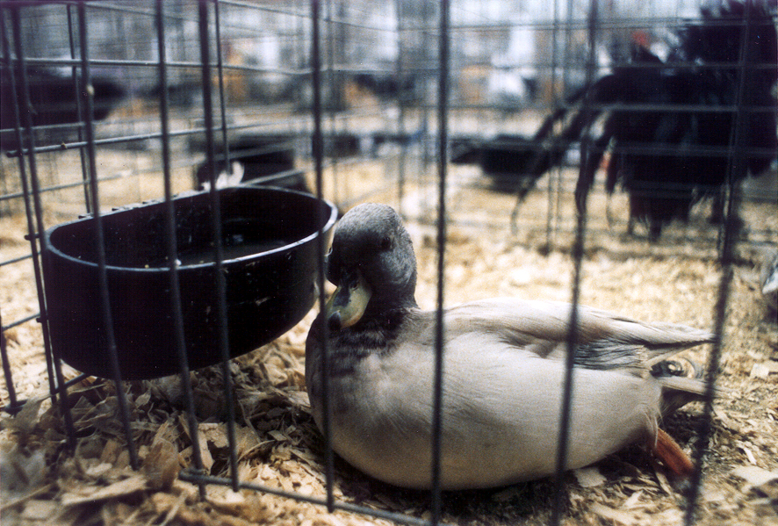
Isolation Areas
Infected or exposed animals should be housed in separate areas
Proper carcass disposal of euthanized or
dead animals
Notes:
Animal housing facility should provide separate housing for sick animals or those requiring veterinary care. Isolation areas should preferably be at a distance from susceptible animals if possible. Additional biosecurity measures will be necessary to minimize the spread of pathogens from this area. The isolation of infected or exposed animals is necessary to minimize the transfer of pathogenic agents to other susceptible animals on the site or additional locations. In the event of animal deaths or euthanasia, proper carcass disposal methods should be used to prevent animals or tissues from being carried off by wildlife. [This photo shows a duck isolated in a cage. Source: Flickr Creative Commons]

Slide 18
Personnel
Poultry handling experience
Training and coordination
  Incident Command System critical
  Animal handling
  Personal protection and appropriate PPE
  Infection control procedures
Guidelines for injury or medical emergencies
Notes:
The temporary shelter should be staffed by qualified animal care personnel. Training for personnel should include poultry handling procedures, personal protection measures, and infection control (or biosecurity) policies. All personnel involved should be familiar with Incident Command System (ICS) terminology and assignments for the shelter. Proper poultry handling procedures should be reviewed to ensure the safety of the animals and handlers. Personnel should wear proper PPE when needed. The type of PPE to be worn will vary depending on the situation and risk of exposure. Infection control policies will be essential for the shelter and should be followed by all personnel. First aid supplies should be available, with guidelines detailing procedures to follow in case of an injury or medical emergency.

Slide 19
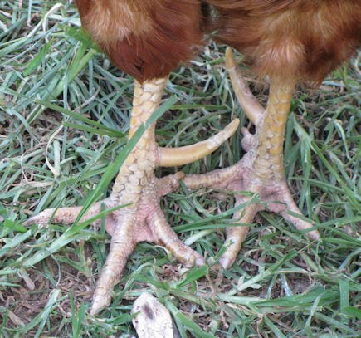
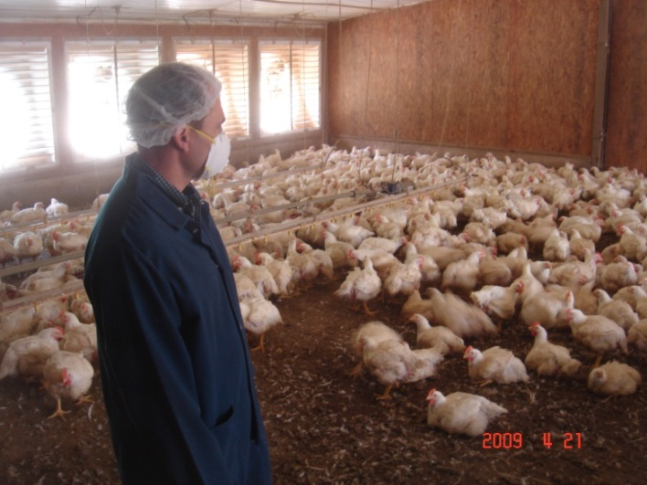
Safety
Avoid injuries
from poultry
  Beaks
  Claws
  Spurs (roosters)
  Quick movements
Masks
  Dust and dander
Any injuries must be reported
Notes:
Most cage birds are usually docile but they can peck, scratch, or inflict puncture wounds if not handled correctly. When grabbing the bird’s legs, make sure the shanks (or legs) are side by side so to not injure the handler or the bird. Always use caution around roosters; they have quick movements and large spurs on their legs (top photo) that can cause serious injury.
Another safety concern is dust and dander stirred up from poultry movement. Responders should wear protective masks when working with poultry to minimize inhalation of these materials. Zoonotic diseases of poultry, such as avian influenza or Newcastle disease, may warrant additional personal protective measures. Any injuries must be reported immediately. Any injuries that occur should be reported and documented. [The top photo shows a large spur (yellow arrow) on the leg of a rooster. Source: Maison Nord Natural Farm; the bottom photo shows a poultry worker wearing a mask to protect his respiratory tract from dust and danger generated from poultry movement. Source: Don Ritter, Iowa State University]

Slide 20

Site Security
Limit unauthorized access
  Protect animals
  Prevent pillage of supplies
Methods
  Shelter well lit
  Control entry and exit
  Record of all
  persons/vehicles
  entering and exiting
  Locked doors at night
  Personnel present at all hours
Notes:
Site security measures must be considered when establishing a temporary animal shelter. These measures are needed to limit unauthorized access to the facility or animals on-site. These measures also serve to prevent pillage of stored supplies. Site security is primarily established by controlling the entry and exit to the premises. Response sites should maintain a log book to record any individuals or vehicles entering and exiting the shelter area. It is also important to ensure shelter areas are well lit, especially in the evening. Shelter staff should also develop procedures for nighttime operations that include locking doors and having a staff member present during all hours. If the shelter is going to be open for a significant period of time, shelter managers should consider providing security personnel to maintain a 24-hour presence at the shelter. [Graphic illustration by Clint May, Iowa State University]

Slide 21
Resources
Temporary Housing and Care for Livestock and Poultry – Monograph No. 003, Nebraska Department of Agriculture
  http://www.agr.state.ne.us/homeland/monograph_003.pdf
Cleaning and Disinfection Procedures for Poultry Facilities
  http://www.poultry.uga.edu/agrosecurity/section4/cleaning.htm
Notes:
For more information on temporary housing of poultry during an animal health emergency response, see the following resources.

Slide 22
Acknowledgments
Development of this presentation was by the Center for Food Security and Public Health at Iowa State University through funding from the Multi-State Partnership for Security in Agriculture
Authors: Abbey Smith; Glenda Dvorak, DVM, MPH, DACVPM
Notes:
Information provided in this presentation was developed by the Center for Food Security and Public Health at Iowa State University College of Veterinary Medicine, through funding from the Multi-State Partnership for Security in Agriculture.

