Slide 1
Temporary Sheltering
Livestock
Notes:
October 2010
The temporary sheltering of livestock species may be a necessary action following an animal health emergency situation. This Just-In-Time training will focus on issues to address when planning for and implementing temporary sheltering situations for livestock species.

Slide 2
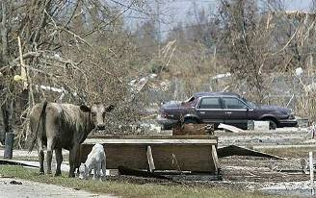
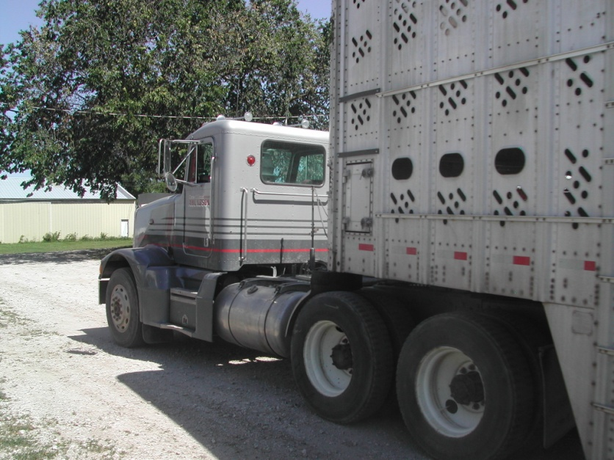
Situations
Natural Disasters
  Displacement
  Evacuation
Animal Health Emergency
  In-transit
Notes:
The temporary sheltering of livestock species may be needed for a variety of animal health emergencies. Preceding a disaster situation, the evacuation of animals and their owners may raise a need for temporary housing locations for animals. Following the disaster, animals left behind may become displaced, require rescue and subsequent sheltering until reunited with their owner. During emergencies involving highly contagious animal diseases, infected premises may be quarantined. Animals in these situations will require continued care, until the disease is eliminated or animals are depopulated. During this situation, animals in-transit may include potentially exposed animals in need of off-loading for quarantine purposes or unexposed animals in need of off-loading to avoid entering quarantine zones. Either of these situations will require temporary sheltering facilities and subsequent care of the animals.

Slide 3
Assessment and Planning
Locations
Animals
  Infected or non-infected animals
  Food and water requirements
  Species/housing requirements
Waste management
Personnel
  Security
Length of time
Notes:
The establishment of temporary housing facilities for livestock will take careful assessment and planning, preferably prior to a situation. Locations to house animals temporarily should be identified. The number of locations needed will depend on the quantity of animals anticipated as well as the number of different species involved. Another consideration will be whether or not the animals to be housed will be infected with a highly contagious or zoonotic disease. This determination will be paramount as a more isolated location will be needed for these situations. The level of biosecurity needed will also depend on this determination. Additional factors to be addressed during planning will include how food, water, bedding and other requirements will be obtained and maintained; how will waste removal and management will be handled and the number of personnel required for the care of the animals. Security measures will need to be implemented to prevent access to animals by unauthorized persons, as well as prevent pillage of stored supplies. Planning for these factors primarily will depend on the length of time the animals will need to be housed. Depending on the situation, this may be as short as a few days or as long as several weeks.

Slide 4
Facilities
Containment
Setup
Waste Management
Special Needs
Notes:
When selecting a location for temporary sheltering of livestock, there are several factors to consider. These include methods of containment, facility setup, waste management and addressing any special needs housed animals will have.

Slide 5
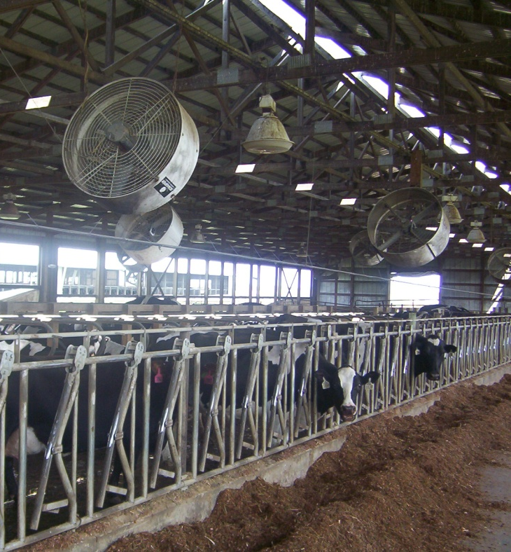
Shelter Requirements
Containment
  Fencing, pens, stalls
  Check for sharp objects
  Spacing
Shelter from elements
  Wind breaks
  Shade, fans
  Warmth
Ventilation
Temperature
Notes:
The first factor is determining how the animals will be contained at the location. This may involve the set up and use of fencing, pens or stalls. The devices must be sturdy enough to prevent escape. Electric fencing should be avoided if possible. Upon entry, animals will test the containment boundaries looking for weak spots, so extreme vigilance will be necessary during the first few days of introduction to the area. The containment of animals serves not only to keep the animals confined, but also protects them from wildlife contact and predators. Before placing animals in the housing area, check for any items that might cause physical injury (e.g., nails, sharp objects, hazardous materials). The facility should provide adequate shelter from the elements and an appropriate temperature for the time of year, whether it be shade in the summer or warmth in the winter. Attention to ventilation will be important to maintain adequate air flow throughout the building. If animals are housed outdoors, adequate wind protection and shade should be provided.

Slide 6
Shelter Requirements
Bedding
Waste disposal
Isolation area for sick animals
Special needs
  Dairy cattle
  Young animals
Notes:
Animals will require appropriate bedding. The need for bedding materials (e.g., straw) will depend on the season. If grassed areas are part of the enclosure, no bedding should be required. If animals are housed without outdoor access or in cold conditions, some bedding will be needed for the animals. Waste disposal measures will need to be addressed. Proper waste disposal is necessary not only to minimize disease transmission but to provide a humane and sanitary area for the animals to be sheltered. Isolation areas must be available to allow for the separation of ill animals if needed. Some animals will have special needs for care. Sites must possess equipment to properly address these issues. A prime example of this is having adequate milking equipment when housing dairy animals.

Slide 7
Possible Shelter Sites
Publicly owned lands
Fairgrounds
Abandoned or empty feedlots
Fenced pastures
  Climate permitting
Other buildings
  Airplane hangers
  Livestock auction markets
  Build shelter on a site
Notes:
Possible temporary shelter sites may include publicly owned lands, fenced pastures (if weather is permitting), county fairgrounds or abandoned or empty feedlots or sale barns. Other less traditional options such as an airplane hanger, may serve as a temporary housing option in absence of other sites. In some situations, a temporary shelter may need to be built at a particular location using items such as portable gate panels.

Slide 8
Supplies
General Supplies
  Halters, lead ropes
Cleaning supplies
  Shovels, rakes, wheelbarrows
  Buckets hoses
Office Supplies
  Paper, pens, computer
  Intake, release, identification forms
  Documentation of labor and supplies
Notes:
Temporary sheltering facilities will need to have a number of supplies available for the handling and care of animals housed there. General supplies such as halters and lead ropes may be useful for handling individual animals. Cleaning equipment such as shovels, rakes, wheelbarrows, buckets, and hoses will also be needed. Office supplies, such as paper, pens, computers, as well as any intake, release or identification forms will be necessary to keep the proper documentation of animals held at the facility. Documentation of labor and supplies should be kept for indemnity payments, if applicable.

Slide 9
Transportation
All-weather surface road
  Two lane
  One way traffic flow
Unload animals at distance
from the shelter
Vehicles left at shelter should be cleaned and disinfected
Notes:
Ideally access to the facility should be an all-weather surface road, which is wide enough for two lanes of traffic. Establishing a one way flow of traffic will aid in the “check-in” and unloading process. Incoming vehicles should not be allowed direct access into the shelter but should unload livestock in a reasonable distance from the shelter to minimize the risk for disease transmission. If transportation vehicles need to be left at the site, they should be thoroughly cleaned and disinfected.

Slide 10
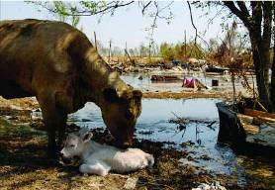
Housing the Animals
Animals should be segregated by:
  Sex
  By herd or flock
  By species
  Mothers and young
  Pregnant animals
  Isolate sick animals
  Appropriate density
Notes:
All animals should have some form of permanent identification (e.g., microchip, ear tag, tattoo, branding). When housing the animals, different species will have different grouping requirements. Most livestock species can usually be grouped together, however the sex of the animal should be considered, as it is usually inappropriate to house intact males together or with females. When feasible, animals from the same farm or owner should be housed together or next to each other. This will help to reduce animal stress and lessen the chance of fighting and possibly injury. Young animals need to be housed with their mothers for most species. Likewise, pregnant animals will need special housing and grouping. Finally, isolate any sick animals from healthy ones and any disease-exposed animals away from all animals. The sheltering area must have adequate spacing to allow the animals movement and room to rest. Overcrowding situations should be avoided to reduce stress to the animals as well as decrease disease transmission. [Photo: Cow photo: http://www.avma.org/onlnews/javma/nov05/images/051101e1.jpg]

Slide 11
Waste Management
Prompt removal of waste
Daily cleaning of stalls
Equipment should be cleaned and disinfected after use
Separate equipment should be used for isolation animals
Notes:
Waste management will be essential during temporary sheltering situations. The prompt removal of animal waste ensure hygienic conditions for the animals and reduced the risk for disease transmission between animals. Stalls and pens should be cleaned daily. Any equipment (e.g., shovels, rakes) used for waste management should be cleaned and disinfected after each use. In areas housing isolated animals, dedicated cleaning equipment should be used and disinfected afterwards.

Slide 12
Health
Food and Water
Illness and Injury
Handling
Notes:
Next, lets look at some of the health factors associated when temporarily sheltering livestock. These include food and water, illness and injury, and proper handling. Food and water will be essential for sheltered animals. The requirements will vary with species and will be discussed in greater detail later with species specific information.

Slide 13
Veterinary Care
Incoming and outgoing animals need to be thoroughly examined
Isolate incoming animals
Daily inspections
Isolate sick animals
Animal disease recognition information should be posted
Notes:
Animals should be examined for disease or injury when coming into the shelter and when exiting the shelter. If there are multiple influxes of animals (e.g., on different days), incoming animals should be kept separate from the animals already present to avoid mixing and potential disease transfer. While in the shelter, animals should be monitored daily for any signs of illness or injury. Any animal that is showing symptoms of illness should be immediately isolated away from other animals in the shelter. Prompt veterinary care should be provided. When disease monitoring is ongoing, it is helpful to have animal disease recognition information for any volunteers or responders aiding with the care and handling of the animals.

Slide 14
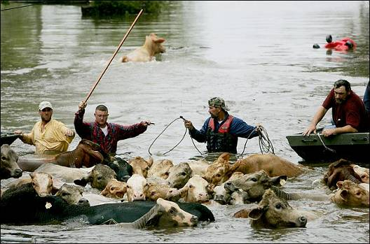
Handling
Animal behavior
  Stress, panic
  New surroundings
  Unpredictable
Proper handling
minimizes stress
Responders with experience
  Need to know species
Notes:
Animal behavior can be abnormal in times of stress. New surroundings coupled with an increase in handling may alter the way animals act. The heightened sense of awareness and stress in the animal can easily cascade into panic, resulting in unpredictable actions that may be harmful not only to the animal but also other animals in the group as well as responders. Proper handling is key when dealing with animals during emergency response situations. Responders who are moving animals should be experienced in handling the species they are working with. Experience lends itself to proper handling procedures to keep both the animal and the responder safe.
[Photo: http://www.beefusa.org/NEWSHurricaneIkeWreaksHavoconTexasLouisianaCattlemen36768.aspx]

Slide 15
Species Specific
Notes:
Now let’s look briefly at some of the species specific requirements for temporary sheltering situations.

Slide 16
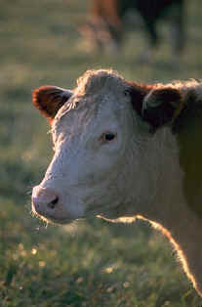
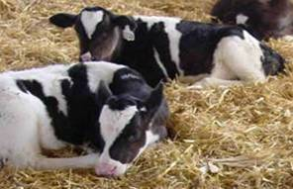
Cattle
Food and water
  Open pasture
  Grass or baled hay
    20-25 lb/day
  Water
    12-15 gallons/day
Young animals
  Additional nutritional requirements
Water consumption will increase
in hot weather conditions
Notes:
Cattle are generally amendable to open pasture sheltering and can be maintained during most events by providing water and forages. Generally, cattle can tolerate a fairly wide temperature range if windbreaks or shade are provided as appropriate. Lactating diary cattle will require consideration for milking and milk disposal, increasing the requirements for shelter, water, electricity and specialized equipment. As estimates, in moderate weather conditions, mature dairy cattle will consume 20-25 pounds hay/head/day and 12 to 15 gallons of water per head per day. Water consumption will increase with hot weather conditions. [For specifics on nutritional requirements of various species, see the AVMA Disaster Preparedness Guidelines Tab E pp. 155-http://www.avma.org/disaster/emerg_prep_resp_guide.pdf]

Slide 17
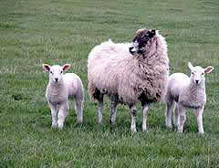
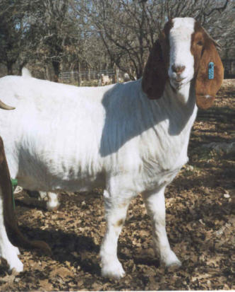
Small Ruminants
Food and water
  Sheltered pasture
    Windbreaks, shade
  Food 3-5 pounds hay/day
  Water ½-1 gallon/day
Difficult to confine
Pregnant animals
  Enhanced shelter
Dairy breeds will require milking
Notes:
Similar to cattle, small ruminant species are also fairly tolerant of pasture shelters (with adequate windbreaks and shade) and can be maintained during an event with water and forages. If indoors, 3-5 pounds of hay and ½ -1 gallon of water per head per day will be required. Goats are notoriously difficult to keep confined; typical cattle and equine fencing options are usually insufficient. During lambing and kidding seasons, greater protection from environmental conditions will be needed. Dairy breeds of goats will also require milking; however since these herds are generally smaller in number and produce less volume, hand-milking by an experienced herdsman may be feasible.

Slide 18
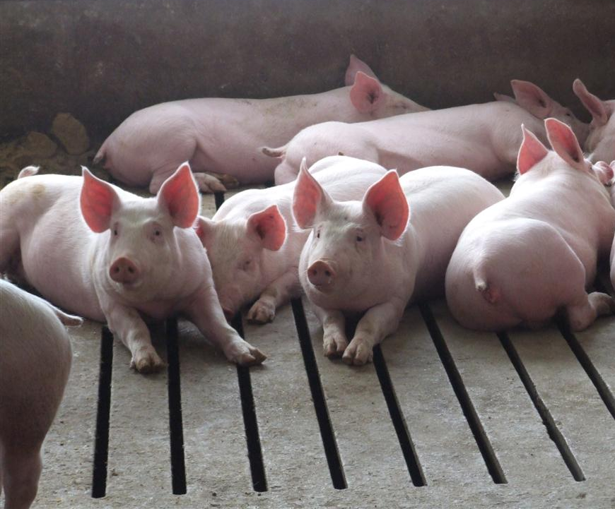
Swine
Food and water
  Food
    0.5#/100#
  Water
    ½-1 gallon/head/day
Hard surfaces
  2.5 sq feet/100# sleeping
  5 sq feet/100# general living space
Heat stress is significant concern
Notes:
Swine need to be confined on a hard surfaces. Sheltering on pasture or other soft surfaces will encourage the expression of rooting and escape behaviors. Space recommendations include 2.5 sq. feet/100# of sleeping area and 5 sq. ft./100# of general living space. A feeding rate of 0.5#/100# is adequate during a sheltering event. Young animals will need to be provided with significant environmental shelter and temperature moderation while older stock will require shade or bedding as appropriate to the environmental conditions. Heat stress is a significant concern.

Slide 19
Resources
AVMA Disaster Preparedness and Response Guidebook
  http://www.avma.org/disaster/emerg_prep_resp_guide.pdf
Temporary Housing and Care for Livestock and Poultry – Monograph No. 003, Nebraska Department of Agriculture
  http://www.agr.state.ne.us/homeland/monograph_003.pdf
Notes:
This presentation provided a brief overview of factors to consider when planning and establishing temporary shelter facilities for livestock. For additional information on this topic , see the AVMA Disaster Preparedness and Response Guidebook.

Slide 20
Acknowledgments
Development of this presentation was by the Center for Food Security and Public Health at Iowa State University through funding from the Multi-State Partnership for Security in Agriculture
Authors: Sara Viera, MPH; Glenda Dvorak, DVM, MPH, DACVPM
Notes:
Information provided in this presentation was developed by the Center for Food Security and Public Health at Iowa State University College of Veterinary Medicine, through funding from the Multi-State Partnership for Security in Agriculture.

