Slide 1
Temporary Sheltering
Equine
Notes:
June 2014
The temporary sheltering of equine species may be a necessary action during an animal health emergency situation. This Just-In-Time training presentation will focus on issues to address when planning for and implementing temporary sheltering situations for equine species.

Slide 2
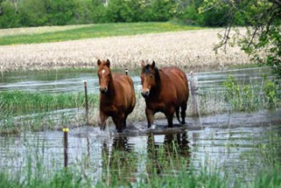
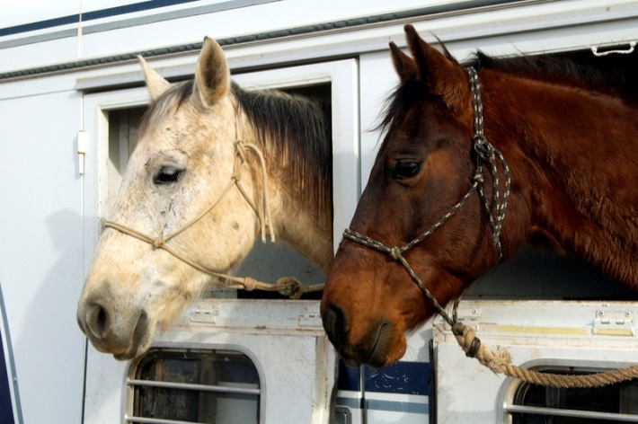
Situations
Natural Disasters
  Displacement
  Rescue
Animal Health
Emergency
  Quarantine
  In-transit
Notes:
The temporary sheltering of equine may be needed for a variety of animal health emergencies. Preceding a disaster situation, the evacuation of animals and their owners may raise a need for temporary housing locations. Following the disaster, animals left behind may become displaced, and require rescue and subsequent sheltering until they can be returned to their owner. During emergencies involving highly contagious animal diseases, infected premises may be quarantined. Animals in disease outbreak situations will require continued care until the disease is contained or eliminated, or depopulation efforts to control the outbreak are completed. Also during these outbreak situations, equine in-transit may include potentially exposed animals in need of off-loading for quarantine purposes. Unexposed animals in need of off-loading should avoid entering quarantine zones to prevent them from becoming infected with the outbreak disease. Any of these situations will require temporary sheltering facilities and subsequent care of the animals until further notice by the proper authorities. [Photo: Two displaced horses wading through flood water. Source: dressagedaily.com]

Slide 3
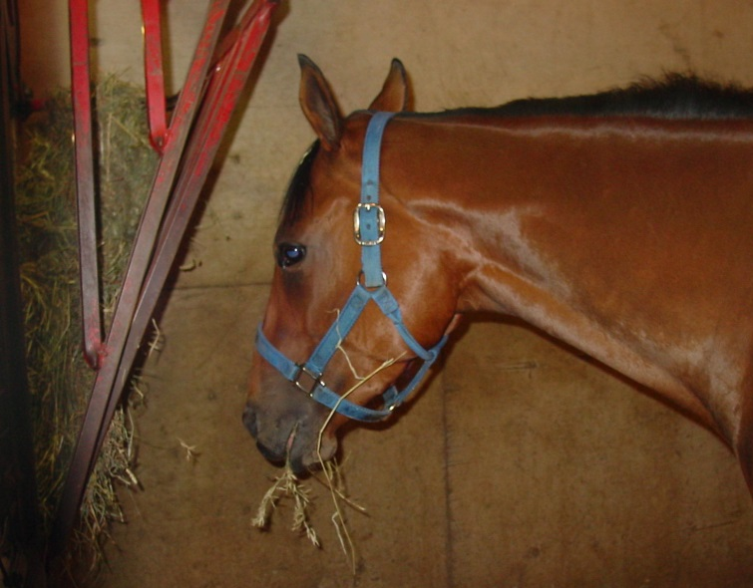
Assessment and Planning
Location and facilities
Animal requirements
  Food, water, bedding
Supplies
  Cleaning
  Administrative
Waste management
Security
Personnel
Notes:
The establishment of temporary housing facilities for equine will take careful assessment and planning to ensure effectiveness of the facility. Locations to temporarily house animals should be identified preferably prior to an emergency situation. The number of locations needed will depend on the quantity of animals anticipated. Another consideration will be whether or not the animals to be housed will be infected with a highly contagious or zoonotic disease. This determination will be paramount as a more isolated location will be needed for these situations. The level of biosecurity needed will also depend on this determination. Additional factors to be addressed during planning will include how food, water, bedding and other requirements will be obtained and maintained; how will waste removal and management will be handled and the number of personnel required for the care of the animals. Security measures will need to be implemented to prevent access to animals by unauthorized persons, as well as prevent pillage of stored supplies. Planning for these factors primarily will depend on the length of time the animals will need to be housed. Depending on the situation, this may be as short as a few days or as long as several weeks. The personnel tending to the animals should be properly trained to handle these large animals in stressful situations. All animal handling personnel should be clearly identified so no unauthorized personnel is working with the animals. [Photo: Horse eating hay in a stall during an animal health emergency situation. Source: Danelle Bickett-Weddle, Iowa State University]

Slide 4
Facilities
Containment
Facility Setup
Waste Management
Special Needs
Notes:
When selecting a location for temporary sheltering of equids, there are several factors to consider. These include methods of containment, facility setup, waste management and addressing any special needs housed animals will have.

Slide 5
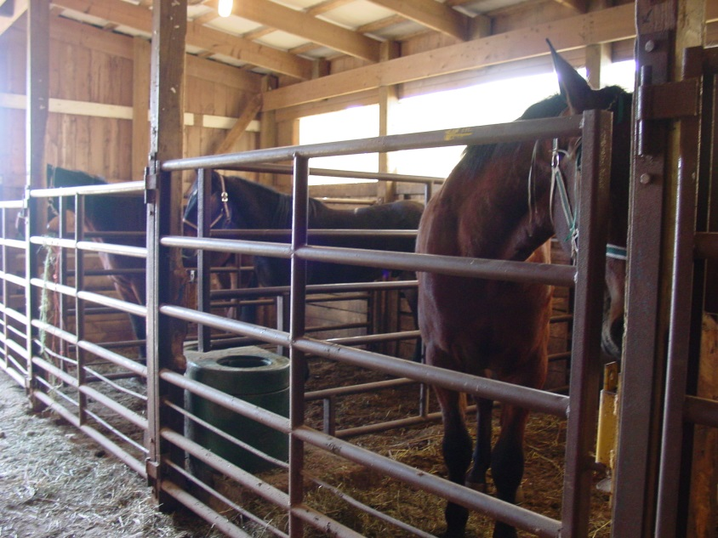
Shelter Requirements
Containment
  Sturdy fencing,
  pens, stalls
  Check for
  sharp objects
Shelter from elements
Temperature control
Ventilation
Notes:
The first factor is determining how the animals will be contained within the location. This may involve the set up and use of fencing, pens, or stalls. The devices must be sturdy enough to prevent escape. Electric fencing should be avoided if possible; if unavoidable, tie strips of cloth along the wire at 4-6 foot intervals to better demarcate the fence. Upon entry, animals will test the containment boundaries looking for weak spots, so extreme vigilance will be necessary during the first few days of introduction to the area. The containment of animals serves not only to keep the animals confined, but also protects them from wildlife contact and predators. Before placing animals in the housing area, check for any items that might cause physical injury (e.g., nails, sharp objects, hazardous materials). The facility should provide adequate shelter from the elements and an appropriate temperature for the time of year, whether it be shade in the summer or warmth in the winter. Attention to ventilation will be important to maintain adequate air flow throughout the building. If animals are housed outdoors, adequate wind protection and shade should be provided. [Photo: Horses being kept in a barn with pens in an emergency situation. Source: Danelle Bickett-Weddle, Iowa State University]

Slide 6
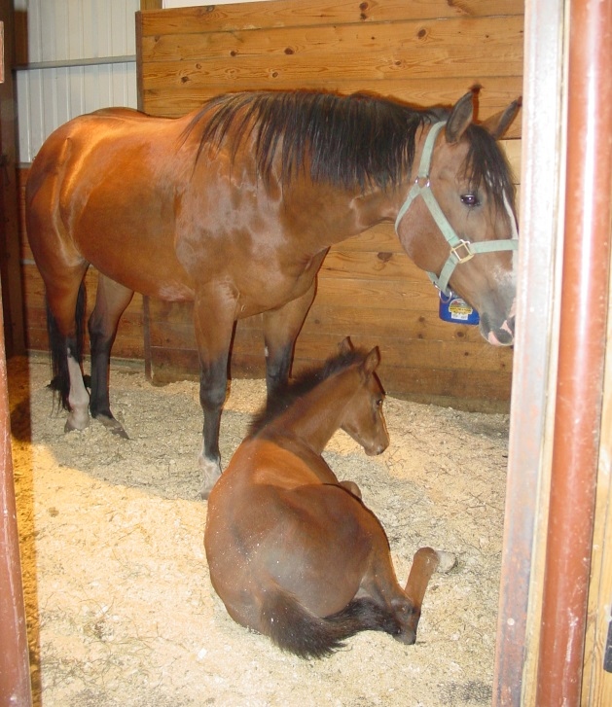
Shelter Requirements
Wood chip or straw bedding
Waste disposal
Isolation areas
  Sick animals
  Disease quarantine
Special care
  Mothers with offspring
  Young animals
Notes:
Equine will require appropriate bedding such as wood chips or straw, if they are housed in stalls or indoor pens. The need will depend on the season. If grass areas are part of the enclosure, no bedding should be required. If animals are housed without outdoor access or in cold conditions, some bedding will be needed for the animals for cleanliness and warmth, respectively. Waste disposal measures will need to be addressed and is necessary not only to minimize disease transmission, but to provide a humane and sanitary area for the animals to be sheltered. Isolation areas must be available to allow for the separation of ill animals if needed. Some animals, such as pregnant mares or foals, will require special care. [Photo: Mare and foal in a bedded stall. Source: Danelle Bickett-Weddle, Iowa State University]

Slide 7
Possible Shelter Sites
Sites
  Fairgrounds
  Rodeo arenas
  Public lands
  Sale barns
  Feedlots
  Fenced pastures
Get proper permission for shelter use
Shelters built
on-site
Sturdy panels, stalls, and gates
Notes:
Shelter sites need to be determined before disaster strikes and protocols should be in place for transportation to such sites. Possible sites can include fairgrounds, rodeo arenas, publicly owned lands, sale barns, feedlots, or fenced pastures. Proper permission needs to be obtained to address any legal issues. Some situations may require that a shelter be built on-site using portable panels. It is imperative that the shelter panels, stalls, or gates be sturdy enough to contain these animals as they can test the boundaries of their confinements.

Slide 8
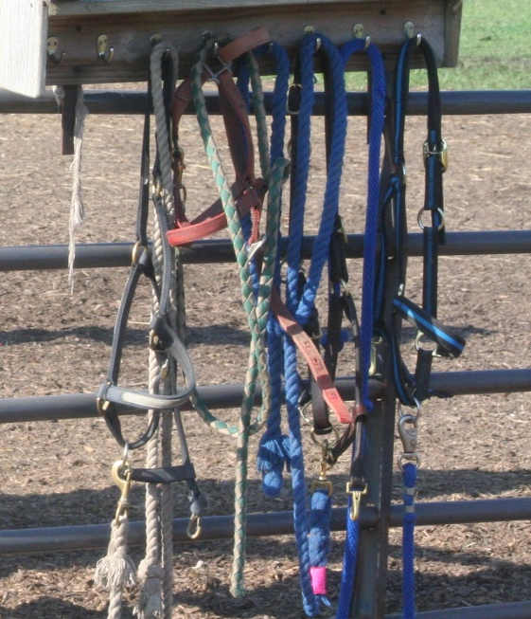
Supplies
Animal supplies
  Halters, lead ropes, buckets
Cleaning supplies
  Buckets, shovels,
  stall forks, rakes, wheelbarrows, hoses
Administrative supplies
  Computer, paper, pens,
  paperwork forms
  Document labor and supplies
Notes:
Along with the physical set up of the temporary shelter, there are various supplies that will be needed to care for the animals as well as to administratively run the shelter. Supplies, such as halters, lead ropes, feed and water buckets will be needed for animal handling and care. Cleaning supplies, including cleaning buckets, shovels, stall forks, wheelbarrows, hoses and disinfectants, should also be available at the shelter. Supplies for administrative purposes, such as computers, paper and pens, will be needed for recordkeeping, animal identification and other paperwork. Documentation of labor and supplies should be kept for indemnity payments, if applicable. [Photo: Halters needed for handling horses. Source: Patricia Futoma, Iowa State University]

Slide 9
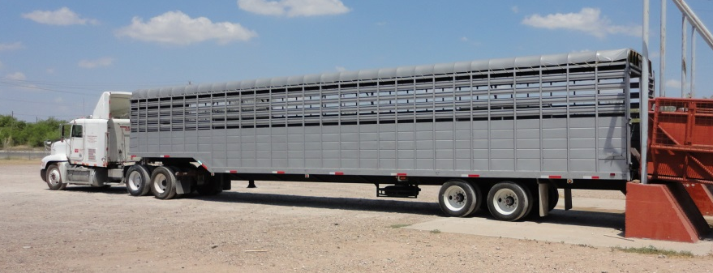
Transportation
All-weather surface road
  Two lane
  One way traffic flow
Unload animals
at distance from
the shelter
Vehicles left at shelter should be cleaned and disinfected
Notes:
Ideally access to the facility should be an all-weather surface road, which is wide enough for two lanes of traffic. Establishing a one way flow of traffic will aid in the “check-in” and unloading process. Incoming vehicles should not be allowed direct access into the shelter but should unload livestock in a reasonable distance from the shelter to minimize the risk for disease transmission. If transportation vehicles need to be left at the site, they should be thoroughly cleaned and disinfected. [Photo: Semi tractor-trailer backing up to an loading dock to unload horses. Source: Joey Astling, Iowa State University]

Slide 10
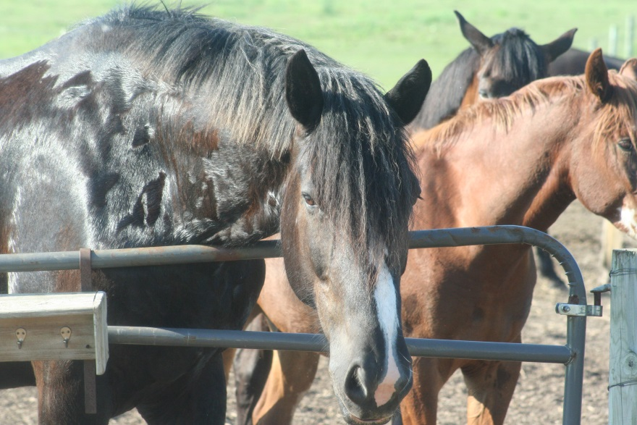
Equine Housing
Proper stocking densities
Separate animals
based on:
  Gender, herds,
  species
  Mothers with offspring,
  pregnant mares
Permanent identification
Isolate sick
Notes:
Housing animals in the temporary shelter should be done by segregating the animals based on certain criteria such as gender, pre-established herds, species, mothers with offspring and pregnant mares. Separating animals based on these criteria decreases the chances of fighting and stress for all animals in the shelter. All animals should be identifiable with permanent identification such as a brand, microchip, or tattoo. The sheltering area must have adequate spacing to allow the animals movement and room to rest. Overcrowding situations should be avoided to reduce stress to the animals as well as decrease disease transmission. Sick animals should be separated and isolated from all other animals until healthy. [Photo: Horse separated by gender in fenced pastures. Source: Patricia Futoma, Iowa State University]

Slide 11
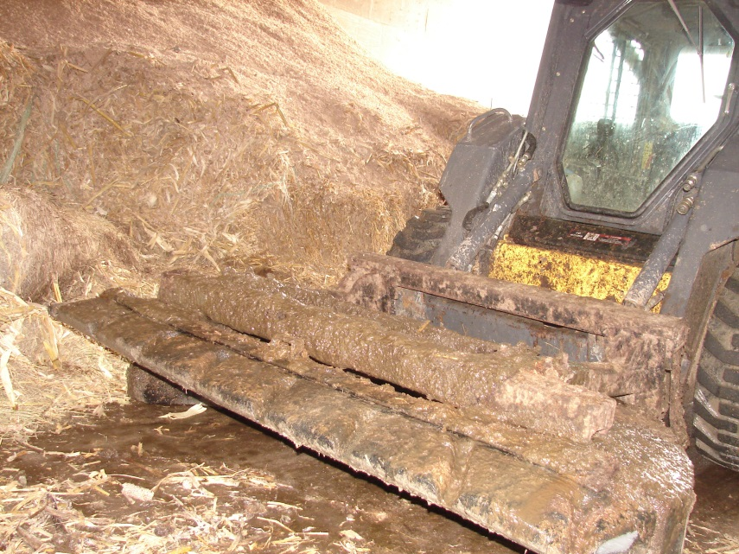
Waste Management
Prompt removal
of waste
Daily cleaning
of stalls
Equipment should
be cleaned and
disinfected after use
Separate equipment should be used for isolation animals
Notes:
Waste management will be essential during temporary sheltering situations. The prompt removal of animal waste ensure hygienic conditions for the animals and reduced the risk for disease transmission between animals. Stalls and pens should be cleaned daily. Any equipment (e.g., shovels, rakes) used for waste management should be cleaned and disinfected after each use. In areas housing isolated animals, dedicated cleaning equipment should be used and disinfected afterwards. [Photo: Manure being scraped out of a building. Source: Danelle Bickett-Weddle, Iowa State University]

Slide 12
Animal Requirements
Food and Water
Isolation Areas
Safety and Security
Veterinary Care
Handling
Notes:
Next, let’s look at some of the daily requirements for the animals housed in the shelters. These will include food and water, isolation areas, safety and security, veterinary care, and handling.

Slide 13
Animal Care
Feed
  1-2% of body weight
  Hay or grass pastures
    20 pounds hay/1000 pound animal
  Be aware of grain provided
Water
  5 gallons water/1000 pound animal
Monitor all feed and water intake
Notes:
Equids housed in the temporary shelter will require food and water. Feed will depend on availability. Ideally, a high quality grass hay, such as Bermuda, orchard grass or timothy, should be provided a1-2% of their body weight (or 10-20 pounds of hay per 1000 pound animal). This amount may be reduced in situations where grass pasture is available. It may be increased in situations involving extreme cold temperatures. Grain may not be necessary, except for juvenile animals, lactating mares or severely underweight animals. Equids will need at least 5 gallons of water per 1000 pound animal. If horses are stabled in large groups, several water sources and feed sources should be available to reduce territoriality and exclusion among the animals. Horses may not eat in a stressful animal health emergency situation. These animals should be monitored closely and examined by a veterinarian.

Slide 14
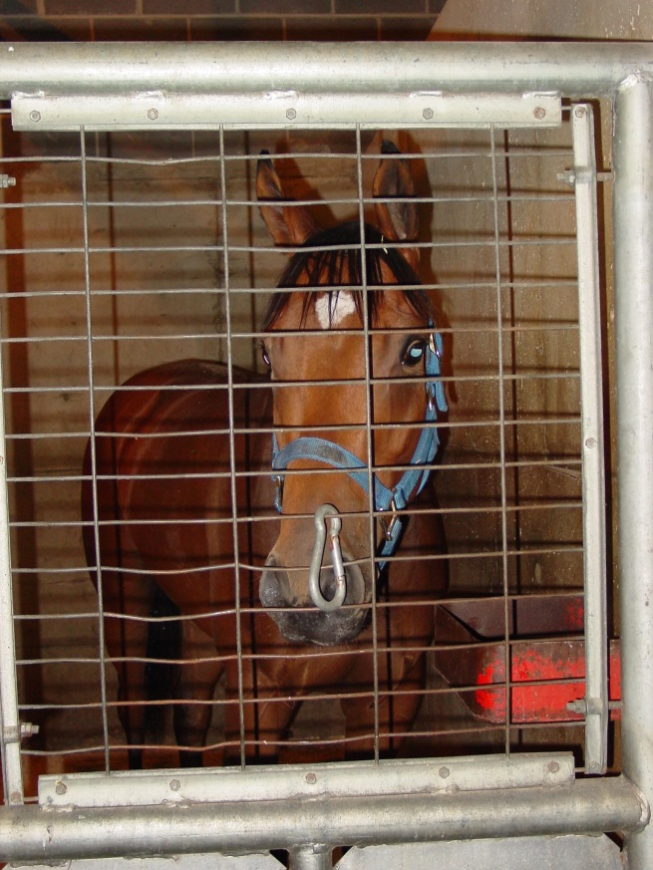
Isolation Areas
Kept separate from other animals
Keep isolation areas at a distance from main shelter areas
Biosecurity
Utilize proper disposal methods
for dead animals
Notes:
Any animal exhibiting signs of illness should be isolated from other animals. Isolation areas should be some distance away from the main sheltering areas. Biosecurity procedures such as wearing personal protective equipment and disinfecting the area will be necessary in isolation areas. If death occurs in any of the animals, they should be disposed of properly by methods such as incineration or rendering. [Photo: Horse in an isolation stall. Source: Danelle Bickett-Weddle, Iowa State University]

Slide 15
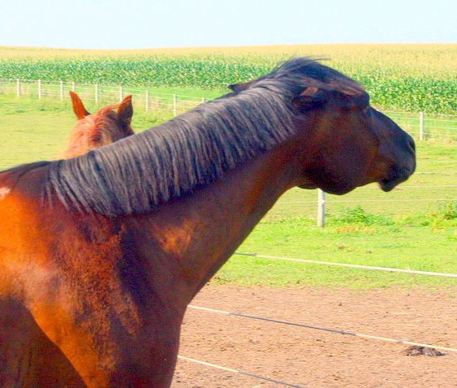
Safety and Security
Can be dangerous in stressful situations
Only allow
experienced
volunteers to
handle horses
Keep up with shelter security once the shelter is establish
Notes:
Equine animals can be potentially be dangerous, especially in stressful situations. It is important to remain calm when working around them and best to only have experienced handlers work with the animals. Security of the shelter should be made a priority to ensure that no unauthorized personnel are allowed in the shelter. [Photo: A horse with its ears pinned in a stressful housing situation. Source: Patricia Futoma, Iowa State University]

Slide 16
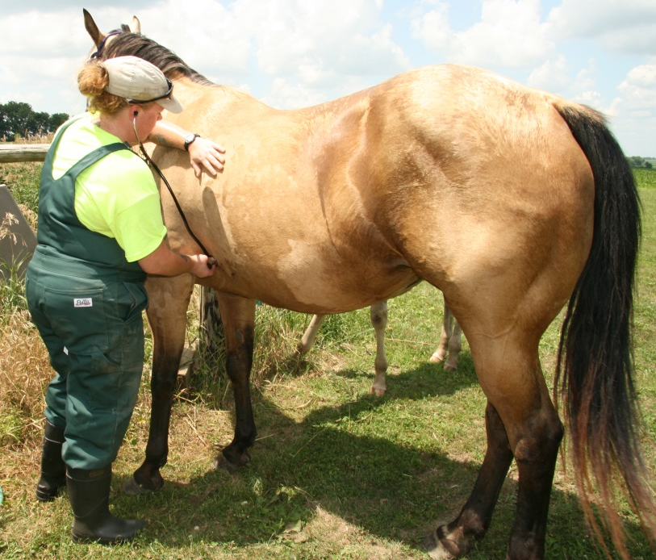
Veterinary Care
Examine animals
upon entry and
exit from shelter
Isolate sick animals
House animals
based on when they
entered the shelter
Educate volunteers on disease symptoms
Notes:
Animals entering and exiting the shelter should be examined by a veterinarian for any signs of disease or injury. All animals with diseases or injury should be tended to at once. As additional animals enter the shelter, they should initially be housed away from those already present to decrease disease spread. Animals should be monitored daily for any signs of illness or injury. All volunteers should be familiar with possible signs of disease for equids. [Photo: Veterinarian examining a horse. Source: Jessica Kennicker, Iowa State University]

Slide 17
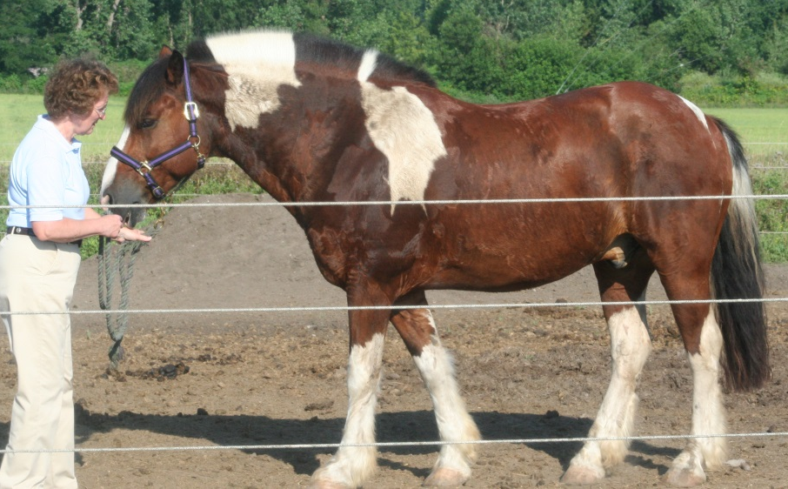
Equine Handling
Herd animals
Elevated stress
Handlers must have experience with
equine animals
Stressed animals
become unpredictable
Notes:
Equids are herd animals by nature, and may become anxious when separated from herd-mates. New surroundings coupled with an increase in handling may raise stress on animals. Only those experienced in moving horses should be handling them in stressful situations. Animals in stressed situations can become unpredictable. A Just-In-Time presentation on the handling and restraint of equids during an animal health emergency is available. [Photo: Horse being handled calmly in a stressful situation. Source: Patricia Futoma, Iowa State University]

Slide 18
Resources
AVMA Disaster Preparedness
and Response Guidebook
  http://www.avma.org/disaster/emerg_prep_resp_guide.pdf
Basics of Feeding Horses:
Feeding Management. University of Nebraska-Lincoln Extension
  http://www.ianrpubs.unl.edu/pages/publicationD.jsp?publicationId=914
Emergency Treatment and Management of Horses Under Hurricane Conditions. Mississippi State Extension.
  http://msucares.com/pubs/infosheets/is1713.pdf
Notes:
For more information on the temporary sheltering and care of equine during animal health emergencies, see the following resources.

Slide 19
Acknowledgments
Development of this presentation was by the Center for Food Security and Public Health at Iowa State University through funding from the Multi-State Partnership for Security in Agriculture
Authors: Abbey Smith; Glenda Dvorak, DVM, MPH, DACVPM
Notes:
Information provided in this presentation was developed by the Center for Food Security and Public Health at Iowa State University College of Veterinary Medicine, through funding from the Multi-State Partnership for Security in Agriculture.

