Slide 1
Temporary Sheltering
Companion Animals
Notes:
The temporary sheltering of companion animal species may be a necessary action following a natural disaster. This Just-In-Time training presentation will focus on issues to address when planning for and implementing temporary sheltering situations for companion animal species.

Slide 2
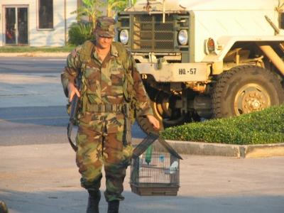
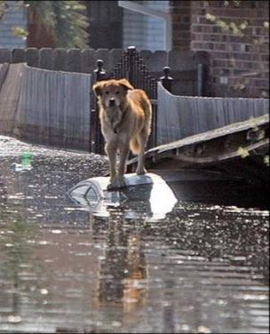
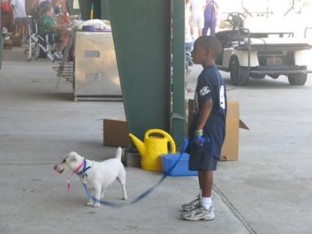
Natural Disasters
People evacuating with their pets
  Evacuation facilities do not allow pets
  Pet owners may refuse to evacuate
Pets left behind
Injured, displaced
or lost pets
Dogs, cats, pocket pets, birds
Notes:
The temporary sheltering of companion animal species may be needed for a variety of natural disaster situations. Preceding a disaster, the evacuation of people and their pets will raise the need for temporary housing locations. Most human evacuation facilities will not allow pets. As a result, people may refuse to evacuate if they are not allowed to take their pets with them. This occurred during Hurricane Katrina. Following a disaster, animals left behind may be injured or displaced, requiring rescue and subsequent sheltering until reunited with their owner. Companion animals that may need temporary sheltering during a disaster include dogs, cats, small mammals or pocket pets and pet birds.
[Top photo shows pet birds being rescued. Photo from Tom Ratke; Middle photo shows a dog in need of rescue following Hurricane Katrina. Photo from Garry Goemann, Veterinary Medical Assistance Team (VMAT) 5; Bottom photo shows a boy and his dog at an evacuation shelter. Photo from Tom Ratke]

Slide 3
Setting up a shelter
Notes:
Let’s first look at the requirements for setting up a temporary animal shelter.

Slide 4
Assessment and Planning
Location and facilities
Animal requirements
Supplies and housing
Sanitation
Security
Volunteer training and coordination
Notes:
The establishment of temporary housing facilities for companion animals will require careful assessment and planning. A number of factors must be addressed prior to the arrival of animals. These include locations and facilities for the temporary shelter; ways to meet animal requirements, such as food and water; and procedures for sanitation and security. A variety of supplies for the care and maintenance of animals at the shelter, including housing, will also need to be obtained. Additionally, a plan for the training and coordination of volunteers helping at the shelter should be determined. Ideally, all of these factors would be determined prior to any disaster situation. Planning for these factors will be affected by the length of time the animals will need to be housed. Depending on the situation, this may be as short as a few days or as long as several weeks.

Slide 5
Location
Out of affected area
Near human shelters
Possible locations
  Animal control or humane society shelters
  Veterinary hospitals
  Pet boarding facilities
  Dog training centers
  Fairgrounds, school gyms, parking garage, warehouses
Notes:
Locations and facilities for sheltering animals must first be identified. The number of locations needed will depend on the quantity of animals anticipated as well as the number of different species involved. Shelter locations should be outside the affected area and if possible, located near human shelters. This will not only reduce pet owner’s stress about their animals, but can provide assistance for animal care within the shelter, as pet owners may be utilized for some or all of their pet’s care. Local animal control and/or humane society shelters may serve as possible sheltering locations; however, depending on the scale of the event, these locations may have been damaged during the disaster, or may already be at capacity and therefore, unable to take in additional animals. Other possible locations for use as temporary shelters for companion animals may include local veterinary hospitals, pet boarding facilities, or dog training centers. If large capacity areas are needed, fairgrounds, school gyms, parking garages, or warehouses may be alternative solutions.

Slide 6
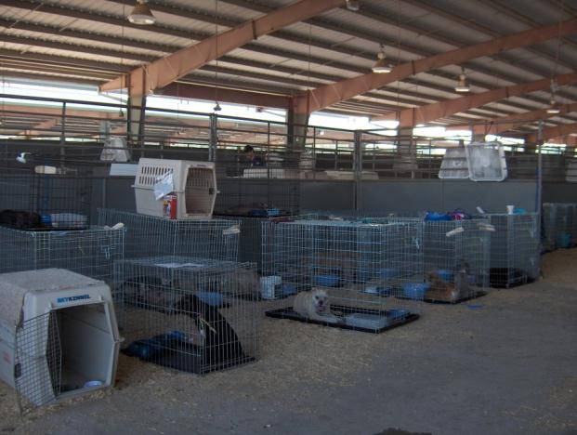
Facilities
Water source
Adequate size
Ventilation and
climate control
Sanitation and
waste disposal
Allow for animal segregation
  Species, age,
  illness, aggression
Notes:
When choosing the location for a temporary shelter, several factors must be met. The facility should have access to an adequate and safe water source for animal care and sanitation purposes. The facility must be of adequate size for the incoming volume of animals. Overcrowding situations should be avoided to reduce stress to the animals as well as decrease potential for disease transmission. Ventilation and climate control will be needed to provide optimum living conditions for the housed animals. Additionally, means of sanitation and waste disposal will need to be determined. The facilities should also allow for segregation of species and age groups, as well as have areas to separate ill or aggressive animals.
[Photo shows temporary sheltering setup during Hurricane Katrina. Photo from Dr. Heather Case, American Veterinary Medical Association]

Slide 7
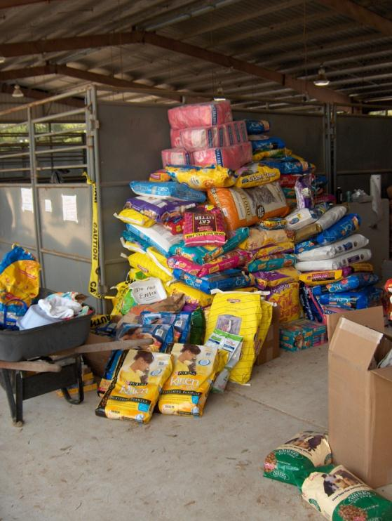
Supplies
Animal supplies
  Food and water
  Kennels and crates
  Collars, leashes
  Bowls
  Cat litter
Medical supplies
Cleaning supplies
Office Supplies
Notes:
A variety of supplies will need to be procured and stored at the facility. Pet food, kennels and crates, collars, leashes, bowls, muzzles, equipment for waste removal and cat litter may be purchased, donated, or provided by pet owners. Pet food donations are often made during disaster situations and can often overwhelm an emergency shelter if storage options are not considered. Medical supplies including gloves, bandaging material, IV fluids and medications will be needed to care for any sick or injured animals. Cleaning supplies including buckets, hoses, mops, scrub brushes, cloths, detergent and disinfectants will need to be obtained and safely stored. Office supplies, such as pens and pencils, permanent markers, duct tape, clip boards, will be needed for animal identification and management procedures.
[Photo shows a supply of dog food during Hurricane Katrina. Photo from Dr. Heather Case, American Veterinary Medical Association]

Slide 8
Sanitation
Prevent spread of disease
Keep environment clean
Procedures for
  Waste removal and disposal
  Cleaning and disinfection
Shovels or scoopers, buckets and mops, hoses, scrub brushes, trash cans, sawdust
Detergent, broad spectrum disinfectants, paper towels, disposable gloves
Separate equipment should be used for isolated animals
Notes:
Proper sanitation will help control the spread of disease within the shelter environment. Locations for waste removal and disposal will need to be identified and procedures for waste clean up determined. A variety of equipment, such as shovels or scoopers, buckets, hoses, and mops, and scrub brushes should be obtained. Sawdust may be useful to contain and remove urine. Trash cans with liners (or trash bags) should be placed throughout the animal housing areas. Detergent, broad spectrum disinfectants, and disposable cleaning cloths or paper towels will also be needed for clean up activities. Disposable gloves should be available to protect owner or personnel from direct contact with fecal material during cleaning procedures. Areas that will house isolated or ill animals will require dedicated cleaning equipment.

Slide 9
Site Security
Needed to limit unauthorized access
  Protect animals on-site
  Prevent pillage of stored supplies
  Controlled substances
    Locked cabinets
    Authorized veterinary personnel
Methods
  Shelter is well lit, especially in evening
  Control entry and exit points
  Log book of persons entering/exiting shelter
  Locked doors at nighttime
  Personnel present at all times of day
Notes:
Site security measures must be considered when establishing a temporary animal shelter. These measures are needed to limit unauthorized access to the facility and animals on-site, as well as prevent pillage of stored supplies. Additionally, controlled substances used for the medical treatment of animals at the shelter site should be secured within locked cabinets or rooms; access should be limited to only authorized veterinary personnel.
Site security is primarily established by controlling the entry and exit to the premises. Response sites should maintain a log book to record individuals entering and exiting the shelter. Control of shelter access can be facilitated by scheduling designated visiting and care hours for the pets. It is also important to ensure shelter areas are well lit, especially in the evening. Shelter staff should also develop procedures for nighttime operations that include locking doors and having a staff member present during all hours. If the shelter is going to be open for a significant period of time, shelter managers should consider providing security personnel to maintain a 24-hour presence at the shelter.

Slide 10
Volunteers
Animal handling experience
  Pre-exposure rabies vaccination desirable
Register all volunteers
Training and coordination
  Incident Command System critical
  Animal handling
  Personal protection and appropriate PPE
  Infection control procedures
Notes:
The pet shelter should be staffed by qualified animal care personnel with animal handling experience. If at all possible, these individuals should have been vaccinated against rabies prior to the event. Records regarding vaccination status for rabies and tetanus for staff members should be maintained. If volunteers will be used to maintain the shelter, it is best that these individuals be registered and trained before a disaster situation. If this is not possible, volunteers assisting at the shelter should receive proper training prior to caring for the animals. A volunteer coordinator should be designated to manage volunteer recruitment, registration, job assignments, orientation and training. Training for volunteers should include the Incident Command System, animal handling procedures, personal protection measures, and infection control policies. The Incident Command System (ICS) will be critical to the operation and success of the shelter; therefore all managerial and volunteer personnel involved should be familiar with ICS terminology and assignments for the shelter. Proper animal handling procedures should be reviewed to insure the safety of the animals and handlers. Personnel should wear proper PPE when needed. The type of PPE to be worn will vary depending on the situation and risk of exposure. Infection control policies will also be essential for the shelter and should be followed by all personnel, including volunteers. Any bites or injuries must be reported immediately. First aid supplies should be available, with guidelines detailing procedures to follow in case of a bite, suspected zoonotic disease exposure, or medical emergency.

Slide 11
Animal arrival
Notes:
Next, lets look at procedures to use once animals start arriving at the temporary shelter. The intake and registration area will be the location where pet owners arrive with their animals and fill out the paperwork necessary to house their pets in the shelter. During the intake process a copy of the shelter’s rules and owner’s responsibilities should be distributed.

Slide 12

Animal Identification
Identification number and collar
Record sheet
  Animal description
  Owner’s name, cell
  Location found
  Date found
Photograph
  Book of photos for owners to find pets
Notes:
All animals entering the shelter must be assigned an identification or tracking number to be used while at the facility. This number should be placed on a color-coded temporary identification collar placed around the animal’s neck. Each family should be give a matching colored band to place on their wrists. This band must be worn for the owner to access their animal(s) while at the shelter. All animals entering the facility should also have a record sheet. This page of data should include the animal’s identification number and a complete description of the animal (including the animal’s name (if known), sex, color, age, breed, scars, injuries, and any other identifying characteristics). If the animal was brought in by its owner, owner information (name, cell phone number) and any vaccination information should be documented. In the case of displaced or rescued animals, the location where the animal was found, by whom, and on what date should be recorded. The animal’s record sheet should be placed in vinyl sheet protector with a zip tie to attach to its cage or kennel. All rescued or displaced animals entering the facility should be photographed. A book of photographs can then be made available to owners looking for lost pets, rather than walking through the animal shelter facility. To ensure that animals are returned to their rightful owners, an identification number should be the only information displayed with the photograph.
[Photo shows a cat with a temporary animal identification collar. Photo from www.tabband.com]

Slide 13
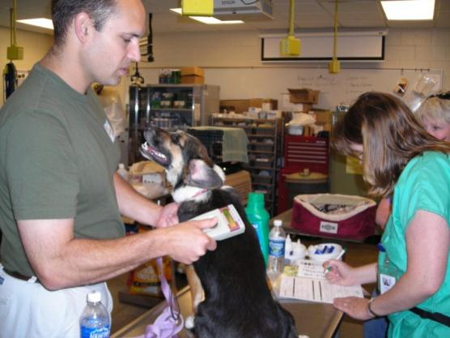
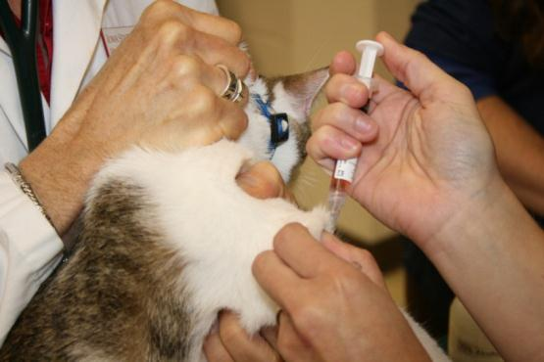
Incoming Assessment
Physical exam
  Veterinarian
Microchip scan
Triage
  Sick and injured animals
Potential procedures
  Bathing
  Parasite treatment
  Vaccination
Notes:
Next, all animals should be assessed and given a physical examination by a veterinarian. All lost or displaced animals should be scanned for a microchip. Actions taken after intake and assessment will differ depending on the disaster situation. If animals have been exposed to flood waters or skin contaminants, bathing may be necessary. Animals exposed to smoke may require oxygen treatment. Dogs and cats should be treated for intestinal parasites while staying at the shelter. This is particularly important when the pet is younger than 6 months old. External parasite treatments (i.e., flea and tick preventives) may be needed depending on the season and region. All dogs, cats, and ferrets must have proof of current vaccination against rabies, or be vaccinated upon entry to the shelter. Vaccinations for additional infectious diseases may be indicated, especially if prolonged housing is anticipated. Sick or injured animals presented to the shelter must be triaged. Cases requiring care beyond the resources of the temporary shelter may need to be transferred to appropriate facilities, if possible.
[Top photo shows veterinarian looking for a microchip. Photo from Kevan Flaming, Iowa State University; Bottom photo shows a cat being vaccinated. Photo from Andrew Kingsbury, Iowa State University]

Slide 14
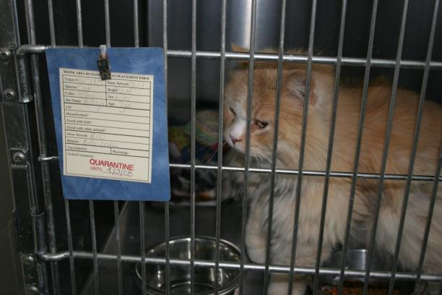
Animal Handling
Stressed and fearful
Proper handling
minimizes stress
Decrease risk
through training
Report all animal
bites and scratches
Highly aggressive animals should only be handled by experienced personnel
Notes:
It is important to remember that animal behavior can be abnormal in times of stress. New surroundings coupled with an increase in handling may alter the way animals act. Normally docile animals may become aggressive due to fear or stress from the situation, and therefore more apt to bite or scratch caretakers. Volunteers will have a wide range of experience, skills, and abilities of handling animals, providing training in animal handling and safety prior to helping in the shelter can minimize stress for the animal and decrease the risk of injury to the volunteer. Any known, highly aggressive animal should only be handled by experienced personnel. Cages of these animals should be indicated with signage. Any bite or scratch must be reported immediately. Many animals brought to the shelter will be coming with unknown histories. In addition to the risk of bacterial infection, some animal bites may carry a risk of rabies. Reporting the incident will allow for assessment of risk and need for post-exposure rabies vaccination if warranted.
[Photo show a cat being isolated for observation. Photo from Dani Ausen, Iowa State University]

Slide 15
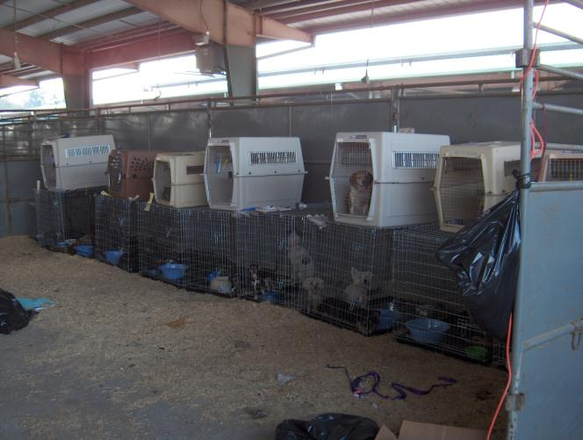
Animal Housing
Every pet needs
a cage
Plastic, collapsible, wire
Large enough for
  Food dishes
  Standing
  Lying down
  Litter box for cats
Appropriate density
Notes:
Every animal brought to the shelter needs its own housing. If possible, owners bringing their pets to a temporary shelter should be asked to provide a clearly labeled cage or carrier for their pets. Humane organizations may have a number of cages available for use during a disaster. Crates or cages must be of adequate size to allow the animals movement and room to rest. Plastic crates are commonly used; wire cages and collapsible cages provide better ventilation which is especially important in hot climates and they can be easier to clean. Dog kennels should be large enough to hold 2 no-spill bowls and allow enough room for dogs to stand and turn around. Cages for cats should be large enough to hold a small litter pan and two small dishes and allow cats enough room to lie down.
The animal housing areas should be established in an area that is easy to clean and disinfect. Facilities with concrete, tile, or vinyl floors with floor drainage can allow for easy cleaning during operation and after closing the shelter. Separate housing areas should be established for each species (e.g., dog area, cat area), as well as having areas for elderly animals and animals sensitive to noise; animals that are too aggressive to handle; sick and injured animals; and animals in heat. Each housing area will typically consists of rows and stacks of the animal crates or kennels. Each animal housing area should be set up so that shelter staff and visitors are able to travel unobstructed to the shelter’s emergency exits. If possible, cages should be positioned so animals have a limited view of other animals to help minimize stress. Covering the animals’ crates with blankets, towels, or sheets can also reduce the animals’ stress levels by decreasing their exposure to bright lights and distractions. However, this may not be practicable in hot, un-air-conditioned environments where air circulation should be maximized.

Slide 16
Sanitation
Processing areas, high traffic areas
  Between each animal
  Entire area once a day
Feces
  Removed daily from runs and cages
  Removed immediately from play areas
Broad spectrum disinfection
  Use according to product label
  New solutions daily or when visibly dirty
Clean and disinfect equipment after use
Separate equipment for isolation animals
Notes:
Proper sanitation will help control the spread of disease and make the shelter a safe environment for the animals and shelter staff. Incoming animal processing areas and exam areas should be cleaned between each animal, and the whole area should be cleaned and disinfected at least once a day. High traffic areas should be cleaned frequently throughout the day and thoroughly disinfected at least once a day. Feces should be cleaned up at least once a day in runs and cages, and should be removed immediately from common play areas and disposed of properly. Proper PPE should be worn at all times. Any broad spectrum disinfectant, such as bleach (diluted 1:32) or quaternary ammonium compounds, will be effective against most bacteria and viruses and can be used for routine disinfection. Isolation areas with known infectious disease agents may require different disinfection products. Disinfection solutions should be used according to product label. New solutions should be made daily or when the container becomes visibly dirty. Any equipment (e.g. shovels, rakes, buckets, pooper scoopers) used for waste management should be cleaned and disinfected after each use. In areas housing isolated animals, dedicated cleaning equipment should be used and disinfected afterwards.

Slide 17
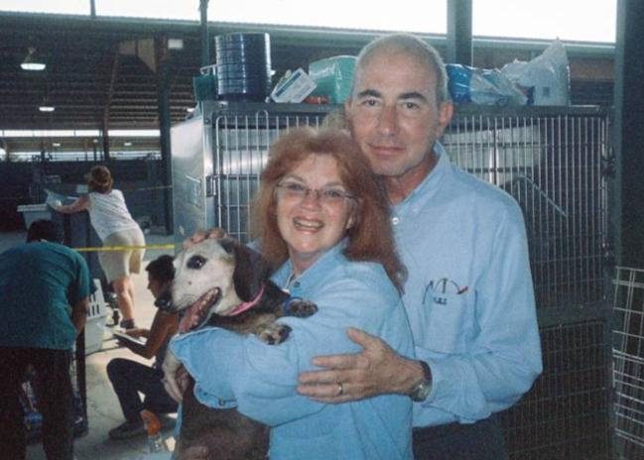
Animal Management
Daily
  Food and water
  Clean bowls and cages
  Dogs walked
  Visual health checks
As needed
  Medical treatment
  Bathing
Record sheet
Notes:
Every animal must be taken care of while at the shelter. For each animal, these tasks will include daily food and water, cleaning of bowls and crates and feces removal. Dogs will need to be let out and walked at least twice a day. Daily visual health checks should be performed by veterinary personnel and/or volunteers. Medical treatments and bathing will need to be provided as needed. When possible, pet owners should assume most of the responsibility for the care of their animal. Pet owners should not handle or touch pets other than their own. The shelter should have designated walking areas with plastic bags available for feces pickup and disposal. Daily care, including any medical treatments, should be marked on the animal’s record sheet.
[Photo shows two owners and their dog. Photo from Garry Goemann, Veterinary Medical Assistance Team 5]

Slide 18
Infection Control
Infectious disease
  Cleaning and disinfection
  Isolation area
  Clear posting on cage
  Limit contact
  Protective clothing
Visual health checks before handling
Notes:
With large groups of animals, from many various sources, gathered at one location, the potential for disease spread is possible. Disease transmission can be a serious issue in shelters caring for animals, therefore proper actions must be taken in order to detect and control the spread of disease. Daily monitoring of the each animal’s health can enhance detection of disease should it develop. Implementing cleaning and disinfection procedures in animal areas can aid to minimize disease occurrence and spread.
If an infectious disease is diagnosed or suspected, the animal should be moved to the isolation area. Information on the disease, along with any precautionary measures for handling the animal should be placed on the animal’s cage. The number of individuals caring for animals in the isolation area should be limited to only those necessary for direct care. Protective clothing should be worn and then removed before leaving the isolation area.

Slide 19
Resources
American Veterinary Medical Association. Emergency: Preparedness and Response Guide
  https://ebusiness.avma.org/EBusiness50/files/productdownloads/emerg_prep_resp_guide.pdf
AVMA and CDC. Interim Guidelines for Animal Health and Control of Disease Transmission in Pet Shelters
  https://www.llis.dhs.gov/member/secure/detail.cfm?content_id=19712
U.S. Department of Homeland Security
  Lessons Learned Information Sharing: Shelter Operations – Pet-Friendly Shelters
  http://www.lsart.org/sites/site-1707/documents/ShelterOperations-PetFriendlyShelters2.pdf
Notes:
There are many helpful resources available for setting up temporary shelters for companion animals. The next two slides list a few.

Slide 20
Resources (cont’d)
LSU Emergency Animal Shelter Disaster Response Manual
  http://www.lsuemergencyanimalshelter.org/
Louisiana State Animal Response Team
  Companion Animal Evacuation and Sheltering Manual
  www.lsart.org/refId,12776/refDownload.pml
ASPCA (American Society for the Prevention of Cruelty to Animals)
  Sample Plans for Evacuation and Sheltering
  http://www.aspcapro.org/sample-plans-for-evacuation-and-shelteri.php

Slide 21
Acknowledgments
Development of this presentation was by the Center for Food Security and Public Health at Iowa State University through funding from the Multi-State Partnership for Security in Agriculture
Authors: Sarah Weiland; Katie Steneroden, DVM, MPH, PhD, DACVPM
Reviewer: Glenda Dvorak, DVM, MPH, DACVPM
Notes:
Information provided in this presentation was developed by the Center for Food Security and Public Health at Iowa State University College of Veterinary Medicine, through funding from the Multi-State Partnership for Security in Agriculture.

