Slide 1
Animal Behavior and Restraint
Poultry
Notes:
December 2012
During animal health emergencies involving poultry, tasks requiring the handling and restraint of the birds are likely. Having a basic understanding of poultry behavior and humane restraint methods will help minimize the stress on the birds and reduce the risk of injury to responders. This Just-In-Time training presentation will overview basic poultry handling and restraint measures that may be needed for animal health emergencies.

Slide 2
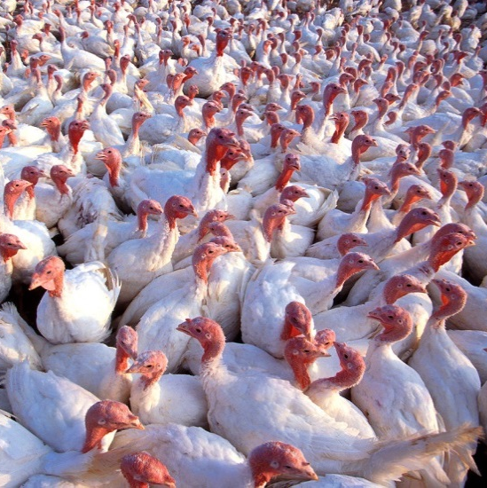
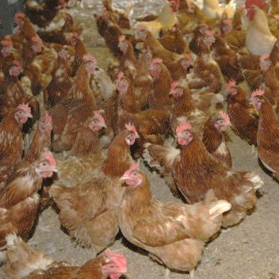
Poultry
Birds reared
for commercial purposes
  Chickens, turkeys
  Ducks, geese
  Pheasant, quail
  Others…
Notes:
Poultry encompasses a diverse group of birds reared for commercial purposes, including eggs or meat. Chickens by far are the most well known species, but other types of birds, from turkeys, to waterfowl, such as ducks and geese, or game birds, such as pheasants or quail may be reared. With such diversity, comes variability in sizes, not only between chicks and adults, but from the various bird species as well. Game birds are generally smaller, with adults weighing between a pound or less, to 6-8 pounds for chickens, or up to 26 pounds for turkeys. [The top photo shows a flock of turkeys. Source: Scott Bauer/USDA ARS. The bottom photo shows a flock of chickens. Source: USDA APHIS Image Gallery]

Slide 3
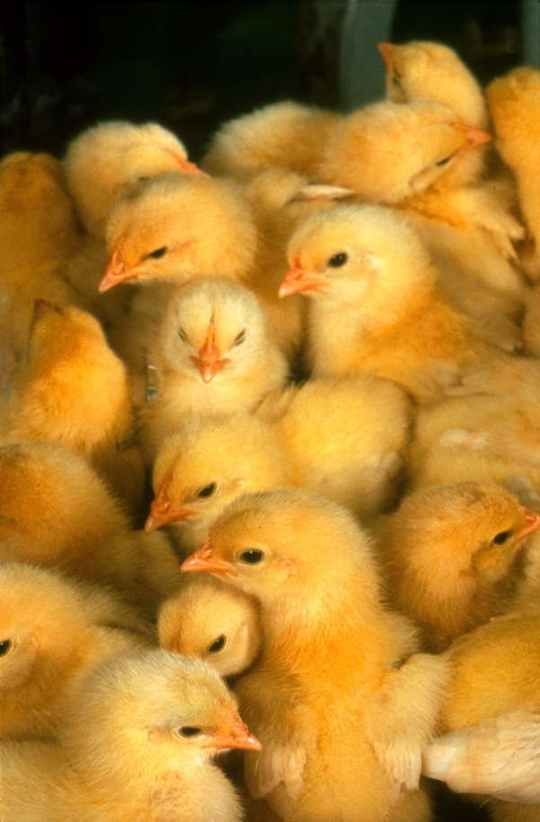
Poultry Characteristics
Prey animals
Fast heart rate
and respiration rate
Pneumatic bones
Most cannot fly
Pecking order
  Hierarchy
  Dominant and submissive
Notes:
Poultry are prey animals by nature and stress easily. Their heart rates and respiration rates are much faster than a human’s. Usually, the smaller the bird, the faster the heart rate. Birds also have pneumatic bones, which means there are air pockets within the bones to make them lighter for flying. Although most domesticated birds, such as chickens and turkeys, can no longer fly, some can get a few feet off the ground and cover short distances. Within the flock there will be a distinct pecking order. This organization or ranking within the group establishes which birds are dominant and which are submissive. Once a hierarchy is established, the birds generally live in a harmonious state. However, the addition of new birds or merging of flocks can disrupt this balance, leading to restructuring of the pecking order. Dominant birds can be very aggressive to submissive birds, and this behavior may even evolve into cannibalism. [This photo shows a group of chicks. Source: Keith Weller/USDA ARS]

Slide 4
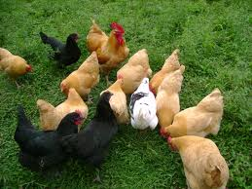
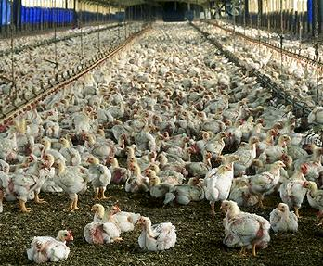
Poultry Characteristics
Social animals
  Stay together in flocks
Flock flight zone
  Birds move away
  as a group when handler approaches
  Distance varies
  with species and between flocks
Notes:
Poultry species may be reared in cages, open floor facilities or free range situations. Handling and moving birds in these situations will require different techniques. Increased stress, leg breakage, and mortality have been associated with poor catching and loading techniques. Poultry flocks reared in open floor facilities or that are free range can be moved using herding principles similar to other livestock species. Poultry are very social creatures and like to stay together in flocks. This characteristic allows for the herding of some bird species using principles of the flight zone. The “flight zone” is the animal's personal space and is used as an indicator of impending threats. The flock itself will also have a defined “flight zone”, which determines how close the handler may approach the flock before they all move away as a group. The size of the “flight zone” will vary depending on the birds familiarity with human contact. Some birds, such as turkeys, will move towards a human when they enter the pen. Using the flock “flight zone” to herd birds can work to reduce stress on the flock and make moving or catching birds easier and faster. [The top photo shows a small flock of backyard poultry. Source: USDA; the bottom photo shows a flock of commercial chicken poults. Source: Larry Rana/USDA]

Slide 5
Stressors
Rapid movement
  Walk slowly
  Slow, steady movements
Bright light
  Dim lights when moving
Sound
  Minimize noise
Strangers
Notes:
Birds may be come stressed during catching and loading procedures. Stressors can include rapid movements, bright lights, sound, and strangers.
Sudden movements can panic the entire flock. This can result in piling and potential injury to the birds. Additionally, if approached too quickly, birds may jump up or try to fly to escape. This can potentially injure the bird as well as the responder; it also stirs up a dust, making working conditions difficult. When working with poultry, walk slowly when nearing the birds. All movements must be slow and steady. Poultry are very sensitive to light and bright lights can distress birds. When possible lights should be dimmed to keep the birds calm during movement. Even bright or white color clothing can stress birds. When possible, crew members moving poultry should wear darker colored clothing. As with other animal species, birds are stressed by loud noises. Herding and handling procedures should be done as quietly as possible. The presence of unfamiliar persons can stress birds, however this is most likely unavoidable during an animal health emergencies. Reducing the other potential stressor situations will help keep the stress to the birds at a minimum.

Slide 6
Signs of Stress in Birds
Overheating
  Red-flushed faces, combs, wattles
  Rapid panting and open-mouthed breathing
Chilling
  Blue combs
  Feathers fluffed up
  Shivering
Lack of oxygen
  Gasping and stretching of neck when breathing
  Purple combs and wattles
Notes:
When working with poultry, as well as after the birds have been captured and contained into an area, it is important to monitor the birds’ condition and activity levels for signs of overheating, chilling or lack of oxygen. Birds that are over heated will have red-flushed faces, combs and wattles. They will have open-mouthed breathing and rapid panting. If birds become chilled, their combs will become bluish in color. Birds may have fluffed up feathers or show signs of shivering. If there is limited oxygen to the flock due to overcrowding, the birds will be gasping and stretching their neck to breathe; their combs and wattles will have a purple coloration to them.

Slide 7
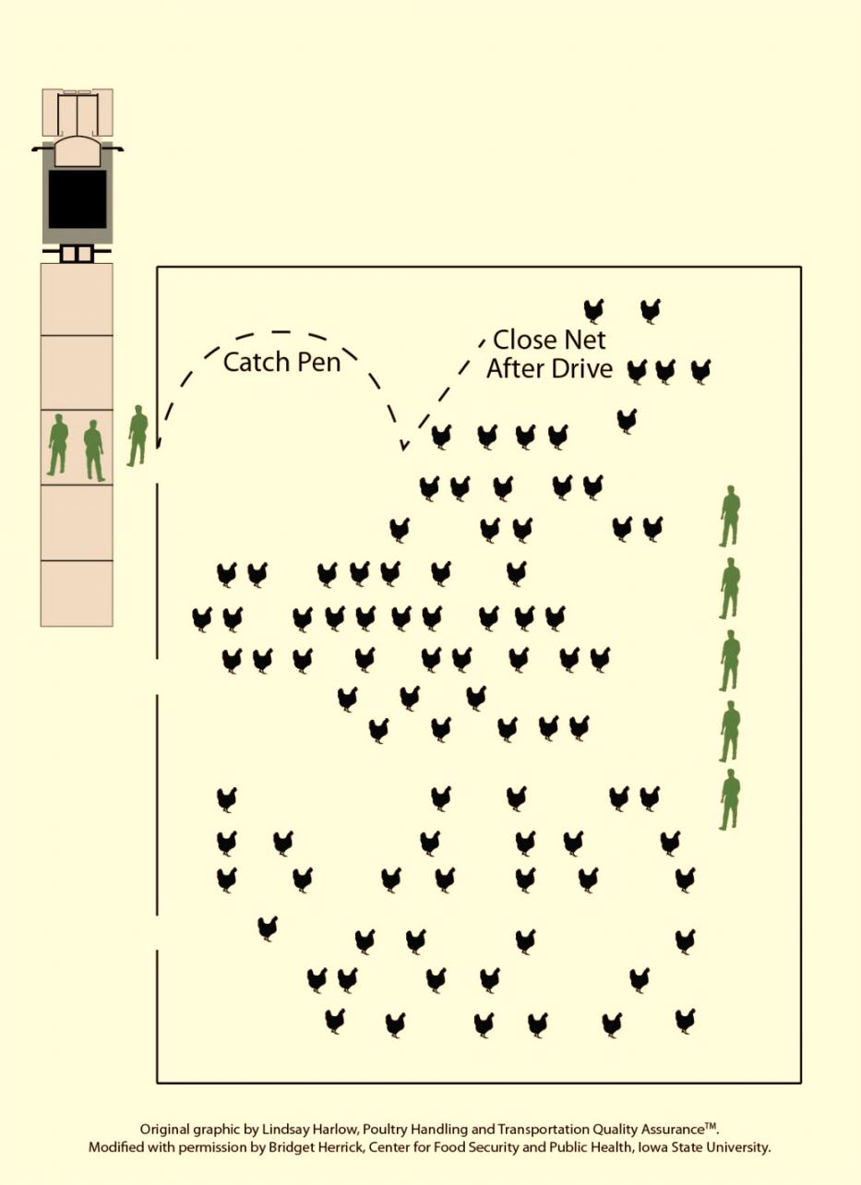
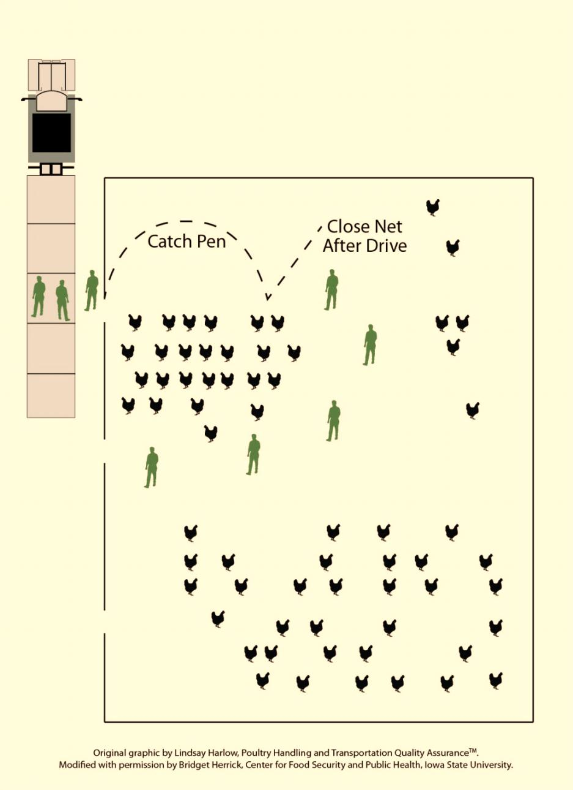
Herding Flocks
Notes:
When herding floor reared birds, it is best to divide the flock into smaller groups for easier movement. Herding movements will progress toward a “catch pen” (yellow circle) that will then allow for loading or handling of the birds. Note: The catch pen should not be placed directly against the building wall. Should a pile up of birds occur as the flock congregates in the catch pen, the net will need to be lifted to prevent injury to the birds from the pile up. Begin the herding process with responders in a straight line (green box in left graphic) along the wall away from the catch pen. Movement should then begin slowly toward the catch pen. As the drive line progresses forward it should wrap around to form a “J” shape (as depicted by the green arrow in right graphic) as the birds get closer to the catch pen.
[These graphics show the process for herding poultry in a safe, low stress manner. The graphics have been adapted, with permission, from the Poultry Handling and Transportation Quality Assurance™ Training Manual for Certification. Graphics by Bridget Wedemeier, Center for Food Security and Public Health]

Slide 8
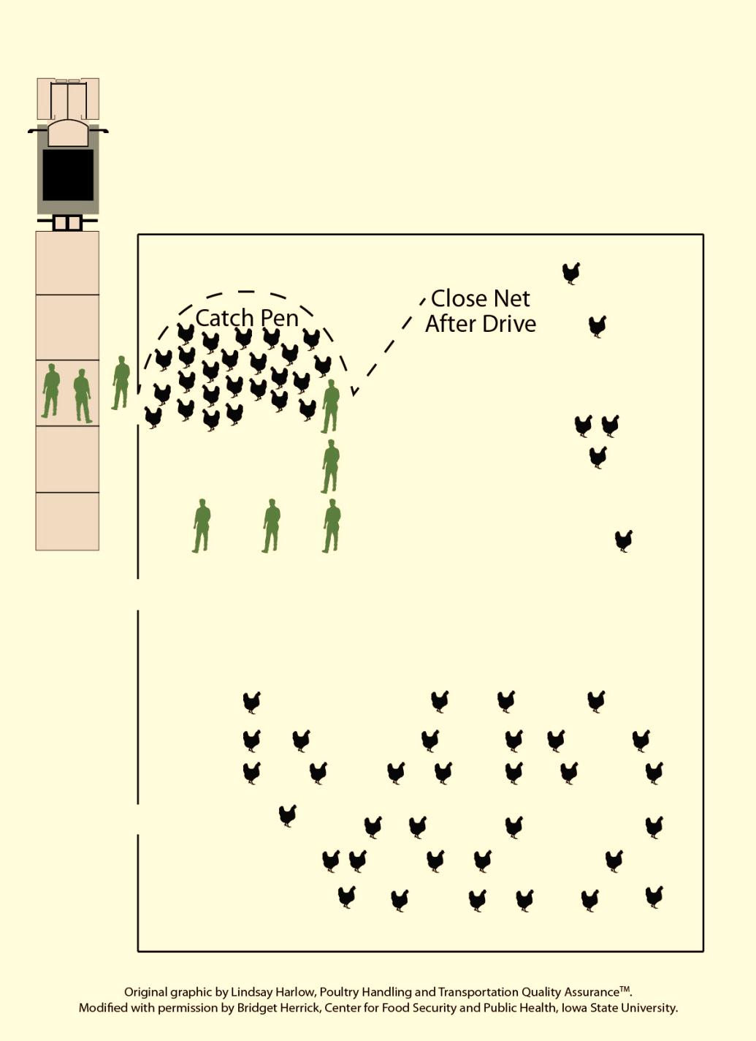
Notes:
As the birds go deeper into the catch pen (yellow circle), responders should tighten into a reverse “L” formation (green box), encouraging the birds to move forward. After birds are within the catch pen, the gate of the catch pen can be closed to ensure birds do not escape. Move calmly and quietly at all times during the herding process to avoid causing distress to the birds. As capture and containment progress, monitor the flock closely for birds piling up along the edges of the catch pen. This can lead to suffocation of the birds on the bottom of the pile. Smothering is the leading cause of mortality while capturing and loading poultry. If the birds begin to pile, time is critical and the birds must be separated immediately to avoid smothering. Sometimes it is necessary to lift the bottom of the net to allow some of the birds to escape.
[These graphics show the process for herding poultry in a safe, low stress manner. The graphics have been adapted, with permission, from the Poultry Handling and Transportation Quality Assurance™ Training Manual for Certification. Graphics by Bridget Wedemeier, Center for Food Security and Public Health]

Slide 9
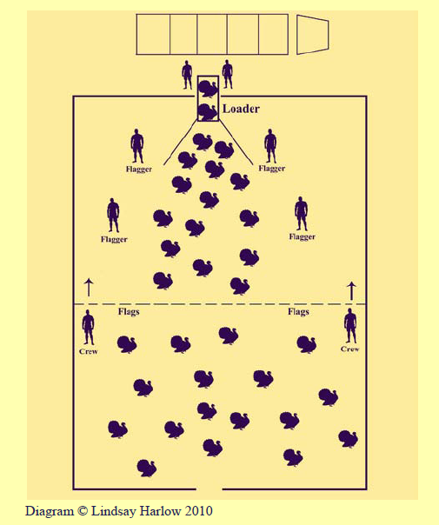
Herding
Turkeys
Notes:
There are some special considerations when herding turkeys. Be aware that turkeys are very curious and will often try to walk towards people when they enter the area. Waving items such as flags or a garbage bag on a stick may aid in herding turkeys. Also, due to their large size, turkeys can get stressed easily if walking too far or too quickly. When herding these birds, work slowly and allow some occasional resting breaks for the birds. Do not let the birds jump on each other; this will cause trauma and back scratches to the other bird.
[This graphic shows the positioning for herding turkeys in a safe, low stress manner. Graphic by Lindsay Harlow, used with permission, from the Poultry Handling and Transportation Quality Assurance™ Training Manual for Certification. ]

Slide 10
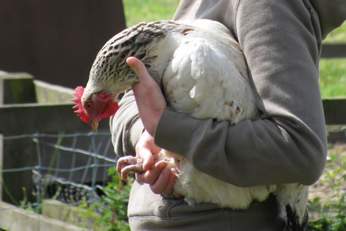
Restraint
Slow, steady movements
Grab both legs
Do not handle
by wings
Use one hand to
support the body
Hold securely
Use a towel
if necessary
Notes:
Some response procedures, such as caging birds or obtaining diagnostic samples, may involve the individual handling of poultry. Similar techniques used for herding flocks apply – slow, steady movements with minimal noise. Avoid chasing the birds, as this will only cause them stress. Poultry should be caught individually by grasping both legs, just above the feet. Poultry should not be picked up or moved by the wing unless it is grasped near the base close to the body. Once captured, one hand should be used to support the bird’s body; however, minimize the amount of pressure around the bird’s thorax to avoid compromising their ability to breathe.
All poultry will flap their wings when caught, inverted or if struggling for balance or footing. This can lead to joint dislocation, bone fracture, or bruising of the wings when they strike objects or other birds. Place your arm over the bird’s wings to minimize flapping. Birds should be carried upright whenever possible. They can be carried with their head facing forward or backward. If the bird is stressed, carry them with their head backward to minimize their movement. Once restrained, hold them securely, but don’t squeeze them. If they are being examined, place a towel around them to reduce wing flapping.
If birds are in cages, they must be gently removed from the cages, without excessive force or pulling. Both legs should be grasped above their feet. The birds should never be grabbed by the neck, tail, or by a single leg. When returning birds back to a cage, handling must minimize any damage to the birds including, broken bones, bruising or other trauma. Control each bird by securing its leg and breast, then place it head first into the cage. Care should be taken when closing and securing cages to ensure the bird’s head, legs and wings are free from the doors.

Slide 11
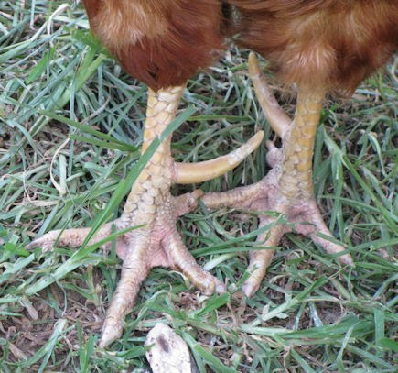
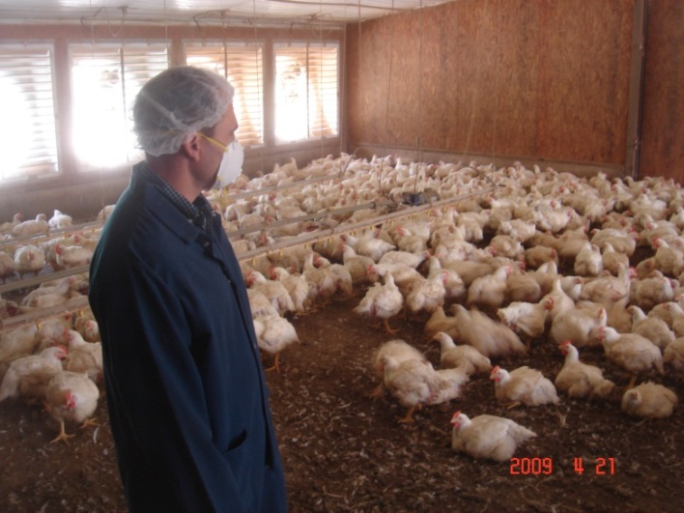
Safety
Avoid Injuries
from Poultry
  Beaks
  Claws
  Spurs (roosters)
  Quick movements
Masks
  Dust and dander
Notes:
Most cage birds are usually docile but they can peck, scratch, or inflict puncture wounds if not handled correctly. When grabbing the bird’s legs, make sure the shanks are side by side so to not injure the handler or the bird. Always use caution around roosters; they can have quick movements and have large spurs on their legs that can cause serious injuries. Another safety concern is dust and dander stirred up from poultry movement. Responders should wear protective masks when working with poultry to minimize inhalation of these materials. Zoonotic diseases of poultry, such as avian influenza or Newcastle disease, may warrant additional personal protective measures. [The top photo shows a large spur (yellow arrow) on the leg of a rooster. Source: Maison Nord Natural Farm; the bottom photo shows a poultry worker wearing a mask to protect his respiratory tract from dust and danger generated from poultry movement. Source: Don Ritter, Iowa State University]

Slide 12
Additional Information
A Quality Assurance Program for Handlers and Transports of Poultry
  http://www.poultryhandling.org/pdf/JAN2011PHTQAweb2.pdf
Federation of Animal Science Societies – Guide for the Care and Use of Agricultural Animals in Research and Teaching, Third Edition
  http://www.fass.org
Notes:
Proper handling and restraint of poultry can minimize stress on the birds. For more information on the poultry behavior and handling, see the following documents.

Slide 13
Acknowledgments
Development of this presentation was by the Center for Food Security and Public Health at Iowa State University through funding from the Multi-State Partnership for Security in Agriculture
Authors: Abbey Smith; Glenda Dvorak, DVM, MPH, DACVPM
Notes:
Information provided in this presentation was developed by the Center for Food Security and Public Health at Iowa State University College of Veterinary Medicine, through funding from the Multi-State Partnership for Security in Agriculture.

